Slide 1
Chapter 2
Measurements and Calculations

Slide 2
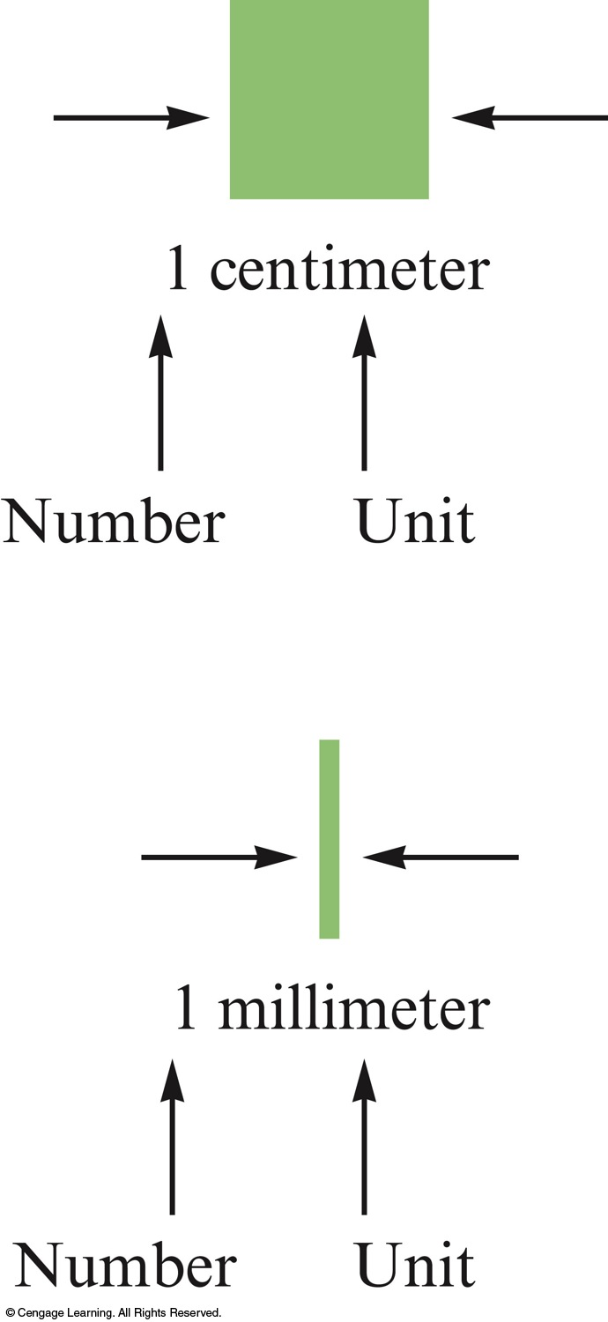
Measurement
Quantitative observation.
Has 2 parts – number and unit.
  Number tells comparison.
  Unit tells scale.

Slide 3
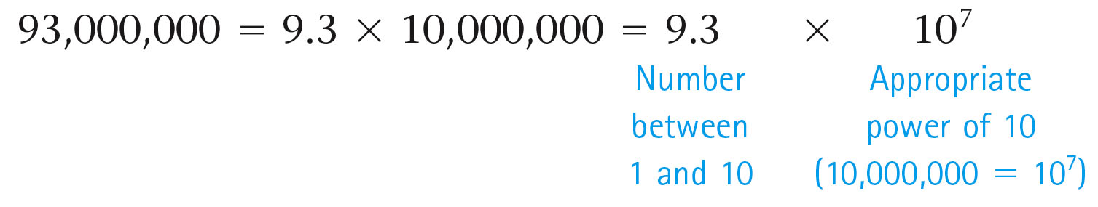
  Technique used to express very large or very small numbers.
  Expresses a number as a product of a number between 1 and 10 and the appropriate power of 10.

Slide 4
Using Scientific Notation
  Any number can be represented as a product of a number between 1 and 10 and the appropriate power of 10 (either positive or negative).
  The power of 10 depends on the number of places the decimal point is moved and in which direction.

Slide 5
Using Scientific Notation
  The number of places the decimal point is moved determines the power of 10. The direction of the move determines whether the power of 10 is positive or negative.

Slide 6
Using Scientific Notation
  If the decimal point is moved to the left, the power of 10 is positive.
  345 = 3.45 × 10²
  If the decimal point is moved to the right, the power of 10 is negative.
  0.0671 = 6.71 × 10^{–2}

Slide 7

Concept Check
Which of the following correctly expresses 7,882 in scientific notation?
  7.882 × 10⁴
  788.2 × 10³
  7.882 × 10³
  7.882 × 10^{–3}
Notes:
The correct answer is c. The decimal point should be moved three places to the left to be correctly expressed in scientific notation.

Slide 8
Concept Check
Which of the following correctly expresses 0.0000496 in scientific notation?
  4.96 × 10^{–5}
  4.96 × 10^{–6}
  4.96 × 10^{–7}
  496 × 10⁷
Notes:
The correct answer is a. The decimal point should be moved five places to the right to be correctly expressed in scientific notation.

Slide 9
Nature of Measurement
  Measurement
Quantitative observation consisting of two parts.
  Number
  Unit
Examples
  20 grams
  6.63 × 10–34 joule·seconds

Slide 10
The Fundamental SI Units
Physical Quantity | Name of Unit | Abbreviation
Mass | kilogram | kg
Length | meter | m
Time | second | s
Temperature | kelvin | K
Electric current | ampere | A
Amount of substance | mole | mol

Slide 11
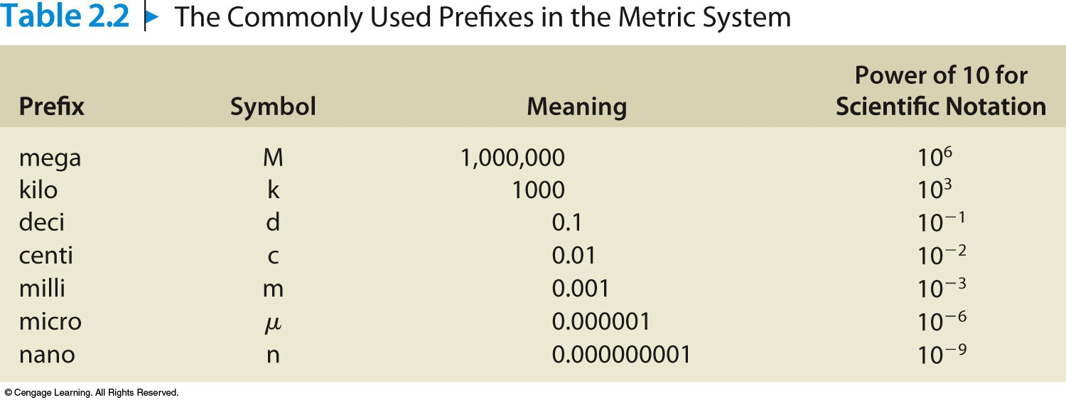
Prefixes are used to change the size of the unit.

Slide 12
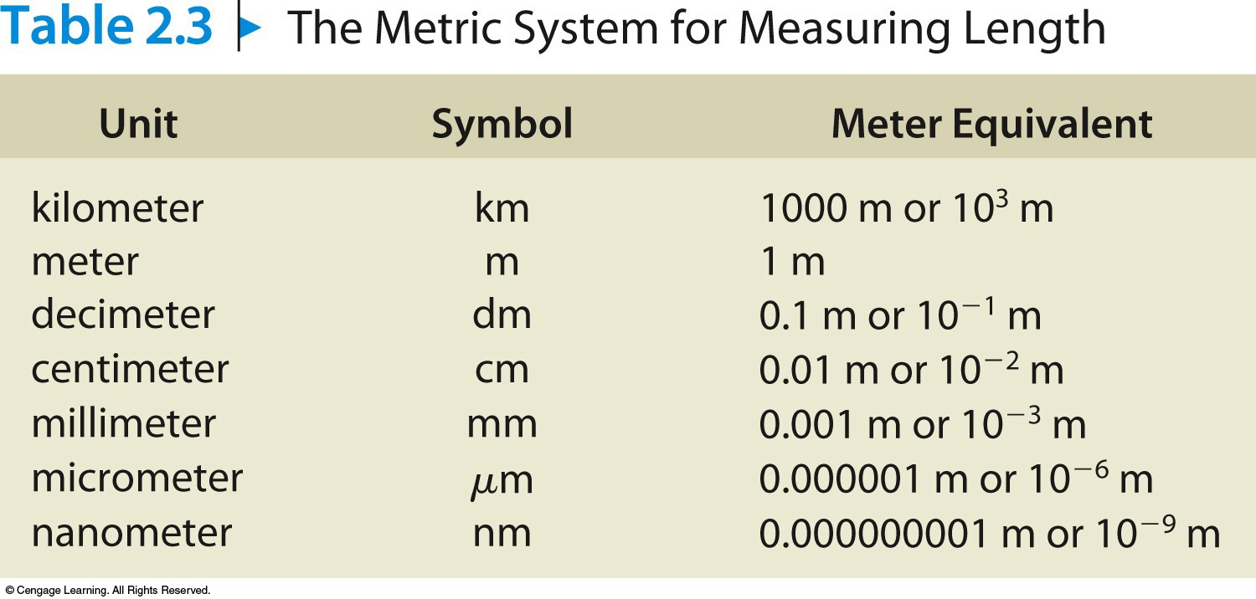
Fundamental SI unit of length is the meter.

Slide 13
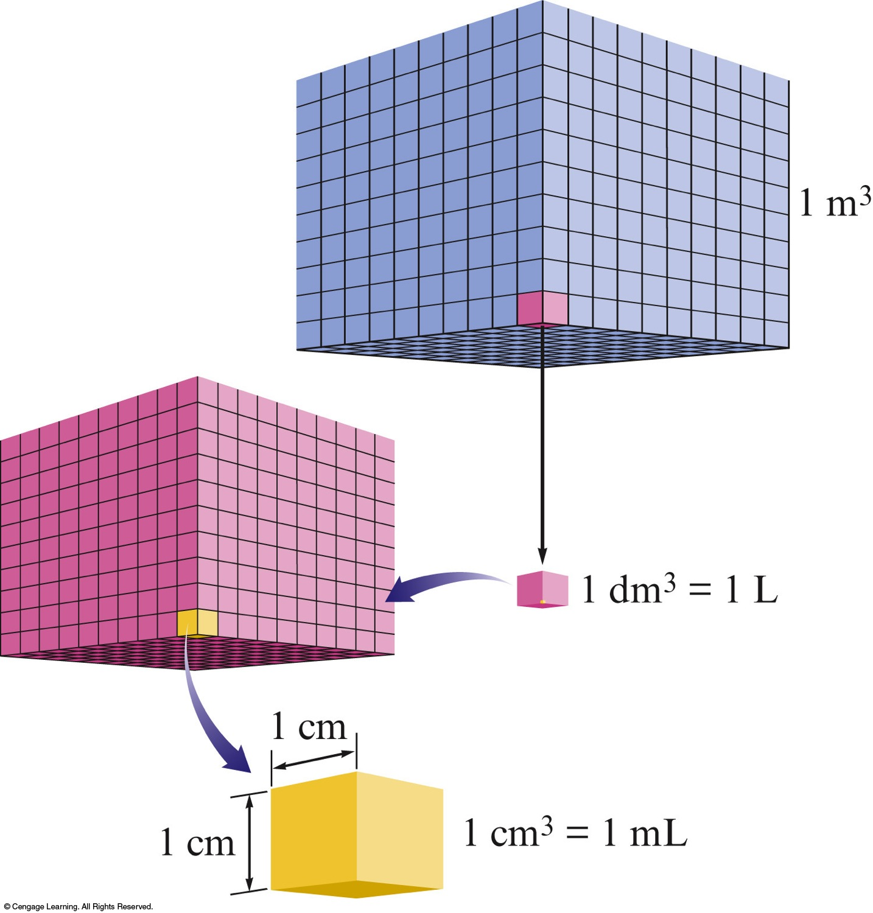
Volume
Measure of the amount of 3-D space occupied by a substance.
SI unit = cubic meter (m³)
Commonly measure solid volume in cm³.
1 mL = 1 cm³
1 L = 1 dm³

Slide 14
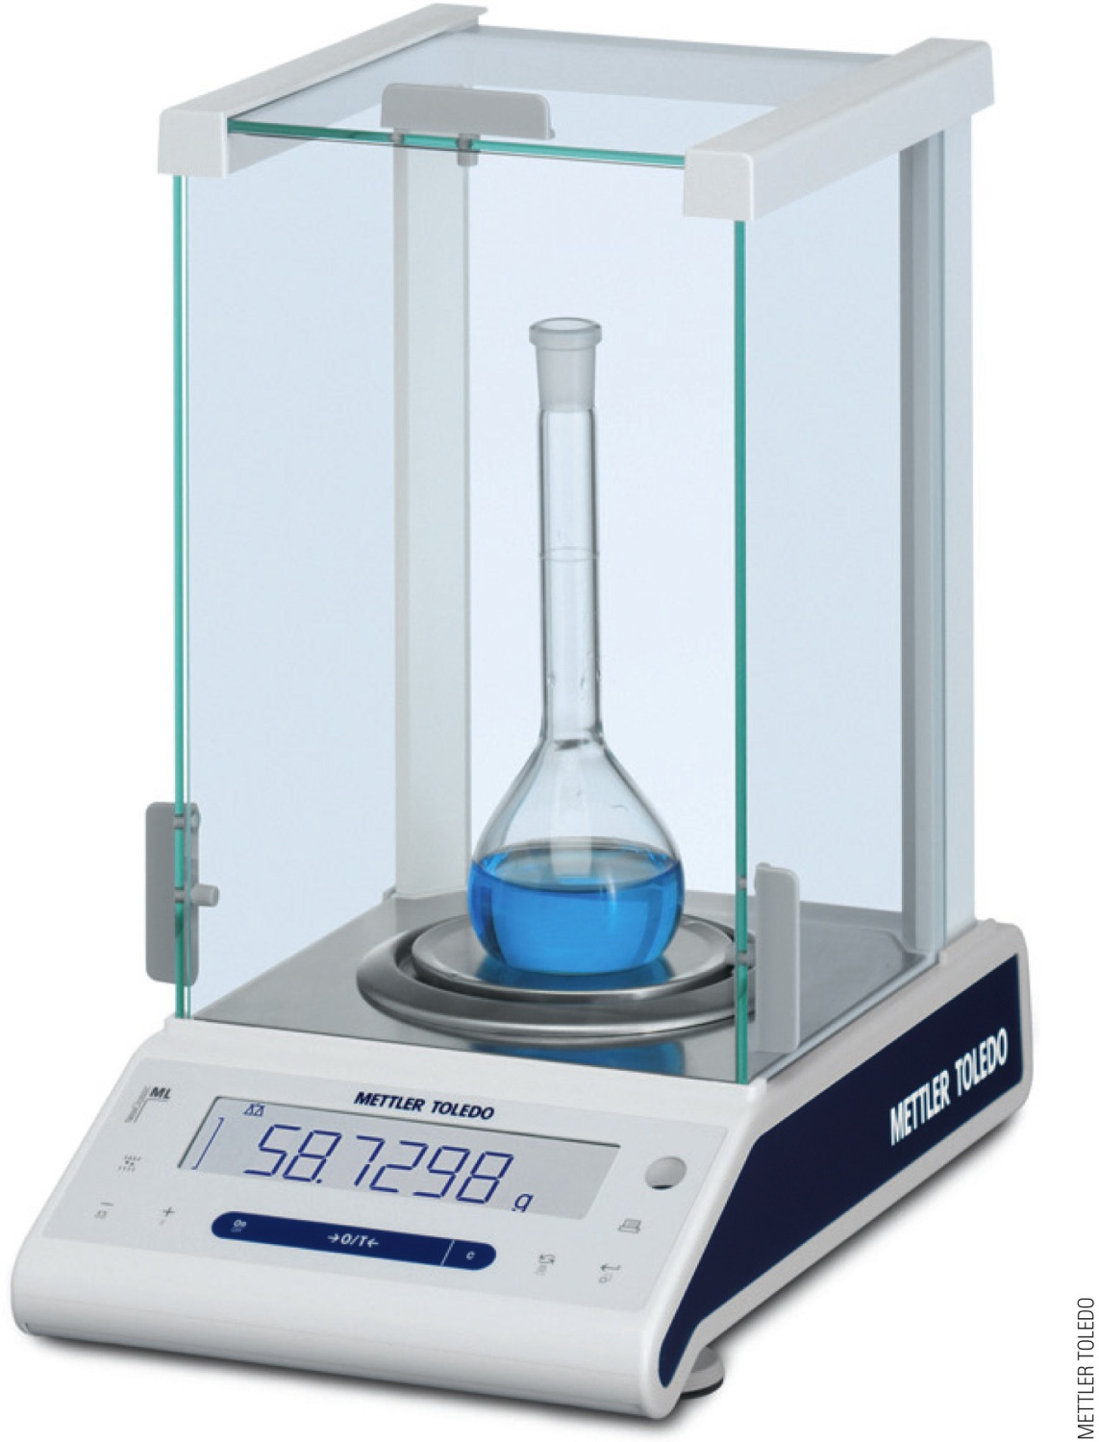
Measure of the amount of matter present in an object.
SI unit = kilogram (kg)
1 kg = 2.2046 lbs
1 lb = 453.59 g

Slide 15
Concept Check
Choose the statement(s) that contain improper use(s) of commonly used units (doesn’t make sense)?
  A gallon of milk is equal to about 4 L of milk.
  A 200-lb man has a mass of about 90 kg.
  A basketball player has a height of 7 m tall.
  A nickel is 6.5 cm thick.
Notes:
A basketball player cannot be 7 m tall (but rather 7 feet tall). There are about 3 feet in a meter so it’s more likely that the player has a height of 2.3 m.
A nickel cannot be 6.5 cm thick. There are 10 mm in every cm, so it’s more likely that the nickel could be about 3 mm thick.

Slide 16
A digit that must be estimated is called uncertain.
A measurement always has some degree of uncertainty.
Record the certain digits and the first uncertain digit (the estimated number).

Slide 17
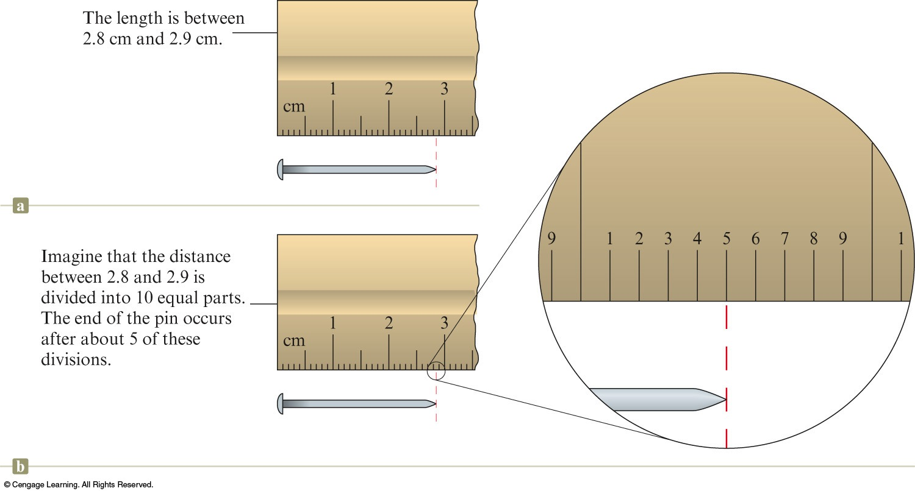
Measurement of Length Using a Ruler
The length of the pin occurs at about 2.85 cm.
  Certain digits: 2.85
  Uncertain digit: 2.85

Slide 18
Rules for Counting Significant Figures
1. Nonzero integers always count as significant figures.
  3456 has 4 sig figs (significant figures).

Slide 19
Rules for Counting Significant Figures
2. Zeros
There are three classes of zeros.
a. Leading zeros are zeros that precede all of the nonzero digits. These never count as significant figures.
  0.048 has 2 sig figs.

Slide 20
Rules for Counting Significant Figures
b. Captive zeros are zeros that fall between nonzero digits. These always count as significant figures.
  16.07 has 4 sig figs.

Slide 21
Rules for Counting Significant Figures
c. Trailing zeros are zeros at the right end of the number. They are significant only if the number contains a decimal point.
  9.300 has 4 sig figs.
  150 has 2 sig figs.

Slide 22
Rules for Counting Significant Figures
3. Exact numbers have an unlimited number of significant figures.
  1 inch = 2.54 cm, exactly.
  9 pencils (obtained by counting).

Slide 23
Exponential Notation
Example
  300. written as 3.00 × 10²
  Contains three significant figures.
Two Advantages
  Number of significant figures can be easily indicated.
  Fewer zeros are needed to write a very large or very small number.

Slide 24
Rules for Rounding Off
1. If the digit to be removed is less than 5, the preceding digit stays the same.
  5.64 rounds to 5.6 (if final result to 2 sig figs)

Slide 25
Rules for Rounding Off
1. If the digit to be removed is equal to or greater than 5, the preceding digit is increased by 1.
  5.68 rounds to 5.7 (if final result to 2 sig figs)
  3.861 rounds to 3.9 (if final result to 2 sig figs)

Slide 26
Rules for Rounding Off
2. In a series of calculations, carry the extra digits through to the final result and then round off. This means that you should carry all of the digits that show on your calculator until you arrive at the final number (the answer) and then round off, using the procedures in Rule 1.

Slide 27
Significant Figures in Mathematical Operations
1. For multiplication or division, the number of significant figures in the result is the same as that in the measurement with the smallest number of significant figures.
  1.342 × 5.5 = 7.381 → 7.4

Slide 28
Significant Figures in Mathematical Operations
2. For addition or subtraction, the limiting term is the one with the smallest number of decimal places.

Slide 29
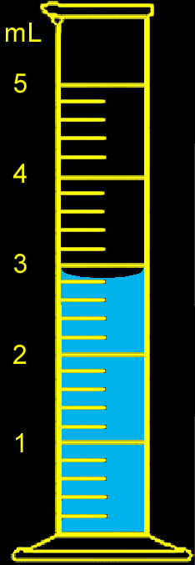
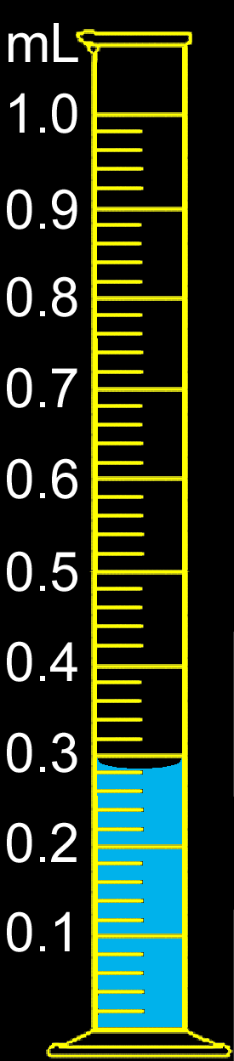
Concept Check
You have water in each graduated cylinder shown. You then add both samples to a beaker (assume that all of the liquid is transferred).
How would you write the number describing the total volume?
3.1 mL
What limits the precision of the total volume?
1st graduated cylinder
Notes:
The total volume is 3.1 mL. The first graduated cylinder limits the precision of the total volume with a volume of 2.8 mL. The second graduated cylinder has a volume of 0.28 mL. Therefore, the final volume must be 3.1 mL since the first volume is limited to the tenths place.

Slide 30
Use when converting a given result from one system of units to another.
  To convert from one unit to another, use the equivalence statement that relates the two units.
  Choose the appropriate conversion factor by looking at the direction of the required change (make sure the unwanted units cancel).
  Multiply the quantity to be converted by the conversion factor to give the quantity with the desired units.
  Check that you have the correct number of sig figs.
  Does my answer make sense?

Slide 31
Example #1
To convert from one unit to another, use the equivalence statement that relates the two units.
1 ft = 12 in
The two unit factors are:
  A golfer putted a golf ball 6.8 ft across a green. How many inches does this represent?

Slide 32
Example #1
  A golfer putted a golf ball 6.8 ft across a green. How many inches does this represent?
Choose the appropriate conversion factor by looking at the direction of the required change (make sure the unwanted units cancel).

Slide 33
Example #1
  A golfer putted a golf ball 6.8 ft across a green. How many inches does this represent?
Multiply the quantity to be converted by the conversion factor to give the quantity with the desired units.
Correct sig figs? Does my answer make sense?

Slide 34
Example #2
  An iron sample has a mass of 4.50 lb. What is the mass of this sample in grams?
  (1 kg = 2.2046 lbs; 1 kg = 1000 g)

Slide 35
Concept Check
What data would you need to estimate the money you would spend on gasoline to drive your car from New York to Los Angeles? Provide estimates of values and a sample calculation.
Sample Answer:
Distance between New York and Los Angeles: 2500 miles
Average gas mileage: 25 miles per gallon
Average cost of gasoline: $3.25 per gallon
Notes:
This problem requires that the students think about how they will solve the problem before they can plug numbers into an equation. A sample answer is:
Distance between New York and Los Angeles: 2500 miles
Average gas mileage: 25 miles per gallon
Average cost of gasoline: $3.25 per gallon
(2500 mi) × (1 gal/25 mi) × ($3.25/1 gal) = $325
Total cost = $325

Slide 36
Three Systems for Measuring Temperature
Fahrenheit
Celsius
Kelvin

Slide 37
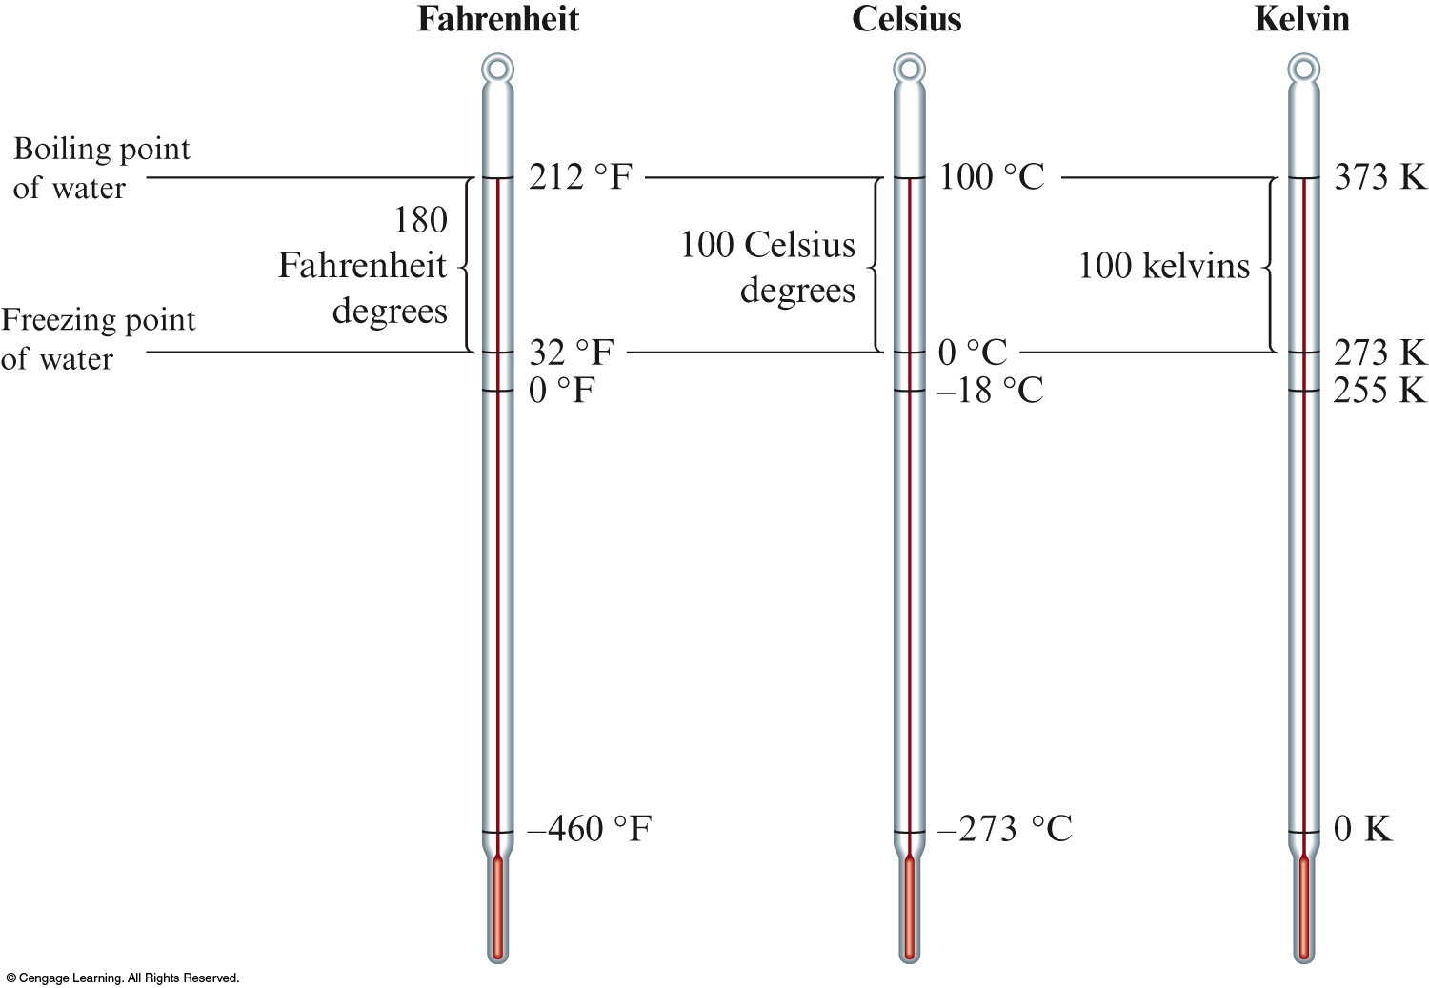
The Three Major Temperature Scales

Slide 38
Converting Between Scales

Slide 39

Exercise
The normal body temperature for a dog is approximately 102ºF. What is this equivalent to on the Kelvin temperature scale?
  a) 373 K
  b) 312 K
  c) 289 K
  d) 202 K
Notes:
The correct answer is b.
(102 – 32) / 1.80 = 39°C
39 + 273 = 312 K

Slide 40
Exercise
At what temperature does °C = °F?
Notes:
The answer is -40. Since °C equals °F, they both should be the same value (designated as variable x). Use one of the conversion equations such as °C = (°F-32)(5/9), and substitute in the value of x for both °C and °F. Solve for x.

Slide 41
Solution
Since °C equals °F, they both should be the same value (designated as variable x).
Use one of the conversion equations such as:
Substitute in the value of x for both T_{°C} and T_{°F}. Solve for x.

Slide 42
Solution
So –40°C = –40°F

Slide 43
Mass of substance per unit volume of the substance.
Common units are g/cm³ or g/mL.

Slide 44
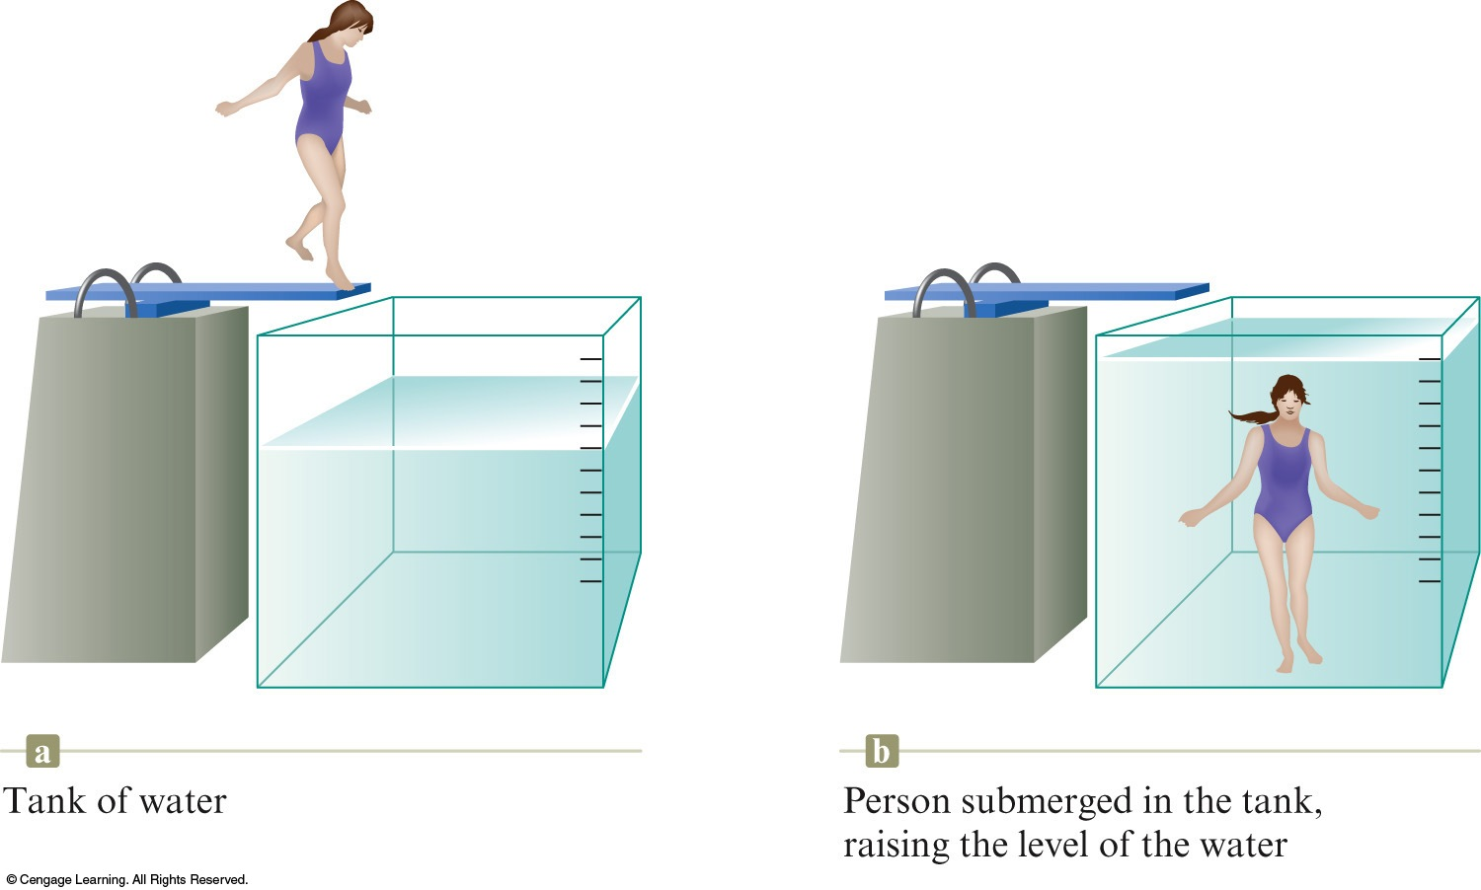
Measuring the Volume of a Solid Object by Water Displacement

Slide 45
Example #1
  A certain mineral has a mass of 17.8 g and a volume of 2.35 cm3. What is the density of this mineral?

Slide 46
Example #2
  What is the mass of a 49.6 mL sample of a liquid, which has a density of 0.85 g/mL?

Slide 47
Exercise
If an object has a mass of 243.8 g and occupies a volume of 0.125 L, what is the density of this object in g/cm³?
  a) 0.513
  b) 1.95
  c) 30.5
  d) 1950
Notes:
The correct answer is b. Density = mass/volume. First convert 0.125 L to cm³.
0.125 L × (1000 mL/1 L) × (1 cm³/1mL) = 125 cm³
Density = 243.8 g / 125 cm³ = 1.95 g/cm³

Slide 48
Concept Check
Copper has a density of 8.96 g/cm³. If 75.0 g of copper is added to 50.0 mL of water in a graduated cylinder, to what volume reading will the water level in the cylinder rise?
  a) 8.4 mL
  b) 41.6 mL
  c) 58.4 mL
  d) 83.7 mL
Notes:
The correct answer is c. Using the density and mass of copper, determine the volume of metal present.
75.0 g × (cm³/8.96 g) = 8.37 cm³
Since the density of water is 1 g/1 mL, the volume of the metal can be determined by displacement. Therefore, the water level will rise to 58.4 mL (50.0 + 8.37 mL).

