Slide 1
Chapter 4 (part 2)
Chemical Foundations: Elements, Atoms, and Ions

Slide 2
Most elements are very reactive.
Elements are not generally found in uncombined form.
Exceptions are:
Noble metals – gold, platinum and silver
Noble gases – Group 8

Slide 3
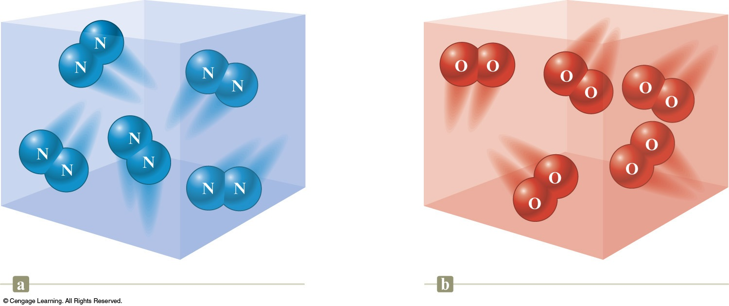
Diatomic Molecules
Nitrogen gas contains N₂ molecules.
Oxygen gas contains O₂ molecules.

Slide 4
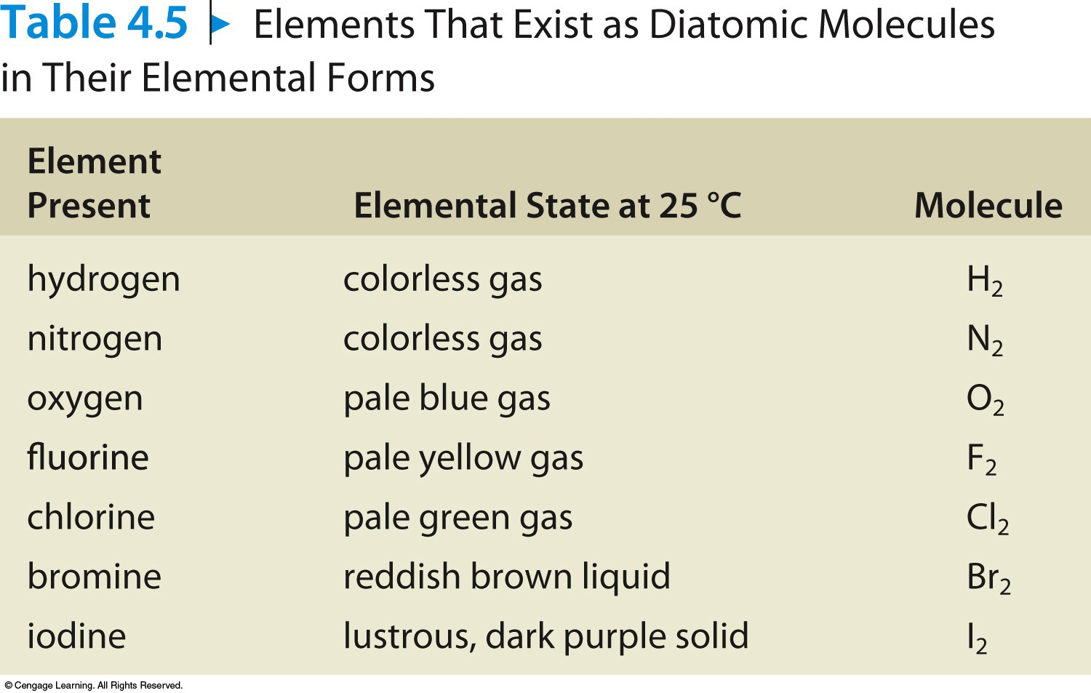
Diatomic Molecules

Slide 5
Allotropes
Different forms of a given element.
Example:
Solid carbon occurs in three forms.
Diamond
Graphite
Buckminsterfullerene

Slide 6
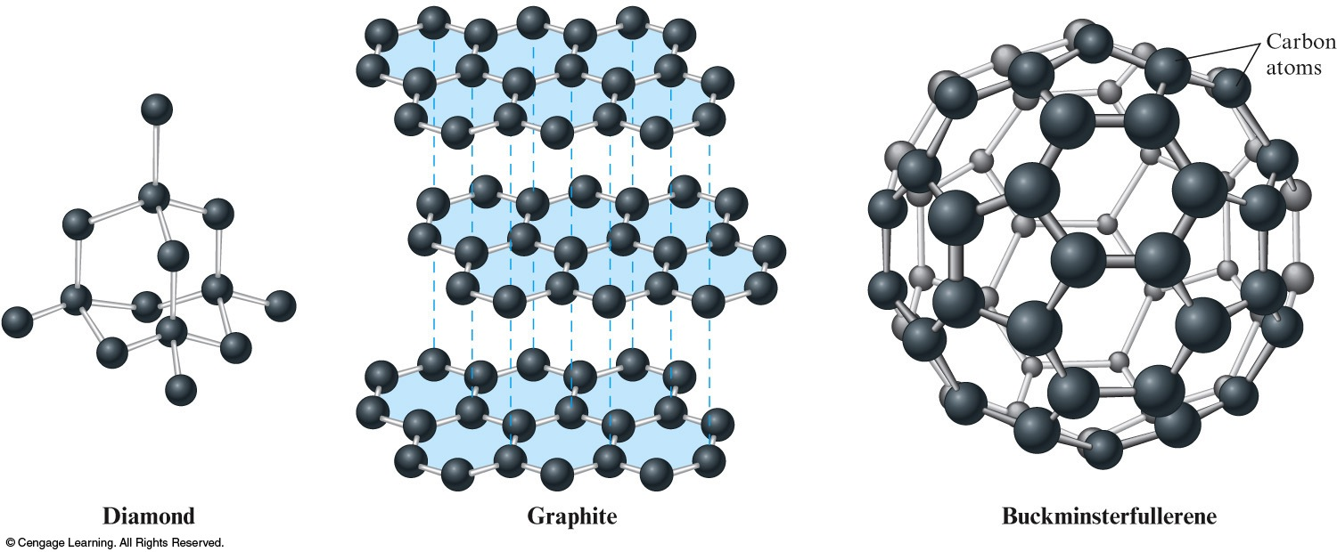
Carbon Allotropes

Slide 7
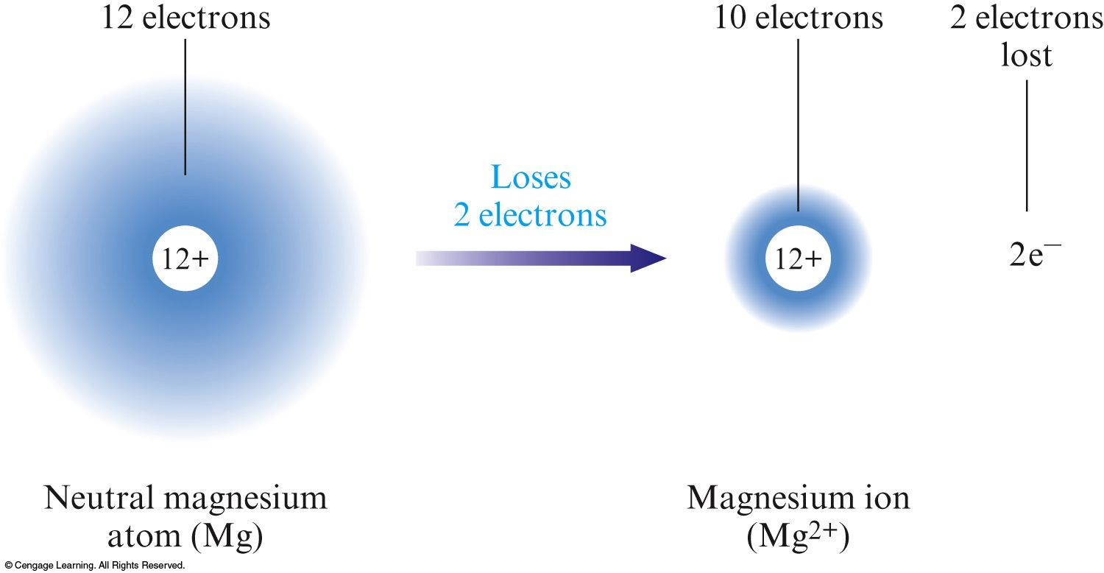
Atoms can form ions by gaining or losing electrons.
Metals tend to lose one or more electrons to form positive ions called cations.
Cations are generally named by using the name of the parent atom.

Slide 8
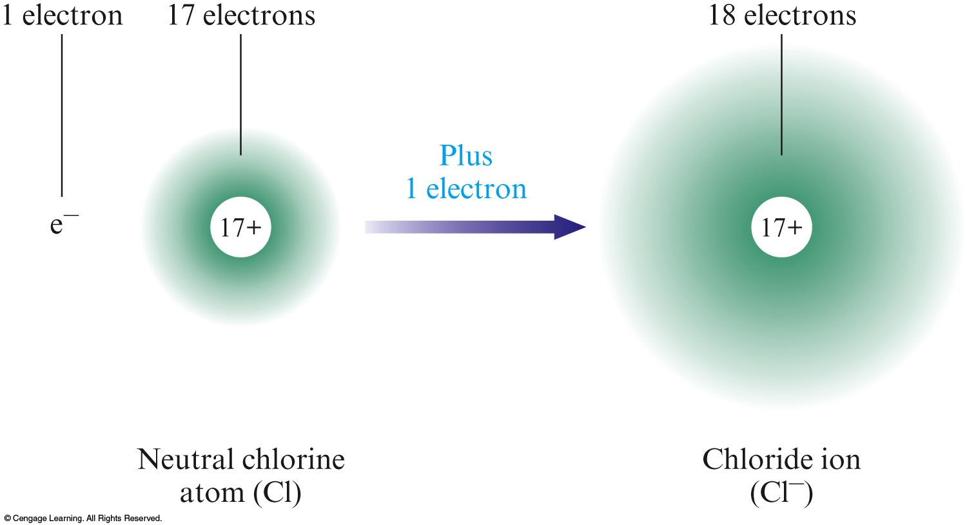
Nonmetals tend to gain one or more electrons to form negative ions called anions.
Anions are named by using the root of the atom name followed by the suffix –ide.

Slide 9
Ion Charges and the Periodic Table
The ion that a particular atom will form can be predicted from the periodic table.
Group or Family | Charge
Alkali Metals (1A) | 1+
Alkaline Earth Metals (2A) | 2+
Halogens (7A) | 1–
Noble Gases (8A) | 0

Slide 10
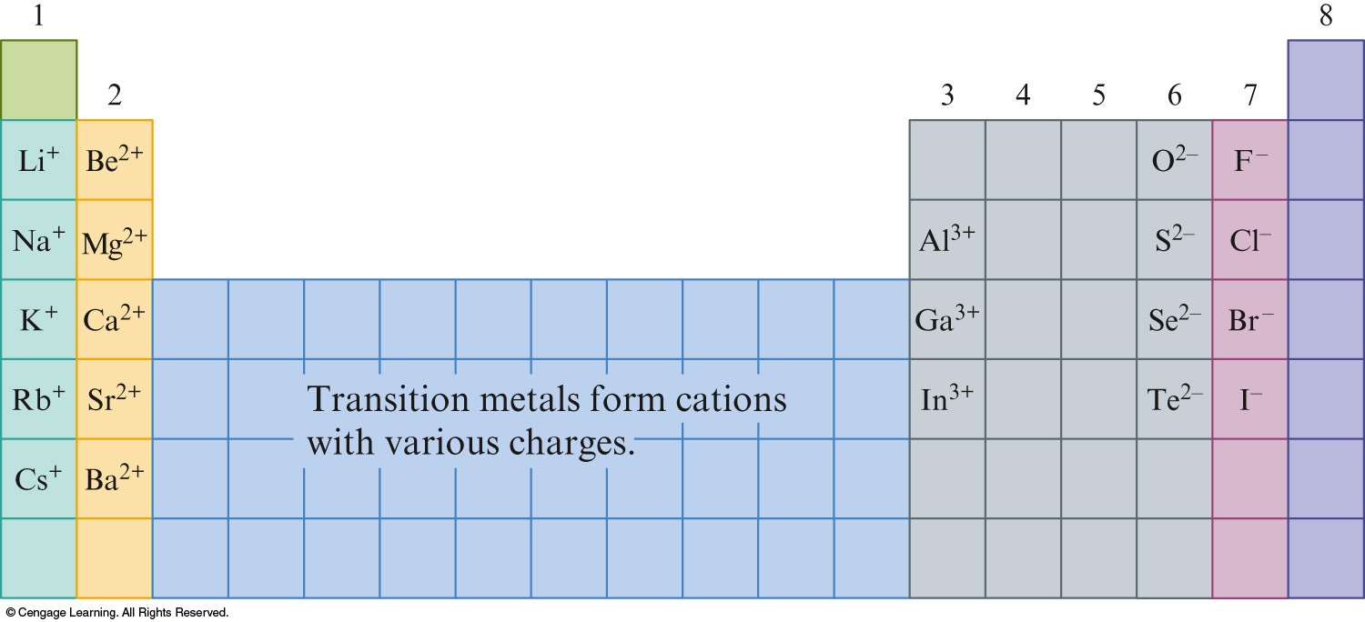
Ion Charges and the Periodic Table

Slide 11
Exercise
An ion with a 3+ charge contains 23 electrons. Which ion is it?
a) Fe³⁺
b) V³⁺
c) Ca³⁺
d) Sc³⁺
Notes:
The 3+ charge on the ion means that the ion has lost 3 electrons, therefore the number of protons is 26 (23+3). The ion is Fe³⁺.

Slide 12
Exercise
A certain ion X⁺ contains 54 electrons and 78 neutrons.
What is the mass number of this ion?
133
Notes:
The mass number is 133. The plus charge in X+ means that the ion has lost an electron, therefore the number of protons is 55 (54+1). The ion is Cs⁺ with a mass number of 133 (55+78).

Slide 13
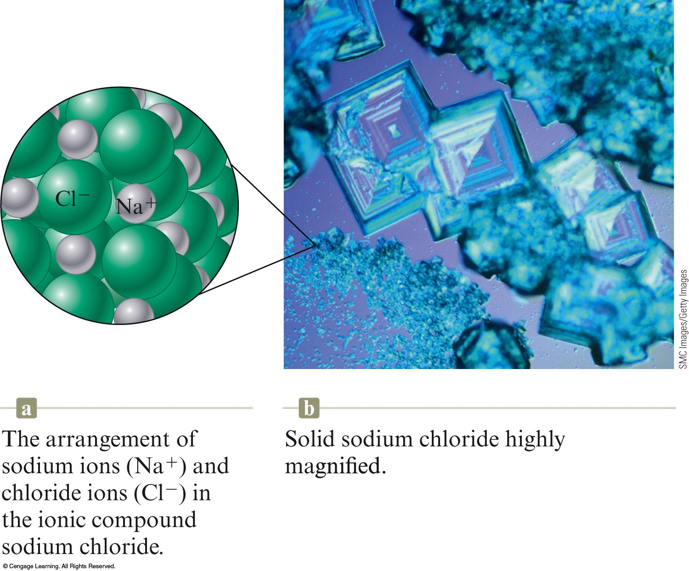
Ions combine to form ionic compounds.
Properties of ionic compounds
High melting points
Conduct electricity
If melted
If dissolved in water

Slide 14
Ionic compounds are electrically neutral.
The charges on the anions and cations in the compound must sum to zero.

Slide 15
Formulas for Ionic Compounds
Write the cation element symbol followed by the anion element symbol.
The number of cations and anions must be correct for their charges to sum to zero.

Slide 16
Concept Check
A compound contains an unknown ion X and has the formula XCl₂. Ion X contains 20 electrons. What is the identity of X?
a) Ti²⁺
b) Sc⁺
c) Ca²⁺
d) Cr²⁺
Notes:
The charge on the cation must be +2 since there are two Cl’s each with a –1 charge (giving an overall charge of –2 for the anion side). The cation can now be represented as X²⁺, containing 20 electrons. Therefore, 22 protons must be present to give a charge of +2 (+22p – 20e = +2). The element with 22 protons is titanium.

Slide 17
Concept Check
A member of the alkaline earth metal family whose most stable ion contains 36 electrons forms a compound with bromine. What is the correct formula for this compound?
a) CaBr₂
b) KrBr
c) RbBr
d) SrBr₂
Notes:
An element in the alkaline earth metal family (Group 2) forms a +2 charge when forming a compound. Therefore two Br– ions will be required to give a net zero charge overall. 38 protons must be present to give a charge of +2 (+38p – 36e = +2). The element with 38 protons is strontium. The compound is therefore SrBr₂.

