Slide 1
Chapter 5
Nomenclature

Slide 2
Binary Compounds
  Composed of two elements
Binary Ionic Compounds
  Metal—nonmetal
Binary Covalent Compounds
  Nonmetal—nonmetal

Slide 3
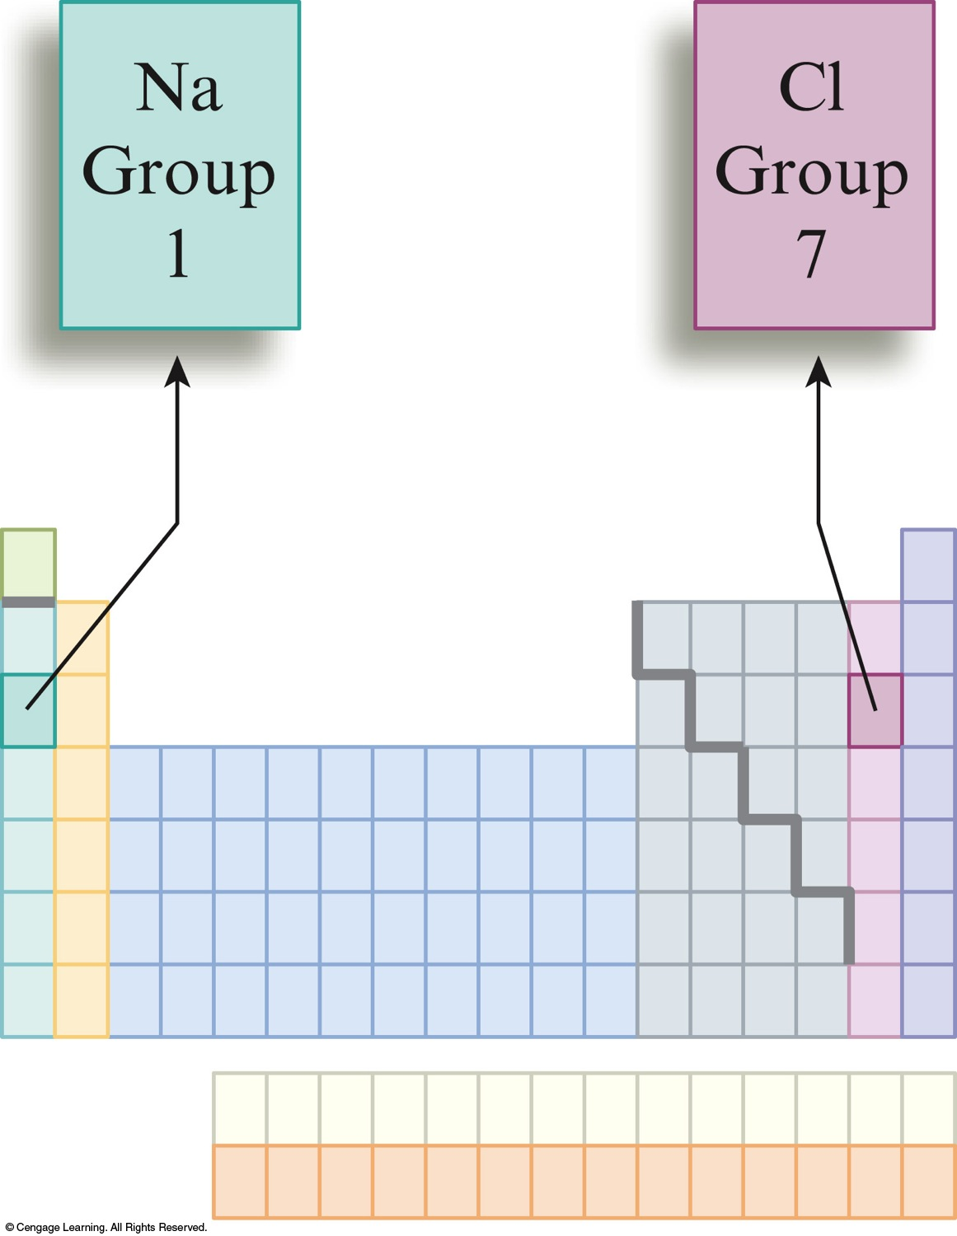
Binary ionic compounds contain positive cations and negative anions.
  Type I compounds
    Metal present forms only one cation.
  Type II compounds
    Metal present can form 2 or more cations with different charges.

Slide 4
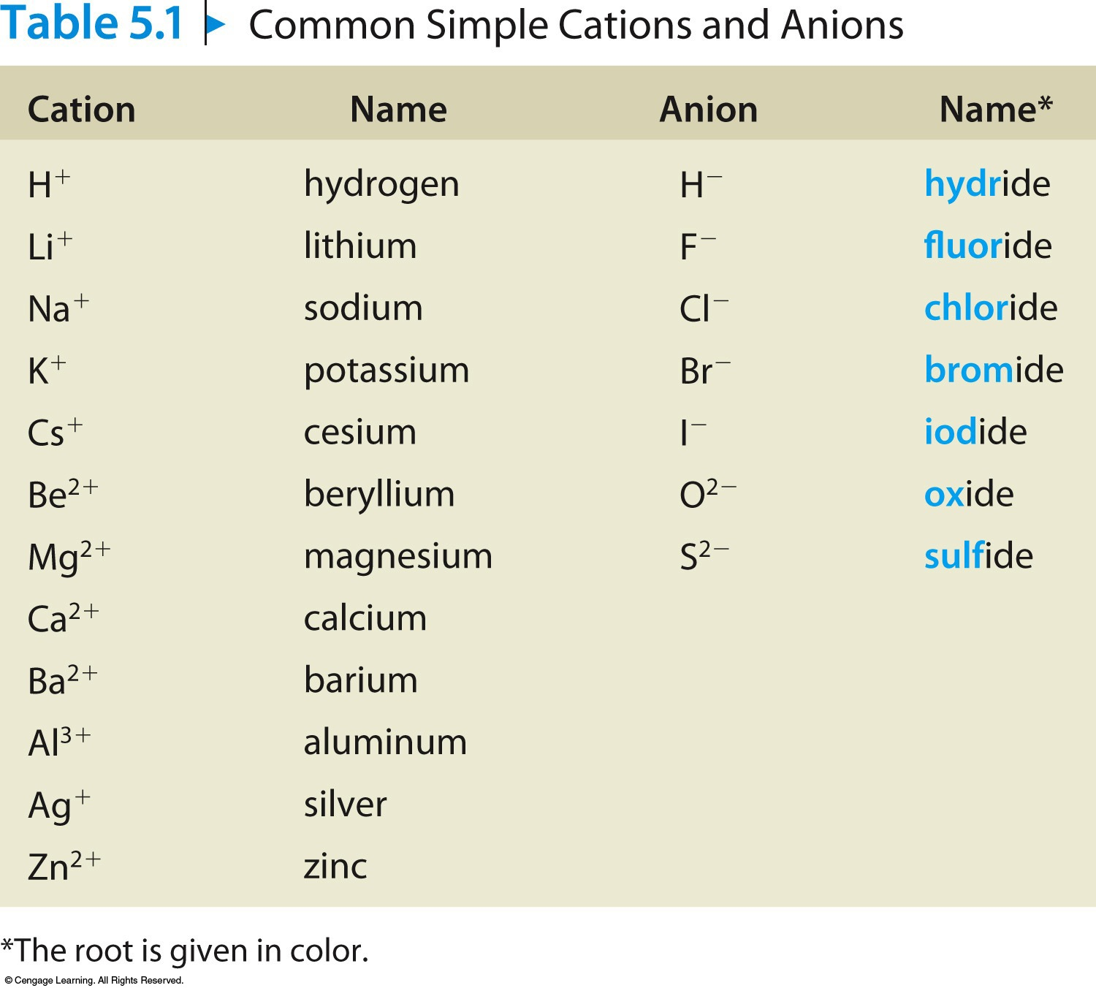
Common Simple Cations and Anions

Slide 5
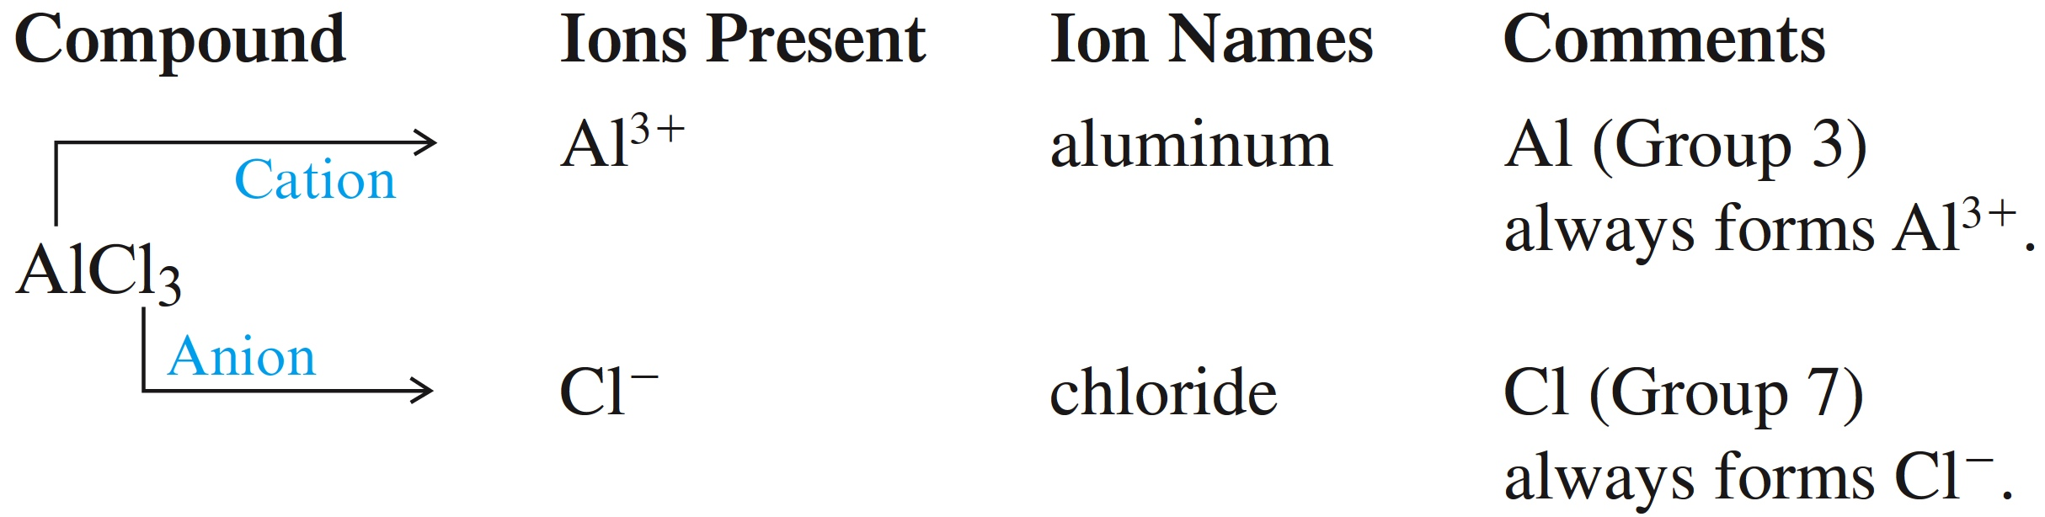
Rules for Naming Type I Ionic Compounds
1. The cation is always named first and the anion second.
2. A simple cation takes its name from the name of the element.
A simple anion is named by taking the first part of the element name (the root) and adding –ide.

Slide 6
Binary Ionic Compounds (Type I)
Examples:
KCl Potassium chloride
MgBr₂ Magnesium bromide
CaO Calcium oxide

Slide 7

Exercise
What is the name of the compound SrBr₂?
  a) strontium bromine
  b) sulfur bromide
  c) strontium dibromide
  d) strontium bromide
Notes:
Strontium bromide. Sr is the symbol for strontium. Br is the symbol for bromine, but take the first part of the element name (the root) and add –ide to get the name bromide.

Slide 8
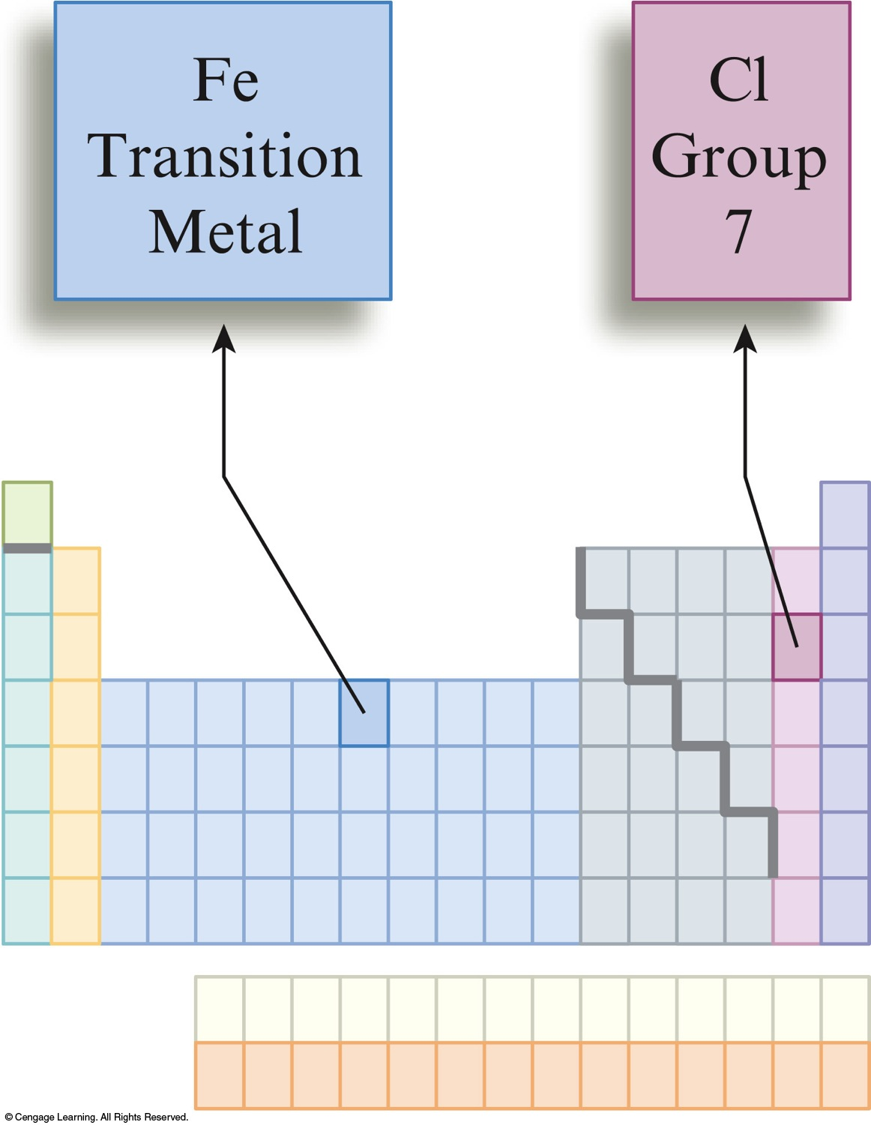
Binary Ionic Compounds (Type II)
Metals in these compounds can form more than one type of positive charge.
Charge on the metal ion must be specified.
Roman numeral indicates the charge of the metal cation.
Transition metal cations usually require a Roman numeral.

Slide 9
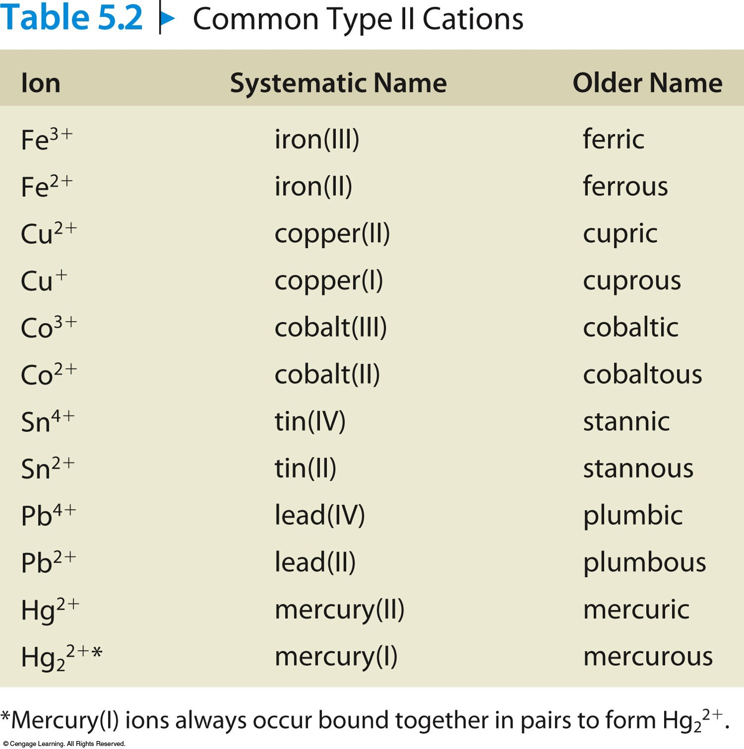
Common Type II Cations

Slide 10
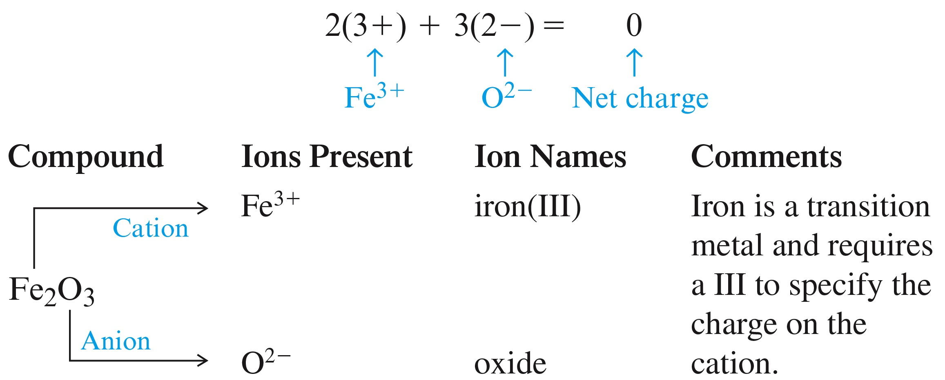
Rules for Naming Type II Ionic Compounds
1. The cation is always named first and the anion second.
2. Because the cation can assume more than one charge, the charge is specified by a Roman numeral in parentheses.

Slide 11
Binary Ionic Compounds (Type II)
Examples:
CuBr Copper(I) bromide
FeS Iron(II) sulfide
PbO₂ Lead(IV) oxide

Slide 12
Exercise
What is the name of the compound CrO₂?
  a) chromium oxide
  b) chromium(II) oxide
  c) chromium(IV) oxide
  d) chromium dioxide
Notes:
Chromium(IV) oxide. Cr is the symbol for chromium. O is the symbol for oxygen, but take the first part of the element name (the root) and add –ide to get the name oxide. Since chromium can have more than one charge, a Roman numeral must be used to identify that charge. There are two oxygen ions each with a 2– charge, giving an overall charge of –4. Therefore, the charge on chromium must be +4.

Slide 13
Exercise
What is the correct name of the compound that results from the most stable ion for sulfur and the metal ion that contains 24 electrons?
  a) iron(III) sulfide
  b) chromium(II) sulfide
  c) nickel(III) sulfate
  d) iron(II) sulfide
Notes:
Iron(II) sulfide. For sulfur, take the first part of the element name (the root) and add –ide to get the name sulfide. Iron with a +2 charge (as the Roman numeral indicates) contains 24 electrons (26p – 24e = +2 charge).

Slide 14
Rules for Naming Type III Binary Compounds
Formed between two nonmetals.
1. The first element in the formula is named first, and the full element name is used.
2. The second element is named as though it were an anion.
3. Prefixes are used to denote the numbers of atoms present.
4. The prefix mono- is never used for naming the first element.

Slide 15
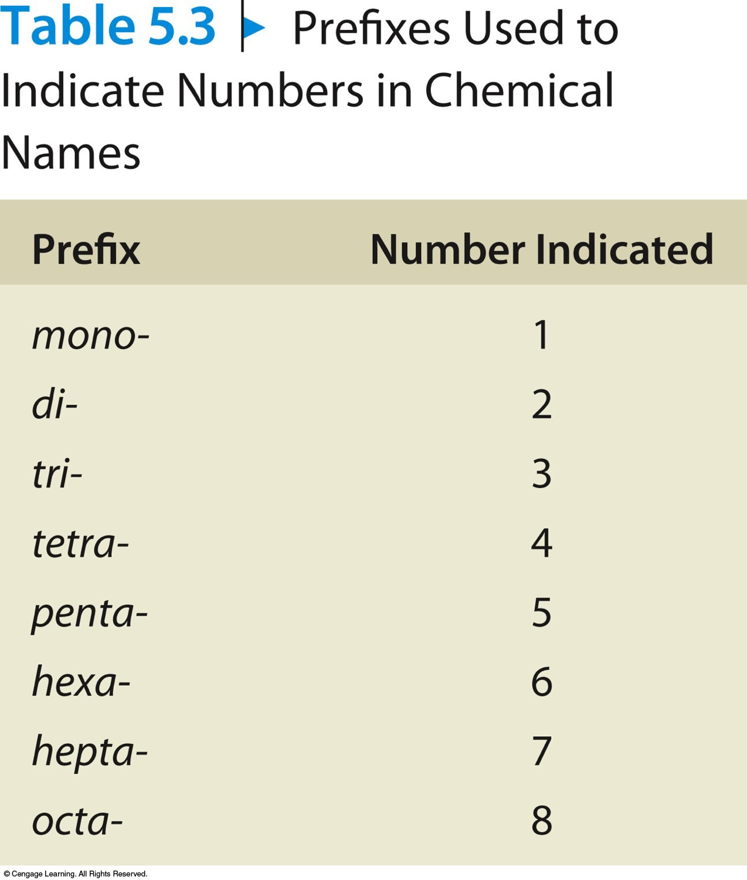
Prefixes Used to Indicate Numbers in Chemical Names

Slide 16
Binary Covalent Compounds (Type III)
Examples:
CO₂ Carbon dioxide
SF₆ Sulfur hexafluoride
N₂O₄ Dinitrogen tetroxide

Slide 17
Exercise
What is the name of the compound SeO₂?
  a) selenium oxide
  b) selenium dioxide
  c) selenium(II) oxide
  d) selenium(IV) dioxide
Notes:
Selenium dioxide. Se is the symbol for selenium. O is the symbol for oxygen, but take the first part of the element name (the root) and add –ide to get the name oxide. Since they are both nonmetals, prefixes are used to identify the elements (except mono- is not used for the first element). Two oxygen atoms require the use of the prefix di-, making the name dioxide.

Slide 18
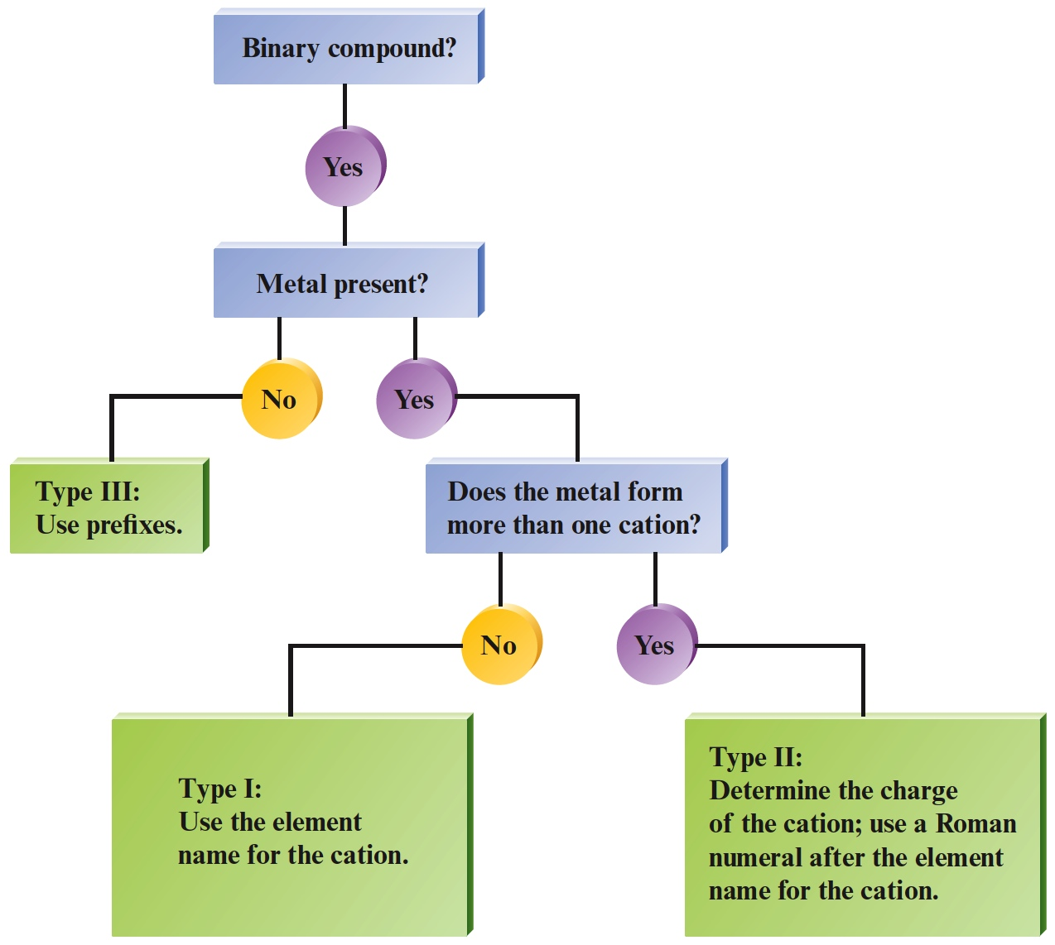
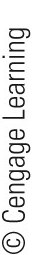
Flow Chart for Naming Binary Compounds

Slide 19
Polyatomic ions are charged entities composed of several atoms bound together.
They have special names and must be memorized.

Slide 20
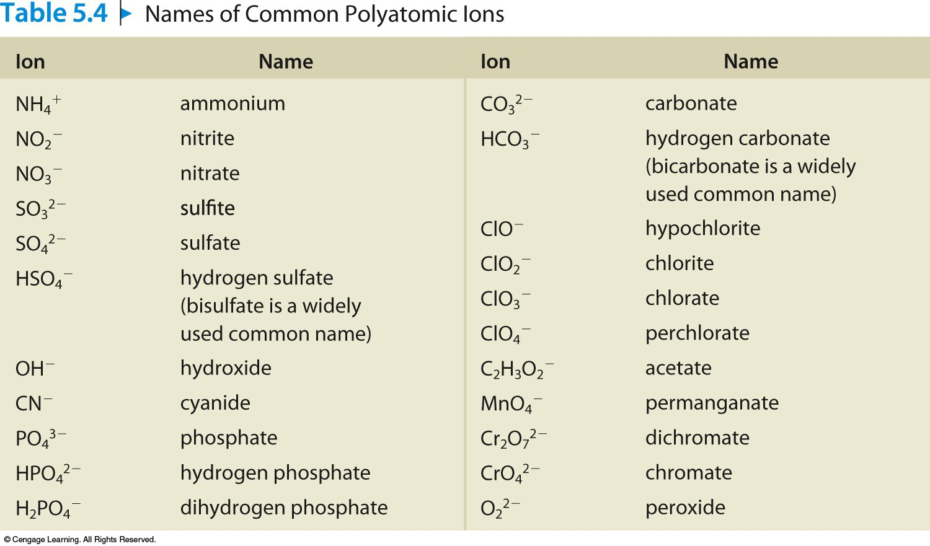
Names of Common Polyatomic Ions

Slide 21
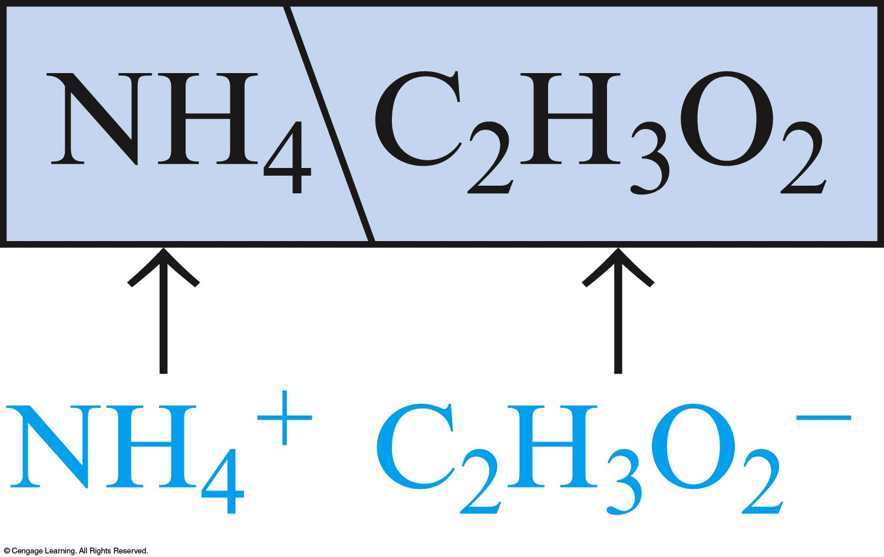
Naming ionic compounds containing polyatomic ions follows rules similar to those for binary compounds.
  Ammonium acetate

Slide 22
Examples
NaOH Sodium hydroxide
Mg(NO₃)₂ Magnesium nitrate
(NH₄)₂SO₄ Ammonium sulfate
FePO₄ Iron(III) phosphate

Slide 23
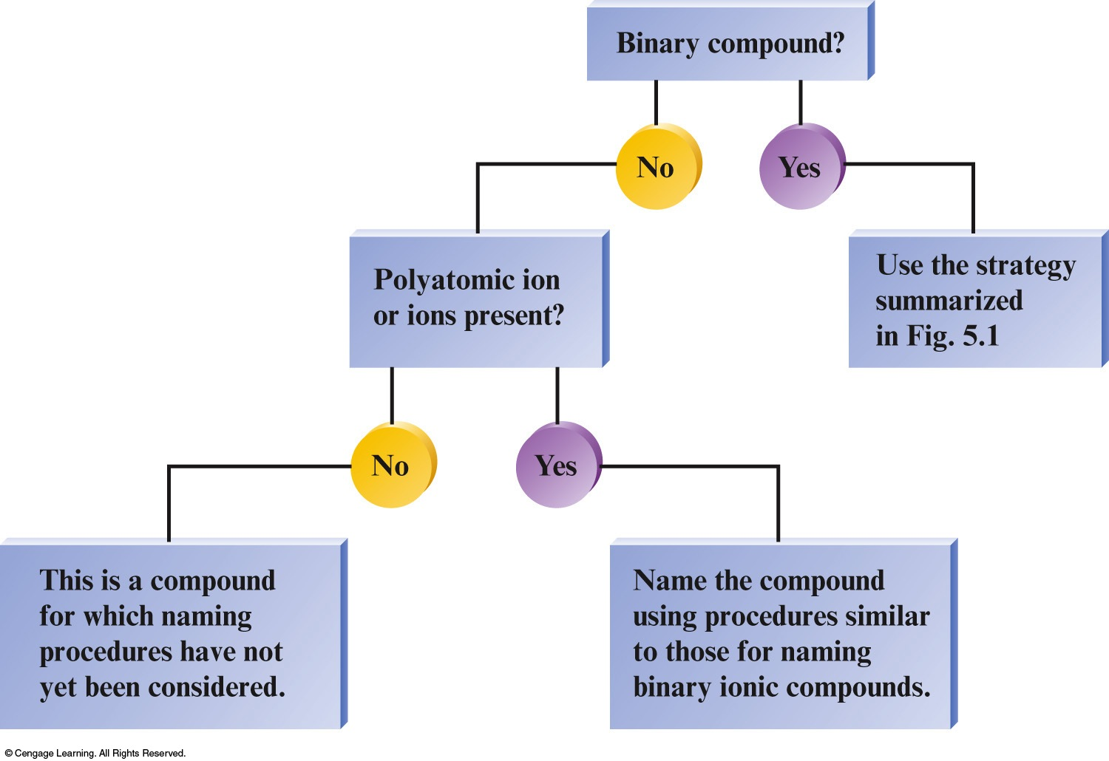
Overall Strategy for Naming Chemical Compounds

Slide 24
Exercise
What is the name of the compound KClO₃?
  a) potassium chlorite
  b) potassium chlorate
  c) potassium perchlorate
  d) potassium carbonate
Notes:
ClO₃– is the polyatomic ion chlorate.

Slide 25
Exercise
Examine the following table of formulas and names. Which of the compounds are named correctly?
  a) I, II
  b) I, III, IV
  c) I, IV
  d) I only
 | Formula | Name
I | P₂O₅ | Diphosphorus pentoxide
II | ClO₂ | Chlorine oxide
III | PbI₄ | Lead iodide
IV | CuSO₄ | Copper(I) sulfate
Notes:
Only Formula I is named correctly. Formula II is chlorine dioxide. Formula III is lead(IV) iodide. Formula IV is copper(II) sulfate.

Slide 26
Acids
Acids can be recognized by the hydrogen that appears first in the formula—HCl.
Molecule with one or more H⁺ ions attached to an anion.

Slide 27
Rules for Naming Acids
If the anion does not contain oxygen, the acid is named with the prefix hydro– and the suffix –ic attached to the root name for the element.
Examples:
HCl Hydrochloric acid
HCN Hydrocyanic acid
H₂S Hydrosulfuric acid

Slide 28
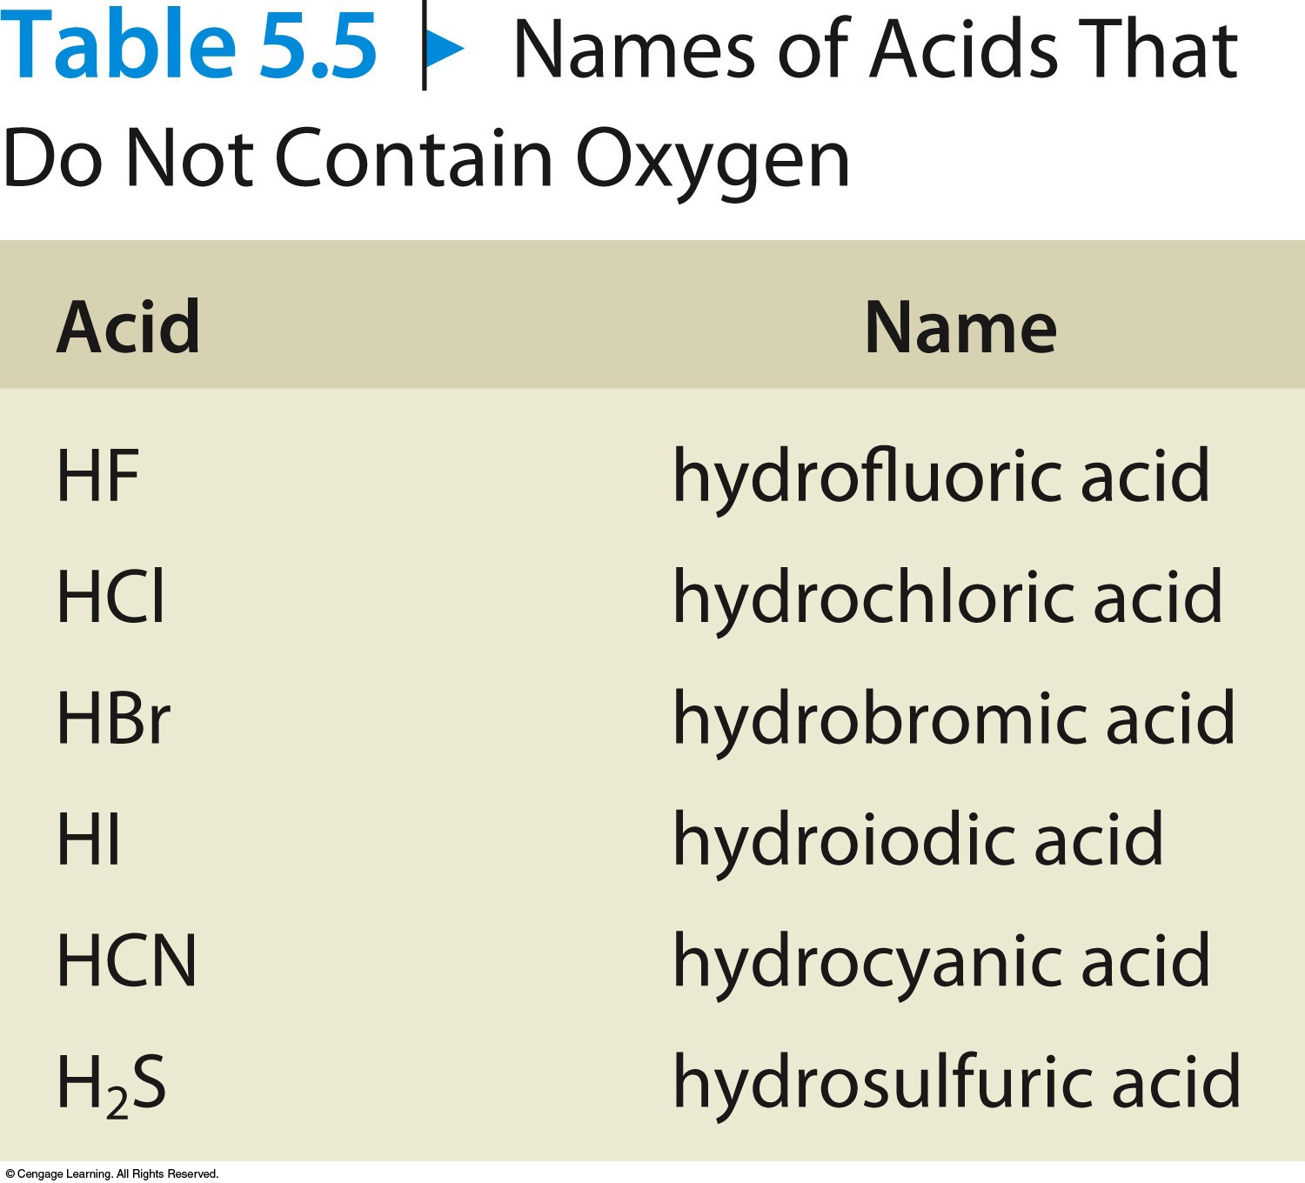
Acids That Do Not Contain Oxygen

Slide 29
Rules for Naming Acids
If the anion contains oxygen:
  The suffix –ic is added to the root name if the anion name ends in –ate.
Examples:
HNO₃ Nitric acid
H₂SO₄ Sulfuric acid
HC₂H₃O₂ Acetic acid

Slide 30
Rules for Naming Acids
If the anion contains oxygen:
  The suffix –ous is added to the root name if the anion name ends in –ite.
Examples:
HNO₂ Nitrous acid
H₂SO₃ Sulfurous acid
HClO₂ Chlorous acid

Slide 31
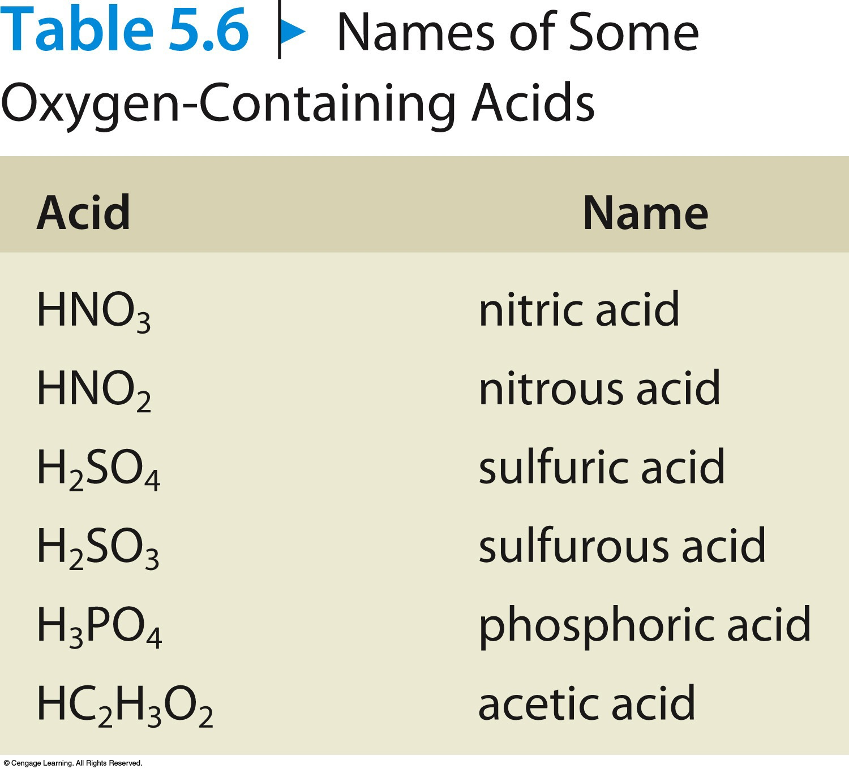
Some Oxygen-Containing Acids

Slide 32
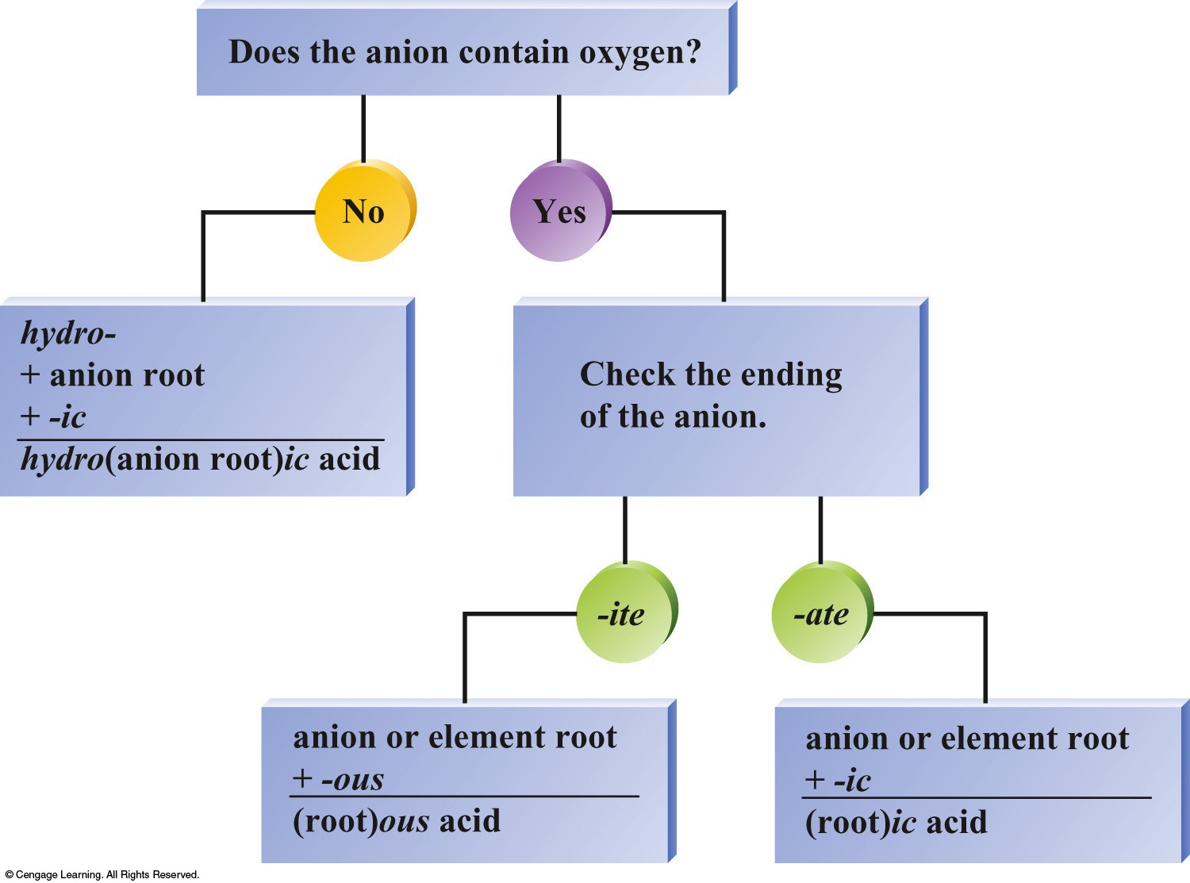
Flowchart for Naming Acids

Slide 33
Exercise
Which of the following compounds is named incorrectly?
KNO₃ potassium nitrate
TiO₂ titanium(II) oxide
Sn(OH)₄ tin(IV) hydroxide
PBr₅ phosphorus pentabromide
H₂SO₃ sulfurous acid
Notes:
The correct answer is “b”. The charge on oxygen is 2–. Since there are two oxygen atoms, the overall charge is 4–. Therefore, the charge on titanium must be 4+ (not 2+ as the Roman numeral indicates).

Slide 34
Examples
Sodium hydroxide
  NaOH
Potassium carbonate
  K₂CO₃
Sulfuric acid
  H₂SO₄
Dinitrogen pentoxide
  N₂O₅
Cobalt(III) nitrate
  Co(NO₃)₃

Slide 35
Exercise
A compound has the formula XCl₃ where X could represent a metal or nonmetal. What could the name of this compound be?
a) phosphorus trichloride
b) carbon monochloride
c) tin(IV) chloride
d) magnesium chloride
Notes:
Phosphorus trichloride. Carbon monochloride has the formula CCl. Tin(IV) chloride has the formula SnCl₄. Magnesium chloride has the formula MgCl₂. Phosphorus trichloride has the formula PCl₃ and is therefore the correct answer.

