Slide 1
Chapter 6
Chemical Reactions: An Introduction

Slide 2
What are the clues that a chemical change has taken place?
Chemical reactions often give a visual signal.
But reactions are not always visible.

Slide 3
Some Clues That a Chemical Reaction Has Occurred

Slide 4
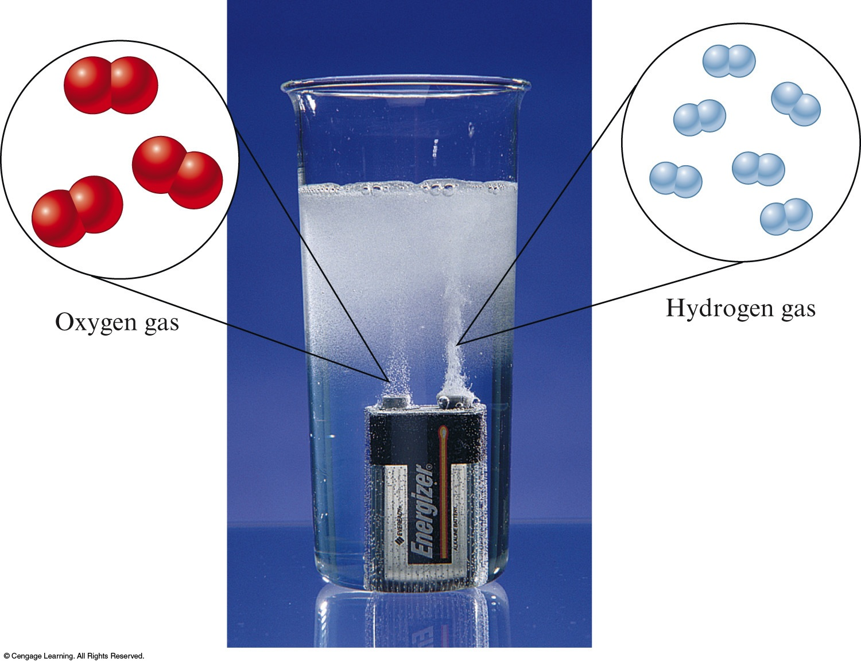
Exercise
What is a clue that a chemical reaction has occurred?
a) The color changes.
b) A solid forms.
c) Bubbles are present.
d) A flame is produced.
Notes:
The answer is c. The formation of bubbles (a gas) is a sign that a chemical reaction has taken place.

Slide 5
Exercise
What is a clue that a chemical reaction has occurred?
“Colorless hydrochloric acid is added to a red solution of cobalt(II) nitrate, turning the solution blue.”
a) The color changes.
b) A solid forms.
c) Bubbles are present.
d) A flame is produced.
Notes:
The answer is a. The solution turning blue is a sign that a chemical reaction has taken place.

Slide 6
Exercise
What is a clue that a chemical reaction has occurred?
“A solid forms when a solution of sodium dichromate is added to a solution of lead nitrate.”
a) A gas forms.
b) A solid forms.
c) Bubbles are present.
d) A flame is produced.
Notes:
The answer is b. The formation of a yellow solid is a sign that a chemical reaction has taken place.

Slide 7
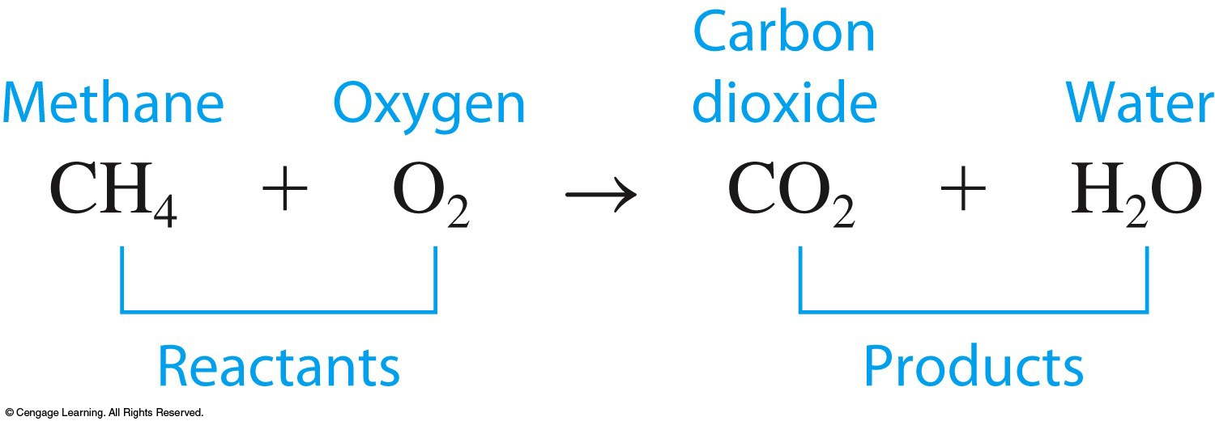
Chemical reactions involve changing the ways atoms are grouped.
A chemical equation represents a chemical reaction.
Reactants are shown to the left of the arrow.
Products are shown to the right of the arrow.

Slide 8
In a chemical reaction atoms are not created or destroyed.
All atoms present in the reactants must be accounted for in the products.
Same number of each type of atom on both sides of the arrow.

Slide 9
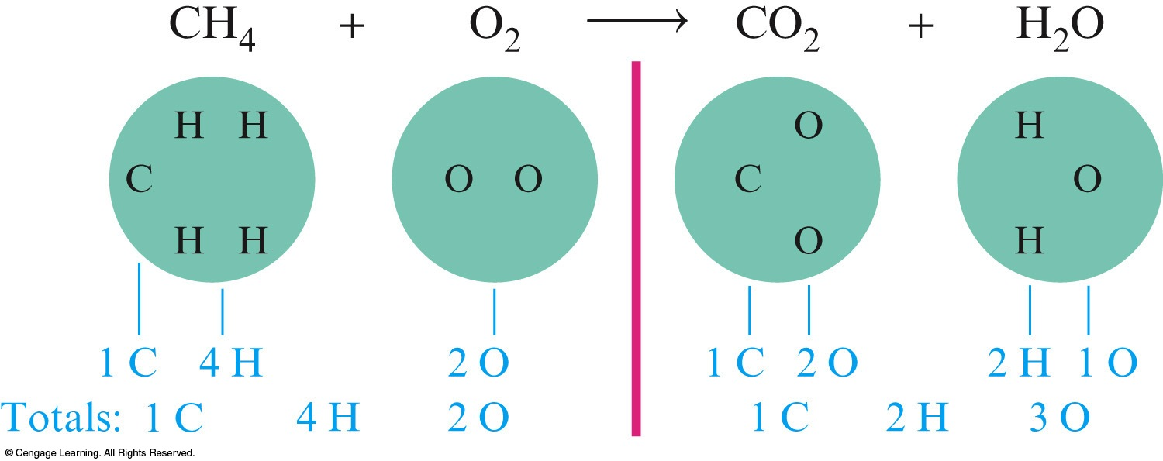
Balancing a Chemical Equation
Unbalanced Equation:
Balancing the Equation:
The balanced equation: CH₄ + 2O₂ → CO₂ + 2H₂O

Slide 10
Physical States
Physical states of compounds are often given in a chemical equation.

Slide 11
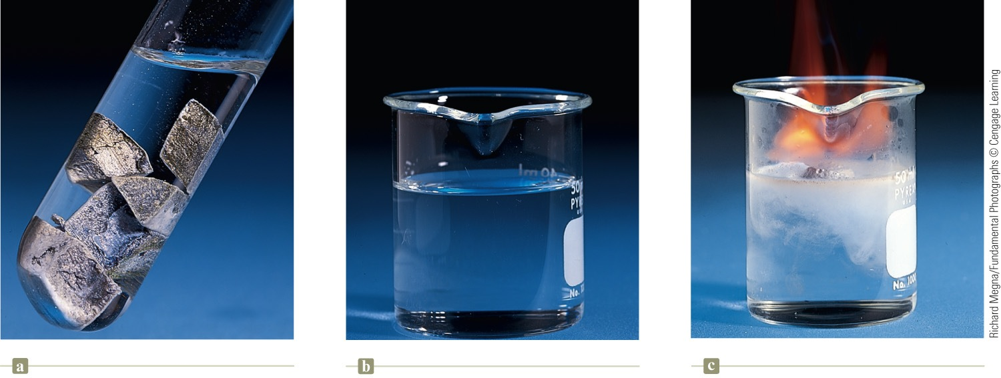
Example

Slide 12
Exercise
When blue light shines on a mixture of hydrogen and chlorine gas, the elements react explosively to form gaseous hydrochloric acid. What is the unbalanced equation for this process?
a) H₂(g) + CH₄(g) HCl(g)
b) HCl(g) H(g) + Cl(g)
c) H(g) + Cl(g) HCl(g)
d) H₂(g) + Cl₂(g) HCl(g)
Notes:
The answer is d. Notice that the reactants, hydrogen and chlorine, are both diatomic gases. We have only one product (hydrochloric acid).

Slide 13
The principle that lies at the heart of the balancing process is that atoms are conserved in a chemical reaction.
Atoms are neither created nor destroyed.
The same number of each type of atom is found among the reactants and among the products.

Slide 14
Chemists determine the identity of the reactants and products of a reaction by experimental observation.
The identities (formulas) of the compounds must never be changed in balancing a chemical equation.

Slide 15
How to Write and Balance Equations
Read the description of the chemical reaction. What are the reactants, the products, and their states? Write the appropriate formulas.
Hydrogen gas (H₂) and oxygen gas (O₂) combine to form liquid water (H₂O).
Write the unbalanced equation that summarizes the information from step 1.
H₂(g) + O₂(g) → H₂O(l)

Slide 16
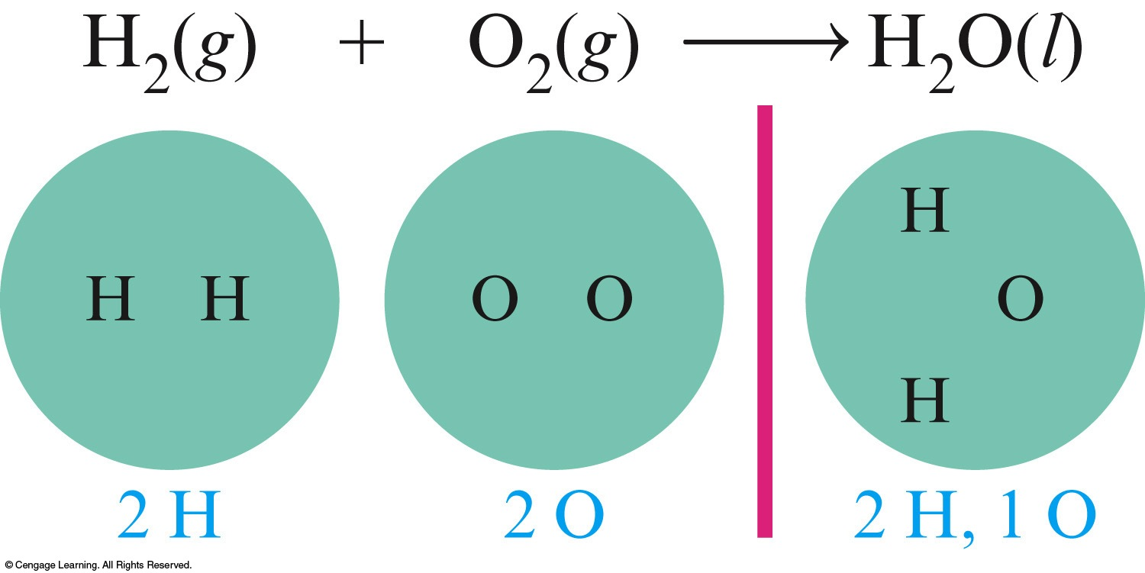
How to Write and Balance Equations
Balance the equation by inspection, starting with the most complicated molecule.
Equation is unbalanced by counting the atoms on both sides of the arrow.

Slide 17
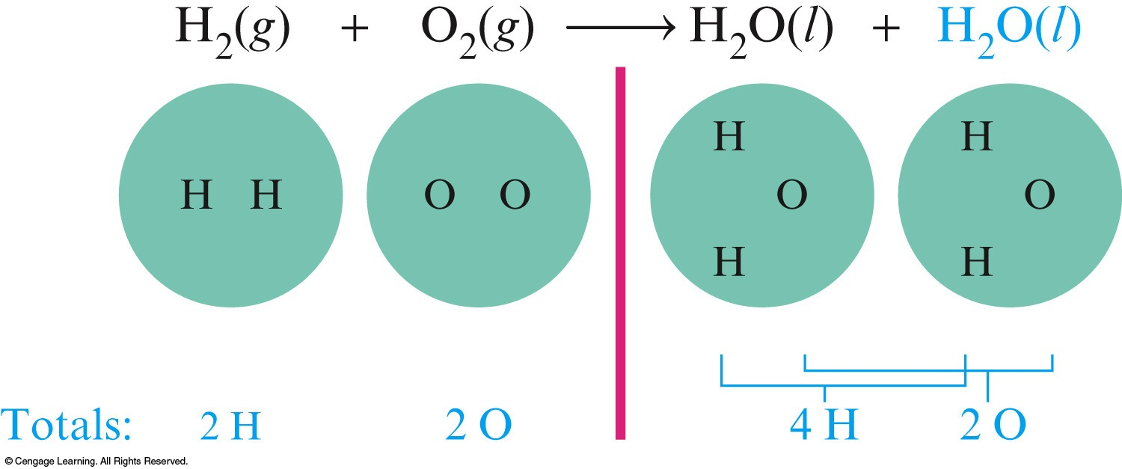
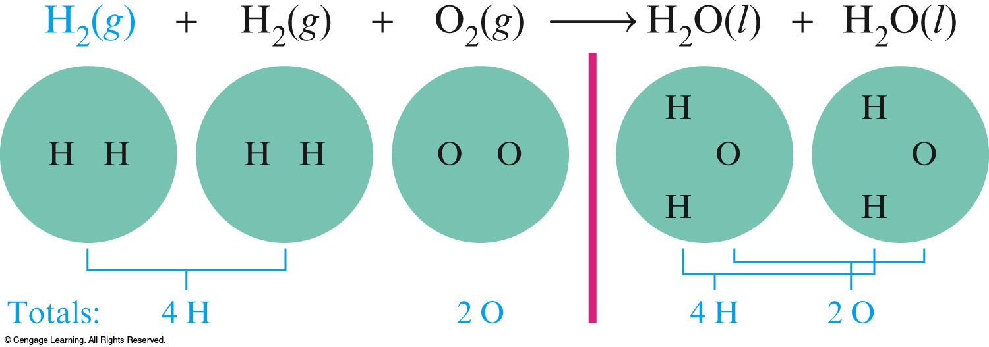
How to Write and Balance Equations
Balance the equation by inspection, starting with the most complicated molecule.
We must balance the equation by adding more molecules of reactants and/or products.

Slide 18
How to Write and Balance Equations
4. Check to see that the coefficients used give the same number of each type of atom on both sides of the arrow. Also check to see that the coefficients used are the smallest integers that give the balanced equation.
The balanced equation is:
2H₂(g) + O₂(g) → 2H₂O(l)
or could be:
4H₂(g) + 2O₂(g) → 4H₂O(l)
preferred

Slide 19
Exercise
Balance the following equation in standard form (lowest multiple integers) and determine the sum of the coefficients?
FeO(s) + O₂(g) → Fe₂O₃(s)
a) 3
b) 4
c) 7
d) 14
Notes:
The answer is c. The balanced equation is:
4FeO(s) + O₂(g) → 2Fe₂O₃(s). The sum of the coefficients is therefore 4 + 1 + 2 = 7.

Slide 20
Exercise
Which of the following correctly balances the chemical equation given below? There may be more than one correct balanced equation. If a balanced equation is incorrect, explain what is incorrect about it.
CaO + C → CaC₂ + CO₂
I. CaO₂ + 3C → CaC₂ + CO₂
II. 2CaO + 5C → 2CaC₂ + CO₂
III. CaO + (2.5)C → CaC₂ + (0.5)CO₂
IV. 4CaO + 10C → 4CaC₂ + 2CO₂
Notes:
II, III, and IV are correct. I is not correct because you cannot use subscripts to balance a chemical equation.

Slide 21
Exercise
Of the three that are correct, which one is preferred most (the most accepted convention)? Why?
CaO + C → CaC₂ + CO₂
I. CaO₂ + 3C → CaC₂ + CO₂
II. 2CaO + 5C → 2CaC₂ + CO₂
III. CaO + (2.5)C → CaC₂ + (0.5)CO₂
IV. 4CaO + 10C → 4CaC₂ + 2CO₂
Notes:
II is preferred most (most accepted convention) because it is the balanced equation with the smallest integers (whole numbers).

Slide 22
Concept Check
When balancing a chemical equation, which of the following statements is false?
a) Subscripts in the reactants must be conserved in the products.
b) Coefficients are used to balance the atoms on both sides.
c) When one coefficient is doubled, the rest of the coefficients in the balanced equation must also be doubled.
d) Phases are often shown for each compound but are not critical to balancing an equation.
Notes:
The answer is a. Subscripts in the reactants do not have to be conserved in the products in order to make the equation balance. Coefficients are used to balance the atoms on both sides. For example:
2H₂(g) + O₂(g) → 2H₂O(g).
Balancing using subscripts will change the compounds.

Slide 23
Notice
The number of atoms of each type of element must be the same on both sides of a balanced equation.
Subscripts must not be changed to balance an equation.
A balanced equation tells us the ratio of the number of molecules which react and are produced in a chemical reaction.
Coefficients can be fractions, although they are usually given as lowest integer multiples.

