Slide 1
Chapter 7
Reactions in Aqueous Solutions

Slide 2
Four Driving Forces Favor Chemical Change
  Formation of a solid
  Formation of water
  Transfer of electrons
  Formation of a gas

Slide 3
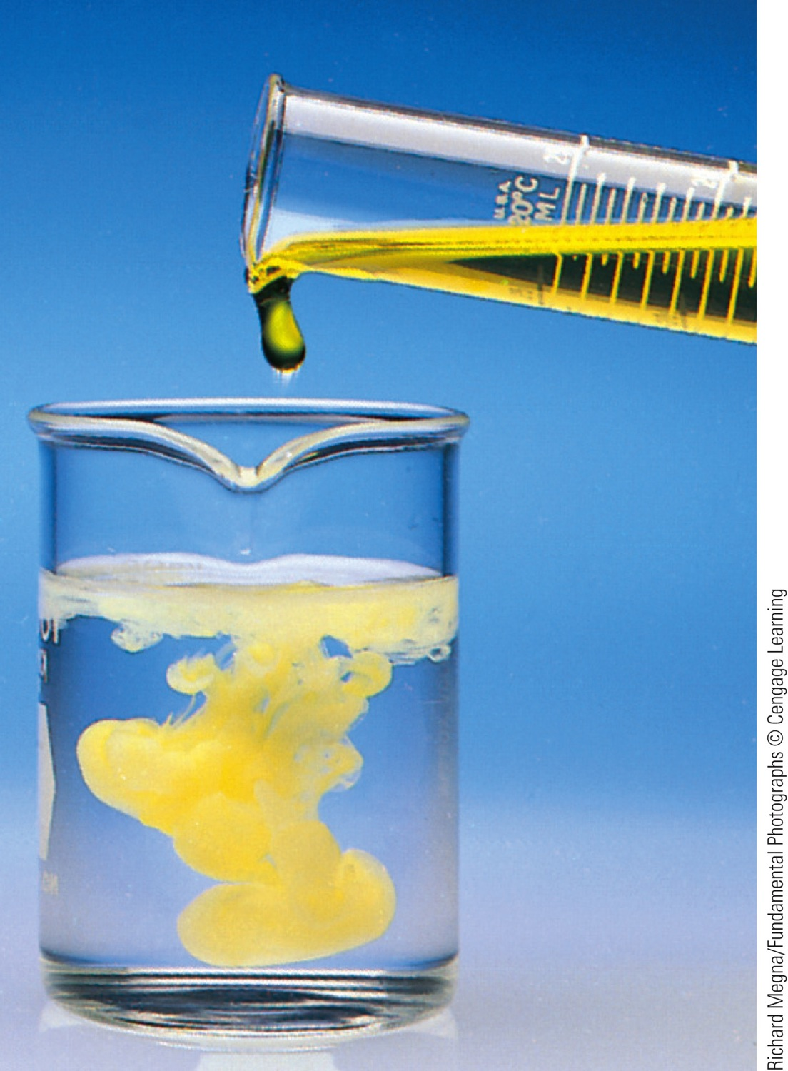
Precipitation
A reaction in which a solid forms is called a precipitation reaction.
  Solid = precipitate

Slide 4
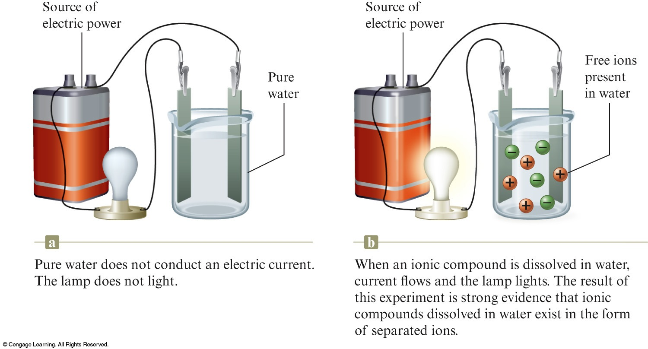
What Happens When an Ionic Compound Dissolves in Water?
The ions separate and move around independently.
Strong electrolyte – each unit of the substance that dissolves in water produces separated ions.

Slide 5
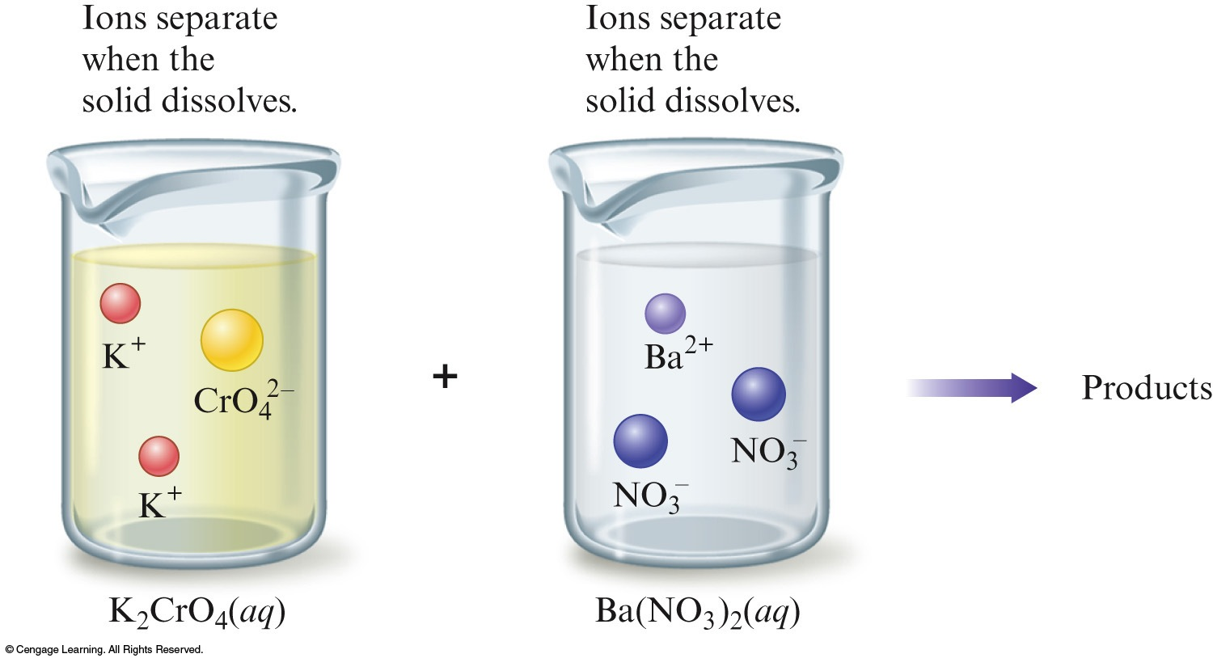
What Happens When an Ionic Compound Dissolves in Water?
K₂CrO₄(aq) + Ba(NO₃)₂(aq) → Products

Slide 6
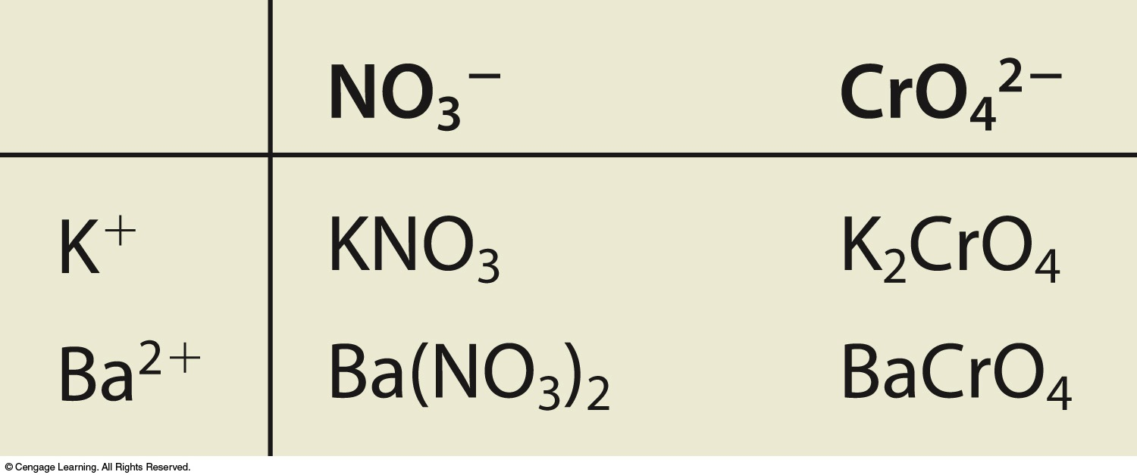
How to Decide What Products Form
K₂CrO₄(aq) + Ba(NO₃)₂(aq) → Products
The mixed solution contains four types of ions: K⁺, CrO₄^{2–}, Ba²⁺, and NO₃–.
Determine the possible products from the ions in the reactants. The possible ion combinations are:

Slide 7
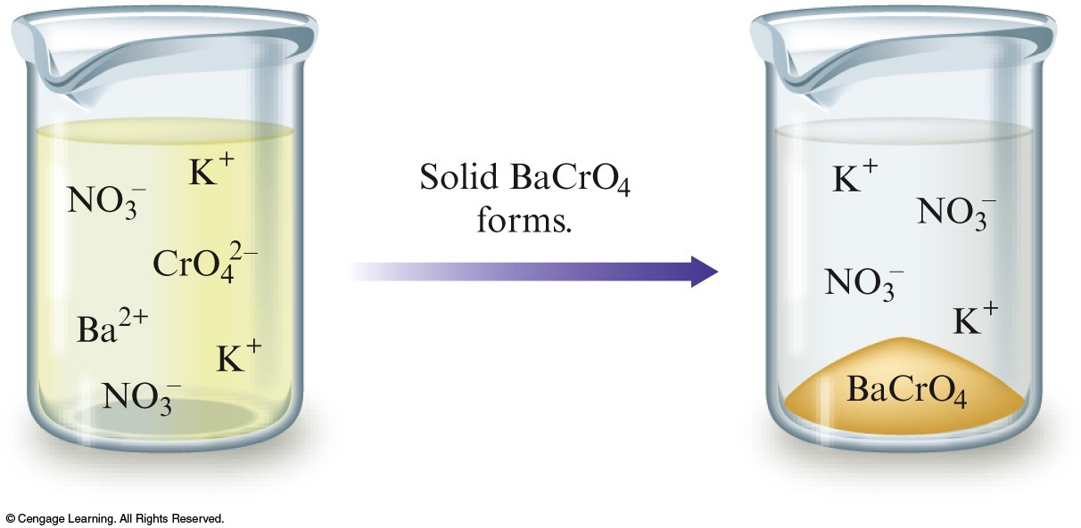
How to Decide What Products Form
Decide which is most likely to be the yellow solid formed in the reaction.
K₂CrO₄(aq) reactant
Ba(NO₃)₂(aq) reactant
The possible combinations are KNO₃ and BaCrO₄.
  KNO₃ white solid
  BaCrO₄ yellow solid

Slide 8
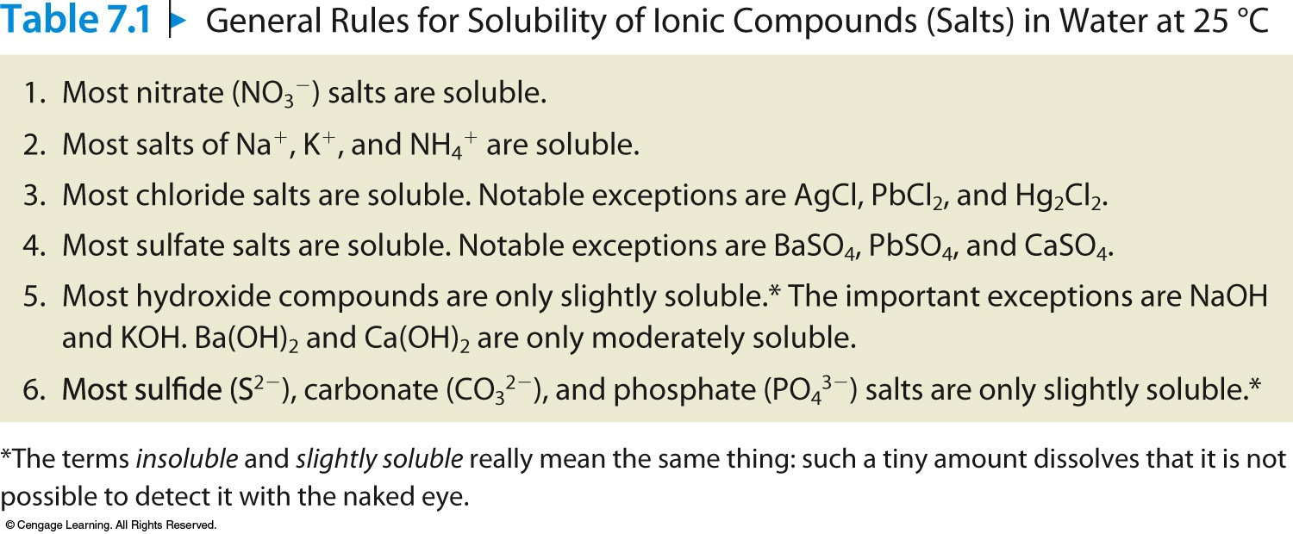
Using Solubility Rules

Slide 9
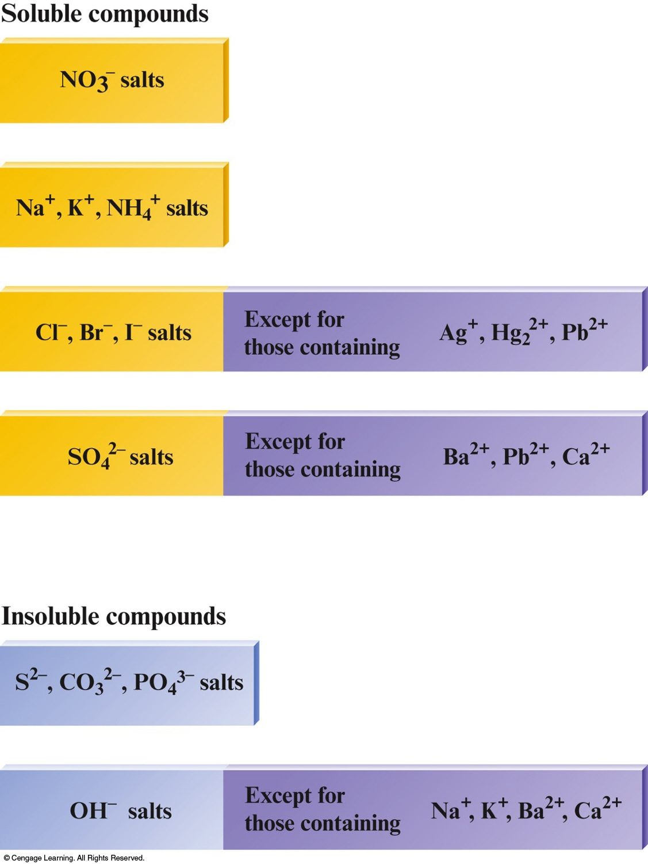
Using Solubility Rules
Predicting Precipitates
  Soluble solid
  Insoluble solid
  Slightly soluble solid

Slide 10
How to Predict Precipitates When Solutions of Two Ionic Compounds Are Mixed
Write the reactants as they actually exist before any reaction occurs. Remember that when a salt dissolves, its ions separate.
Consider the various solids that could form. To do this, simply exchange the anions of the added salts.
Use the solubility rules (Table 7.1) to decide whether a solid forms and, if so, to predict the identity of the solid.

Slide 11

Concept Check
Which of the following ions form compounds with Pb²⁺ that are generally soluble in water?
a) S^{2–}
b) Cl–
c) NO₃–
d) SO₄^{2–}
e) Na⁺
Notes:
The answer is c). a), b), and d) all form precipitates with Pb²⁺. A compound cannot form between only Pb²⁺ and Na⁺.

Slide 12
Concept Check
A sodium phosphate solution reacts with a lead(II) nitrate solution. What precipitate, if any, will form?
a) Pb₃(PO₄)₂
b) NaNO₃
c) Pb(NO₃)₂
d) No precipitate will form.
Notes:
The correct answer is a. Following the solubility rules, the chemical equation is 2Na₃PO₄(aq) + 3Pb(NO₃)₂(aq) → Pb₃(PO₄)₂(s) + 6NaNO₃(aq).

Slide 13
Concept Check
Consider a solution with the following ions present:
When all are allowed to react (and there is plenty available of each), how many different solids will form? List them.
Five different solids will form.
PbCl₂, PbSO₄, Pb₃(PO₄)₂, AgCl, Ag₃PO₄
Notes:
Five different solids will form.
PbCl₂, PbSO₄, Pb₃(PO₄)₂, AgCl, Ag₃PO₄

Slide 14
Types of Equations for Reactions in Aqueous Solutions
Molecular Equation
  Shows the complete formulas of all reactants and products.
  It does not give a very clear picture of what actually occurs in solution.

Slide 15
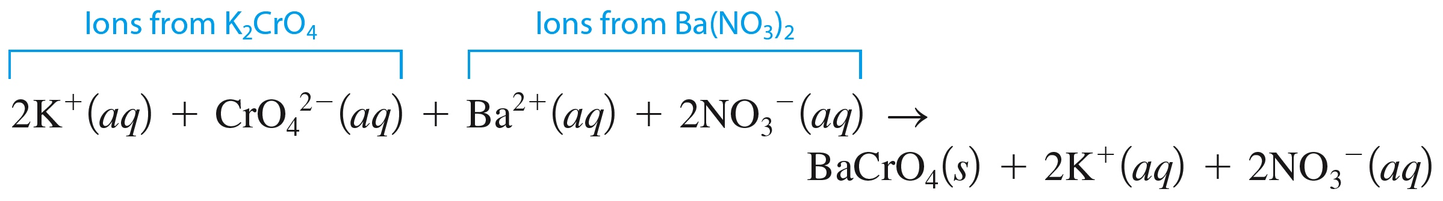
Types of Equations for Reactions in Aqueous Solutions
2. Complete Ionic Equation
  All strong electrolytes are shown as ions.
  Notice: K⁺ and NO₃– ions are present in solution both before and after the reaction.

Slide 16
Types of Equations for Reactions in Aqueous Solutions
2. Complete Ionic Equation
  Spectator ions – ions which do not participate directly in a reaction in solution.

Slide 17
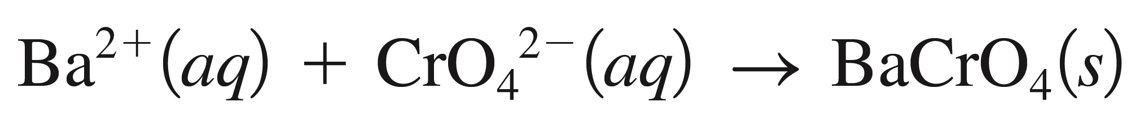
Types of Equations for Reactions in Aqueous Solutions
3. Net Ionic Equation
  Only those components of the solution that undergo a change.
  Notice: Spectator ions are not shown in the net ionic equation.

Slide 18
Concept Check
Write the correct molecular equation, complete ionic equation, and net ionic equation for the reaction between cobalt(II) chloride and sodium hydroxide.
Molecular Equation:
CoCl₂(aq) + 2NaOH(aq) → Co(OH)₂(s) + 2NaCl(aq)
Complete Ionic Equation:
Co²⁺(aq) + 2Cl⁻(aq) + 2Na⁺(aq) + 2OH⁻(aq) →
Co(OH)₂(s) + 2Na⁺(aq) + 2Cl⁻(aq)
Net Ionic Equation:
Co²⁺(aq) + 2OH⁻(aq) → Co(OH)₂(s)

Slide 19
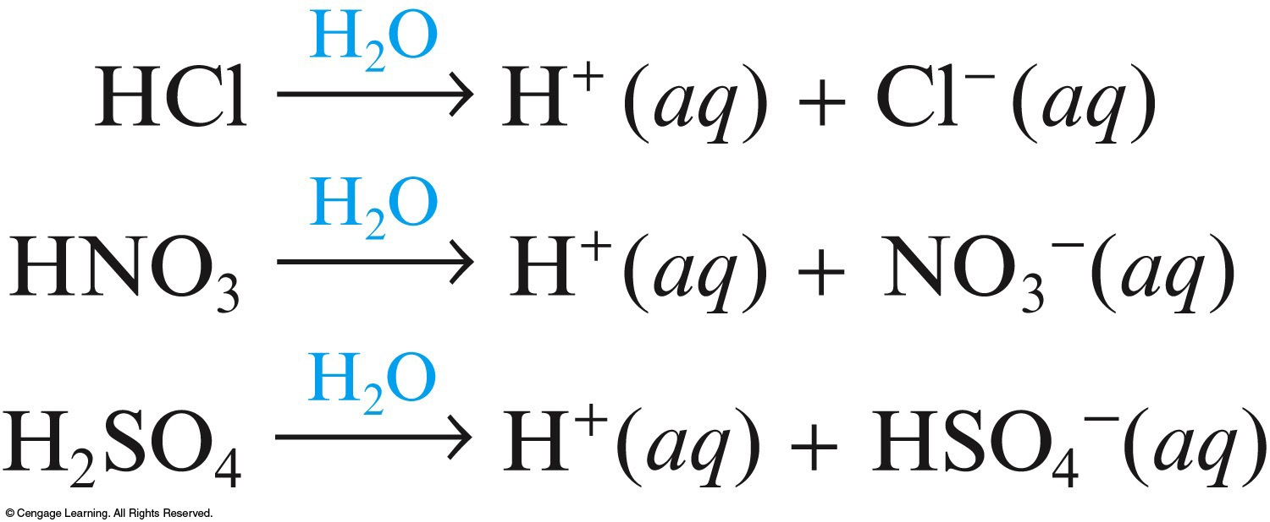
Arrhenius Acids and Bases
A strong acid is one in which virtually every molecule dissociates (ionizes) in water to an H⁺ ion and an anion.

Slide 20
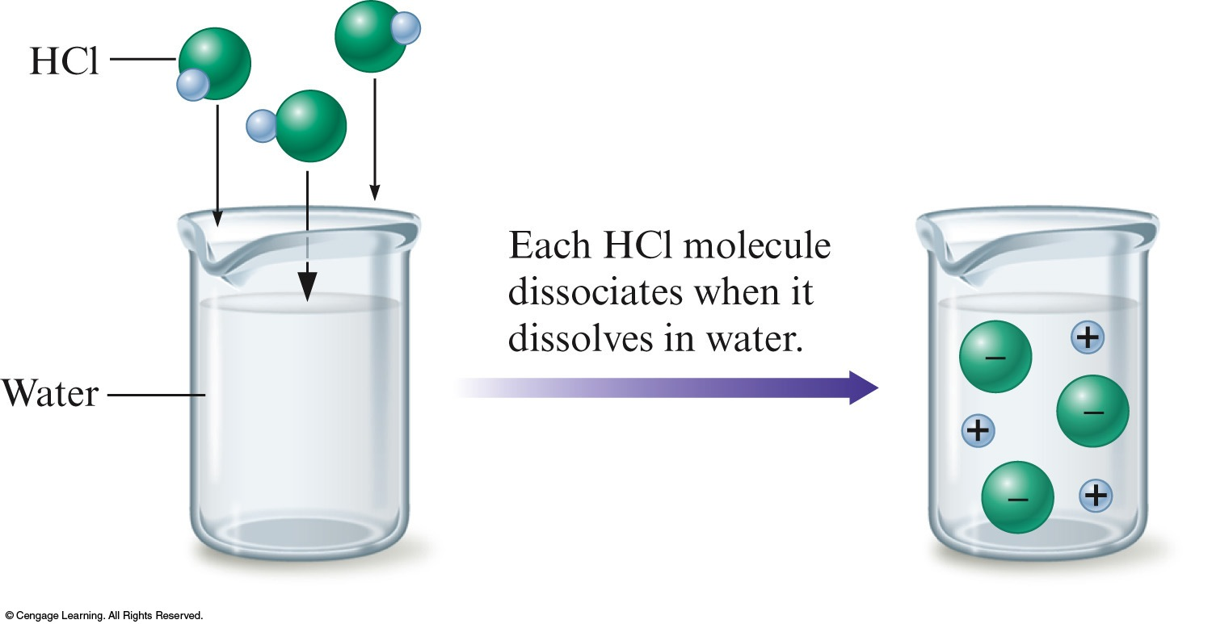
Strong Acids Behave as Strong Electrolytes

Slide 21
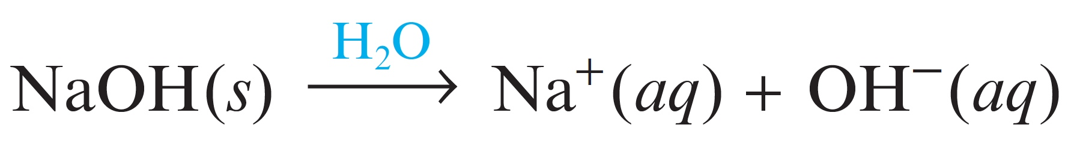

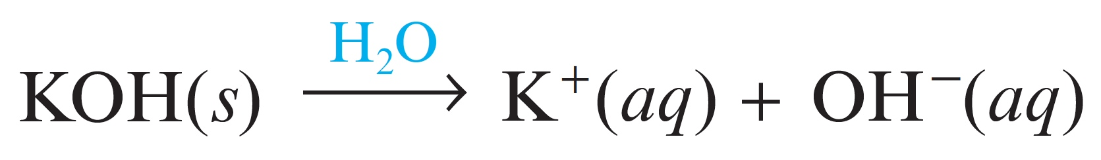
Arrhenius Acids and Bases
A strong base is a metal hydroxide that is completely soluble in water, giving separate OH⁻ ions and cations.
  Most common examples: NaOH and KOH

Slide 22
Arrhenius Acids and Bases
The products of the reaction of a strong acid and a strong base are water and a salt.
  Salt ⇒ Ionic compound
Net ionic equation
  H⁺(aq) + OH⁻(aq) → H₂O(l)
Reaction of H⁺ and OH⁻ is called an acid-base reaction.
  H⁺ ⇒ acidic ion
  OH⁻ ⇒ basic ion

Slide 23
Summary of Strong Acids and Strong Bases
The common strong acids are aqueous solutions of HCl, HNO₃, and H₂SO₄.
A strong acid is a substance that completely dissociates (ionizes) in water (into H⁺ ions and anions).
A strong base is a metal hydroxide compound that is very soluble in water (and dissociates into OH– ions and cations).

Slide 24
Summary of Strong Acids and Strong Bases
4. The net ionic equation for the reaction of a strong acid and a strong base is always the same: it shows the production of water.
5. In the reaction of a strong acid and a strong base, one product is always water and the other is always an ionic compound called a salt, which remains dissolved in the water. This salt can be obtained as a solid by evaporating the water.

Slide 25
Summary of Strong Acids and Strong Bases
6. The reaction of H⁺ and OH– is often called an acid-base reaction, where H⁺ is the acidic ion and OH– is the basic ion.

Slide 26
Concept Check
The net ionic equation for the reaction of HNO₃ and LiOH is
a) H⁺ + NO₃– + LiOH → H₂O + LiNO₃
b) HNO₃ + LiOH → H₂O + LiNO₃
c) H⁺ + OH– → H₂O
d) Li⁺ + NO₃– → LiNO₃
Notes:
The correct answer is c. Li⁺ and NO₃– are spectator ions.

Slide 27
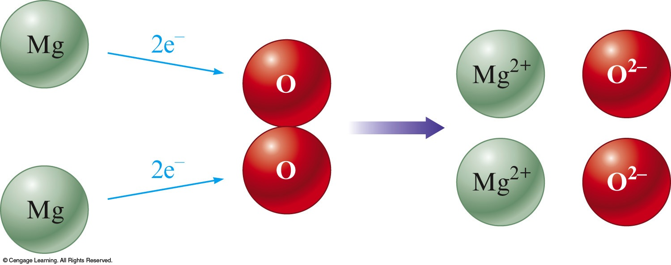
Oxidation–Reduction Reaction
Reactions between metals and nonmetals involve a transfer of electrons from the metal to the nonmetal.
A reaction that involves a transfer of electrons.
  2Mg(s) + O₂(g) → 2MgO(s)

Slide 28
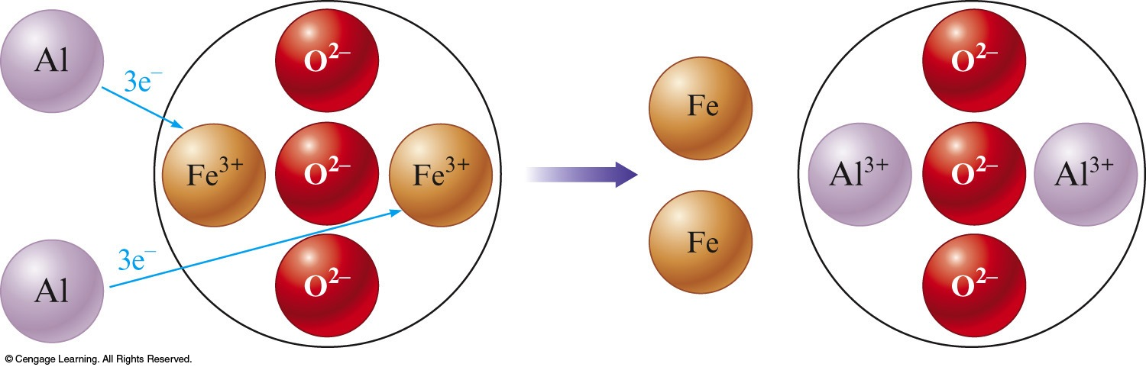
Concept Check
Which of the following best describes what is happening in the following representation of an oxidation–reduction reaction:
a) Metal Al gains 3 e– and O^{2 –} in Fe₂O₃ loses these 3e–.
b) Metal Al gains 3 e– and Fe³⁺ in Fe₂O₃ loses these 3e–.
c) Metal Al loses 3 e– and O^{2 –} in Fe₂O₃ gains these 3e–.
d) Metal Al loses 3 e– and Fe³⁺ in Fe₂O₃ gains these 3e–.
Notes:
The correct answer is d.

Slide 29
Characteristics of Oxidation–Reduction Reactions
A metal–nonmetal reaction can always be assumed to be an oxidation–reduction reaction, which involves electron transfer.
Two nonmetals can also undergo an oxidation–reduction reaction. At this point we can recognize these cases only by looking for O₂ as a reactant or product. When two nonmetals react, the compound formed is not ionic.

Slide 30
Driving Forces for a Reaction
Formation of a solid
Formation of water
Transfer of electrons
Formation of a gas

Slide 31
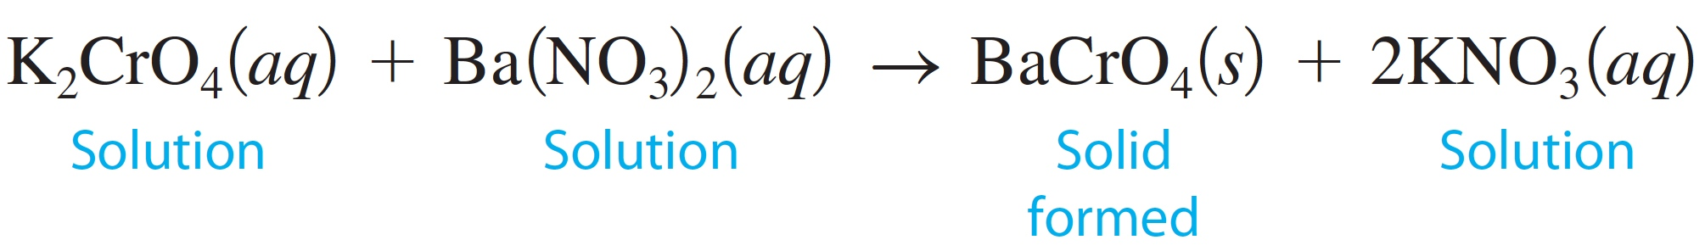
Precipitation Reaction
Formation of a solid when two solutions are mixed.
Notice this is also a double–displacement reaction.
  AB + CD → AD + CB

Slide 32
Acid–Base Reaction
Involves an H⁺ ion that ends up in the product water.
  H⁺(aq) + OH⁻(aq) → H₂O(l)
  HCl(aq) + KOH(aq) → H₂O(l) + KCl(aq)

Slide 33
Oxidation–Reduction Reaction
Transfer of electrons
  2Li(s) + F₂(g) → 2LiF(s)

Slide 34
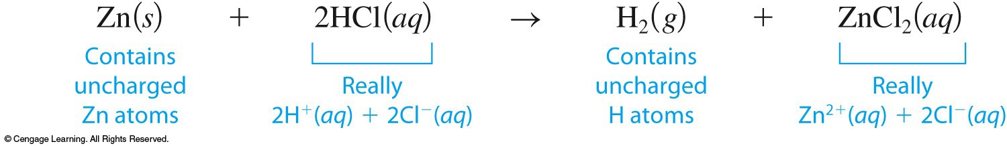
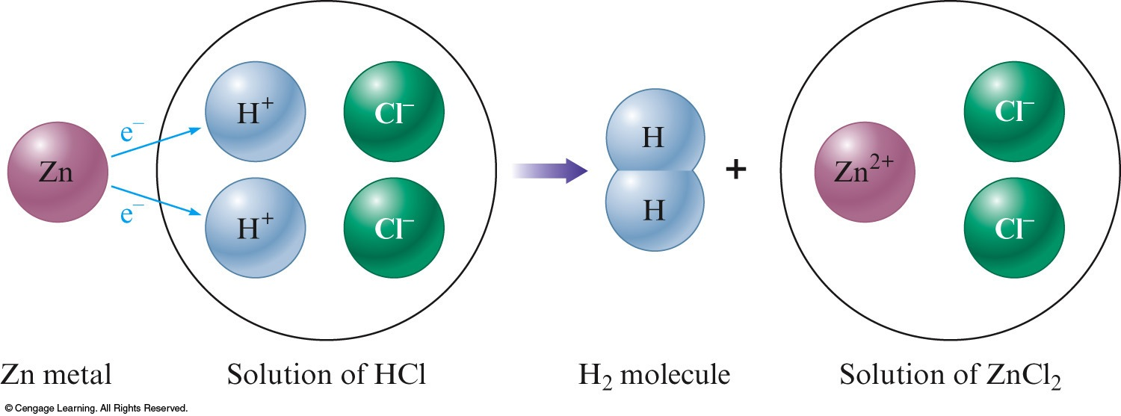
Formation of a Gas
Oxidation–reduction reaction
Single–replacement reaction
  A + BC → B + AC

Slide 35
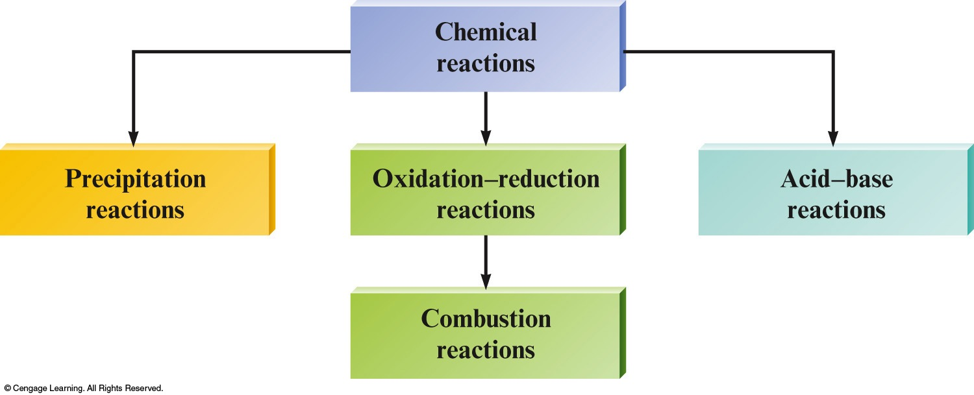
Combustion Reactions
Involve oxygen and produce energy (heat) so rapidly that a flame results.
  CH₄(g) + 2O₂(g) → CO₂(g) + 2H₂O(g)
  Special class of oxidation–reduction reactions.

Slide 36
Synthesis (Combination) Reactions
A compound forms from simpler materials.
  C(s) + O₂(g) → CO₂(g)
  Special class of oxidation–reduction reactions.

Slide 37
Decomposition Reactions
Occurs when a compound is broken down into simpler substances.
  2H₂O(l) → 2H₂(g) + O₂(g)
  Special class of oxidation–reduction reactions.

Slide 38
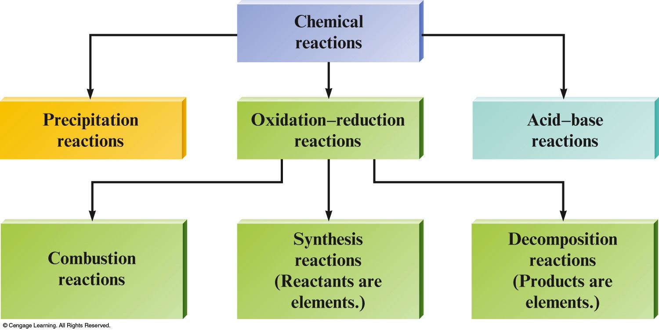
Summary

Slide 39
Concept Check
The reaction between hydrogen and oxygen to form water
2H₂ + O₂ → 2H₂O
can be classified as a(n) ___________ reaction.
oxidation–reduction
synthesis
combustion
All of the above
Notes:
The answer is d. Hydrogen is oxidized in a combustion reaction to synthesize the compound water.

