Slide 1
Chapter 8
Chemical Composition

Slide 2
Objects do not need to have identical masses to be counted by weighing.
All we need to know is the average mass of the objects.
To count the atoms in a sample of a given element by weighing we must know the mass of the sample and the average mass for that element.

Slide 3
Averaging the Mass of Similar Objects
Example: What is the mass of 1000 jelly beans?
Not all jelly beans have the same mass.
Suppose we weigh 10 jelly beans and find:
3. Now we can find the average mass of a bean.
4. Finally we can multiply to find the mass of 1000 beans!
Bean | 1 | 2 | 3 | 4 | 5 | 6 | 7 | 8 | 9 | 10
Mass | 5.1 g | 5.2 g | 5.0 g | 4.8 g | 4.9 g | 5.0 g | 5.0 g | 5.1 g | 4.9 g | 5.0 g

Slide 4
Averaging the Mass of Different Objects
Two samples containing different types of components (A and B), both contain the same number of components if the ratio of the sample masses is the same as the ratio of the masses of the individual components.

Slide 5
Exercise
A pile of marbles weigh 394.80 g. 10 marbles weigh 37.60 g. How many marbles are in the pile?
Notes:
Average mass of one marble = 37.60 g / 10 marbles = 3.76 g / marble
394.80 g / 3.76 g = 105 marbles

Slide 6
Atoms have very tiny masses so scientists created a unit to avoid using very small numbers.
1 atomic mass unit (amu) = 1.66 ×10^{–24} g
The average atomic mass for an element is the weighted average of the masses of all the isotopes of an element.

Slide 7
Average Atomic Mass for Carbon
Even though natural carbon does not contain a single atom with mass 12.01, for our purposes, we can treat carbon as though it is composed of only one type of atom with a mass of 12.01.
This enables us to count atoms of natural carbon by weighing a sample of carbon.

Slide 8
Example Using Atomic Mass Units
Calculate the mass (in amu) of 431 atoms of carbon.
The mass of 1 carbon atom = 12.01 amu.
Use the relationship as a conversion factor.

Slide 9
Exercise
Calculate the mass (in amu) of 75 atoms of aluminum.
2024 amu
Notes:
Determine the mass of 1 Al atom. 1 atom of Al = 26.98 amu
Use the relationship as a conversion factor. 75 Al atoms × (26.98 amu/1 Al atom) = 2024 amu

Slide 10
The number equal to the number of carbon atoms in 12.01 grams of carbon.
1 mole of anything = 6.022 x 10²³ units of that thing (Avogadro’s number).
1 mole C = 6.022 x 10²³ C atoms = 12.01 g C

Slide 11
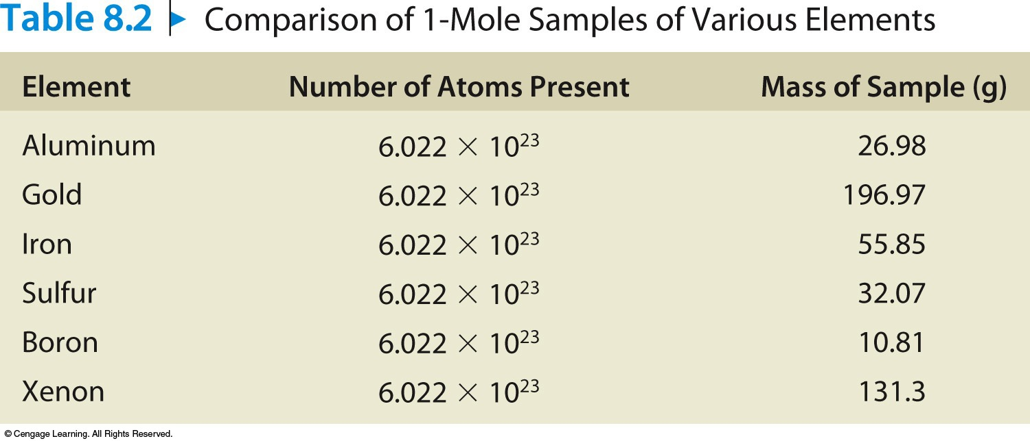
A sample of an element with a mass equal to that element’s average atomic mass (expressed in g) contains one mole of atoms (6.022 × 10²³ atoms).
Comparison of 1-Mol Samples of Various Elements

Slide 12
Concept Check
Determine the number of copper atoms in a 63.55 g sample of copper.
6.022×10²³ Cu atoms
Notes:
6.022×10²³ Cu atoms; 63.55 g of Cu is 1 mole of Cu, which is equal to Avogadro’s number.

Slide 13
Concept Check
Which of the following is closest to the average mass of one atom of copper?
a) 63.55 g
b) 52.00 g
c) 58.93 g
d) 65.38 g
e) 1.055 x 10⁻²² g
Notes:
The correct answer is e. The mass of one atom of copper is going to be extremely small, so only letter “e” makes sense. The calculated solution is (1 Cu atom) × (1 mol Cu/6.022×10²³ Cu atoms) × (63.55 g Cu/1 mol Cu).

Slide 14
Concept Check
Calculate the number of iron atoms in a 4.48 mole sample of iron.
2.70 × 10²⁴ Fe atoms
Notes:
(4.48 mol Fe) × (6.022×10²³ Fe atoms / 1 mol Fe) = 2.70×10²⁴ Fe atoms.

Slide 15
Concept Check
A sample of 26.98 grams of Al has the same number of atoms as _______ grams of Au.
a) 26.98 g
b) 13.49 g
c) 197.0 g
d) 256.5 g
Notes:
The correct answer is c. That is the mass of 1 mole of gold. The 26.98 g of Al represents 1 mole of Al. Thus both samples contain Avogadro’s number, 6.022 × 10²³ atoms.

Slide 16
Concept Check
Which of the following 100.0 g samples contains the greatest number of atoms?
Magnesium
Zinc
Silver
Notes:
The correct answer is a. Magnesium has the smallest average atomic mass (24.31 amu). Since magnesium is lighter than zinc and silver, it will take more atoms to reach 100.0 g.

Slide 17
Exercise
Rank the following according to number of atoms (greatest to least):
107.9 g of silver
70.0 g of zinc
21.0 g of magnesium
b) a) c)
Notes:
b, a, c; The greater the number of moles, the greater the number of atoms present. Zinc contains 1.07 mol, Ag contains 1.000 mol, and Mg contains 0.864 mol.

Slide 18
Conceptual Problem Solving
Where are we going?
Read the problem and decide on the final goal.
How do we get there?
Work backwards from the final goal to decide where to start.
Reality check.
Does my answer make sense? Is it reasonable?

Slide 19
Mass in grams of one mole of the substance:
Molar Mass of N = 14.01 g/mol
Molar Mass of H₂O = 18.02 g/mol
(2 × 1.008 g) + 16.00 g
Molar Mass of Ba(NO₃)₂ = 261.35 g/mol
137.33 g + (2 × 14.01 g) + (6 × 16.00 g)

Slide 20
Calculations Using Molar Mass
Moles of a compound =
Mass of a sample (g) = (moles of sample)(molar mass of compound)

Slide 21
Exercise
What is the molar mass of nickel(II) carbonate?
a) 118.7 g/mol
b) 134.7 g/mol
c) 178.71 g/mol
d) 296.09 g/mol
The formula for nickel(II) carbonate is NiCO₃. Therefore the molar mass is:
58.69 + 12.01 + 3(16.00) = 118.7 g/mol.
Notes:
The correct answer is a. The formula for nickel(II) carbonate is NiCO₃. Therefore the molar mass is: 58.69 + 12.01 + 3(16.00) = 118.7 g/mol.

Slide 22
Exercise
Consider equal mole samples of N₂O, Al(NO₃)₃, and KCN. Rank these from least to most number of nitrogen atoms in each sample.
a) KCN, Al(NO₃)₃, N₂O
b) Al(NO₃)₃, N₂O, KCN
c) KCN, N₂O, Al(NO₃)₃
d) Al(NO₃)₃, KCN, N₂O
Notes:
The correct answer is c. Assume you have one mole of each sample. This means you have 1 mole of N in KCN, 2 moles of N in N₂O and 3 moles of N in Al(NO₃)₃. Moles are directly related through Avogadro’s number.

Slide 23
Exercise
Consider separate 100.0 gram samples of each of the following:
H₂O, N₂O, C₃H₆O₂, CO₂
Rank them from greatest to least number of oxygen atoms.
H₂O, CO₂, C₃H₆O₂, N₂O
Notes:
H₂O, CO₂, C₃H₆O₂, N₂O; The number of oxygen atoms in each is:
H₂O = 3.343×10²⁴
CO₂ = 2.737×10²⁴
C₃H₆O₂ = 1.626×10²⁴
N₂O = 1.368×10²⁴

Slide 24
Exercise
How many grams of fluorine are contained in one molecule of boron trifluoride?
a) 3.155 × 10^{–23} g
b) 9.465 × 10^{–23} g
c) 6.022 × 10²³ g
d) 3.433 × 10²⁵ g
Notes:
The correct answer is b.
1 molecule BF₃ × (3 atoms F/1 molecule BF₃) × (1 mol F/6.022×10²³ atoms F) × (19.00 g F/1 mol F) = 9.465 × 10^{–23} g F

Slide 25
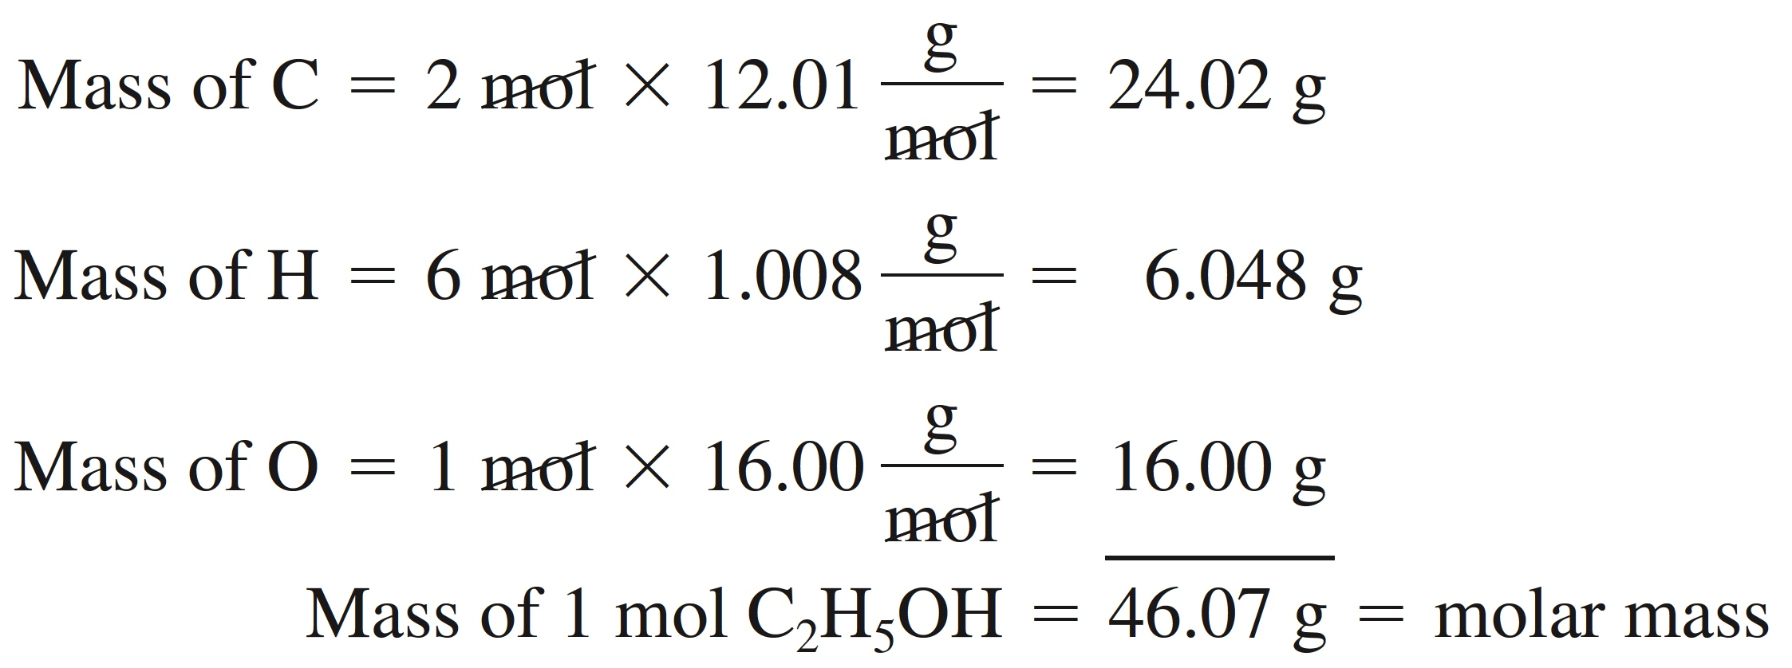
Mass percent of an element:
For Carbon in C₂H₅OH:

Slide 26
Exercise
Morphine, derived from opium plants, has the potential for use and abuse. It’s formula is C₁₇H₁₉NO₃. What percent, by mass, is the carbon in this compound?
a) 12.0 %
b) 54.8 %
c) 67.9 %
d) 71.6 %
Notes:
The correct answer is d. First determine the molar mass of the compound, then divide that into the total mass of carbon present, and finally multiply that by 100 to convert from a fraction into a percentage.
(17 × 12.01) / [(17 × 12.01) + (19 × 1.01) + (1 × 14.01) + (3 × 16.00)] = 0.716
0.716 × 100 = 71.6 %

Slide 27
Exercise
Consider separate 100.0 gram samples of each of the following:
H₂O, N₂O, C₃H₆O₂, CO₂
Rank them from highest to lowest percent oxygen by mass.
H₂O, CO₂, C₃H₆O₂, N₂O
Notes:
H₂O, CO₂, C₃H₆O₂, N₂O; The percent oxygen by mass in each is:
H₂O = 88.81%
CO₂ = 72.71%
C₃H₆O₂ = 43.20%
N₂O = 36.35%

Slide 28
Empirical Formulas
The empirical formula of a compound is the simplest whole number ratio of the atoms present in the compound.
The empirical formula can be found from the percent composition of the compound.

Slide 29
Formulas
Empirical formula = CH
Simplest whole-number ratio
Molecular formula = (empirical formula)_{n} [n = integer]
Molecular formula = C₆H₆ = (CH)₆
Actual formula of the compound

Slide 30
Steps for Determining the Empirical Formula of a Compound
A gaseous compound containing carbon and hydrogen was analyzed and found to consist of 83.65% carbon by mass. Determine the empirical formula of the compound.
Obtain the mass of each element present (in grams).
Assume you have 100 g of the compound.
83.65% C = 83.65 g C
(100.00 – 83.65)
16.35% H = 16.35 g H

Slide 31
Steps for Determining the Empirical Formula of a Compound
2. Determine the number of moles of each type of atom present.

Slide 32
Steps for Determining the Empirical Formula of a Compound
3. Divide the number of moles of each element by the smallest number of moles to convert the smallest number to 1. If all of the numbers so obtained are integers (whole numbers), these are the subscripts in the empirical formula. If one or more of these numbers are not integers, go on to step 4.

Slide 33
Steps for Determining the Empirical Formula of a Compound
4. Multiply the numbers you derived in step 3 by the smallest integer that will convert all of them to whole numbers. This set of whole numbers represents the subscripts in the empirical formula.

Slide 34
Exercise
The composition of adipic acid is 49.3% C, 6.9% H, and 43.8% O (by mass). What is the empirical formula?
C₃H₅O₂
Notes:
Assume 100.0g. 49.3 g of carbon is 4.105 mol C (49.3/12.01). 6.9 g of hydrogen is 6.845 mol H (6.9/1.008). 43.8 g of oxygen is 2.7375 mol O (43.8/16.00). The ratio of C:H:O is 1.5:2.5:1 (C: 4.105/2.7375 = 1.5; H: 6.845/2.7375 = 2.5). Multiplying each by 2 to get a whole number becomes a ratio of 3:5:2. The empirical formula is therefore C₃H₅O₂.

Slide 35
The molecular formula is the exact formula of the molecules present in a substance.
The molecular formula is always an integer multiple of the empirical formula. Molecular formula = (empirical formula)_{n}
where n is a whole number

Slide 36
Continued Example…
A gaseous compound containing carbon and hydrogen was analyzed and found to consist of 83.65% carbon by mass. The molar mass of the compound is 86.2 g/mol. You determined the empirical formula to be C₃H₇. What is the molecular formula of the compound?
Molar mass of C₃H₇ = 43.086 g/mol
C₃H₇ × 2 = C₆H₁₄

Slide 37
Exercise
The composition of adipic acid is 49.3% C, 6.9% H, and 43.8% O (by mass). The molar mass of the compound is about 146 g/mol. The empirical formula is C₃H₅O₂. What is the molecular formula?
C₆H₁₀O₄
Notes:
The molar mass of the empirical formula is 73.07 g/mol, which goes into the molar mass of the molecular formula 2 times (146/73.07). The molecular formula is therefore C₆H₁₀O₄.

