Slide 1
Chapter 10
(part 1)
Energy

Slide 2
Energy
Ability to do work or produce heat.
That which is needed to oppose natural attractions.
Law of conservation of energy – energy can be converted from one form to another but can be neither created nor destroyed.
  The total energy content of the universe is constant.

Slide 3
Energy
Potential energy – energy due to position or composition.
Kinetic energy – energy due to motion of the object and depends on the mass of the object and its velocity.

Slide 4
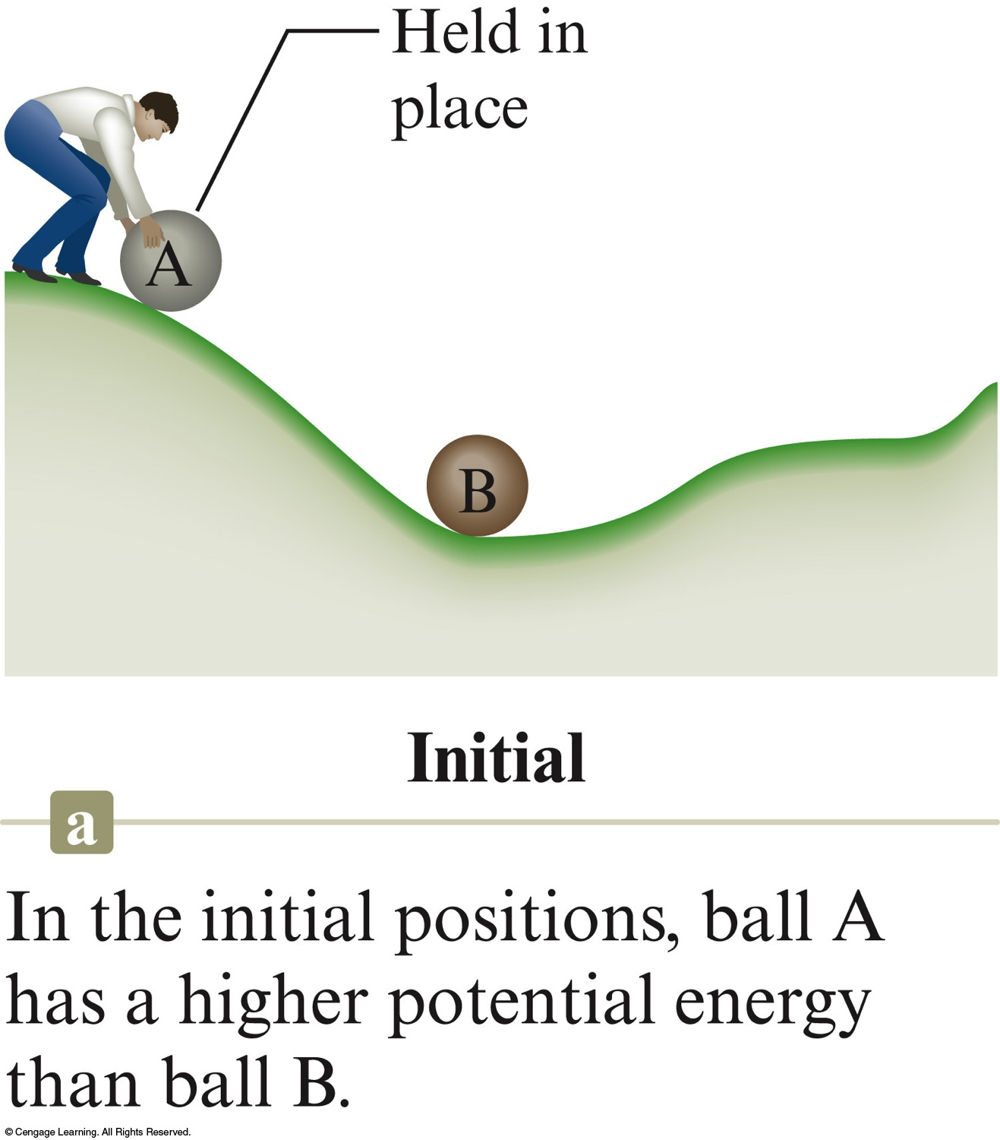
Initial Position
In the initial position, ball A has a higher potential energy than ball B.

Slide 5
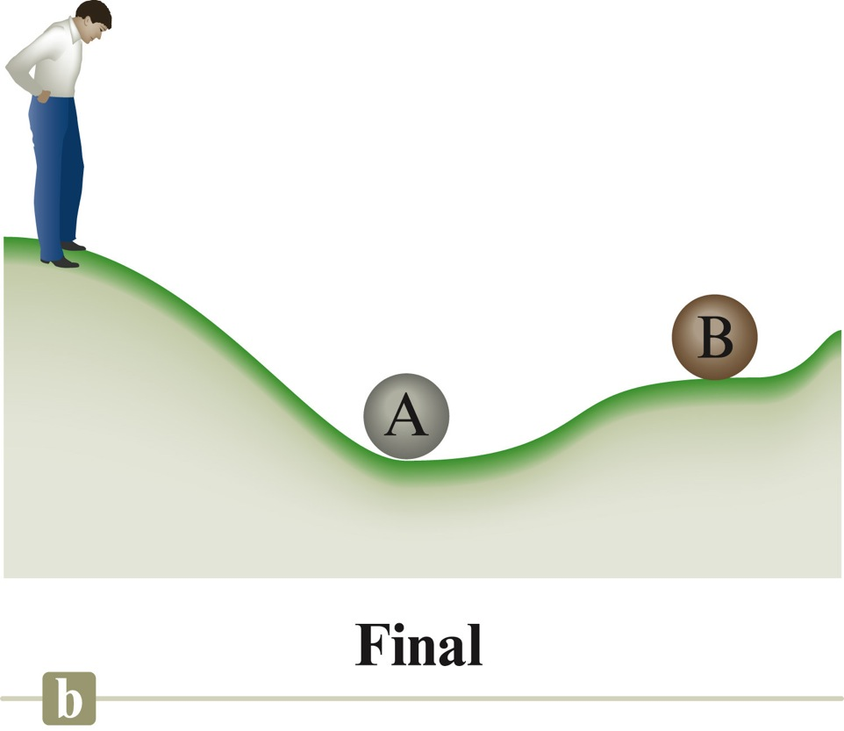
Final Position
After A has rolled down the hill, the potential energy lost by A has been converted to random motions of the components of the hill (frictional heating) and to the increase in the potential energy of B.

Slide 6
Energy
Heat involves the transfer of energy between two objects due to a temperature difference.
Work – force acting over a distance.
Energy is a state function; work and heat are not:
  State Function – property that does not depend in any way on the system’s past or future (only depends on present state).
    Changes independently of its pathway

Slide 7
State Functions?
Distance traveled from one location to another.
  Not a state function – depends on route taken
Change in elevation
  State function – change in elevation is always the same (doesn’t depend on the route taken)

Slide 8
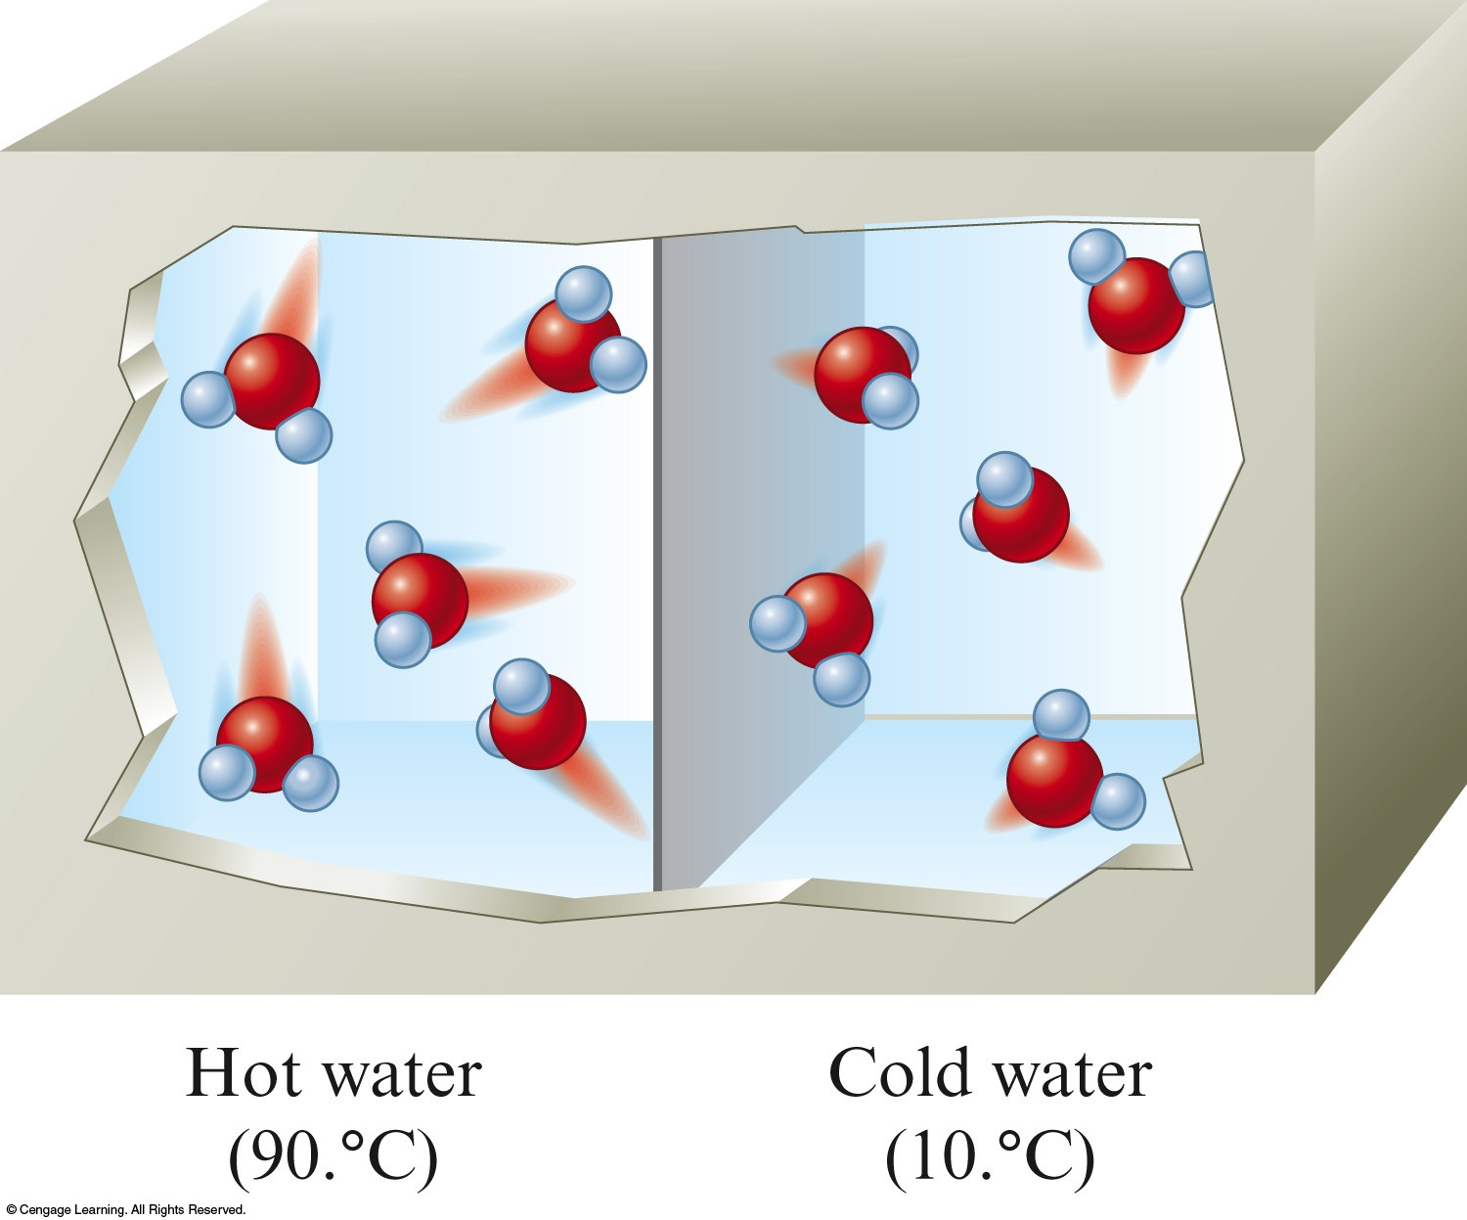
Temperature
A measure of the random motions of the components of a substance.

Slide 9
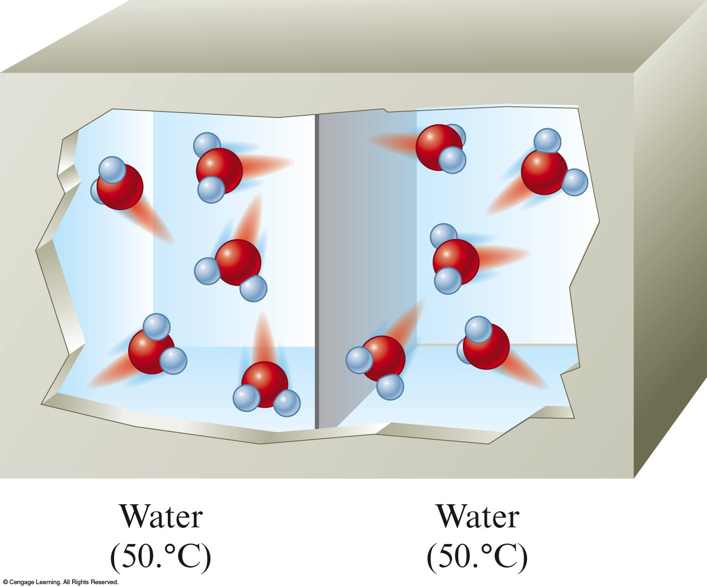
Heat
A flow of energy between two objects due to a temperature difference between the objects.
  Heat is the way in which thermal energy is transferred from a hot object to a colder object.

Slide 10
System – part of the universe on which we wish to focus attention.
Surroundings – include everything else in the universe.

Slide 11
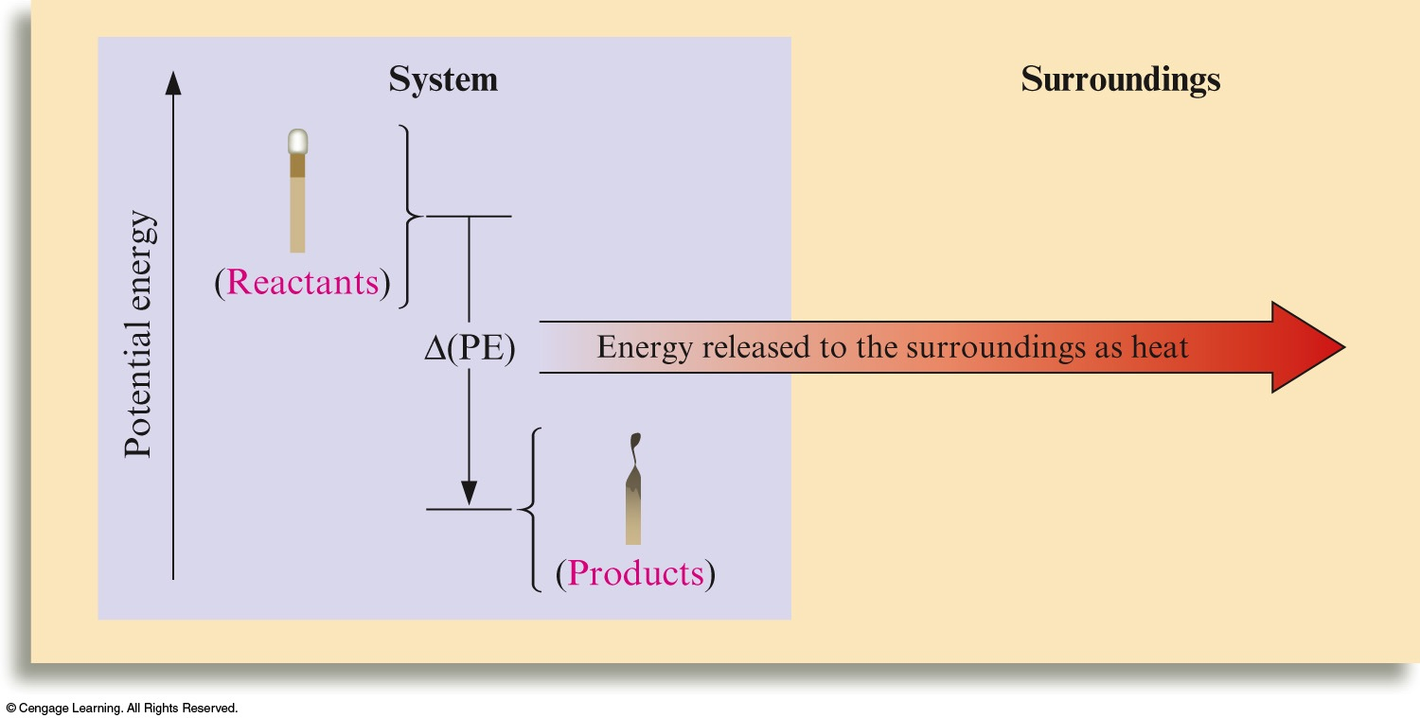
Energy Changes Accompanying the Burning of a Match

Slide 12
Endothermic Process:
  Heat flow is into a system.
  Absorb energy from the surroundings.
Exothermic Process:
  Energy flows out of the system.
Energy gained by the surroundings must be equal to the energy lost by the system.

Slide 13

Concept Check
Is the freezing of water an endothermic or exothermic process? Explain.
Notes:
Exothermic process because you must remove energy in order to slow the molecules down to form a solid.

Slide 14
Concept Check
Classify each process as exothermic or endothermic. Explain. The system is underlined in each example.
  Your hand gets cold when you touch ice.
  The ice gets warmer when you touch it.
  Water boils in a kettle being heated on a stove.
  Water vapor condenses on a cold pipe.
  Ice cream melts.
Exo
Endo
Endo
Exo
Endo
Notes:
Exothermic (heat energy leaves your hand and moves to the ice)
Endothermic (heat energy flows into the ice)
Endothermic (heat energy flows into the water to boil it)
Exothermic (heat energy leaves to condense the water from a gas to a liquid)
Endothermic (heat energy flows into the ice cream to melt it)

Slide 15
Concept Check
For each of the following, define a system and its surroundings and give the direction of energy transfer.
  Methane is burning in a Bunsen burner in a laboratory.
  Water drops, sitting on your skin after swimming, evaporate.
Notes:
System – methane and oxygen to produce carbon dioxide and water; Surroundings – everything else around it; Direction of energy transfer – energy transfers from the system to the surroundings (exothermic)
System – water drops; Surroundings – everything else around it; Direction of energy transfer – energy transfers from the surroundings (your body) to the system (water drops) (endothermic)

Slide 16
Concept Check
Hydrogen gas and oxygen gas react violently to form water.
  Which is lower in energy: a mixture of hydrogen and oxygen gases, or water? Explain.
Notes:
Water is lower in energy because a lot of energy was released in the process when hydrogen and oxygen gases reacted.

Slide 17
Study of energy
Law of conservation of energy is often called the first law of thermodynamics.
  The energy of the universe is constant.

Slide 18
Internal Energy
Internal energy E of a system is the sum of the kinetic and potential energies of all the “particles” in the system.
To change the internal energy of a system: ΔE = q + w
  q represents heat
  w represents work

Slide 19
Internal Energy
Sign reflects the system's point of view.
Endothermic Process:
  q is positive
Exothermic Process:
  q is negative

Slide 20
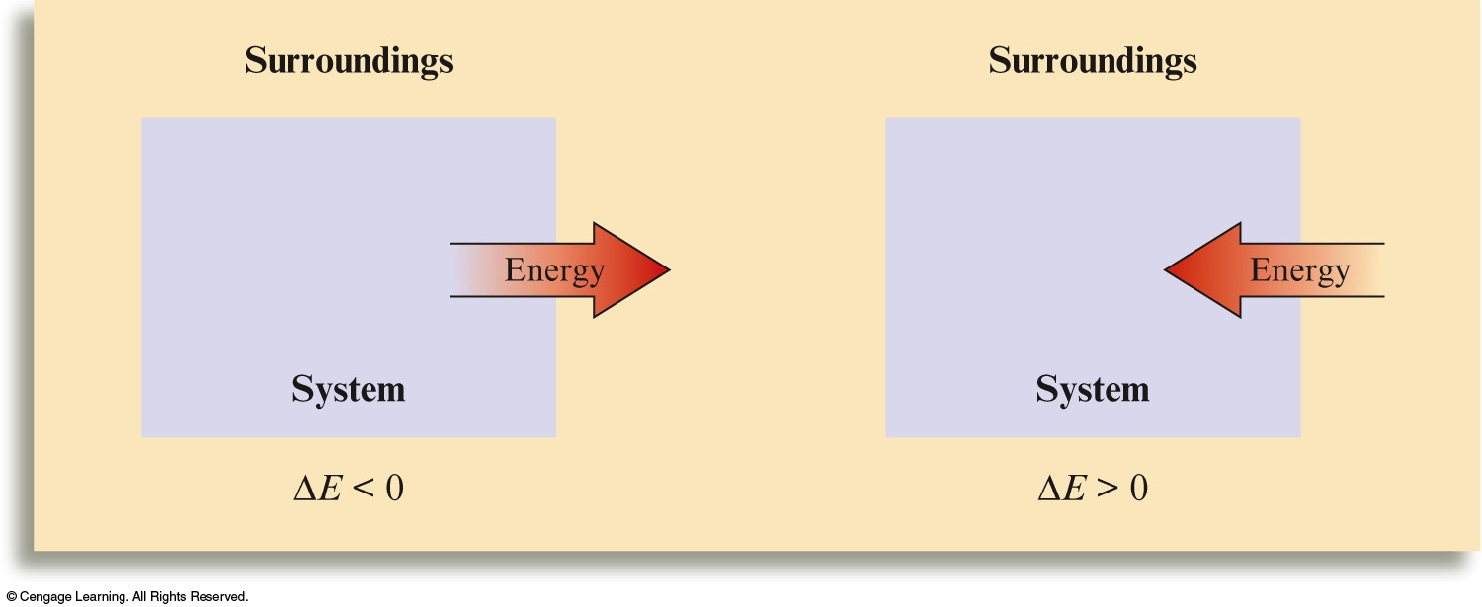

Slide 21
Internal Energy
Sign reflects the system’s point of view.
System does work on surroundings:
  w is negative
Surroundings do work on the system:
  w is positive

Slide 22
Concept Check
Determine the sign of ΔE for each of the following with the listed conditions:
a) An endothermic process that performs work.
  |work| > |heat|
  |work| < |heat|
b) Work is done on a gas and the process is exothermic.
  |work| > |heat|
  |work| < |heat|
Δ E = negative
Δ E = positive
Δ E = positive
Δ E = negative
Notes:
a) q is positive for endothermic processes and w is negative when system does work on surroundings; first condition – ΔE is negative; second condition – ΔE is positive
b) q is negative for exothermic processes and w is positive when surroundings does work on system; first condition – ΔE is positive; second condition – ΔE is negative

Slide 23
The common energy units for heat are the calorie and the joule.
  calorie – the amount of energy (heat) required to raise the temperature of one gram of water 1ºC.
  Joule – 1 calorie = 4.184 joules

Slide 24
Example
Convert 60.1 cal to joules.

Slide 25
Energy (Heat) Required to Change the Temperature of a Substance Depends On:
The amount of substance being heated (number of grams).
The temperature change (number of degrees).
The identity of the substance.
  Specific heat capacity is the energy required to change the temperature of one gram of a substance by one Celsius degree.

Slide 26
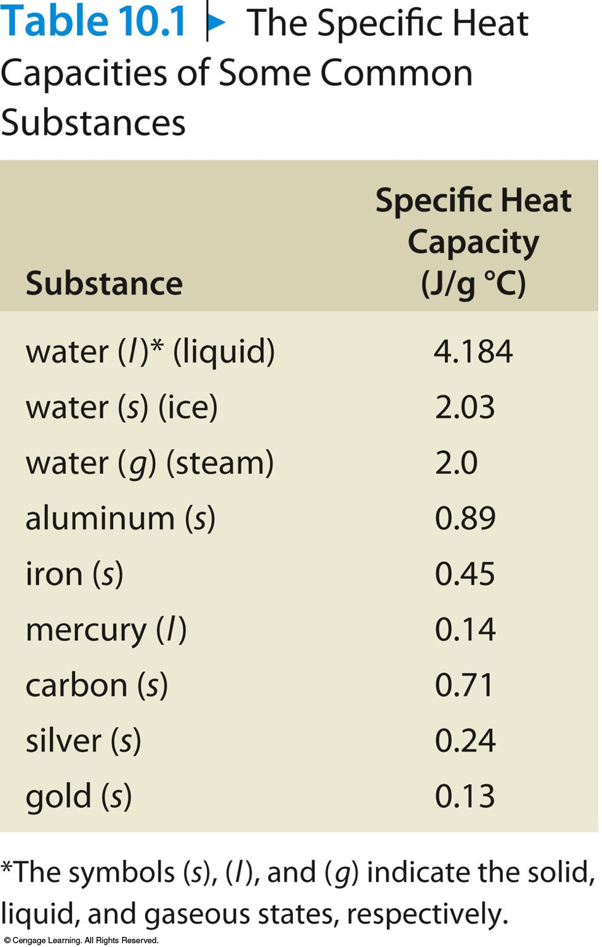
Specific Heat Capacities of Some Common Substances

Slide 27
To Calculate the Energy Required for a Reaction:
Energy (heat) required, Q = s × m × ΔT
Q = energy (heat) required (J)
s = specific heat capacity (J/°C·g)
m = mass (g)
ΔT = change in temperature (°C)

Slide 28
Example
Calculate the amount of heat energy (in joules) needed to raise the temperature of 6.25 g of water from 21.0°C to 39.0°C.
Where are we going?
We want to determine the amount of energy needed to increase the temperature of 6.25 g of water from 21.0°C to 39.0°C.
What do we know?
The mass of water and the temperature increase.

Slide 29
Example
Calculate the amount of heat energy (in joules) needed to raise the temperature of 6.25 g of water from 21.0°C to 39.0°C.
What information do we need?
We need the specific heat capacity of water.
  4.184 J/g°C
How do we get there?

Slide 30

Exercise
A sample of pure iron requires 142 cal of energy to raise its temperature from 23ºC to 92ºC. What is the mass of the sample? (The specific heat capacity of iron is 0.45 J/gºC.)
  a) 0.052 g
  b) 4.6 g
  c) 19 g
  d) 590 g
Notes:
The correct answer is c.
Q = s×m×ΔT
m = Q/ s×ΔT
m = {(142 cal)(4.184 J/1 cal)} / {(0.45 J/g°C)(92°C–23°C)}
m = 19 g

Slide 31
Concept Check
A 100.0 g sample of water at 90°C is added to a 100.0 g sample of water at 10°C.
The final temperature of the water is:
  a) Between 50°C and 90°C
  b) 50°C
  c) Between 10°C and 50°C
Notes:
The correct answer is b).

Slide 32
Concept Check
A 100.0 g sample of water at 90.°C is added to a 500.0 g sample of water at 10.°C.
The final temperature of the water is:
  a) Between 50°C and 90°C
  b) 50°C
  c) Between 10°C and 50°C
Calculate the final temperature of the water.
23°C
Notes:
The correct answer is c). The final temperature of the water is 23°C.
- (100.0 g)(4.18 J/°C·g)(T_{f} – 90.) = (500.0 g)(4.18 J/°C·g)(T_{f} – 10.)
T_{f} = 23°C

Slide 33
Concept Check
You have a Styrofoam cup with 50.0 g of water at 10.°C. You add a 50.0 g iron ball at 90.°C to the water. (s_{H2O} = 4.18 J/°C·g and s_{Fe} = 0.45 J/°C·g)
The final temperature of the water is:
  a) Between 50°C and 90°C
  b) 50°C
  c) Between 10°C and 50°C
Calculate the final temperature of the water.
18°C
Notes:
The correct answer is c). The final temperature of the water is 18°C.
- (50.0 g)(0.45 J/°C·g)(T_{f} – 90.) = (50.0 g)(4.18 J/°C·g)(T_{f} – 10.)
T_{f} = 18°C

Slide 34
Change in Enthalpy
State function
ΔH = q at constant pressure (ΔH_{p} = heat)

Slide 35
Example
Consider the reaction:
S(s) + O₂(g) → SO₂(g)
ΔH = –296 kJ per mole of SO₂ formed. Calculate the quantity of heat released when 2.10 g of sulfur is burned in oxygen at constant pressure.
Where are we going?
We want to determine ΔH for the reaction of 2.10 g of S with oxygen at constant pressure.
What do we know?
When 1 mol SO₂ is formed, –296 kJ of energy is released.
We have 2.10 g S.

Slide 36
Example
Consider the reaction:
S(s) + O₂(g) → SO₂(g)
ΔH = –296 kJ per mole of SO₂ formed. Calculate the quantity of heat released when 2.10 g of sulfur is burned in oxygen at constant pressure.
How do we get there?

Slide 37
Exercise
Consider the combustion of propane:
C₃H₈(g) + 5O₂(g) → 3CO₂(g) + 4H₂O(l)
ΔH = –2221 kJ
Assume that all of the heat comes from the combustion of propane. Calculate ΔH in which 5.00 g of propane is burned in excess oxygen at constant pressure.
–252 kJ
Notes:
(5.00 g C₃H₈)(1 mol / 44.094 g C₃H₈)(-2221 kJ / mol C₃H₈)
ΔH = -252 kJ

Slide 38
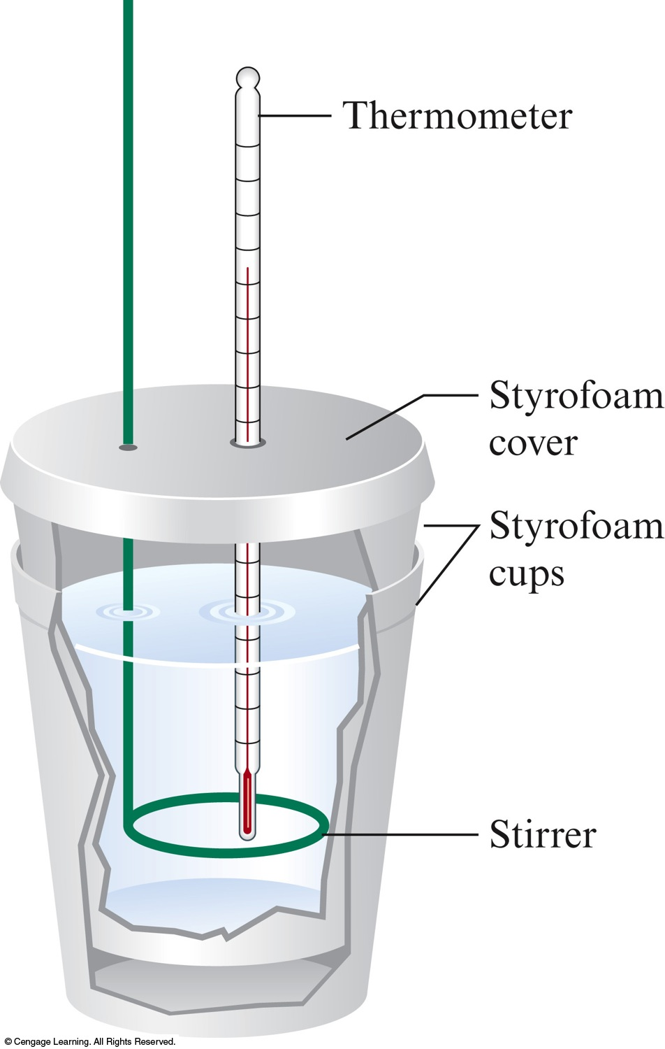
Calorimetry
Enthalpy, H is measured using a calorimeter.

