Slide 1
Chapter 10 (part 2)
Energy

Slide 2
In going from a particular set of reactants to a particular set of products, the change in enthalpy is the same whether the reaction takes place in one step or in a series of steps.

Slide 3
N₂(g) + 2O₂(g) → 2NO₂(g) ΔH₁ = 68 kJ
This reaction also can be carried out in two distinct steps, with enthalpy changes designated by ΔH₂ and ΔH₃.
N₂(g) + O₂(g) → 2NO(g) ΔH₂ = 180 kJ
2NO(g) + O₂(g) → 2NO₂(g) ΔH₃ = – 112 kJ
N₂(g) + 2O₂(g) → 2NO₂(g) ΔH₂ + ΔH₃ = 68 kJ
ΔH₁ = ΔH₂ + ΔH₃ = 68 kJ

Slide 4
Characteristics of Enthalpy Changes
If a reaction is reversed, the sign of ΔH is also reversed.
The magnitude of ΔH is directly proportional to the quantities of reactants and products in a reaction. If the coefficients in a balanced reaction are multiplied by an integer, the value of ΔH is multiplied by the same integer.

Slide 5
Example
Consider the following data:
Calculate ΔH for the reaction

Slide 6
Problem-Solving Strategy
Work backward from the required reaction, using the reactants and products to decide how to manipulate the other given reactions at your disposal.
Reverse any reactions as needed to give the required reactants and products.
Multiply reactions to give the correct numbers of reactants and products.

Slide 7
Example
Reverse the two reactions:
Desired reaction:

Slide 8
Example
Multiply reactions to give the correct numbers of reactants and products:
4( ) 4( )
3( ) 3( )
Desired reaction:

Slide 9
Example
Final reactions:
Desired reaction:
ΔH = +1268 kJ

Slide 10
Concept Check
Calculate ΔH for the reaction:
SO₂ + ½O₂ → SO₃ ΔH = ?
Given: (1) S + O₂ → SO₂ ΔH = –297 kJ (2) 2S + 3O₂ → 2SO₃ ΔH = –792 kJ
a) –693 kJ
b) 101 kJ
c) 693 kJ
d) –99 kJ
Notes:
The correct answer is d.
We have to rearrange the equations so that they add up to the desired equation.
First, reverse equation (1) to give : SO₂ → S + O₂ ΔH = +297 kJ
Then add ½ equation (2) : S + 3/2O₂ → SO₃ ΔH = –396 kJ
The two new eqns add up: SO₂ + ½O₂ → SO₃ ΔH = –99 kJ

Slide 11
When we use energy to do work we degrade its usefulness.
While the total amount or quantity of energy in the universe is constant (1st Law) the quality of energy is degraded as it is used.
Burning of petroleum:

Slide 12
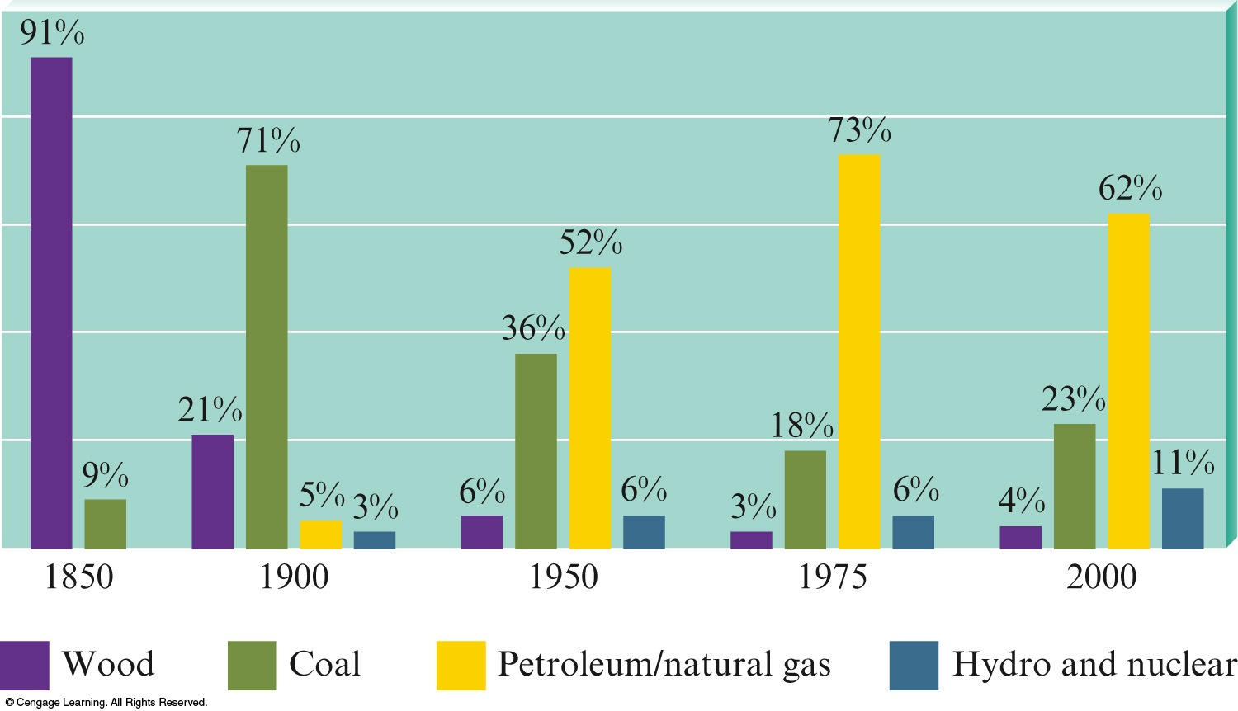
Fossil Fuels
Carbon based molecules from decomposing plants and animals
Energy source for United States

Slide 13
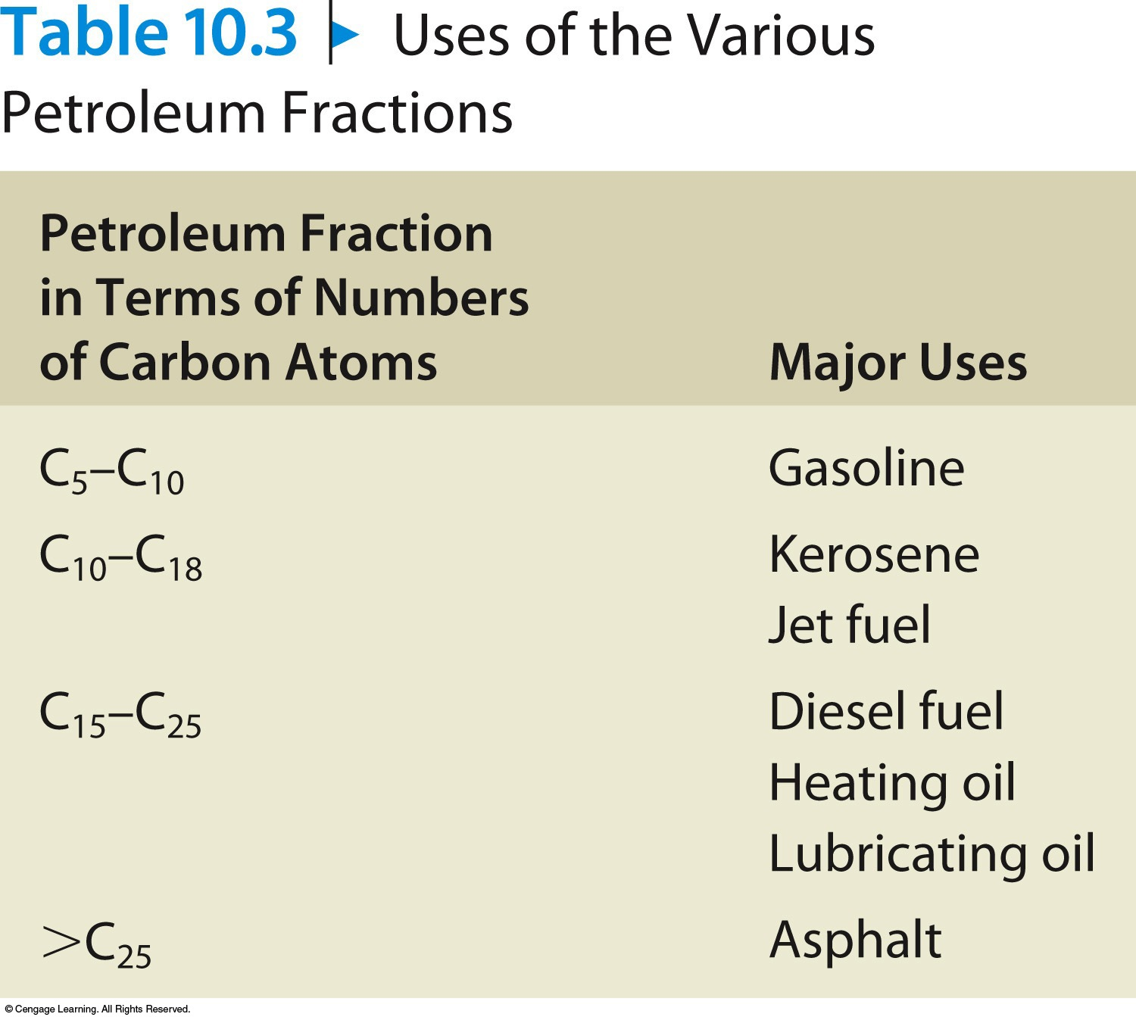
Petroleum
Thick liquids composed of mainly hydrocarbons.
Hydrocarbon – compound composed of C and H.

Slide 14
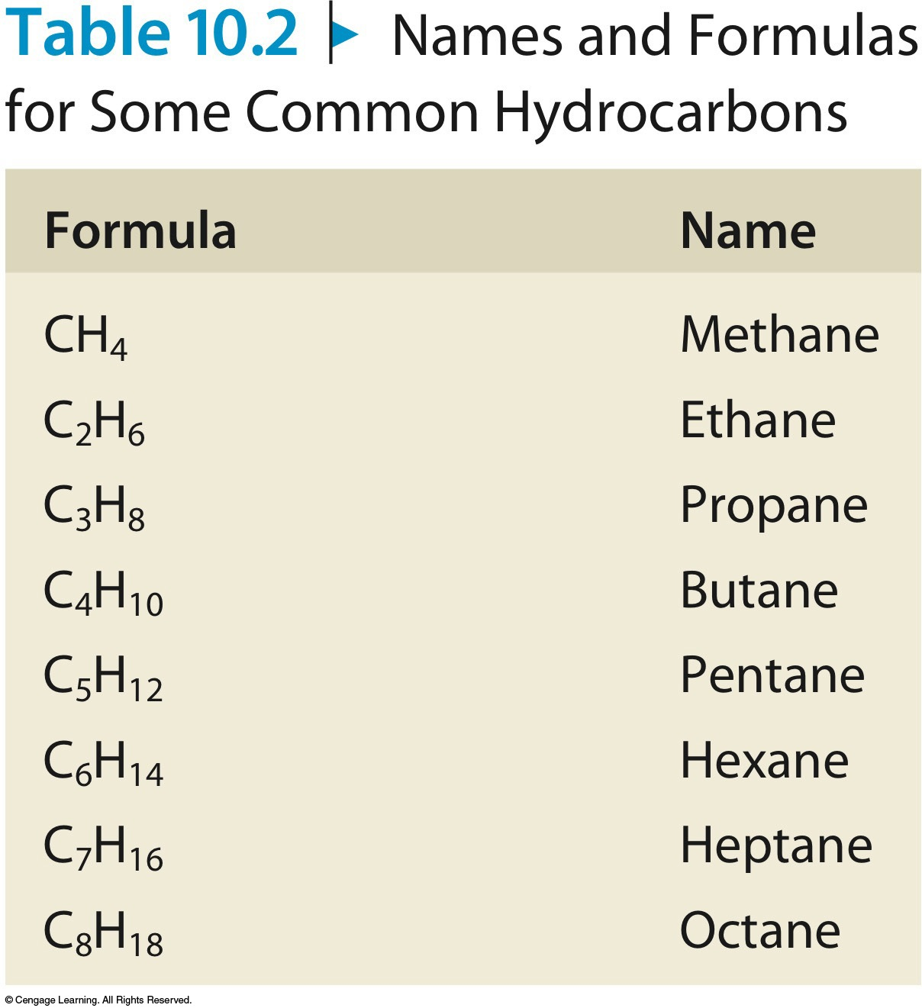
Natural Gas
Gas composed of hydrocarbons.

Slide 15
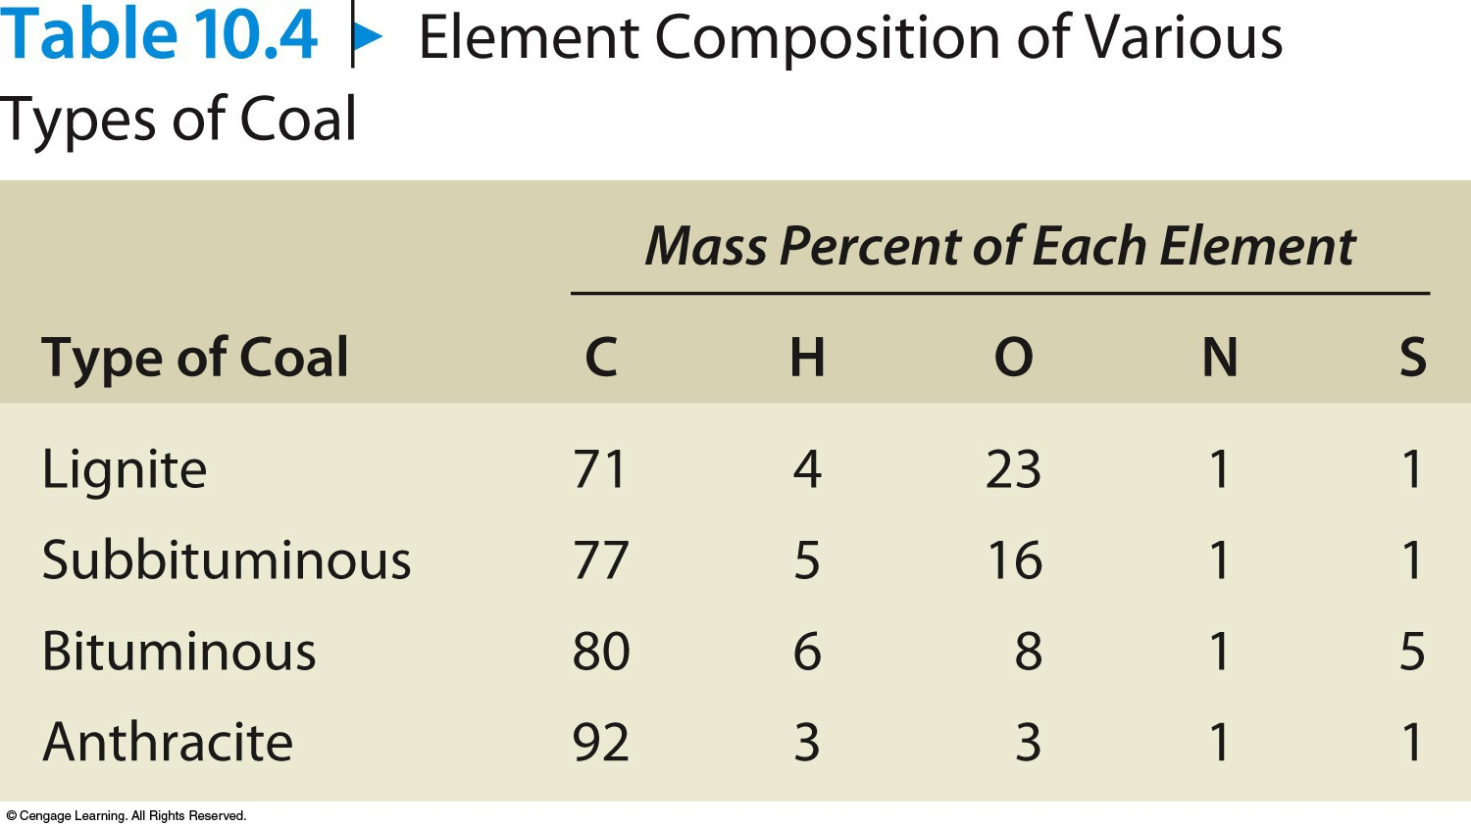
Coal
Formed from the remains of plants under high pressure and heat over time.

Slide 16
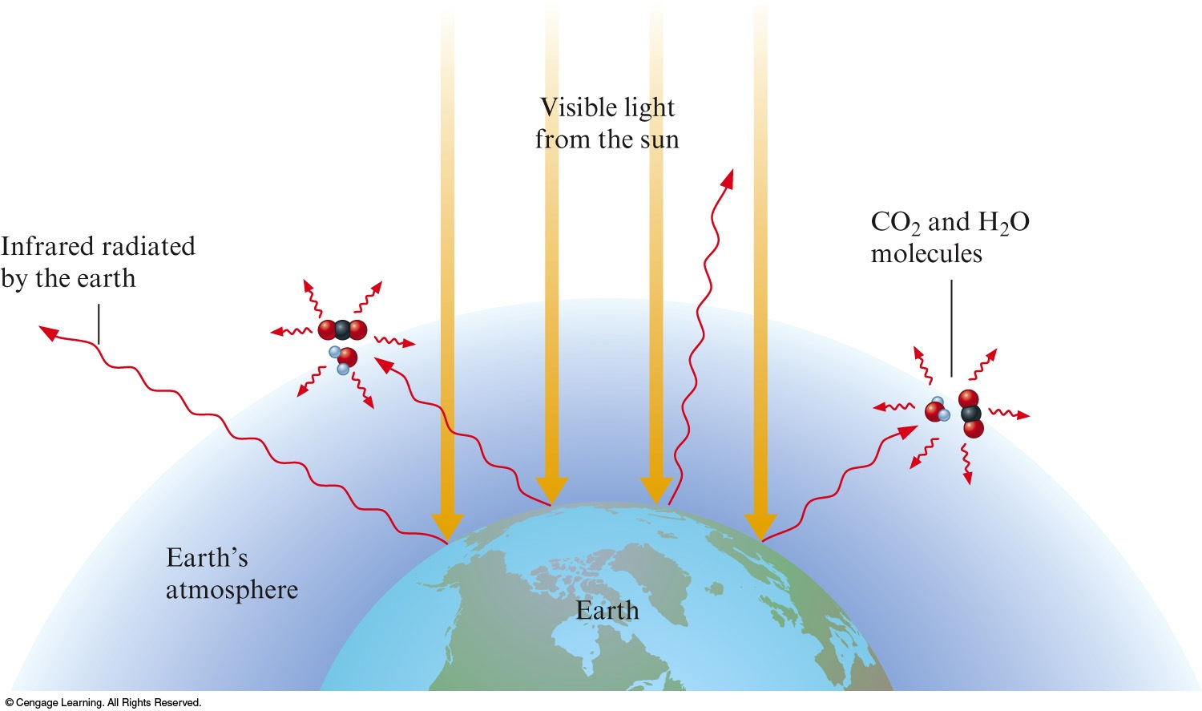
Effects of Carbon Dioxide on Climate
Greenhouse Effect

Slide 17
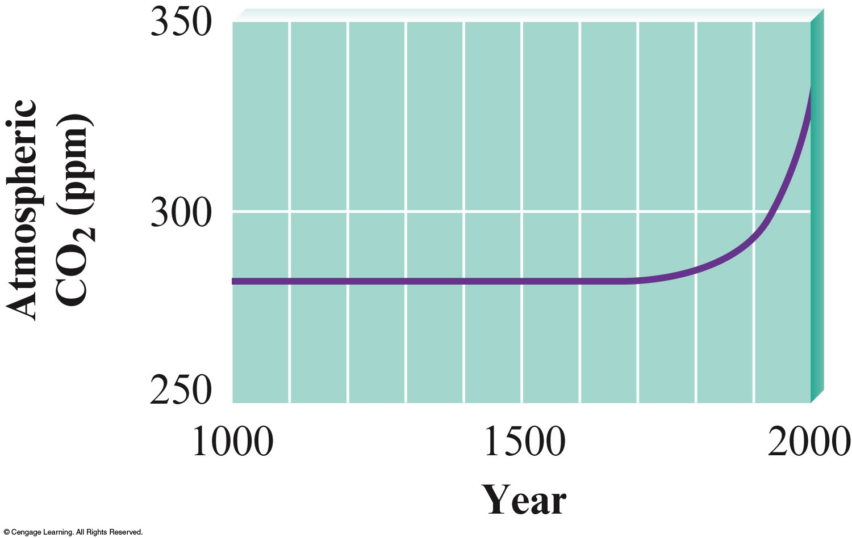
Effects of Carbon Dioxide on Climate
Atmospheric CO₂
Controlled by water cycle
Could increase temperature by 10ºC

Slide 18
New Energy Sources
Solar
Nuclear
Biomass
Wind
Synthetic fuels

Slide 19
Natural processes occur in the direction that leads to an increase in the disorder of the universe.
Example
Consider a gas trapped as shown

Slide 20
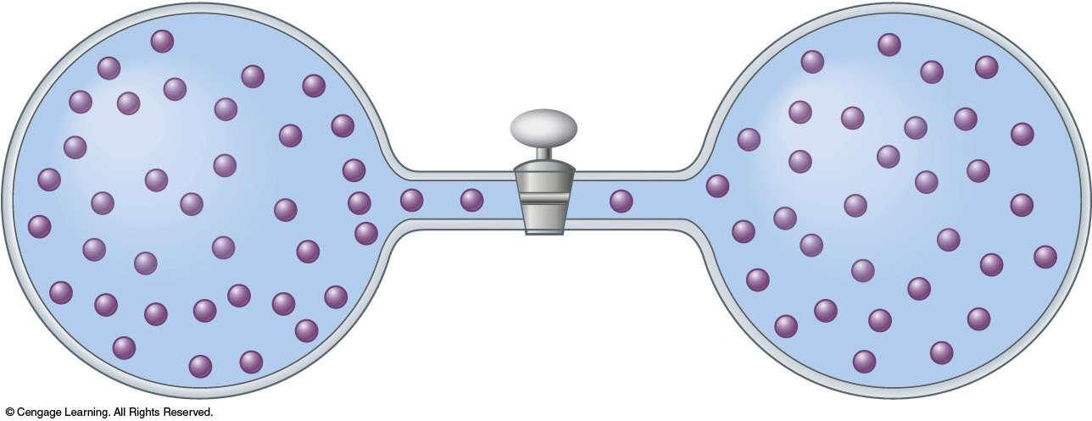
What happens when the valve is opened?

Slide 21
Two Driving Forces
Energy spread
Matter spread

Slide 22
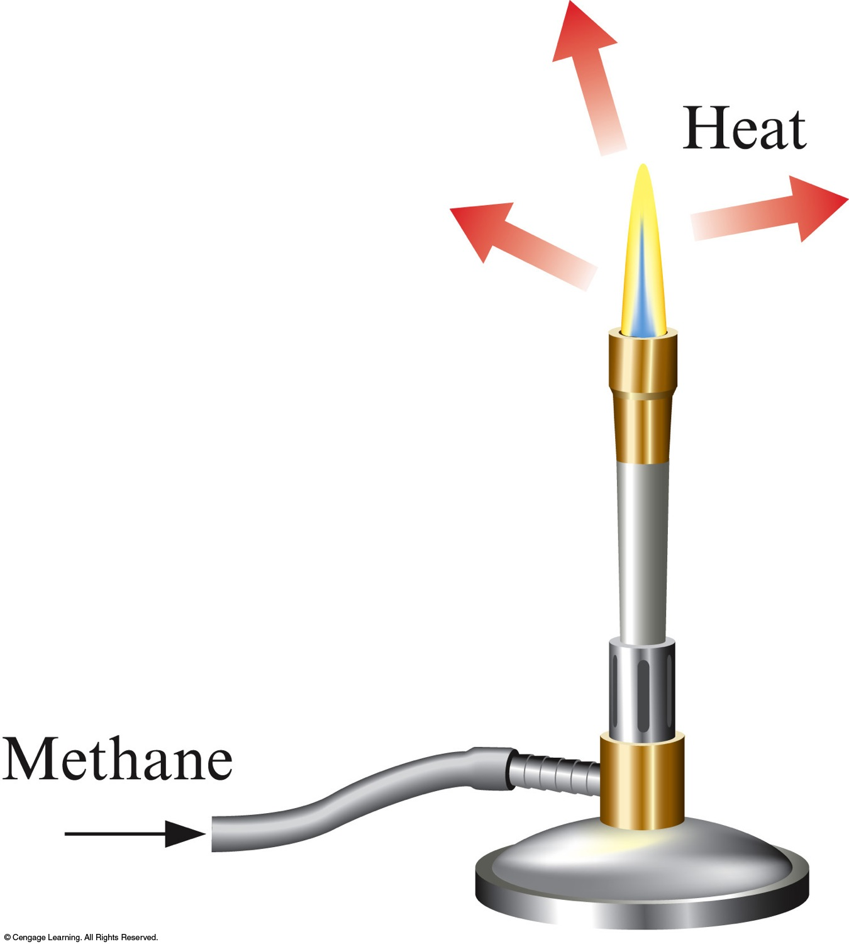
Energy Spread
In a given process concentrated energy is dispersed widely.
This happens in every exothermic process.

Slide 23
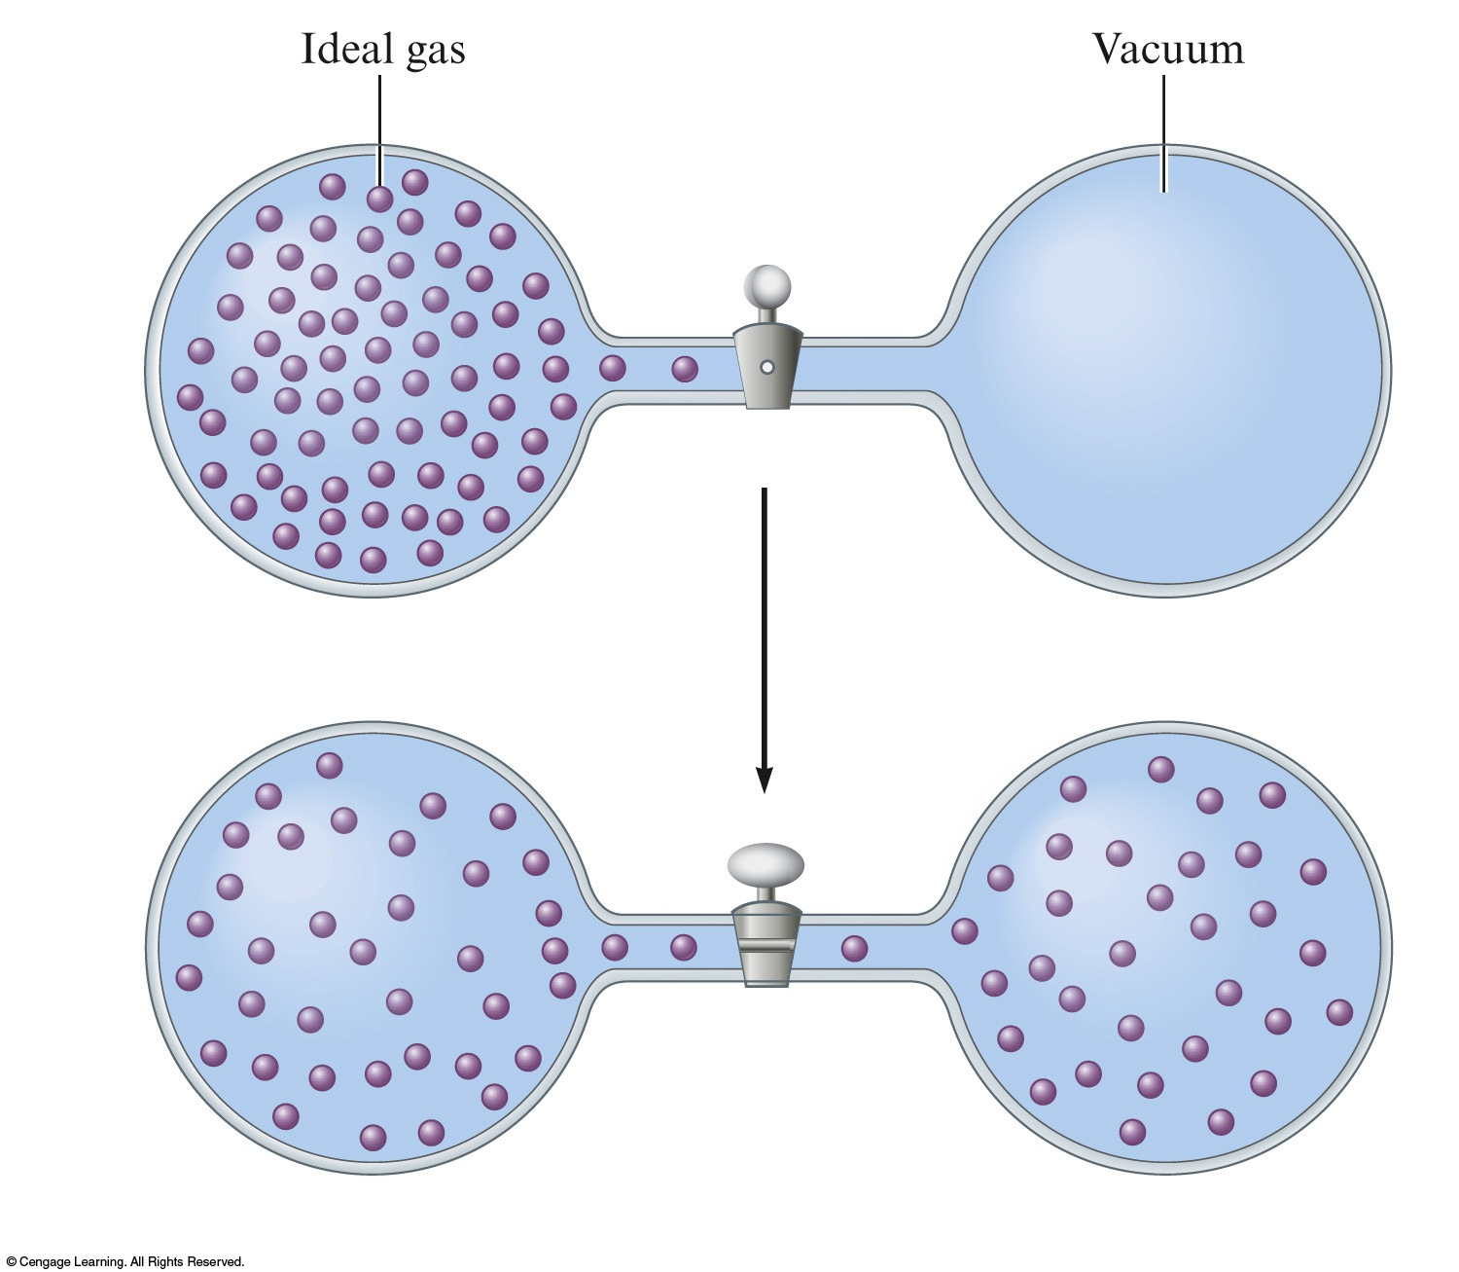
Matter Spread
Molecules of a substance spread out to occupy a larger volume.
Processes are favored if they involve energy and matter spread.

Slide 24
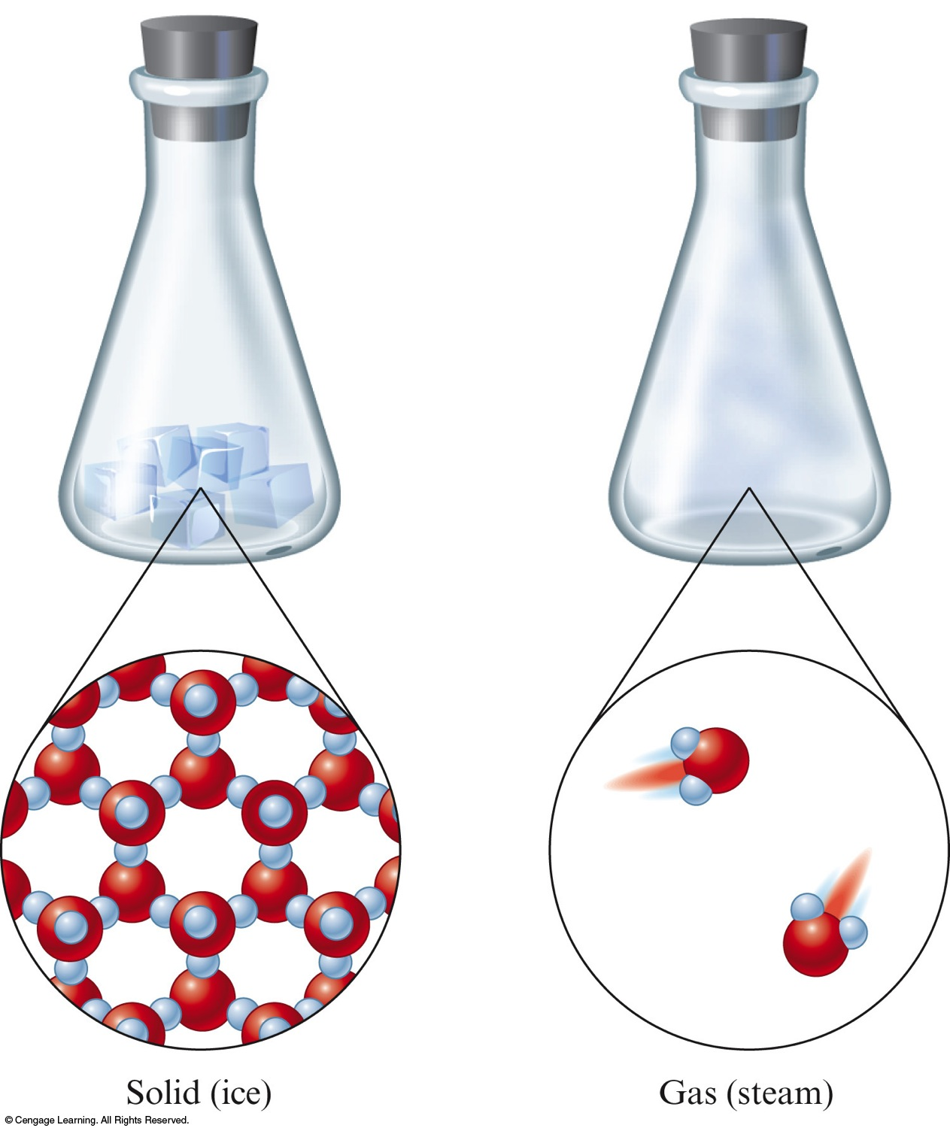
Entropy, S
Function which keeps track of the tendency for the components of the universe to become disordered.
Measure of disorder or randomness

Slide 25
Entropy, S
What happens to the disorder in the universe as energy and matter spread?

Slide 26
Second Law of Thermodynamics
The entropy of the universe is always increasing.

