Slide 1
Chapter 12 (part 1)
Chemical Bonding

Slide 2
Questions to Consider
What is meant by the term “chemical bond”?
Why do atoms bond with each other to form compounds?
How do atoms bond with each other to form compounds?

Slide 3
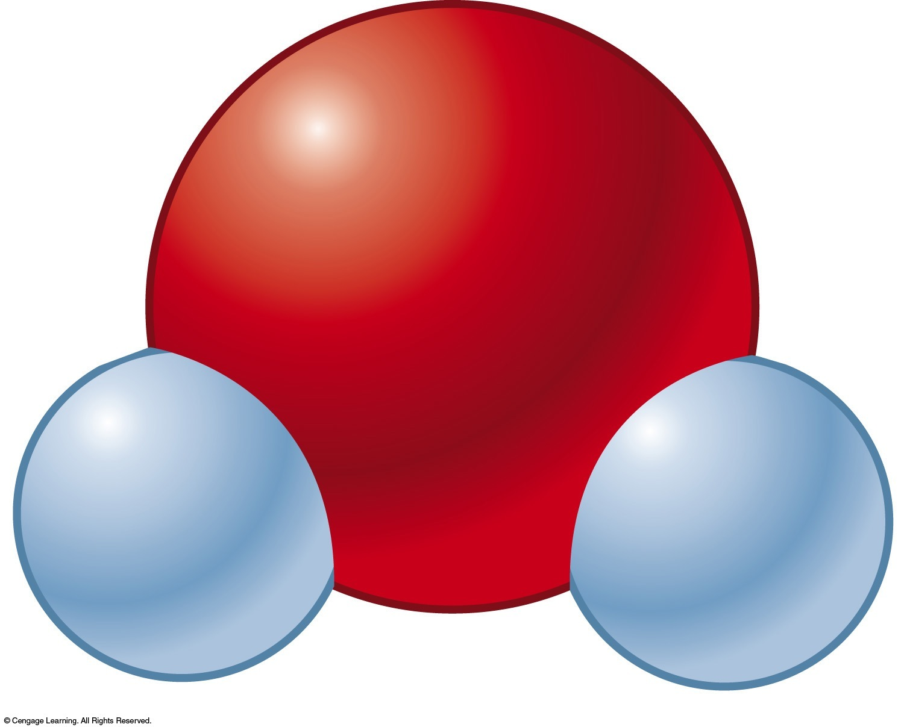
A Chemical Bond
No simple, and yet complete, way to define this.
Forces that hold groups of two or more atoms together and make them function as a unit.
A bond will form if the energy of the aggregate is lower than that of the separated atoms.
Bond energy – energy required to break a chemical bond

Slide 4
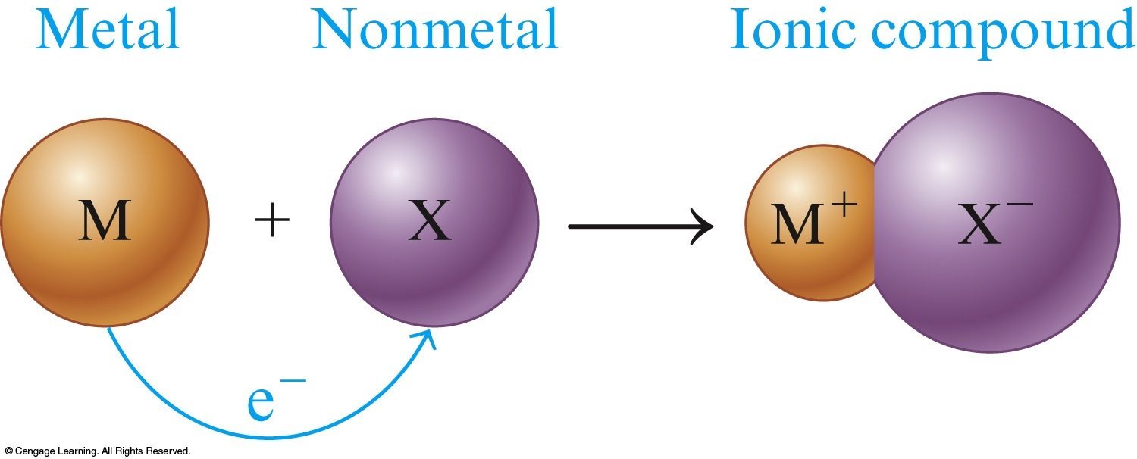
Ionic Bonding
Ionic compound results when a metal reacts with a nonmetal.
Electrons are transferred.

Slide 5
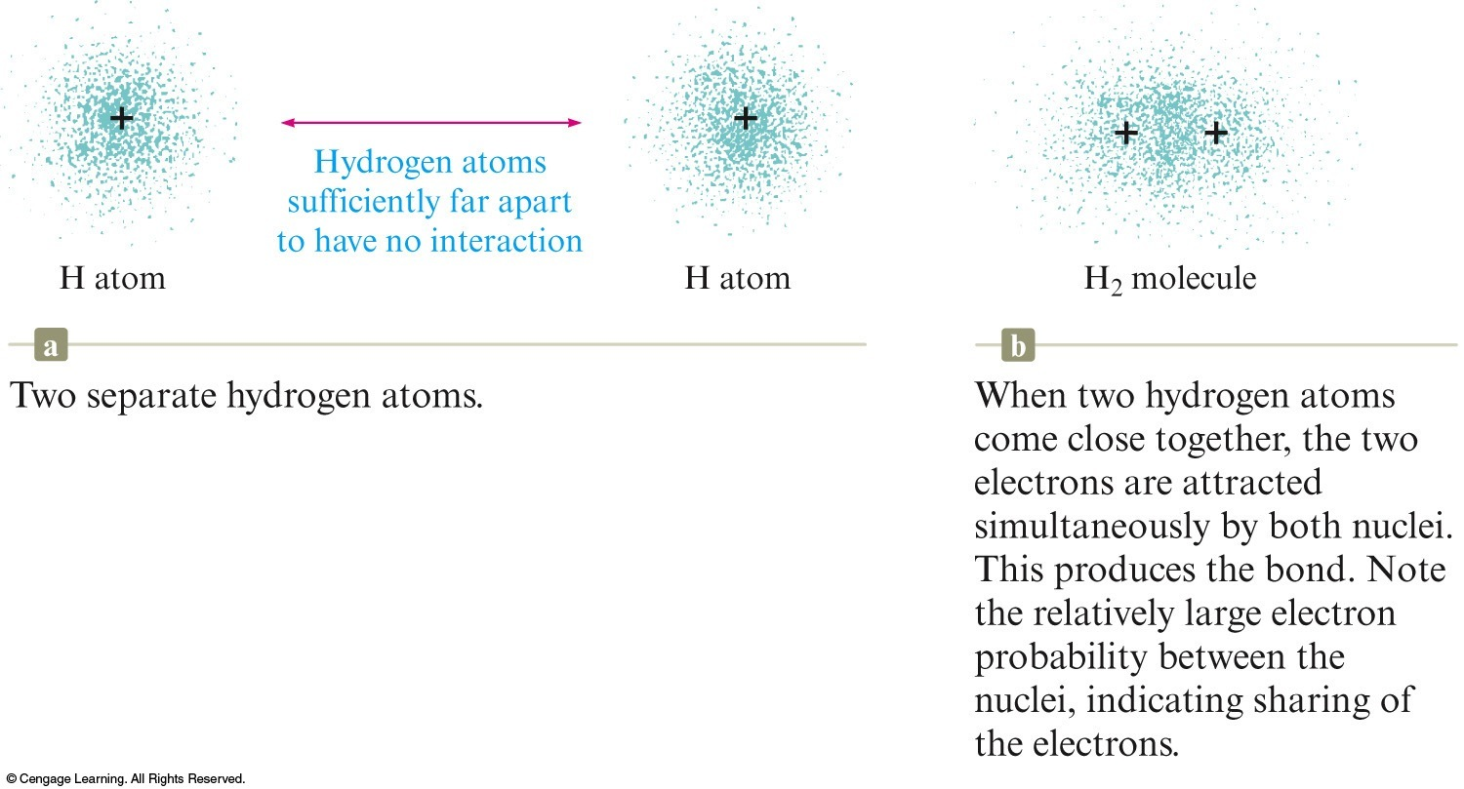
Covalent Bonding
A covalent bond results when electrons are shared by nuclei.

Slide 6
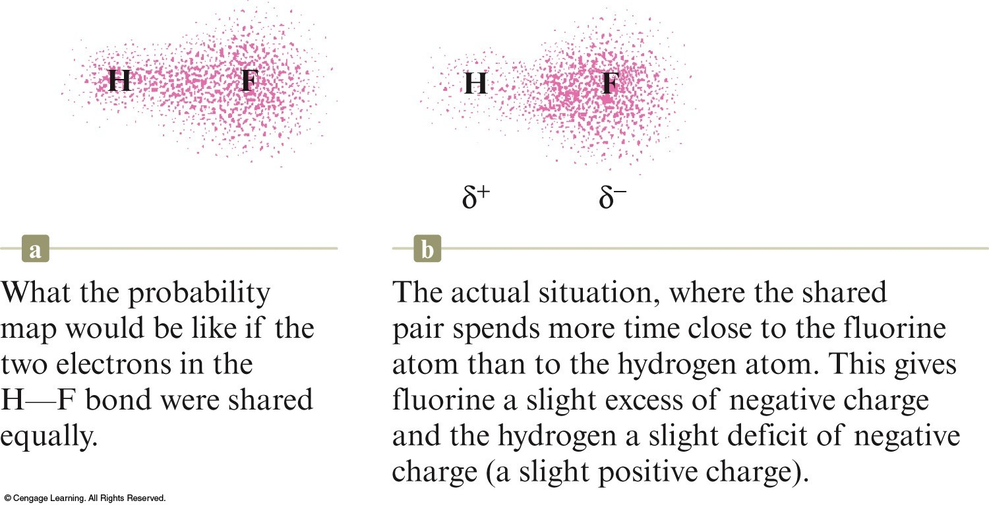
Polar Covalent Bond
Unequal sharing of electrons between atoms in a molecule.
One atom attracts the electrons more than the other atom.
Results in a charge separation in the bond (partial positive and partial negative charge).

Slide 7
Concept Check
What is meant by the term “chemical bond?”
Why do atoms bond with each other to form molecules?
How do atoms bond with each other to form molecules?
Notes:
A chemical bond is difficult to define but in general it can be described as forces that hold groups of atoms together and make them function as a unit.
Atoms will bond with each other to form molecules if the energy of the aggregate is lower than that of the separated atoms.
Atoms bond with each other by either sharing electrons or transferring electrons to form oppositely charged ions which then attract each other.

Slide 8
The ability of an atom in a molecule to attract shared electrons to itself.
For a molecule HX, the relative electronegativities of the H and X atoms are determined by comparing the measured H–X bond energy with the “expected” H–X bond energy.

Slide 9
On the periodic table, electronegativity generally increases across a period and decreases down a group.
The range of electronegativity values is from 4.0 for fluorine (the most electronegative) to 0.7 for cesium and francium (the least electronegative).

Slide 10
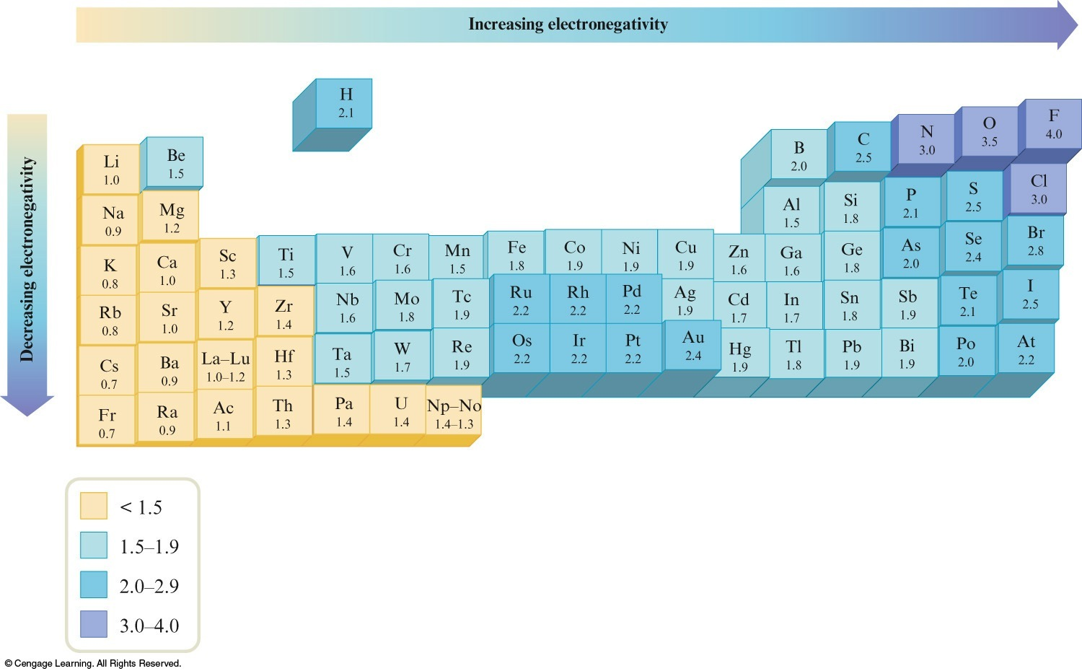
Electronegativity Values for Selected Elements

Slide 11
Concept Check
If lithium and fluorine react, which has more attraction for an electron? Why?
In a bond between fluorine and iodine, which has more attraction for an electron? Why?
Notes:
The fluorine has more attraction for an electron than does lithium. Both have valence electrons in the same principal energy level (the 2nd), but fluorine has a greater number of protons in the nucleus. Electrons are more attracted to a larger nucleus (if the principal energy level is the same).
The fluorine also has more attraction for an electron than does iodine. In this case the nuclear charge of iodine is greater, but the valence electrons are at a much higher principal energy level (and the inner electrons shield the outer electrons).

Slide 12
Concept Check
What is the general trend for electronegativity across rows and down columns on the periodic table?
Explain the trend.
Notes:
Generally speaking, the electronegativity increases in going from left to right across a period because the number of protons increases which increases the effective nuclear charge. The electronegativity decreases going down a group because the size of the atoms increases as you go down so when other electrons approach the larger atoms, the effective nuclear charge is not as great due to shielding from the current electrons present.

Slide 13
The polarity of a bond depends on the difference between the electronegativity values of the atoms forming the bond.

Slide 14
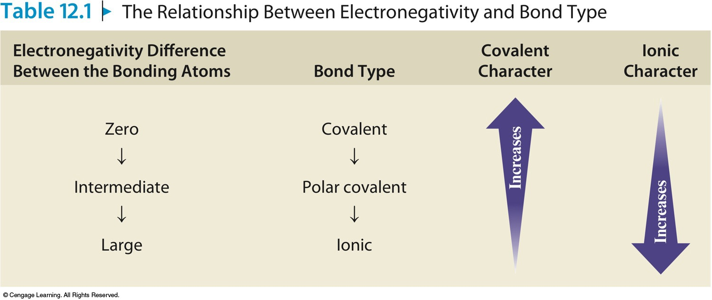
The Relationship Between Electronegativity and Bond Type

Slide 15
Exercise
Arrange the following bonds from most to least polar:
a) N–F O–F C–F
b) C–F N–O Si–F
c) Cl–Cl B–Cl S–Cl
a) C–F, N–F, O–F
b) Si–F, C–F, N–O
c) B–Cl, S–Cl, Cl–Cl
Notes:
The greater the electronegativity difference between the atoms, the more polar the bond.
C-F, N-F, O-F
Si-F, C-F, N-O
B-Cl, S-Cl, Cl-Cl

Slide 16
Concept Check
Which of the following bonds would be the least polar yet still be considered polar covalent?
Mg–O C–O O–O Si–O N–O
Notes:
The correct answer is N-O. To be considered polar covalent, unequal sharing of electrons must still occur. Choose the bond with the least difference in electronegativity yet there is still some unequal sharing of electrons.

Slide 17
Concept Check
Which of the following bonds would be the most polar without being considered ionic?
Mg–O C–O O–O Si–O N–O
Notes:
The correct answer is Si-O. To not be considered ionic, generally the bond needs to be between two nonmetals. The most polar bond between the nonmetals occurs with the bond that has the greatest difference in electronegativity.

Slide 18
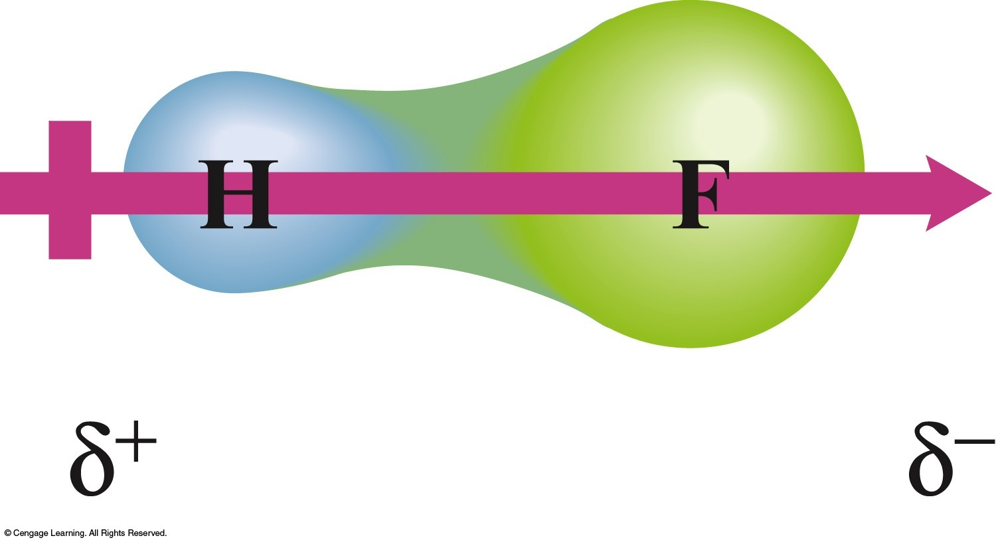
Dipole Moment
Property of a molecule whose charge distribution can be represented by a center of positive charge and a center of negative charge.
Use an arrow to represent a dipole moment.
Point to the negative charge center with the tail of the arrow indicating the positive center of charge.

Slide 19
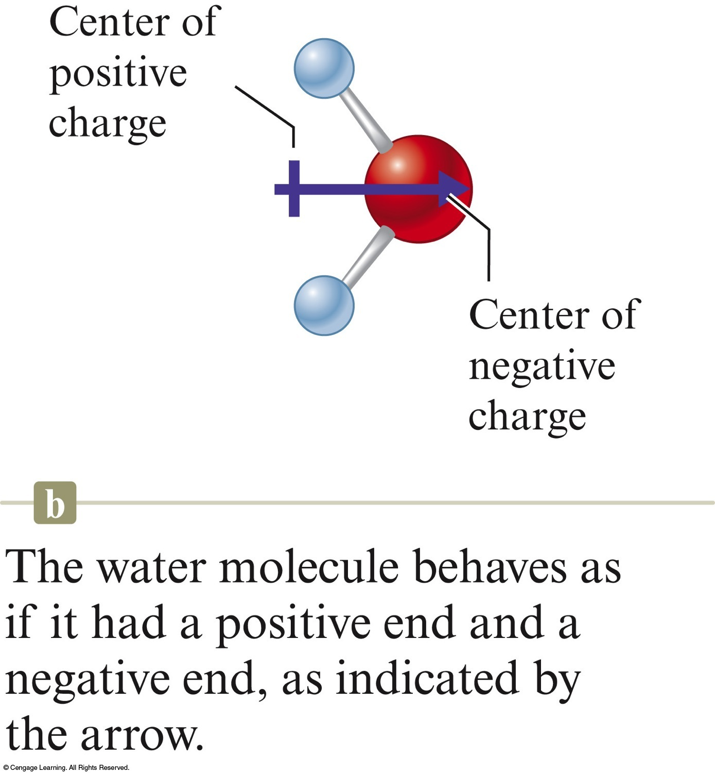
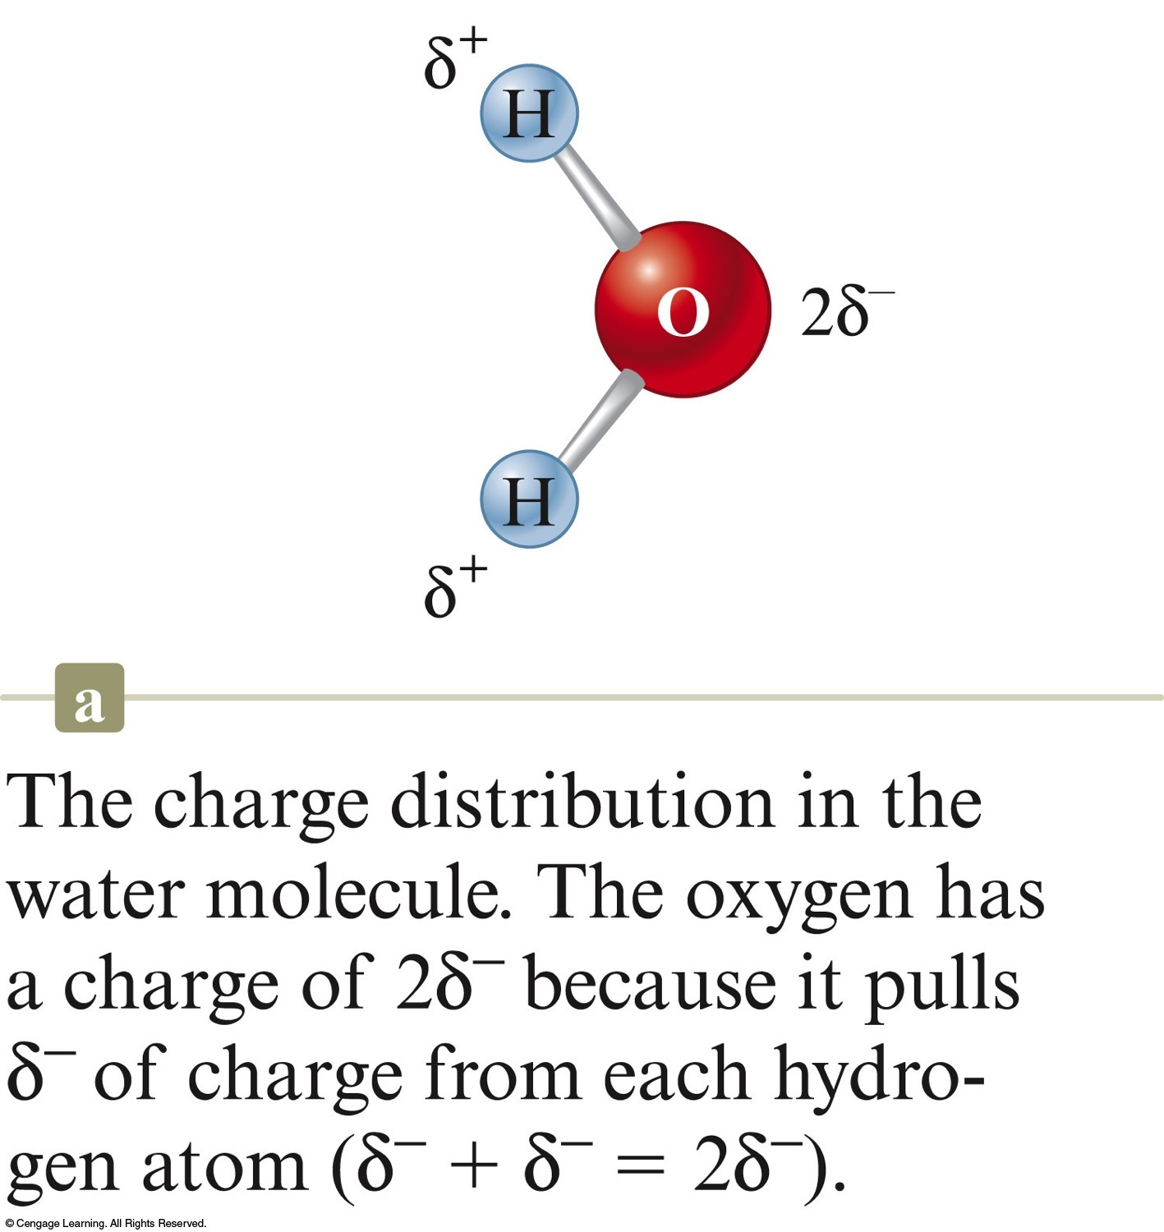
Dipole Moment in a Water Molecule

Slide 20
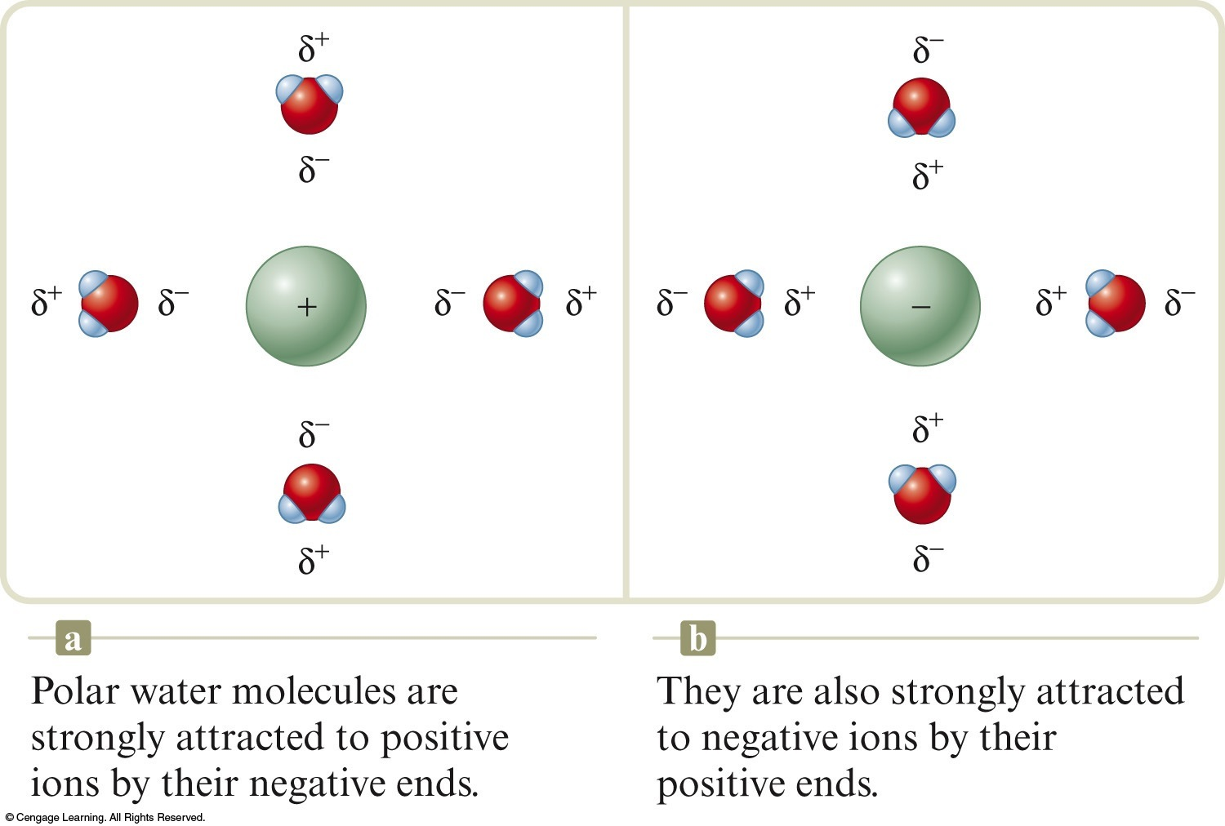
The polarity of water affects its properties.
Permits ionic compounds to dissolve in it.
Causes water to remain liquid at higher temperature.

Slide 21
Review
Group 1 metals always form 1+ cations.
Group 2 metals always form 2+ cations.
Aluminum in Group 3 always forms a 3+ cation.
Group 7 nonmetals form 1– anions.
Group 6 elements always form 2– anions.

Slide 22
Stable Compounds
Atoms in stable compounds usually have a noble gas electron configuration.
Metals lose electrons to reach a noble gas configuration.
Nonmetals gain electrons to reach a noble gas configuration.

Slide 23
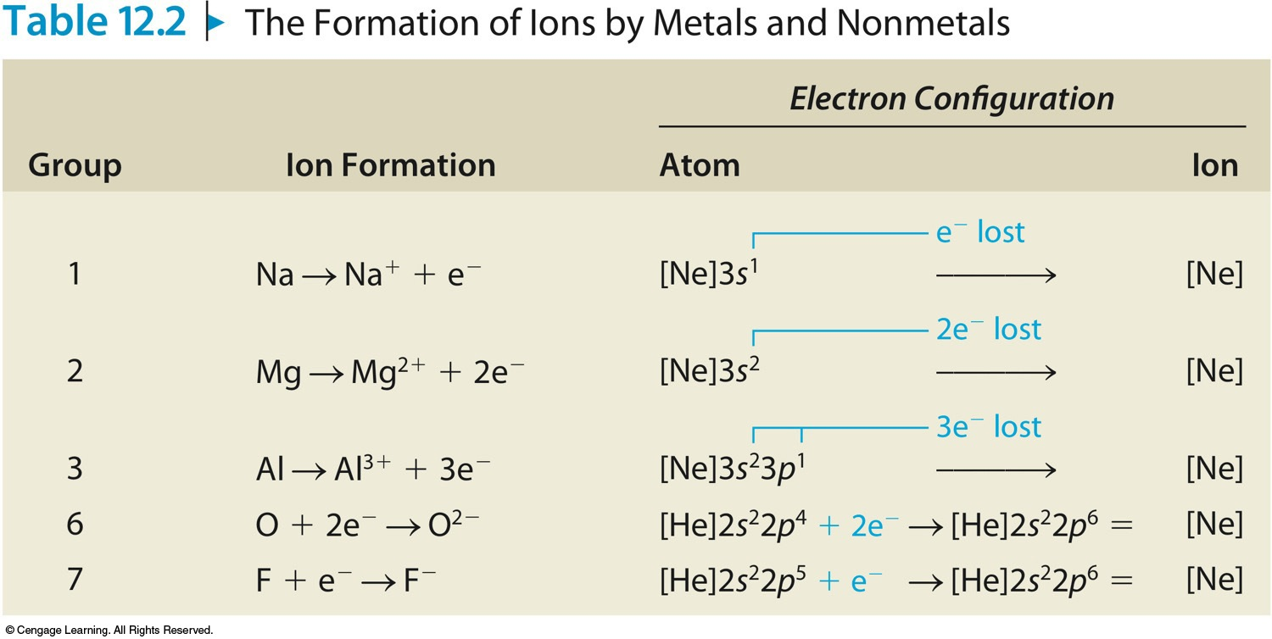
The Formation of Ions by Metals and Nonmetals

Slide 24
Electron Configurations of Ions
Representative (main-group) metals form ions by losing enough electrons to achieve the configuration of the previous noble gas.
Nonmetals form ions by gaining enough electrons to achieve the configuration of the next noble gas.

Slide 25
Electron Configurations and Bonding
When a nonmetal and a Group 1, 2, or 3 metal react to form a binary ionic compound, the ions form in such a way that the valence-electron configuration of the nonmetal is completed to achieve the configuration of the next noble gas and the valence orbitals of the metal are emptied to achieve the configuration of the previous noble gas.
When two nonmetals react to form a covalent bond, they share electrons in a way that completes the valence-electron configurations of both atoms.

Slide 26
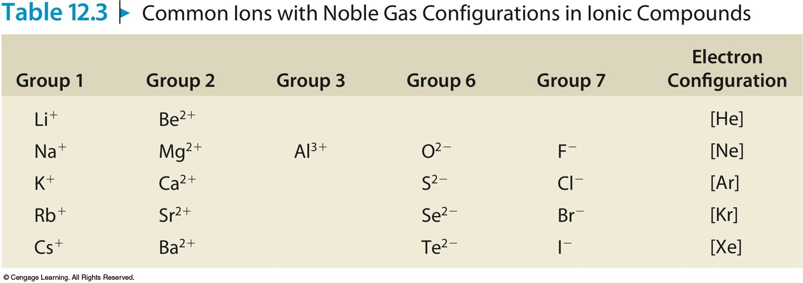
Predicting Formulas of Ionic Compounds
Chemical compounds are always electrically neutral.

Slide 27
Concept Check
What is the expected ground state electron configuration for Te^{2–}?
a) [Kr]5s²4d¹⁰5p⁴
b) [Kr]5s²4d¹⁰4f¹⁴5p⁶
c) [Kr]5s²4d¹⁰5p⁶
d) [Ar]5s²4d¹⁰5p²
Notes:
The correct answer is c. Te^{2–} contains 54 electrons and has the noble gas configuration of Xe.

Slide 28
Concept Check
What is the correct electron configuration for the most stable form of the sulfur ion in an ionic compound?
a) 1s²2s²2p⁶3s²
b) 1s²2s²2p⁶3s²3p²
c) 1s²2s²2p⁶3s²3p⁴
d) 1s²2s²2p⁶3s²3p⁶
Notes:
The correct answer is d. S^{2–} is the most stable form of the sulfur ion in an ionic compound. It contains 18 electrons and has the noble gas configuration of Ar.

Slide 29
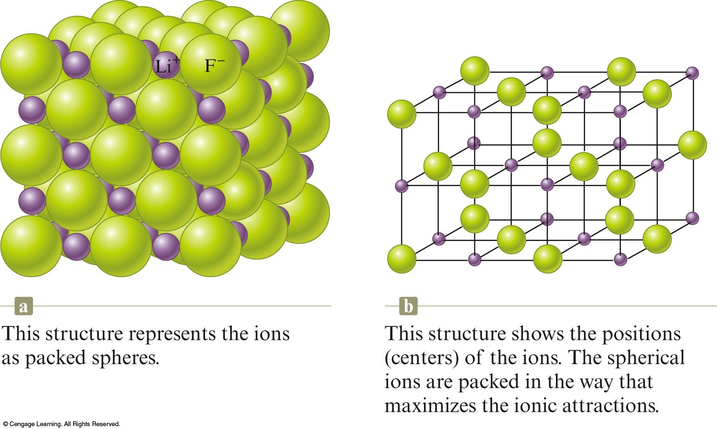
Structures of Ionic Compounds
Ions are packed together to maximize the attractions between ions.

Slide 30
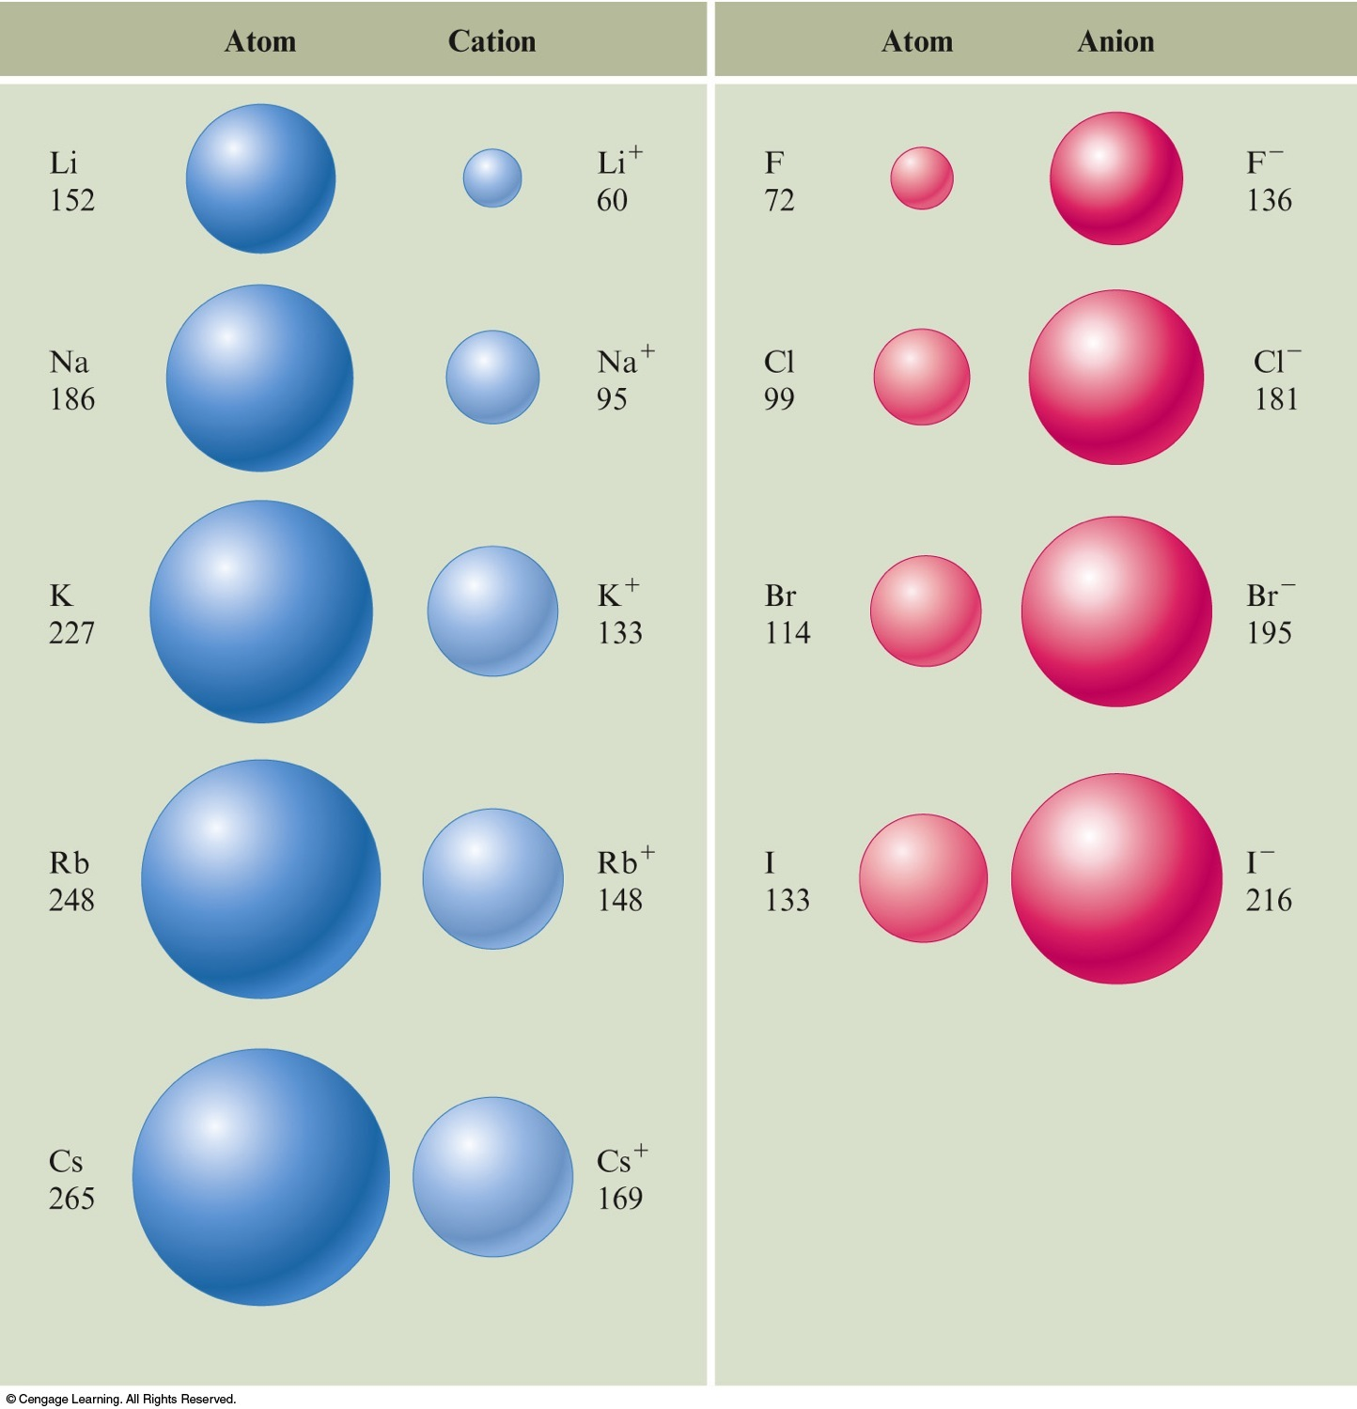
Structures of Ionic Compounds
Cations are always smaller than the parent atom.
Anions are always larger than the parent atom.

Slide 31
Isoelectronic Series
A series of ions/atoms containing the same number of electrons.
O^{2–}, F–, Ne, Na⁺, Mg²⁺, and Al³⁺

Slide 32
Concept Check
Choose an alkali metal, an alkaline earth metal, a noble gas, and a halogen so that they constitute an isoelectronic series when the metals and halogen are written as their most stable ions.
What is the electron configuration for each species?
Determine the number of electrons for each species.
Determine the number of protons for each species.
Rank the species according to increasing radius.
Rank the species according to increasing ionization energy.
Notes:
One example could be:
K⁺, Ca²⁺, Ar, and Cl⁻
The electron configuration for each species is 1s²2s²2p⁶3s²3p⁶.
The number of electrons for each species is 18.
K⁺ has 19 protons, Ca²⁺ has 20 protons, Ar has 18 protons, and Cl⁻ has 17 protons.
Increasing Radius: Ca²⁺, K⁺, Ar, Cl⁻
Increasing Ionization Energy: Cl⁻, Ar, K⁺, Ca²⁺

Slide 33
Concept Check
Rank the following from smallest to largest atomic radius:
Ar, S^{2–}, Ca²⁺, K⁺, Cl–
a) Ar < K⁺ < Ca²⁺ < S^{2–} < Cl–
b) Ca²⁺ < K⁺ < Ar < Cl– < S^{2–}
c) Ar < Cl– < S^{2–} < Ca²⁺ < K⁺
d) S^{2–} < Cl– < Ar < K⁺ < Ca²⁺
Notes:
The correct answer is b. They all have the same electron configuration of the noble gas Ar. Therefore, nuclear charge becomes very important in determining the sizes relative to each other. The higher the nuclear charge, the smaller the ion/atom.

Slide 34
Concept Check
Which atom or ion has the smallest radius?
a) O²⁺
b) O⁺
c) O
d) O^{2–}
Notes:
The correct answer is a. As electrons are removed, the effective nuclear charge has a stronger effect and thus makes the ion, O²⁺, the smallest

Slide 35
Ionic Compounds Containing Polyatomic Ions
Polyatomic ions work in the same way as simple ions.
The covalent bonds hold the polyatomic ion together so it behaves as a unit.

Slide 36
Lewis Structure
Shows how valence electrons are arranged among atoms in a molecule.
Most important requirement
Atoms achieve noble gas electron configuration (octet rule, duet rule).

Slide 37
Writing Lewis Structures
Bonding pairs are shared between 2 atoms.
Unshared pairs (lone pairs) are not shared and not involved in bonding.

Slide 38
Steps for Writing Lewis Structures
Sum the valence electrons from all the atoms.
Use one pair of electrons to form a bond between each pair of bound atoms.
Arrange the remaining electrons to satisfy the octet rule (or duet rule for hydrogen).

Slide 39
Steps for Writing Lewis Structures
Sum the valence electrons from all the atoms. (Use the periodic table.)
Example: H₂O
2 (1 e–) + 6 e– = 8 e– total

Slide 40
Steps for Writing Lewis Structures
Use a pair of electrons to form a bond between each pair of bound atoms.
Example: H₂O

Slide 41
Steps for Writing Lewis Structures
Arrange the remaining electrons to satisfy the octet rule (or duet rule for hydrogen).
Examples: H₂O and PBr₃

Slide 42
Concept Check
Draw a Lewis structure for each of the following molecules:
H₂
F₂
HF
CH₄

Slide 43
Single bond – covalent bond in which 1 pair of electrons is shared by 2 atoms
H–H
Double bond – covalent bond in which 2 pairs of electrons are shared by 2 atoms
O=C=O
Triple bond – covalent bond in which 3 pairs of electrons are shared by 2 atoms

Slide 44
Resonance
A molecule shows resonance when more than one Lewis structure can be drawn for the molecule.
NO₃– = 24e–

Slide 45
Some Exceptions to the Octet Rule
Boron tends to form compounds in which the boron atom has fewer than eight electrons around it (it does not have a complete octet).
BH₃ = 6e–
Molecules containing odd numbers of electrons like NO and NO₂.

Slide 46
Concept Check
Draw a Lewis structure for each of the following molecules:
BF₃
CO₂
CCl₄
CN–

Slide 47
Concept Check
Consider the following compounds:
CO₂ N₂ CCl₄
Which compound exhibits resonance?
a) CO₂
b) N₂
c) CCl₄
d) At least two of the above compounds exhibit resonance.
Notes:
The correct answer is a. Only CO₂ exhibits resonance.

Slide 48
Concept Check
Which of the following supports why Lewis structures are not a completely accurate way to draw molecules?
a) We cannot say for certain where an electron is located, yet when drawing Lewis structures we assume the electrons are right where we place them.
b) When adding up the number of valence electrons for a molecule, it is possible to get an odd number which would make it impossible to satisfy the octet rule for all atoms.
c) Both statements 1 and 2 above support why Lewis structures are not a completely accurate way to draw molecules.
d) Lewis structures are the most accurate way to draw molecules and are completely correct.
Notes:
The correct answer is c.

Slide 49
Three dimensional arrangement of the atoms in a molecule.

Slide 50
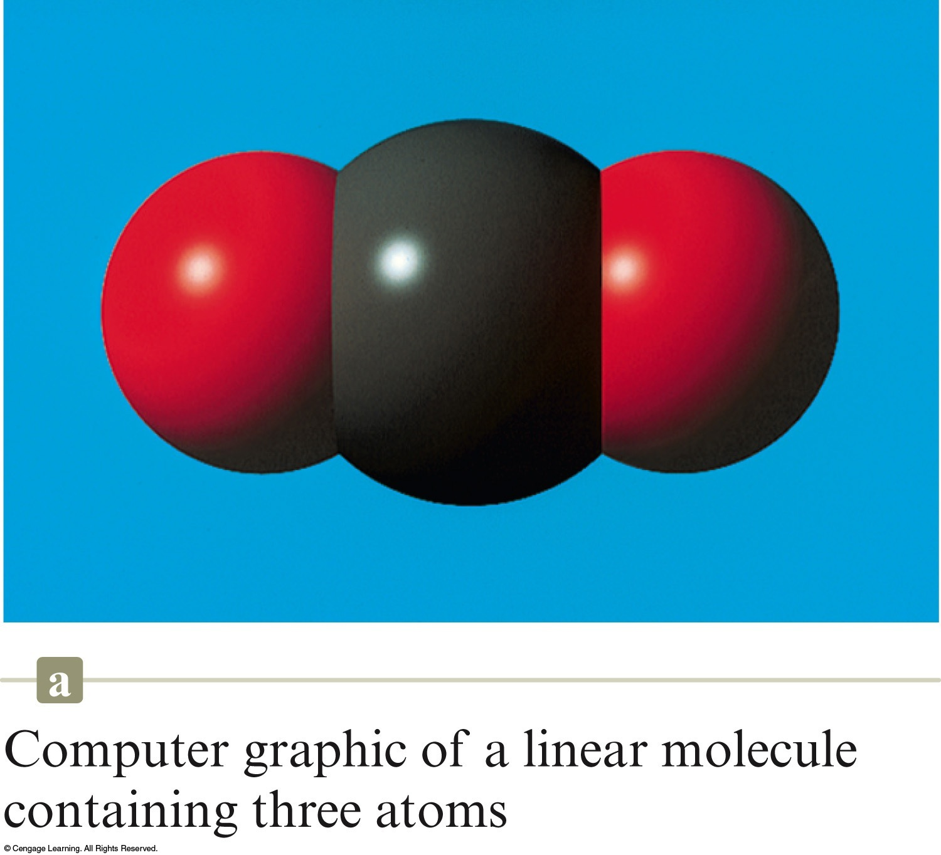
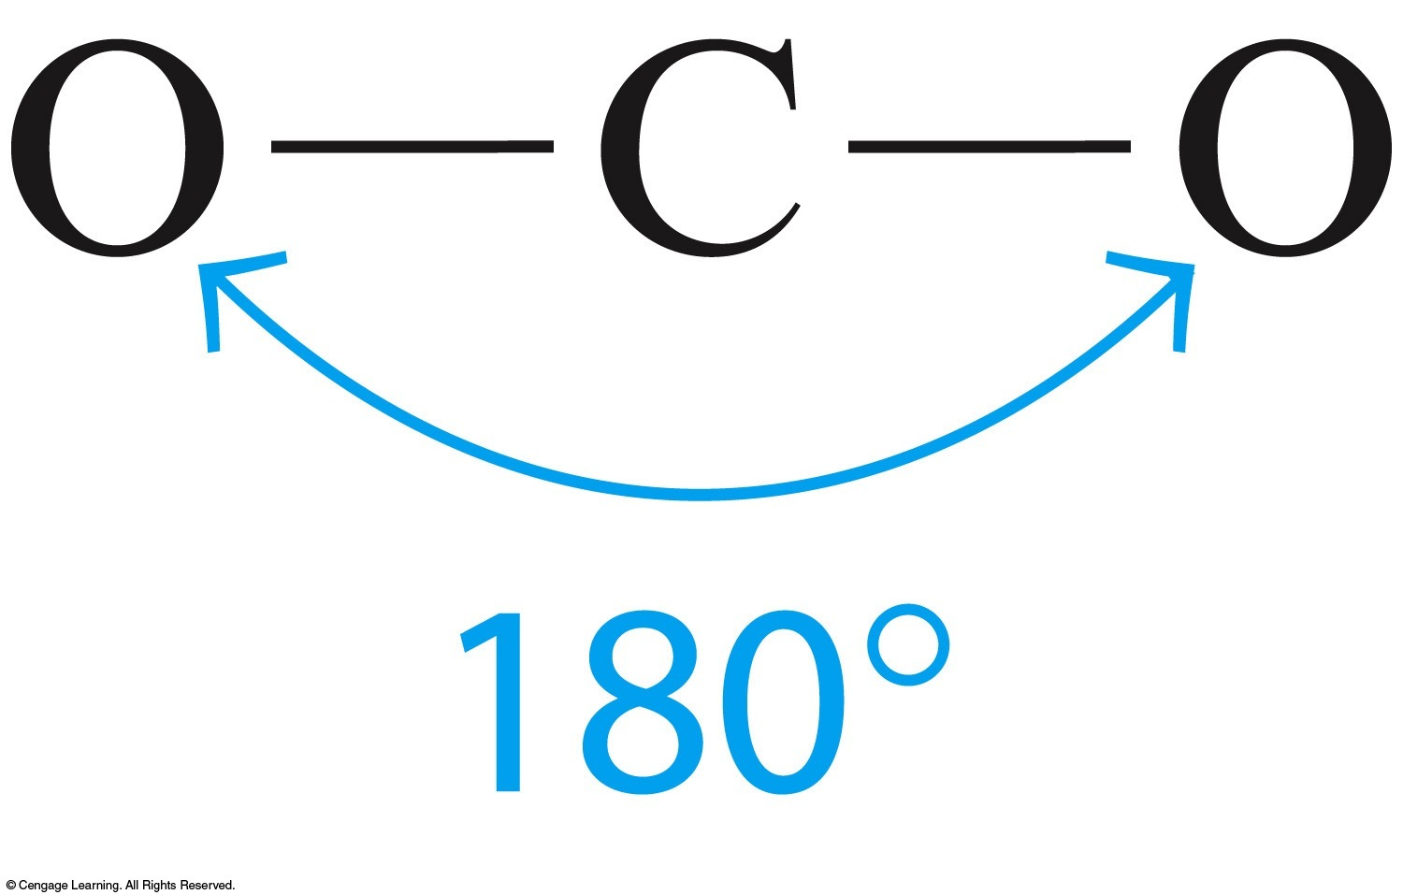
Linear structure – atoms in a line
Carbon dioxide

Slide 51
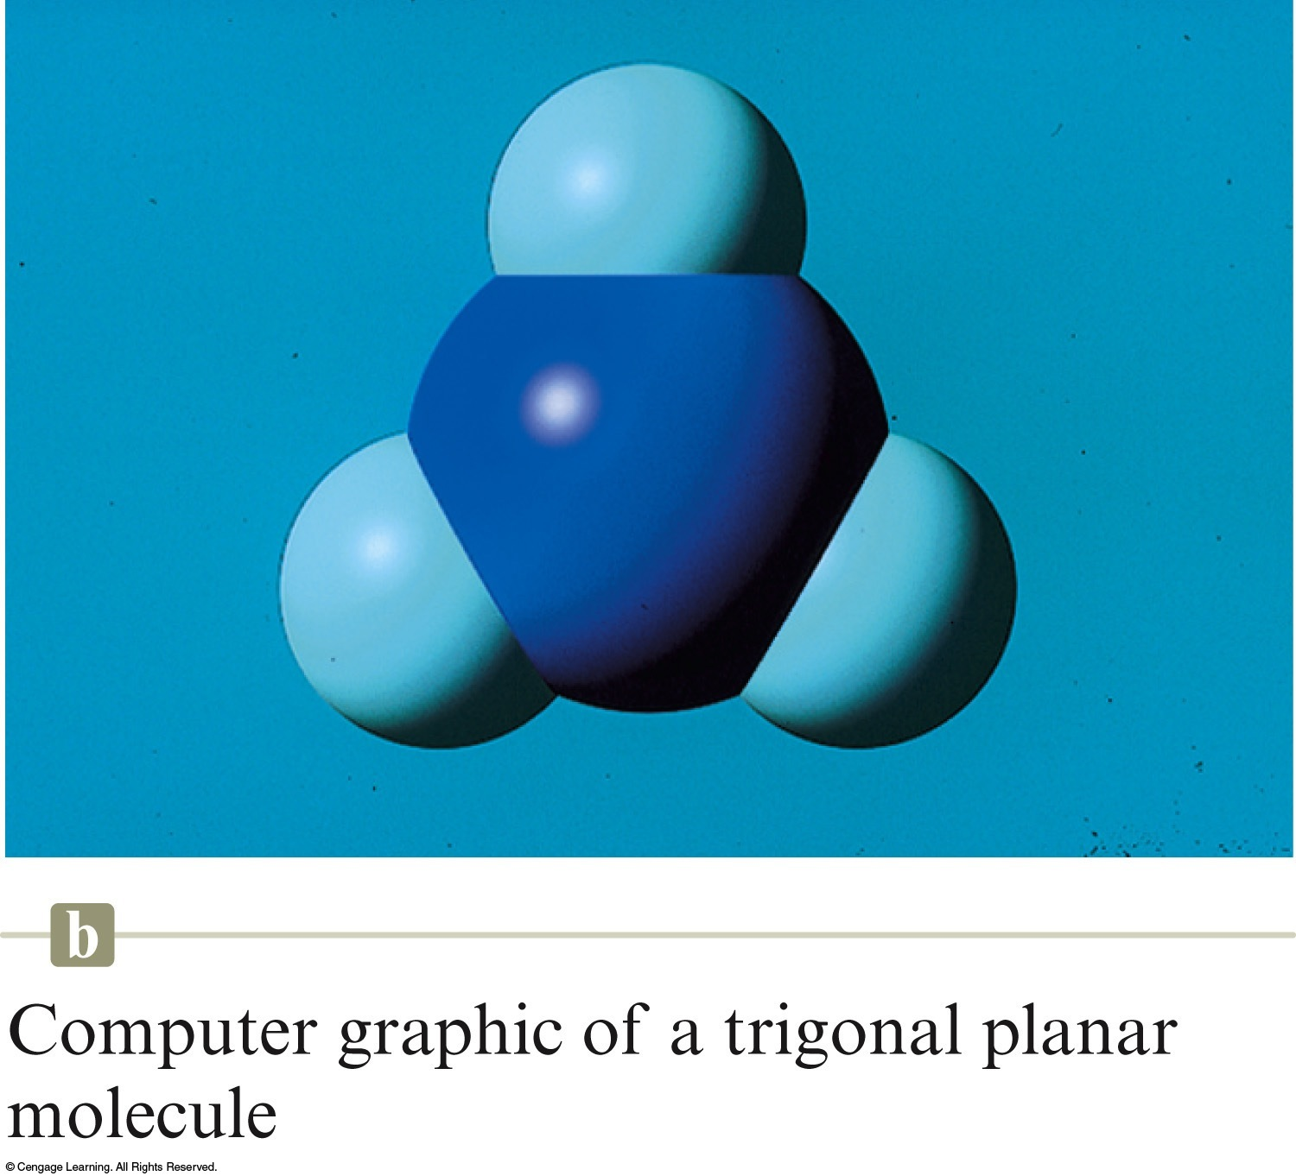
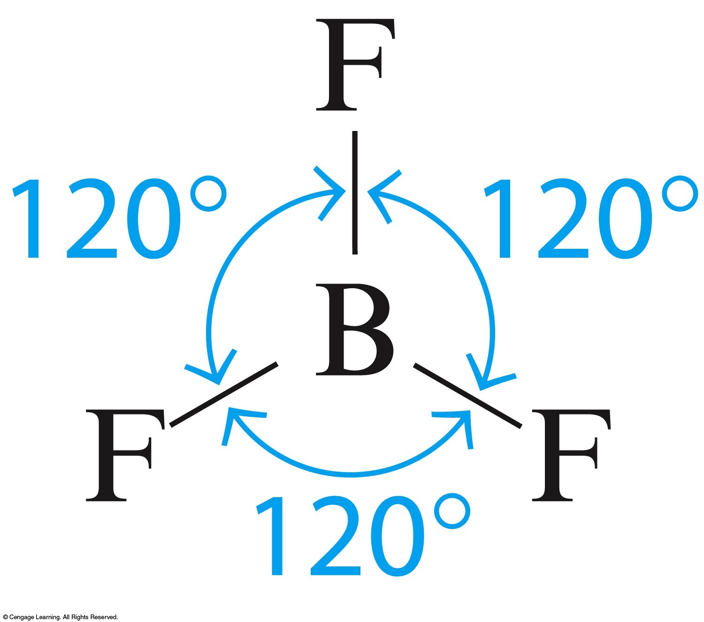
Trigonal planar – atoms in a triangle
Boron trifluoride

Slide 52
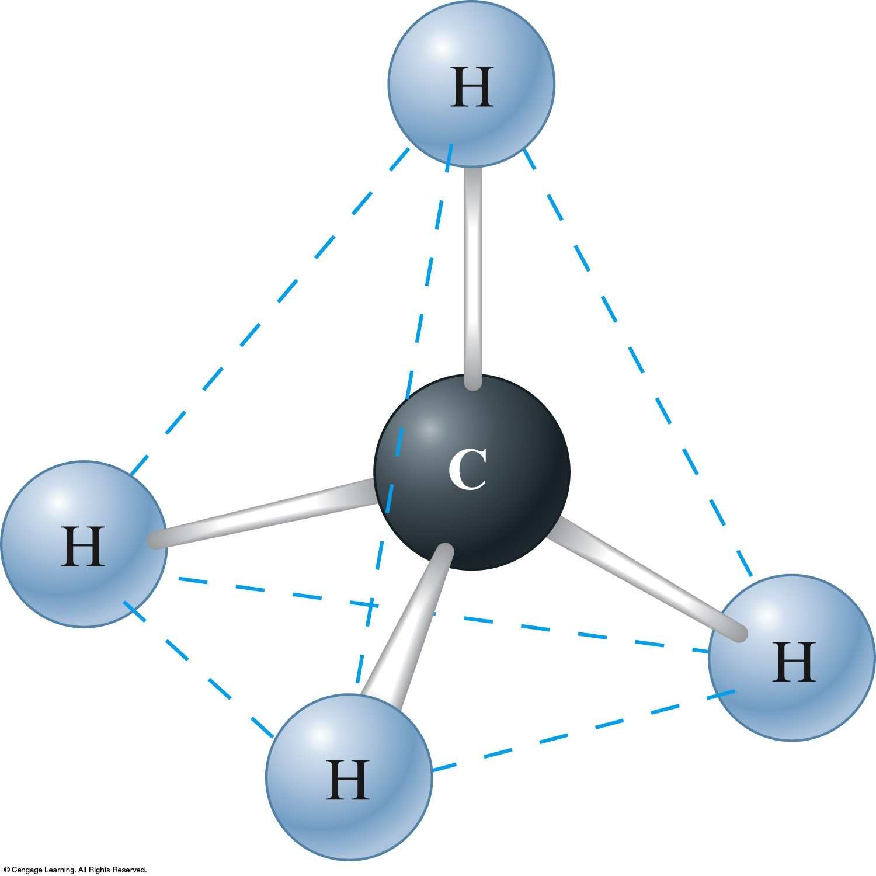
Tetrahedral structure
Methane

