Slide 1
Chapter 12 (part 2)
Chemical Bonding

Slide 2
VSEPR Model
VSEPR: Valence Shell Electron-Pair Repulsion.
The structure around a given atom is determined principally by minimizing electron pair repulsions.

Slide 3
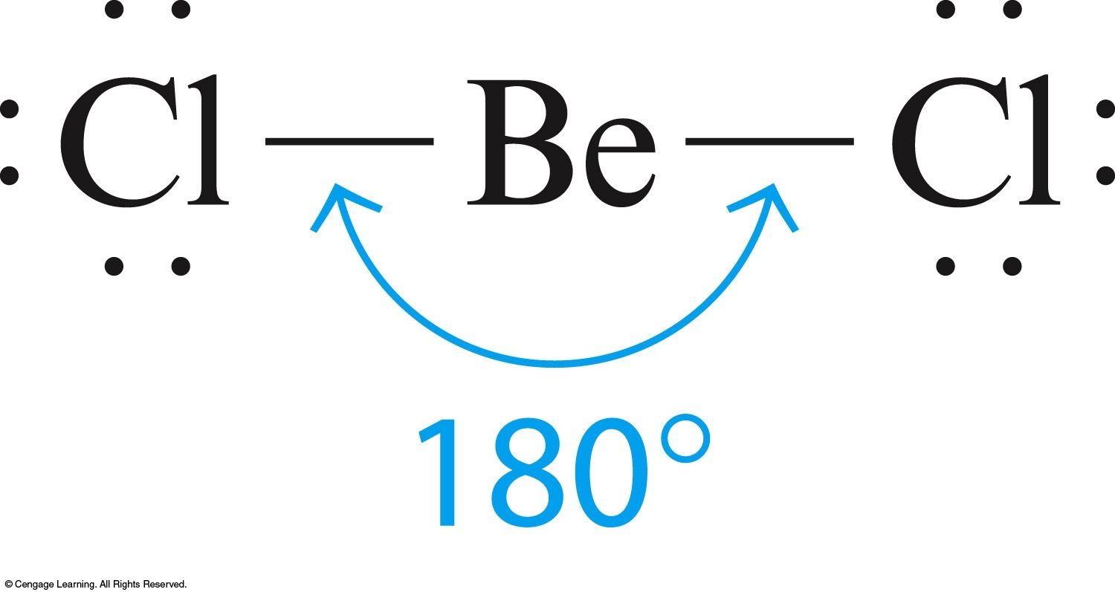
Two Pairs of Electrons
BeCl₂
180°
Linear

Slide 4
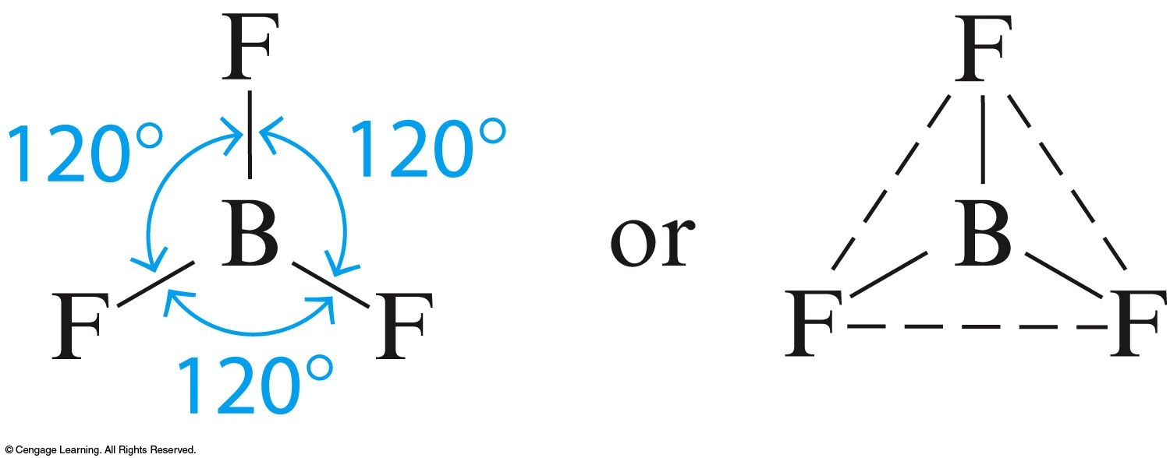
Three Pairs of Electrons
BF₃
120°
Trigonal planar

Slide 5
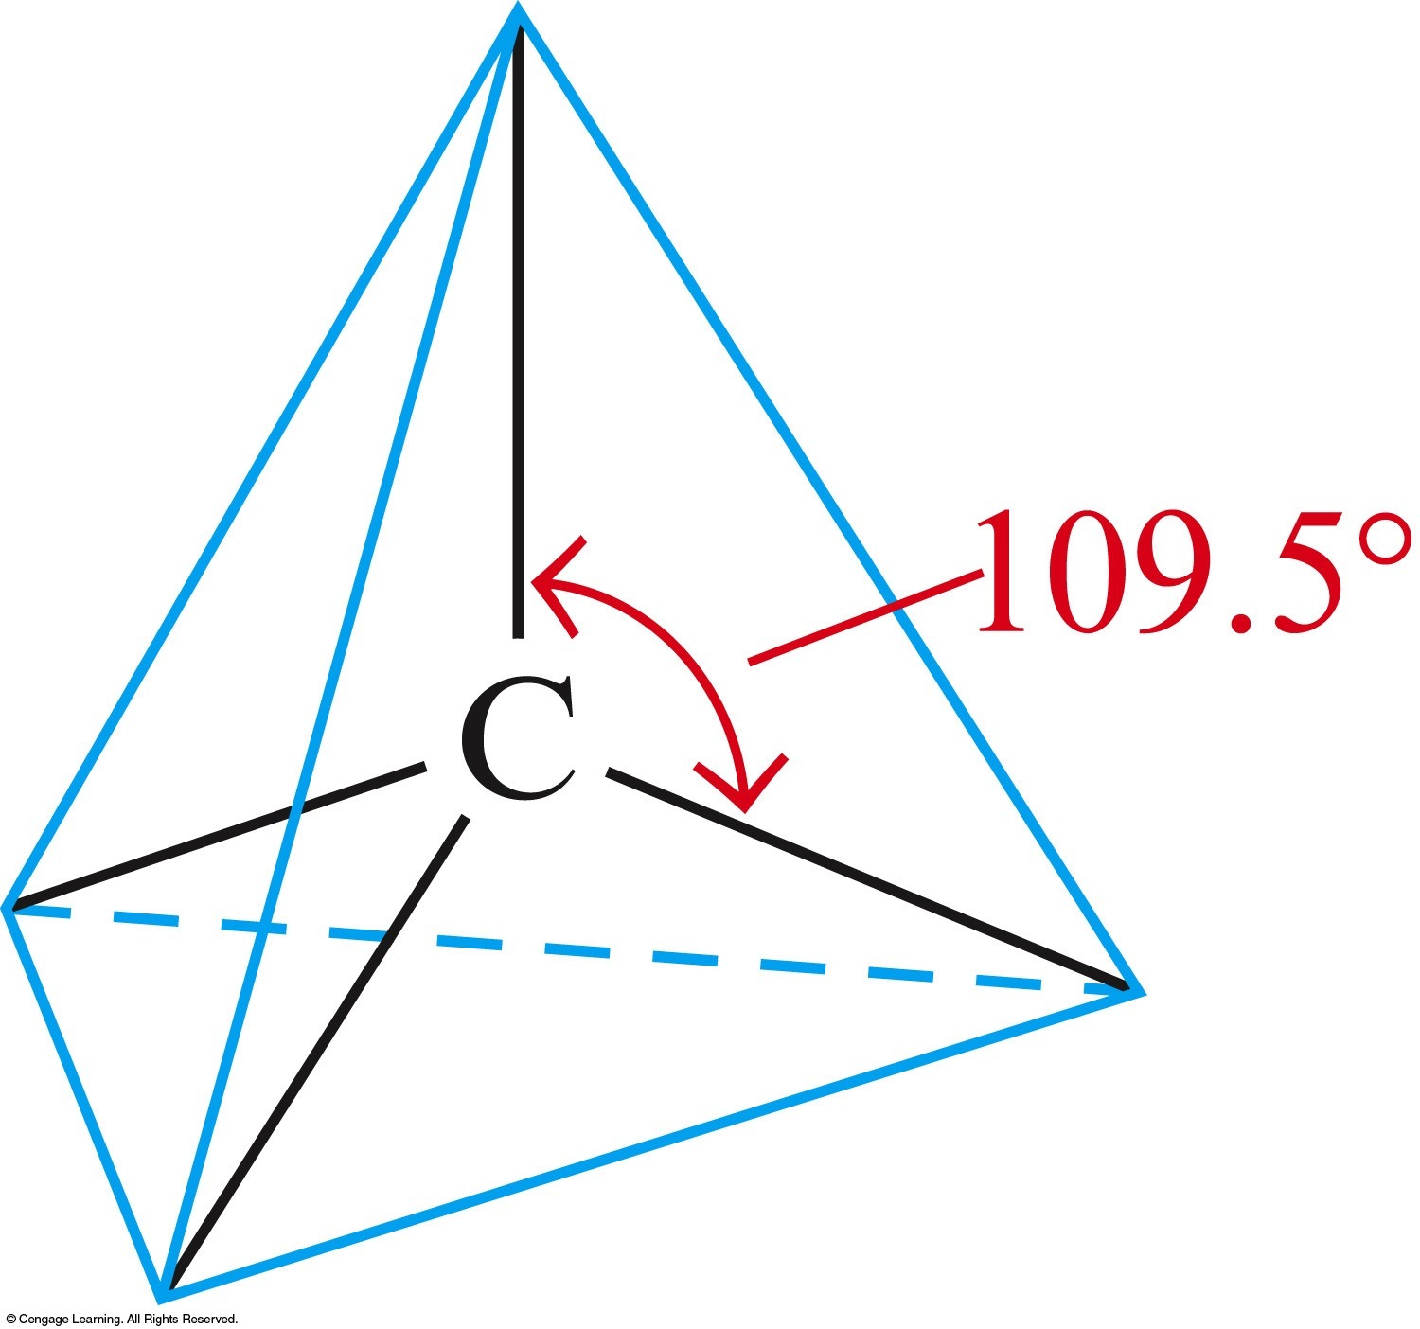
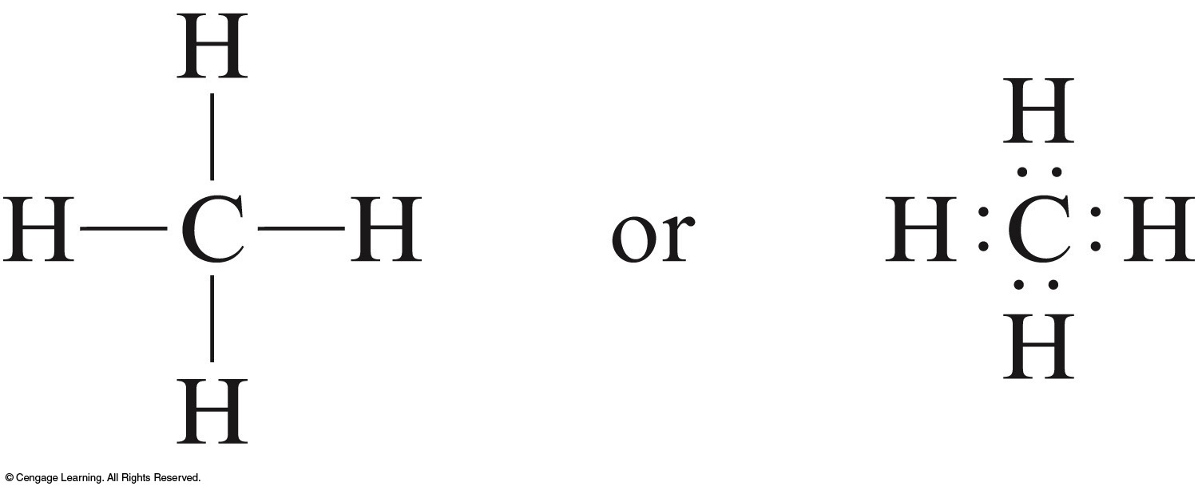
Four Pairs of Electrons
CH₄
109.5°
Tetrahedral

Slide 6
Steps for Predicting Molecular Structure Using the VSEPR Model
Draw the Lewis structure for the molecule.
Count the electron pairs and arrange them in the way that minimizes repulsion (put the pairs as far apart as possible).
Determine the positions of the atoms from the way electron pairs are shared.
Determine the name of the molecular structure from positions of the atoms.

Slide 7
Rules for Predicting Molecular Structure Using the VSEPR Model
Two pairs of electrons on a central atom in a molecule are always place 180° apart.
Three pairs of electrons on a central atom in a molecule are always placed 120° apart in the same plane as the central atom.
Four pairs of electrons on a central atom in a molecule are always placed 109.5° apart.

Slide 8
Rules for Predicting Molecular Structure Using the VSEPR Model
4. When every pair of electrons on the central atom is shared with another atom, the molecular structure has the same name as the arrangement of electron pairs.
5. When one or more of the electron pairs around a central atom are unshared (lone pairs), the name for the molecular structure is different from that for the arrangement of electron pairs.

Slide 9
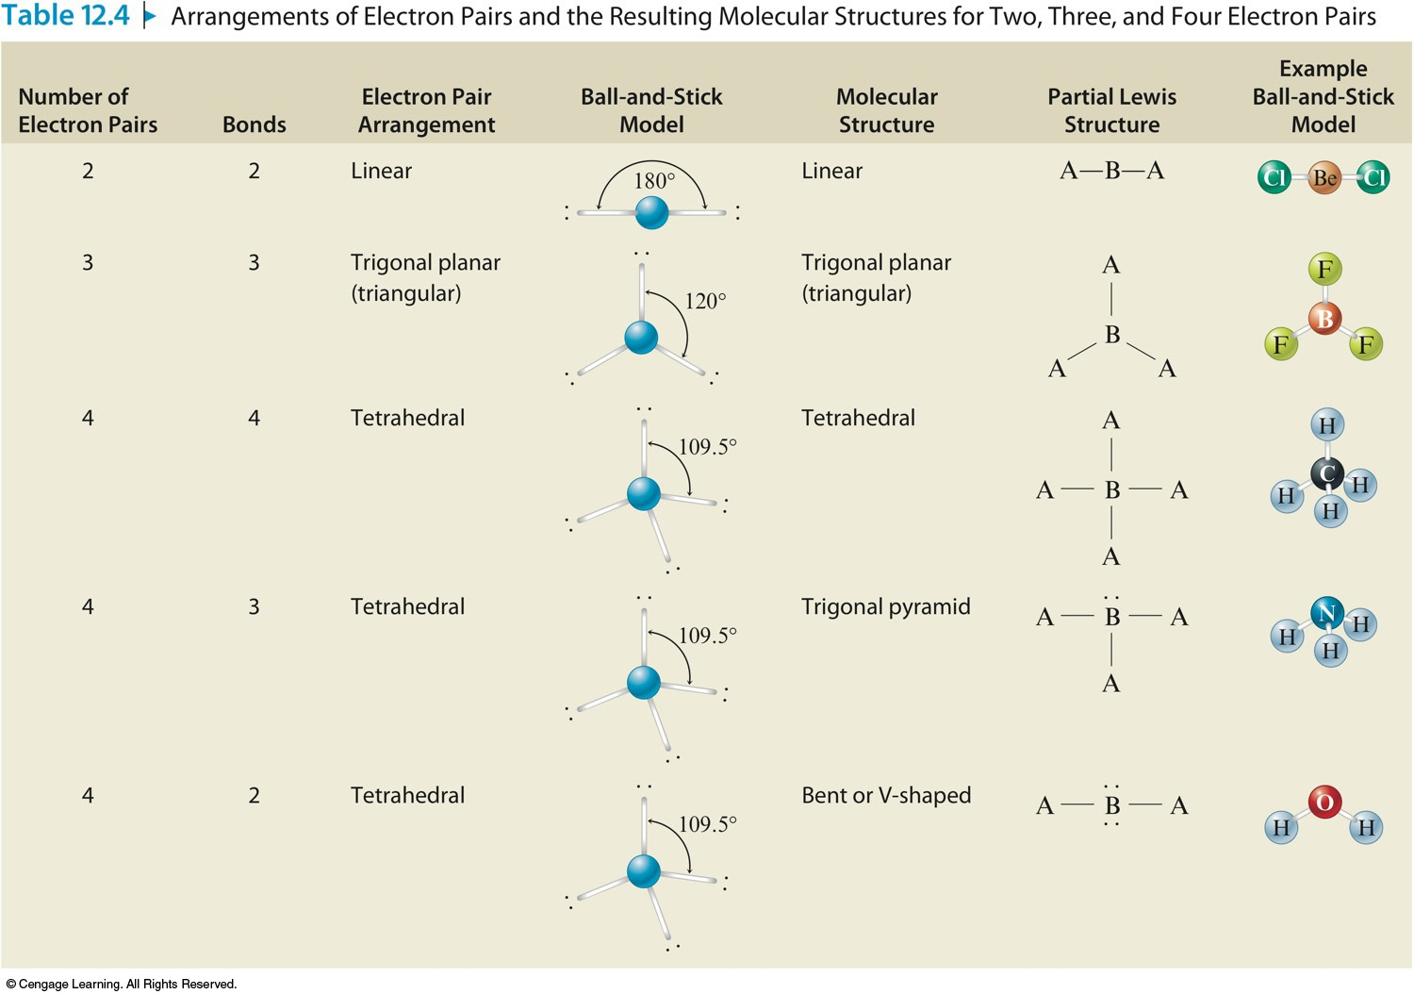
Arrangements of Electron Pairs and the Resulting Molecular Structures for Two, Three, and Four Electron Pairs

Slide 10
Molecules with Double Bonds
When using the VSEPR model to predict the molecular geometry of a molecule, a double or triple bond is counted the same as a single electron pair.
CO₂

Slide 11
Concept Check
Determine the molecular structure for each of the following molecules, and include bond angles:
HCN
PH₃
SeO₂
O₃
HCN – linear, 180º
PH₃ – trigonal pyramid, 109.5º (107º)
SeO₂ – bent, 120º
O₃ – bent, 120º
Notes:
HCN – linear, 180º
PH₃ – trigonal pyramid, 107º
SF₄ – see saw, 90º, 120º

