Slide 1
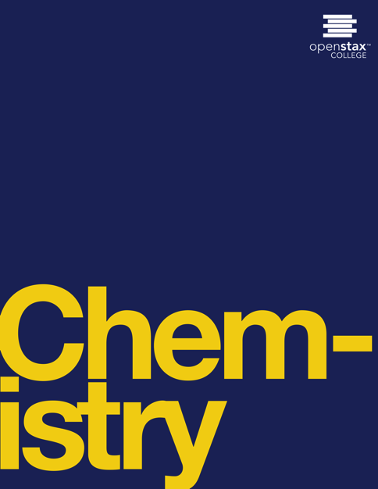

CHEMISTRY
Chapter 1 ESSENTIAL IDEAS
Joseph DePasquale
University of Connecticut

Slide 2
Ch. 1 Outline
1.1: Chemistry in Context
1.2: Phases and Classification of Matter
1.3: Physical and Chemical Properties
1.4: Measurements
1.5: Measurement Uncertainty, Accuracy, and Precision
1.6: Mathematical Treatment of Measurement Results

Slide 3
1.1 Chemistry in context
Chemistry is the study of the composition, properties, and interactions of matter.
Attempts to understand the behavior of matter extend back more than 2500 years.
  Greeks: Matter consists of four elements; earth, air, fire, and water.
  Alchemists attempted to transform “base metals” into “noble metals”.

Slide 4
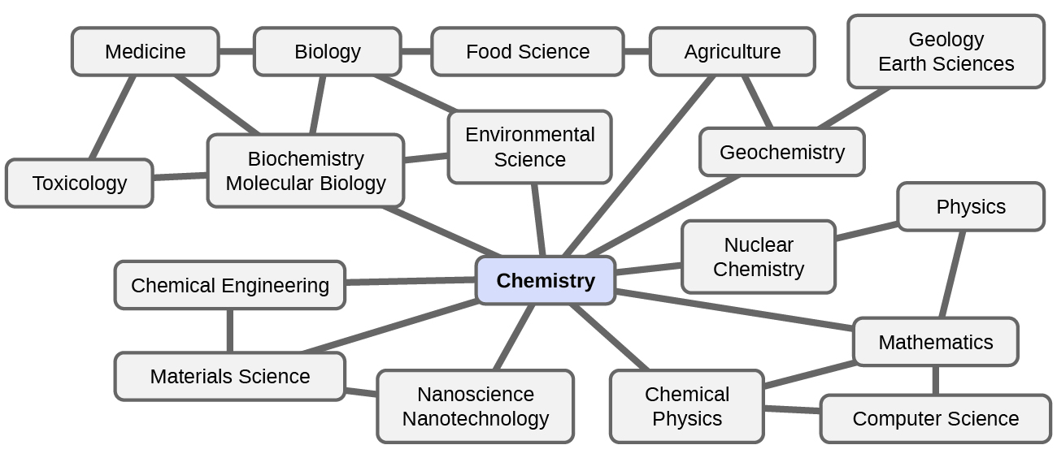
Chemistry the Central Science
Chemistry is interconnected to a vast array of other STEM disciplines.

Slide 5
Chemistry and everyday life
Examples of chemistry in everyday life:
  Digesting food
  Synthesizing polymers for clothing, cookware, and credit cards
  Refining crude oil into gasoline and other products
  And much more…
As you proceed through this course, you will discover:
  Many different examples of changes in the composition and structure of matter.
  How to classify these changes in matter and understand how they occur.
  The changes in energy that accompany these changes in matter.

Slide 6
The Scientific Method
Chemistry is a science based on observation and experimentation.
Chemists often formulate a hypothesis – a tentative explanation of observations.
The laws of science summarize a vast number of experimental observations, and describe or predict some facet of the natural world.
Theory - A well-substantiated, comprehensive, testable explanation of a particular aspect of nature.

Slide 7
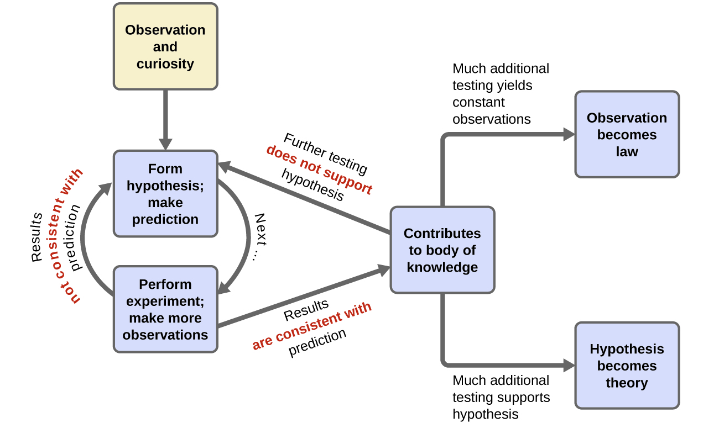
The Scientific Method
The scientific method follows a process similar to the one shown in this diagram. All the key components are shown, in roughly the right order. Scientific progress is seldom neat and clean: It requires open inquiry and the reworking of questions and ideas in response to findings.

Slide 8
The Domains of Chemistry
Chemists study and describe the behavior of matter and energy in three different domains.
1) The macroscopic domain is familiar to us: It is the realm of everyday things that are large enough to be sensed directly by human sight or touch.
2) The microscopic domain of chemistry is almost always visited in the imagination. Micro also comes from Greek and means “small.” Some aspects of the microscopic domains are visible through a microscope.
3) The symbolic domain contains the specialized language used to represent components of the macroscopic and microscopic domains, such as chemical symbols.

Slide 9
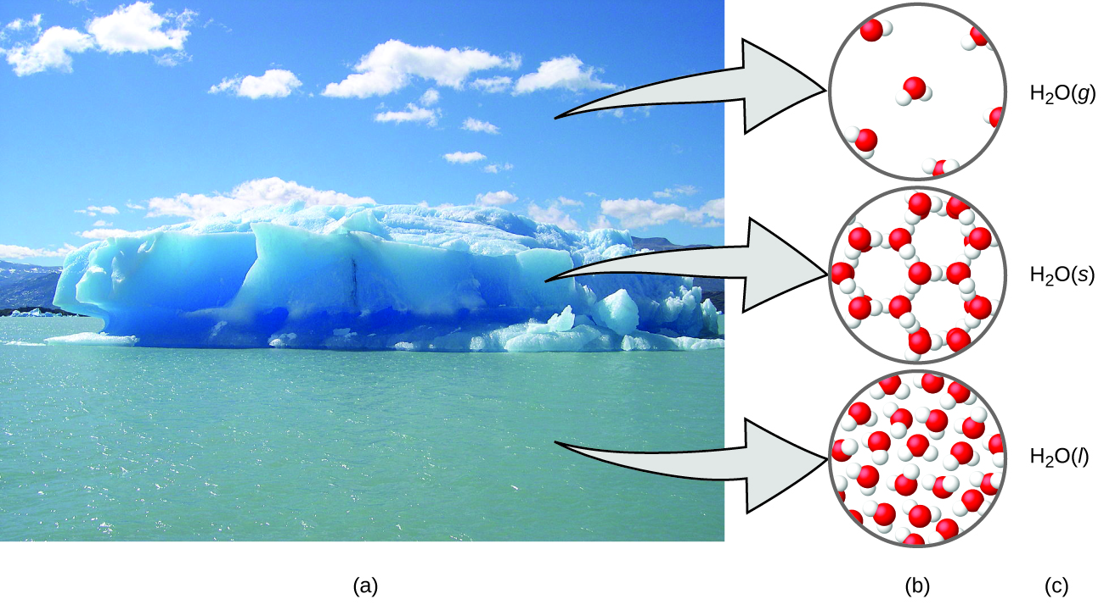
The Domains of Chemistry
Moisture in the air, icebergs, and the ocean represent water in the macroscopic domain.
At the molecular level (microscopic domain), gas molecules are far apart and disorganized, solid water molecules are close together and organized, and liquid molecules are close together and disorganized.
The formula H₂O symbolizes water, and (g), (s), and (l) symbolize its phases. Note that clouds are actually comprised of either very small liquid water droplets or solid water crystals; gaseous water in our atmosphere is not visible to the naked eye, although it may be sensed as humidity. (credit a: modification of work by “Gorkaazk”/Wikimedia Commons)

Slide 10
1.2 Phases and Classification of Matter
Matter - Anything that occupies space and has mass.
The three most common states or phases of matter:
1) A solid is rigid and posses a definite shape.
2) A liquid flows and takes the shape of its container.
3) A gas takes both the shape and volume of its container.

Slide 11
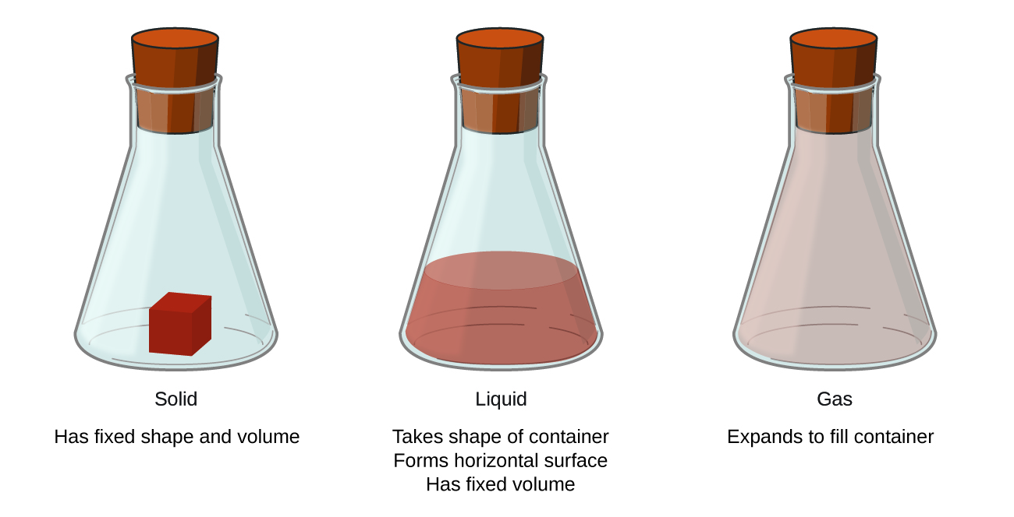
The three most common states or phases of matter are solid, liquid, and gas.

Slide 12
Plasma: A Fourth State of Matter
Plasma – A gaseous state of matter that contains an appreciable amount of electrically charged particles.
Plasma has unique properties distinct from ordinary gases.
Plasma is found in certain high temperature environments.
  Naturally: Stars, lightning.
  Man-made: Television screens.

Slide 13
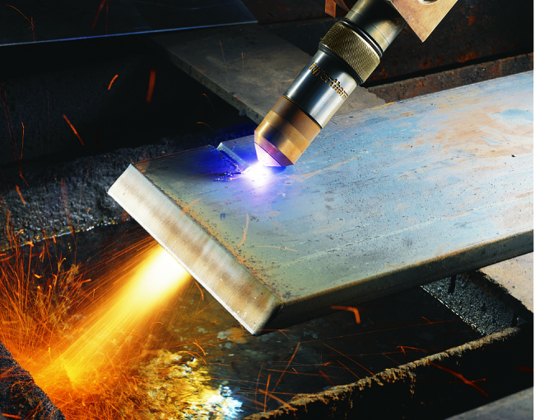
Plasma: A Fourth State of Matter
A plasma torch can be used to cut metal. (credit: “Hypertherm”/Wikimedia Commons)

Slide 14
Mass vs. Weight
Mass is a measure of the amount of matter in an object.
Weight refers to the force that gravity exerts on an object.
An object’s mass is the same on the earth and the moon but its weight is different.

Slide 15
Law of Conservation of Matter
Law of conservation of matter – There is no detectable change in the total quantity of matter present when matter converts from one type to another.
This is true for both chemical and physical changes.

Slide 16
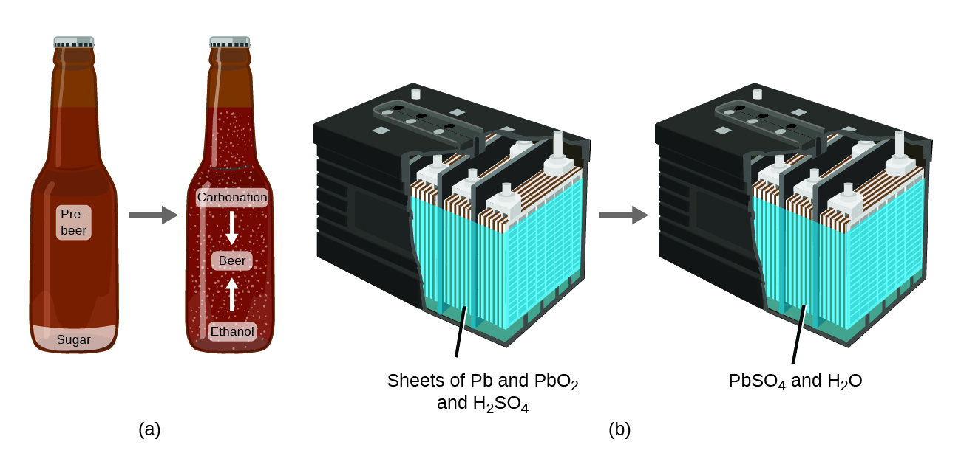
Law of Conservation of Matter
The mass of beer precursor materials is the same as the mass of beer produced: Sugar has become alcohol and carbonation.
The mass of the lead, lead oxide plates, and sulfuric acid that goes into the production of electricity is exactly equal to the mass of lead sulfate and water that is formed.

Slide 17
Elements
An element is a type of pure substance that cannot be broken down into simpler substances by chemical changes.
The known elements are displayed in the periodic table.
  There are more than 100 known elements
  90 of these occur naturally
  Two dozen or so have been created in laboratories

Slide 18
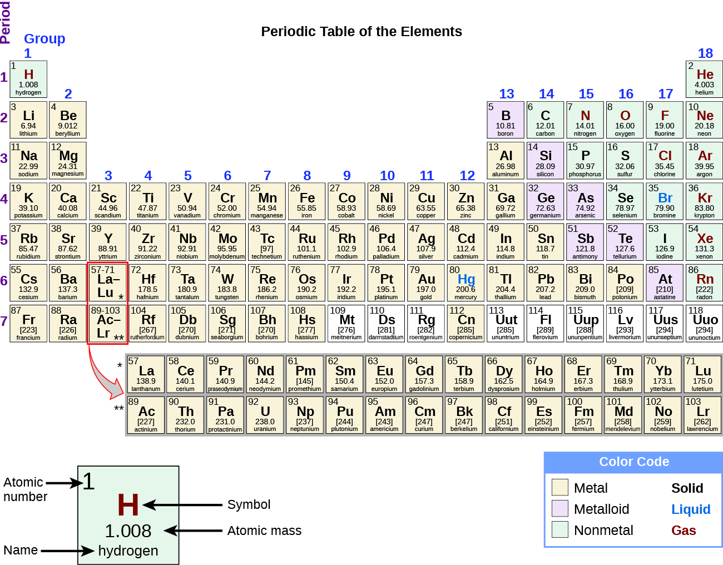

Slide 19
Atoms and Molecules
Atom – The smallest particle of an element that has the properties of that element and can enter into a chemical combination.
  Idea first proposed by Greek philosophers, Leucippus and Democritus, in the 5th century BCE.
  19th century, John Dalton of England supported this hypothesis with quantitative measurements.
Molecule – Consists of two or more atoms connected by strong forces known as chemical bonds.

Slide 20
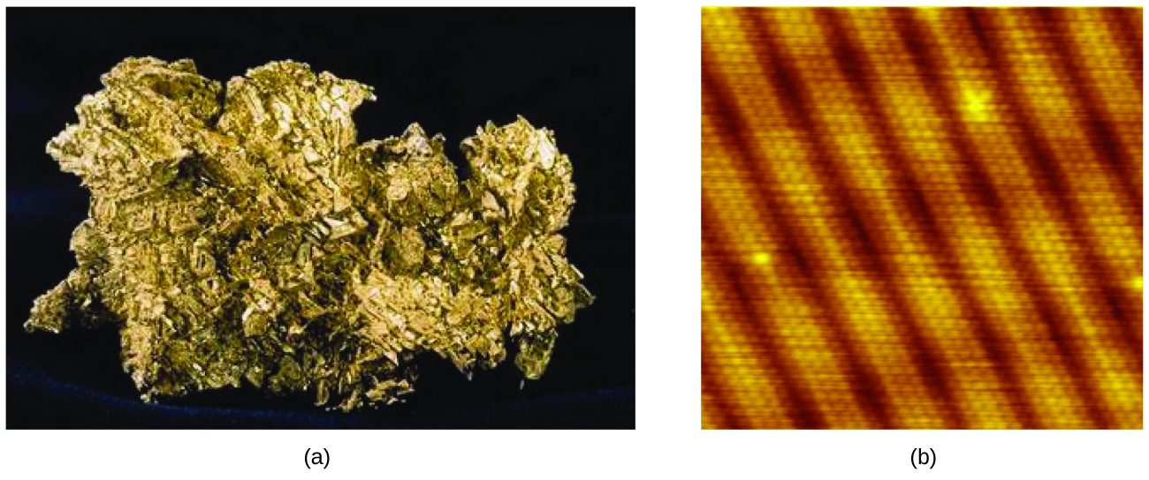
Gold Atoms
This photograph shows a gold nugget.
A scanning-tunneling microscope (STM) can generate views of the surfaces of solids, such as this image of a gold crystal. Each sphere represents one gold atom. (credit a: modification of work by United States Geological Survey; credit b: modification of work by “Erwinrossen”/Wikimedia Commons)

Slide 21
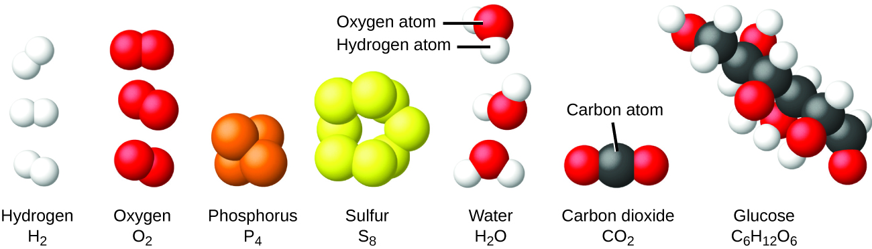
Molecules
Only a few elements exist as individual atoms.
Most elements exist as molecules where two or more atoms of the same element are bonded together.
The elements hydrogen, oxygen, phosphorus, and sulfur form molecules consisting of two or more atoms of the same element.

Slide 22
Molecules
Many molecules consist of two or more atoms of different elements.
Atoms in all types of molecules move as a unit.
The compounds water, carbon dioxide, and glucose consist of combinations of atoms of different elements.

Slide 23
Pure substances and mixtures
Pure substances have constant composition.
  Elements – Pure substance that CANNOT be broken down into simpler substances by chemical changes.
    Consist of one type of element.
    Examples: Gold (Au), Phosphorus (P₄), Oxygen (O₂)
  Compounds – Pure substances that CAN be broken down into simpler substances by chemical changes.
    Consist of two or more types of elements chemically bonded.
    Examples: H₂O, C₆H₁₂O₆, AgCl
    The properties of compounds are different from the uncombined elements making up the compound.

Slide 24
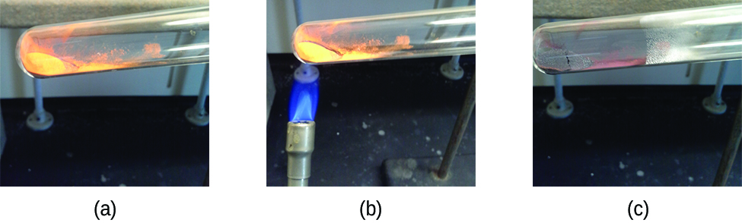
Breaking down a compound
Upon heating, the compound, mercury (II) oxide, is broken down into its elements, mercury and oxygen.
(a) The compound mercury(II) oxide, (b) when heated, (c) decomposes into silvery droplets of liquid mercury and invisible oxygen gas. (credit: modification of work by Paul Flowers)

Slide 25
Pure substances and mixtures
A mixture is composed of two or more types of matter that can be present in varying amounts and can be separated by physical changes.
Evaporation is an example of a physical change.
There are two types of mixtures: homogenous mixtures and heterogeneous mixtures.

Slide 26
Two Type of Mixtures
1) A homogenous mixture exhibits a uniform composition and appears visually the same throughout.
Another name for a homogenous mixture is a solution.
2) A heterogeneous mixture has a composition that varies from point to point.

Slide 27
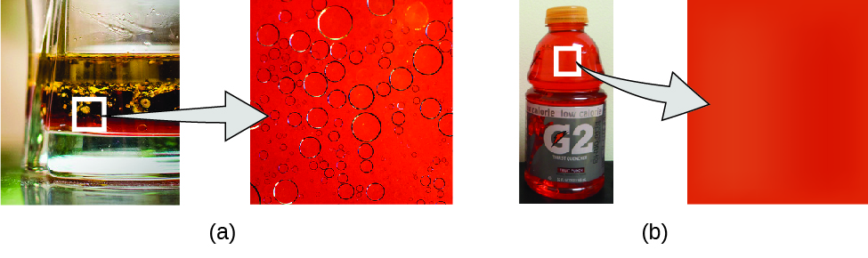
Two Type of Mixtures
Oil and vinegar salad dressing is a heterogeneous mixture because its composition is not uniform throughout.
A commercial sports drink is a homogeneous mixture because its composition is uniform throughout. (credit a “left”: modification of work by John Mayer; credit a “right”: modification of work by Umberto Salvagnin; creditb “left: modification of work by Jeff Bedford)

Slide 28
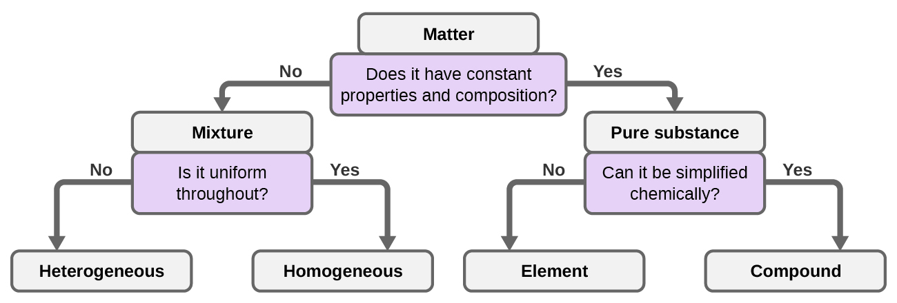
Classifying Matter
Depending on its properties, a given substance can be classified as a homogeneous mixture, a heterogeneous mixture, a compound, or an element.

Slide 29
1.3 Physical and Chemical Properties
The characteristics that enable us to distinguish one substance from another are called properties.
A physical property is a characteristic of matter that is not associated with a change in its chemical composition.
  Examples: density, color, hardness, melting and boiling points, and electrical conductivity.

Slide 30
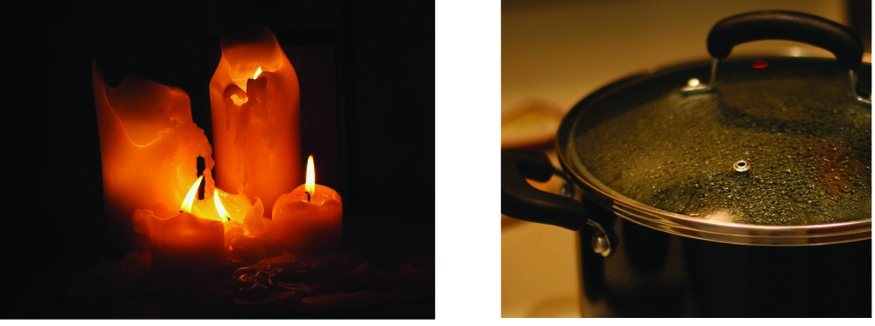
Physical Changes
  A physical change is a change in the state or properties of matter without any accompanying change in its chemical composition.
Wax undergoes a physical change when solid wax is heated and forms liquid wax.
Steam condensing inside a cooking pot is a physical change, as water vapor is changed into liquid water. (credit a: modification of work by “95jb14”/Wikimedia Commons; credit b: modification of work by “mjneuby”/Flickr)

Slide 31
Physical and Chemical Properties
The change of one type of matter into another type (or the inability to change) is a chemical property.
  Examples: flammability, toxicity, acidity, reactivity, and heat of combustion.

Slide 32
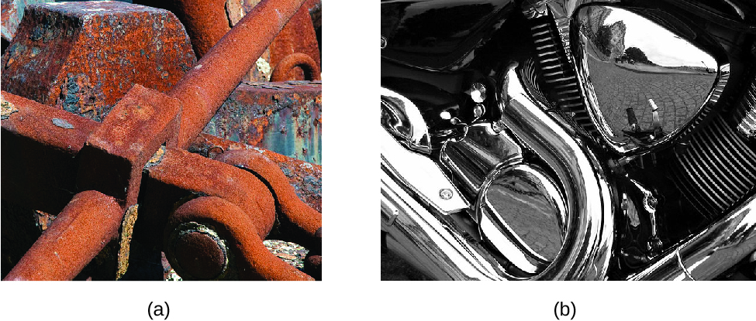
Chemical properties
(a) One of the chemical properties of iron is that it rusts; (b) one of the chemical properties of chromium is that it does not. (credit a: modification of work by Tony Hisgett; credit b: modification of work by “Atoma”/Wikimedia Commons)

Slide 33
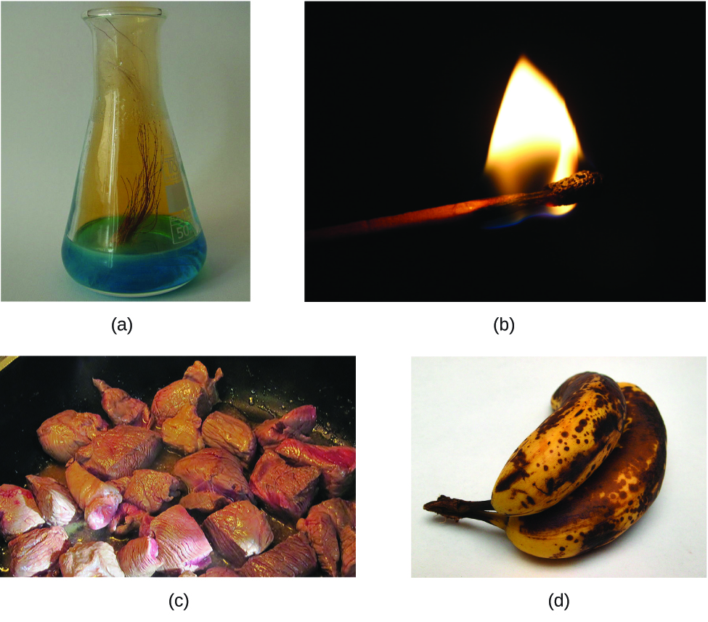
Chemical changes
(a) Copper and nitric acid undergo a chemical change to form copper nitrate and brown, gaseous nitrogen dioxide. (b) During the combustion of a match, cellulose in the match and oxygen from the air undergo a chemical change to form carbon dioxide and water vapor. (c) Cooking red meat causes a number of chemical changes, including the oxidation of iron in myoglobin that results in the familiar red-to-brown color change. (d) A banana turning brown is a chemical change as new, darker (and less tasty) substances form. (credit b: modification of work by Jeff Turner; credit c: modification of work by Gloria Cabada-Leman; credit d: modification of work by Roberto Verzo)

Slide 34
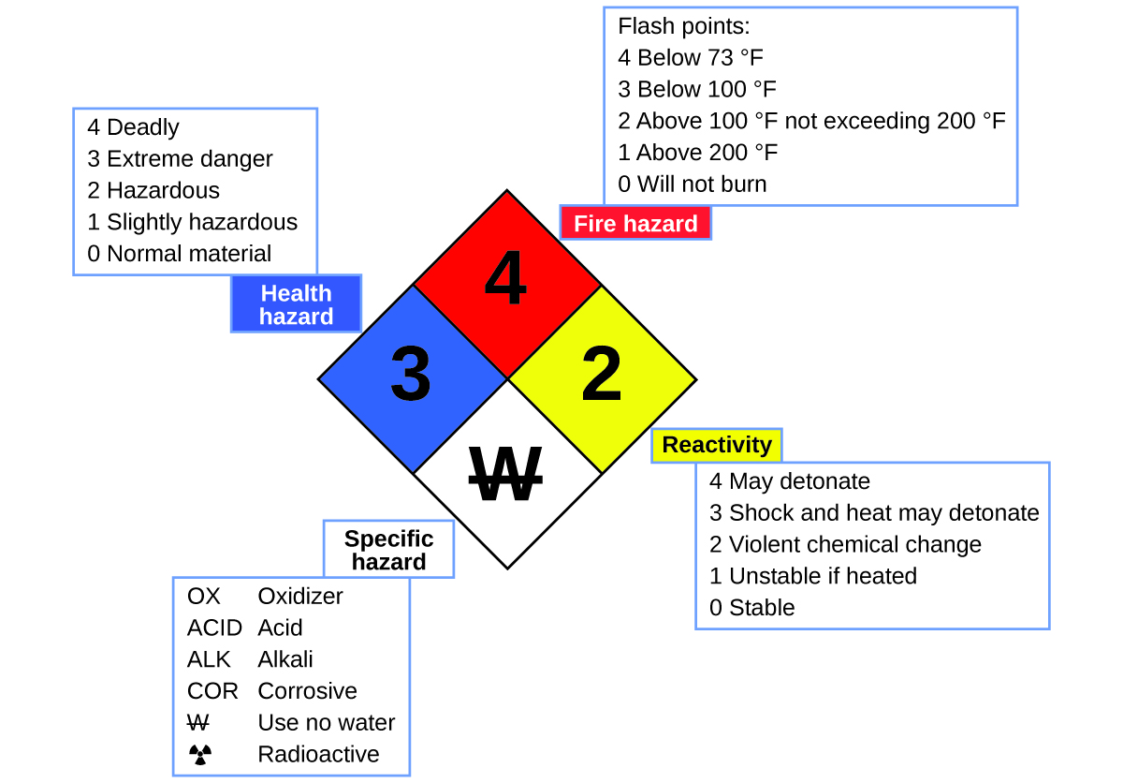
The National Fire Protection Agency (NFPA) hazard diamond summarizes the major hazards of a chemical substance.

Slide 35
Extensive Properties and Intensive Properties
Extensive property
  Depends on the amount of matter present.
  Examples: mass, volume, heat
Intensive property
  Does not depend on the amount of matter present.
  Examples: density, temperature

Slide 36
Periodic table of the elements
The periodic table shows how elements may be grouped according to certain similar properties. Note the background color denotes whether an element is a metal, metalloid, or nonmetal, whereas the element symbol color indicates whether it is a solid, liquid, or gas.

Slide 37
1.4 Measurements
Measurements provide the information that is the basis of most of the hypotheses, theories, and laws in chemistry.
Every Measurement provides three kinds of information:
1) The size or magnitude of the measurement - A Number
2) A standard of comparison for the measurement - A Unit
3) An indication of the uncertainty of the measurement.

Slide 38
Units
Without units a number can be meaningless or confusing!
In chemistry we use an updated version of the metric system known as the International System of Units or SI Units.
  Used since 1964

Slide 39
SI Base Units
Property | Name of Unit | Symbol of Unit
Length | meter | m
Mass | kilogram | kg
Time | second | s
Temperature | kelvin | K
Electric current | ampere | A
Amount of substance | mole | mol
Luminous Intensity | candela | cd

Slide 40
SI Unit Prefixes
Fractional or multiple SI units are named using a prefix and the name of the base unit.
Prefix | Symbol | Factor
femto | f | 10⁻¹⁵
pico | p | 10⁻¹²
nano | n | 10⁻⁹
micro | μ | 10⁻⁶
milli | m | 10⁻³
centi | c | 10⁻²
deci | d | 10⁻¹

Slide 41
SI Unit Prefixes
Fractional or multiple SI units are named using a prefix and the name of the base unit.
Prefix | Symbol | Factor
kilo | k | 10³
mega | M | 10⁶
giga | G | 10⁹
tera | T | 10¹²

Slide 42
Common SI Base Units: Length
The SI unit of length is the meter (m).
The meter was originally intended to be 1/10,000,000 of the distance from the North Pole to the equator.
A meter is now defined as the distance light travels in a vacuum in 1/299,792,458 of one second.
A meter is about three inches longer than a yard.

Slide 43
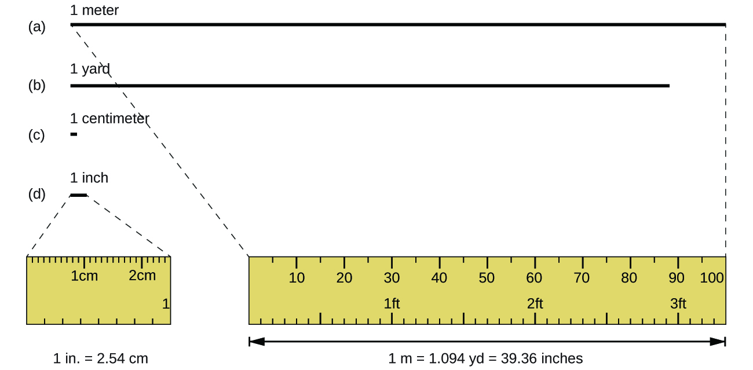
Relative lengths
The relative lengths of 1 m, 1 yd, 1 cm, and 1 in. are shown (not actual size), as well as comparisons of 2.54 cm and 1 in., and of 1 m and 1.094 yd.

Slide 44
Common SI Base Units: Mass
The SI unit of mass is the kilogram (kg).
A kilogram was originally defined as the mass of a liter of water.
It is now defined by a certain cylinder of platinum-iridium alloy, which is kept in France.
One kilogram is about 2.2 pounds (lbs.)

Slide 45
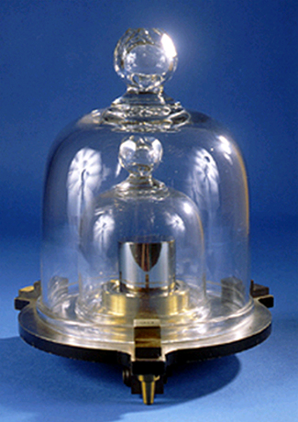
Kilogram
This replica prototype kilogram is housed at the National Institute of Standards and Technology (NIST) in Maryland. (credit: National Institutes of Standards and Technology)

Slide 46
Common SI Base Units: Temperature
The SI unit of temperature is the kelvin (K).
      No degree word nor symbol (°) is used with kelvin.
      The degree Celsius (°C) is also allowed in the SI system.
      Celsius degrees are the same magnitude as those of kelvin, but the two scales place their zeros in different places.
      Water freezes at 273.15 K (0 °C) and boils at 373.15 K (100 °C).

Slide 47
Common SI Base Units: Time
The SI unit of time is the second (s).
      Smaller and larger time intervals can be expressed with the appropriate prefixes.
      Alternatively, hours, days, and years can be used.

Slide 48
Derived SI Units: Volume and Density
We can derive many units from the seven SI base units.
Volume – The measure of the amount of space occupied by an object.
The standard SI unit for volume is the cubic meter (m³), which is derived from the SI base unit of length.
Other units for volume are the liter (L) and milliliter (mL).
1 dm³ = 1 L
1 cm³ = 1 mL

Slide 49
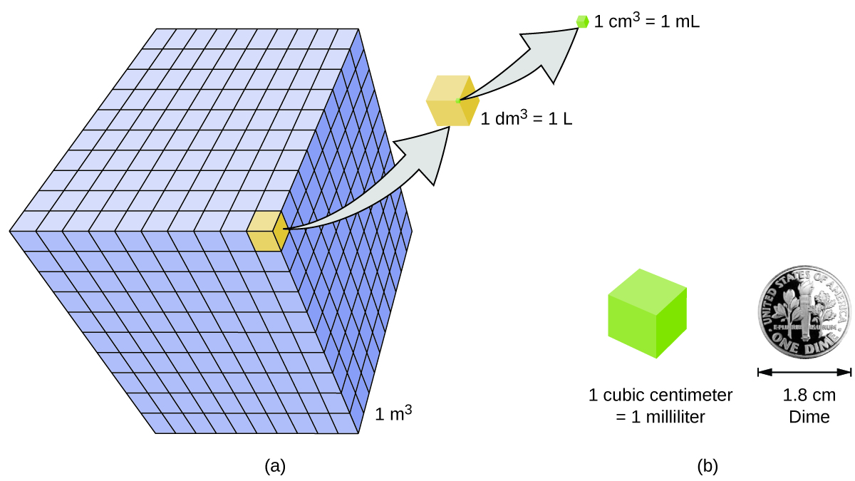
Volume Units
The relative volumes are shown for cubes of 1 m³, 1 dm³ (1 L), and 1 cm³ (1 mL) (not to scale).
The diameter of a dime is compared relative to the edge length of a 1-cm³ (1-mL) cube.

Slide 50
Density
The density of a substance is the ratio of the mass of a sample of the substance to its volume.
The standard SI unit for density is the kilogram per cubic meter (kg/m³).
Commonly used density units based on state of matter:
g/cm³ (solids, liquids)
g/L (gases)

Slide 51
1.5 Measurement Uncertainty, Accuracy, and Precision
Counting is the only type of measurement that is free from uncertainty.
The result of a counting measurement is an example of an exact number.
The numbers for defined quantities are also exact.
  1 foot is exactly 12 inches
  1 inch is exactly 2.54 cm
  1 gram is exactly 0.001 kg

Slide 52
1.5 Measurement Uncertainty, Accuracy, and Precision
Quantities derived from measurements other than counting are uncertain to varying extents.
These numbers are not exact.
There are always practical limitations of the measurement process used.
A measured number must be reported in a way to indicate its uncertainty.
In general, when recording a measurement you are allowed to estimate one uncertain digit.

Slide 53
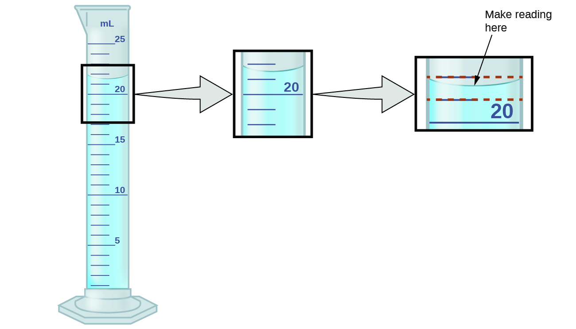
Measurement Uncertainty
To measure the volume of liquid in this graduated cylinder, you must mentally subdivide the distance between the 21 and 22 mL marks into tenths of a milliliter, and then make a reading (estimate) at the bottom of the meniscus.

Slide 54
Significant Figures
On the previous slide, if one recorded the volume in the graduated cylinder to be 21.6 mL.
  2 and 1 are certain digits
  6 is an estimate.
  Someone else might perceive the volume to be 21.5 mL or 21.7mL.
All of the digits in a measurement, including the uncertain last digit, are called significant figures or significant digits.
Frequently we need to know the number of significant figures in a measurement reported by someone else.

Slide 55
Significant Figures
These numbers are always significant.
  Nonzero digits
  Captive zeros
  Trailing zeroes
    When they are to the right of the decimal place.
    When in Scientific Notation.
These numbers are always not significant.
  Leading zeros
  Trailing zeros
    When they are to the left of the decimal place.

Slide 56
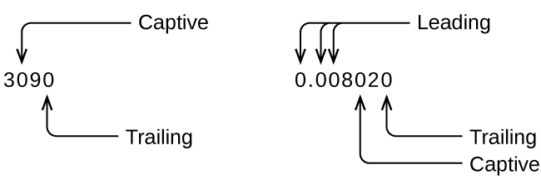

Slide 57
Significant Figures in calculations
Results calculated from measured numbers are at least as uncertain as the measurement itself.
When we add or subtract numbers, we should round the result to the same number of decimal places as the number with the least number of decimal places (the least precise value in terms of addition and subtraction).
When we multiply or divide numbers, we should round the result to the same number of digits as the number with the least number of significant figures (the least precise value in terms of multiplication and division).
If the digit to be dropped (the one immediately to the right of the digit to be retained) is less than 5, we “round down” and leave the retained digit unchanged; if it is more than 5, we “round up” and increase the retained digit by 1; if the dropped digit is 5, we round up or down, whichever yields an even value for the retained digit.

Slide 58
Significant Figures in calculations
The following examples illustrate the application of this rule in rounding a few different numbers to three significant figures:
0.028675 rounds “up” to 0.0287 (the dropped digit, 7, is greater than 5)
18.3384 rounds “down” to 18.3 (the dropped digit, 3, is less than 5)
6.8752 rounds “up” to 6.88 (the dropped digit is 5, and the retained digit is even)
92.85 rounds “down” to 92.8 (the dropped digit is 5, and the retained digit is even)

Slide 59
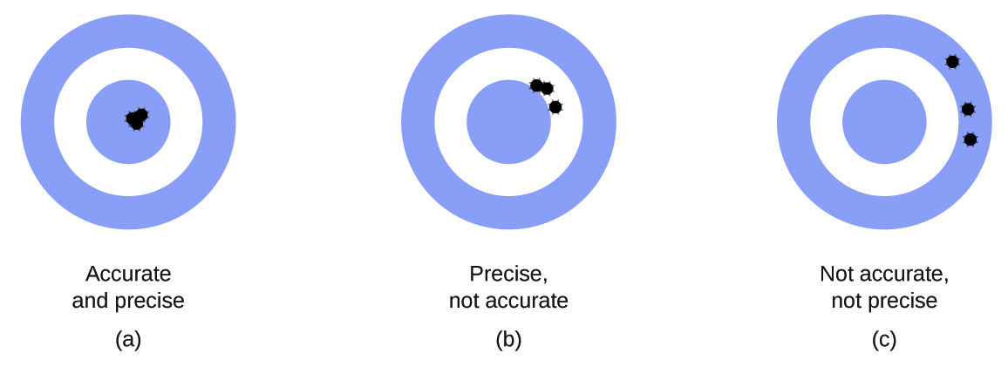
Accuracy and Precision
Measurements are said to be precise if they yield very similar results when repeated in the same manner.
A measurement is considered accurate if it yields a result that is very close to the true or accepted value.

Slide 60
Accuracy and Precision
Volume (mL) of Cough Medicine Delivered by 10-oz (296 mL) Dispensers
Dispenser #1 Dispenser #2 Dispenser #3
283.3 298.3 296.1
284.1 294.2 295.9
283.9 296.0 296.1
284.0 297.8 296.0
284.1 293.9 296.1
Dispenser #1 is precise, but not accurate.
Dispenser #2 is more accurate but less precise.
Dispenser #3 is both accurate and precise.

Slide 61
1.6 Mathematical Treatment of Measurement Results
A quantity of interest may not be easy (or even possible) to measure directly but instead must be calculated from other directly measured properties and appropriate mathematical relationships.
The mathematical approach we will be using is known as dimensional analysis.
Dimensional analysis is based on the premise: the units of quantities must be subjected to the same mathematical operations as their associated numbers.

Slide 62
Conversion factors and dimensional analysis
A conversion factor or unit conversion factor is a ratio of two equivalent quantities expressed with different measurement units.
Example: The lengths 2.54 cm and 1 in. are equivalent.

Slide 63
Common Conversion Factors
Length Volume Mass
1 m = 1.0936 yd 1 L = 1.0567 qt 1 kg = 2.2046 lb
1 in. = 2.54 cm (exact) 1 qt = 0.94635 L 1 lb = 453.59 g
1 km = 0.62137 mi 1 ft3 = 28.317 L 1 (avoirdupois) oz = 28.349 g
1 mi = 1609.3 m 1 tbsp = 14.787 mL 1 (troy) oz = 31.103 g

Slide 64
Conversion factors and dimensional analysis
We must use the form of the conversion factors that results in the original unit canceling out, leaving only the sought unit.
Example: Convert 34 in. to cm.

Slide 65
Conversion of temperature units
Temperature refers to the hotness or coldness of a substance.
Celsius scale
  Water freezes at 0 °C
  Water boils at 100 °C
- Fahrenheit scale
  Water freezes at 32 °F
  Water boils at 212 °F
100 °C covers the same temperature interval as 180 °F.

Slide 66
Conversion of temperature units
The SI unit of temperature is the kelvin (K).
Unlike the Celsius and Fahrenheit scales, the kelvin scale is an absolute temperature scale.
Zero kelvin corresponds to the lowest temperature that can theoretically be achieved.
Kelvin scale
  Water freezes at 273.15 K
  Water boils at 373.15 K
100 °C covers the same temperature interval as 100 K.

Slide 67
Mathematical Relationships Between Temperature Scales
Fahrenheit and Celsius
Kelvin and Celsius

Slide 68
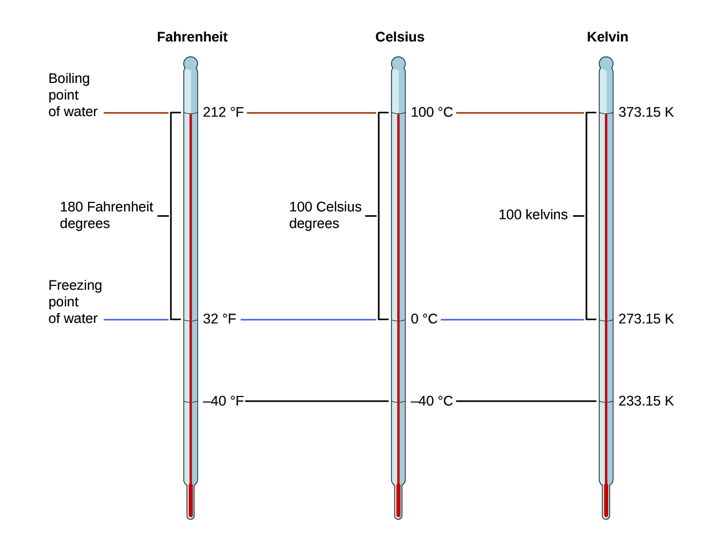
The Fahrenheit, Celsius, and kelvin temperature scales are compared.

Slide 69
This file is copyright 2017, Rice University. All Rights Reserved.

