Slide 1
CHEMISTRY
Chapter 1
Essential Ideas
Slides by Montgomery College licensed under CC BY 4.0.

Slide 2
chapter 1: Essential ideas
1.1 Chemistry in Context
1.2 Phases and Classification of Matter
1.3 Physical and Chemical Properties
1.4 Measurements
1.5 Measurement Uncertainty, Accuracy, and Precision
1.6 Mathematical Treatment of Measurements

Slide 3
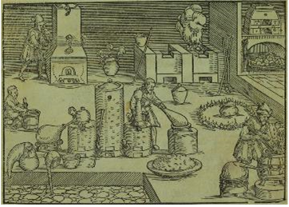
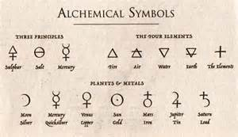
1.1 chemistry in context
Chemists study the composition, properties, and interactions of matter.
Attempts to understand the behavior of matter extend back over 2500 years.
Greeks defined matter in terms of four elements.
Alchemists attempted to transform base (non-precious) metals into noble (precious) metals.
Figure 1.2

Slide 4
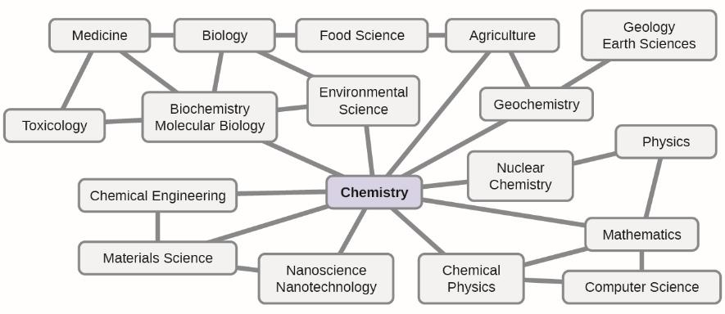
1.1 chemistry in context
Chemistry is related to many disciplines and is often referred to as The Central Science.
Figure 1.3

Slide 5
1.1 chemistry in context
Chemistry is a fundamental part of everyday life.
metabolism of food
synthesis of polymers for clothing and plastics
refining crude oil for gasoline
forensics … and much more!
As you study chemistry, you will discover:
that chemistry is involved in changing the composition of matter.
that these changes can be classified and understood by using basic chemical principles.
that changes in energy accompany changes in matter.

Slide 6
1.1 chemistry in context
Chemistry is a science based upon experimentation and observation.
The Scientific Method is a logical, problem-solving path to discovery used by scientists.
Ask a question or define a problem.
Formulate a hypothesis, a tentative explanation of observations.
Use experiments, calculations, and observations to answer the original question or solve the original problem.
A theory is a well-substantiated, comprehensive, testable explanation of a particular aspect of nature.
The laws of science summarize a vast number of experimental observations and describe/predict some aspect of the natural world.

Slide 7
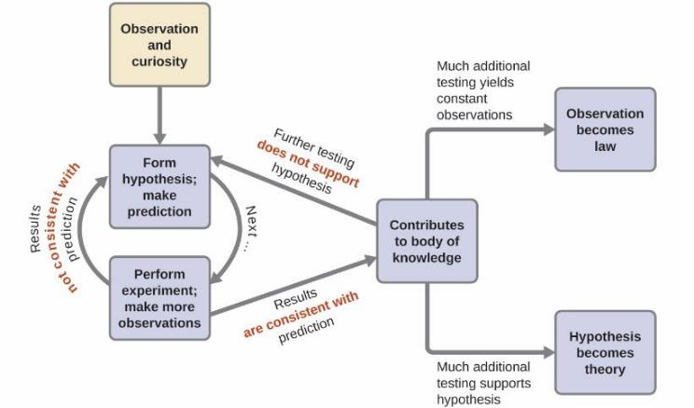
1.1 chemistry in context
The Scientific Method
Figure 1.4

Slide 8
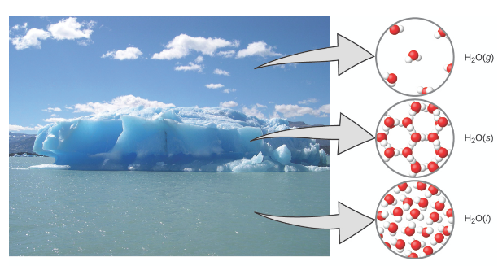
1.1 chemistry in context
The Domains of Chemistry
Figure 1.5
Macroscopic Domain: Moisture in the air, icebergs, and the ocean represent water in the macroscopic domain.
Microscopic Domain: At the molecular level, gas molecules are far apart and disorganized, solid water molecules are close together and organized, and liquid molecules are close together and disorganized.
Symbolic Domain: H₂O is the chemical formula for water, and (g), (s), and (ℓ) symbolize its phases.

Slide 9
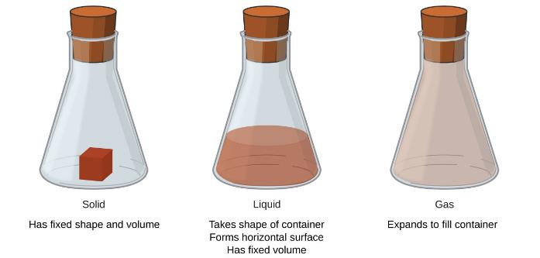
1.2 phases and the classification of matter
Matter is anything that has mass and occupies space.
The common phases or states of matter are:
solid (s) – rigid and posses a definite shape.
liquid (ℓ) – flows and takes the shape of the container.
gas (g) – takes both the shape and volume of the container.

Slide 10
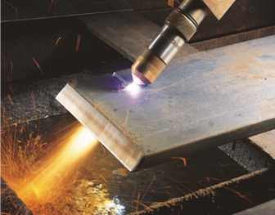
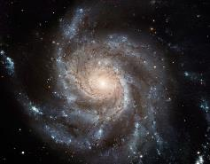
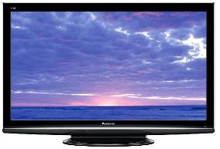
1.2 phases and the classification of matter
Plasma – a fourth state of matter:
from the Greek word for “moldable substance” or “jelly.”
contains an appreciable amount of electrically charged particles.
has properties distinct from ordinary gases.
is found in certain low-pressure or high-temperature environments.
  naturally in stars and lighting
  man-made in some television screens.
OpenStax Video

Slide 11
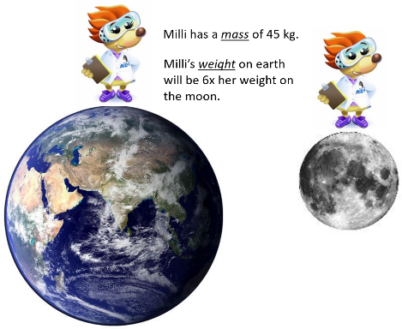
1.2 phases and the classification of matter
Mass vs. Weight
Mass
is a measure of the amount of matter in an object.
Weight
refers to the force that gravity exerts on an object.
An object will have the same mass on both the earth and the moon, but it will have a different weight on each.

Slide 12
1.2 phases and the classification of matter
The Law of Conservation of Matter
During a physical or chemical change, there is no detectable change in the total quantity of matter present. Matter cannot be created or destroyed.
Physical Change
the phase of a substance changes
between solid, liquid, gaseous states
Chemical Change
matter is converted from one type to another
beer brewing: water, yeast, grains, malt, hops, and sugar are converted into beer (water, alcohol, carbonation, and flavoring)

Slide 13
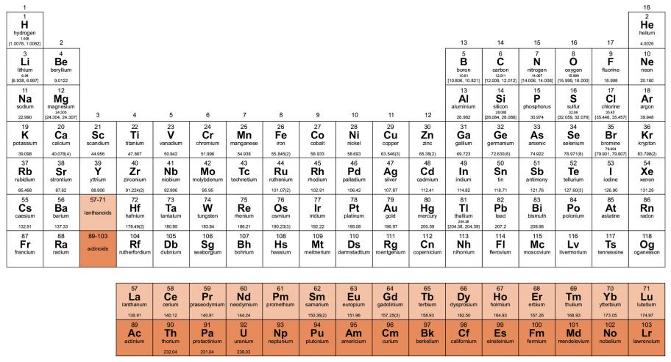
1.2 phases and the classification of matter
Elements
An element is a pure substance that cannot be broken down into simpler substances by chemical changes.
Elements are displayed on the periodic table.
118 elements discovered.
98 occur naturally on earth.
Some elements such as Tc, Pm, At, Fr, Np, Pu, Am, Cm, Bk, and Cf occur only in trace amounts.

Slide 14
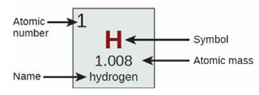
1.2 phases and the classification of matter
The Periodic Table of the Elements

Slide 15
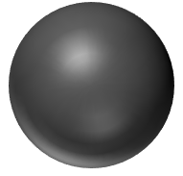
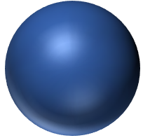
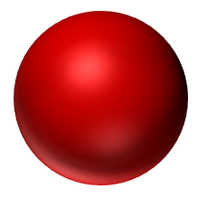
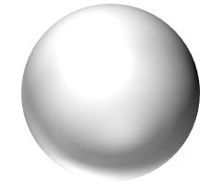
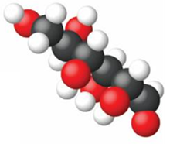


1.2 phases and the classification of matter
Atoms and Molecules
Atoms
Atoms are the smallest particles of an element that have the properties of that element.
carbon
nitrogen
oxygen
hydrogen
Molecules
Molecules are two or more atoms joined together by forces known as chemical bonds.
The atoms in a molecule are bound together and the move around as a unit.
water
molecule
oxygen
molecule
glucose
molecule

Slide 16
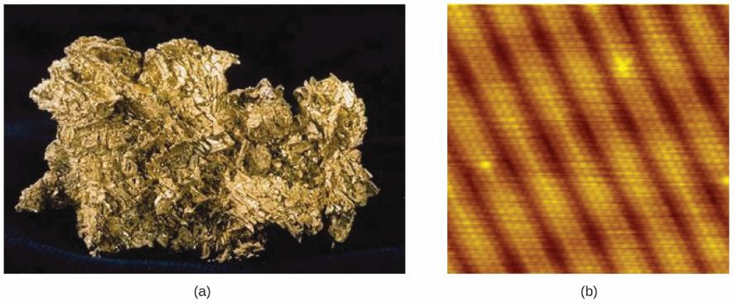
1.2 phases and the classification of matter
Gold
The first photograph shows a gold nugget.
The second image is from a scanning-tunneling microscope (STM) and shows the surface of a gold crystal. Each sphere represents an individual gold atom.

Slide 17
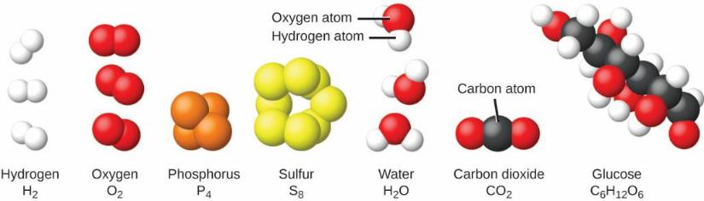
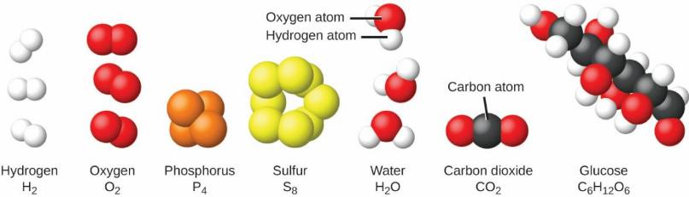
1.2 phases and the classification of matter
Elements and Matter
Elements - Atoms
Elements consist of a single type of atom.
Only six elements exist as single atoms in nature.
  He, Ne, Ar, Xe, Kr, and Rn
Elements - Molecules
Most elements exist as molecules with two or more atoms of that element are bound together.

Slide 18
1.2 phases and the classification of matter
From Atoms to Molecules
Molecules
Some molecules are elements; they consist of one type of atom.
Most molecules consist of atoms of different elements bound together. These molecules are known as compounds.
A water molecule is a compound that consists of two hydrogen atoms and one oxygen atom held together by chemical bonds.
A glucose molecule is made from six carbon atoms, twelve hydrogen atoms, and six oxygen atoms bound together in a specific arrangement.
water
molecule
H₂O
glucose
molecule
C₆H₁₂O₆

Slide 19
1.2 phases and the classification of matter
From Atoms to Molecules
Chemical Compounds – The Opiates
Compare the arrangements of atoms and the shapes of some opiates.
A small difference in the arrangement of atoms can have enormous consequences.
Morphine
Heroin
Codeine
Thebaine
A pain reliever but highly addictive.
Pain reliever like morphine but even more addictive. Illegal substance.
Pain reliever with one tenth the potency of morphine.
Similar to codeine but causes convulsions if ingested.

Slide 20
1.2 phases and the classification of matter
Classifying Matter
Pure Substances
Pure substances have constant composition.
Pure substances that are elements:
  cannot be broken down into simpler substances chemically.
  gold (Au), oxygen (O₂), iron (Fe) for example.
Pure substances that are compounds:
  can be broken down into simpler substances or into its elements by chemical changes.
  H₂O can be broken down into H₂ and O₂.
  have physical properties that are different from the physical properties of its elements.

Slide 21
1.2 phases and the classification of matter
Classifying Matter
Mixtures
A mixture is a combination of substances.
  two or more compounds, two or more elements, or a combination
  can be separated by physical methods.
A heterogeneous mixture has composition that varies from point to point.
A homogeneous mixture, also known as a solution, has uniform composition throughout.

Slide 22
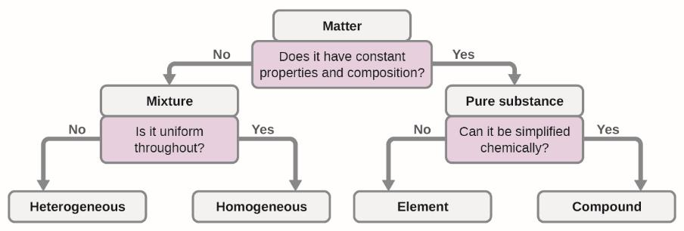
1.2 phases and the classification of matter
Classifying Matter

Slide 23
1.3 physical and chemical properties
Properties of Matter
In order to distinguish one substance from another, properties of matter, both physical and chemical, can be used.
Physical Properties
Physical properties are characteristics of matter are not associated with a change in chemical composition.
density, color, hardness, conductivity, viscosity, etc.
Chemical Properties
The ability to change from one type of matter into another type of matter arises from chemical properties.
flammability, reactivity, acidity, etc.

Slide 24

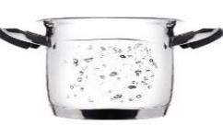
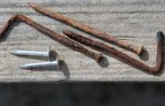
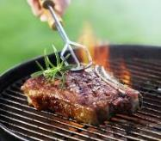
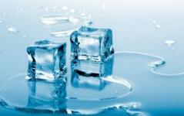
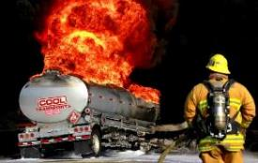



1.3 physical and chemical properties
Physical vs. Chemical Changes

Slide 25
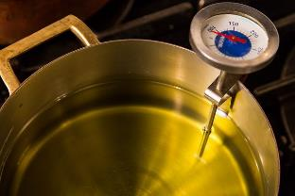
1.3 physical and chemical properties
Intensive vs. Extensive Properties
Intensive Properties
do not depend on the amount of substance present.
examples: density, temperature
Extensive
depend on the amount of substance present.
examples: mass, volume, heat
A drop of cooking oil and a pot of cooking oil may have the same temperature (intensive) but the drop will not burn you as badly as an entire pot would (extensive) because the pot contains more heat.

Slide 26
What is chemistry?
The study of matter.
What is matter?
Something with mass and volume.
How do you talk about matter?
Describe mass and volume.
Measurements

Slide 27
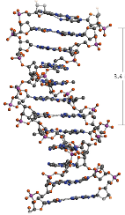
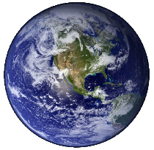
1.4 measurements
Measurements provide the information that is the basis of most hypotheses, theories, and laws in science.
Measurements
NUMBER – size or magnitude
UNITS – a standard for comparison
  A measurement without units is meaningless!
The diameter of the earth is 12,760,000 meters.
The diameter of DNA 23 nanometers.

Slide 28
1.4 measurements
International System of Units (SI Units)
have been in use by US National Institute of Standards and Technology (NIST) since 1964.
Property | Unit | Symbol
Length | meter | m
Mass | kilogram | kg
Time | second | s
Temperature | Kelvin or Celsius | K or °C
Amount | mole | mol
Current | ampere | amp

Slide 29
1.4 measurements
International System of Units (SI Units)
Fractional or multiple SI units are named by using a prefix and the name of the base unit.
Prefix | Symbol | Factor
femto- | f | 10⁻¹⁵
pico- | p | 10⁻¹²
nano- | n | 10⁻⁹
micro- | μ | 10⁻⁶
milli- | m | 10⁻³
centi- | c | 10⁻²
deci- | d | 10⁻¹
kilo- | k | 10⁺³
giga- | G | 10⁺⁹
tera- | T | 10⁺¹²
1 cm = 10⁻² m
or
100 cm = 1 m
1 mL = 10⁻³ L
or
1000 mL = 1 L
1 μg = 10⁻⁶ g
or
1,000,000 μg = 1 g

Slide 30
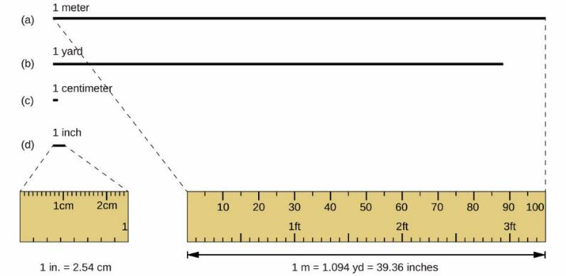
1.4 measurements
Common SI Base Units in Chemistry
Length – meter (m)
Lengths are approximate and relative, not actually to scale.

Slide 31
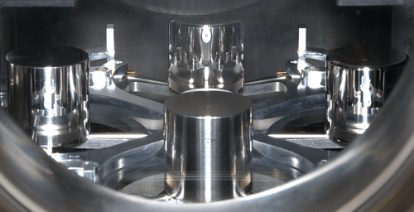
1.4 measurements
Common SI Base Units in Chemistry
Mass – kilogram (kg)
Copies of the International Prototype Kilogram kept at NIST in Gaithersburg, MD. The fourth (K4, back) and twentieth (K20, front) copies of the are shown along with a few other copies. The original is kept in an French vault.

Slide 32
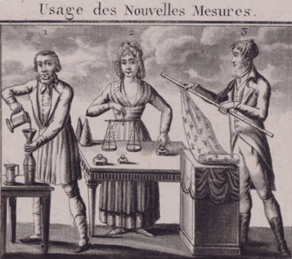
The History of the Kilogram
Near the end of the 1700s, King Louis XVI of France ordered a new system of measurement in an effort to crack down on rampant cheating taking place under the existing systems. The king's commission recommended what would become the decimal metric system, and for mass measurements proposed a new unit called a grave which was defined as the mass of a liter of water at the ice point.
Then came the French Revolution. The new Republic adopted the idea of the metric system with a few changes. Instead of a grave, the Republic picked a new standard – the gramme, whose definition was the absolute weight of 1 cm³ of water at 4 °C.
However, a 1-gram artifact made of water – not much bigger than a pea – was impractical for commercial use. So they chose something more grave-like instead, a solid metal artifact a thousand times more massive than a gram: a kilogram.
On June 22, 1799, the Republic adopted the new mass artifact, forged from platinum and dubbed the "kilogram of the archives" after the building in which it was stored. This new kilogram reigned as the mass standard in France for almost a hundred years.
See the NIST website for more fun facts about standards!
https://www.nist.gov/pml/productsservices/redefining-kilogram
From the National Institute of Standards and Technology

Slide 33
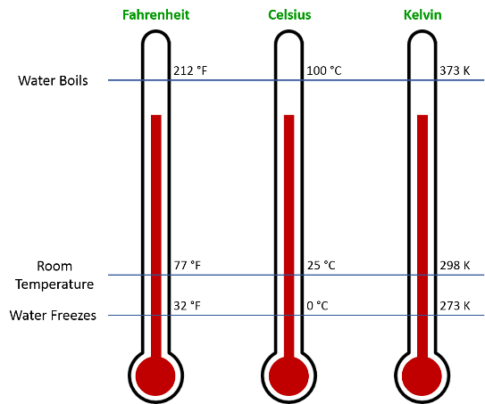
1.4 measurements
Common SI Base Units in Chemistry
Temperature – Kelvin (K) or Celsius (°C)
  note that temperatures in K do not have a degree symbol
°F = °C(9/5) + 32
°C = (°F – 32)(5/9)
K = °C + 273.15

Slide 34
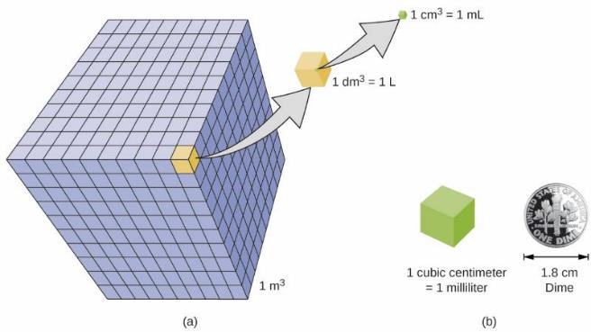
1.4 measurements
Derived SI Units: Volume
Volume
  the amount of space occupied by an object
  SI unit is m³, derived from base unit of meters
  other common units for volume are liter (L) and milliliter (mL)

Slide 35
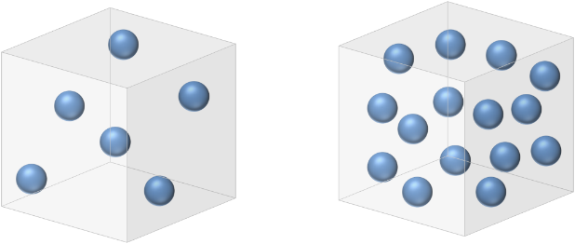




1.4 measurements
Derived SI Units: Density
Density
  the ratio of the mass of sample to its volume
  mass per unit volume
  SI units: density in chemistry usually:
$$\frac{kg}{m^{3}}$$
$$\frac{g}{{cm}^{3}}$$
$$\frac{g}{mL}$$
$$\frac{g}{L}$$

Slide 36
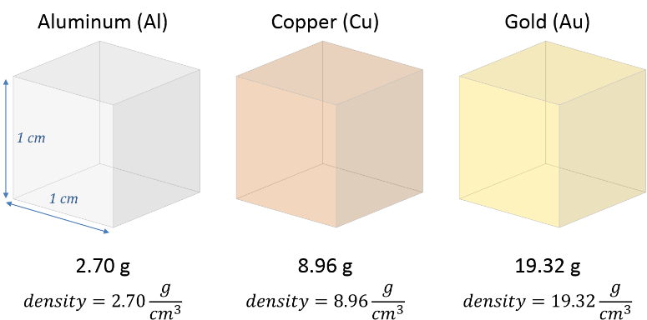
1.4 measurements
Derived SI Units: Density
Density
  Each block has a volume of 1 cm³.
  How would it feel to hold each of these blocks in your hand?

Slide 37
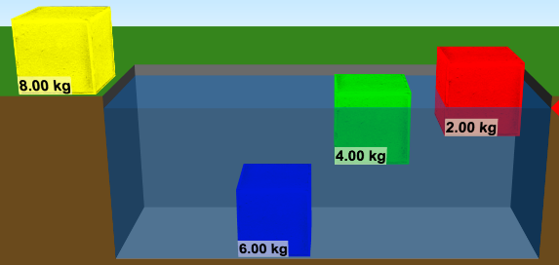

1.4 measurements
Density Experiment #1
All the blocks shown have the same volume. What will happen to the yellow block when it is added to the water? Explain your answer.
(A) It will sink.
(B) It will float
(C) There is not enough information to predict.

Slide 38
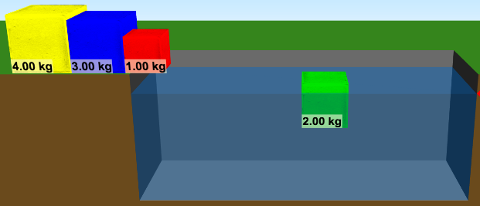
1.4 measurements
Density Experiment #2
All the blocks shown have the same density. What will happen to the blue, yellow, and red blocks?
(A) They will sink.
(B) They will float
(C) Some will sink and others will float.
Try the experiment on your own:
https://phet.colorado.edu/en/simulation/legacy/density

Slide 39
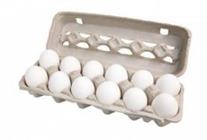
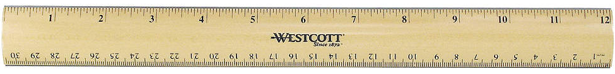
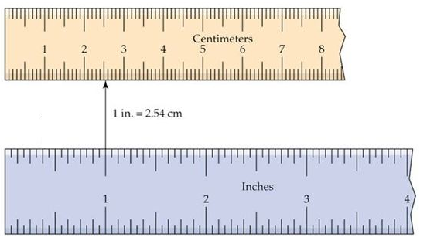
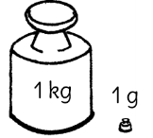
1.5 uncertainty, accuracy, and precision
Exact Numbers
Counting is the only type of measurement that is free from uncertainty.
  A count is an exact number.
    12 eggs
    3 cars
    20 atoms
Defined quantities are exact.
  1 foot is exactly 12 inches.
  1 inch is exactly 2.54 centimeters.
  1 gram is exactly 0.001 kg.

Slide 40
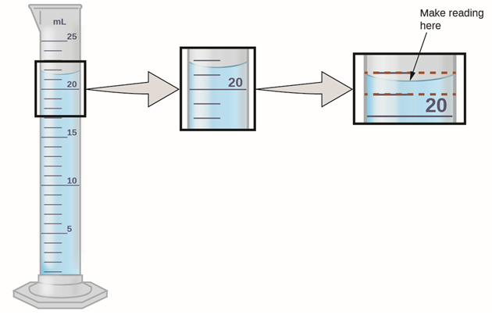
1.5 uncertainty, accuracy, and precision
Measurements and Uncertainty
Measurements are not exact.
  What are the practical limitations of the process?
When making a measurement, estimate one uncertain digit.
22 mL
21 mL
The meniscus is between 21 mL and 22 mL.
The next digit must be estimated.
What should the final measurement be?

Slide 41
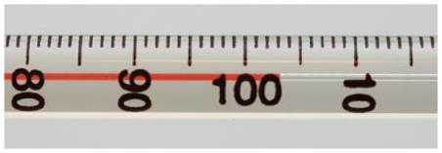
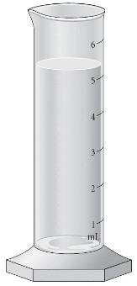
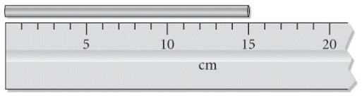
1.5 uncertainty, accuracy, and precision
Measurements and Uncertainty

Slide 42
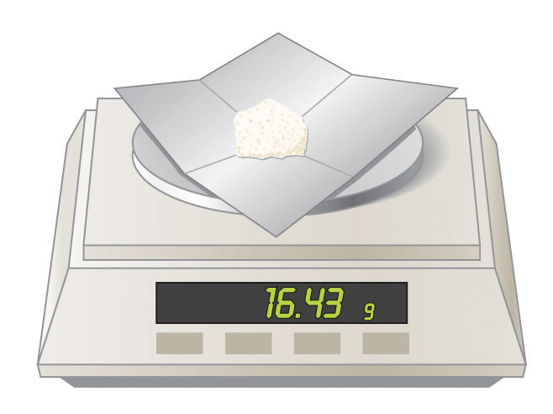

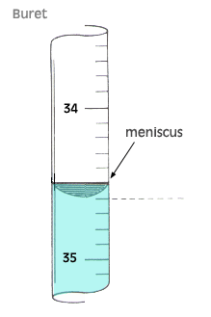
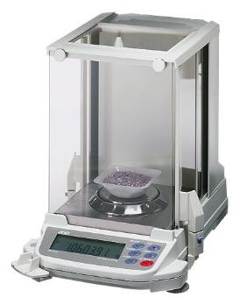
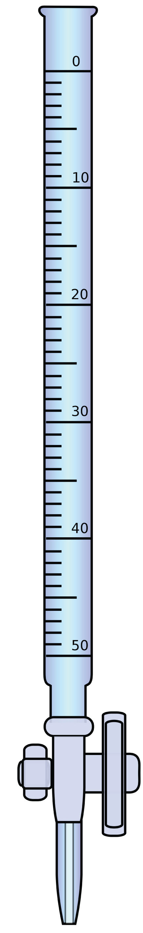

1.5 uncertainty, accuracy, and precision
Measurements and Uncertainty
Read a buret
downward.

Slide 43
1.5 uncertainty, accuracy, and precision
Significant Figures
all nonzero digits
captive zeros
trailing zeros after a decimal point
1267
four significant figures
captive zero
3085
four significant figures
leading zeros (not significant)
0.008020
four significant figures

Slide 44
1.5 uncertainty, accuracy, and precision
Significant Figures
trailing zeros not after a decimal?
avoid ambiguity by using scientific notation
How many significant figures?
ambiguous
3200
significant
3.2 x 10³
3.20 x 10³
two significant figures
three significant figures
0.082057
8.3145 x 10⁻³
96485
6.022 x 10²³

Slide 45
1.5 uncertainty, accuracy, and precision
Significant Figures in Calculations
Results calculated from measured numbers are at least as uncertain as the measurement used.
Addition/Subtraction
Multiplication/Division
Result depends upon the value with the least number of decimal places.
Result depends upon the value with the least number of significant digits.
13.4637 + 1.62 = 15.08
13.4637 x 1.62 = 21.8
four significant figures
three significant figures
13.4637
+ 1.62
15.0837
0.082057 x 298.15 = 24.465
five significant figures
limited to two decimal places

Slide 46
1.5 uncertainty, accuracy, and precision
Rounding
After the number of required significant figures is determined, the calculated value must be rounded properly.
dropped digit > 5 ⇨ round up
dropped digit < 5 ⇨ round down
dropped digit = 5, keep retained digit even ⇨ must round up
dropped digit = 5, keep retained digit even ⇨ must round down
0.028673 to three sig figs ⇨ 0.0287
18.3384 to three sig figs ⇨ 18.3
6.8752 to three sig figs ⇨ 6.88
92.05 to three sig figs ⇨ 92.0
Zero is an even number.

Slide 47

1.5 uncertainty, accuracy, and precision
Example Calculation: Density
A 69.658 g piece of rebar is submerged in water as shown. Determine the density of the rebar.
Remember to consider the number of significant figures in the measurements and calculation.
Example 1.7

Slide 48

1.5 uncertainty, accuracy, and precision
Accuracy and Precision
Accurate measurements yield results close to the true or accepted value.
Precise measurements yield similar results when repeated.

Slide 49


1.5 uncertainty, accuracy, and precision
Accuracy and Precision
Accurate: Actual
Measured values are close to the actual/true value.
Precise: Reproducible
Repeated measurements are close together (clustered).
A scientist wants results that are both accurate and precise.
Which one shows the best experimental results for determining the value X_{c}?

Slide 50


1.5 uncertainty, accuracy, and precision
Accuracy and Precision
Describe each component of the following sets in terms of accuracy and precision.

Slide 51

1.5 uncertainty, accuracy, and precision
Accuracy and Precision
Describe the student melting point data in terms of accuracy and precision.

Slide 52






1.6 dimensional analysis
The Mathematical Treatment of Measurement Results
The units associated with measurements must be subjected to the same mathematical treatment as the numerical values of those measurements.
A conversion factor is a ratio of two equivalent quantities expressed with different measurement units.
$$\frac{1 in}{2.54 cm}$$
$$\frac{2.54 cm}{1 in}$$
One inch is equal to 2.54 centimeters.
or
$$\frac{1 L}{1000 mL}$$
$$\frac{1000 mL}{1 L}$$
One liter is equal to 1000 milliliters.
or
$$\frac{1 lb}{453.59 g}$$
$$\frac{453.59 g}{1 lb}$$
One pound is equal to 453.59 grams.
or

Slide 53


1.6 dimensional analysis
The Mathematical Treatment of Measurement Results
In a calculation, arrange the conversion factor so that the original units cancel out and the desired units remain.
A basketball player’s vertical jump is 34 inches. What is the player’s vertical jump in centimeters?
Know: 34 inch jump
Want: centimeters for jump
1 in = 2.54 cm
$$\frac{2.54 cm}{1 in}$$
$$34 in × \frac{2.54 cm}{1 in} =86 cm$$
The inches cancel and units of centimeters are left.
two
significant
figures
two
significant
figures
exact value

Slide 54
1.6 dimensional analysis
Note: Exact numbers/conversions do not limit your significant figures.
Example #1
How many days does it take for one million seconds to pass?
How many years?
How many days does it take for one billion seconds to pass?
How many years?
Assume that one year is exactly 365 days, and one day is exactly 24 hours.
Know: one million seconds
Want: # days and # years
one billion seconds
Answer: One million seconds is about 12 days.
One billion seconds is about 32 years.

Slide 55






1.6 dimensional analysis
Note: Exact numbers/conversions do not limit your significant figures.
Example #2
A world record for the men’s marathon was set by Dennis Kimetto of Kenya on September 28, 2014. He ran the race in 2:02:57. The official marathon length is 26.219 miles. What speed, in meters per second, did Dennis Kimetto run for that marathon? What was his speed in miles per hour?
Know: 2:02:57
Want: speed in meters/second and miles/hour
26.219 miles
$$2:02:57=2 hr+2\min{+ 57 s=7377 s}$$
$$\frac{2.54 cm}{1 in}$$
1 in = 2.54 cm
$$Speed=\frac{26.219 mi}{7377 s}×\frac{5280 ft}{1 mi}=18.7659 \frac{ft}{s}$$
$$\frac{5280 ft}{1 mi}$$
1 mi = 5280 ft
$$\frac{60 min}{1 hr}$$
1 hr = 60 min
$$18.7659 \frac{ft}{s}×\frac{12 in}{1 ft}×\frac{2.54 cm}{ 1 in}×\frac{1 m}{100 cm}=5.720 \frac{m}{s}$$
$$\frac{12 in}{1 ft}$$
1 ft = 12 in
You convert to miles/hour.
Answer: 12.80 mi/hr.

Slide 56





1.6 dimensional analysis
Example #3
The surface area of one hexagonal gold mirror on NASA’s James Webb Space Telescope is 12.01 ft². What is the area in meters squared?
$$\frac{12 in}{1 ft}$$
and
$$\frac{2.54 cm}{1 in}$$
and
$$\frac{100 cm}{1 m}$$
nasa.gov
$$12.01 {ft}^{2}=12.01 ft∙ft ×\frac{12 in}{1 ft}×\frac{12 in}{1 ft}=1729.44 {in}^{2}$$
Keep extra digits until the end of the calculation to avoid rounding errors.
$$1729.44 {in}^{2}=1729.44 in∙in ×\frac{2.54 cm}{1 in}×\frac{2.54 cm}{1 in}=11576.55 {cm}^{2}$$
$$11576.55 {cm}^{2}=11576.55 cm∙cm ×\frac{1 m}{100 cm}×\frac{1 m}{100 cm}=1.116 m^{2}$$
12.01 has four significant figures, so the answer must have four significant figures.
Note: Exact numbers/conversions do not limit your significant figures.

Slide 57

1.6 dimensional analysis
Example #4
The volume of one of the DNA crystals shown in the photograph is 0.144 nm³. What is the volume in milliliters?
P. Takahara, MIT
Answer: 1.44 x 10⁻²² mL

Slide 58


1.6 dimensional analysis
Example #5
A factory has a solid copper sphere that needs to be drawn into a wire. The mass of the copper sphere is 76.5 kg. The copper needs to be drawn into a wire with a diameter of 9.50 mm. What length of wire, in meters, can be produced? Copper has a density of 8.96 g/cm³.
amazon.com
homedepot.com
Answer: 1.20 x 10² m

Slide 59


1.6 dimensional analysis
Example #5
Golden eagles in the alps hunt from high altitudes. While hunting, eagles can reach diving speeds of up to 322 km/h. Only peregrine falcons can dive faster – at speeds of up to 389 km/h. How fast do each of these birds dive in miles per hour? In meters per second?
Golden Eagle
Peregrine Falcon
BBC America
BBC America
Answer: 2.00 x 10² mi/hr
88.9 m/s
Answer: 2.42 x 10² mi/hr
108 m/s

Slide 60
end of chapter problems – chapter 1
Classification of Matter: #17, 19, 27, 29
Significant Figures: #45, 47, 49, 51, 53, 55
Dimensional Analysis: #41, 59, 67, 69, 77, 81, 89, 91
For detailed solutions to these problems, go to the OpenStax Chemistry website and download the Student Solution Guide.

Slide 61
videos – chapter 1
Basic Terminology (not an MC video - posted on YouTube by Michael van Biezen)
https://youtu.be/5sWyWpO3mN4?list=PLX2gX-ftPVXU4aVNCE9HiVvwxa2MkEj5C
Significant Figures
http://www.youtube.com/watch?v=vXuvbRA6Uz8
http://screencast.com/t/rOVDYL26n30
Metric Prefixes
http://screencast.com/t/UkTuv5uei
Conversion Factors & Dimensional Analysis
http://www.youtube.com/watch?v=IezBwWosNzU
http://screencast.com/t/VEHu2NXEpK (metric conversions)
http://screencast.com/t/C4FkmDZF6r
http://www.youtube.com/watch?v=v5Cc4w7rsf8 (density as a conversion factor)
*All videos were created by MC Chemistry faculty unless otherwise indicated.

Slide 62
simulations – chapter 1
Density
https://phet.colorado.edu/en/simulation/legacy/density

