Slide 1
CHEMISTRY
Chapter 2
Atoms, Molecules, and Ions
Slides by Montgomery College licensed under CC BY 4.0.

Slide 2
chapter 2: atoms, molecules, and ions
2.1 Early Ideas in Atomic Theory
2.2 Evolution of Atomic Theory
2.3 Atomic Structure and Symbolism
2.4 Chemical Formulas
2.5 The Periodic Table
2.6 Molecular and Ionic Compounds
2.7 Chemical Nomenclature

Slide 3
2.1 early ideas in atomic theory
Atoms were first proposed by Greek philosophers.
Matter is composed of small finite particles called atomos.
The term atomos is derived from the Greek word for indivisible.
Elements were first proposed by Aristotle.
The “elements” were fire, earth, air, and water.

Slide 4
2.1 early ideas in atomic theory
John Dalton developed modern atomic theory in 1807.
Matter is composed of exceedingly small particles called atoms. An atom is the smallest unit of an element that can participate in chemical change.
An element consists of only one type of atom, which has a mass that is characteristic of the element and is the same for all atoms of that element.
Atoms of one element differ in properties from atoms of all other elements.

Slide 5
2.1 early ideas in atomic theory
A compound consists of atoms of two or more elements combined in a small, whole number ratio. In a given compound, the numbers of atoms are always present in the same ratio.
Atoms are neither created nor destroyed during a chemical change, but instead are rearranged to yield different substances. This is the law of conservation of matter.

Slide 6
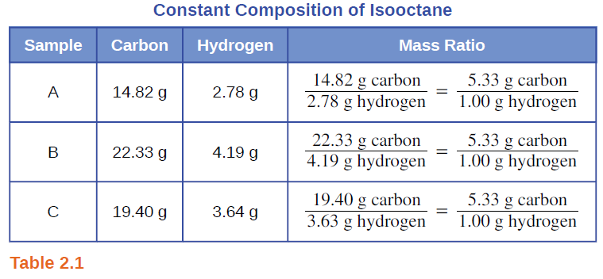
2.1 early ideas in atomic theory
The Law of Definite Proportions
The Law of Constant Composition
All samples of a pure compound contain the same elements in the same proportion by mass.
Is it true that all samples of a particular mass ratio are the same compound?

Slide 7
2.2 evolution of atomic theory
Can atoms be broken down into smaller particles?
J.J. Thomson (1897)
used a cathode ray tube to detect very light particles - electrons
R.A. Millikan (1909)
electrically charged oil droplets in an electric field
determined the charge on a single electron
Rutherford (1913)
bombarded gold foil with fast-moving particles
some were deflected but most were not
atoms are mostly empty space but have a small positively charged nucleus

Slide 8
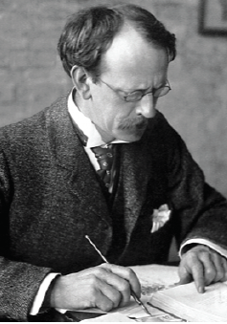
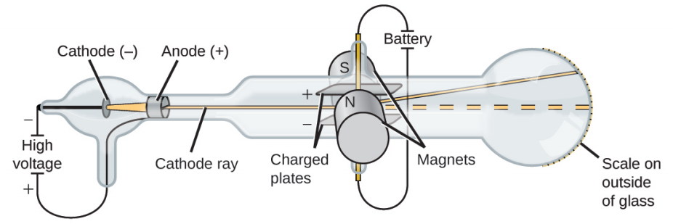
2.2 evolution of atomic theory
J.J. Thomson (1897)
A cathode ray is deflected toward a positive charge and away from a negative charge.
The cathode ray was made up of “electric ions” and calculated the charge/mass ratio of an electron to be 1.759 x 10¹¹ C/kg.

Slide 9
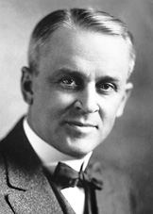
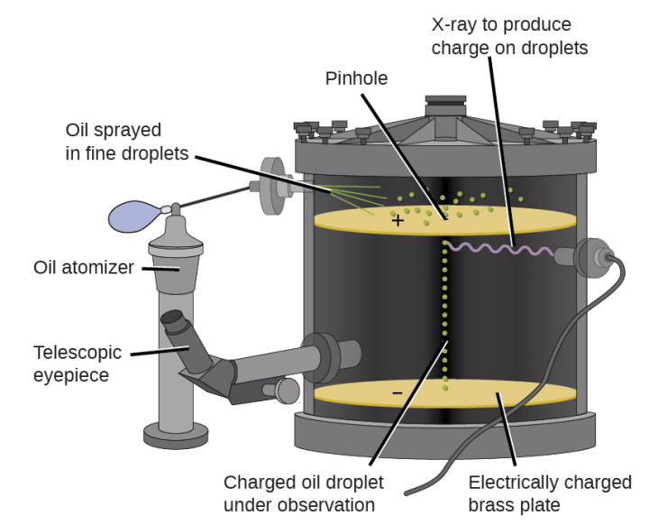
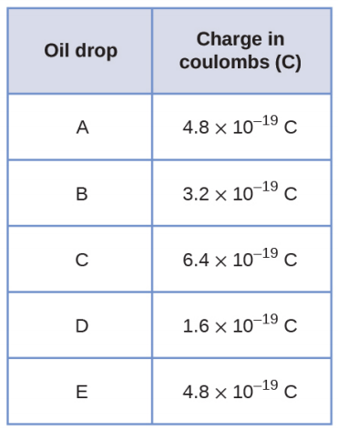
2.2 evolution of atomic theory
Robert A. Millikan (1909)
Electrically charged oil droplets in an electric field were studied.
The charge observed for each oil droplet was a multiple of 1.6 x 10⁻¹⁹ C.
This value is a fundamental charge – the charge on an electron.
Combined with Thomson’s results, the mass of an electron was determined to be 9.107 x 10⁻³¹ kg.

Slide 10
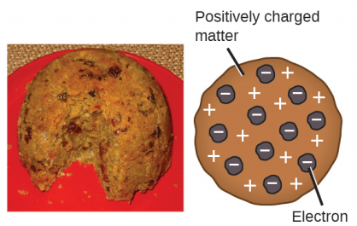
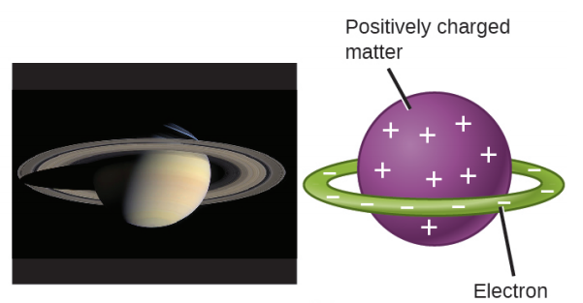
2.2 evolution of atomic theory
Early Models: Where are the particles located?
Thomson and Millikan determined the charge and mass of a negative subatomic particle called an electron.
The atom must contain positive charges to balance out these negatively charged electrons.
Plum Pudding Model
Saturnian Model
Positive charges and electrons are distributed throughout the atom.
Negative charges cannot penetrate into positively charged matter, so the electrons circle around the atom in a ring.

Slide 11
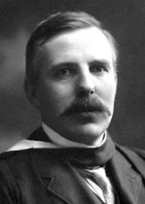
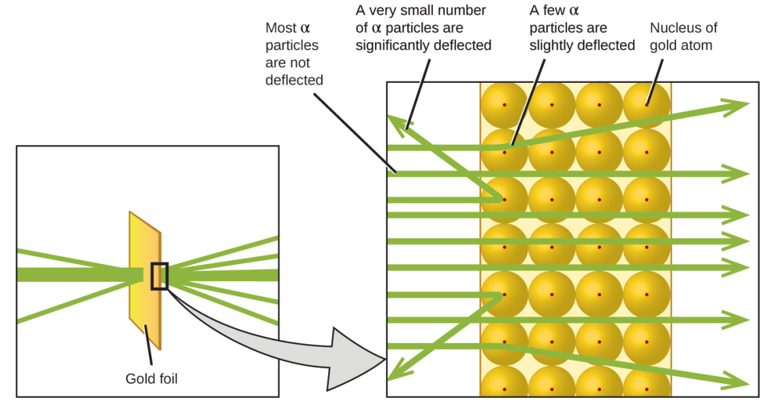
2.2 evolution of atomic theory
Rutherford (1913)
High-speed, positively charged particles were passed through a piece of gold foil.
Most passed straight through. Some were deflected.
Atoms are largely empty space with positively charged particles called protons concentrated in the nucleus.

Slide 12

2.3 atomic structure and symbols
Explore Rutherford Scattering and the Plum Pudding Model
https://phet.colorado.edu/en/simulation/rutherford-scattering

Slide 13
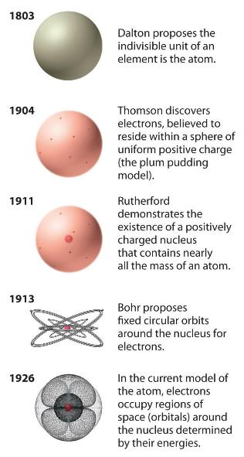
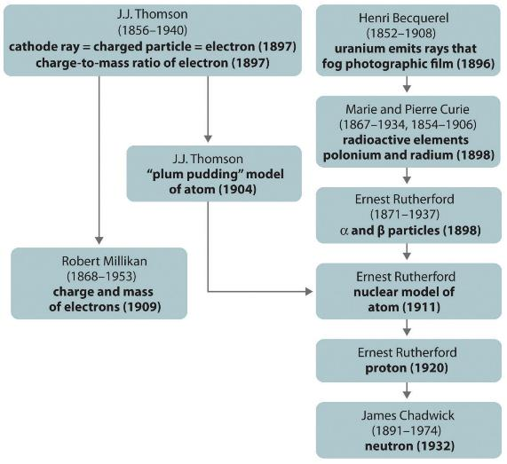
2.2 evolution of atomic theory

Slide 14
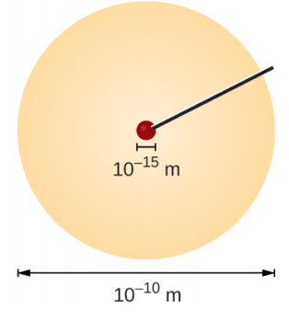
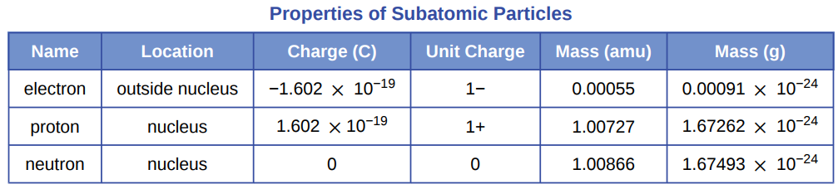
2.3 atomic structure and symbols
Information from Atomic Theory
The mass of an atom is concentrated in the nucleus and comes from protons and neutrons.
Negatively charged particles called electrons circulate around the nucleus but have a very small mass compared to protons and neutrons.
e⁻
e⁻
nucleus:
protons
and
neutrons
e⁻
e⁻
e⁻
e⁻
e⁻
electrons circulate
e⁻

Slide 15
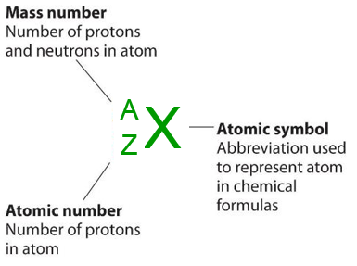
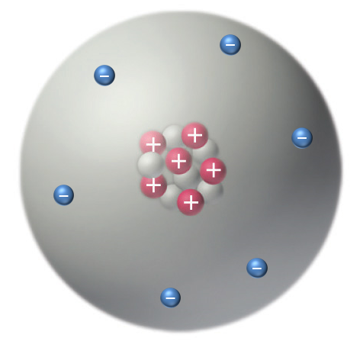
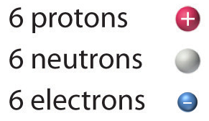
2.3 atomic structure and symbols
A
X
Z
Describing the Atom
Simple notation is used to depict the contents of an atom.
12
C
6

Slide 16
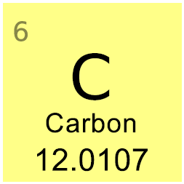
2.3 atomic structure and symbols
A
X
Z
Atomic Symbols
Atomic Number (Z)
Z represents the number of protons in an atomic nucleus.
The value of Z determines the identity of an atom.
Z is the atomic number on the periodic table.
A carbon atom has Z=6.
  Isotopes of carbon may have different mass numbers, but if Z=6, the atom is carbon.
What is the name of the element with:
Z=8? Z=14? Z=30?
Z=78? Z=86? Z=92?

Slide 17
2.3 atomic structure and symbols
A
X
Z
Atomic Symbols
Mass Number (A)
The total number of protons and neutrons in an atom is its mass number (A).
Z = # protons
A = # protons + # neutrons
If an atom has 7 protons and 7 neutrons, what is its mass number?
Name the element.
If an atom has 92 protons and 146 neutrons, what is its mass number? Name the element.
Which element has 114 neutrons and a mass number of 190?

Slide 18
2.3 atomic structure and symbols
A
X
Z
Atomic Symbols
Chemical Symbol (X)
An element is represented on the periodic table by its atomic symbol (X).
A carbon atom is represented by C.
An iron atom is represented by Fe.
A xenon atom is represented by Xe.
You need to learn the names and symbols of the elements!
What is the chemical symbol for an atom with 9 protons?
What is the chemical symbol for an atom with A=35 and Z=17?
What is the chemical symbol for an atom with a mass number of 31 and 16 neutrons?

Slide 19
2.3 atomic structure and symbols
A
X
Z
Atomic Symbols
Isotopes
A, Z, and X can be combined to represent a specific isotope of an element.
What is X for each of the following?
14
X
24
X
131
X
6
12
52
Fill in the missing information for each of the following:
A
X
A
Pb
with 19 neutrons
with 125 neutrons
17
Z
59
X
40
X
with ___ neutrons
with 22 neutrons
27
Z

Slide 20
2.3 atomic structure and symbols
A
X
Z
Atomic Symbols
Isotope Notation
Consider three isotopes:
What is X?
12
X
13
X
14
X
6
6
6
Use a periodic table to fill in the chart.
A
Z
X
# protons
# neutrons
# electrons
mass number

Slide 21
2.3 atomic structure and symbols
A
X
Z
Atomic Symbols
Isotope Notation
These are carbon isotopes.
12
X
13
X
14
X
6
6
6
A | 12 | 13 | 14
Z | 6 | 6 | 6
X | C | C | C
# protons | 6 | 6 | 6
# neutrons | 6 | 7 | 8
# electrons | 6 | 6 | 6
mass number | 12 | 13 | 14
On the periodic table, why does carbon have a mass of 12.0107?

Slide 22
2.3 atomic structure and symbols
A
X
Z
Atomic Symbols
Isotope Notation for Ions
A neutral atom has the same number of protons and electrons.
A neutral atom with Z=10 has 10 protons and 10 electrons.
What happens when there are extra electrons?
What happens when there are not enough electrons?
80
Br⁻
48
Ti⁴⁺
27
Al³⁺
32
P³⁻
16
O²⁻
35
22
13
15
8
protons
neutrons
electrons

Slide 23

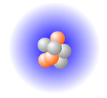
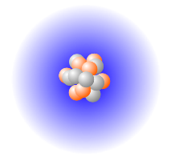
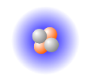
2.3 atomic structure and symbols
Build an Atom
This species has a 1+ charge. The symbol for this ion is:
This neutral atom has: ____ protons
____ neutrons
____ electrons
The element is ____.
The symbol for this neutral atom is:
Try the experiment on your own:
https://phet.colorado.edu/en/simulation/build-an-atom

Slide 24
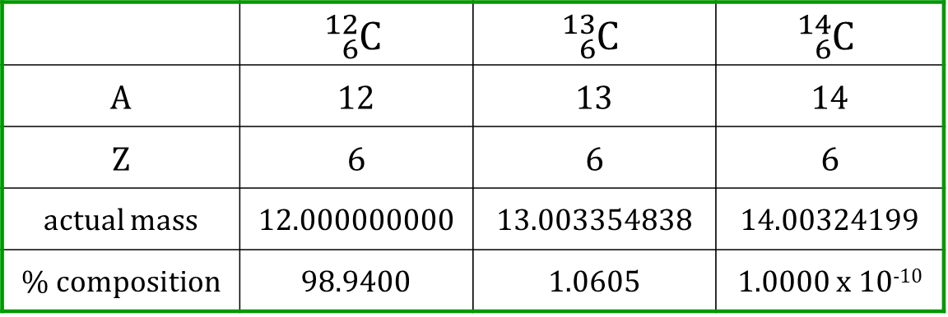
2.3 atomic structure and symbols
Isotopes and Atomic Mass
The atomic mass on the periodic table is a weighted average derived from the masses and abundances of each isotope.
What is the atomic mass of carbon?
What is the difference between atomic mass and mass number?
 | $${}_{6}^{12}C$$ | $${}_{6}^{13}C$$ | $${}_{6}^{14}C$$
A | 12 | 13 | 14
Z | 6 | 6 | 6
actual mass | 12.000000000 | 13.003354838 | 14.00324199
% composition | 98.9400 | 1.0605 | 1.0000 x 10⁻¹⁰
$atomic mass=m_{1}a_{1}+m_{2}a_{2}+$ $m_{3}a_{3}+ …$

Slide 25
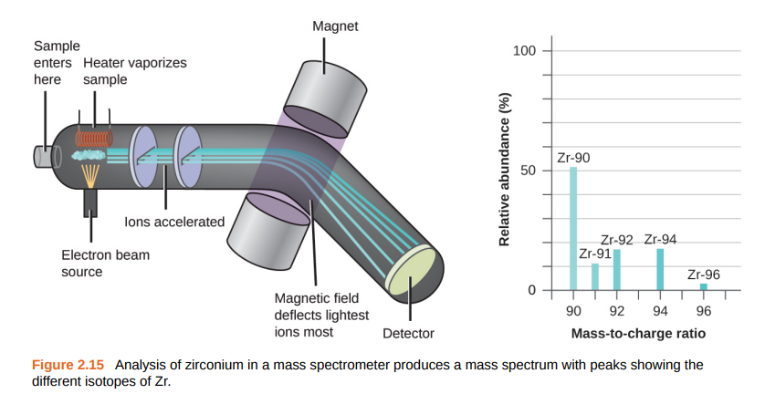
2.3 atomic structure and symbols
Mass Spectrometry: Determining Isotope Mass
See textbook for more details!

Slide 26
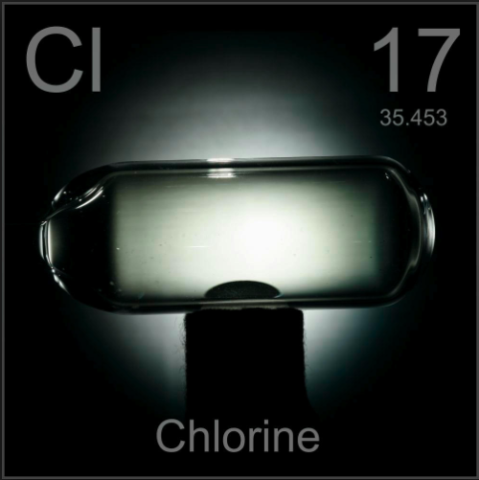
2.3 atomic structure and symbols
Example #1
Chlorine has two major isotopes: ³⁵Cl and ³⁷Cl. Calculate the atomic mass of chlorine from the data given.
Isotope | Mass (amu) | Abundance (%)
³⁵Cl | 34.96885 | 75.76
³⁷Cl | 36.96590 | 24.24
$atomic mass=m_{1}a_{1}+m_{2}a_{2}+$ $m_{3}a_{3}+ …$
Theodore Gray
periodictable.com

Slide 27
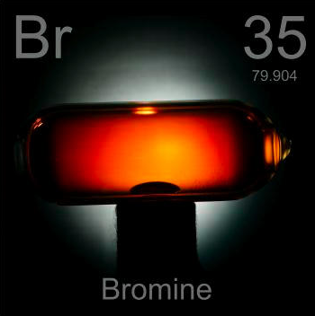
2.3 atomic structure and symbols
Example #2
Bromine has two naturally occurring isotopes. One has a mass of 78.918338 and an abundance of 50.69%. The other has a mass of 80.916291 and an abundance of 49.31%. What is the atomic mass of bromine?
Isotope | Mass (amu) | Abundance (%)
⁷⁹Br | 78.918338 | 50.69
⁸¹Br | 80.916291 | 49.31
$atomic mass=m_{1}a_{1}+m_{2}a_{2}+$ $m_{3}a_{3}+ …$
Theodore Gray
periodictable.com

Slide 28
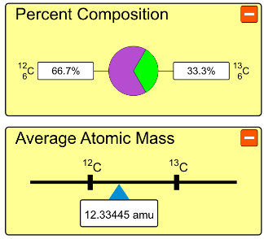
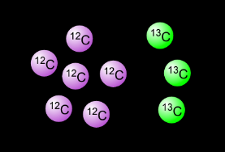
2.3 atomic structure and symbols
Isotopes and Atomic Mass
How would you have to change the mixture in the black box in order to achieve the mixture of carbon isotopes present in nature?
(A) Add more ¹²C. (B) Add more ¹³C. (C) It cannot be done.
Try the experiment on your own:
https://phet.colorado.edu/en/simulation/isotopes-and-atomic-mass

Slide 29
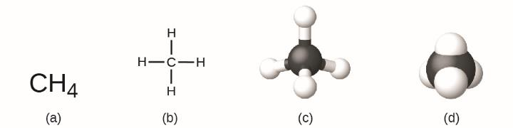
2.4 chemical formulas
Chemical Formulas
Molecular Formula
a representation of a molecule showing the number and types of atoms present
Structural Formula
similar to the molecular formula but shows how atoms are connected in a molecule
molecular formula
structural formula
ball-and-stick model
space-filling model

Slide 30
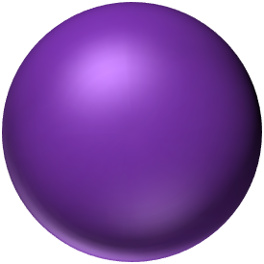
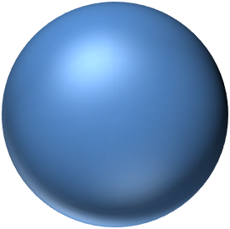

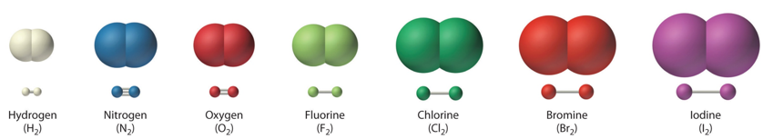
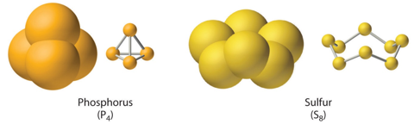
2.4 chemical formulas
Chemical Formulas
Elements:
may be represented by discrete, individual atoms
may exist as diatomic molecules
may exist as polyatomic molecules
Magnesium
Mg
Cobalt
Co
Silver
Ag

Slide 31
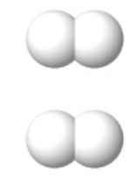
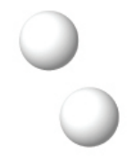

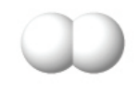
2.4 chemical formulas
Chemical Formulas
Each sphere represents a hydrogen atom.
description | one hydrogen atom | two hydrogen atoms | one hydrogen molecule | two hydrogen molecules
symbol
# atoms
# molecules

Slide 32
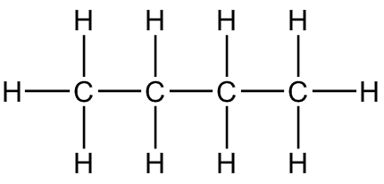
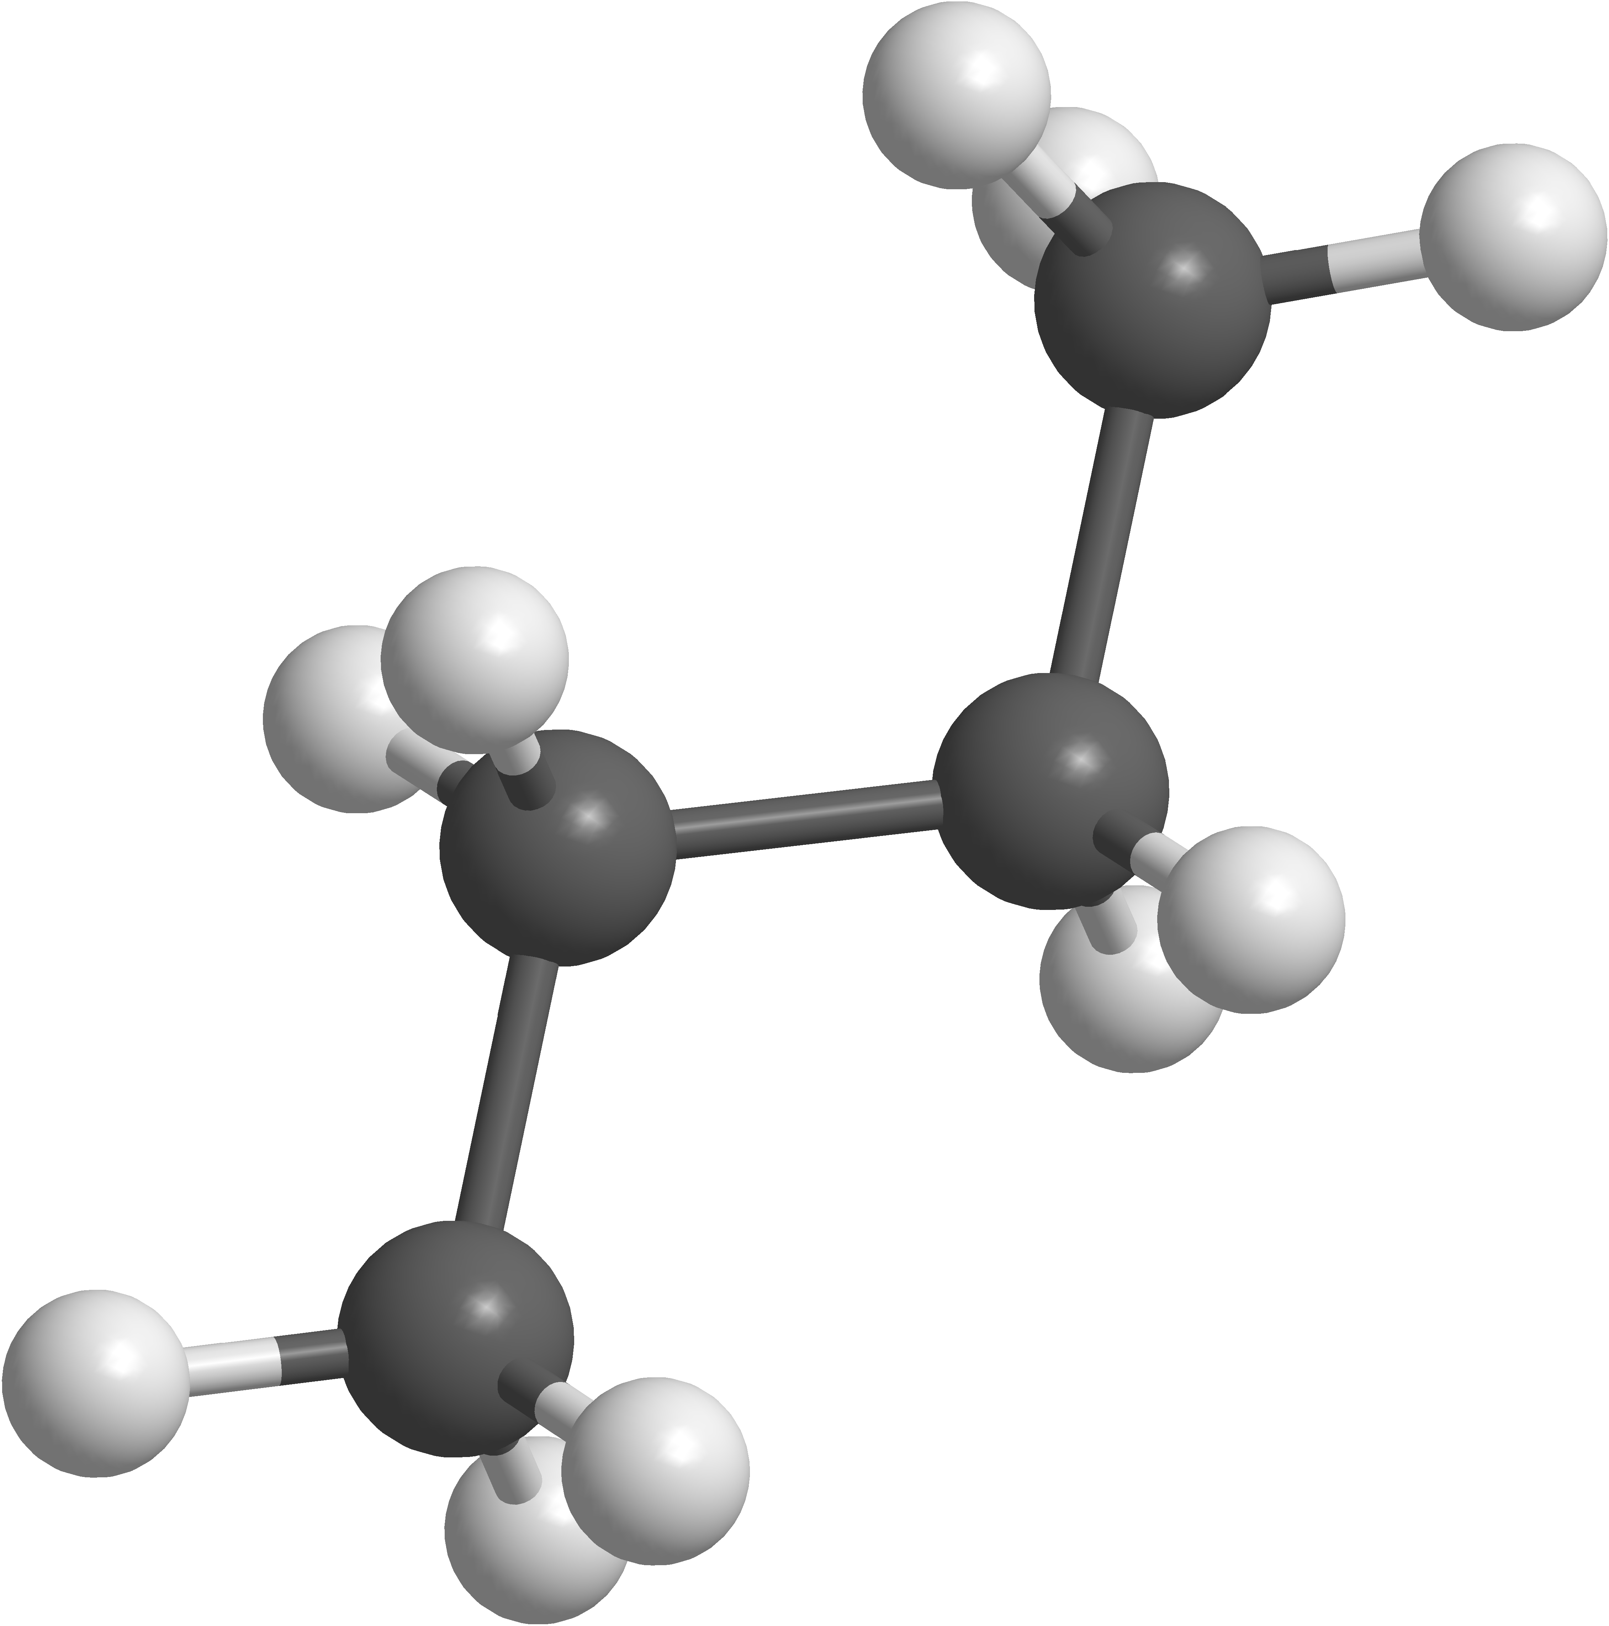
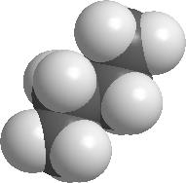
2.4 chemical formulas
Chemical Formulas: Butane
C₄H₁₀
CH₃CH₂CH₂CH₃
Molecular Formula
ratio of atoms
Condensed Formula
indicates connectivity
Structural Formula
shows bonds
C₄H₁₀
C₂H₅
Empirical Formula
simplest whole number ratio of atoms
Ball and Stick
shows bonds
Space Filling
shows volume

Slide 33
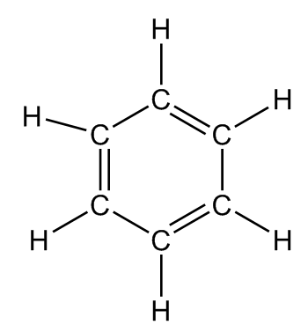
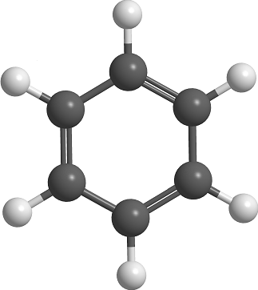
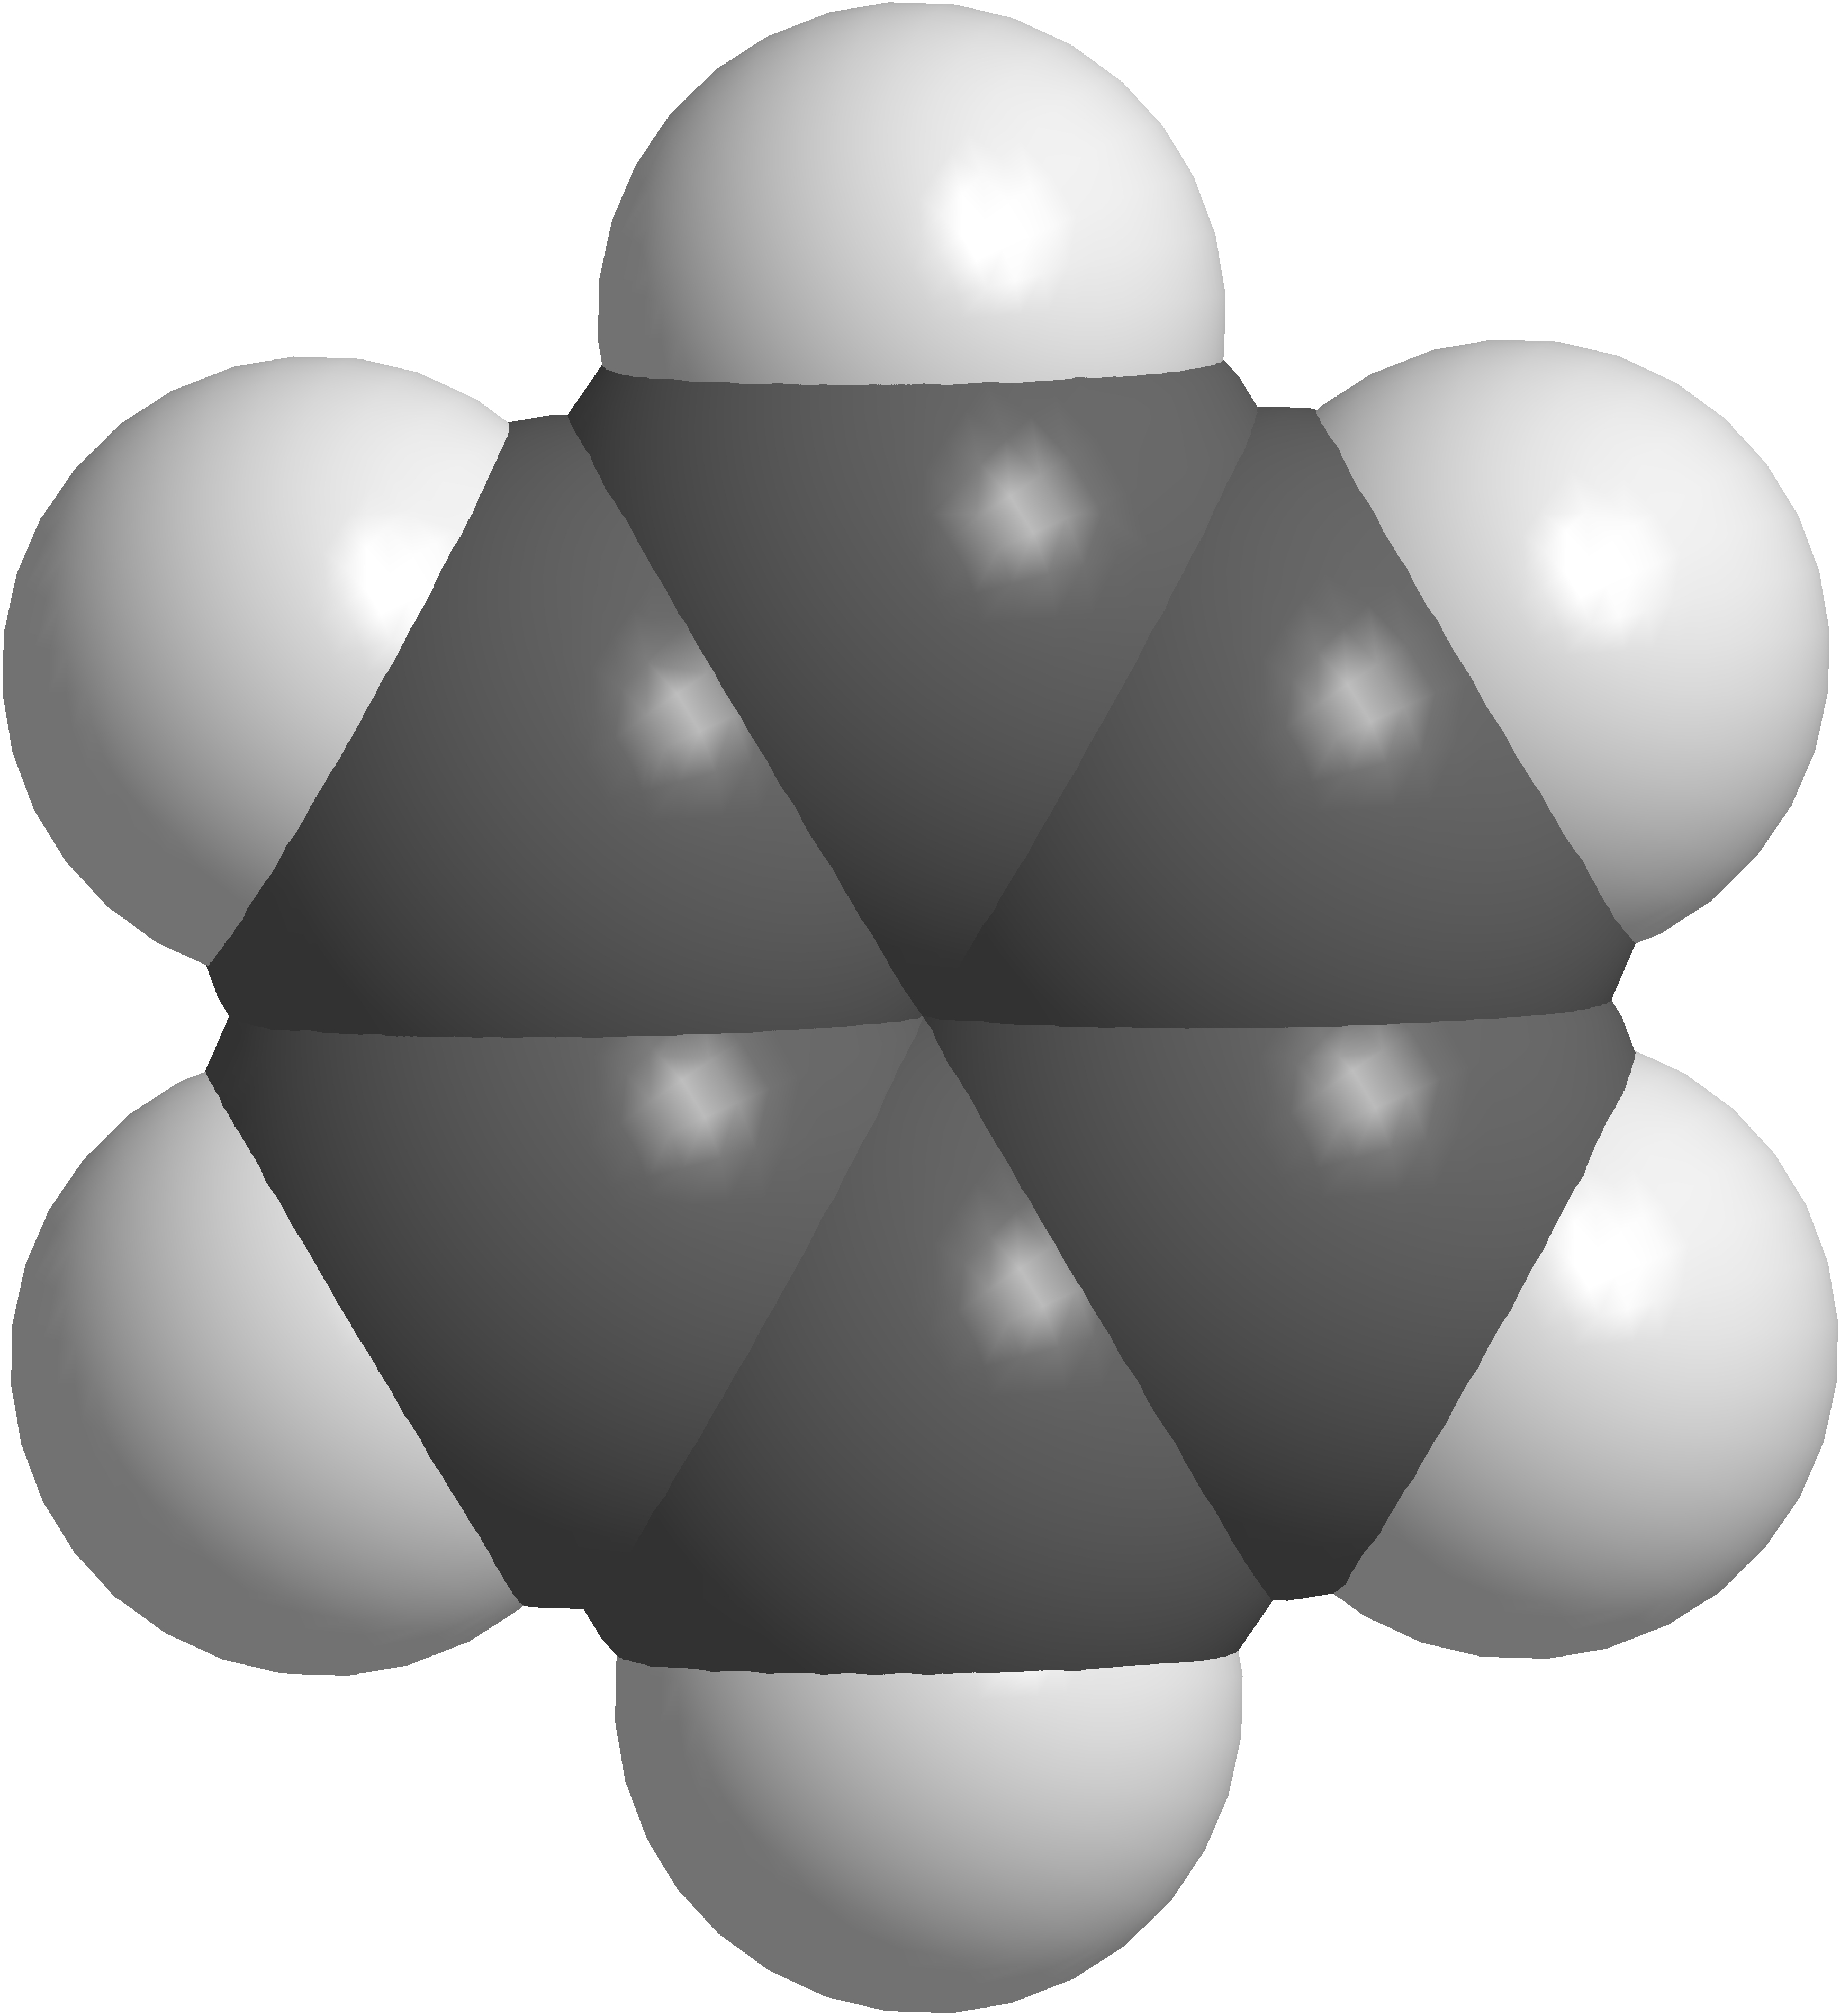
2.4 chemical formulas
Chemical Formulas: Benzene
C₆H₆
C₆H₆
Molecular Formula
ratio of atoms
Condensed Formula
indicates connectivity
Structural Formula
shows bonds
C₆H₆
CH
Empirical Formula
simplest whole number ratio of atoms
Ball and Stick
shows bonds
Space Filling
shows volume

Slide 34
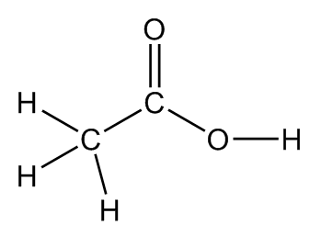
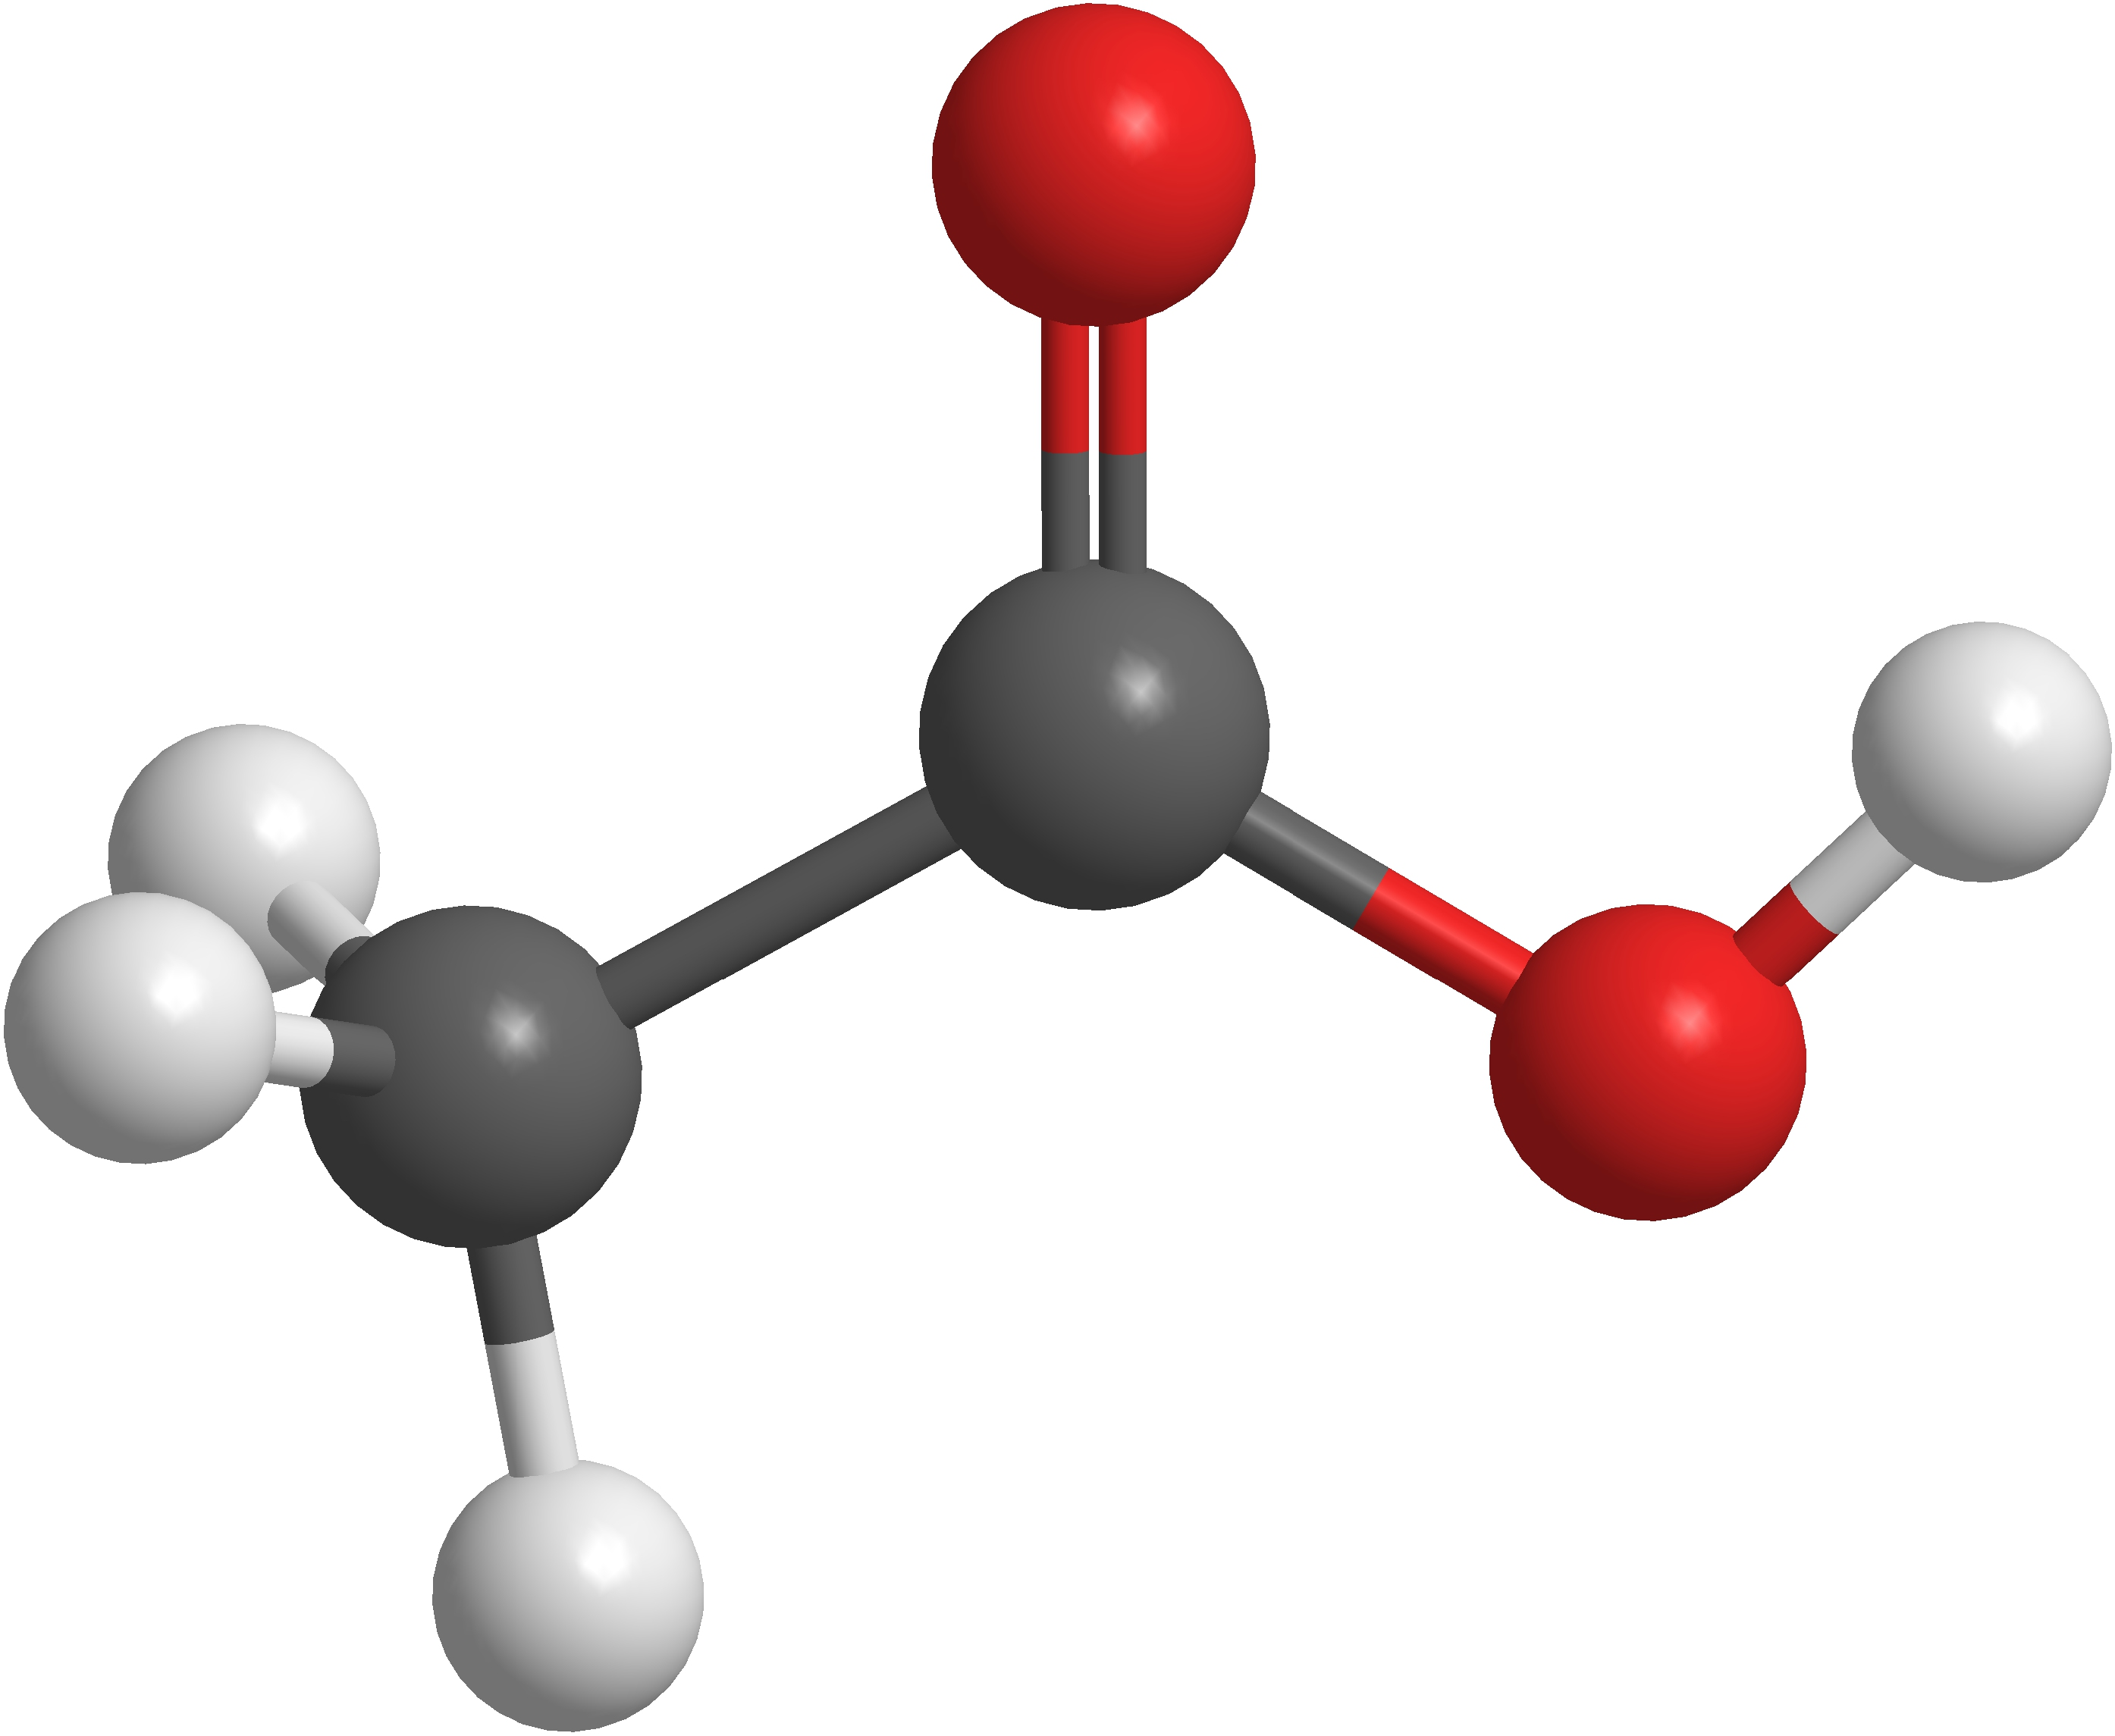
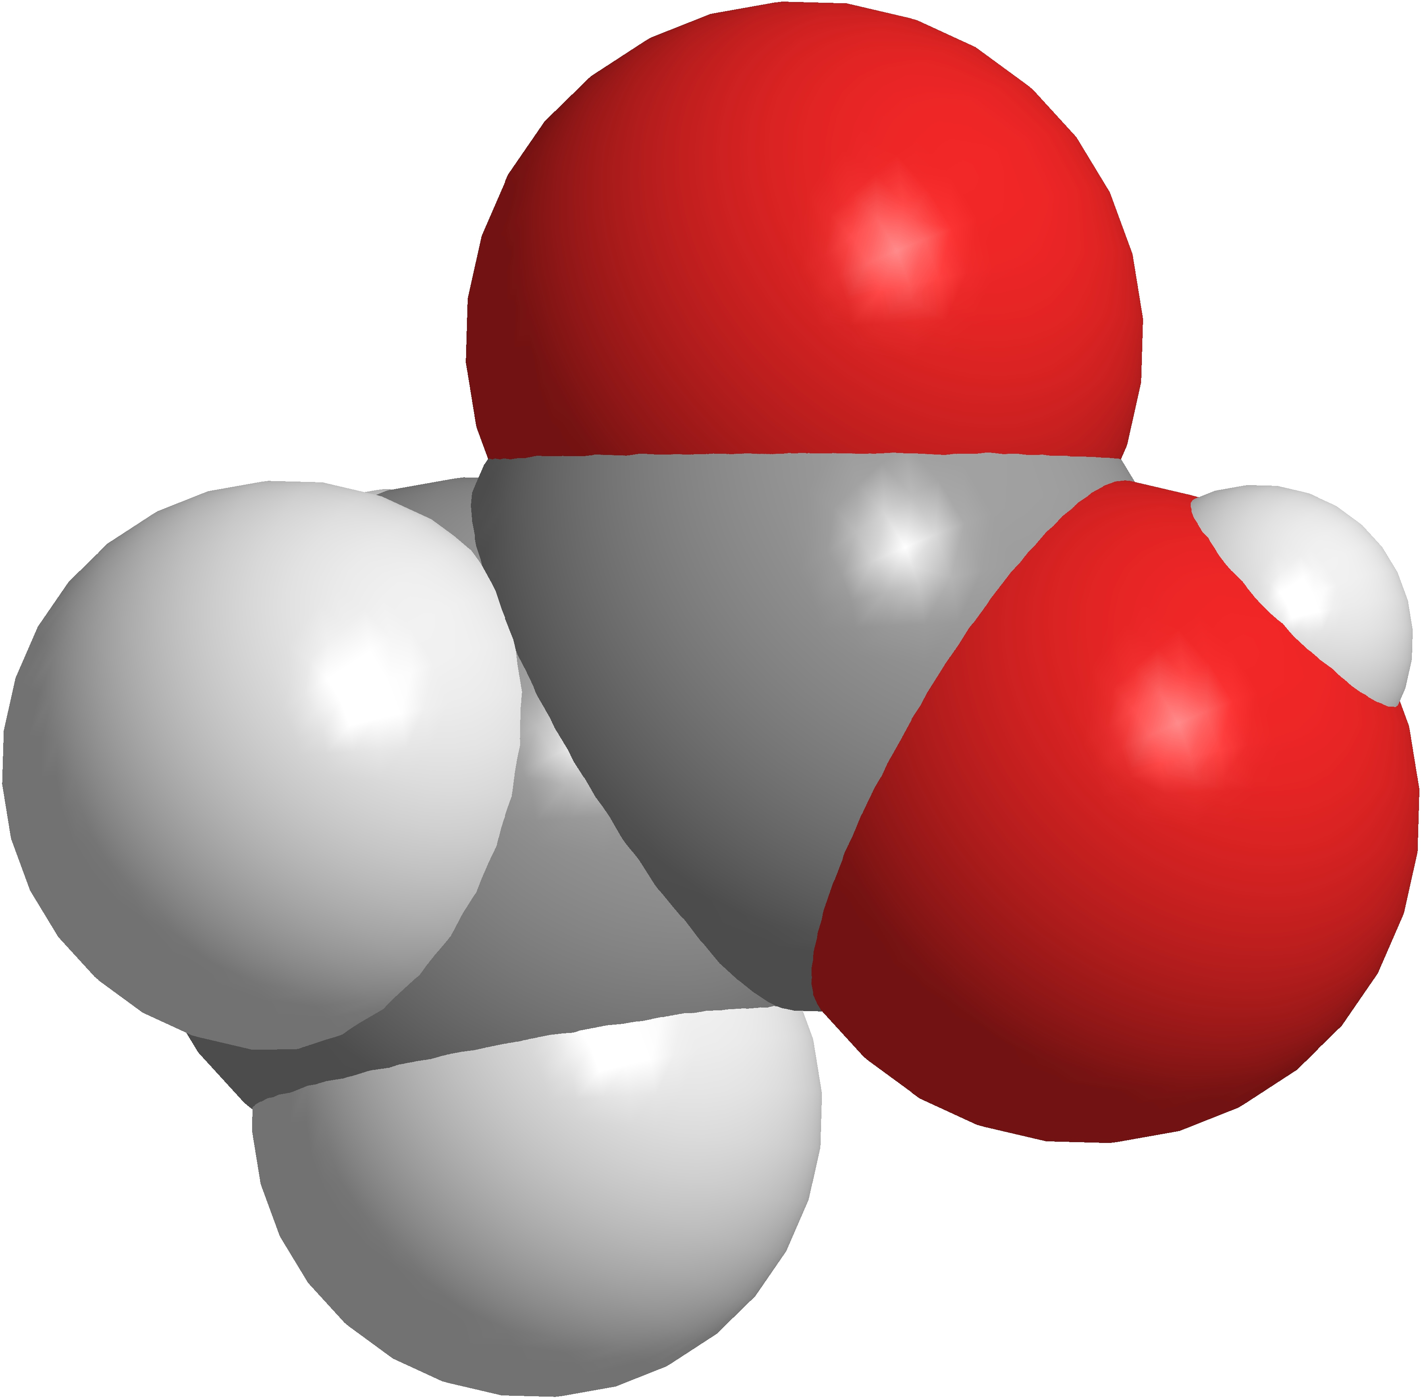
2.4 chemical formulas
Chemical Formulas: Acetic Acid
Vinegar is very dilute acetic acid.
C₂H₄O₂
CH₃COOH
Molecular Formula
ratio of atoms
Condensed Formula
indicates connectivity
Structural Formula
shows bonds
C₂H₄O₂
CH₂O
Empirical Formula
simplest whole number ratio of atoms
Ball and Stick
shows bonds
Space Filling
shows volume

Slide 35
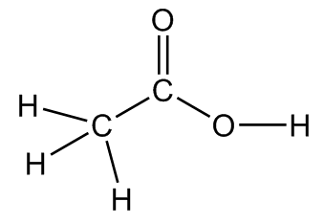
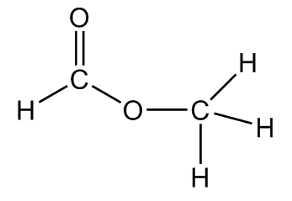
2.4 chemical formulas
Isomers
Molecules may have the same chemical formula but different molecular structures and different chemical properties.
Acetic Acid
Vinegar is dilute acetic acid.
C₂H₄O₂
CH₃COOH
Molecular
Condensed
Structural
Methyl Formate
Methyl formate can be used as an insecticide.
C₂H₄O₂
HCOOCH₃
Molecular
Condensed
Structural

Slide 36
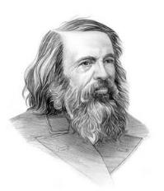
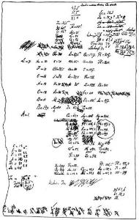
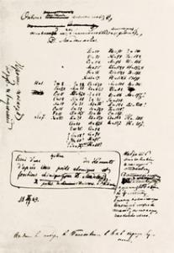
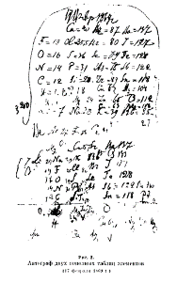
2.5 THE PERIODIC TABLE
Dmitri Mendeleev (1869)
Mendeleev and others recognized that there were periodic relationships between physicochemical properties of known elements.
For example, lithium, sodium, and potassium conduct heat/electricity and react vigorously with water.
The halogens, he noted, reacted easily with other elements and were readily available in nature.
Mendeleev constantly revised his observations and organized the elements until he arrived at a version of what we now call the periodic table.

Slide 37

2.5 THE PERIODIC TABLE
Dmitri Mendeleev (1869)
Mendeleev predicted the existence of gallium and germanium in 1871, and the elements were discovered, with the properties he predicted, a few years later.
Which element is Ga? Which is Ge?

Slide 38

2.5 THE PERIODIC TABLE
Mendeleev Video
The Elements Song
https://youtu.be/AcS3NOQnsQM
https://youtu.be/kuQ0Um4Wcz0

Slide 39
2.5 THE PERIODIC TABLE
Periodic Law
The properties of the elements are periodic functions of their atomic numbers.
Groups
Groups
Periods

Slide 40
2.5 THE PERIODIC TABLE
Classification of the Elements

Slide 41

2.5 THE PERIODIC TABLE
Classification of the Elements
alkali metals
alkaline earths
pnictogens
chalcogens
halogens
noble gases
transition metals
inner
transition metals
lanthanides
actinides

Slide 42

2.6 molecular and ionic compounds
The Elements in Chemical Reactions
In an ordinary chemical reaction:
the nucleus of each atom remains unchanged.
electrons can be shared between atoms to form chemical bonds.
atoms can gain or lose electrons resulting in electrically charged particles called ions.

Slide 43
2.6 molecular and ionic compounds
Predicting Ion Formation
Main group atoms lose or gain electrons so that the overall electron count is the same as the nearest noble gas.
Na atoms lose one electron and become Na⁺.
  Na⁺ has the same overall electron count as Ne.
  Na⁺ has a positive charge and is a cation.
Cl atoms gain one electron and become Cl⁻.
  Cl⁻ has the same overall electron count as Ar.
  Cl⁻ has a negative charge and is an anion.
Transition metals have variable charges and are difficult to predict, but in CHEM 131, we can say that:
  Zinc is usually Zn²⁺
  Silver is usually Ag⁺

Slide 44

2.6 molecular and ionic compounds
Predicting Ion Formation
For main group elements, use the groups on the periodic table.
alkali metals
1+
alkaline
earths
2+
pnictogens
3-
chalcogens
2-
halogens
1-
transition metals
are variable

Slide 45
2.6 molecular and ionic compounds
Predicting Ion Formation
Practice prediction ion formation by filling in the table.
Atom | Ion | Cation or Anion? | Nearest Noble Gas
Mg
K
F
O
Sr
P
Se
Cs

Slide 46
2.6 molecular and ionic compounds
Polyatomic Ions
Thus far, only monatomic ions have been discussed.
Groups of atoms bonded together into electrically charged molecules are known as polyatomic ions.
These ions are very important and appear repeatedly in general chemistry, organic chemistry, and biology.
Memorize the polyatomic ions listed in Table 2.5.
NH₄⁺
CN⎯
CH₃COO⎯
CO₃^{2⎯}
HCO₃⎯
NO₂⎯
NO₃⎯
PO₄^{3⎯}
HPO₄^{2⎯}
H₂PO₄⎯
ClO⎯
ClO₂⎯
ClO₃⎯
ClO₄⎯
OH⎯
SO₃^{2⎯}
SO₄^{2⎯}
HSO₄⎯
CrO₄^{2⎯}
Cr₂O₇^{2⎯}
MnO₄⎯

Slide 47


2.6 molecular and ionic compounds
Polyatomic Ions and Related Acids
Many important acids used in chemistry are related to polyatomic ions.

Slide 48
2.6 molecular and ionic compounds
Chemical Bonding: Attractive Forces
Ionic Bonds
Electrons can be transferred from one atom to another.
Ionic bonds are formed by the electrostatic forces between anions and cations.
Covalent Bonds
Alternatively, electrons can be shared between two atoms.
Covalent bonds are formed when one or more pairs of electrons are shared between two atomic nuclei.
The type of bond formed between two atoms depends upon the chemical properties of the atoms involved.

Slide 49
2.6 molecular and ionic compounds
Chemical Bonding: Ionic Compounds
Ionic Compounds:
are neutral and held together by electrostatic forces.
can be predicted from the location of elements on the periodic table.
a metal combined with a nonmetal usually forms an ionic compound.
charges must add up to zero.
solids have high melting points, liquids/aqueous are conductive
Predict the compound:
cesium + chlorine
sodium + sulfur
1+ and 2+ metals
3-/2-/1- nonmetals
magnesium + oxygen
lithium + nitrogen
calcium + phosphorus

Slide 50


2.6 molecular and ionic compounds
Nomenclature
Ionic Compounds
cation followed by anion
monatomic ions: the name of the nonmetal is changed to –ide
polyatomic anions: use the same ending as the ion

Slide 51
2.6 molecular and ionic compounds
Chemical Bonding: Ionic Compounds
Ionic Compounds:
can also be formed by using polyatomic ions.
  the bonds within a polyatomic ion are covalent.
Cation | Anion | Cation Formula | Anion Formula | Ionic Compound
sodium | carbonate
calcium | sulfate
lithium | nitrate
magnesium | phosphate
barium | chromate
ammonium | hydroxide

Slide 52

2.6 molecular and ionic compounds
Nomenclature
Transition Metal Ionic Compounds
Transition metals may have variable charge.
Roman numerals are used to denote the charge in a compound.
Note: Older texts and literature may use –ic and –ous endings to designate some charges, but these are considered obsolete.

Slide 53
2.6 molecular and ionic compounds
Chemical Bonding: Molecular Compounds
Molecular Compounds
are discrete, neutral molecules formed by a combination of nonmetals.
form when atoms share electrons between nuclei.
are usually gases and liquids with low boiling points or solids with low melting points.
Examples:
NO₂
nonmetals
PCl₃
CO₂
SF₆
SiCl₄

Slide 54

2.6 molecular and ionic compounds
Nomenclature
Molecular Compounds
Ionic compounds have atomic ratios that are obvious from the charges of the component ions.
Inorganic molecular compounds held together by covalent bonds do not have obvious ratios and must be named more specifically.
  Prefixes are used to specify the number of atoms of each element.

Slide 55

2.6 molecular and ionic compounds
Nomenclature
Molecular Compounds (continued)
The more metallic element – the one toward the left/bottom of the periodic table – is named first.
The more non-metallic element – the one toward the right/top of the periodic table – is named last with the suffix –ide.
Note: There are exceptions for several common compounds. H₂O is water, not dihydrogen monoxide. N₂O is nitrous oxide, not dinitrogen monoxide.

Slide 56

2.6 molecular and ionic compounds
Nomenclature
Binary Acids
Some compounds containing hydrogen form an important class of substances known as acids.
A mixture of water with binary acids are named as follows:
  The word “hydrogen” is changed to hydro–.
  The nonmetallic element is named with the suffix –ic.
  Add the word “acid” to the name.

Slide 57

2.6 molecular and ionic compounds
Nomenclature
Oxyacids
Some acids contain hydrogen, oxygen, and one other element.
To name oxyacids:
  Omit the word “hydrogen.”
  Start with the root name of the anion.
  Replace –ate with –ic or –ite with –ous.
  Add the word “acid” to the name.

Slide 58
end of chapter problems – chapter 2
The Structure of the Atom: #11, 17, 19, 23, 25, 43
Names and Formulas of Compounds: #45, 49, 51, 53, 55, 57, 59
For detailed solutions to these problems, go to the OpenStax Chemistry website and download the Student Solution Guide.

Slide 59
videos – chapter 2
Atomic Number, Isotopes and Atomic Mass
http://screencast.com/t/RWh2hcfH
Naming Inorganic Compounds
http://screencast.com/t/QL4NTOd9
*All videos were created by MC Chemistry faculty unless otherwise indicated.

Slide 60
simulations – chapter 2
Build an Atom (Atoms, Atomic Structure, Isotope Symbols)
https://phet.colorado.edu/en/simulation/build-an-atom
Isotopes and Atomic Mass
https://phet.colorado.edu/en/simulation/isotopes-and-atomic-mass
Rutherford Scattering (Atomic Nuclei, Atomic Structure)
https://phet.colorado.edu/en/simulation/rutherford-scattering
Build a Molecule (Atoms, Molecules, Molecular Formula)
https://phet.colorado.edu/en/simulation/legacy/build-a-molecule

