Slide 1
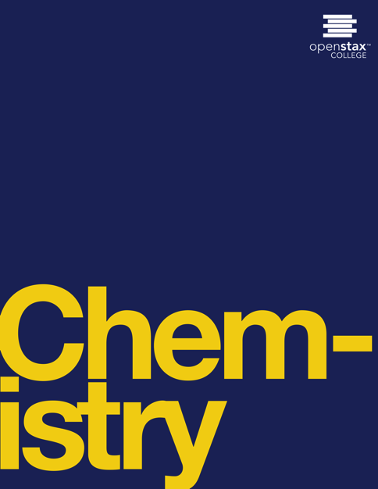

CHEMISTRY
Chapter 3 COMPOSITION OF SUBSTANCES AND SOLUTIONS
Joseph DePasquale
University of Connecticut

Slide 2
Ch. 3 Outline
3.1: Formula Mass and the Mole Concept
3.2: Determining Empirical and Molecular Formulas
3.3: Molarity
3.4: Other Units for Solution Concentrations

Slide 3
3.1 formula mass and the mole concept
The formulas mass of a substance is the sum of the average atomic masses of all the atoms in the substance’s formula.
Covalent substances exist as discrete molecules.
The formula mass of a covalent substance may be correctly referred to as a molecular mass.

Slide 4
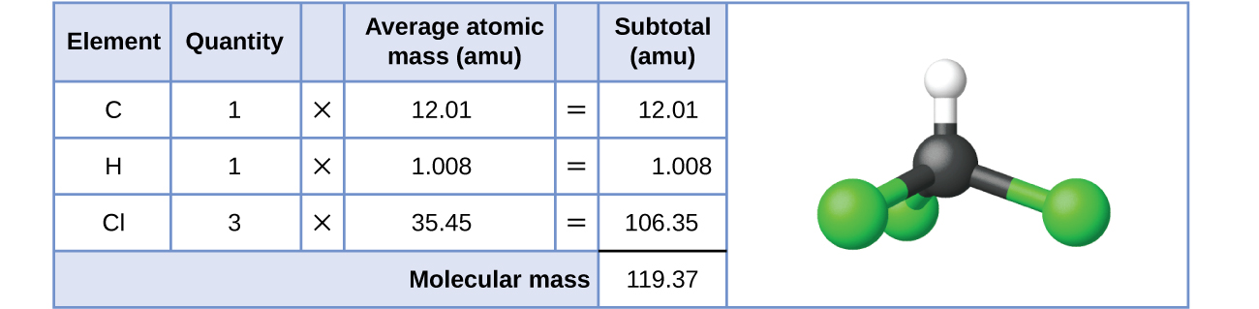
Figure 3.2
The average mass of a chloroform molecule, CHCl₃, is 119.37 amu, which is the sum of the average atomic masses of each of its constituent atoms. The model shows the molecular structure of chloroform.

Slide 5
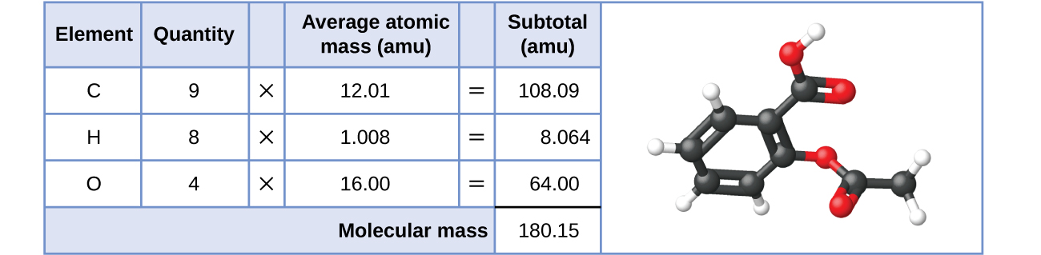
Figure 3.3
The average mass of an aspirin molecule is 180.15 amu. The model shows the molecular structure of aspirin, C₉H₈O₄.

Slide 6
formula mass for ionic compounds
Ionic substances are composed of discrete cations and anions combined in ratios to yield electrically neutral bulk matter.
Ionic compounds do NOT exist as molecules.
The formula mass for an ionic compound may NOT correctly be referred to as a molecular mass.
The average atomic masses of the ions can be approximated to be the same as the average atomic masses of the neutral atoms.

Slide 7
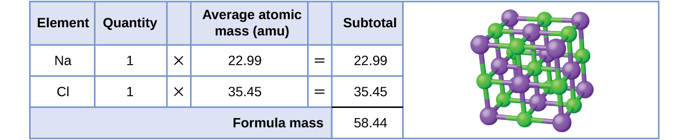
Figure 3.4
Table salt, NaCl, contains an array of sodium and chloride ions combined in a 1:1 ratio. Its formula mass is 58.44 amu.

Slide 8
The mole
The mole is an amount unit similar to familiar units like pair, dozen, gross, etc.
The mole is defined as the amount of a substance containing the same number of discrete entities (such as atoms, molecules, or ions) as the number of atoms in a sample of pure carbon-12 weighing exactly 12 g.
The mole provides a link between the mass of a sample and the number of atoms, molecules, or ions in that sample.

Slide 9
Avogadro’s number
The number of entities composing a mole has been determine to be 6.02214179 x 10²³.
This constant is named after Italian scientist Amedeo Avogradro and is known as Avogadro’s Number.
Avogadro’s Number (N_{A}) = 6.022 x 10²³
The masses of 1 mole of different elements, however, are different, since the masses of the individual atoms are drastically different.

Slide 10
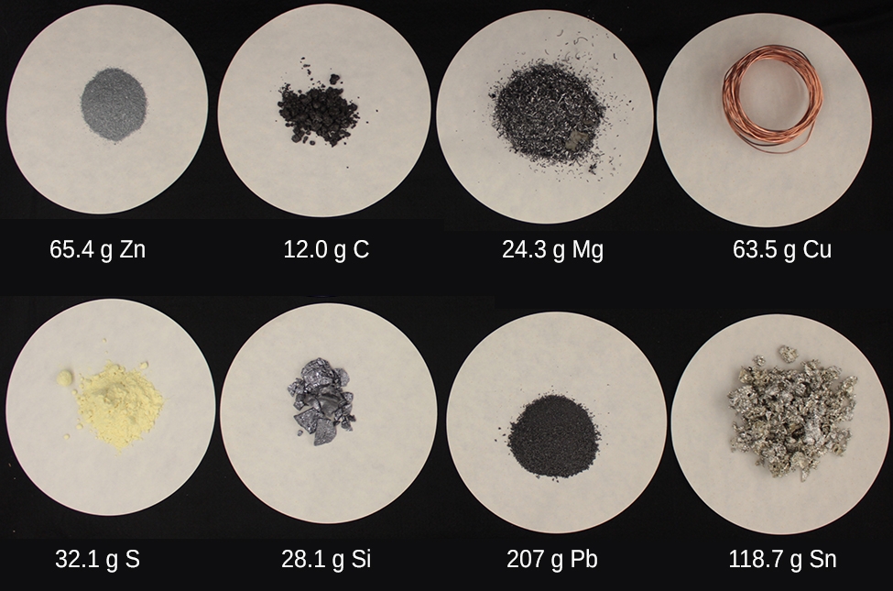
Figure 3.5
Each sample contains 6.022 × 10²³ atoms —1.00 mol of atoms. From left to right (top row): 65.4 g zinc, 12.0 g carbon, 24.3 g magnesium, and 63.5 g copper. From left to right (bottom row): 32.1 g sulfur, 28.1 g silicon, 207 g lead, and 118.7 g tin. (credit: modification of work by Mark Ott)

Slide 11
Molar mass
The molar mass of an element (or compound) is the mass in grams of 1 mole of that substance, a property expressed in units of grams per mole (g/mol).
The molar mass of any substance is numerically equivalent to its atomic or formula mass in amu.
Example:
  A single ¹²C atom has a mass of 12 amu.
  A mole of ¹²C atoms have a mass of 12 g.

Slide 12
Molar mass of elements
Element Average Atomic Mass (amu) Molar Mass (g/mol)
C 12.01 12.01
H 1.008 1.008
O 16.00 16.00
Na 22.99 22.99
Cl 35.45 33.45

Slide 13
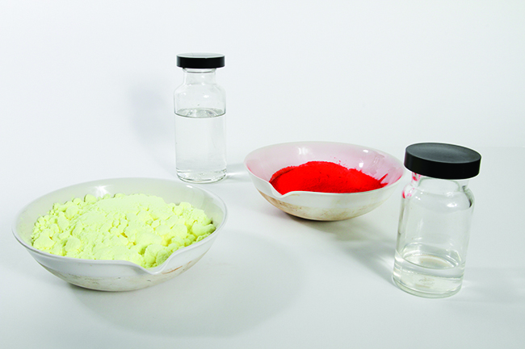
Figure 3.6
Each sample contains 6.02 × 10²³ molecules or formula units—1.00 mol of the compound or element. Clock-wise from the upper left: 130.2 g of C₈H₁₇OH (1-octanol, formula mass 130.2 amu), 454.9 g of HgI₂ (mercury(II) iodide, formula mass 459.9 amu), 32.0 g of CH₃OH (methanol, formula mass 32.0 amu) and 256.5 g of S₈ (sulfur, formula mass 256.6 amu). (credit: Sahar Atwa)

Slide 14

Figure 3.7
The number of molecules in a single droplet of water is roughly 100 billion times greater than the number of people on earth. (credit: “tanakawho”/Wikimedia commons)

Slide 15
calculations
The relationships between formula mass, the mole, and Avogadro’s number can be applied to compute various quantities that describe the composition of substances and compounds.

Slide 16
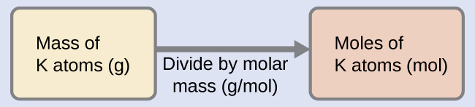
Example 3.3
According to nutritional guidelines from the US Department of Agriculture, the estimated average requirement for dietary potassium is 4.7 g. What is the estimated average requirement of potassium in moles?

Slide 17
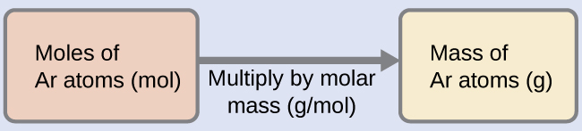
Example 3.4
A liter of air contains 9.2 × 10⁻⁴ mol argon. What is the mass of Ar in a liter of air?

Slide 18
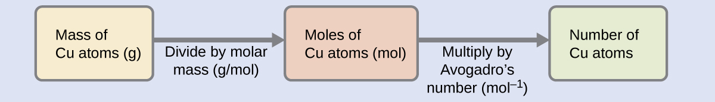
Example 3.5
Copper is commonly used to fabricate electrical wire. How many copper atoms are in 5.00 g of copper wire?

Slide 19
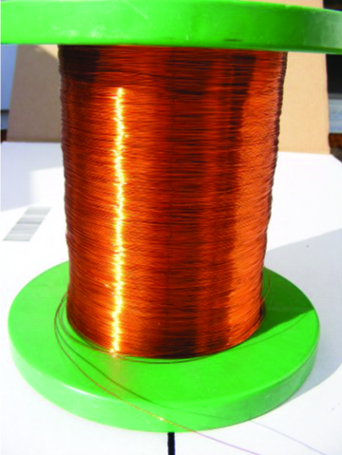
Figure 3.8
Copper wire is composed of many, many atoms of Cu. (credit: Emilian Robert Vicol)

Slide 20
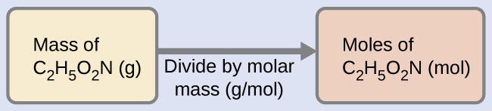
Example 3.6
Our bodies synthesize protein from amino acids. One of these amino acids is glycine, which has the molecular formula C₂H₅O₂N. How many moles of glycine molecules are contained in 28.35 g of glycine?

Slide 21
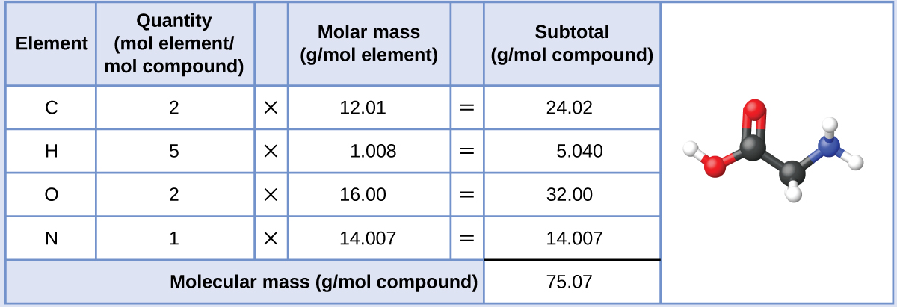
Example 3.6

Slide 22

Example 3.7
Vitamin C is a covalent compound with the molecular formula C₆H₈O₆. The recommended daily dietary allowance of vitamin C for children aged 4–8 years is 1.42 × 10⁻⁴ mol. What is the mass of this allowance in grams? The molar mass for this compound is computed to be 176.124 g/mol.

Slide 23
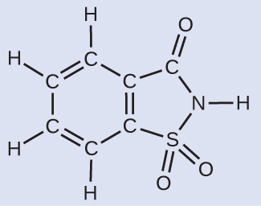
Example 3.8
A packet of an artificial sweetener contains 40.0 mg of saccharin (C₇H₅NO₃S), which has the structural formula:
Given that saccharin has a molar mass of 183.18 g/mol, how many saccharin molecules are in a 40.0-mg (0.0400-g) sample of saccharin? How many carbon atoms are in the same sample?

Slide 24
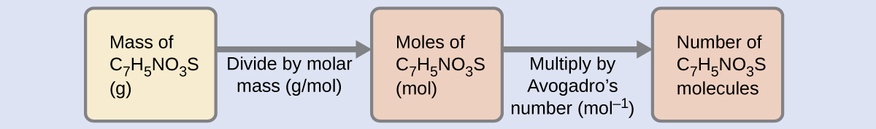
Example 3.8

Slide 25
3.2 determining empirical and molecular formulas
Percent composition - The percentage by mass of each element in a compound.
Example: A 10.0 g sample of a compound is determined to contain 2.5 g hydrogen and 7.5 g carbon.

Slide 26
determining percent composition from formula mass
  For compounds of known formula, the percent composition can also be derived from the formula mass and the atomic masses of the constituent elements.
Example: NH₃ (formula mass = 17.03 amu)

Slide 27
Determination of empirical formulas
A compound’s empirical formula can be determined from the masses of its constituent elements.
  Convert element masses to moles using molar masses.
  2) Divide each number of moles by the smallest number of moles.
  3) If necessary, multiply by an integer, to give the smallest whole-number ratio of subscripts.

Slide 28
Determination of empirical formulas
Example: A compound is determined to contain 1.71 g C and 0.287 g H.
1)
2)

Slide 29
Determination of empirical formulas
Example: A compound is determined to contain 5.31 g Cl and 8.40 g O.
After steps 1 and 2 the tentative formula is obtained.
3) To convert into whole numbers, multiply each of the subscripts by two, giving the empirical formula.

Slide 30
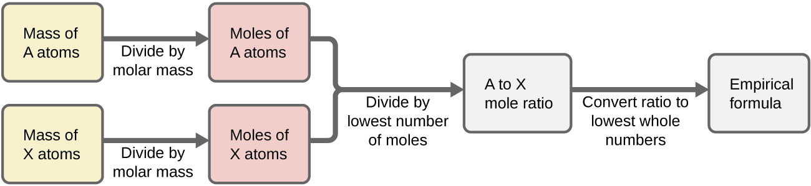
Figure 3.11
The empirical formula of a compound can be derived from the masses of all elements in the sample.

Slide 31
Determination of empirical formulas
A compound’s empirical formula can be determined from its percent composition.
  Convert percent composition to masses of elements by assuming a 100 g sample of compound.
  2) Convert element masses to moles using molar masses.
  3) Divide each number of moles by the smallest number of moles.
  4) If necessary, multiply by an integer, to give the smallest whole-number ratio of subscripts.

Slide 32
Example 3.12
The bacterial fermentation of grain to produce ethanol forms a gas with a percent composition of 27.29% C and 72.71% O. What is the empirical formula for this gas?

Slide 33
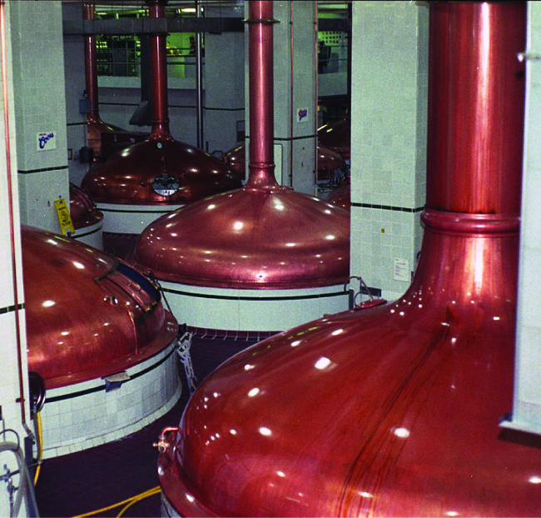
Figure 3.13
An oxide of carbon is removed from these fermentation tanks through the large copper pipes at the top. (credit: “Dual Freq”/Wikimedia Commons)

Slide 34
Derivation of molecular formulas
A compound’s molecular formula can be determined from its empirical formula and its molecular or molar mass.
The molecular formula is then obtained by multiplying each subscript in the empirical formula by n.

Slide 35
Derivation of molecular formulas
Example: A compound has an empirical formula of CH₂O (empirical formula mass = 30 amu) and a molecular mass of 180 amu.
The molecular formula of this compound is C₆H₁₂O₆

Slide 36
3.3 molarity
In preceding sections, we focused on the composition of pure substances.
However, mixtures—samples of matter containing two or more substances physically combined—are more commonly encountered in nature than are pure substances.
Similar to a pure substance, the relative composition of a mixture plays an important role in determining its properties.

Slide 37

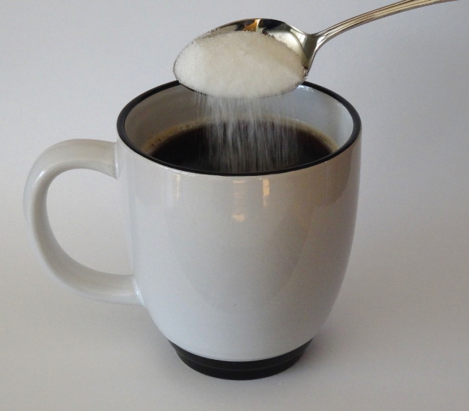
Figure 3.14
Sugar is one of many components in the complex mixture known as coffee. The amount of sugar in a given amount of coffee is an important determinant of the beverage’s sweetness. (credit: Jane Whitney)

Slide 38
solutions
Solutions occur frequently in nature.
Solutions are another term used for a homogeneous mixture – uniform composition and properties throughout its entire volume.
The relative amount of a given solution component is known as its concentration.

Slide 39
solutions
A solution consists of two components:
1) Solvent - component with a concentration that is significantly greater than that of all other components.
2) Solute – component that is typically present at a much lower concentration than the solvent.
A solution in which water is the solvent is called an aqueous solution.

Slide 40
solutions
Qualitative terms used to describe a solution:
  Concentrated – Relatively high concentration of solute.
  Dilute – Relatively low concentration of solute.

Slide 41
molarity
Molarity (M) - the number of moles of solute in exactly 1 liter (1 L) of the solution:
Molarity (M) is a useful concentration unit for many applications in chemistry.

Slide 42
Example 3.14
A 355 mL soft drink sample contains 0.133 mol of sucrose (table sugar). What is the molar concentration of sucrose in the beverage?

Slide 43
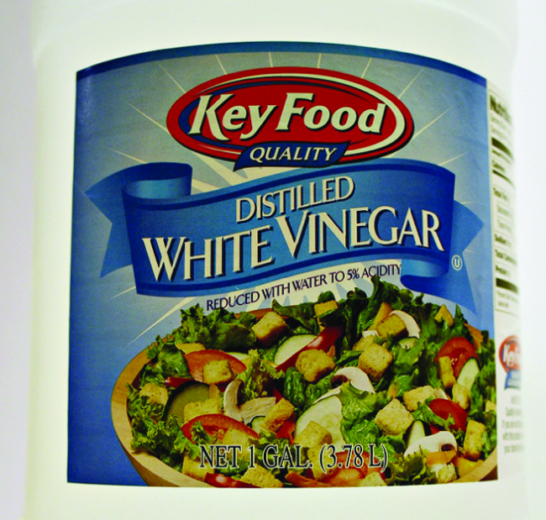
Figure 3.15
Distilled white vinegar is a solution of acetic acid in water.

Slide 44
Dilution of solutions
Dilution is the process whereby the concentration of a solution is lessened by the addition of solvent.
Dilution is a common means of preparing solutions of a desired concentration.
By adding solvent to a measured portion of a more concentrated stock solution, we can achieve a particular concentration.

Slide 45
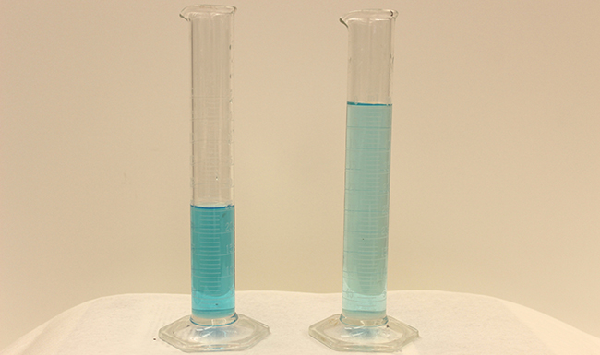
Figure 3.16
Both solutions contain the same mass of copper nitrate. The solution on the right is more dilute because the copper nitrate is dissolved in more solvent. (credit: Mark Ott)

Slide 46
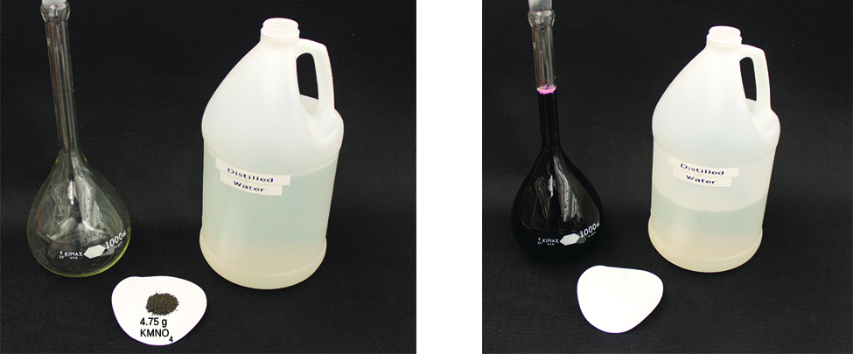
Figure 3.17
A solution of KMnO₄ is prepared by mixing water with 4.74 g of KMnO₄ in a flask. (credit: modification of work by Mark Ott)

Slide 47
Dilution of solutions
The molar amount of solute (n) in a solution is equal to the product of the solution’s molarity and its volume in liters:
Expressions like these may be written for a solution before (1) and after (2) it is diluted:

Slide 48
Dilution of solutions
Since the dilution process does not change the amount of solute in the solution, n₁ = n₂.
Thus, these two equations may be set equal to one another to derive the dilution equation:
Other units of concentration (C) and volume (V) may be used.

Slide 49
Example 3.19
If 0.850 L of a 5.00-M solution of copper nitrate, Cu(NO₃)₂, is diluted to a volume of 1.80 L by the addition of water, what is the molarity of the diluted solution?

Slide 50
3.4 other units for solution concentrations
Molarity is a very useful unit for evaluating the concentration of solutions.
In this section, we will introduce some other units of concentration that are commonly used in various applications.

Slide 51
Mass percentage
The mass percentage of a solution component is defined as the ratio of the component’s mass to the solution’s mass, expressed as a percentage:
We are generally most interested in the mass percentages of solutes, but it is also possible to compute the mass percentage of solvent.

Slide 52
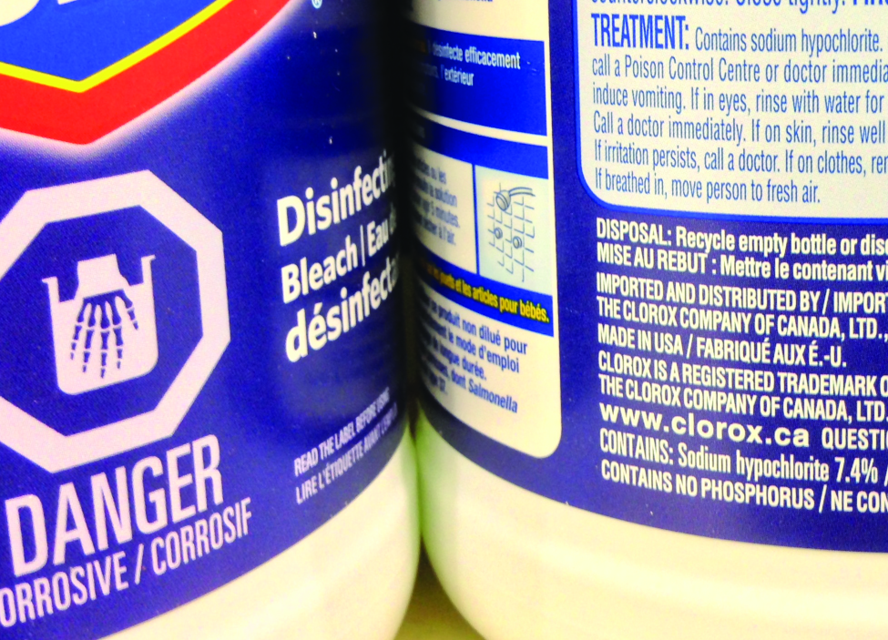
Figure 3.18
Liquid bleach is an aqueous solution of sodium hypochlorite (NaOCl). This brand has a concentration of 7.4% NaOCl by mass.

Slide 53
volume percentage
The concentration of a solution formed by dissolving a liquid solute in a liquid solvent is often expressed as a volume percentage.

Slide 54
Mass-volume percentage
A mass-volume percent is a ratio of a solute’s mass to the solution’s volume expressed as a percentage.
The specific units used for solute mass and solution volume may vary, depending on the solution.
For example, physiological saline solution, used to prepare intravenous fluids, has a concentration of 0.9% mass/volume (m/v), indicating that the composition is 0.9 g of solute per 100 mL of solution.

Slide 55
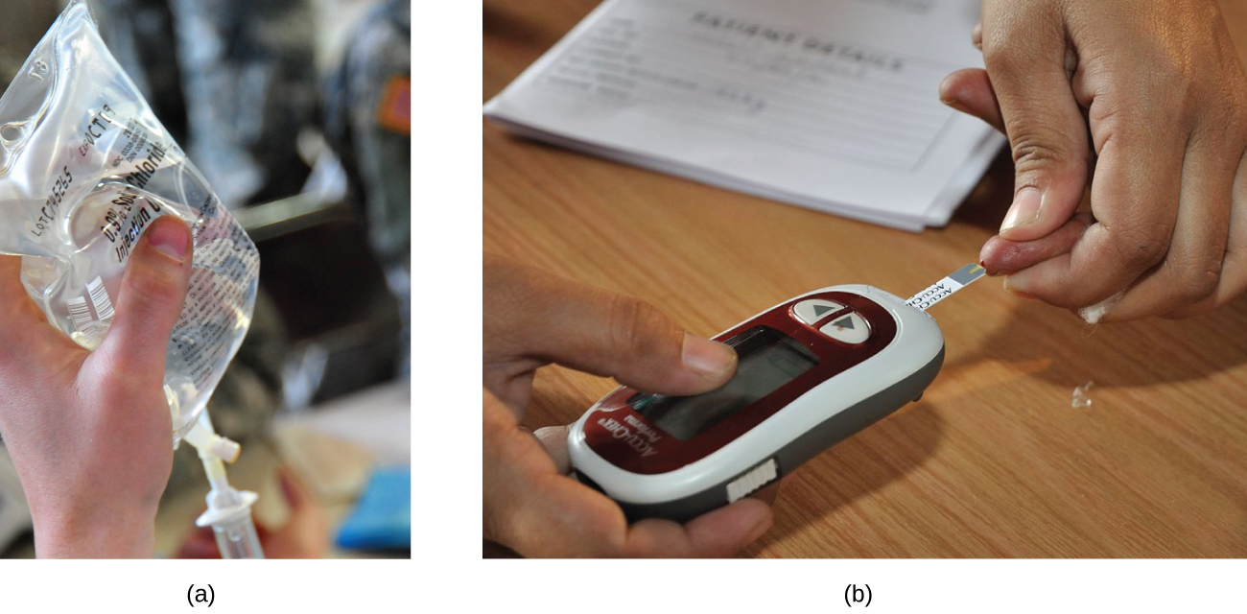
Figure 3.19
“Mixed” mass-volume units are commonly encountered in medical settings.
The NaCl concentration of physiological saline is 0.9% (m/v).
This device measures glucose levels in a sample of blood. The normal range for glucose concentration in blood (fasting) is around 70–100 mg/dL. (credit a: modification of work by “The National Guard”/Flickr; credit b: modification of work by Biswarup Ganguly)

Slide 56
Parts per million and parts per billion
Very low solute concentrations are often expressed using appropriately small units such as parts per million (ppm) or parts per billion (ppb).
The mass-based definitions of ppm and ppb:

Slide 57
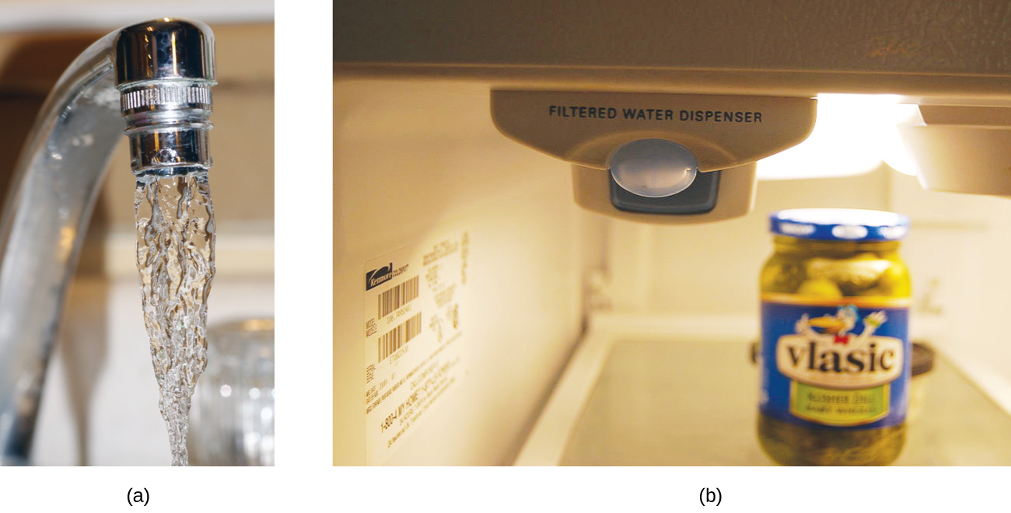
Figure 3.20
In some areas, trace-level concentrations of contaminants can render unfiltered tap water unsafe for drinking and cooking.
Inline water filters reduce the concentration of solutes in tap water. (credit a: modification of work by Jenn Durfey; credit b: modification of work by “vastateparkstaff”/Wikimedia commons)

Slide 58
This file is copyright 2017, Rice University. All Rights Reserved.

