Slide 1
CHEMISTRY
Chapter 4
Stoichiometry of Chemical Reactions
Slides by Montgomery College licensed under CC BY 4.0.

Slide 2
chapter 4: Stoichiometry
4.1 Writing and Balancing Chemical Equations
4.2 Classifying Chemical Reactions
4.3 Reaction Stoichiometry
4.4 Reaction Yields
4.5 Quantitative Chemical Analysis

Slide 3
4.1 Writing and balancing chemical equations
How do you know if a chemical reaction has taken place?

Slide 4
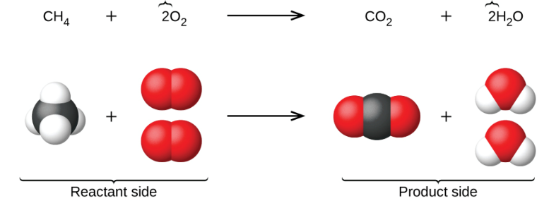
4.1 Writing and balancing chemical equations
Chemical Equations
Representing Chemical Reactions
When atoms gain or lose electrons to form ions, or when atoms combine with other atoms to form molecules, their symbols are modified so as to appropriately represent the species formed.
A chemical equation is used to represent the relative quantities of reactants used and products formed in a chemical process.
stoichiometric
coefficients

Slide 5
4.1 Writing and balancing chemical equations
Chemical Equations
In the reaction shown:
CH₄ and O₂ are reactants. CO and H₂O are products.
For one molecule of CH₄, the process requires two molecules of oxygen.
The the reaction produces one molecule of CO₂ and two molecules of H₂O.
Moles can be used to count products and reactants as well.
How many moles of water are produced if three moles of CH₄ are used?
stoichiometric
coefficients

Slide 6
4.1 Writing and balancing chemical equations
Chemical Equations
Balancing Chemical Equations
When representing a chemical reaction, the equation must be balanced.
The number and type of atoms on the reactant side must be equal to the number and type of atoms on the product side.
Balance the chemical equations shown below. Use whole number coefficients.
H₂O(ℓ) → H₂(g) + O₂(g)
N₂(g) + O₂(g) → N₂O₅(g)
C₂H₆(g) + O₂(g) → CO₂(g) + H₂O(g)

Slide 7
4.1 Writing and balancing chemical equations
Chemical Equations
Additional Information in Chemical Equations
Information about the physical states of reactants and products should be included in chemical equations.
solid (s)
liquid (ℓ)
gas (g)
aqueous (aq) for a substance dissolved in water
Solid sodium reacts with water to produce aqueous sodium hydroxide and hydrogen gas.
2Na(s) + 2H₂O(ℓ) → 2NaOH(aq) + H₂(g)

Slide 8
4.1 Writing and balancing chemical equations
Chemical Equations
Equations for Ionic Reactions
The chemical species involved in such aqueous reactions can be represented as molecules or as ions.
A molecular equation does not explicitly list ionic species present during a reaction.
An ionic equation is written with dissolved ions listed.
  A complete ionic equation lists all dissolved ions.
  A net ionic equation only includes species involved in the chemical reaction.
  A net ionic equation does not include spectator ions.

Slide 9
4.1 Writing and balancing chemical equations
Chemical Equations
Equations for Ionic Reactions
molecular equation
CaCl₂(aq) + 2AgNO₃(aq) → Ca(NO₃)₂(aq) + 2AgCl(s)
complete ionic equation
Ca²⁺(aq) + 2Cl⎯(aq) + 2Ag⁺(aq) + 2NO₃⎯(aq)
→ Ca²⁺(aq) + 2NO₃⎯(aq) + 2AgCl(s)
net ionic equation
Ca²⁺ and NO₃⎯ are spectator ions are omitted.
2Cl⎯(aq) + 2Ag⁺(aq) → 2AgCl(s)
simplify
Cl⎯(aq) + Ag⁺(aq) → AgCl(s)

Slide 10
4.2 classifying chemical reactions
Classes of Chemical Reactions
Double Displacement
    Precipitation Reactions
    Acid-Base Reactions
Single Replacement
    oxidation-reduction (redox)
Combustion
            a special class of redox reactions
            burning in the presence of oxygen
Synthesis
Decomposition

Slide 11
4.2 classifying chemical reactions
Precipitation Reactions
Solubility
Precipitation reactions occur when dissolved substances react to form one or more insoluble, or solid, products.
When aqueous calcium nitrate and potassium phosphate are mixed, solid calcium phosphate forms. Calcium phosphate is a major component of kidney stones.
3Ca(NO₃)₂(aq) + 2K₃(PO₄)(aq) → Ca₃(PO₄)₂(s) + 6KNO₃(aq)
3Ca²⁺(aq) + 6NO₃⎯(aq) + 6K⁺(aq) + 2PO₄^{3⎯}(aq)
→ 6K⁺(aq) + 6NO₃⎯(aq) + Ca₃(PO₄)₂(s)
3Ca²⁺(aq) + 2PO₄^{3⎯}(aq) → Ca₃(PO₄)₂(s)

Slide 12
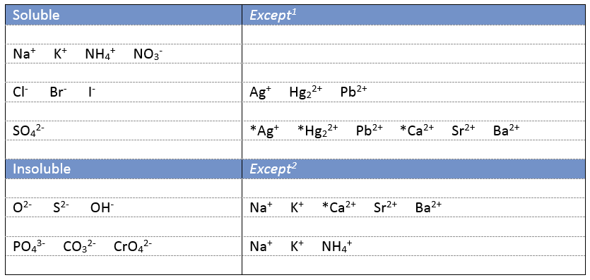
4.2 classifying chemical reactions
Solubility Rules: Predicting Precipitation Reactions
¹ For example, chloride compounds are usually soluble, but when combined with Ag⁺ an insoluble solid, AgCl, forms.
² For example, oxides are typically insoluble compounds, but when combined with Na⁺, a soluble compound, Na₂O, forms.
* These compounds are slightly soluble or slightly insoluble.

Slide 13
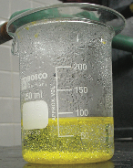
4.2 classifying chemical reactions
Precipitation Reactions
Solubility Rules
Precipitation is a one kind of double displacement reaction.
The ions from one reactant swap places with the ions from the other reactant; one of the products is insoluble.
Unreactive, soluble ions are spectator ions.
Pb(NO₃)₂(aq) + 2KI(aq) → PbI₂(s) + 2KNO₃(aq)
net ionic equation: Pb²⁺(aq) + 2I⎯(aq) → PbI₂(s)
Predict the products:
potassium sulfate and barium nitrate →
lithium chloride and silver acetate →
lead nitrate and ammonium carbonate →

Slide 14
4.2 classifying chemical reactions
Classes of Chemical Reactions
Double Displacement
    Precipitation Reactions
    Acid-Base Reactions
Single Replacement
    oxidation-reduction (redox)
Combustion
            a special class of redox reactions
            burning in the presence of oxygen
Synthesis
Decomposition

Slide 15
4.2 classifying chemical reactions
Acid-Base Reactions
Acids
Acids dissolve in water to yield hydronium ions (H₃O⁺).
  H⁺ ions are transferred from HCl to H₂O molecules.
  HCl(aq) + H₂O(ℓ) → Cl⎯(aq) + H₃O⁺(aq)
Strong acids completely dissociate in aqueous solution.
  HCl, HNO₃, and H₂SO₄ are examples strong acids.
Weak acids only partially dissociate in water.
  CH₃COOH (acetic acid or vinegar) is an example of a weak acid.
  CH₃COOH(aq) + H₂O(ℓ) ⇌ CH₃COO⎯(aq) + H₃O⁺(aq)
  Only ~1% of CH₃COOH molecules react to form CH₃COO⎯.

Slide 16
4.2 classifying chemical reactions
Acid-Base Reactions
Bases
Bases dissolve in water to yield hydroxide ions, OH⎯.
  NaOH, KOH, Ba(OH)₂
  NaOH(aq) → Na⁺(aq) + OH⎯(aq)
  Common bases are ionic compounds of alkali metals or alkaline earth metals.
Strong bases completely dissociate in water.
  NaOH, KOH, and Ba(OH)₂ are examples of strong bases.
Weak bases include molecules that can react with water to produce hydroxide ion.
  Ammonia is an example of a weak base.
  NH₃(aq) + H₂O(ℓ) ⇌ NH₄⁺(aq) + OH⎯(aq)

Slide 17
4.2 classifying chemical reactions
Acid-Base Reactions
Neutralization
A neutralization reaction, another kind of double displacement reaction, occurs between a strong acid and a strong base.
  NaOH(aq) + HCl(aq) → NaCl(aq) + H₂O(ℓ)
  Na⁺(aq) + OH⎯(aq) + H⁺(aq) + Cl⎯(aq)
    → Na⁺(aq) + Cl⎯(aq) + H₂O(ℓ)
  H⁺(aq) + OH⎯(aq) → H₂O(ℓ)
The products of an acid-base neutralization reaction are a salt and water.
molecular
complete
ionic
net ionic
A neutralization reaction takes place when aqueous barium hydroxide and aqueous nitric acid are mixed.
Write the molecular equation, the complete ionic equation, and the net ionic equation.

Slide 18
4.2 classifying chemical reactions
Classes of Chemical Reactions
Double Displacement
    Precipitation Reactions
    Acid-Base Reactions
Single Replacement
    oxidation-reduction (redox)
Combustion
            a special class of redox reactions
            burning in the presence of oxygen
Synthesis
Decomposition

Slide 19
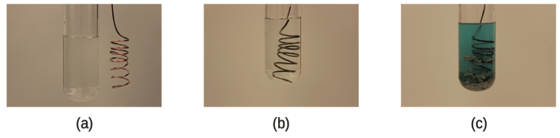
4.2 classifying chemical reactions
Oxidation-Reduction Reactions
Single Replacement
In one type of single replacement reaction, an ion in solution is often displaced or replaced via an oxidation-reduction reaction, or a redox reaction.
An example of such a reaction is:
Cu(s) + 2AgNO₃(aq) → Cu(NO₃)₂(aq) + 2Ag(s)

Slide 20

4.2 classifying chemical reactions
Oxidation-Reduction Reactions
Oxidation
The term oxidation was originally used to refer to reactions involving O₂.
Now oxidation is used to refer to a reaction in which electrons are lost by a chemical species.
Reduction
When an oxidation reaction takes place, it is always coupled to a reduction reaction.
The term reduction refers to a reaction in which electrons are gained by a chemical species.
LEO says GRRRRR!
Loss of electrons is oxidation.
Gain is reduction.

Slide 21
4.2 classifying chemical reactions
Oxidation-Reduction Reactions
Redox Reactions
If a species gets oxidized another species must get reduced.
Keep track of the electrons by looking at the oxidation state of the species.
Determine the oxidation states of the metal ions in blue.
Would the elemental form of each metal need to be oxidized or reduced to form the compounds listed?
KMnO₄ AgCl OsO₄ MnO₂ Fe₂O₃
LEO says GRRRRR!
Loss of electrons is oxidation.
Gain is reduction.

Slide 22
4.2 classifying chemical reactions
Oxidation-Reduction Reactions
Redox Reactions
To see where electrons are going, separate a redox reaction into two parts:
  oxidation half-reaction
  reduction half-reaction
Zn²⁺(aq) + Cu(s) → Cu²⁺(aq) + Zn(s)
  oxidation half-reaction: Zn²⁺(aq) + 2e⎯ → Zn(s)
  reduction half-reaction: Cu(s) → Cu²⁺(aq) + 2e⎯
LEO says GRRRRR!
Loss of electrons is oxidation.
Gain is reduction.

Slide 23
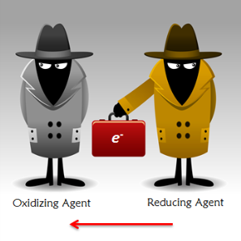
4.2 classifying chemical reactions
Oxidation-Reduction Reactions
Redox Reactions
An oxidizing agent takes electrons and causes oxidation.
A reducing agent gives electrons and causes reduction.
Zn²⁺(aq) + Cu(s) → Cu²⁺(aq) + Zn(s)
  oxidation: Zn²⁺(aq) + 2e⎯ → Zn(s)
  reduction: Cu(s) → Cu²⁺(aq) + 2e⎯
Which species is the oxidizing agent?
Which species is the reducing agent?
An oxidizing agent gets reduced. A reducing agent gets oxidized.

Slide 24
4.2 classifying chemical reactions
Classes of Chemical Reactions
Double Displacement
    Precipitation Reactions
    Acid-Base Reactions
Single Replacement
    oxidation-reduction (redox)
Combustion
            a special class of redox reactions
            burning in the presence of oxygen
Synthesis
Decomposition

Slide 25
4.2 classifying chemical reactions
Combustion Reactions
Components and Balancing
In a combustion reaction, the reducing agent is called the fuel.
The oxidizing agent is usually O₂.
When compounds composed of just carbon and hydrogen undergo combustion, CO₂ and H₂O are products.
Heat and light are also often produced.
Complete and balance the following combustion reactions. For each, determine which species is the oxidizing agent and which is the reducing agent.
CH₄(g) + O₂(g) →
C₂H₆(g) + O₂(g) →
C₃H₈(g) + O₂(g) →

Slide 26
4.2 classifying chemical reactions
Classes of Chemical Reactions
Double Displacement
    Precipitation Reactions
    Acid-Base Reactions
Single Replacement
    oxidation-reduction (redox)
Combustion
            a special class of redox reactions
            burning in the presence of oxygen
Synthesis
Decomposition

Slide 27
4.2 classifying chemical reactions
Synthesis and Decomposition Reactions
Synthesis
When two or more chemical species react and form bonds, the process is called synthesis.
Examples of synthesis reactions are:
2Na(s) + Cl₂(g) → 2NaCl(s)
CaO(s) + CO₂(g) → CaCO₃(s)
Decomposition
Decomposition occurs when a substance is broken down into small chemical units.
Examples of decomposition reactions are:
H₂O₂(aq) → H₂(g) + O₂(g)
2KClO₃(s) → 2KCl(s) + 3O₂(g)

Slide 28
4.2 classifying chemical reactions
The Synthesis of Alum from Aluminum
What is the net reaction for the synthesis of alum?
1)
2)
3)
4)
2Al(s) + 2 KOH(aq) + 6 H₂O(ℓ) → 2KAl(OH)₄(aq) + 3H₂(g)
2KAl(OH)₄(aq) + H₂SO₄(aq) → 2Al(OH)₃(s) + K₂SO₄(aq) + 2H₂O(ℓ)
2Al(OH)₃(s) + 3H₂SO₄(aq) → Al₂(SO₄)₃(aq) + 6H₂O(ℓ)
Al₂(SO₄)₃(aq) + K₂SO₄(aq) + 24H₂O(ℓ) → 2 KAl(SO₄)₂ ⋅ 12H₂O(s)

Slide 29
4.2 classifying chemical reactions
Summary
Double Displacement
    Precipitation: AgNO₃(aq) + NaCl(aq) → AgCl(s) + NaNO₃(aq)
    Acid- Base: HCl(aq) + NaOH(aq) → H₂O(ℓ) + NaCl(aq)
Single Replacement
    Mg(s) + 2 HCl(aq) → MgCl₂(aq) + H₂(g)
    Zn(s) + CuCl₂(aq) → ZnCl₂(aq) + Cu(s)
Combustion
    2C₄H₁₀(g) + 13O₂(g) → 8CO₂(g) + 10H₂O(g)
Synthesis
    2Na(s) + Cl₂(g) → 2 NaCl(s)
Decomposition
    4C₃H₅(NO₃)₃(ℓ) → 6N₂(g) + O₂(g) + 12CO₂(g) + 10H₂O(ℓ)

Slide 30
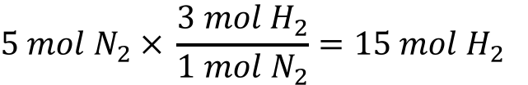
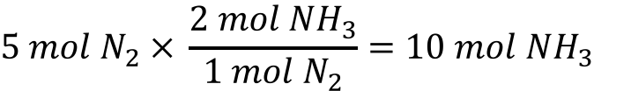
4.3 reaction stoichiometry
Balanced Reactions and Calculations
Stoichiometry
The term stoichiometry comes from the Greek stoicheion (element) and metron (measure).
Stoichiometric coefficients from a balanced chemical reaction can be used to derive quantitative relationships between reactants and products.
relationships from the balanced reaction
N₂(g) + 3H₂(g) → 2NH₃(g)
How many moles of ammonia can be formed from 5 moles of nitrogen gas?
$$5 mol N_{2} × \frac{2 mol {NH}_{3}}{1 mol N_{2}}=10 mol {NH}_{3}$$
How many moles of hydrogen gas would be required?
$$5 mol N_{2} × \frac{3 mol H_{2}}{1 mol N_{2}}=15 mol H_{2}$$

Slide 31
4.3 reaction stoichiometry
Balanced Reactions and Calculations
Moles and Masses
In the laboratory, the amounts of chemicals used are measured in grams.
Stoichiometry relates the reactants and products of a reaction in terms of molecules or moles.
N₂(g) + 3H₂(g) → 2NH₃(g)
If 21.000 g of N₂ are allowed to react with excess H₂, what mass of ammonia is formed?
Know: grams of N₂
Want: grams of NH₃
moles of N₂
moles of NH₃
Continued on the next slide.

Slide 32
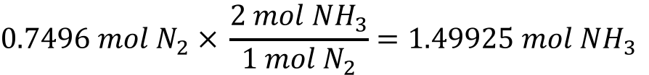
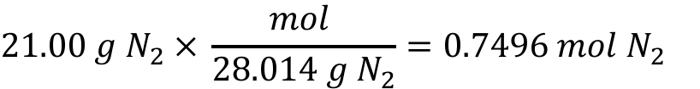
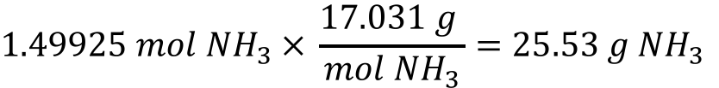
4.3 reaction stoichiometry
N₂(g) + 3H₂(g) → 2NH₃(g)
If 21.00 g of N₂ are allowed to react with excess H₂, what mass of ammonia is formed?
Know: grams of N₂
Want: grams of NH₃
(1)
(3)
(2)
moles of N₂
moles of NH₃
(1)
$$21.00 g N_{2} × \frac{mol }{28.014 g N_{2}}=0.7496 mol N_{2}$$
(2)
$$0.7496 mol N_{2} × \frac{2 mol {NH}_{3}}{1 mol N_{2}}=1.49925 mol {NH}_{3}$$
(3)
$$1.49925 mol {NH}_{3} × \frac{17.031 g }{mol {NH}_{3}}=25.53 g {NH}_{3}$$

Slide 33
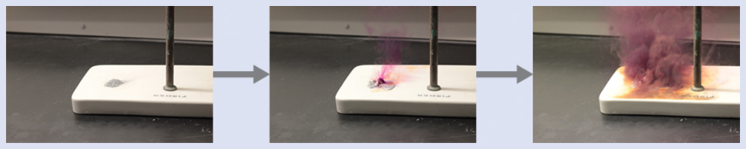
4.3 reaction stoichiometry
Example 4.8
Aluminum and molecular iodine (I₂) react to form aluminum triiodide. How many moles of iodine are required to react with 0.429 mol of aluminum?

Slide 34
4.3 reaction stoichiometry
Example 4.9
How many carbon dioxide molecules are produced when 0.75 mol of propane (C₃H₈) undergoes combustion?

Slide 35
4.3 reaction stoichiometry
Example 4.10
The active ingredient in the antacid milk of magnesia is magnesium hydroxide. What mass of sodium hydroxide is required to produce 16 g of magnesium hydroxide?

Slide 36
4.3 reaction stoichiometry
Example 4.10 Check Your Learning
The reaction between gallium solid and oxygen gas produces gallium oxide, Ga₂O₃.What mass of gallium oxide, Ga₂O₃, can be prepared from 29.0 g of gallium metal?

Slide 37
4.4 reaction Yields
Limiting Reactant
Reaction Stoichiometry
When reactants are mixed for a chemical reaction, the amounts are rarely mixed in perfect stoichiometric amounts.
The limiting reactant will be entirely consumed, and some amount of the excess reactant will be left over.
Use stoichiometry to determine which reactant is limiting before attempting to calculate the yield, or amount of product produced.

Slide 38
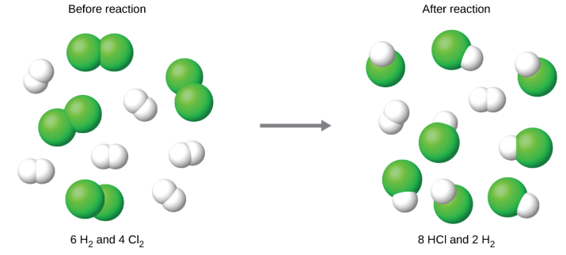
4.4 reaction Yields
Limiting Reactant
If 6 molecules of H₂ react with 4 molecules of Cl₂, HCl is produced. Which reactant is limiting?
H₂(g) + Cl₂(g) → 2HCl(g)

Slide 39
4.4 reaction Yields
Limiting Reactant
Identifying a Limiting Reactant
Determine the number of moles of each reactant.
Use stoichiometry to conduct two trials.
  Calculate the amount of product formed if the first reactant is consumed completely.
  Calculate the amount of product formed if the second reactant is consumed completely.
The reactant the produces the least amount of product is the limiting reactant.
The reaction yield can then be calculated based on complete consumption of the limiting reactant.

Slide 40
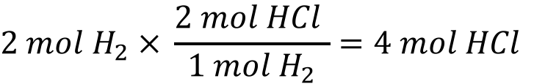
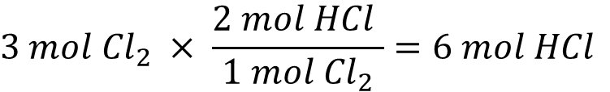
4.4 reaction Yields
Limiting Reactant
If 2 moles of H₂ react with 3 moles of Cl₂, HCl is produced. Which reactant is limiting?
H₂(g) + Cl₂(g) → 2HCl(g)
Trial #1
Use up H₂
$$2 mol H_{2} × \frac{2 mol HCl }{1 mol H_{2}}=4 mol HCl$$
Using up H₂ results in fewer moles of product.
H₂ is the limiting reactant.
Trial #2
Use up Cl₂
$$3 mol {Cl}_{2} × \frac{2 mol HCl }{1 mol {Cl}_{2}}=6 mol HCl$$

Slide 41
4.3 reaction stoichiometry
Limiting Reactant
Example 4.12
Silicon nitride, Si₃N₄(s), is a hard, temperature-resistant ceramic used to make turbine blades for jet engines. Silicon nitride is synthesized by reacting solid silicon with nitrogen gas.
What is the limiting reactant when 2.00 g of silicon and 1.50 g nitrogen gas react?

Slide 42
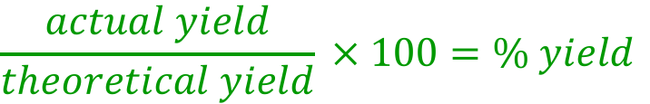
4.4 reaction Yields
Reaction Yield
Stoichiometry and Reaction Products
The amount of product that can be produced, if everything in a reaction process goes perfectly, is the theoretical yield.
The amount of product produced when a reaction is carried out in the laboratory is the actual yield.
The percent yield is:
$$\frac{actual yield}{theoretical yield} × 100=\% yield$$
Note: Percent yield should not be confused with percent error.
$$\frac{actual value −theoretical value}{theoretical value} × 100=\% error$$

Slide 43
4.4 reaction Yields
Reaction Yield
Example 4.13
When 1.274 g of copper(II) sulfate and excess zinc metal, 0.392 g copper metal was obtained.
What is the limiting reactant?
What is the theoretical yield of copper metal?
What is the percent yield of copper metal?

Slide 44
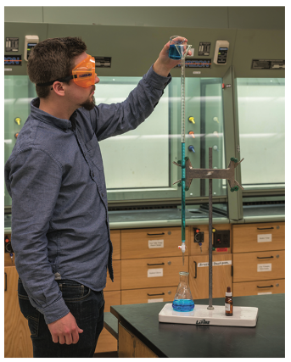
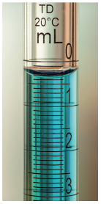
4.5 quantitative chemical analysis
Titrations
Analysis of Solutions
The amount of solute in a solution can be determined by using an analytical process called titration.
Titrations involve the use of a buret to make incremental additions of a solution of known concentration, the titrant, to a solution of unknown concentration, the analyte.
A complete reaction between the titrant and the analyte, the equivalence point, can be observed by a color change if an indicator is used.
The volume of titrant used, along with reaction stoichiometry, can be used to determine the concentration of analyte.

Slide 45
4.5 quantitative chemical analysis
Example 4.14
A 50.00 mL sample of aqueous HCl requires the addition of 35.23 mL of 0.250 M NaOH. Determine the concentration of the hydrochloric acid solution.
Titration Reaction
HCl(aq) + NaOH(aq) → NaCl(aq) + H₂O(ℓ)

Slide 46
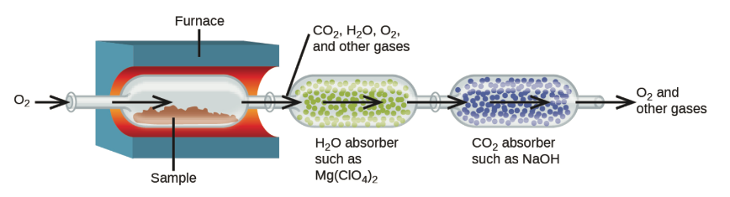
4.5 quantitative chemical analysis
Combustion Analysis
Analysis of Hydrocarbons
The elemental composition of hydrocarbons and related compounds can be determined by heating a sample to high temperatures in a stream of oxygen gas.
The amounts of CO₂ and H₂O produced can be used to determine the empirical formula of the sample.

Slide 47
4.5 quantitative chemical analysis
Combustion Analysis
Example 4.16
Polyethylene is a hydrocarbon polymer used to produce flexible plastic items. Combustion analysis of 0.00125 g sample of polyethylene yields 0.00394 g CO₂ and 0.00161 g H₂O. What is the empirical formula of polyethylene?
C_{x}H_{y}(g) + O₂(g) → ? CO₂(g) + ? H₂O(g)
All the carbon in CO₂ comes from C_{x}H_{y}.
All the hydrogen in H₂O comes from C_{x}H_{y}.
Use the #g CO₂ to determine #mol CO₂ and #mol C.
Use the #g H₂O to determine #mol H₂O and #mol H.
  Remember that one mole of H₂O gives two moles of H.
Divide by the smallest #mol to get the empirical formula.

Slide 48
extra problems
Stoichiometry of Chemical Reactions
The White Cliffs of Dover and Sacré-Coeur Basilica
Thermite - Stoichiometry
H₂O₂ Decomposition: Elephant Toothpaste - Stoichiometry
Titanium Dioxide – Limiting Reactant
Titanium Nitride – Limiting Reactant
Combustion of Octane
Combustion Analysis
*Challenging problems.

Slide 49
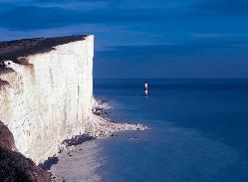
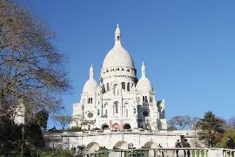
extra problems
The White Cliffs of Dover are made of calcium carbonate from the skeletons of ancient microscopic plankton.
Sacré-Coeur Basilica is constructed from travertine limestone, also calcium carbonate, and tends to stay brilliant white.
Calcium carbonate undergoes a series of as shown below. Classify each of the reactions. Explain how acid rain affects both the cliffs and the basilica.
CaCO₃(s) + H₃O⁺(aq) → Ca²⁺(aq) + HCO₃⁻(aq)
HCO₃⁻(aq) + H₃O⁺(aq) → CO₂(aq) + 2H₂O(ℓ)
CO₂(aq) + H₂O(ℓ) → H₂CO₃(aq)
The White Cliffs of Dover
Sacré-Coeur Basilica

Slide 50
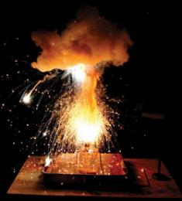
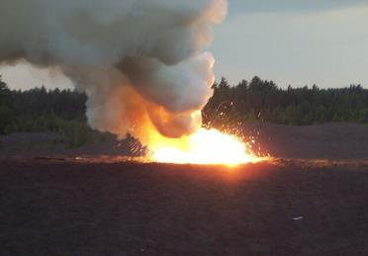
extra problems
The thermite reaction occurs when iron(III) oxide reacts with solid aluminum. The reaction is so hot that molten iron forms as a product.
Fe₂O₃(s) + Al(s) → Fe(ℓ) + Al₂O₃(s)
What mass of aluminum should be used in order to completely consume 10.0 g Fe₂O₃(s)? If the reaction described produces 5.3 g Al₂O₃(s), what is the percent yield?

Slide 51


extra problems
Elephant Toothpaste Demo
Hydrogen peroxide, H₂O₂, has a density of 1.45 g/cm³ and decomposes spontaneously but slowly. The decomposition reaction will proceed at a faster rate if iodide ion, a catalyst, is added. The steps for the catalyzed reaction are:
H₂O₂(aq) + I⁻ (aq) → H₂O(𝓁) + OI⁻(aq)
H₂O₂(aq) + OI⁻(aq) → H₂O(𝓁) + O₂(g) + I⁻(aq)
What is the net reaction?
If 10.00 mL of H₂O₂ undergoes this reaction, what mass of oxygen is produced?
If the reaction has an 85.5% yield, what mass of oxygen is actually produced?

Slide 52
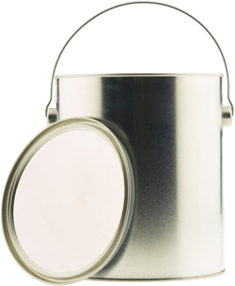




extra problems
Titanium oxide, TiO₂, is a white pigment used in many consumer products. It is also a important part of the composite materials used to build next-generation aircraft like the Boeing 787.
  125.0 grams of titanium solid and 125.0 grams of oxygen gas are mixed in a sealed container under combustion conditions. What is the limiting reactant? How many grams of TiO₂ will be made? How many grams of each reactant will be left over?

Slide 53

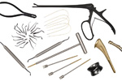
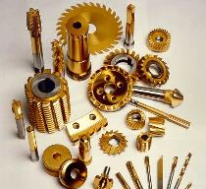


extra problems
Titanium is the only metal that burns in nitrogen gas to form a nitride. Titanium nitride, TiN, is extremely hard and strong. Chemical vapor deposition is used to coat tools, surgical equipment, and orthotics with TiN.
  375.0 grams of titanium solid and 100.0 grams of nitrogen gas are mixed in a sealed container under combustion conditions. What is the limiting reactant? How many grams of TiN will be made? How many grams of each reactant will be left over?
knee
collarbone

Slide 54
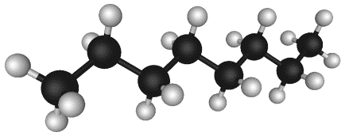
extra problems
What mass of carbon dioxide is formed from burning one gallon of octane, C₈H₁₈? Octane has a density of 0.703 kg/m³.
  1 L = 0.2642 gal
  1 lb. = 453.592 g

Slide 55
extra problems: Titrations
Commercial vinegar is packaged as a 5% solution of acetic acid in water. What is the molarity of a 5.00% (w/v) acetic acid (vinegar) solution?

Slide 56
extra problems: Titrations
6.20 mL of commercial vinegar from the previous problem and 25 mL deionized water are placed in a 125 mL Erlenmeyer flask along with one drop of phenolphthalein. A volume of 24.50 mL of sodium hydroxide solution is required for the color of the solution in the flask to change from clear to light pink.
What is the concentration of the sodium hydroxide solution?

Slide 57
extra problems: Titrations
A volume of 35.60 mL of 0.2255 M sodium hydroxide was required to completely react with 19.90 mL of phosphoric acid solution. Find the molarity of the phosphoric acid solution.

Slide 58
extra problems: Titrations
A 1.631 g sample of an unknown triprotic acid was dissolved in water and diluted to 250.0 mL in a volumetric flask. 20.00 mL of the acid solution required 19.74 mL of 0.1063 M NaOH to reach the endpoint of the titration. Determine the molar mass of the triprotic acid.

Slide 59
extra problems: Titrations
Potassium hydrogen phthalate, KHC₈H₄O₄ (KHP) is often used to standardize solutions of bases. The acidic anion reacts with strong bases according to the following equation:
KHC₈H₄O₄(aq) ⁺ OH⁻(aq) → C₈H₄O₄²⁻(aq) + H₂O(ℓ) + K⁺(aq)
0.9820 g sample of KHP is dissolved in water and titrated to the equivalence point with 26.45 mL of NaOH solution. What is the concentration (molarity) of the NaOH solution?

Slide 60
end of chapter problems – chapter 4
Ionic Equations: #9, 11
Reaction Stoichiometry: #47, 49, 51, 57
Reaction Yields and Limiting Reactants: #61, 63, 71
Solution Stoichiometry: #87, 89, 93
For detailed solutions to these problems, go to the OpenStax Chemistry website and download the Student Solution Guide.

Slide 61
videos – chapter 4
Stoichiometry
http://youtu.be/_w92AZzxCQ4
http://screencast.com/t/Eb9M5o8ocap
http://screencast.com/t/tgkPSqgUN
Molarity w/ Stoichiometry Calculations
http://youtu.be/xH_pAR3ujcA
http://screencast.com/t/CGjYQfkApBc4
Limiting Reactants
http://youtu.be/dxvAQPtvHDI
http://screencast.com/t/zDM7TCFtT (moles to moles)
http://screencast.com/t/YxNEU8EkT2tw (grams to grams)
Theoretical and Percent Yield
http://screencast.com/t/hErS01pOr2Dw
Titration Calculation (not an MC video - posted on YouTube by Khan Academy)
https://youtu.be/aj34f2Bg9Vw
Writing Ionic Equations
http://youtu.be/hRoFbybPEOQ
http://screencast.com/t/hEToemAg
Determining Oxidation States
http://screencast.com/t/IkyR8yBiTluz
http://screencast.com/t/Fijyit5wz
*All videos were created by MC Chemistry faculty unless otherwise indicated.

Slide 62

simulations – chapter 4
Balancing Chemical Equations
https://phet.colorado.edu/en/simulation/balancing-chemical-equations
Reactants, Products, and Leftovers (Chemical Reactions, Limiting Reactants)
https://phet.colorado.edu/en/simulation/reactants-products-and-leftovers

