Slide 1
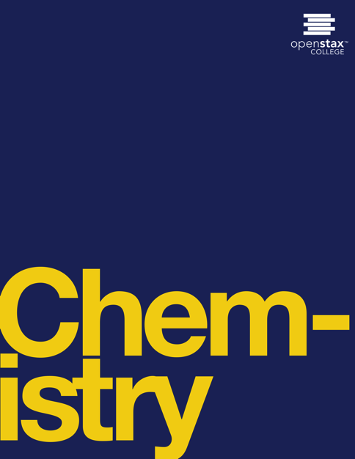

CHEMISTRY
Chapter 5 THERMOCHEMISTRY
Joseph DePasquale
University of Connecticut

Slide 2
Ch. 5 Outline
5.1: Energy Basics
5.2: Calorimetry
5.3: Enthalpy

Slide 3
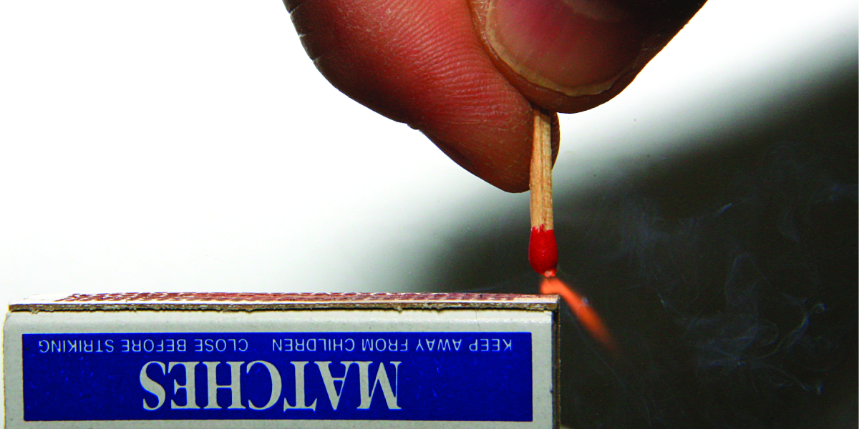
Figure 5.1
Sliding a match head along a rough surface initiates a combustion reaction that produces energy in the form of heat and light. (credit: modification of work by Laszlo Ilyes)

Slide 4
5.1 energy basics
Chemical changes and their accompanying changes in energy are important parts of our everyday world.
  The reactions involved in the metabolism of food.
  The burning of fossil fuels (gasoline, natural gas, coal).
  The production of useful products from raw materials.
Thermochemistry – The study of the heat absorbed or released during chemical and physical changes.

Slide 5
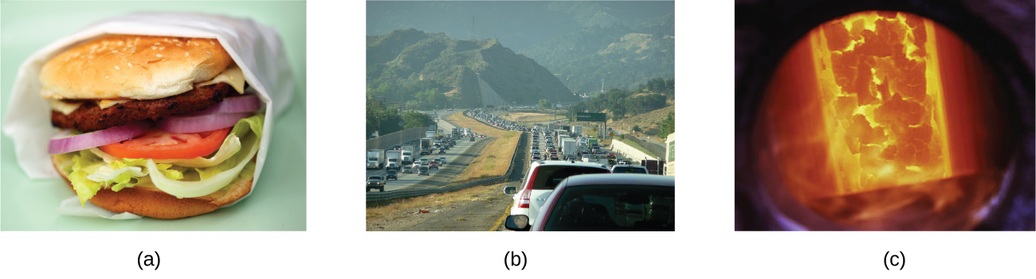
Figure 5.2
The energy involved in chemical changes is important to our daily lives: (a) A cheeseburger for lunch provides the energy you need to get through the rest of the day; (b) the combustion of gasoline provides the energy that moves your car (and you) between home, work, and school; and (c) coke, a processed form of coal, provides the energy needed to convert iron ore into iron, which is essential for making many of the products we use daily. (credit a: modification of work by “Pink Sherbet Photography”/Flickr; credit b: modification of work by Jeffery Turner)

Slide 6
energy
Energy - The capacity to supply heat or do work.
Two main types of energy:
  Potential energy - the energy an object has because of its relative position, composition, or condition.
  Kinetic energy - the energy that an object possesses because of its motion.

Slide 7
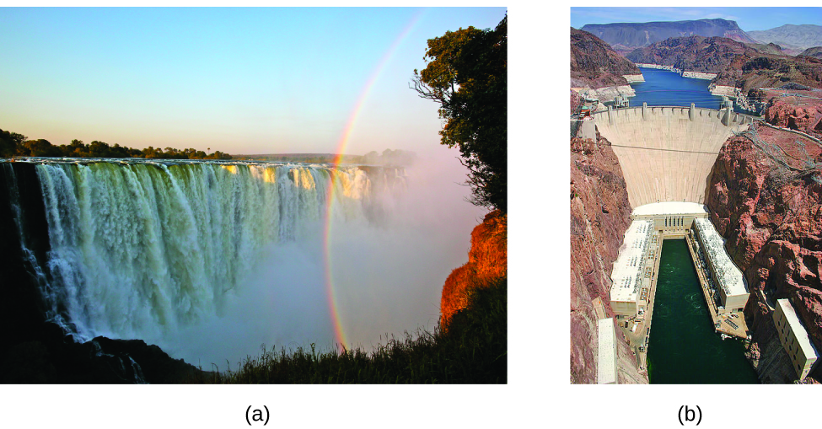
Figure 5.3
Water that is higher in elevation, for example, at the top of Victoria Falls, has a higher potential energy than water at a lower elevation. As the water falls, some of its potential energy is converted into kinetic energy.
If the water flows through generators at the bottom of a dam, such as the Hoover Dam shown here, its kinetic energy is converted into electrical energy. (credit a: modification of work by Steve Jurvetson; credit b: modification of work by “curimedia”/Wikimedia commons)

Slide 8
Law of conservation of energy
Law of conservation of energy – During a chemical or physical change, energy can be neither created nor destroyed, although its form can change.

Slide 9
Thermal energy and temperature
Thermal energy is a type of kinetic energy (KE) associated with the random motion of atoms and molecules.
Temperature is a quantitative measure of “hot” or “cold.”
Fast moving molecules ➔ High thermal energy ➔ “Hot”
Slow moving molecules ➔ Low thermal energy ➔ “Cold”

Slide 10
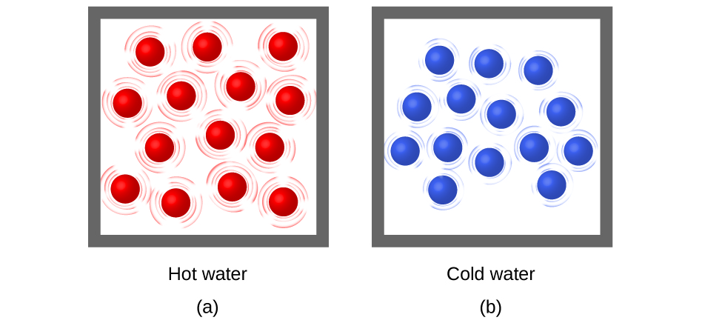
Figure 5.4
(a) The molecules in a sample of hot water move more rapidly than (b) those in a sample of cold water.

Slide 11
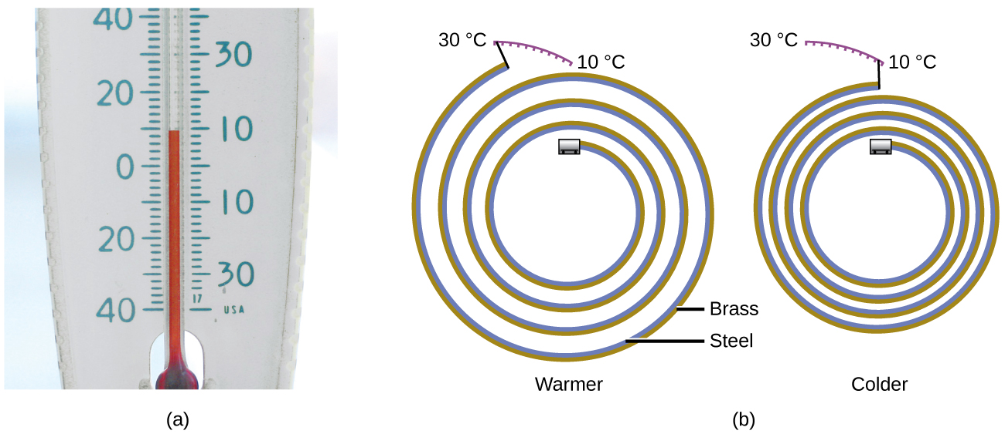
Figure 5.5
In an alcohol or mercury thermometer, the liquid (dyed red for visibility) expands when heated and contracts when cooled, much more so than the glass tube that contains the liquid.
In a bimetallic thermometer, two different metals (such as brass and steel) form a two-layered strip. When heated or cooled, one of the metals (brass) expands or contracts more than the other metal (steel), causing the strip to coil or uncoil. Both types of thermometers have a calibrated scale that indicates the temperature. (credit a: modification of work by “dwstucke”/Flickr)

Slide 12
Heat
Heat (q) is the transfer of thermal energy between two bodies at different temperatures.
Heat flow (a redundant term, but one commonly used) increases the thermal energy of one body and decreases the thermal energy of the other.
When two substances are placed in contact, thermal energy will always flow from the high temperature substance to the low temperature substance.
  Heat flow will continue until both substances are at the same temperature.

Slide 13
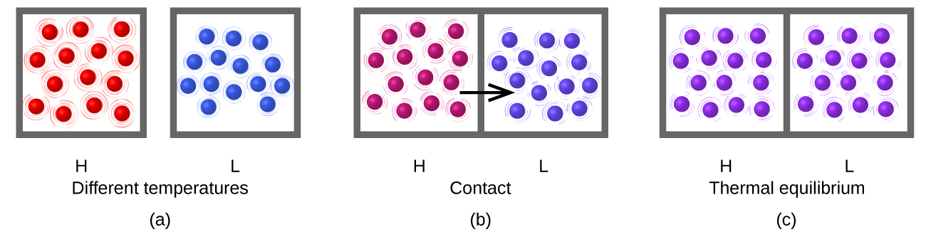
Figure 5.6
Substances H and L are initially at different temperatures, and their atoms have different average kinetic energies.
When they are put into contact with each other, collisions between the molecules result in the transfer of kinetic (thermal) energy from the hotter to the cooler matter.
The two objects reach “thermal equilibrium” when both substances are at the same temperature, and their molecules have the same average kinetic energy.

Slide 14
Exothermic and endothermic processes
Matter undergoing chemical reactions and physical changes can release or absorb heat.
A change that releases heat is called an exothermic process.
  Example: the combustion reaction that occurs when using an oxyacetylene torch.
A change that absorbs heat is an endothermic process.
  Example: The reaction in a cold pack used to treat muscle strains.

Slide 15
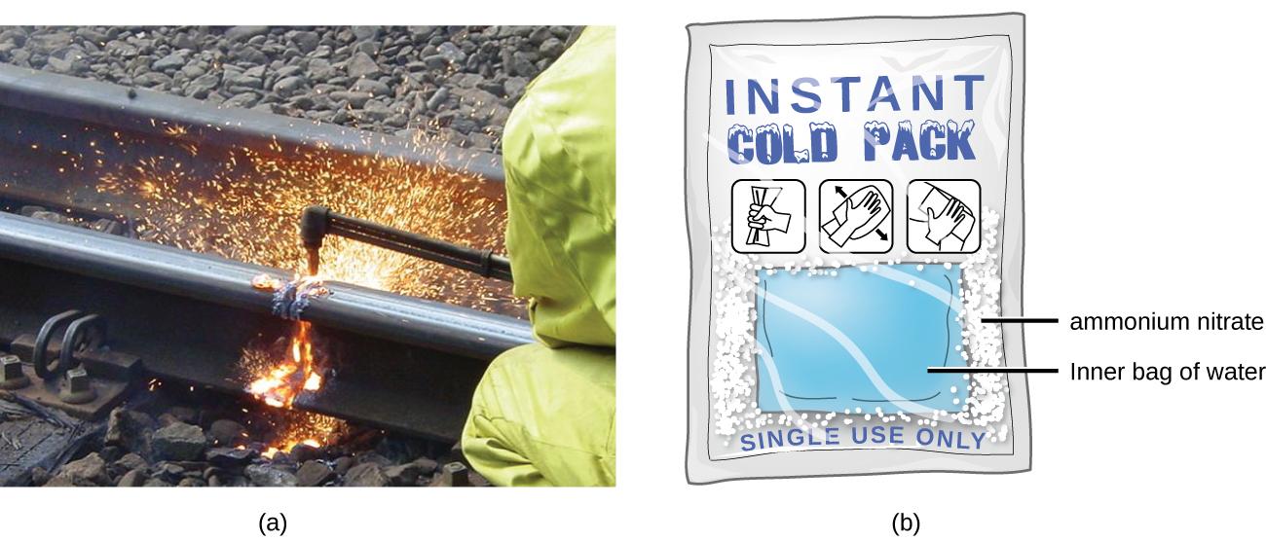
Figure 5.7
An oxyacetylene torch produces heat by the combustion of acetylene in oxygen. The energy released by this exothermic reaction heats and then melts the metal being cut. The sparks are tiny bits of the molten metal flying away.
A cold pack uses an endothermic process to create the sensation of cold. (credit a: modification of work by “Skatebiker”/Wikimedia commons)

Slide 16
Heat units
Historically, energy was measured in units of calories (cal).
A calorie is the amount of energy required to raise one gram of water by 1 °C (or 1 kelvin).
The Calorie (with a capital C), or large calorie, commonly used in quantifying food energy content, is a kilocalorie.

Slide 17
Heat units
The SI unit of heat, work, and energy is the joule.
A joule (J) is defined as the amount of energy used when a force of 1 newton moves an object 1 meter.
It is named in honor of the English physicist James Prescott Joule.
1 calorie = 4.184 joules.

Slide 18
Heat capacity
The heat capacity (C) of a body of matter is the quantity of heat (q) it absorbs or releases when it experiences a temperature change (ΔT) of 1 °C (or 1 kelvin):
Heat capacity is an extensive property.
For example, the heat capacity of a large cast iron pan is greater than the heat capacity of a small cast iron pan.

Slide 19
Specific Heat capacity
The specific heat capacity (c) of a substance, commonly called its “specific heat,” is the quantity of heat required to raise the temperature of 1 gram of a substance by 1 °C (or 1 kelvin):
Specific heat capacity is an intensive property – it only depends on the identity of the substance, not the amount.
For example, the specific heat capacity of a large and small cast iron pan are identical.

Slide 20
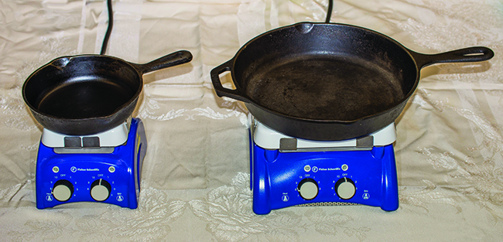
Figure 5.8
Due to its larger mass, a large frying pan has a larger heat capacity than a small frying pan. Because they are made of the same material, both frying pans have the same specific heat. (credit: Mark Blaser)

Slide 21
Specific Heats of common substances (Table 5.1)
Substance Symbol (state) Specific Heat (J/g °C)
helium He(g) 5.193
water H₂O(l) 4.184
ethanol C₂H₆O(l) 2.376
ice H₂O(s) 2.093 (at −10 °C)
water vapor H₂O(g) 1.864
nitrogen N₂(g) 1.040
air 1.007
oxygen O₂(g) 0.918
aluminum Al(s) 0.897
carbon dioxide CO₂(g) 0.853
argon Ar(g) 0.522
iron Fe(s) 0.449
copper Cu(s) 0.385
lead Pb(s) 0.130
gold Au(s) 0.129
silicon Si(s) 0.712

Slide 22
Calculating heat
The amount of heat, q, entering or leaving a substance can be calculated:
If a substance gains thermal energy, T_{final} > T_{initial}, then the value of q is positive.
If a substance loses thermal energy, T_{final} < T_{initial}, then the value of q is negative.

Slide 23
Example 5.1
A flask containing 8.0 × 10² g of water is heated, and the temperature of the water increases from 21 °C to 85 °C. How much heat did the water absorb?

Slide 24
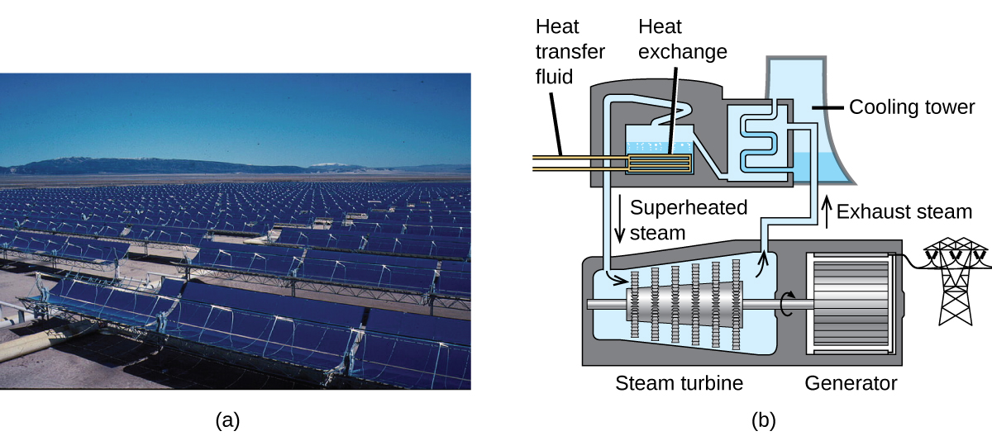
Figure 5.9
This solar thermal plant uses parabolic trough mirrors to concentrate sunlight. (credit a: modification of work by Bureau of Land Management)

Slide 25
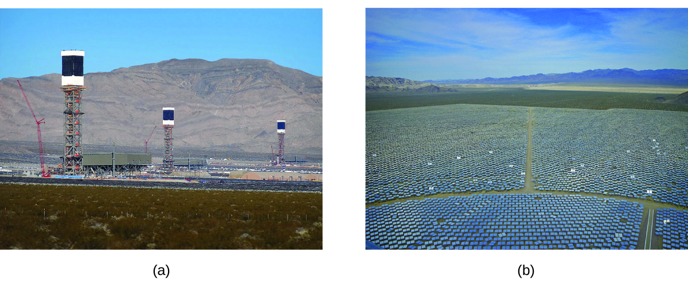
Figure 5.10
The Ivanpah solar thermal plant uses 170,000 mirrors to concentrate sunlight on water-filled towers.
It covers 4000 acres of public land near the Mojave Desert and the California-Nevada border.(credit a: modification of work by Craig Dietrich; credit b: modification of work by “USFWS Pacific Southwest Region”/Flickr)

Slide 26
5.2 calorimetry
One technique that can be used to measure the amount of heat involved in a chemical or physical process is known as calorimetry.
Calorimetry is used to measure the amount of heat transferred to or from a substance.
The heat is exchanged with a calibrated object (calorimeter).
The change in temperature of the measuring part of the calorimeter is converted into the amount of heat.

Slide 27
System and surroundings
System - the substance or substances undergoing the chemical or physical change.
Surroundings - the other components of the measurement apparatus that serve to either provide heat to the system or absorb heat from the system.

Slide 28
calorimeter
A calorimeter is a device used to measure the amount of heat involved in a chemical or physical process.
Many processes measured in a calorimeter occur in solution.
If the reaction is exothermic, the heat produced by the reaction is absorbed by the solution.
If the reaction is endothermic, the heat required for the reaction to occur is provided by the solution.

Slide 29
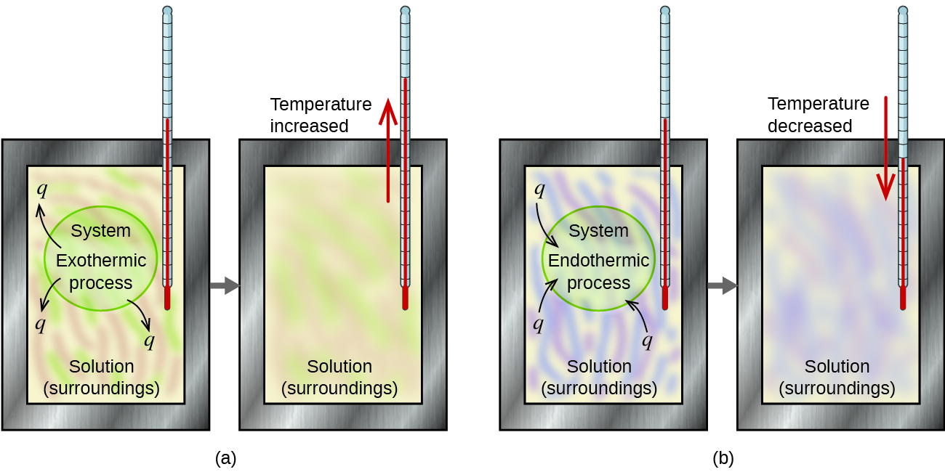
Figure 5.11
In a calorimetric determination, either (a) an exothermic process occurs and heat, q, is negative, indicating that thermal energy is transferred from the system to its surroundings, or (b) an endothermic process occurs and heat, q, is positive, indicating that thermal energy is transferred from the surroundings to the system.

Slide 30
calorimeter
The calorimeter must be well insulated in order to prevent the transfer of heat with the outside environment.
To obtain accurate results, all heat exchange must take place only between the system and the surroundings.
Coffee-cup calorimeters (constructed of polystyrene cups) are often used in general chemistry labs.
Commercial calorimeters of better design are used in industry and for research.

Slide 31
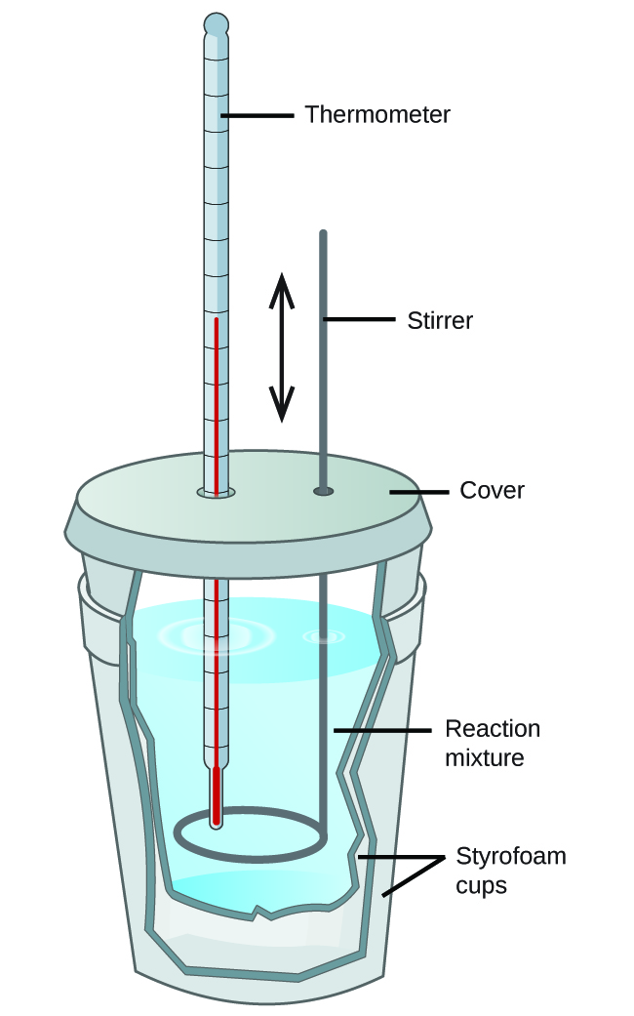
Figure 5.12
A simple calorimeter can be constructed from two polystyrene cups. A thermometer and stirrer extend through the cover into the reaction mixture.

Slide 32
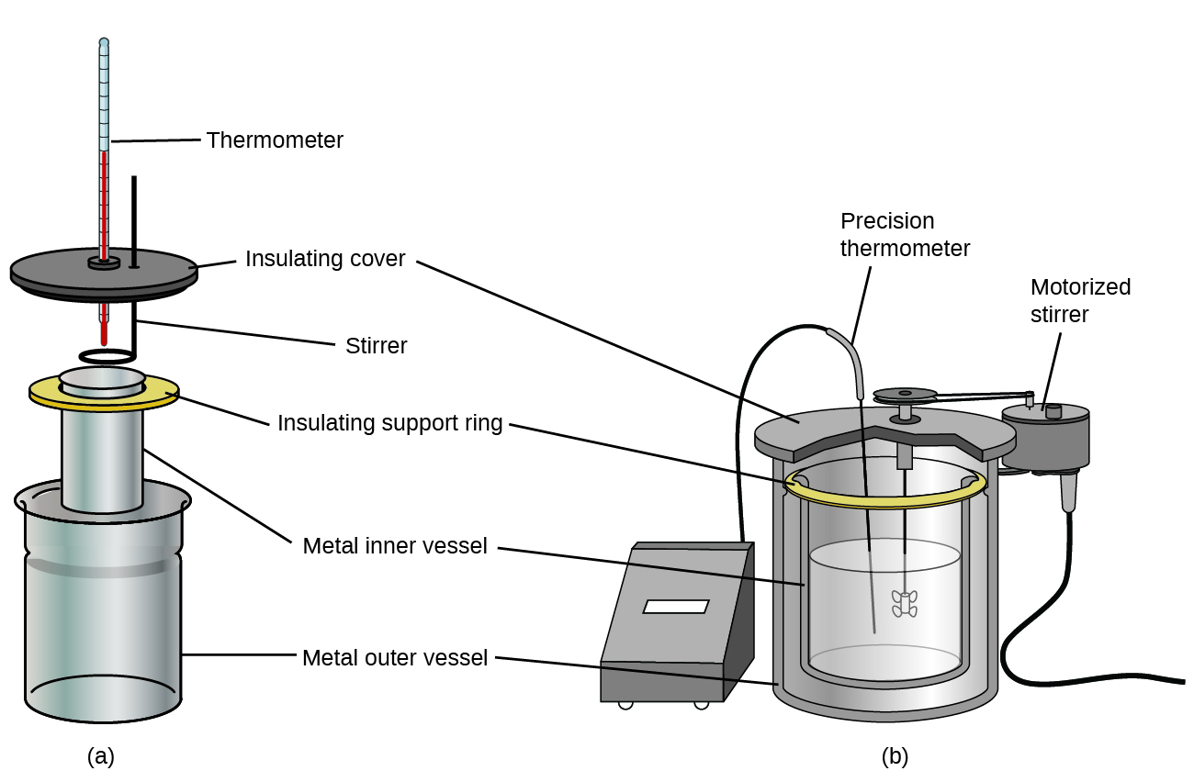
Figure 5.13
Commercial solution calorimeters range from (a) simple, inexpensive models for student use to (b) expensive, more accurate models for industry and research.

Slide 33
Calorimetry principles
Consider a hot piece of metal (M) and cool water (W).
If the metal is placed in the water within a calorimeter, heat will transfer from M to W.
The temperature of M will decrease.
The temperature of W will increase.
Eventually thermal equilibrium will be reached and both objects will have the same temperature.

Slide 34
Calorimetry principles
Since this is done in a calorimeter the heat exchange is only between M and W.
The net change in heat is zero.
Rearranging shows that the heat gained by M is equal to the heat lost by W.
The heat of both substances is equal in magnitude, but opposite in sign.

Slide 35
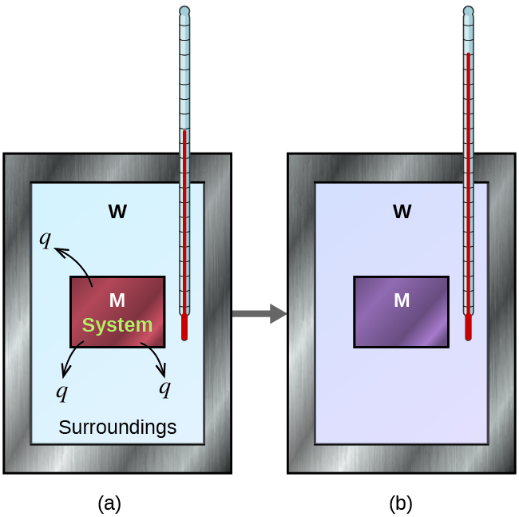
Figure 5.14
In a simple calorimetry process, (a) heat, q, is transferred from the hot metal, M, to the cool water, W, until (b) both are at the same temperature.

Slide 36
Example 5.3
A 360-g piece of rebar (a steel rod used for reinforcing concrete) is dropped into 425 mL of water at 24.0 °C. The final temperature of the water was measured to be 42.7 °C. Calculate the initial temperature of the piece of rebar. Assume the specific heat of steel is approximately the same as that for iron (Table 5.1), and that all heat transfer occurs between the rebar and the water (there is no heat exchange with the outside environment).

Slide 37
Example 5.3
The temperature of the water increases from 24.0 °C to 42.7 °C, so the water absorbs heat. That heat came from the piece of rebar, which must of been initially at some higher temperature. Assuming that all heat transfer was between the rebar and the water, with no heat “lost” to the outside environment, then
heat given off by rebar = −heat taken in by water, or:

Slide 38
Example 5.3
Since we know how heat is related to other measurable quantities, we have:
Letting f = final and i = initial, in expanded form, this becomes:

Slide 39
Example 5.3
The density of water is 1.0 g/mL, so 425 mL of water = 425 g. Noting that the final temperature of both the rebar and water is 42.7 °C, substituting known values yields:
Solving this equation gives T_{i,rebar}= 248 °C, so the initial temperature of the rebar was 248 °C.

Slide 40
Calorimetry principles
When we use calorimetry to determine the heat involved in a chemical reaction, the same principles we have been discussing apply.
Because energy is neither created nor destroyed during a chemical reaction, there is no overall energy change.
The heat produced or consumed by the reaction (the “system”), q_{reaction}, plus the heat absorbed or lost by the solution (the “surroundings”), q_{solution}, must add up to zero.

Slide 41
Calorimetry principles
This means that the amount of heat produced or consumed by the reaction equals the amount of heat absorbed or lost by the solution:
This concept lies at the heart of all calorimetry problems and calculations.

Slide 42
Example 5.5
When 50.0 mL of 1.00 M HCl(aq) and 50.0 mL of 1.00 M NaOH(aq), both at 22.0 °C, are added to a coffee cup calorimeter, the temperature of the mixture reaches a maximum of 28.9 °C. What is the approximate amount of heat produced by this reaction?
HCl(aq) + NaOH(aq) ⟶ NaCl(aq) + H₂O(l)

Slide 43
Example 5.5
To visualize what is going on, imagine that you could combine the two solutions so quickly that no reaction took place while they mixed; then after mixing, the reaction took place. At the instant of mixing, you have 100.0 mL of a mixture of HCl and NaOH at 22.0 °C. The HCl and NaOH then react until the solution temperature reaches 28.9 °C.
The heat given off by the reaction is equal to that taken in by the solution. Therefore:

Slide 44
Example 5.5
Next, we know that the heat absorbed by the solution depends on its specific heat, mass, and temperature change:

Slide 45
Example 5.5
To proceed with this calculation, we need to make a few reasonable assumptions or approximations. Since the solution is aqueous, we can proceed as if it were water in terms of its specific heat and density values.
The density of water is approximately 1.0 g/mL, so 100.0 mL has a mass of about 1.0 × 10² g (two significant figures). The specific heat of water is 4.184 J/g °C, so we use this value for the specific heat of the solution. Substituting these values gives:

Slide 46
Example 5.5
Finally, since we are trying to find the heat of the reaction, we have:
The negative sign indicates that the reaction is exothermic. The reaction produces 2.9 kJ of heat.

Slide 47
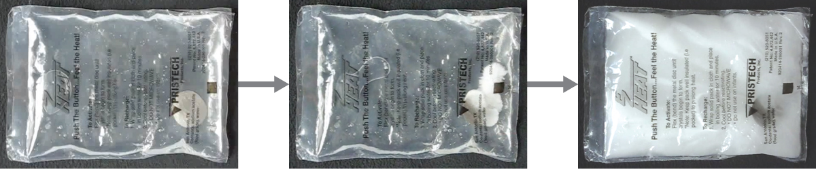
Figure 5.15
Chemical hand warmers produce heat that warms your hand on a cold day. In this one, you can see the metal disc that initiates the exothermic precipitation reaction. (credit: modification of work by Science Buddies TV/YouTube)

Slide 48
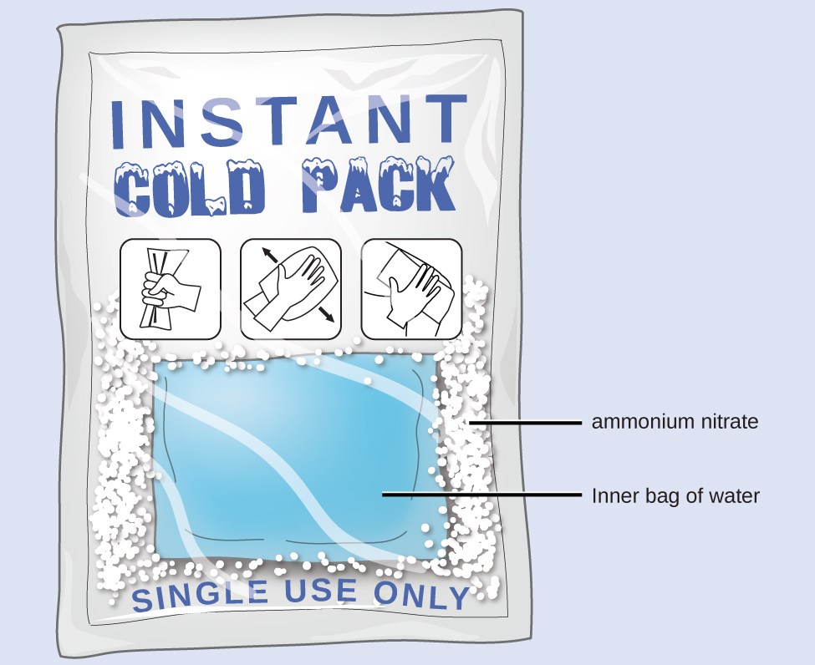
Figure 5.16
An instant cold pack consists of a bag containing solid ammonium nitrate and a second bag of water. When the bag of water is broken, the pack becomes cold because the dissolution of ammonium nitrate is an endothermic process that removes thermal energy from the water. The cold pack then removes thermal energy from your body.

Slide 49
Bomb calorimeter
A bomb calorimeter, is used to measure the energy produced by reactions that yield large amounts of heat and gaseous products, such as combustion reactions.
This type of calorimeter consists of a robust steel container (the “bomb”) that contains the reactants and is itself submerged in water.
The energy produced by the reaction is trapped in the steel bomb and the surrounding water.

Slide 50
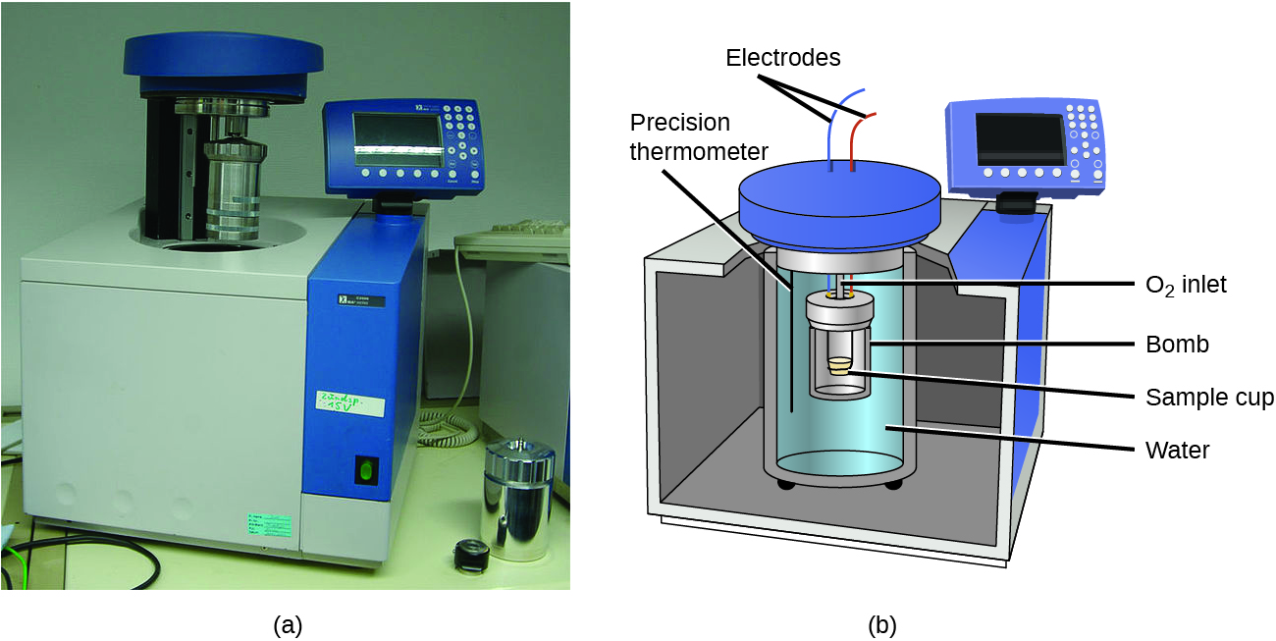
Figure 5.17
A bomb calorimeter is used to measure heat produced by reactions involving gaseous reactants or products, such as combustion.
The reactants are contained in the gas-tight “bomb,” which is submerged in water and surrounded by insulating materials. (credit a: modification of work by “Harbor1”/Wikimedia commons)

Slide 51
Whole-body calorimeter
Whole-body calorimeters of various designs are large enough to hold an individual human being.
These calorimeters are used to measure the metabolism of individuals under different conditions.
  environmental conditions
  dietary regimes
  health conditions, such as diabetes.
A nutritional calorie (Calorie) is the energy unit used to quantify the amount of energy derived from the metabolism of foods.

Slide 52
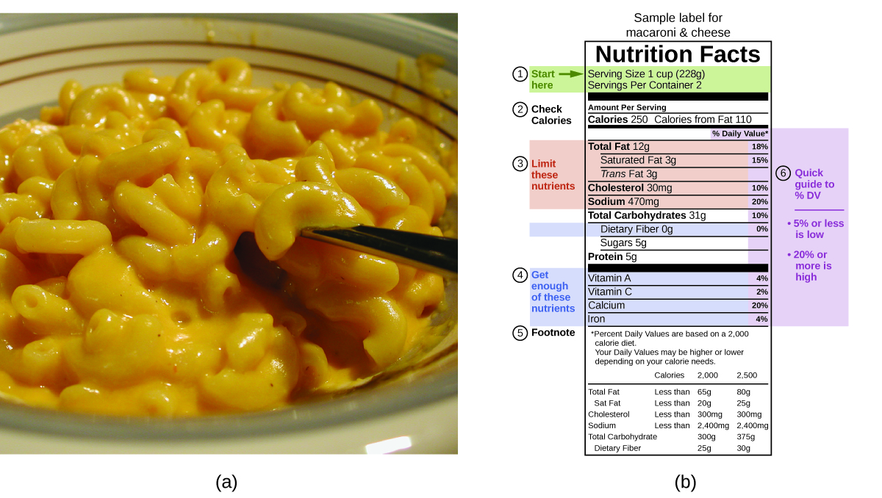
Figure 5.18
Macaroni and cheese contain energy in the form of the macronutrients in the food.
The food’s nutritional information is shown on the package label. In the US, the energy content is given in Calories (per serving); the rest of the world usually uses kilojoules. (credit a: modification of work by “Rex Roof”/Flickr)

Slide 53
5.3 enthalpy
Thermochemistry is a branch of chemical thermodynamics, the science that deals with the relationships between heat, work, and other forms of energy.
Substances act as reservoirs of energy, meaning that energy can be added to them or removed from them.
Energy is stored in a substance when the kinetic energy of its atoms or molecules is raised.

Slide 54
Internal energy
The total of all possible kinds of energy present in a substance is called the internal energy (U), sometimes symbolized as E.
The relationship between the change in internal energy (ΔU), heat (q), and work (w) is summarized in the 1st Law of Thermodynamics:

Slide 55
Internal energy
Energy can be transported into a system resulting in an increase in internal energy.
  The system absorbs heat from the surroundings: +q
  or the surroundings do work on the system: +w
Energy can also be transferred out of a system resulting in a decrease in internal energy.
  The system releases heat to the surroundings: -q
  or the system does work on the surroundings: -w

Slide 56
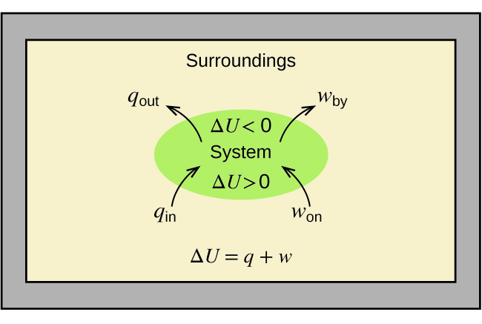
Figure 5.19
The internal energy, U, of a system can be changed by heat flow and work. If heat flows into the system, q_{in}, or work is done on the system, w_{on}, its internal energy increases, ΔU > 0. If heat flows out of the system, q_{out}, or work is done by the system, w_{by}, its internal energy decreases, ΔU < 0.

Slide 57
work
A type of work called expansion work (or pressure-volume work) occurs when:
  A system pushes back the surroundings against a restraining pressure.
  The surroundings compress the system.

Slide 58
Internal energy, Work, and heat example
Consider an internal combustion engine.
  System = Gasoline and Oxygen
  Surroundings = Rest of the universe including the engine.
  The reaction is exothermic so heat is given off to the surroundings: -q
  The reaction pushes the pistons out so work is done on the surroundings: -w
  Internal energy of the system decreases: -ΔU

Slide 59
State function
Internal energy is a type of quantity known as a state function (or state variable).
The value of a state function depends only on the state that a system is in, and not on how that state is reached.
Altitude or elevation is also a state function.
If you stand on the summit of Mt. Kilimanjaro, you are at an altitude of 5895 m, it does not matter whether you hiked there or parachuted there.

Slide 60
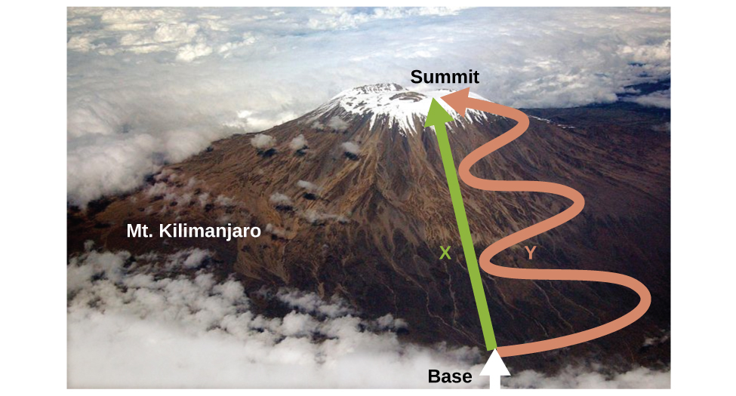
Figure 5.20
Paths X and Y represent two different routes to the summit of Mt. Kilimanjaro. Both have the same change in elevation (altitude or elevation on a mountain is a state function; it does not depend on path), but they have very different distances traveled (distance walked is not a state function; it depends on the path). (credit: modification of work by Paul Shaffner)

Slide 61
Enthalpy (H)
Enthalpy (H) is defined as the sum of a system’s internal energy (U) and the mathematical product of its pressure (P) and volume (V):
Enthalpy is also a state function.
Enthalpy values for specific substances cannot be measured directly; only enthalpy changes (ΔH) for chemical or physical processes can be determined.

Slide 62
Enthalpy Change (ΔH)
Commonly, chemical and physical processes occur at constant pressure.
At constant pressure the enthalpy change (ΔH) is:
The mathematical product PΔV represents pressure- volume work (w). By definition, the arithmetic signs of ΔV and w will always be opposite:

Slide 63
Enthalpy Change (ΔH)
At constant pressure q = q_{p} and
Substituting into the enthalpy-change equation yields:
q_{p} is the heat of reaction at constant pressure.

Slide 64
Enthalpy Change (ΔH)
Chemists usually perform experiments in open containers under normal atmospheric conditions so the external pressure is constant.
So, at these conditions, if the only work done is caused by expansion or contraction, then the heat flow (q_{p}) and the enthalpy change (ΔH) for the process are equal.
This makes enthalpy the most convenient choice for determining heat.

Slide 65
Thermochemical equations
Chemists use a thermochemical equation to represent the changes in both matter and energy.
In a thermochemical equation, the enthalpy change (ΔH) of a reaction is written to the right of the balanced equation.
Example:
H₂(g) + ½O₂(g) ⟶ H₂O(l) ΔH = −286kJ
This ΔH value indicates the amount of heat associated with the reaction as written.

Slide 66
Conventions of Thermochemical equations
1) If the coefficients of the chemical equation are multiplied by some factor, the enthalpy change must also be multiplied by that same factor (ΔH is an extensive property).
H₂(g) + ½O₂(g) ⟶ H₂O(l) ΔH = −286kJ
Multiply by a factor of two:
2H₂(g) + O₂(g) ⟶ 2H₂O(l) ΔH = 2 × (−286kJ) = -572kJ
Multiply by a factor of one-half:
½H₂(g) + ¼O₂(g) ⟶ ½H₂O(l) ΔH = ½ ×(−286kJ) = -143kJ

Slide 67
Conventions of Thermochemical equations
2) The ΔH of a reaction depends on the physical state of the reactants and products, so these must be shown.
H₂(g) + ½O₂(g) ⟶ H₂O(l) ΔH = −286kJ
For example, if gaseous water was formed instead of liquid water:
H₂(g) + ½O₂(g) ⟶ H₂O(g) ΔH = −242kJ

Slide 68
Conventions of Thermochemical equations
3) If the direction of a chemical equation is reversed, the arithmetic sign of ΔH is also reversed.
Negative ΔH indicates an exothermic reaction.
Positive ΔH indicates an endothermic reaction.
A process that is exothermic in one direction is endothermic in the opposite direction and vice-versa.
H₂(g) + ½O₂(g) ⟶ H₂O(l) ΔH = −286kJ
H₂O(l) ⟶ H₂(g) + ½O₂(g) ΔH = +286kJ

Slide 69
Example 5.9
A gummy bear contains 2.67 g sucrose, C₁₂H₂₂O₁₁. When the gummy bear reacts with 7.19 g potassium chlorate, KClO₃, 43.7 kJ of heat is produced. Determine the enthalpy change for the following reaction.
C₁₂H₂₂O₁₁(aq) + 8KClO₃(aq) ⟶ 12CO₂(g) + 11H₂O(l) + 8KCl(aq)

Slide 70
Example 5.9
Since, 0.00734 mol C₁₂H₂₂O₁₁ is needed, C₁₂H₂₂O₁₁ is the excess reactant and KClO₃ is the limiting reactant.

Slide 71
Example 5.9
The reaction uses 8 mol KClO₃
Therefore the thermochemical equation is:
C₁₂H₂₂O₁₁(aq) + 8KClO₃(aq) ⟶ 12CO₂(g) + 11H₂O(l) + 8KCl(aq)
ΔH = −5960kJ

Slide 72
Standard state
Enthalpy changes are typically tabulated for reactions in which both the reactants and products are at the same conditions.
A standard state is a commonly accepted set of conditions used as a reference point for the determination of properties under other different conditions.
The IUPAC standard state conditions:
  Pressure of 1 bar (or 1 atm; 1 bar = 0.987 atm)
  Solutions at 1 M concentration

Slide 73
Standard state change in enthalpy
We will include a superscripted “o” in the enthalpy change symbol to designate standard state conditions.
The usual (but not technically standard) temperature is 298.15 K.
  A subscripted “298” is used to designate this temperature.
The symbol, , is used to indicate an enthalpy change for a process occurring under these conditions.

Slide 74
Standard state change in enthalpy
The enthalpy changes for many types of chemical and physical processes are available in the reference literature.
Recall ΔH is an extensive property – it is proportional to the amount of substances involved.
Often ΔH is normalized to a per-mole basis.

Slide 75
Standard Enthalpy of combustion
Standard enthalpy of combustion (ΔH°_{C}) is the enthalpy change when exactly 1 mole of a substance burns (combines vigorously with oxygen) under standard state conditions.
Sometimes called the “heat of combustion”.

Slide 76
Standard Enthalpy of combustion
For example, the enthalpy of combustion of ethanol is −1366.8 kJ/mol
This is the amount of heat produced when 1 mole of ethanol undergoes complete combustion at 25 °C and 1 atm pressure, yielding products also at 25 °C and 1 atm.
C₂H₅OH(l) + 3O₂(g) ⟶ 2CO₂ + 3H₂O(l)
= −1366.8 kJ

Slide 77
Standard molar enthalpies of combustion (Table 5.2)
Substance Combustion Reaction Enthalpy of Combustion, ΔH∘c
(kJ/mol at 25°C)
carbon C(s) + O₂(g) ⟶ CO₂(g) −393.5
hydrogen H₂(g) + ½ O₂(g) ⟶ H₂O(l) −285.8
magnesium Mg(s) + ½ O₂(g) ⟶ MgO(s) −601.6
sulfur S(s) + O₂(g) ⟶ SO₂(g) −296.8
carbon monoxide CO(g) + ½ O₂(g) ⟶ CO₂(g) −283.0

Slide 78
Standard molar enthalpies of combustion (Table 5.2)
Substance Combustion Reaction Enthalpy of Combustion, ΔH∘c
(kJ/mol at 25°C)
methane CH₄(g) + 2O₂(g) ⟶ CO₂(g) + 2H₂O(l) −890.8
acetylene C₂H₂(g) + 5/2 O₂(g) ⟶ 2CO₂(g) + H₂O(l) −1301.1
ethanol C₂H₅OH(l) + 3O₂(g) ⟶ 2CO₂(g) + 3H₂O(l) −1366.8
methanol CH₃OH(l) + 3/2 O₂(g) ⟶ CO₂(g) + 2H₂O(l) −726.1
isooctane C₈H₁₈(l) + 25/2 O₂(g) ⟶ 8CO₂(g) + 9H₂O(l) −5461

Slide 79

Figure 5.21
The combustion of gasoline is very exothermic. (credit: modification of work by “AlexEagle”/Flickr)

Slide 80
Example 5.10
As Figure 5.21 suggests, the combustion of gasoline is a highly exothermic process. Let us determine the approximate amount of heat produced by burning 1.00 L of gasoline, assuming the enthalpy of combustion of gasoline is the same as that of isooctane, a common component of gasoline. The density of isooctane is 0.692 g/mL.

Slide 81
Example 5.10
Starting with a known amount (1.00 L of isooctane), we can perform conversions between units until we arrive at the desired amount of heat or energy. The enthalpy of combustion of isooctane provides one of the necessary conversions. Table 5.2 gives this value as −5460 kJ per 1 mole of isooctane (C₈H₁₈).

Slide 82
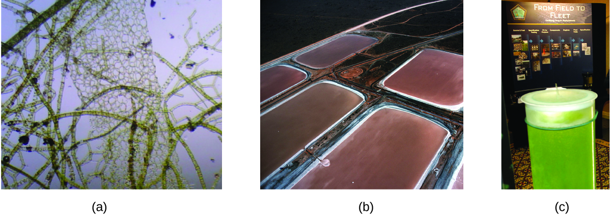
Figure 5.22
(a) Tiny algal organisms can be (b) grown in large quantities and eventually (c) turned into a useful fuel such as biodiesel. (credit a: modification of work by Micah Sittig; credit b: modification of work by Robert Kerton; credit c: modification of work by John F. Williams)

Slide 83
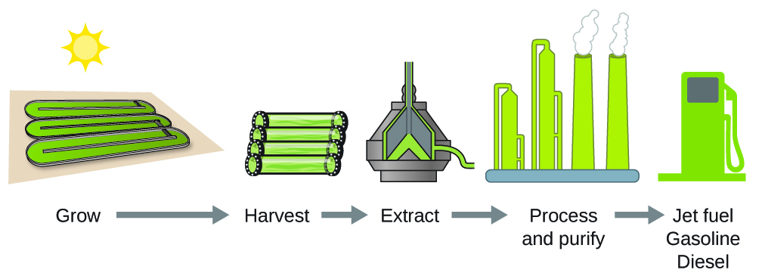
Figure 5.23
Algae convert sunlight and carbon dioxide into oil that is harvested, extracted, purified, and transformed into a variety of renewable fuels.

Slide 84
Standard Enthalpy of formation
Standard enthalpy of formation (ΔH°_{f}) is an enthalpy change for a reaction in which exactly 1 mole of a pure substance is formed from its constituent free elements in their most stable states under standard state conditions.
For example, ΔH°_{f} of CO₂(g) is −393.5 kJ/mol.
C(s) + O₂(g) ⟶ CO₂(g) ΔH°_{f} = = −393.5kJ
By definition, the standard enthalpy of formation of an element in its most stable form is equal to zero under standard conditions.

Slide 85
Example 5.12
Write the heat of formation reaction equations for:
(a) C₂H₅OH(l)
(b) Ca₃(PO₄)₂(s)
Remembering that ΔH°_{f} reaction equations are for forming 1 mole of the compound from its constituent elements under standard conditions, we have:
(a) 2C(s,graphite) + 3H₂(g) + ½ O₂(g) ⟶ C₂H₅OH(l)
(b) 3Ca(s) + ½ P₄(s) + 4O₂(g) ⟶ Ca₃(PO₄)₂(s)
Note: The standard state of carbon is graphite, and phosphorus exists as P₄.

Slide 86
Hess’s law
There are two ways to determine the amount of heat involved in a chemical change:
  Measure it experimentally
  Calculate it from other experimentally determined enthalpy changes.
Some reactions are difficult, if not impossible, to investigate and make accurate measurements experimentally.
For these reactions the amount of heat involved must be calculated, usually with the use of Hess’s law.

Slide 87
Hess’s law
Hess’s law - If a process can be written as the sum of several stepwise processes, the enthalpy change of the total process equals the sum of the enthalpy changes of the various steps.
Hess’s law is valid because enthalpy is a state function.
Enthalpy changes depend only on where a chemical process starts and ends, but not on the path it takes from start to finish.

Slide 88
Hess’s law
For example, we can think of the reaction of carbon with oxygen to form carbon dioxide as occurring either directly or by a two-step process.
The direct process is written:
C(s) + O₂(g) ⟶ CO₂(g) = −394 kJ

Slide 89
Hess’s law
In the two-step process:
  First carbon monoxide is formed.
  Then, carbon monoxide reacts further to form carbon dioxide.
Step 1: C(s) + ½ O₂(g) ⟶ CO(g) = −111 kJ
Step 2: CO(g) + ½ O₂(g) ⟶ CO₂(g) = −283 kJ
Sum: C(s) + ½ O₂(g) + CO(g) + ½ O₂(g) ⟶ CO(g) + CO₂(g)
Net Change: C(s) + O₂(g) ⟶ CO₂(g)

Slide 90
Hess’s law
According to Hess’s law, the enthalpy change of the reaction will equal the sum of the enthalpy changes of the steps.
The enthalpy change of the entire two step reaction:
We see that ΔH of the overall reaction is the same whether it occurs in one step or two.

Slide 91
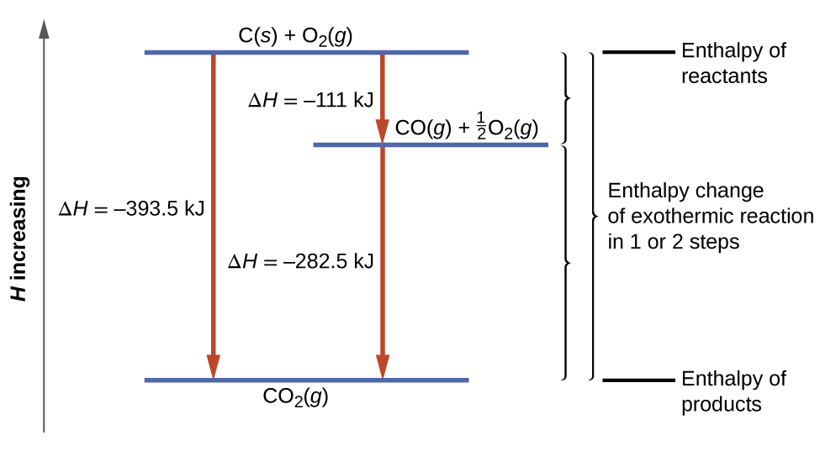
Figure 5.24
The formation of CO₂(g) from its elements can be thought of as occurring in two steps, which sum to the overall reaction, as described by Hess’s law. The horizontal blue lines represent enthalpies. For an exothermic process, the products are at lower enthalpy than are the reactants.

Slide 92
Hess’s law and enthalpies of formation
We also can use Hess’s law to determine the enthalpy change of any reaction if the corresponding enthalpies of formation of the reactants and products are available.
The stepwise reactions we consider are:
  (i) decompositions of the reactants into their component elements (for which the enthalpy changes are proportional to the negative of the enthalpies of formation of the reactants), followed by
  (ii) re-combinations of the elements to give the products (with the enthalpy changes proportional to the enthalpies of formation of the products).

Slide 93
Hess’s law and enthalpies of formation
The standard enthalpy change of the overall reaction is therefore equal to:
  (ii) the sum of the standard enthalpies of formation of all the products
  plus (i) the sum of the negatives of the standard enthalpies of formation of the reactants.
This is usually rearranged slightly to be written as follows:
With ∑ representing “the sum of” and n representing the stoichiometric coefficients.

Slide 94
Example 5.15
What is the standard enthalpy change for the reaction:
3NO₂(g) + H₂O(l) ⟶ 2HNO₃(aq) + NO(g) ΔH° = ?
Use the special form of Hess’s law given previously and the enthalpy of formation values found in Appendix G:

Slide 95
This file is copyright 2017, Rice University. All Rights Reserved.

