Slide 1
CHEMISTRY
Chapter 5
Thermochemistry
Slides by Montgomery College licensed under CC BY 4.0.

Slide 2
chapter 5: thermochemistry
5.1 Energy Basics
5.2 Calorimetry
5.3 Enthalpy

Slide 3
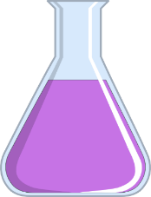
5.1 energy basics
Thermochemistry
Physical and chemical changes are accompanied by changes in energy.
Thermochemistry is the study and quantitation of thermal energy absorbed or released during a physical or chemical process.
Processes that absorb heat are endothermic
Processes that give off or release heat are exothermic.
heat in
exothermic
endothermic
heat out

Slide 4

5.1 energy basics
Energy
Energy the capacity to supply heat or do work.
The energy that is transferred between two objects is heat (q).
Energy that is used to move objects is work (w).
The total energy change for a process is a combination of heat and work:
$$ΔE=q+w$$
Energy can be divided into two types:
Potential energy is energy an object has due to its relative position, composition, and condition.
Kinetic energy is the energy of an object as a result of motion.

Slide 5
5.1 energy basics
Conservation of Energy
Energy can be converted from one form into another, but it cannot be created or destroyed.
  Many engineers focus on the conversion of potential energy into kinetic energy.
  Mechanical and electrical engineers design products like cars and drills.
  Mechanical and civil engineers might design a roller coaster to make sure that there is enough potential energy to convert into kinetic energy.

Slide 6
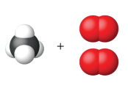
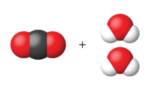
5.1 energy basics
Conservation of Energy and Matter
In a chemical process, there are also changes in potential energy and kinetic energy.
Bonds are broken or formed and energy is used or released.
In most chemical processes there is no detectable change in the total amount of matter.
CH₄
16.04 amu
2 O₂
64.00 amu
CO₂
44.01 amu
2 H₂O
36.03 amu
Total: 80.04 amu
Total: 80.04 amu
Overall, the total quantity of matter and energy in the universe is fixed.

Slide 7
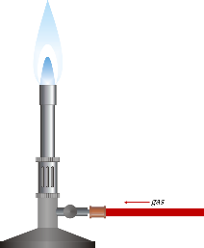
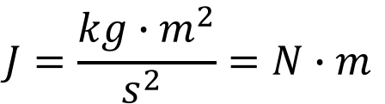

5.1 energy basics
The Joule
The SI unit for heat, work, and energy is the joule.
A joule (J) is the amount of energy used when a force of 1 newton (N) moves an object 1 meter (m).
$$J=\frac{kg∙m^{2}}{s^{2} }=N∙m$$
1 cm
1 cm³ = 1 mL
of water
1 cm
A kilojoule (kJ) is equal to 1000 J.
A calorie (cal) is 4.184 J.
It takes 1 calorie or 4.184 J to raise 1 mL or 1 cm³ of water by one degree Celsius.
$$∆T=1 ℃$$
requires
$$q=4.184 J$$

Slide 8


5.1 energy basics
Heat Capacity (C)
The heat capacity (C) of a sample is the quantity of heat (q) absorbed or released when the object experiences a temperature change of 1 °C.
$$C=\frac{q}{∆T }$$
Specific Heat Capacity (c)
The specific heat capacity (c) of a substance is the quantity of heat (q) absorbed or released when one gram of the substance experiences a temperature change of 1 °C.
$$c=\frac{q}{m∆T }$$

Slide 9
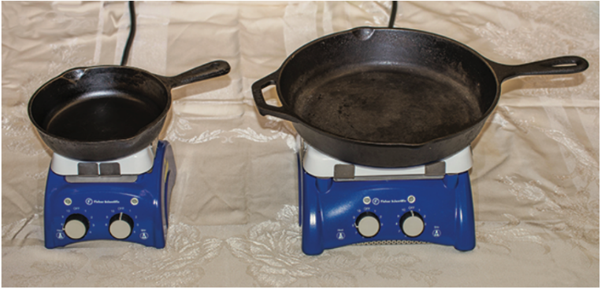
5.1 energy basics
Heat Capacity (C) vs. Specific Heat Capacity (c)
C_{small pan} vs. C_{large pan}
c_{small pan} vs. c_{large pan}

Slide 10

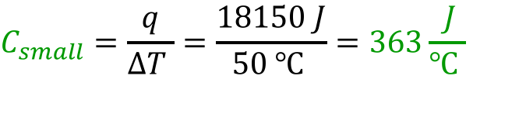

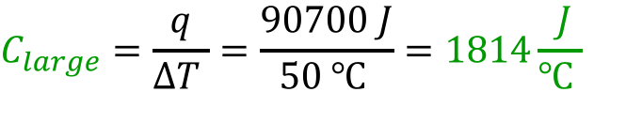
5.1 energy basics
$$C=\frac{q}{∆T }$$
The heat capacity (C) of an object is the quantity of heat (q) absorbed or released when the object experiences a temperature change of 1 °C.
The small frying pan requires 18,150 J to raise the temperature by 50 °C. The large frying pan requires 90,700 J to raise the temperature.
$$C_{small}=\frac{q}{∆T }=\frac{18150 J}{50 ℃ }=363\frac{ J}{℃ }$$
$$C_{large}=\frac{q}{∆T }=\frac{90700 J}{50 ℃ }=1814\frac{ J}{℃ }$$
The large frying pan has a larger heat capacity.
Note the use of an uppercase C for the heat capacity of an object.

Slide 11
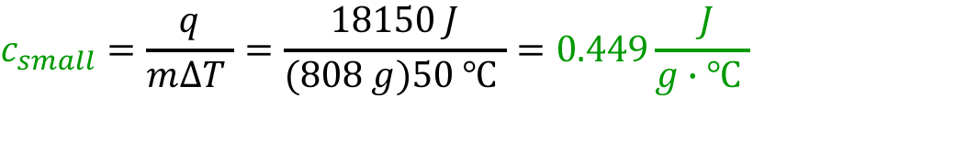

5.1 energy basics
$$c=\frac{q}{m∆T }$$
The specific heat capacity (c) of a sample is the quantity of heat (q) absorbed or released when one gram of a substance experiences a temperature change of 1 °C.
The small frying pan has a mass of 808 g and the large frying pan has a mass of 4040 g.
$$c_{small}=\frac{q}{m∆T }=\frac{18150 J}{(808 g)50 ℃ }=0.449\frac{ J}{g∙℃ }$$
$$c_{large}=\frac{q}{m∆T }=\frac{90700 J}{(4040 g)50 ℃ }=0.449\frac{ J}{g∙℃ }$$
Both frying pans have the same specific heat capacity.
Note the use of an lowercase c for the specific heat capacity of a substance.

Slide 12
5.2 Calorimetry
Calorimetry Basics
Heat Transfer
Calorimetry is the study of heat transfer between two substances during a chemical or physical process.
In order to measure the heat transfer, a system and its surroundings must be defined.
The system is the process undergoing change.
The diagram shows the system losing heat to the surroundings in an exothermic process.
system
⎻ q
surroundings
The surroundings includes anything that exchanges heat (q) with the system.
system
In this diagram, the system gains heat from the surroundings in an endothermic process.
surroundings
+ q

Slide 13
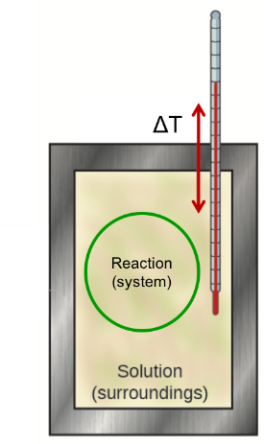

5.2 Calorimetry
Calorimetry Basics
Calorimeters
A calorimeter is a device used to measure the amount of heat transferred between the system and surroundings in a chemical or physical process.
The system either produces or absorbs heat and the temperature change of the surroundings can be measured.
A calorimeter is insulated so that the system and surroundings do not exchange a measureable amount of heat with the laboratory.
$$q=mc∆T$$

Slide 14
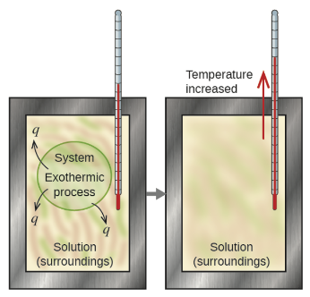
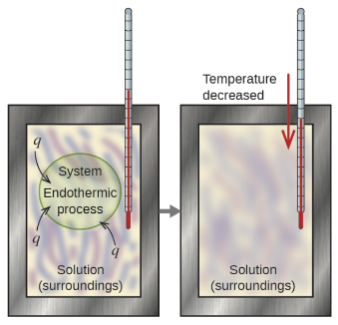
5.2 Calorimetry
Calorimetry Basics
In an exothermic process, heat is transferred from the system to the surroundings.
q < 0 and the temperature of the surroundings increases.
In an endothermic process, heat is absorbed by the system from the surroundings.
q > 0 and the temperature of the surroundings decreases.

Slide 15




5.2 Calorimetry
Calorimetry Basics
The First Law of Thermodynamics
Energy is conserved; it can be neither created nor destroyed.
There is no overall energy change during a chemical or physical process.
The amount of heat produced or consumed by the system must be equal to the amount of heat absorbed or lost by the surroundings.
$$q_{system}+q_{surroundings}=0$$
$$q_{system}=−q_{surroundings}$$
$$q_{reaction}+q_{solution}=0$$
$$q_{reaction}=−q_{solution}$$

Slide 16
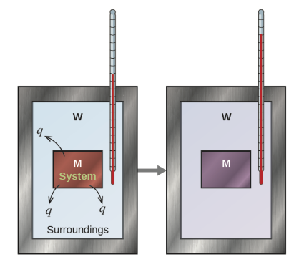




5.2 Calorimetry
$$q=mc∆T$$
Example 5.3
The diagram below shows the transfer of heat between a hot metal block, M, and cooler water surrounding it, W. The metal is a 360 g piece of steel submerged in 425 mL of water that was initially at 24.0 °C. The final temperature of the water ends up being 42.7 °C. What was the initial temperature of the piece of metal?
c for steel = 0.449 J/g.°C
c for water = 4.184 J/g.°C
$$q_{M}+q_{W}=0$$
$$mc∆T$$
$$mc∆T$$
for metal
for water
Assume that the density of water is 1.000 g/cm³.

Slide 17
5.2 Calorimetry
Lecture Example #1: Hot Metal in Water
55.0 g of iron at 99.8 °C is placed into 225 g water initially at 21.0 °C. At thermal equilibrium, both substances are at 23.1 °C. What is the specific heat capacity of the metal?
The specific heat capacity for water is 4.184 J/g.°C.

Slide 18
5.2 Calorimetry
Lecture Example #2: Mixing Water at Two Temperatures
One flask contains 150.0 g water at 20.0 °C. A second flask contains 350.0 g water at 95.0 °C. If the two water samples are mixed, what will the final temperature of the water be?
Assume that the density of water is 1.000 g/cm³.
The specific heat capacity for water is 4.184 J/g.°C.

Slide 19
5.2 Calorimetry
Lecture Example #3: Melting Ice
A flask contains 250.0 g water at 20.00 °C. If you add 5.000 g ice to the flask and let the solution reach equilibrium …
a. what is the temperature change of the water?
b. what is the final temperature of the water?
c. is there any ice left floating in the water?
c_{p} for water is 4.184 J/g.°C.
The energy required to melt ice = 333.6 J/g
This means it takes 333.6 J to melt 1.0 g ice.

Slide 20
5.2 Calorimetry
Lecture Example #4: Melting Ice
Three ice cubes (55 g each) at 0.00 °C are dropped into 2.00 cups (kitchen measuring cups) of tea. The tea was at room temperature (25.0 °C) before the ice was added. After the ice and tea have been mixed and thermal equilibrium has been established the temperature of the tea was 0.0 °C. How much ice remains floating in the tea?
c_{p} for water is 4.184 J/g.°C.
The energy required to melt ice = 333.6 J/g
This means it takes 333.6 J to melt 1.0 g ice.
1 cup = 236.6 mL

Slide 21
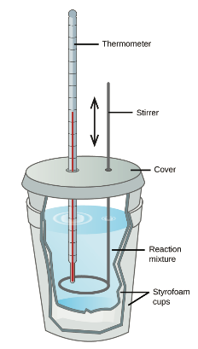
5.2 Calorimetry
$$q=mc∆T$$
Constant Pressure Calorimetry
Coffee Cup Calorimetry
In the general chemistry laboratory, the heat associated with a chemical reaction is often studied in a constant pressure calorimeter.
This type of calorimeter can be constructed from nested styrofoam cups or a thermos.
The reaction takes place in aqueous solution.
The temperature before and after the reaction can be measured and the heat (q) of the reaction can be calculated.
$$q_{reaction}+q_{solution}=0$$

Slide 22
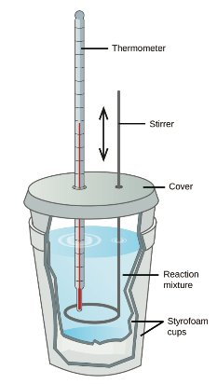
5.2 Calorimetry
Example 5.5
When 50.0 mL of 0.10 M HCl (aq) and 50.0 mL of 0.10 M NaOH(aq), both at 22.0 °C, are mixed the resultant solution reaches a maximum temperature of 28.9 °C. What is amount of heat produced by the reaction? Assume the specific heat capacity and density of the solution are the same as for water.
Is the reaction endothermic or exothermic?

Slide 23
5.2 Calorimetry
Hand Warmers and Cold Packs
A supersaturated solution of aqueous sodium acetate quickly crystallizes when nucleation sites form. In type of hand warmer, nucleation sites are created by bending or snapping a small metal disk. The crystallization process is exothermic. Upon crystallization, the temperature of a 35.00 mL of saturated sodium acetate solution changes from 21.5 °C to 35.0 °C. What amount of heat is produced by the reaction?
The specific heat capacity for saturated sodium acetate is 3.45 J/g.°C and the density is 1.15 g/cm³.

Slide 24
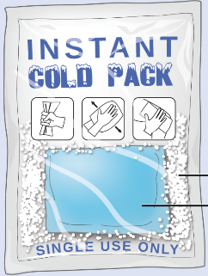
5.2 Calorimetry
Example 5.6 – Cold Packs
When 3.21 g of solid ammonium nitrate dissolves in 50.0 g of water at 24.9 °C, the temperature of the solution drops to 20.3 °C. What is q for this reaction?
3.21 g NH₄NO₃(s)
50.0 g H₂O(𝓁)

Slide 25
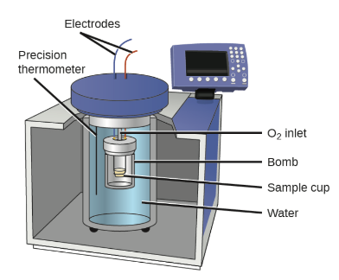


5.2 Calorimetry
Constant Volume Calorimetry
Bomb Calorimetry
Another type of calorimetry, is done at constant volume; the pressure is allowed to increase within the reaction vessel.
Constant volume calorimetry is often referred to as bomb calorimetry with the reaction taking place inside a thick walled “bomb” that is submerged in water in the calorimeter.
$$q_{reaction}+q_{water}+q_{bomb}=0$$
$$q_{bomb}=C_{bomb}∆T$$
The value for C_{bomb} must be determined before each experiment by using a calibration sample. Note that mass is not included.

Slide 26

5.2 Calorimetry
Example 5.7
When 3.12 g of glucose, C₆H₁₂O₆, is burned in a bomb calorimeter, the temperature of water in the calorimeter increases from 23.8 °C to 35.6 °C. The calorimeter contains 775 g of water, and the bomb itself has a heat capacity of 893 J/°C. How much heat is produced by the combustion of the glucose sample?
$$q_{reaction}+q_{water}+q_{bomb}=0$$

Slide 27
The Laws of Thermodynamics
Zeroth Law
If two systems, A and B, are at thermal equilibrium with one another, and system B is in thermal equilibrium with system C, then all the systems are in equilibrium with each other.
First Law
Energy is conserved; it can be neither created nor destroyed.
Second Law
In an isolated system, natural processes are spontaneous when they lead to increase in disorder, or entropy.
Third Law
The entropy of a perfect crystal is zero when the temperature of the crystal is equal to absolute zero.
This semester, enthalpy and the first law of thermodynamics will be examined.
The second and third laws of thermodynamics will be covered in more detail next semester.

Slide 28

5.3 Enthalpy
The First Law of Thermodynamics
Changes in Energy
Thermochemistry is the study of relationships between heat, work, and other forms of energy in the context of chemical and physical processes.
The first law of thermodynamics states that total energy must be conserved; it can be neither created nor destroyed.
The total of all possible kinds of energy in a substance, also known as the internal energy of a substance is symbolized as U.
The change in internal energy of a substance is:
internal energy
$$∆U=q+w$$
heat
work

Slide 29
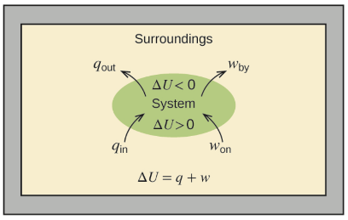

5.3 Enthalpy
The First Law of Thermodynamics
Internal Energy
The change in internal energy of a substance is:
$$∆U=q+w$$
heat
work
Energy for the system and the surroundings can be exchanged during a chemical or physical process, but overall, energy cannot be gained or lost.
The is a statement of the first law of thermodynamics.

Slide 30
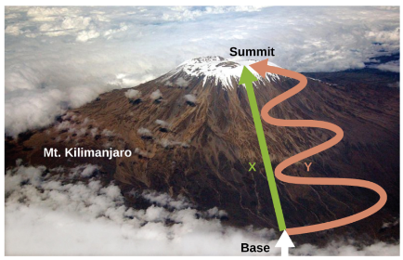

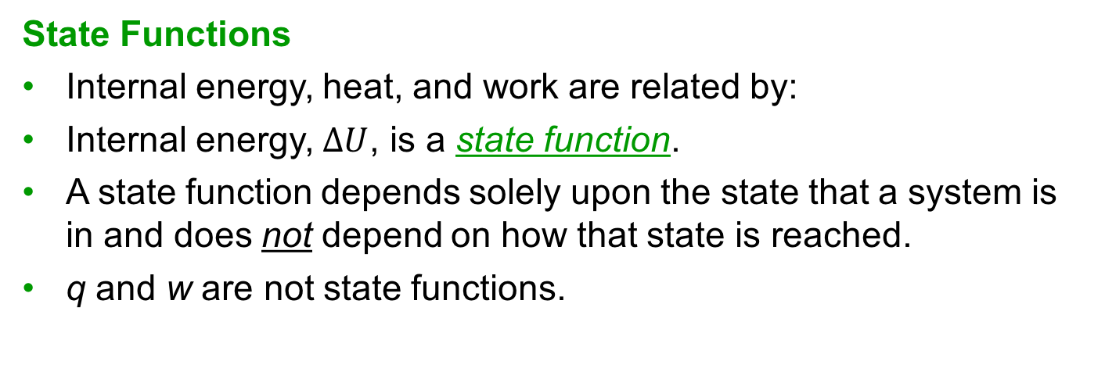
5.3 Enthalpy
The First Law of Thermodynamics
State Functions
Internal energy, heat, and work are related by:
Internal energy, $∆U$, is a state function.
A state function depends solely upon the state that a system is in and does not depend on how that state is reached.
q and w are not state functions.
$$∆U=q+w$$
The distance traveled by a person to reach the summit of Mt. Kilimanjaro differs depending on the path taken. Distance is not a state function but the elevation reached would be the same no matter what. Elevation is a state function.

Slide 31






5.3 Enthalpy
Thermodynamics and Enthalpy
Chemical and Physical Processes
Enthalpy, H, is defined as the sum of a system’s internal energy, U, and the product of its pressure and volume, PV:
$$U=H+PV$$
$$P∆V=−w$$
expansion work done by the system at constant pressure
The enthalpy change of a system is:
$$∆H=∆U+P∆V$$
$$∆U=q+w$$
$$∆H=q+w−w$$
$$∆H=q_{p}$$
enthalpy at constant pressure

Slide 32

5.3 Enthalpy
Thermodynamics and Enthalpy
Chemical and Physical Processes
If a chemical or physical process is carried out at constant pressure, then heat and enthalpy are equal.
$$∆H=q_{p}$$
Chemists usually perform experiments under normal atmospheric conditions, at constant pressure with q = ΔH, which makes enthalpy the most convenient choice for determining the amount of heat involved in a process.
Is q = ΔH for a process carried out in a bomb calorimeter?

Slide 33

5.3 Enthalpy
Enthalpy: Conventions
Writing Reactions and ΔH
The ΔH value for a chemical reaction indicates the amount of heat associated with the reaction involving the number of moles of reactants and products as written in the chemical equation.
The enthalpy change associated with one mole of hydrogen gas reacting with one-half mole of oxygen gas to form one mole of liquid water the release of 286 kJ.
If the entire equation is multiplied by two, so is the enthalpy change:

Slide 34




5.3 Enthalpy
Enthalpy: Conventions
Physical States and ΔH
The physical states of a reaction’s reactants and products is important.
On the previous slide, the reaction between hydrogen gas and oxygen gas to form liquid water was written with ΔH = − 286 kJ.
A similar reaction for the production of gaseous water has a different enthalpy change associated with it.

Slide 35
5.3 Enthalpy
Enthalpy: Conventions
Endothermic vs. Exothermic Processes
An endothermic reaction has q > 0 and ΔH > 0.
An exothermic reaction has q < 0 and ΔH < 0.
If a reaction is written in the opposite direction, the sign of ΔH changes.
What is ΔH for the the decomposition of one mole of liquid water into one mole hydrogen gas and one-half mole of oxygen gas?

Slide 36
5.3 enthalpy
Example 5.8
When 0.0500 mol of HCl(aq) reacts with 0.0500 mol of NaOH(aq) to form 0.0500 mol of NaCl(aq), 2.9 kJ of heat are produced. What is ΔH, the enthalpy change, per mole of acid?
*Write the reaction first and be sure to check for a limiting reactant!

Slide 37
5.3 enthalpy
Example 5.8 – Check Your Learning
When 1.34 g Zn(s) reacts with 60.0 mL of 0.750 M HCl(aq), 3.14 kJ of heat are produced. Determine the enthalpy change per mole of zinc.
Zn(s) + 2HCl(aq) → ZnCl₂(aq) + H₂(g)
*Be sure to check for a limiting reactant!

Slide 38


5.3 Enthalpy
Enthalpy and Standard State
Enthalpy values for many reactions are tabulated.
The reactants and products for tabulated reactions are at standard state.
  Pressure = 1 bar* Concentration = 1 M
The enthalpy for a process at standard conditions is denoted by .
If a process occurs at a specific temperature such as 25 °C (298 K), the enthalpy may be written as .
$$∆H^{°}$$
$$∆H_{298}^{°}$$
As defined by the International Union of Pure and Applied Chemistry (IUPAC).
The SI unit for pressure is the pascal (Pa).
101325 Pa = 1.01325 bar = 1 atm = 760 torr

Slide 39

5.3 Enthalpy
Heat of Combustion
The standard enthalpy of combustion is the enthalpy change when one mole of a substance burns under standard conditions.
This is also known as the heat of combustion, .
$$∆H_{c}^{°}$$
The heat of combustion of ethanol, −1366.8 kJ/mol, is the amount of heat produced when one mole of ethanol undergoes complete combustion at 25 °C and 1 bar, yielding products also at 25 °C and 1 bar.

Slide 40


5.3 enthalpy
Example 5.10
Determine the approximate amount of heat produced by burning 1.00 L of gasoline at standard conditions. Assume that the enthalpy of combustion of gasoline is the same as that of isooctane (C₈H₁₈), a common component of gasoline.
The density of isooctane is 0.692 g/mL.
$$∆H_{c}^{°}=−5461 kJ/mol$$

Slide 41
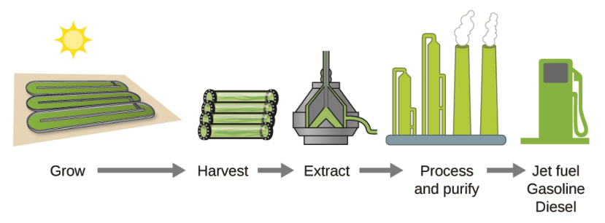
5.3 Enthalpy
Algae and Biofuel
Some of the most promising biofuels being developed are derived from algae that are nontoxic, biodegradable, and are among the worlds fastest-growing organisms.
About 50% of algal weight is oil that can be readily converted into fuel such as biodiesel.
Algae is also being used by the US Air Force to produce jet fuel for under $5 per gallon.

Slide 42




5.3 Enthalpy
Enthalpy of Formation
The enthalpy change for a reaction in which one mole of a pure substance is formed from its free elements in their standard states under standard conditions.
By definition, the standard enthalpy of formation for an element in its standard state is zero.

Slide 43


5.3 enthalpy
Example 5.11
Ozone, O₃(g), forms from oxygen, O₂(g), in an endothermic process. In the upper atmosphere, the reaction is driven by energy from ultraviolet radiation. Assuming that both the reactants and products of the reaction are in their standard states, determine the standard enthalpy of formation for ozone, from the following reaction:
3O₂(g) → 2O₃(g)
$$∆H_{298}^{°}=+286 kJ$$
$$∆H_{formation}^{°} for O_{3}?$$

Slide 44






5.3 Enthalpy
Hess’s Law
If a process can be written as the sum of several stepwise processes, the enthalpy change of the total process equals the sum of the enthalpy changes of the various steps.
Hess’s law is valid because enthalpy is a state function
  Enthalpy changes depend only on where a chemical process starts and ends, but not on the path it takes from start to finish.
Step 1
add
Step 2
Net

Slide 45
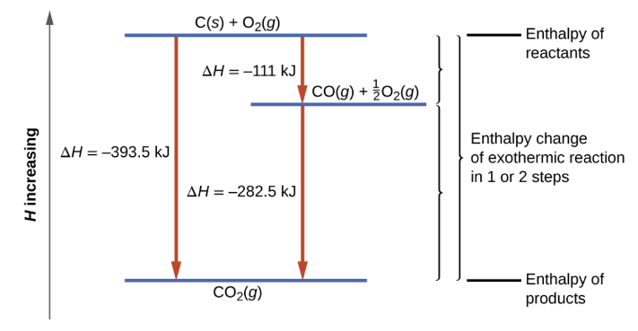
5.3 Enthalpy
Hess’s Law
The formation of CO₂(g) from its elements can be thought of as occurring in two steps, which sum to the overall reaction, as described by Hess’s law.
The horizontal blue lines represent enthalpies.
For an exothermic process, the products are at lower enthalpy than are the reactants.

Slide 46



5.3 enthalpy
Example 5.13
Determine the enthalpy of formation, ,of FeCl₃ from the enthalpy changes of the following two step process.
$$∆H_{f}^{°}$$
Fe(s) + Cl₂(g) → FeCl₂(s)
$$∆H_{298}^{°}=−348.1 kJ$$
FeCl₂(s) + ½Cl₂(g) → FeCl₃(s)
$$∆H_{298}^{°}=−57.7 kJ$$

Slide 47




5.3 enthalpy
Example 5.14
Chlorine monofluoride can react with fluorine to form chlorine trifluoride:
Use the following reactions to determine ΔH° for the reaction above.
ClF(g) + F₂(g) → ClF₃(g)
$$∆H^{°}= ?$$
(1)
2OF₂(g) → O₂(g) + 2F₂(g)
$$∆H_{298}^{°}=−49.4 kJ$$
(2)
2ClF(g) + O₂(g) → Cl₂O(g) + OF₂(g)
$$∆H_{298}^{°}=+205.6 kJ$$
(3)
1
3
$$∆H_{298}^{°}=+266.7 kJ$$
ClF₃(g) + O₂(g) → Cl₂O(g) + OF₂(g)
2
2

Slide 48
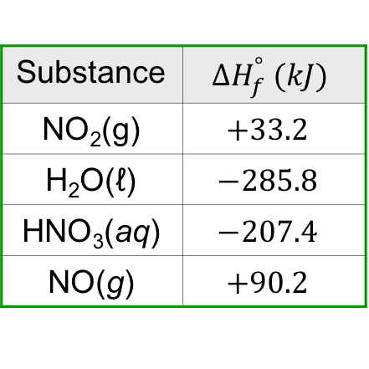
5.3 Enthalpy
Hess’s Law: Using Enthalpies of Formation
If the enthalpies of formation are available for all reactants and products in a reaction, the enthalpy change for the reaction can be calculated:
Example 5.15
What is the standard enthalpy change, ΔH°, for the reaction:
3NO₂(g) + H₂O(ℓ) → 2HNO₃(aq) + NO(g)
Substance | $${∆H}_{f}^{°} (kJ)$$
NO₂(g) | $$+33.2$$
H₂O(ℓ) | $$−285.8$$
HNO₃(aq) | $$−207.4$$
NO(g) | $$+90.2$$

Slide 49
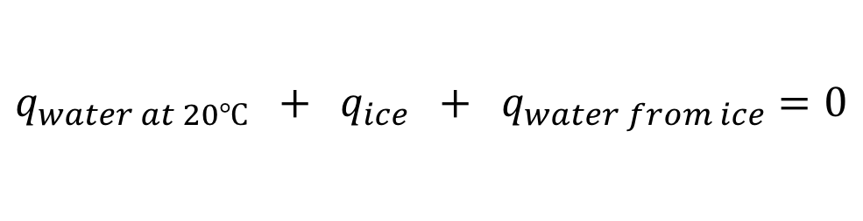
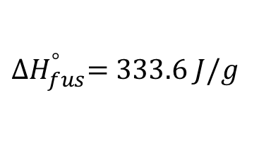



5.3 enthalpy
Extra Problem
A flask contains 250.0 g water at 20.00 °C. If you add 5.000 g ice to the flask and let the solution reach equilibrium, what is the final temperature of the water?
$${∆H}_{fus}^{°}=333.6 J/g$$
It takes 333.6 J to melt one gram of ice.
$$q_{water at 20℃} + q_{ice} + q_{water from ice}=0$$
$$q=mc∆T$$
$$q_{ice}=m_{ice}{∆H}_{fus}^{°}$$
$$q=mc∆T$$

Slide 50
5.3 enthalpy
Extra Problem
Hydrazine (N₂H₄) is a hypergolic propellant; it ignites upon contact with an oxidizing agent and requires no external ignition source. Hydrazine is used during rocket launches and spacecraft maneuvering. Write a balanced reaction for the combustion of liquid hydrazine in oxygen gas to form nitrogen gas and liquid water.
Continued on the next slide.
Hydrazine is extremely toxic. Notice the engineer’s protective equipment, and he is using a small amount compared to that needed for a rocket launch!

Slide 51
5.3 enthalpy
Extra Problem (continued)
Determine the heat involved in the combustion of liquid hydrazine by using the following reactions. Use the balanced equation determined on the previous slide to begin.
2NH₃(g) + 3N₂O(g) → 4N₂(g) + 3H₂O(ℓ) ΔH° = –1013 kJ/mol
N₂O(g) + 3H₂(g) → N₂H₄(ℓ) + H₂O(ℓ) ΔH° = –317 kJ/mol
2NH₃(g) + ½O₂(g) → N₂H₄(ℓ) + H₂O(ℓ) ΔH° = –142.9 kJ/mol
H₂(g) + ½ O₂(g) → H₂O(ℓ) ΔH° = –285.8 kJ/mol
Launching a small spacecraft to study Jupiter required approximately 28 million kJ. Assume that hydrazine was the only fuel. What mass of hydrazine, in kilograms, was needed for the launch?

Slide 52
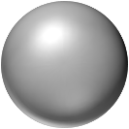
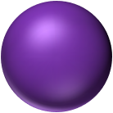
review: making and breaking bonds
Endothermic
Energy needed to break bonds.
Exothermic
Energy released when bonds form.

Slide 53
end of chapter problems – chapter 5
Calorimetry : #7, 9, 11, 25, 27, 31
Enthalpy of Formation: #55, 69, 71
Hess’s Law: #63, 65, 67, 81
For detailed solutions to these problems, go to the OpenStax Chemistry website and download the Student Solution Guide.

Slide 54
videos – chapter 5
Basic Thermochemistry/Heat Transfer
http://screencast.com/t/GUnQoBSO
Coffee Cup Calorimetry Calculations
http://youtu.be/EhqvVTvuwnM
http://screencast.com/t/1M6XG8eGdM
http://screencast.com/t/YgAMci09t9ct
Bomb Calorimeter Calculation
http://youtu.be/EK2EGGY5dSs (NOTE: The answer should be NEGATIVE for the problem solved in this video. A minus sign was accidentally dropped in the calculations shown.)
Hess’s Law
http://youtu.be/0lRcq7d2uLE
http://screencast.com/t/IHHvvb3W7
Definition of Enthalpy of Formation
http://screencast.com/t/Hvrz5ZP5kJy
Calculating ΔH Using Enthalpies of Formation
http://youtu.be/S_eJ6_P23rI
http://screencast.com/t/KiqhFShhaf
*All videos were created by MC Chemistry faculty unless otherwise indicated.

Slide 55

simulations – chapter 5
Energy Forms and Changes (Energy, Conservation of Energy)
https://phet.colorado.edu/en/simulation/legacy/energy-forms-and-changes

