Slide 1
CHAPTER 7: Chemical Bonding and Molecular Geometry
OpenStax
Joseph DePasquale

Slide 2
Ch. 7 Outline
7.1: Ionic Bonding
7.2: Covalent Bonding
7.3: Lewis Symbols and Structures
7.4 Formal Charge and Resonance
Omit Section 7.5
7.6: Molecular Structure and Polarity

Slide 3
7.1: Ionic Bonding
Recall that many main-group atoms, form ions that have the same number of electrons as the nearest noble gas.
  Main-groups atoms form ions that are isoelectronic with the nearest noble gas.
  Isoelectronic – Group of ions or atoms that have identical electron configurations.

Slide 4
Isoelectronic Species
Atoms and ions shown in the same color are isoelectronic.

Slide 5
Formation of Ionic Compounds
  These ions then come together to form an ionic bond.

Slide 6
Stability of Noble Gases
  The stability of noble gases are a result of their electron configuration.
  A filled valence shell results in stability.
  Main-group elements either lose, gain, or share electrons in order to have a filled valence shell, making that element now isoelectronic with a noble gas.

Slide 7
Electron Configuration of Main-Group Cations
  For all main group elements, the number of valence electrons is equal to the last digit of the group number.
  Main-group metals form cations by losing all of their valence electrons resulting in a filled valence shell.
  Exceptions: Tl, Sn, Pb, Bi (post-transition metals)
    Tl³⁺, Sn⁴⁺, Pb⁴⁺, and Bi⁵⁺ do form
    Tl⁺, Sn²⁺, Pb²⁺, and Bi³⁺ also form

Slide 8
Electron Configuration of Transition Metal and Inner Transition Metal Cations
  Transition metals and Inner Transition metals behave differently than Main-Group metals.
  The cations formed by Transition Metals and Inner Transition Metals are typically NOT isoelectronic with a noble gas.

Slide 9
Electron Configuration of Anions
  Anions usually form when a non-metal atom gains enough electrons to have a filled valence shell.
  The charge of the anion is equal to the number of electrons gained by the atom.

Slide 10
7.2: Covalent Bonding
A metal and a non-metal tend to exchange electrons with each other and form ionic bonds.
Nonmetals tend to share electrons with each other forming covalent bonds.
Covalent bonds are formed between atoms that have similar abilities to attract electrons.

Slide 11
H₂: Covalent Compound
  Consider the H₂ molecule
    H: 1s¹
    Each hydrogen contributes a 1s electron in forming a covalent bond.
    Each H now has a first valence shell filled with 2 electrons, just like the noble gas, He.

Slide 12
HF: Covalent Compound
  Consider HF
    Only the valence electrons are involved in the formation of a covalent bond.
    After forming a covalent bond, both H and F are each isoelectronic with a noble gas.

Slide 13
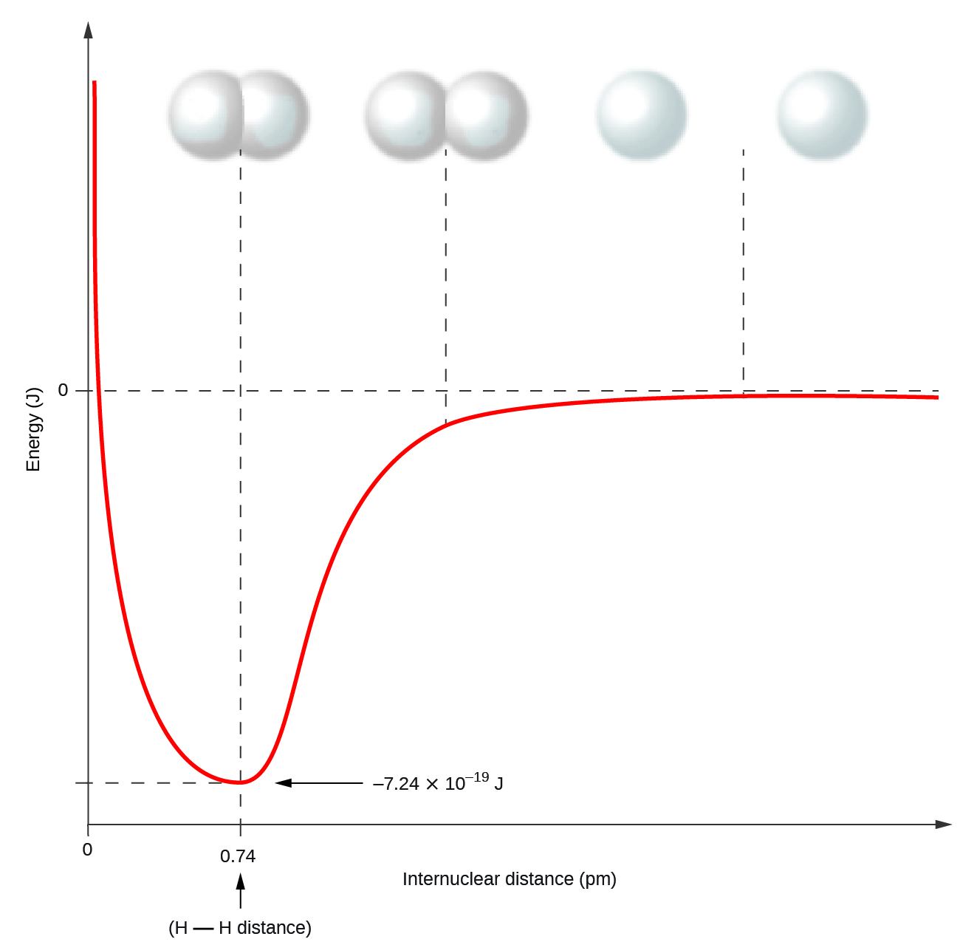
Formation of H₂ molecule.
Distance of lowest potential energy is the bond length.
The potential energy of two separate hydrogen atoms (right) decreases as they approach each other, and the single electrons on each atom are shared to form a covalent bond. The bond length is the internuclear distance at which the lowest potential energy is achieved.

Slide 14
Formation of Covalent Bonds
To break chemical bonds, energy must be added (endothermic process).
The formation of chemical bonds results in the release of energy (exothermic process).
  The bond makes each atom more stable and therefore in a lower energy state.

Slide 15
Types of covalent bonds
All covalent bonds involve the sharing of electrons. But the electrons are not always shared equally…
Two types of covalent bonds:
1) Pure Covalent bonds (Non-polar covalent bonds) – Equal sharing of electrons
2) Polar Covalent Bonds – Unequal sharing of electrons
These different types of covalent bonds arise from electronegativitiy differences amongst the bonded atoms.

Slide 16
Electronegativity
Electronegativity (EN) is a measure of the tendency of an atom to attract electrons towards itself.
Linus Pauling came up with electronegativity values for the elements.
Electronegativity Trend in the Periodic Table:
  Increases across a period from left to right.
  Decreases across down a group from top to bottom.

Slide 17
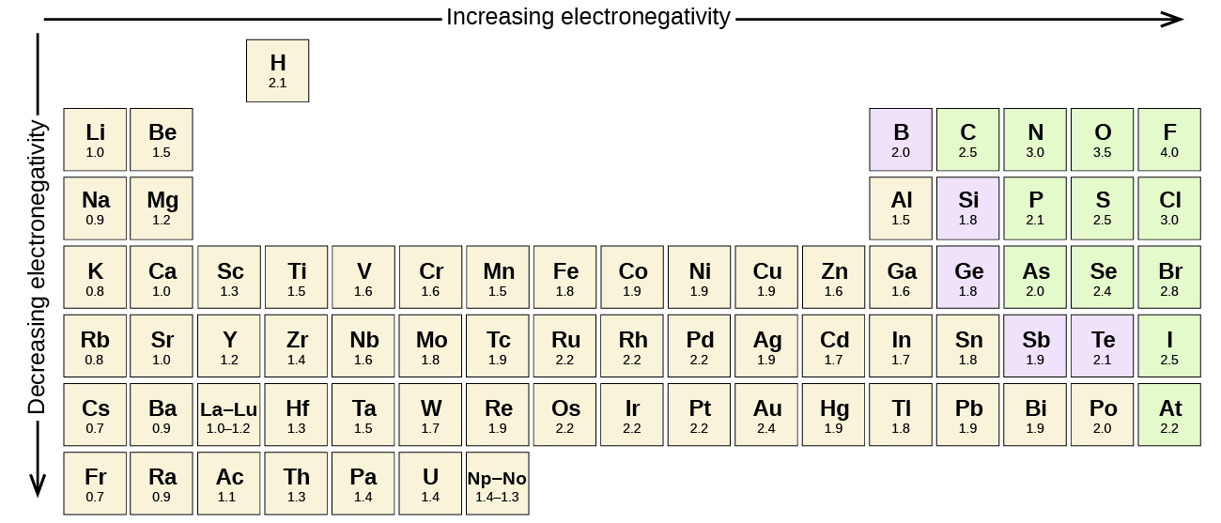
Electronegativity and the Periodic Table
Note that noble gases are excluded. Why?

Slide 18
Pure Covalent Bonds
1) Pure Covalent bonds (Non-polar covalent bonds) – Equal sharing of electrons
Form when the atoms have the exact same or very similar electronegativity values.
This occurs in all bonds when the atoms are the same (X-X)
C-H bonds are a common pure covalent bond.

Slide 19
Polar Covalent Bonds
2) Polar Covalent Bonds – Unequal sharing of electrons
Form when the atoms have significantly different EN values.
Most covalent bonds involving different atoms (X-Y), are polar covalent bonds.
The polarity of a bond increases with increasing EN difference between the bonded atoms.
The polar bond is a dipole
  Less EN atom is partially positive (δ⁺), while the more EN atom is partially negative (δ⁻).

Slide 20
Pure vs. Polar Covalent Bonds

Slide 21
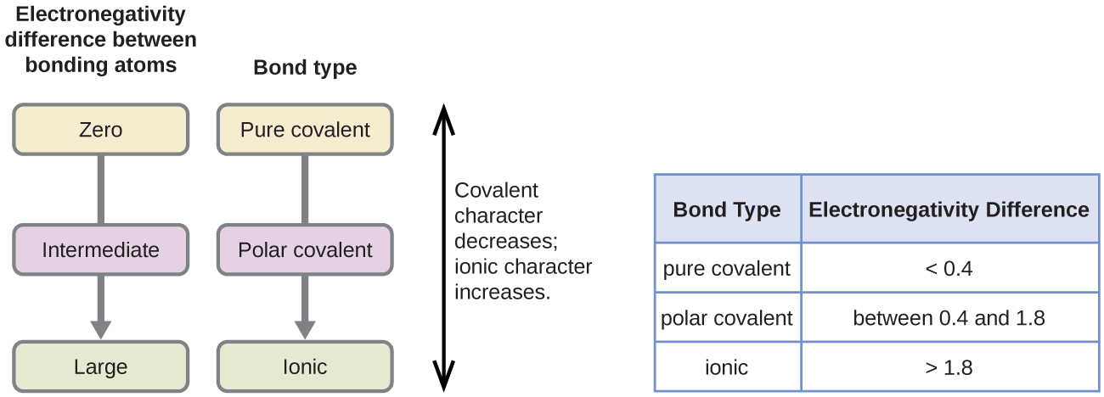
Electronegativity and Bond Type
The absolute value of the difference in electronegativity (ΔEN) provides a rough measure of bond type.
Below is only a general guide, there are many exceptions.
As the electronegativity difference increases between two atoms, the bond becomes more ionic.

Slide 22
Electronegativity and Bond Type
As the electronegativity difference increases between two atoms, the bond becomes more ionic.

Slide 23
7.3: Lewis Symbols and Structures
All bonds involve the sharing or transfer of valence electrons between atoms.
Lewis Symbol – Consists of an elemental symbol surrounded by one dot for each of its valence electrons.
Boron Carbon Nitrogen
1s²2s²2p¹ 1s²2s²2p² 1s²2s²2p³

Slide 24
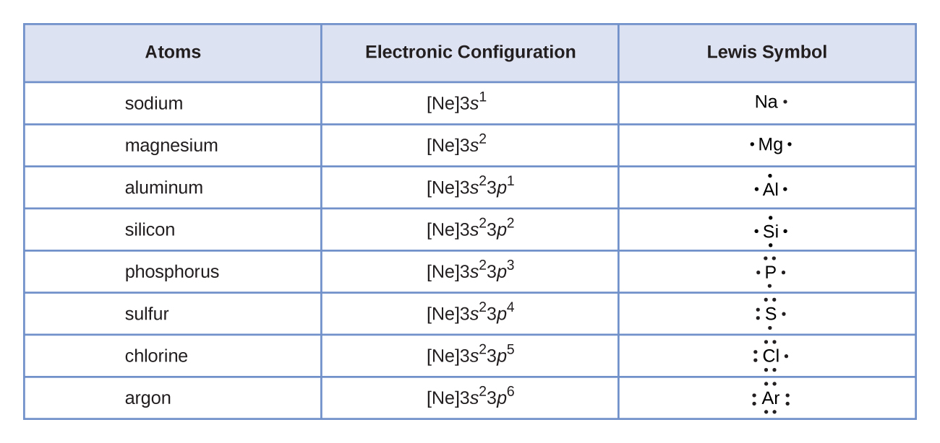
Lewis symbols illustrating the number of valence electrons for each element in the third period of the periodic table.

Slide 25
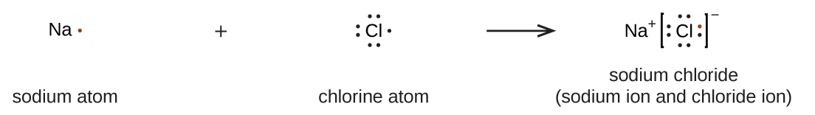
Lewis Symbols of Ions
Cations are formed when atoms lose electrons, represented by fewer Lewis dots, whereas anions are formed by atoms gaining electrons. The total number of electrons does not change.
An ionic bond forms between Na⁺ and Cl⁻ to form the ionic compound, NaCl.
The valence electron from sodium is transferred to chlorine.

Slide 26
Lewis Structures
Lewis Structures – Drawings that use Lewis Symbols to describe the bonding in molecules and polyatomic ions.
We will work with compounds containing only main-group elements.
Lewis structures show the arrangement of all valence electrons in a covalent compound.

Slide 27
Lewis Structures
  In the Lewis structure of a molecule or polyatomic ion, valence electrons ordinarily occur in pairs.
  1) A pair of shared electrons between two atoms is a covalent bond and is shown as a straight line connecting the atoms.
  2) An unshared pair, or lone pair of electrons, is shown as a pair of dots on an atom.

Slide 28
The Octet Rule
Noble gases, except for He, have 8 valence electrons.
The Octet Rule – Nonmetals, except for hydrogen, form molecules whereby sharing electrons allows them to be surrounded by eight valence electrons and therefore isoelectronic with a noble gas.
Hydrogen is an octet rule exception, because it only needs two electrons (duet of electrons) to have a filled valence shell.

Slide 29
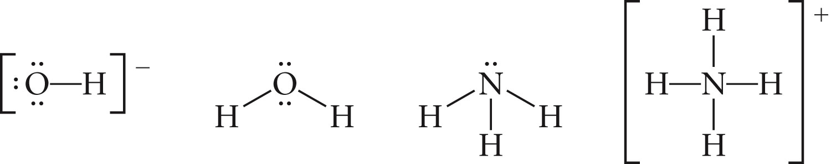
Examples of Lewis Structures
H₂O, OH⁻, NH₄⁺

Slide 30
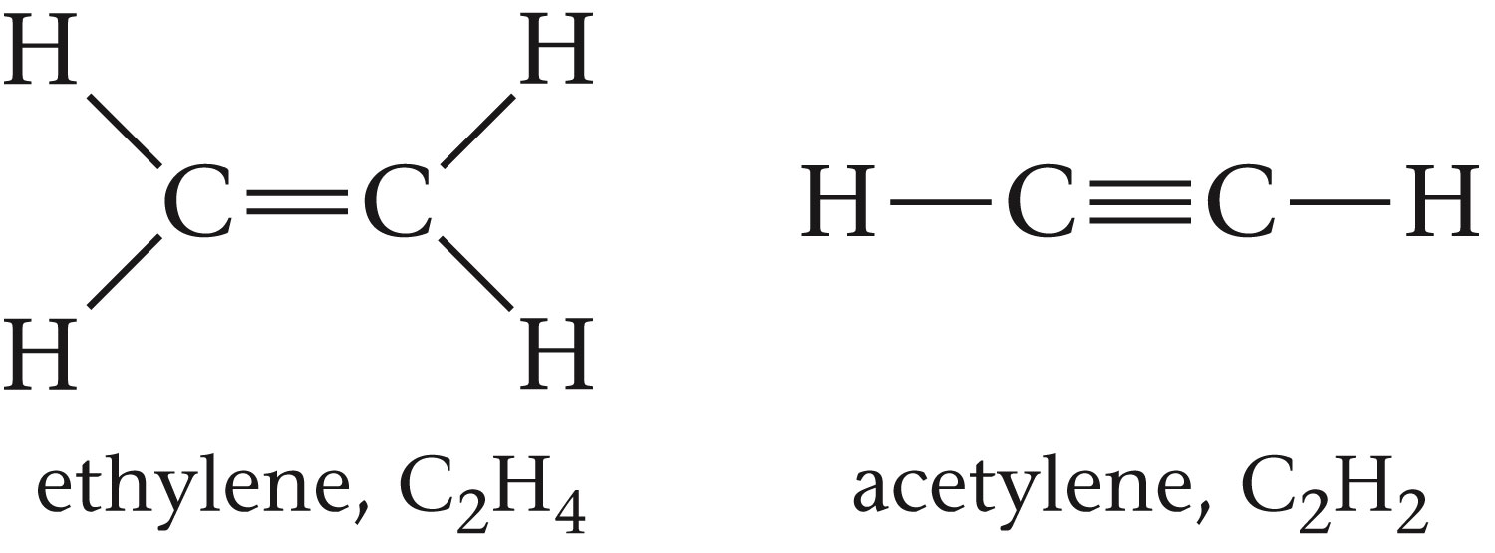
Examples of Lewis Structures
C₂H₄, C₂H₂

Slide 31
Writing Lewis Structures
1) Determine the total number of valence electrons (VE).
  For cations, subtract one electron for each positive charge.
  For anions, add one electron for each negative charge.
2) Draw a skeleton structure of the molecule or ion, using single bonds to attach terminal atoms to a central atom.
  Generally, the least electronegative element should be the central atom.
  Many times there is only one central atom and it is written first in the formula.

Slide 32
Writing Lewis Structures
3) Distribute the remaining electrons as lone pairs on the terminal atoms (except hydrogen), completing an octet around each atom.
4) If any electrons remain then place on the central atom.
5) If an atom does not have an octet at this point, then rearrange the lone pairs on the terminal atoms to make multiple bonds with the central atom until an octet is obtained.

Slide 33
Exceptions to the Octet Rule
Most molecules and polyatomic ions do follow the octet rule.
There are some notable exceptions.
Sometimes an atom in a Lewis structure will be surrounded by less than 8 electrons – Electron deficient molecules.
Sometimes an atom in a Lewis structure will be surrounded by more than 8 electrons – Hypervalent molecules.

Slide 34
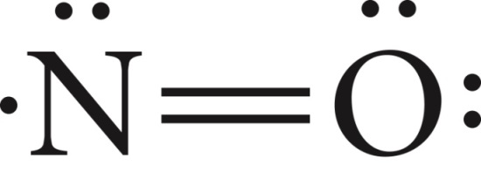
Electron Deficient Molecules
  Occasionally a molecule or ion contains an odd number of valence electrons.
    These species are known as free radicals.
    Impossible to write a Lewis structure with all atoms obeying the octet rule.
    Get each atom as close as possible to 8 electrons.
    Example: NO

Slide 35
Electron Deficient Molecules
  Sometimes a central atom will violate the octet rule by only being surrounded by 4 or 6 electrons.
  This sometimes occurs in molecules where the central atom is from group 2 or 13, such as Be or B.
  Examples: BeF₂, BeH₂, BH₃, BF₃

Slide 36
Electron Deficient Molecules
Structure II is confirmed by experiment for both molecules.
More on C_{f} (formal charge) shortly…

Slide 37
Hypervalent Molecules
Elements in the second period (n = 2) can only accommodate 8 electrons in their valence shell.
Beginning with the third period (n = 3), the presence of empty d orbitals may allow central atoms to have 10 or 12 electrons.
Hypervalent Molecules – Molecules with a central atom surrounded by more than 8 electrons.
Most common violation of the octet rule.

Slide 38
Central Atoms Capable of forming Hypervalent Molecules
Period | Grp 15 | Grp 16 | Grp 17 | Grp 18
3 | P | S | Cl
4 | As | Se | Br | Kr
5 | Sb | Te | I | Xe

Slide 39
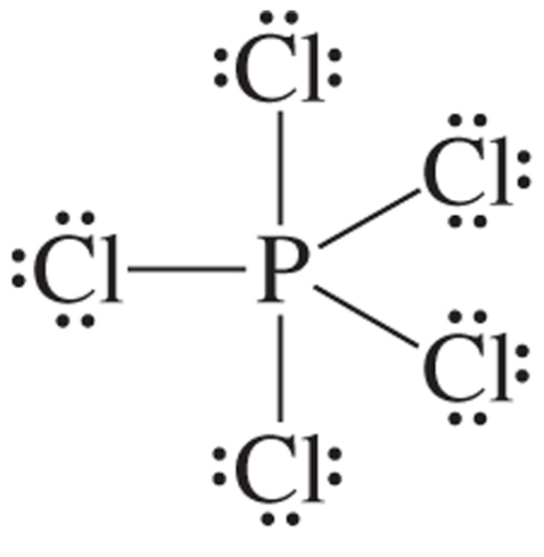
Examples of Hypervalent Molecules

Slide 40
7.4: Formal Charges and Resonance
Sometimes there is more than one Lewis Structure that can be drawn from a given molecular formula.
In these instances, the concept of formal charge can be used to help choose the most appropriate Lewis Structure.
The Formal charge of an atom in a molecule is the hypothetical charge that the atom would have if electrons were shared equally.
As with oxidation numbers:
  Formal charges are NOT actual charges
  Formal Charges help track electron ownership

Slide 41
Formal Charge (FC)
Each atom in a Lewis structure can be assigned a formal charge.
FC = # VE – # lone pair electrons – ½ (# bonding electrons)
The sum of the formal charges must equal the charge of the entire species.
  Zero for a molecule
  For a polyatomic ions, the charge of the ion
  This rule can be used to check your Lewis Structure.

Slide 42
Using Formal Charge to Predict the Best Structure
The quality of a Lewis structure can be determined by the distribution of formal charges.
The most likely Lewis Structure will have
1) Formal charges as close to zero as possible.
2) Adjacent formal charges of zero or of the opposite sign.
3) If there must be an atom with a negative formal charge, then it is assigned to the most electronegative atom in the structure.

Slide 43
Formal Charge and the Octet Rule
There are some exceptions to the octet rule.
On rare occasion, the correct Lewis structure does not obey the octet rule.
Formal charge can be used to help predict these instances.

Slide 44
Resonance Forms
In certain cases, a single Lewis structure does not adequately predict the properties of a molecule or ion.
For these compounds, two or more Lewis structures can be drawn. These individual Lewis structures are called resonance forms.
Individual resonance forms do not exist!
Resonance – If two or more Lewis Structures with the same arrangement of atoms can be drawn for a molecule or ion, then the actual distribution of electrons is an average of that shown by the various structures.

Slide 45
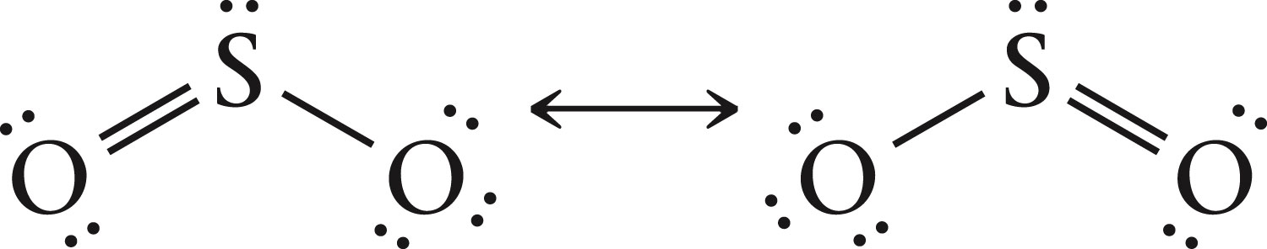
Resonance Forms
  Consider SO₂ and its resonance forms.
  Both S-O bonds are identical in all properties, as determined by experiment.
  The actual structure of the molecule is an average of the resonance forms, known as a resonance hybrid.

Slide 46
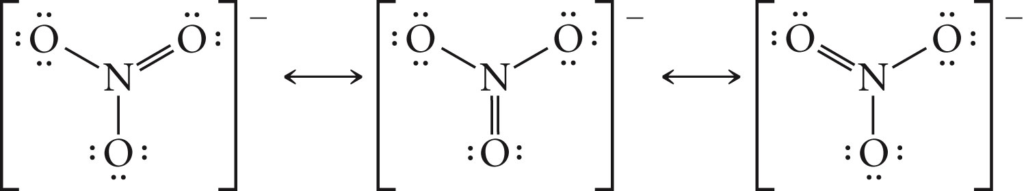
Resonance in the Nitrate Ion
All three N-O bonds are identical in properties.
These bonds are intermediate in length between a single and a double bond.

Slide 47
Notes on Resonance Hybrid Molecules
1) A resonance hybrid never posses a structure described by either resonance form.
2) A resonance hybrid does NOT fluctuate between the different resonance forms. Electrons are NOT shifting between the different structures.
3) Resonance arises when two Lewis structures are equally plausible.
4) Resonance forms only differ in the distribution of electrons. Not in the arrangement of atoms.

Slide 48
7.6: Molecular Structure and Polarity
Diatomic molecules have the easiest geometry to visualize.
Diatomic molecules are linear
  Examples: HCl and Cl₂
The molecular geometry of molecules containing three or more atoms is not always so obvious.
Many geometries are 3-Dimensional.

Slide 49
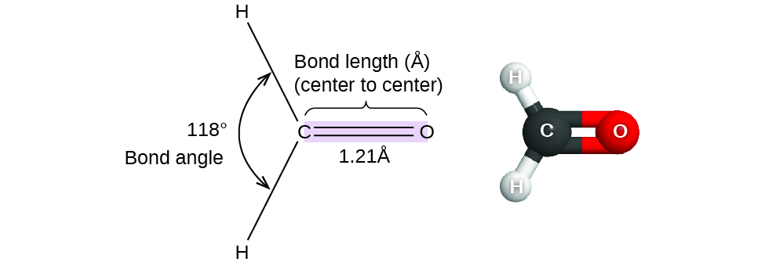
Bond Distance (or Bond Length) – The distance between the nuclei of two bonded atoms.
Bond Angle – The angle between any two bonds that include a common atom.
Bond distances (lengths) and angles are shown for the formaldehyde molecule, H₂CO.

Slide 50
Valence Shell Electron Pair Repulsion Theory (VSEPR)
The molecular geometry of a molecule, including bond angles, is based on electron pair repulsion.
VSEPR Model – The valence electron pairs surrounding an atom repel one another. Consequently, the orbitals containing those electron pairs become oriented so that they are as far apart from each other as possible.

Slide 51
Ideal Electron Pair Geometries
Consider a central atom, A, surrounded by a certain number of electron pairs (bonded or lone pair), represented as different balloons.
Like balloons tied at their ends, the electron pairs want to be situated as far from each other as possible.
linear
trigonal
planar
tetrahedral
trigonal
bipyramidal
octahedral

Slide 52
Two Types of Geometries
We will focus primarily on the geometry that results about the central atom.
Electron Pair Geometry – Describes the placement of all electron pairs (bonded and unshared).
Molecular Structure – Describes only the placement of the atoms in the molecule.
We will first focus on molecules where the central atom has no lone pairs and therefore the electron pair geometry and molecular structure are the same.

Slide 53
The A-X-E Notation
A denotes a central atom
X denotes a terminal atom
E denotes a lone pair

Slide 54
Two bonded electron pairs around “A”
AX₂
Molecular Structure = Linear
180° bond angle
Central atom is electron deficient
Example: BeF₂

Slide 55
Three bonded electron pairs around “A”
AX₃
Molecular Structure = Trigonal Planar
X atoms are directed to the corners of an equilateral triangle.
120° bond angles
Central atom is electron deficient
Example: BF₃

Slide 56
Four bonded electron pairs around “A”
AX₄
Molecular Structure = Tetrahedral
X atoms are directed to the corners of a tetrahedron.
109.5° bond angles
Central atom has an octet.
Example: CH₄

Slide 57
Five bonded electron pairs around “A”
AX₅
Molecular Structure = Trigonal bipyramid
Two triangular pyramids fused together base to base.
Bond Angles: 90°, 120°
Molecule is hypervalent
Example: PF₅

Slide 58
Six bonded electron pairs around “A”
AX₆
Molecular Structure = Octahedral
Two square pyramids fused together base to base.
Bond Angles: 90°
Molecule is hypervalent
Example: SF₆

Slide 59
Molecular Structure for when Central Atom has Lone Pairs
When the central atom has lone pairs, the electron pair geometry and molecular structure are different.
Lone pairs cause deviations from the ideal bond angles.
Order of electron pair repulsion:
lone pair-lone pair > lone pair-bonding pair > bonding pair-bonding pair

Slide 60
Why are there Ideal Bond Angle Deviations?
Lone pairs take up a larger region of space on the central atom.
  There is only one nucleus attracted to a lone pair so these electrons are able to spread out over a larger area of space.
  As a result, lone pair(s) takes up a larger volume and push the bonded pairs closer together, decreasing the bond angle(s).

Slide 61
Ammonia
Electron Pair Geometry Molecular Structure

Slide 62
Water
Electron Pair Geometry Molecular Structure

Slide 64
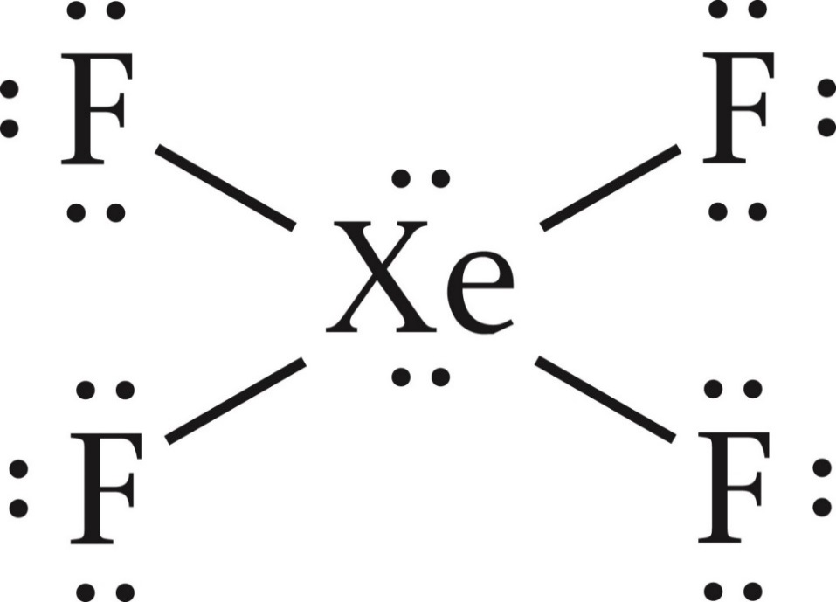
Lone Pairs and Hypervalent Molecules
In many hypervalent molecules, lone pairs are on the central atom.
Example: XeF₄

Slide 65
Hypervalent Molecules with Lone Pairs: 5 e⁻ pairs
Lone pairs always occupy the equatorial positions, allowing them more space.

Slide 66
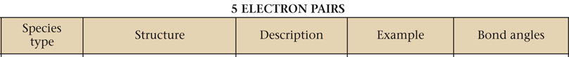
Hypervalent Molecules with Lone Pairs: 5 e⁻ pairs
Lone pairs always occupy the equatorial positions, allowing them more space.

Slide 67
Hypervalent Molecules with Lone Pairs: 6 e⁻ pairs

Slide 68
Multi Bonds and Geometry
Multi bonds also cause deviations from ideal bond angles.
Double and triple bonds occupy more space than a single bond.
Region of space occupied:
lone pair > triple bond > double bond > single bond

Slide 69
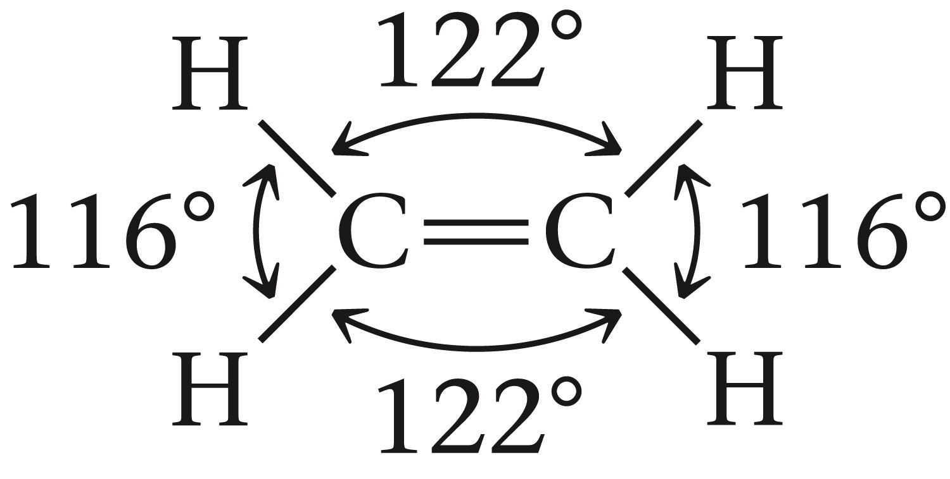
Geometry of molecules with multi bonds and multiple center atoms
We can describe the local structure about each interior atom.

Slide 70
Geometry of molecules with multi bonds and without a single central atom

Slide 71
How to Determine Structure with VSEPR Theory
1) Draw Lewis Structure
2) Count the number of regions of electron density (lone pairs and bonds) around the central atom.
  A lone pair, single bond, double bond, and triple bond all count as one region.
3) Identify the electron-pair geometry
4) Determine the molecular structure. Recognize where possible deviations from ideal bond angles exist.

Slide 72
Molecular Polarity and Dipole Moment
Recall, that polar bonds are dipoles.
The separation of charge results in a bond dipole moment (μ)
Q = magnitude of partial charges
r = bond distance

Slide 73
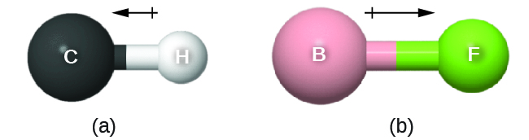
Bond Dipole Moment
The dipole moment (μ) can be represented as a vector, having both direction and magnitude.
There is a small difference in electronegativity between C and H, represented as a short vector.
The electronegativity difference between B and F is much larger, so the vector representing the bond moment is much longer.

Slide 74
Molecular Polarity and Dipole Moment
If a molecule has a molecular dipole moment, then it is considered polar.
A polar molecule contains a positive pole and a negative pole.
  One end of the molecule has a partial positive charge (δ⁺) - positive pole.
  The other end of the molecule has a partial negative charge (δ⁻) - negative pole.
There are no positive or negative poles in a nonpolar molecule.

Slide 75
Deciding if a Molecule is Polar or Non-polar
For diatomic molecules it is simple.
  If the bond is polar then the molecule is polar.
  If the bond is non-polar then the molecule is non-polar
For molecules with three or more atoms it is not so simple. Two conditions must be satisfied in order for a molecule to be considered polar.
  1) The molecule must have at least one polar bond.
  2) The molecule must have an overall dipole moment.

Slide 76
Molecular Dipoles
If both those criteria are NOT met then the molecule is non-polar.
We have to consider molecular geometry when determining if a molecule has an overall dipole moment.
Sometimes bond dipoles will cancel each other out, making the molecule non-polar.
If the polar A-X bonds in a molecule of type AX_{m}E_{n} are arranged symmetrically around the central atom A, the molecule is nonpolar.

Slide 78
Lone pairs on the central atom, often break the molecules symmetry resulting in the molecule having an overall dipole moment meaning that it is polar.

Slide 79
Having more than one type of bond dipole can also lead to a polar molecule.

Slide 80
Polar molecules respond to an applied electrical field.

