Slide 1
CHEMISTRY
Chapter 7
Chemical Bonding and
Molecular Geometry
Slides by Montgomery College licensed under CC BY 4.0.

Slide 2
chapter 7: Electronic structure
7.1 Ionic Bonding
7.2 Covalent Bonding
7.3 Lewis Symbols and Structures
7.4 Formal Charges and Resonance
7.5 Strengths of Ionic and Covalent Bonds
7.6 Molecular Structure and Polarity

Slide 3
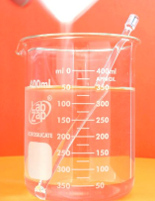
7.1 ionic bonding
Properties of Ionic Compounds
Ionic compounds, also known as salts, are held together by electrostatic forces of attraction between cations and anions.
Ionic compounds have distinct chemical and physical properties.
The properties of ionic compounds are very different from those of its constituent neutral atoms.
crystalline
rigid and brittle
high melting points
dissolve readily in water
conduct electricity in aqueous solution
Na(s)
NaCl(s)
Cl₂ (g)
NaCl(aq)

Slide 4
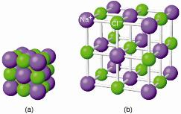
7.1 Ionic bonding
Formation of Ionic Compounds
Ionic compounds must be electrically neutral.
# of positive charges = # negative charges
The simplest ratio of atoms is used for the formula.
Na⁺
NaCl
Cl⁻
Al³⁺
Al₂O₃
O²⁻
2 x (3+)
3 x (2−)
6+
6−
som.web.cmu.edu

Slide 5

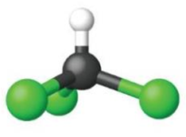

7.2 Covalent bonding
Properties of Covalent Bonds
Electrons are shared between atoms in a covalent bond.
Both atoms have similar electron affinities.
Covalently bonded compounds:
  have lower melting and boiling points than ionic compounds
  can be liquids or gases at room temperature
  form softer solids than ionic compounds
  are mostly insoluble in water and are poor conductors
Nonmetals generally form covalent bonds with other nonmetals.
Hydrogen
(H₂)
Oxygen
(O₂)
Chloroform
(CHCl₃)

Slide 6
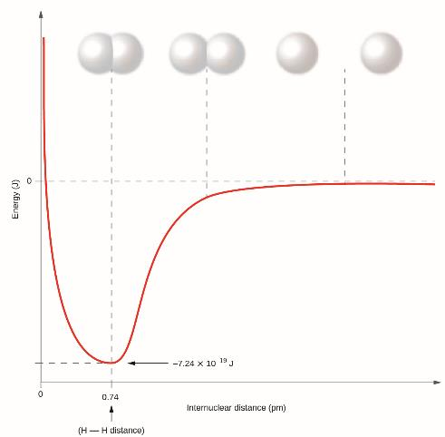
7.2 Covalent bonding
Formation of Covalent Bonds
s-orbitals of the atoms can overlap to form a covalent bond.
Bond length is determined by the distance at which lowest potential energy is achieved.
Energy must be added to break a chemical bond, so energy is released when one is formed.

Slide 7
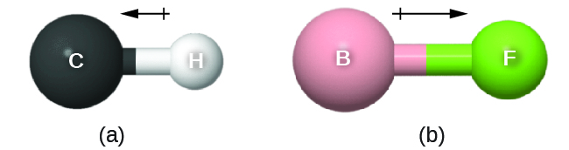

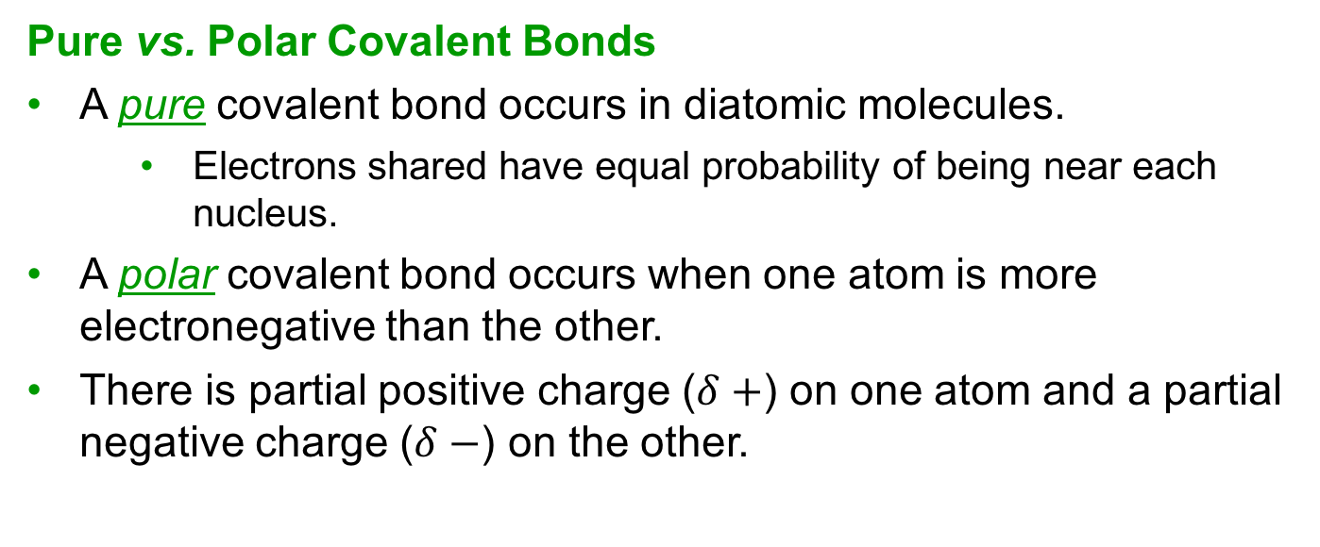



7.2 Covalent bonding
Pure vs. Polar Covalent Bonds
A pure covalent bond occurs in diatomic molecules.
  Electrons shared have equal probability of being near each nucleus.
A polar covalent bond occurs when one atom is more electronegative than the other.
There is partial positive charge ($δ+$) on one atom and a partial negative charge ($δ−$) on the other.
$δ−$
$δ+$
$δ+$
$δ−$

Slide 8
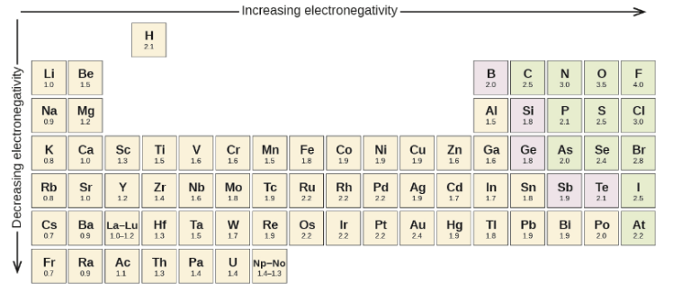
7.2 Covalent bonding
Electronegativity
The extent that a bond is polarized is determined by the electronegativity of the atoms involved.
Electronegativities as derived by Linus Pauling are listed in the table below.
Consider the polarity of an N-O bond versus that of a Si-O bond.

Slide 9
7.2 Covalent bonding
Reminder: Electron Affinity vs. Electronegativity
Be careful not to confuse electronegativity and electron affinity.
The electron affinity of an element is a measurable physical quantity: energy released or absorbed when an isolated gas-phase atom acquires an electron (kJ/mol).
The electronegativity describes how tightly an atom attracts electrons in a bond.
  a dimensionless quantity that is calculated, not measured.
  derived by Pauling as he compared the amounts of energy required to break different types of bonds
  on an arbitrary relative scale ranging from 0 to 4

Slide 10
Linus Pauling
Linus Pauling (1901-1994) is the only person to have received two unshared Nobel Prizes.
  Chemistry in 1954 for his work on the nature of chemical bonds.
  Peace in 1962 for his opposition to weapons of mass destruction.
Pauling developed many fundamental chemical concepts such as electronegativity and resonance structures.
nobelprize.org
Pauling also discovered the cause of sickle cell anemia—the presence of a genetically inherited abnormal protein in the blood—and paved the way for the field of molecular genetics.
Pauling was also a prominent activist, publicizing issues related to health and nuclear weapons.
  He proved that radioactive fallout from nuclear testing posed a public health risk.

Slide 11
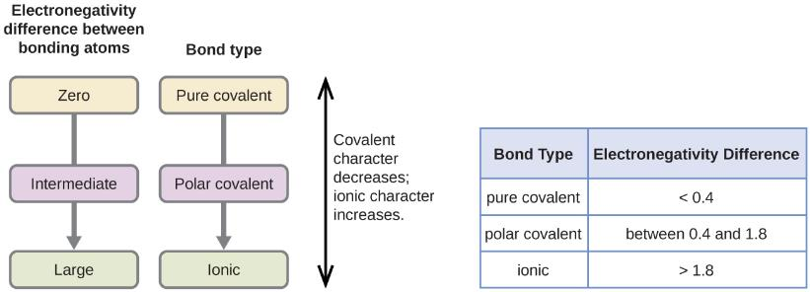
7.2 Covalent bonding
Electronegativity and Bond Polarity
The absolute value of the electronegativity difference (ΔE) between two atoms provides a measure of polarity.
When ΔE is small, the bond has more covalent character.
A large value of ΔE means that the bond is ionic in character.

Slide 12
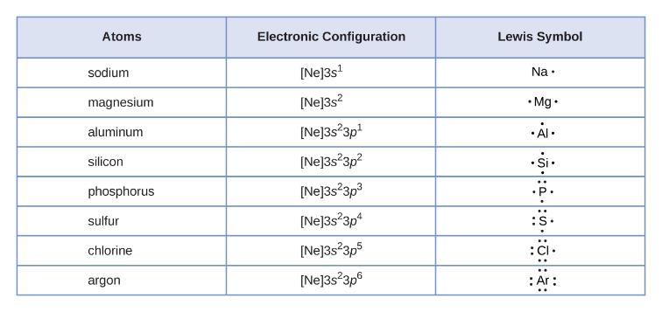
7.3 Lewis symbols and structures
Lewis Symbols
G.N. Lewis devised a way to represent valence electrons around atoms and monatomic ions.
A Lewis symbol consists of an elemental symbol surrounded by one dot per valence electron.

Slide 13

7.3 Lewis symbols and structures
Lewis Symbols
For ions, Lewis symbols are used as well.
For cations:
For anions:

Slide 14
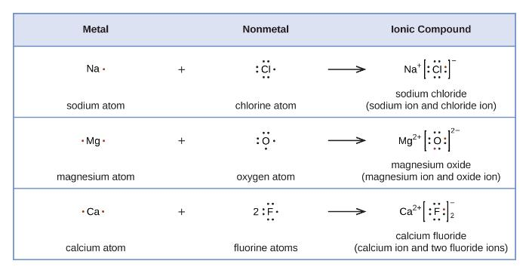
7.3 Lewis symbols and structures
Lewis Symbols for Ionic Compounds
The metal (cation) and nonmetal (anion) must be considered.
  The cation loses electrons.
  The anion gains electrons.
The total number of electrons does not change.

Slide 15
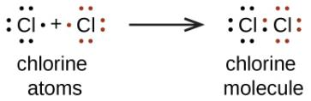
7.3 Lewis symbols and structures
Lewis Structures
Covalent compounds can be represented as Lewis structures.
A bond requires that an electron pair be shared between atoms.
  One pair of electrons shared → single bond.
  Two pairs → double bond
  Three pairs → triple bond
Electrons not involved in bonding are called lone pairs and are drawn on the outside of each atom.

Slide 16
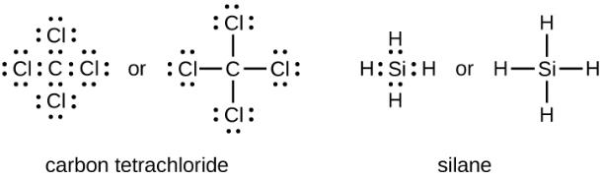
7.3 Lewis symbols and structures
The Octet Rule
The tendency of main group atoms to form enough bonds to obtain eight valence electrons is known as the octet rule.
The number of bonds an atom can form can be predicted from the number of electrons needed to reach an octet.
Carbon atoms require four electrons to reach an octet and can do this by forming four covalent bonds.
Locate silicon on the periodic table. Does the silane structure make sense?

Slide 17
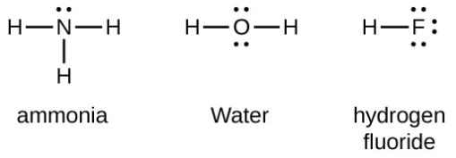
7.3 Lewis symbols and structures
The Octet Rule
Group 15 elements require three bonds to reach an octet.
Group 16 elements require two bonds.
Group 17 elements require one bond.
ammonia
water
hydrogen
fluoride

Slide 18
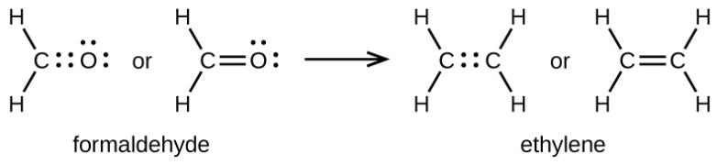

7.3 Lewis symbols and structures
Double and Triple Bonds
When two atoms share multiple electrons pairs, double and triple bonds can form.

Slide 19
7.3 Lewis symbols and structures
Writing Lewis Structures
For simple molecules, Lewis structures can be drawn by pairing up the unpaired electrons on each atom.
For more complicated molecules, a step-by-step procedure can be used.

Slide 20
7.3 Lewis symbols and structures
Procedure for Writing Lewis Structures
Determine the total # of valence electrons.
Draw a skeleton structure with the least electronegative atom (generally) in the center. Connect to outer atoms with a single bond.
Distribute the remaining valence electrons on outer atoms.
Place any remaining electrons on the central atom.
Rearrange atoms/bonds so that all atoms have an octet.
SiH₄
CHO₂⁻
OF₂

Slide 21
7.3 Lewis symbols and structures
Example 7.4
NASA’s Cassini-Huygens mission detected a large cloud of toxic hydrogen cyanide (HCN) on Titan, one of Saturn’s moons. Titan also contains ethane (H₃CCH₃), acetylene (HCCH), and ammonia (NH₃). What are the Lewis structures of these molecules?
HCN
HCCH
H₃CCH₃
NH₃

Slide 22
7.3 Lewis symbols and structures
Exceptions to the Octet Rule
Many covalent molecules have central atoms that do not have octets.
If a molecule has an odd number of valence electrons, it will have an unpaired electron or a free radical.
Rearrange the electrons to make multiple bonds with the central atom in order to obtain octets wherever possible. We know that an odd-electron molecule cannot have an octet for every atom, but we want to get each atom as close to an octet as possible.
Draw Lewis structures for:
NO
HO
CH₃
nitric oxide
hydroxyl
radical
methyl
radical

Slide 23
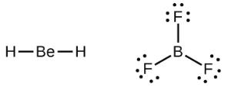
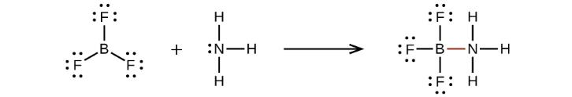
7.3 Lewis symbols and structures
Exceptions to the Octet Rule
Electron deficient molecules have a central atom with fewer than eight electrons.
Hydrogen is usually a terminal atom and does not have an octet.
Be and B also form molecules with fewer than eight electrons around the central atom.
electron deficient
lone pair can be shared

Slide 24
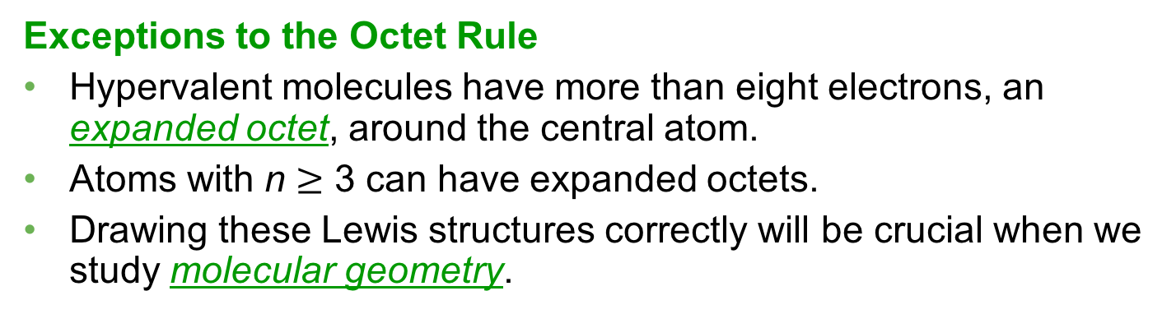
7.3 Lewis symbols and structures
Exceptions to the Octet Rule
Hypervalent molecules have more than eight electrons, an expanded octet, around the central atom.
Atoms with n $≥$ 3 can have expanded octets.
Drawing these Lewis structures correctly will be crucial when we study molecular geometry.
PF₅
SF₆
IF₅
XeF₄

Slide 25
7.4 Formal charges and resonance
Formal Charge
The formal charge of an atom in a molecule is the hypothetical charge the atom would have if we could redistribute the electrons in the bonds evenly between the atoms.
# valence shell electrons (free atom) − # lone pair electrons
− ½ # bonding electrons
The formal charge is hypothetical and not the actual charge on an atom.
Formal charges are useful for predicting molecular structure, as we shall see.
Draw Lewis structures and assign formal charges for:
ICl₄⁻
CO
BrCl₃

Slide 26
7.4 Formal charges and resonance
Formal Charge and Molecular Structure
The arrangement of atoms in a molecule or ion is called its molecular structure.
For a molecular structure:
  formal charges of zero preferred
  adjacent formal charges should be zero or opposite sign
  a negative formal charge should reside on an electronegative atom and a positive on the least electronegative atom.
  charge separation should be minimized
Choose the favored Lewis structure from the possibilities given:
CO₂
[NCS] ⁻
Skeleton:

Slide 27

7.4 Formal charges and resonance
Example 7.8
Nitrous oxide, N₂O, commonly known as laughing gas, is used as an anesthetic in minor surgeries, such as the routine extraction of wisdom teeth. Which is the likely structure for nitrous oxide?
Draw all possible Lewis structures for NO₂⁻. Choose the most favored structure.

Slide 28
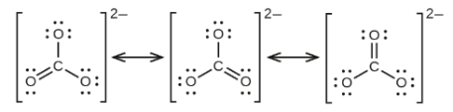
7.4 Formal charges and resonance
Resonance
If two or more Lewis structures with the same arrangement of atoms can be drawn for a molecule or ion, the actual distribution of electrons is an average of the two.
The individual arrangements are called resonance structures.
The average is called a resonance hybrid.
Draw the resonance structures and the resonance hybrid for CO₃²⁻ and O₃.
CO₃²⁻
O₃
Skeleton:

Slide 29

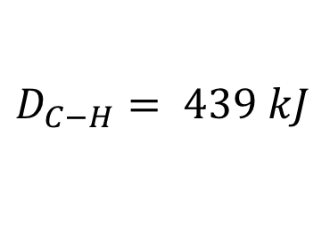


7.5 strengths of ionic and covalent bonds
Bond Strength: Covalent Bonds
The strength of a covalent bond is measured by the energy required to break it.
The energy required to break a covalent bond in one mole of gaseous molecules is the bond energy, or bond dissociation energy.
The bond energy for a molecule is the standard enthalpy of change for the endothermic process required to break the bond.
XY(g) → X(g) + Y(g)
$$D_{X−Y}={ΔH}^{°}$$
H₂(g) → 2H(g)
$$D_{H−H}={ΔH}^{°}=436 kJ$$
CH₄(g) → C(g) + 4H(g)
$${ΔH}_{rxn}^{°}=1660 kJ$$
for 4 C-H bonds
$$D_{C−H}= 439 kJ$$

Slide 30
7.5 strengths of ionic and covalent bonds
Bond Strength: Covalent Bonds
In general, as bond strength increases, bond length decreases.
Triple bonds are shorter and stronger than double bonds.
Double bonds are shorter and stronger than single bonds.

Slide 31
7.5 strengths of ionic and covalent bonds
Bond Strength: Covalent Bonds
What periodic trends can be noted from the bond energies (kJ/mol) in the table?

Slide 32
7.5 strengths of ionic and covalent bonds
Covalent Bond Energies and Enthalpy
Bond energies can be used to calculate enthalpy changes for reactions where enthalpies of formation are not available.
Such a calculation will also show whether a reaction is exothermic or endothermic.
An exothermic reaction (ΔH < 0) results when the bonds in the products are stronger than the bonds in the reactants.
An endothermic reaction (ΔH > 0) results when the bonds in the products are weaker than those in the reactants.
ΔH_{rxn} = ƩD_{bonds broken} − ƩD_{bonds formed}
D = bond energy (kJ/mol)

Slide 33
7.5 strengths of ionic and covalent bonds
Bond Energies and Enthalpy
Consider the reaction between hydrogen gas and chlorine gas to form hydrochloric acid.
H₂(g) + Cl₂(g) → HCl(g)
H₂(g) + Cl₂(g) → 2HCl(g)
H − H(g) + Cl − Cl(g) → 2H − Cl(g)
one mole H-H bonds broken
one mole Cl-Cl bonds broken
two moles H-Cl bonds formed
ΔH_{rxn} = ƩD_{bonds broken} − ƩD_{bonds formed}
Values are tabulated in the textbook.
ΔH_{rxn} = Ʃ[D_{H-H} + D_{Cl-Cl}] − Ʃ[2D_{H-Cl}]
ΔH_{rxn} = [436 + 243] − [2(432)] = – 185 kJ

Slide 34
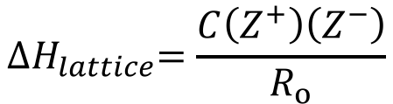

7.5 strengths of ionic and covalent bonds
Bond Strength: Ionic Bonds and Lattice Energy
Ionic bonds are held together by electrostatic interactions between positive and negative ions.
The energy required to convert one mole of an ionic compound into gaseous ions is called the lattice energy, ΔH_{lattice}.
Lattice energies will always be positive.
Energy is released when a lattice forms.
$${∆H}_{lattice}=769 kJ$$
It requires 769 kJ to separate one mole of solid NaCl into gaseous Na⁺ and Cl– ions.
When one mole each of gaseous Na⁺ and Cl– ions form solid NaCl, 769 kJ of heat is released.
How would the lattice energy change for a compound like MgO?
$${∆H}_{lattice}=\frac{C\left(Z^{+}\right)\left(Z^{−}\right)}{R_{o}}$$
constant
ion
charges
distance between ions

Slide 35






7.5 strengths of ionic and covalent bonds
The Born-Haber Cycle
Lattice energies cannot be measured directly, but it can be calculated using a thermochemical cycle.
The Born-Haber Cycle is an application of Hess’s Law.
Individual steps for the formation of ionic solids are considered.
standard enthalpy of formation of compound
ionization energy of the metal
electron affinity of the nonmetal
enthalpy of sublimation of the metal
bond dissociation energy of the nonmetal
lattice energy of the compound
$${ΔH}_{formation}^{°}$$
$${IE}_{metal}$$
$${EA}_{nonmetal}$$
$${ΔH}_{sublimation}^{°}$$
$$D_{nonmetal}$$
$${∆H}_{lattice}$$

Slide 36
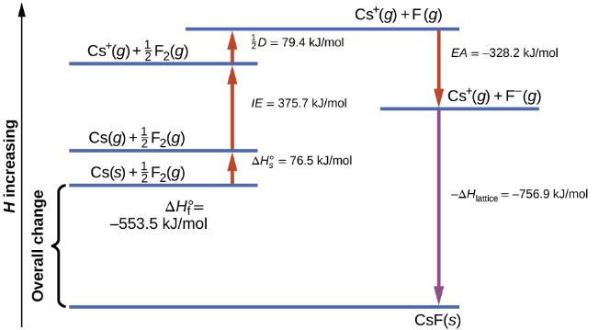
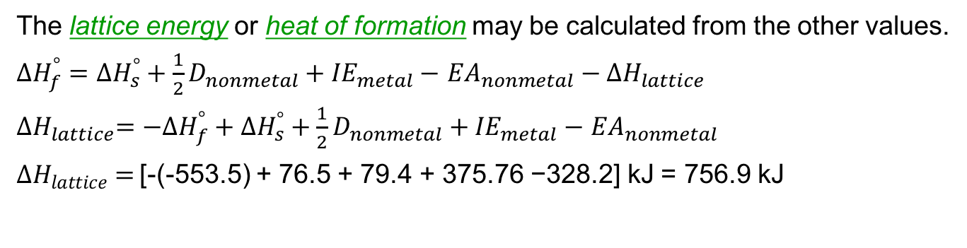
7.5 strengths of ionic and covalent bonds
The Born-Haber Cycle: Cesium Fluoride
$${ΔH}_{formation}^{°}$$
$${IE}_{metal}$$
$${EA}_{nonmetal}$$
$${ΔH}_{sublimation}^{°}$$
$$D_{nonmetal}$$
$${∆H}_{lattice}$$
The lattice energy or heat of formation may be calculated from the other values.
${ΔH}_{f}^{°}={ΔH}_{s}^{°}+{\frac{1}{2}D}_{nonmetal}+{IE}_{metal}−$ ${EA}_{nonmetal}−{∆H}_{lattice}$
${{∆H}_{lattice}=−ΔH}_{f}^{°}+{ΔH}_{s}^{°}+{\frac{1}{2}D}_{nonmetal}+{IE}_{metal}−$ ${EA}_{nonmetal}$
${∆H}_{lattice} =$[-(-553.5) + 76.5 + 79.4 + 375.76 −328.2] kJ = 756.9 kJ

Slide 37




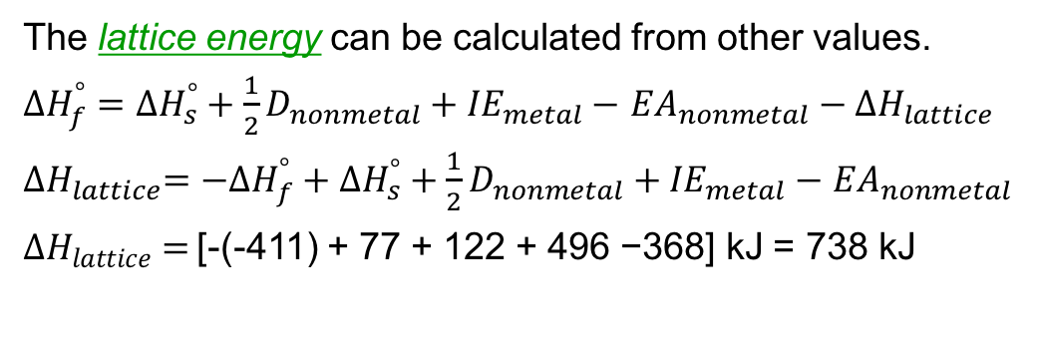

7.5 strengths of ionic and covalent bonds
The Born-Haber Cycle: Cesium Chloride
The lattice energy can be calculated from other values.
${ΔH}_{f}^{°}={ΔH}_{s}^{°}+{\frac{1}{2}D}_{nonmetal}+{IE}_{metal}−$ ${EA}_{nonmetal}−{∆H}_{lattice}$
${{∆H}_{lattice}=−ΔH}_{f}^{°}+{ΔH}_{s}^{°}+{\frac{1}{2}D}_{nonmetal}+{IE}_{metal}−$ ${EA}_{nonmetal}$
${∆H}_{lattice} =$[-(-411) + 77 + 122 + 496 −368] kJ = 738 kJ
$${ΔH}_{formation}^{°}$$
$${IE}_{metal}$$
$${EA}_{nonmetal}$$
$${ΔH}_{sublimation}^{°}$$
$$D_{nonmetal}$$
$${∆H}_{lattice}$$

Slide 38
7.6 Molecular structure and polarity
Depicting Molecules in Three Dimensions
Molecules can be represented by Lewis structures, but a more complete representation includes three-dimensional geometries.
The distances between atoms, bond angles, and relative arrangements in space are critical for understanding molecular structures.
A bond angle (degrees) is the angle between two bonds that have a common atom.
A bond length (Ångstroms) is the distance between the nuclei of two bonded atoms.
1 Å = 10⁻¹⁰ m

Slide 39
7.6 Molecular structure and polarity
VSEPR Theory
The molecular structure of molecules can be predicted by using valence shell electron pair repulsion theory (VSEPR).
Electron pairs in the valence shell of the central atom will adopt an arrangement so that they are as far apart in space as possible.
This minimizes repulsion between electron pairs.
Draw the Lewis structure for each molecule and predict a geometry that will minimize electron pair repulsion.
BeF₂
BF₃

Slide 40
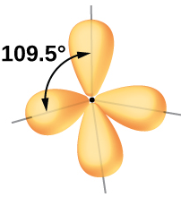
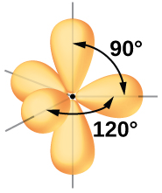
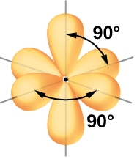
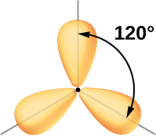
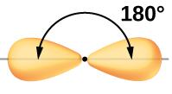
7.6 Molecular structure and polarity
Electron Density and Geometry
For more complicated molecules, all regions of high electron density around a central atom need to be considered.
Both bonded atoms and electron pairs on a central atom are considered regions of high electron density must be considered when starting to determine molecular geometry.
Regions | 2 | 3 | 4 | 5 | 6
Arrangement

Slide 41
7.6 Molecular structure and polarity
Electron Density and Geometry
When considering regions of high electron density, bonding atoms and lone pairs must be considered.
The arrangement of these regions in space is referred to as the electron pair geometry.
The possible arrangements for electron pair geometry are limited and fall into five general categories.
Regions | 2 | 3 | 4 | 5 | 6
Arrangement
Electron Pair Geometry | linear | trigonal planar | tetrahedral | trigonal bipyramidal | octahedral

Slide 42
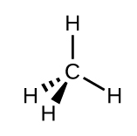
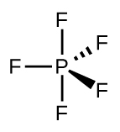
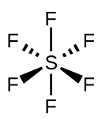
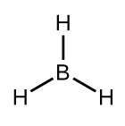
7.6 Molecular structure and polarity
From Electron Pair Geometry to Molecular Structure
The electron pairs cannot be “seen” so the actual molecular geometry is determined by the placement of atoms.
The electron pairs are critical, however, because each occupies a relatively large region in space.
The groups with two regions of electron densities are linear and do not involve lone pairs.
Lone pair arrangements must be considered in higher order groups.
Trigonal Planar
Group
Tetrahedral
Group
Trigonal Bipyramidal
Group
Octahedral
Group

Slide 43
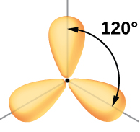
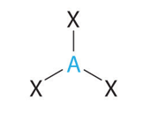
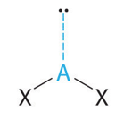
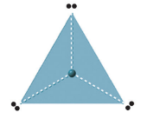
7.6 Molecular structure and polarity
Trigonal Planar Group
If there are three regions of electron density around a central atom, the best arrangement in space is trigonal planar.
The molecular geometries depend on the combination of atoms and electron pairs arrayed about the central atom.
Trigonal Planar
Group
AX₃
AX₂
3 atoms
0 lone pairs
2 atoms
1 lone pair
trigonal planar
bent

Slide 44
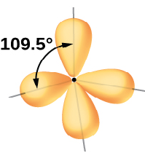
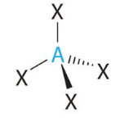
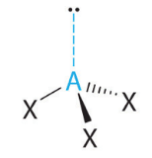
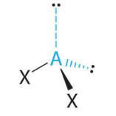
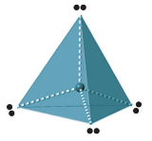
7.6 Molecular structure and polarity
Tetrahedral Group
If there are four regions of electron density around a central atom, the best arrangement in space is tetrahedral.
The molecular geometries depend on the combination of atoms and electron pairs arrayed about the central atom.
Tetrahedral
Group
AX₄
AX₃
AX₂
4 atoms
0 lone pairs
3 atoms
1 lone pair
2 atoms
2 lone pairs
tetrahedral
trigonal
pyramidal
bent

Slide 45
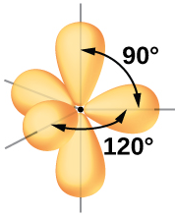
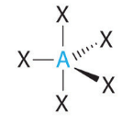
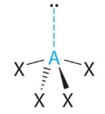
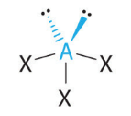
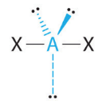
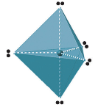
7.6 Molecular structure and polarity
Trigonal Bipyramidal
If there are five regions of electron density around a central atom, the best arrangement in space is trigonal bipyramidal.
The molecular geometries depend on the combination of atoms and electron pairs arrayed about the central atom.
Trigonal Bipyramidal
Group
AX₅
AX₄
AX₃
AX₂
5 atoms
0 lone pairs
4 atoms
1 lone pair
3 atoms
2 lone pairs
2 atoms
3 lone pairs
trigonal
bipyramidal
see-saw
t-shaped
linear

Slide 46
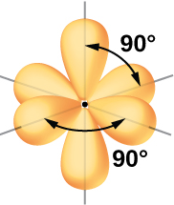
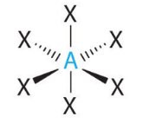
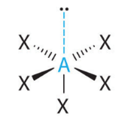


7.6 Molecular structure and polarity
Octahedral
If there are six regions of electron density around a central atom, the best arrangement in space is octahedral.
The molecular geometries depend on the combination of atoms and electron pairs arrayed about the central atom.
Octahedral
Group
AX₆
AX₅
AX₄
6 atoms
0 lone pairs
5 atoms
1 lone pair
4 atoms
2 lone pairs
octahedral
square
pyramidal
square
planar

Slide 47











7.6 Molecular structure and polarity
Summary of Molecular Geometries
Geometry | 0 lone pairs | 1 lone pair | 2 lone pairs | 3 lone pairs
linear
trigonal planar
tetrahedral
trigonal bipyramidal
octahedral

Slide 48


Slide 49
7.6 Molecular structure and polarity
Example 7.14
Sulfur tetrafluoride, SF₄, is extremely valuable for the preparation of fluorine-containing compounds used as herbicides. Predict the electron-pair geometry and the molecular geometry of the SF₄ molecule.
Hint: For this molecule, consider the difference
between axial and equatorial positions.

Slide 50
7.6 Molecular structure and polarity
Example 7.15
Of all the noble gases, xenon is the most reactive, frequently reacting with elements such as oxygen and fluorine. Predict the electron-pair geometry and molecular structure of the XeF₄ molecule.

Slide 51

7.6 Molecular structure and polarity
Example 7.16 – The Structure of a Multicenter Molecule
The Lewis structure for the amino acid glycine, H₂NCH₂CO₂H is shown. Predict the local geometry of the atoms indicated.
#2
#1
#4
#3

Slide 52

7.6 Molecular structure and polarity
From Molecular Geometry to Polarity
When two atoms of differing electronegativities are connected by a covalent bond, one atom has a partial positive charge ($δ+$) and the other has a partial negative charge ($δ−$).
The separation of charge gives rise to a bond dipole moment.
The dipole moment is represented as a vector, a quantity having both direction and magnitude, pointing from the partial positive charge to the partial negative charge.
A small difference in electronegativity for C vs. H is represented by a short vector.
A larger difference in electronegativity between B and F is represented by a longer vector.

Slide 53
7.6 Molecular structure and polarity
From Molecular Geometry to Polarity
A molecule with an overall dipole moment is said to be polar.
The vectors for each polar bond must be added to get the overall polarity of the molecule.
Why is it useful to know whether a molecule is polar or not?
nonpolar
molecule
polar
molecule

Slide 54
7.6 Molecular structure and polarity
Example Structures
Determine the molecular geometry of each molecule. State whether the molecule is polar or not.
a. BeF₂ b. BF₃ c. CF₄ d. PF₅ e. SF₆

Slide 55
end of chapter problems – chapter 7
Lewis Structure and Formal Charges: #23, 29a-h, 51
Polarity and Bonds: #15, 17, 21, 97
VSEPR: #85, 91, 95
For detailed solutions to these problems, go to the OpenStax Chemistry website and download the Student Solution Guide.

Slide 56
videos – chapter 7
Lattice Energy
http://screencast.com/t/3tODFuL7rZ
Lewis Dot Structures for Individual Atoms
http://screencast.com/t/j5dnOkm3D
Drawing Lewis Dot Structures for Molecules
http://youtu.be/Vio5mIzvYW8
http://screencast-o-matic.com/watch/cDfXfI1AoN
Simple Resonance Structures
http://screencast.com/t/yJikVInxjxU
Assigning Formal Charges
http://youtu.be/Xp3a6GJ8aUE
VSEPR – General Shapes of Molecules
http://screencast.com/t/nYK2Hzm9
Drawing Orbital Overlap Diagrams (Sigma and Pi Bonds)
http://screencast.com/t/XoxiDNDV7JMW
*All videos were created by MC Chemistry faculty unless otherwise indicated.

Slide 57

simulations – chapter 7
Molecule Polarity (Polarity, Electronegativity)
https://phet.colorado.edu/en/simulation/legacy/molecule-polarity

