Slide 1
CHAPTER 8: ADVANCED THEORIES OF COVALENT BONDING
OpenStax
Joseph DePasquale

Slide 2
Ch. 8 Outline
8.1: Valence Bond Theory
8.2: Hybrid Atomic Orbitals
8.3: Multiple Bonds
Omit Section 8.4

Slide 3
Orbitals and Covalent Bonding
Linus Pauling and others (1930s) developed the valance bond theory of covalent bonding.
Electrons reside in orbitals.
Covalent bonds form when electrons are shared by the overlapping of singly occupied orbitals.
Electrons in these overlapping orbitals must have opposite spins.

Slide 4
Valence Bond Theory
Consider the formation of the H₂ molecule.

Slide 5
Valence Bond Theory
Consider the formation of the HF molecule.

Slide 6
Valence Bond Theory
To form a covalent bond, an atom must have an unpaired electron.
Number of bonds formed by an atom is determined by the number of unpaired electrons.
This theory works well for explaining the bonding in diatomic molecules with only single bonds.
This theory also works well for explaining the lack of bonding experienced by the noble gases.

Slide 7
Limitations of the Valence Bond Model
Valence bond theory must be modified to explain the covalent bonds formed in other molecules.
Consider BeF₂, BF₃, and CH₄

Slide 8
Hybrid Orbitals
Bonding in other molecules is best explained with hybrid orbitals.
Keep in mind when working with hybrid orbitals.
The number of hybrid orbitals formed always equals the number of atomic orbitals that are combined.

Slide 9
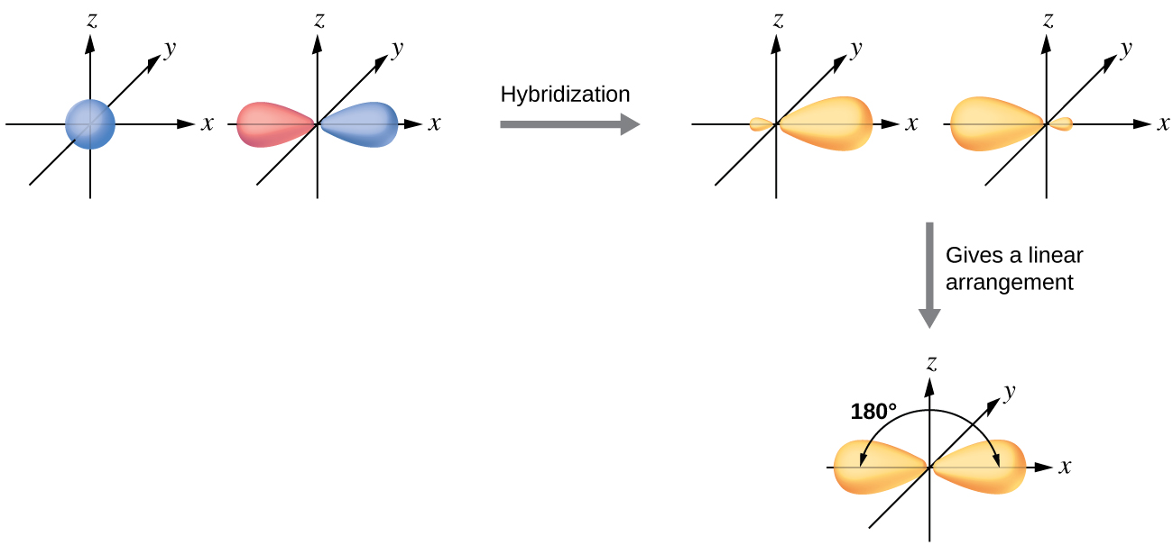
sp Hybrid Orbitals
Two atomic orbitals can hybridize to produce two hybrid orbitals.
one s orbital + one p orbital → two sp hybrid orbitals
Occurs when a central atom is surrounded by two regions of electron density.
Hybridization of an s orbital (blue) and a p orbital (red) of the same atom produces two sp hybrid orbitals (purple). Each hybrid orbital is oriented primarily in just one direction. Note that each sp orbital contains one lobe that is significantly larger than the other. The set of two sp orbitals are oriented at 180°, which is consistent with the geometry for two domains.

Slide 10
sp² Hybrid Orbitals
Three atomic orbitals can hybridize to produce three hybrid orbitals.
one s orbital + two p orbitals → three sp² hybrid orbitals
Occurs when a central atom is surrounded by three regions of electron density.

Slide 11
sp³ Hybrid Orbitals
Four atomic orbitals can hybridize to produce four hybrid orbitals.
one s orbital + three p orbitals → four sp³ hybrid orbitals
Occurs when a central atom is surrounded by four regions of electron density.

Slide 12
sp³d Hybrid Orbitals
Five atomic orbitals can hybridize to produce five hybrid orbitals.
one s orbital + three p orbitals + one d orbital → five sp³d hybrid orbitals
Occurs when a central atom is surrounded by five regions of electron density.

Slide 13
sp³d² Hybrid Orbitals
Six atomic orbitals can hybridize to produce six hybrid orbitals.
one s orbital + three p orbitals + two d orbitals → six sp³d² hybrid orbitals
Occurs when a central atom is surrounded by six regions of electron density.

Slide 14
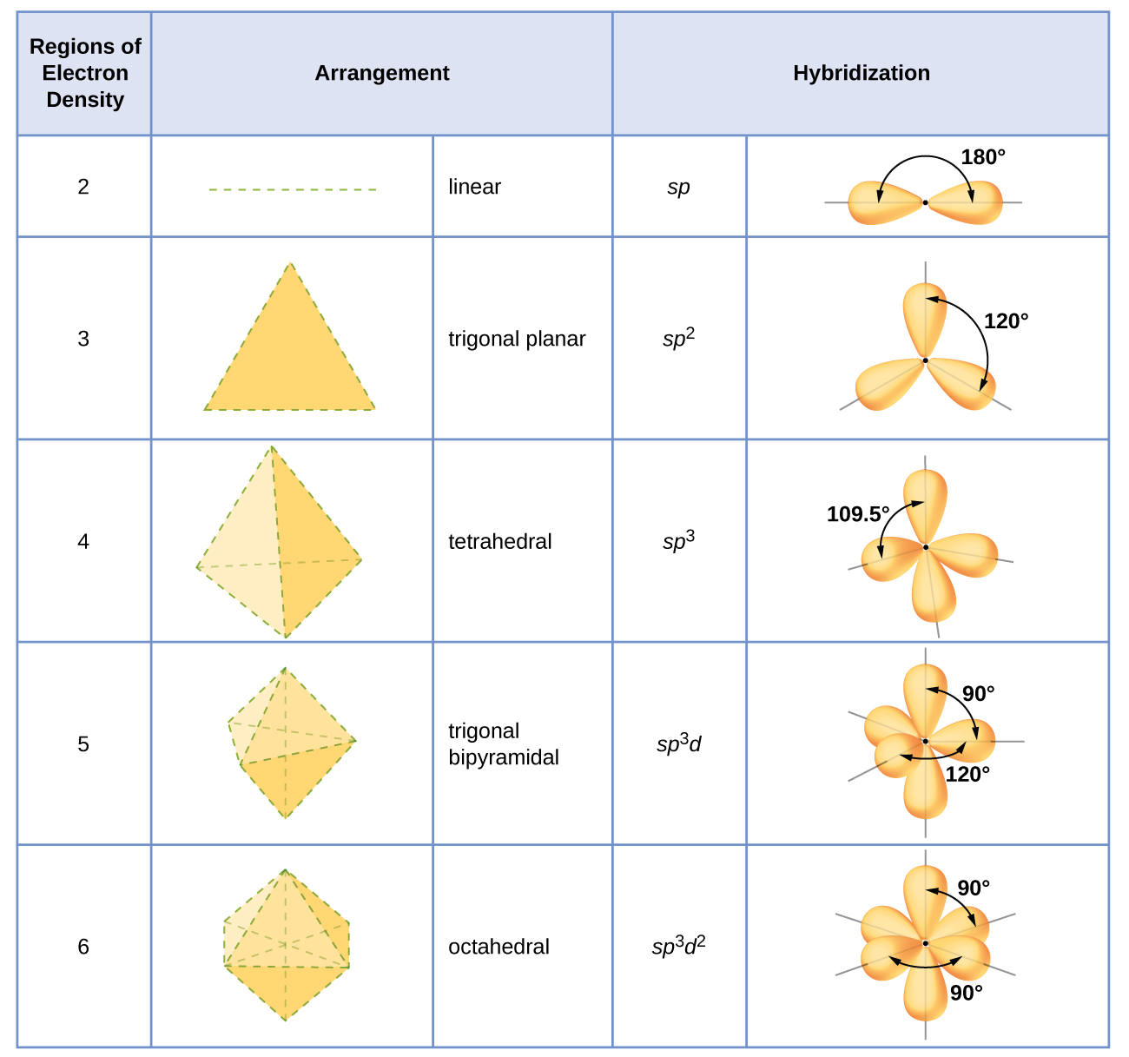
The shapes of hybridized orbital sets are consistent with the electron-pair geometries. For example, an atom surrounded by three regions of electron density is sp² hybridized, and the three sp² orbitals are arranged in a trigonal planar fashion.

Slide 16
Single, Double, and Triple Bonds
Single bonds are formed by the direct overlap of two hybrid orbitals, p-orbitals, or s orbitals.
These are called sigma (σ) bonds.
The additional electrons shared in a multi bond are not a result of directly overlapping hybrid orbitals, but are a result of side-by-side overlap of two regular “p” atomic orbitals.
These are called pi (π) bonds.
Single Bond = 1 sigma bond
Double Bond = 1 sigma bond, 1 pi bond
Triple Bond = = 1 sigma bond, 2 pi bonds

Slide 17
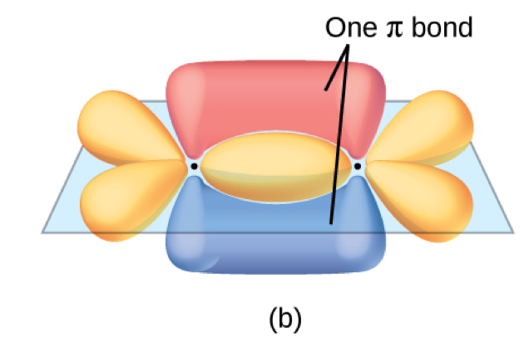
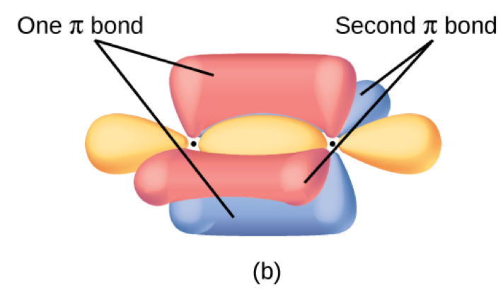
Double and Triple Bonds
To determine the hybridization in molecules with multi bonds, recall that a double or triple bond is each one region of electron density.
The π bond is formed by the side-by-side overlap of the two unhybridized p orbitals in the two carbon atoms, which are shown in red. The two lobes of the π bond are above and below the plane of the σ system.
This shows the overall outline of the bonds in C₂H₂. The two lobes of each of the π bonds are positioned across from each other around the line of the C–C σ bond.

