Slide 1
CHEMISTRY
Chapter 8
Advanced Theories of
Covalent Bonding
Slides by Montgomery College licensed under CC BY 4.0.

Slide 2
chapter 8: Advanced theories of covalent bonding
8.1 Valence Bond Theory
8.2 Hybrid Atomic Orbitals
8.3 Multiple Bonds
8.4 Molecular Orbital Theory

Slide 3
Bonding Theories
Lewis Theory and VSEPR
Dots arrayed about a central atom represent bonds and lone pairs of electrons.
The arrangement of atoms in three-dimensions and molecular geometry can be predicted.
Molecular polarity can also be predicted from the molecular structure.
Valence Bond Theory
Electrons are in orbitals on each atom.
Orbitals may be hybrids and overlapping orbitals in space form bonds.
Molecular Orbital Theory
Electrons are in orbitals spread over the entire molecule rather than attached to specific atoms.
This model accommodates experimental observations of magnetism not compatible with other, simpler theories.

Slide 4
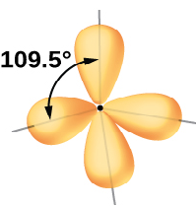
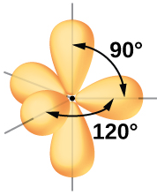
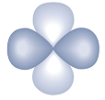


8.1 Valence Bond Theory
VSEPR Theory Weaknesses
VSEPR is model that can be used to predict three-dimensional shapes of molecules.
Bond angles seen in VSEPR models such as 109° and 120° do not agree with the geometries of s, p, and d atomic orbital.

Slide 5
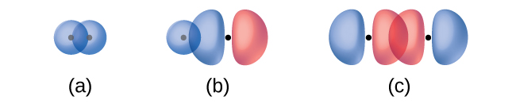
8.1 Valence Bond Theory
Valence Bond Theory
The covalent overlap of atomic orbitals, each containing a single electron, that yields an electron pair and a bond between two atoms is best described by valence bond theory.
In valence bond theory, orbitals overlap when a portion of one atomic orbital and a portion of a second atomic orbital occupy the same region of space.
overlap of two s-orbitals
to form a single bond
overlap of two p-orbitals
to form a single bond
s-orbital and p-orbital overlap to form a single bond

Slide 6
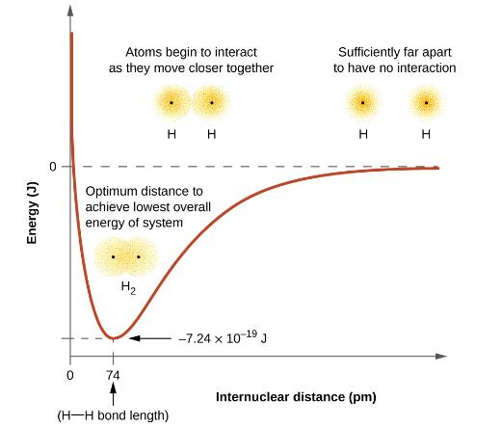
8.1 Valence Bond Theory
Energy and Orbital Overlap
The energy of a system depends upon orbital overlap.
No overlap occurs when atoms are far apart and the energy is zero.
As orbitals approach and begin to overlap, each electron begins to feel the attraction of the nucleus in the other atom.
Electrons also begin to repel each other, as do the nuclei.
While separated, attractive forces are greater than repulsive forces, and the energy of the system decreases; a bond begins to form.

Slide 7

8.1 Valence Bond Theory
Energy and Orbital Overlap (continued)
While moving together, overlap increases, and both attractions and repulsions increase.
At some specific distance between the atoms the energy reaches its lowest value.
This optimum distance between is where a stable bond between the two atoms form.
What is happening on the left side of the plot?

Slide 8
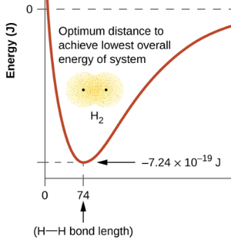
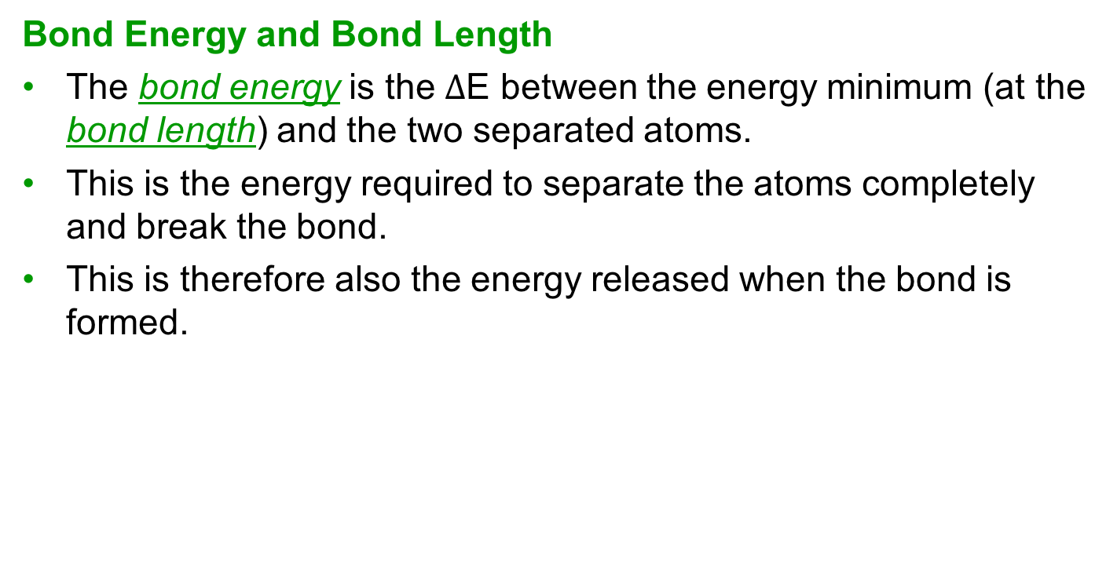
8.1 Valence Bond Theory
Bond Energy and Bond Length
The bond energy is the $∆$E between the energy minimum (at the bond length) and the two separated atoms.
This is the energy required to separate the atoms completely and break the bond.
This is therefore also the energy released when the bond is formed.
7.24 x 10-19 J required to break one H-H bond.
What is the energy required to break one mole of H-H bonds?

Slide 9

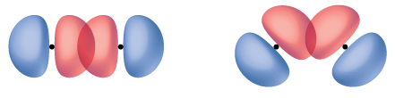
8.1 Valence Bond Theory
Orbital Overlap: Distance and Orientation
The formation of a bond depends upon the distance between atomic nuclei and the orientation of the orbitals involved.
Orbitals overlap most effectively when they are oriented on a direct line between two nuclei.
The overlap between two s-orbitals is simple because they are spherically symmetric.
When two p-orbitals interact to form a bond, orientation is important so that overlap is maximized.

Slide 10

8.1 Valence Bond Theory
Sigma (σ) and Pi (π) Bonds
Sigma (σ) bonds are produced when overlap occurs between:
  two s-orbitals
  one s-orbital and one p-orbital
  two p-orbitals
Pi (π) bonds are produced when two p-orbitals overlap in a side-by-side orientation.

Slide 11
8.1 Valence Bond Theory
Sigma (σ) and Pi (π) Bonds
Single bonds are always σ–bonds.
Multiple bonds are a combination of σ–bonds and π–bonds.
  double bond: one σ-bond, one π-bond
  triple bond: one σ-bond, two π-bond
Molecules containing these types of bonds are shown below and the bonds will be described in more detail later in the chapter.

Slide 12
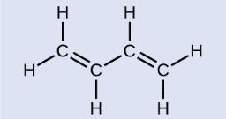

8.1 Valence Bond Theory
Example 8.1
Butadiene, C₆H₆, is used to make synthetic rubber. Identify the number of σ and π bonds contained in this molecule.
Example 8.1 – Check Your Learning
Identify the type of bond depicted in each illustration.

Slide 13
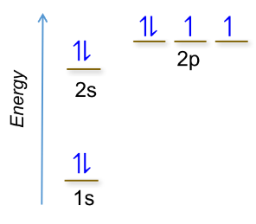
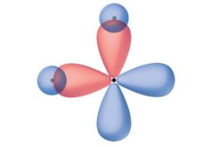
8.2 Hybrid Atomic Orbitals
Describing Orbital Overlap for Water
A water molecule is a central oxygen atom bound to two hydrogen atoms.
The electron configuration for oxygen is 1s² 2s² 2p⁴
It would make sense to predict that each of the ½ filled p-orbitals would overlap with a spherical s-orbital from a hydrogen atom.
s-orbital from H
oxygen atom
(isolated)
s-orbital from H

Slide 14

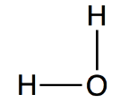
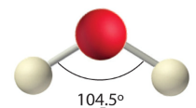
8.2 Hybrid Atomic Orbitals
Describing Orbital Overlap for Water
The problem is that this model gives a molecular structure that is does not match experimental evidence.
The simple orbital overlap results in a molecule with a 90° bond angle whereas experimental evidence shows that the bond angle for water is 104.9°.

Slide 15
8.2 Hybrid Atomic Orbitals
Describing Orbital Overlap for Water
Returning to VSEPR theory, there are four regions of electron density around an oxygen atom.
This means that water is in the tetrahedral group.
Water has two lone pairs of electrons and therefore has bent molecular geometry.
The bond angles observed experimentally show that valence bond theory must include a hybridization component in order to be an accurate model for bonding.
:
:

Slide 16
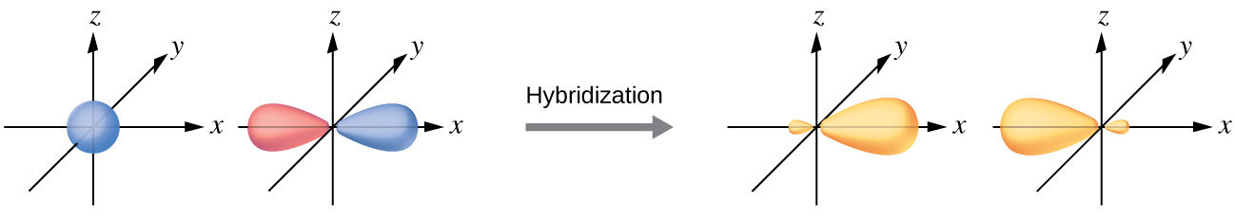
8.2 Hybrid Atomic Orbitals
Hybrid Orbitals …
do not exist in an isolated atom.
only form when atoms come together to bond.
have shapes/orientations very different from atomic orbitals.
are generated by combining a set of atomic orbitals;
  # of hybrid orbitals created = # of atomic orbitals used.
in a set are equivalent in shape and energy.
depend upon electron-pair geometry and VSEPR theory.
overlap to form σ–bonds; unhybridized orbitals must be used to form π–bonds.

Slide 17
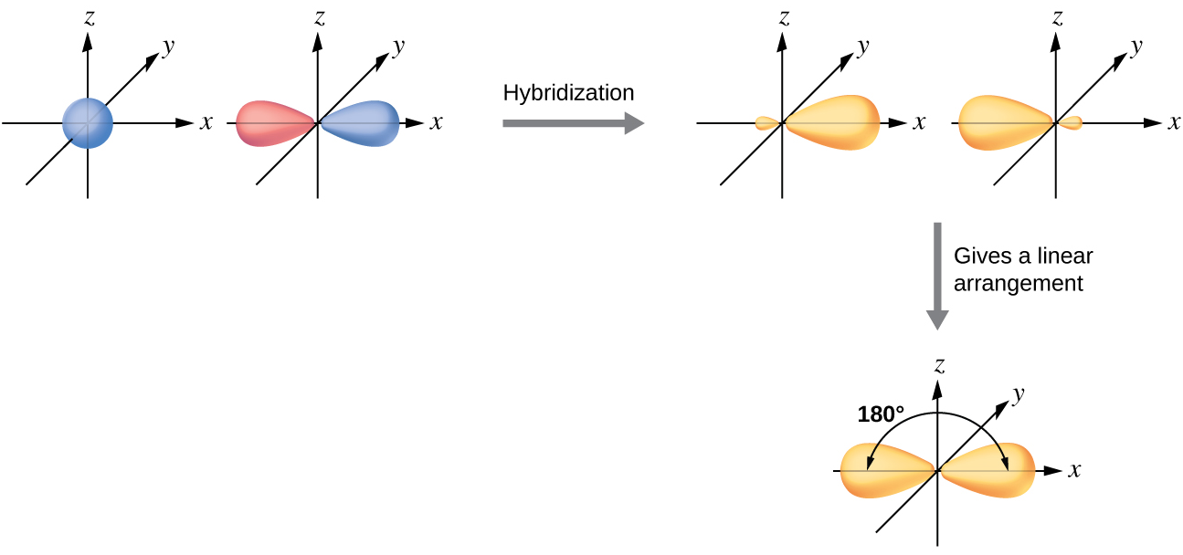
8.2 Hybrid Atomic Orbitals
sp Hybridization
One valence s-orbital mixes with a valence p-orbital to yield two equivalent sp hybrid orbitals.

Slide 18
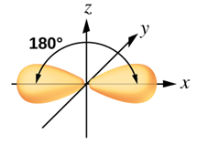
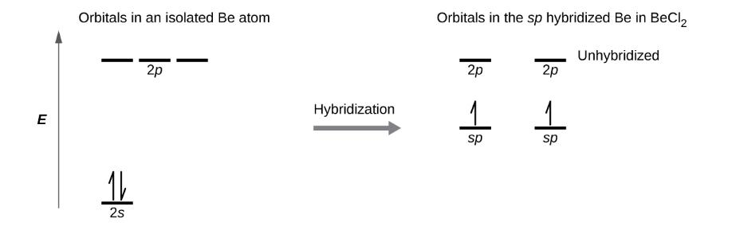
8.2 Hybrid Atomic Orbitals
sp Hybridization
One valence s-orbital mixes with a valence p-orbital to yield two equivalent sp hybrid orbitals.
These hybrid sp orbitals on Be overlap with Cl atomic orbitals.

Slide 19
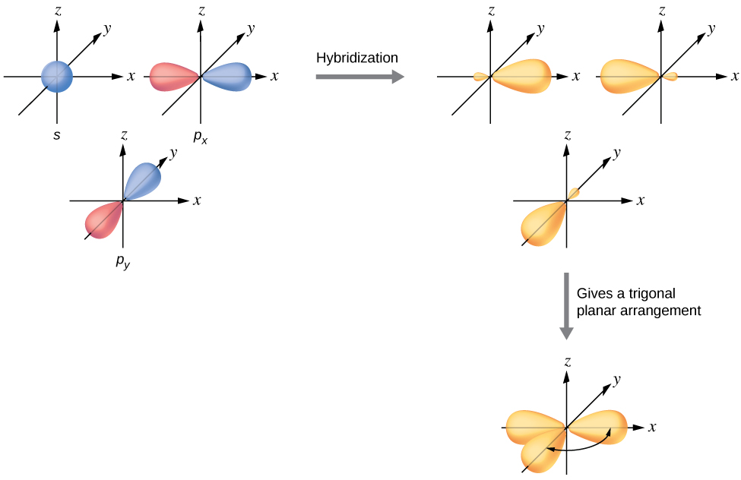
8.2 Hybrid Atomic Orbitals
sp² Hybridization
Any central atom surrounded by three regions of electron density forms a set of three sp² hybrid orbitals.
Note the trigonal planar arrangement.
120°

Slide 20
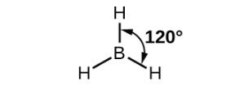
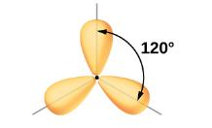
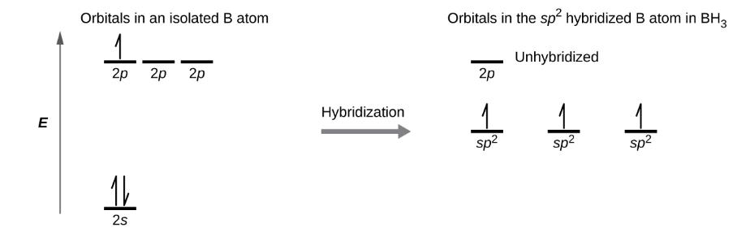
8.2 Hybrid Atomic Orbitals
sp² Hybridization
Any central atom surrounded by three regions of electron density forms a set of three sp² hybrid orbitals.
These hybrid sp² orbitals on B overlap with H atomic orbitals.

Slide 21
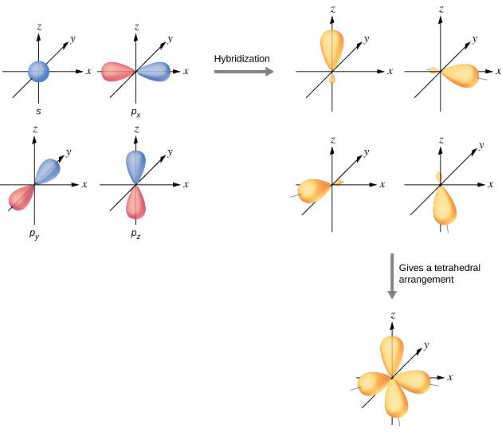
8.2 Hybrid Atomic Orbitals
sp³ Hybridization
Any central atom surrounded by four regions of electron density forms a set of four sp³ hybrid orbitals.
Note the tetrahedral arrangement.

Slide 22
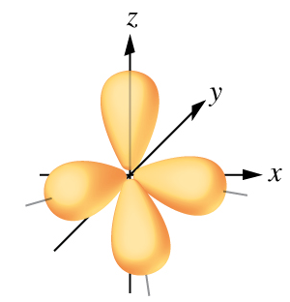
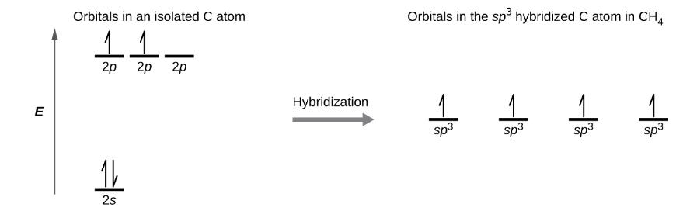
8.2 Hybrid Atomic Orbitals
sp³ Hybridization
Any central atom surrounded by four regions of electron density forms a set of four sp³ hybrid orbitals.
These hybrid sp³ orbitals on C overlap with H atomic orbitals.

Slide 23
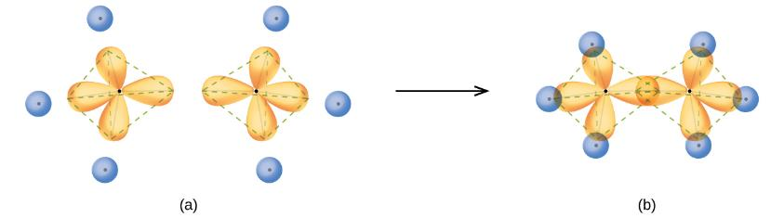
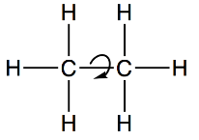
8.2 Hybrid Atomic Orbitals
sp³ Hybridization
The structure of ethane, C₂H₆, is similar to that of methane.
Each carbon sits at the center of a tetrahedron, and each carbon is sp³ hybridized.
Rotation around the σ–bond bond created between the two carbon atoms occurs readily.

Slide 24
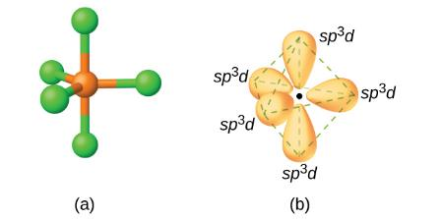
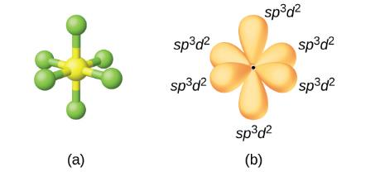
8.2 Hybrid Atomic Orbitals
sp³d and sp³d² Hybridization
To describe the five bonding orbitals in a trigonal bipyramidal arrangement, five valence shell atomic orbitals must be used.
  one s + three p + one d = five sp³d hybrid orbitals
For an octahedral arrangement with six bonding orbitals:
  one s + three p + two d = six sp³d² hybrid orbitals
These hybrid orbitals are only available for atoms having d-orbitals in the third period and beyond.
trigonal bipyramidal
octahedral

Slide 25
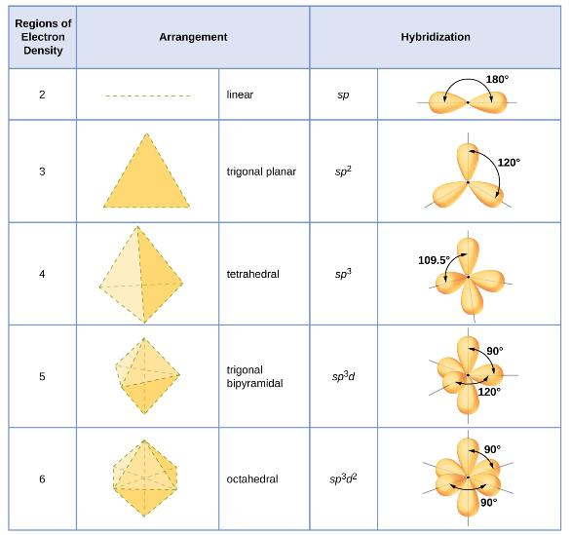
8.2 Hybrid Atomic Orbitals
Summary of Hybridized Orbitals and Geometries
What is the hybridization for SO₄²⁻?
What is the hybridization for SF₄?
What is the hybridization for XeF₄?

Slide 26
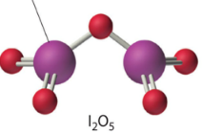
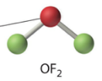
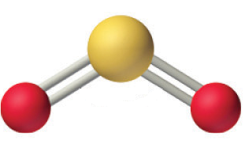

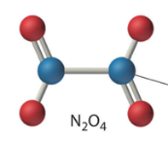
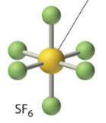
8.2 Hybrid Atomic Orbitals
Examples
Identify the hybridization of indicated atoms.
sulfur
iodine
oxygen
sulfur
nitrogen

Slide 27
8.2 Hybrid Atomic Orbitals
Examples
Three different analgesics are shown below. Identify the hybridization of the indicated atoms.
aspirin
acetaminophen/
paracetamol
(Tylenol)
ibuprofen
(Motrin)

Slide 28
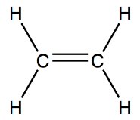
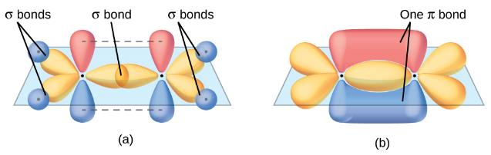
8.3 Multiple Bonds
Sigma (σ) and Pi (π) Bonds in Molecules
In ethene, C₂H₄, each carbon atom is surrounded by two hydrogen atoms and another carbon atom.
The three regions of electron density around each carbon require sp² hybrid orbitals.
  These hybrid orbitals combine to create one σ–bond and one π–bond between the carbon atoms.
  There are also σ–bonds from each carbon atom to two hydrogen atoms.
Ethene contains a total of 5 σ–bonds and 1 π–bond.

Slide 29
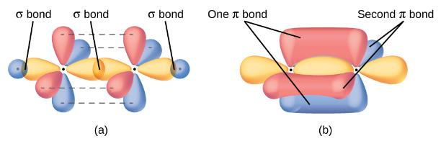

8.3 Multiple Bonds
Sigma (σ) and Pi (π) Bonds in Molecules
In acetylene, C₂H₂, each carbon atom is surrounded by one hydrogen atom and another carbon atom.
The two regions of electron density around each carbon require sp hybrid orbitals.
  These hybrid orbitals combine to create one σ–bond and one π–bond between the carbon atoms.
  There are also σ–bonds from each carbon atoms to one hydrogen atoms.
Acetylene contains a total of 3 σ–bonds and 2 π–bonds.

Slide 30
8.3 multiple bonds
Examples
Determine the number of σ–bonds and π–bonds in each of the analgesics shown below.
acetaminophen/
paracetamol
(Tylenol)
aspirin
σ–bonds: _____
π–bonds: _____
σ–bonds: _____
π–bonds: _____
ibuprofen
(Motrin)
σ–bonds: _____
π–bonds: _____

Slide 31
Practice
What is the geometry and polarity for each molecule?
Molecule | Lewis Structure | Geometry | Hybridization | Polar?
a. BeF₂
b. BF₃
c. CF₄
d. PF₅
e. SF₆

Slide 32
Practice
What is the geometry and polarity for each molecule?
Molecule | Lewis Structure | Geometry | Hybridization | Polar?
f. NH₃
g. SF₄
h. ClF₃
i. XeF₂
j. ICl₄⁻

Slide 33
Practice
What is the geometry and polarity for each molecule?
Molecule | Lewis Structure | Geometry | Hybridization | Polar?
k. H₂O
l. ClF₂⁺
m. BrF₅
n. XeF₄
o. XeOF₄

Slide 34
8.4 Molecular Orbitals
B₂, C₂, N₂
O₂, F₂, Ne₂
significant s-p mixing
less s-p mixing

Slide 35
8.4 Molecular Orbitals
diamagnetic
paramagnetic
σ*
σ*
↿
↿
π*
π*
π*
π*
2p
⥮
2p
2p
⥮
⥮
2p
σ
π
π
⥮
⥮
⥮
π
π
σ
⥮
⥮
σ*
σ*
2s
⥮
2s
2s
⥮
2s
σ
σ
⥮
⥮
σ*
σ*
1s
⥮
1s
1s
⥮
1s
σ
σ
N
N
O
O
N₂
O₂

Slide 36
8.4 Molecular Orbitals
B₂, C₂, N₂
significant s-p mixing
σ*
σ*
σ*
π*
π*
π*
π*
π*
π*
⥮
σ
σ
σ
↿
↿
⥮
⥮
⥮
⥮
π
π
π
π
π
π
⥮
⥮
⥮
σ*
σ*
σ*
⥮
⥮
⥮
σ
σ
σ
⥮
⥮
⥮
σ*
σ*
σ*
⥮
⥮
⥮
σ
σ
σ

Slide 37
8.4 Molecular Orbitals
O₂, F₂, Ne₂
less s-p mixing
⥮
σ*
σ*
σ*
⥮
⥮
⥮
⥮
π*
π*
π*
π*
π*
π*
↿
↿
⥮
⥮
⥮
⥮
π
π
π
π
π
π
⥮
⥮
⥮
σ
σ
σ
⥮
⥮
⥮
σ*
σ*
σ*
⥮
⥮
⥮
σ
σ
σ
⥮
⥮
⥮
σ*
σ*
σ*
⥮
⥮
⥮
σ
σ
σ

Slide 38
8.4 Molecular Orbitals
B₂
C₂
N₂
O₂
F₂
Ne₂
⥮
σ*
σ*
σ*
σ*
σ*
σ*
↿
↿
⥮
⥮
⥮
⥮
π*
π*
π*
π*
π*
π*
π*
π*
π*
π*
π*
π*
⥮
⥮
⥮
⥮
⥮
⥮
⥮
σ
σ
σ
π
π
π
π
π
π
↿
↿
⥮
⥮
⥮
⥮
⥮
⥮
⥮
π
π
π
π
π
π
σ
σ
σ
⥮
⥮
⥮
⥮
⥮
⥮
σ*
σ*
σ*
σ*
σ*
σ*
⥮
⥮
⥮
⥮
⥮
⥮
σ
σ
σ
σ
σ
σ
⥮
⥮
⥮
⥮
⥮
⥮
σ*
σ*
σ*
σ*
σ*
σ*
⥮
⥮
⥮
⥮
⥮
⥮
σ
σ
σ
σ
σ
σ
Large 2s-2p mixing
Less 2s-2p mixing

Slide 39
PRACTICE
B₂, C₂, N₂
significant s-p mixing

Slide 40
PRACTICE
O₂, F₂, Ne₂
less s-p mixing

Slide 41
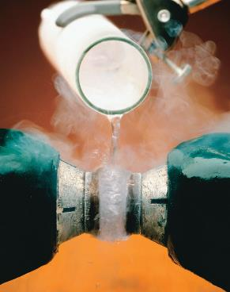
Paramagnetic O₂!
Experiments show that O₂ is attracted to a magnet while N₂ is not (video).
Draw the Lewis structures of N₂ and O₂.
Explain why the structures conflict with the experimental results shown in the picture and seen in the video.

Slide 42
O₂ vs. O₂⁻ vs. O₂²⁻
8.4 Molecular Orbitals
Molecular Orbital Diagram
Lewis Dot Structure
σ*
↿
↿
2p
⥮
↿
↿
π*
π*
⥮
↿
↿
⥮
⥮
Bond Order
π
π
⥮
σ
⥮
Energy
2s
⥮
σ*
⥮
⥮
There are two bonding interactions. One σ and one π.
Note: It is still a π bond even if the electrons are unpaired in those orbitals. Electron pairing is nice to have and stable, but it is not required.
The two π orbital unpaired electrons show that this molecule is paramagnetic.
σ
⥮
1s
⥮
σ*
⥮
⥮
σ
O
O
O₂

Slide 43
O₂ vs. O₂⁻ vs. O₂²⁻
8.4 Molecular Orbitals
Molecular Orbital Diagram
Lewis Dot Structure
σ*
⥮
↿
2p
⥮
↿
π*
π*
⥮
↿
↿
⥮
⥮
Bond Order
π
π
⥮
σ
⥮
Energy
2s
⥮
σ*
⥮
⥮
There are two bonding interactions, but there are now three antibonding electrons. The overall bond order is 1.5 making the bond longer than O₂ but shorter than O₂²⁻
The molecule is paramagnetic.
σ
⥮
1s
⥮
σ*
⥮
⥮
σ
O
O
O₂⁻

Slide 44
O₂ vs. O₂⁻ vs. O₂²⁻
8.4 Molecular Orbitals
Molecular Orbital Diagram
Lewis Dot Structure
σ*
⥮
⥮
2p
⥮
⥮
↿
π*
π*
⥮
⥮
↿
⥮
⥮
Bond Order
π
π
⥮
σ
⥮
Energy
2s
⥮
σ*
⥮
⥮
σ
There is one σ bond and the overall bond order is 1. The bond is longer than both O₂ but and O₂⁻.
The molecule is diamagnetic.
⥮
1s
⥮
σ*
⥮
⥮
σ
O
O
O₂²⁻

Slide 45
Energy levels differ for the atomic orbitals.
8.4 Molecular Orbitals
Heteronuclear Diatomic Molecules

Slide 46
8.4 Molecular Orbitals
Nitric Oxide
N atom
O atom

Slide 47
8.4 Molecular Orbitals
Carbon Monoxide
C atom
O atom

Slide 48
8.4 Molecular Orbitals
Cyanide Ion
C atom
N atom

Slide 49
8.4 Molecular Orbitals
Hydrofluoric Acid
H atom
F atom

Slide 50
end of chapter problems – chapter 8
Valence Bond Theory: #13, 15, 19
Multiple Bonds: #25, 27
Molecular Orbital Theory: #41a-c
For detailed solutions to these problems, go to the OpenStax Chemistry website and download the Student Solution Guide.

Slide 51
videos – chapter 8
Paramagnetism of Liquid Oxygen
(Harvard Natural Sciences Lecture Demonstration)
https://www.youtube.com/watch?v=Lt4P6ctf06Q
*All videos were created by MC Chemistry faculty unless otherwise indicated.

