Slide 1
CHEMISTRY
Chapter 9
Gases
Slides by Montgomery College licensed under CC BY 4.0.

Slide 2
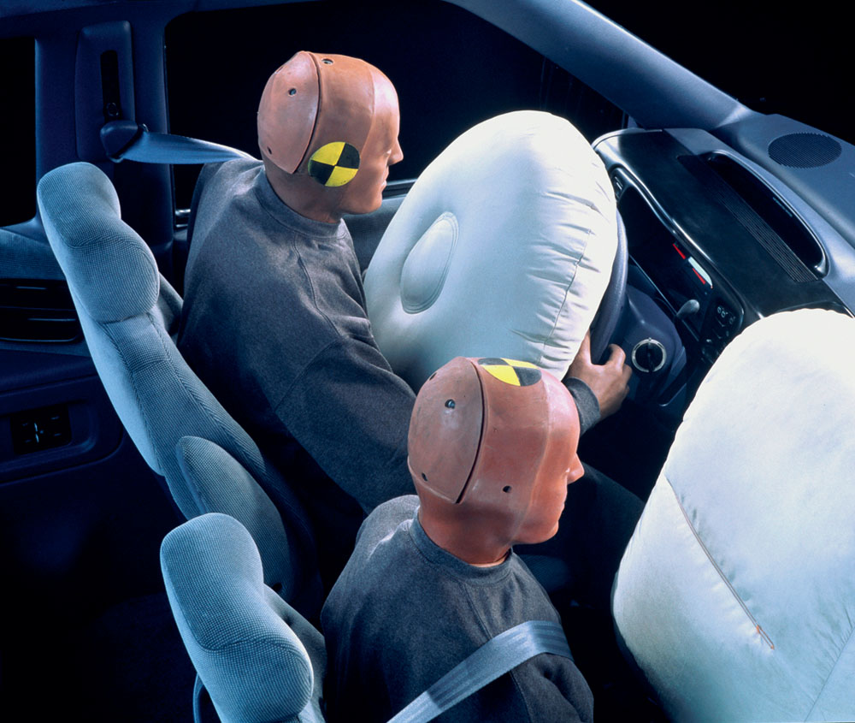
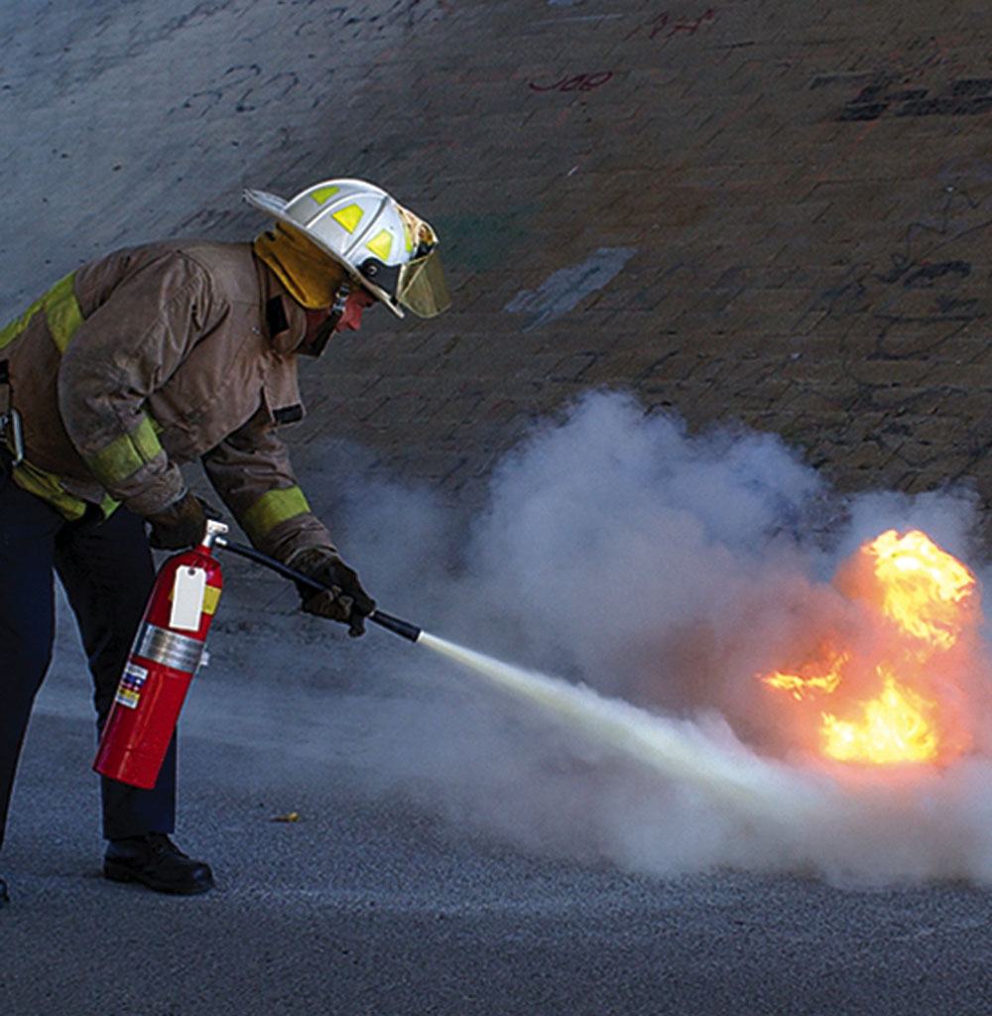
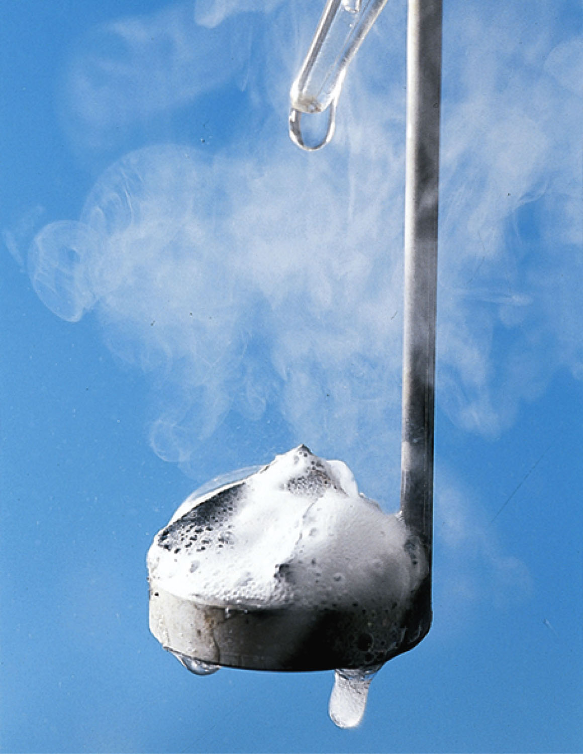
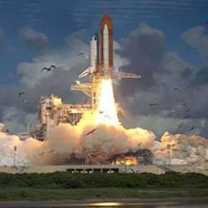

chapter 9: Gases
9.1 Gas Pressure
9.2 The Ideal Gas Law
9.3 Stoichiometry and Gases
9.4 Effusion and Diffusion
9.5 The Kinetic-Molecular Theory
9.6 Non-Ideal Gas Behavior

Slide 3

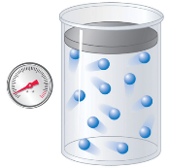

9.1 Gas Pressure
Describing Gases
Four quantities are needed to describe a sample of gas.
Pressure
Volume
Amount
(moles)
Temperature

Slide 4


9.1 Gas Pressure
Pressure
Pressure is the force exerted on an area of some surface.
$$P=\frac{F}{A}$$
SI Unit: Pa
1 Pa = 1 N/m²
Chemistry Units: atm or bar
1 atm = 1.01325 bar
1 atm = 101325 Pa
Force
P = pressure
F = force (N)
A = area (m²)
Area
Gas pressure is caused by the force exerted by gas molecules colliding with the interior walls of a container.

Slide 5
9.1 Gas Pressure
Pressure
Atmospheric pressure is caused by the weight of the column of air molecules in the atmosphere above the earth’s surface.
Atmospheric pressure can be measured by using a barometer.
The height (mm) of the liquid in the tube is proportional to the pressure exerted by the atmosphere. 1 atm = 760 mmHg

Slide 6
9.1 Gas Pressure
Pressure
One way to measure pressure in the laboratory is by using a manometer.
  A closed-end manometer can be used to measure gas trapped in a container. The distance between the mercury level is proportional to the pressure of the gas in the flask.
  An open-end manometer is similar but the distance between the mercury levels corresponds to the difference between the pressure in the flask and the pressure in the container.

Slide 7
9.1 Gas Pressure
Measuring Blood Pressure
A sphygmomanometer (Greek sphygmos = “pulse”) is used to measure blood pressure.
The inflatable cuff is placed around the upper arm and inflated until blood flow is completely blocked.
The air in the cuff is slowly released and as the heart beats, blood is forced through arteries causing a rise in pressure.
When blood flow begins, it can be heard with a stethoscope; this is the systolic pressure, the peak pressure in the cardiac cycle.
As the heart’s ventricles prepare for another beat, there is a decrease in pressure. The pressure at which sound is no longer heard is the diastolic pressure, the lowest pressure in the cardiac cycle.
Blood pressure units from a sphygmomanometer are in mmHg.

Slide 8
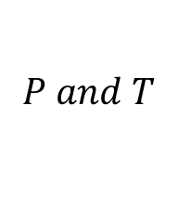
9.2 The Ideal Gas Law
$$P and T$$
Pressure and Temperature: Amonton’s Law
If a sealed flask is filled with gas, the atoms or molecules in that gas exert pressure by colliding with the sides of the flask.
If the temperature of the container is raised, the gas inside gets hotter and more collisions occur causing the pressure to increase.
Note that the volume and the amount of gas are constant through the experiment.

Slide 9




9.2 The Ideal Gas Law
$$P∝T$$
$$P=kT$$
Pressure and Temperature: Amonton’s Law
Pressure increases with an increase in temperature for any sample of gas where volume and amount are held constant.
From the data, it is clear that pressure is directly proportional to temperature when volume is held constant.
$$P∝T$$
$$P=kT$$
k is a constant

Slide 10

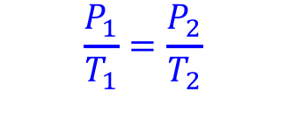

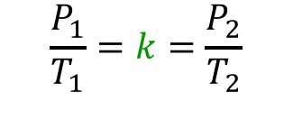


9.2 The Ideal Gas Law
$$P∝T$$
$$P=kT$$
Pressure and Temperature: Amonton’s Law
The direct relationship between pressure and temperature (at constant amount and constant volume) for a gas holds at different conditions as shown:
Condition 1
Condition 2
$$P_{1}=kT_{1}$$
$$P_{2}=kT_{2}$$
$$\frac{P_{1}}{T_{1}}=k$$
$$\frac{P_{2}}{T_{2}}=k$$
$$\frac{P_{1}}{T_{1}}=k=\frac{P_{2}}{T_{2}}$$
$$\frac{P_{1}}{T_{1}}=\frac{P_{2}}{T_{2}}$$

Slide 11
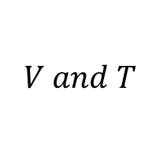
9.2 The Ideal Gas Law
$$V and T$$
Volume and Temperature: Charles’s Law
Study the data and graph.
Describe the relationship between temperature and volume.

Slide 12
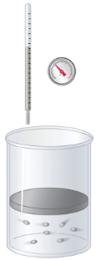
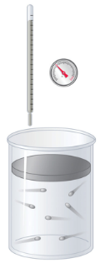





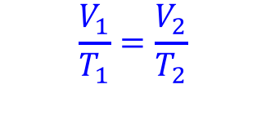

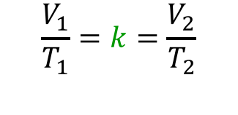
9.2 The Ideal Gas Law
$$V∝T$$
$$V=kT$$
Volume and Temperature: Charles’s Law
For gases, there is also direct relationship between volume and temperature. When the temperature is raised, volume increases.
Condition 1
Condition 2
$$V_{1}=kT_{1}$$
$$V_{2}=kT_{2}$$
$$\frac{V_{1}}{T_{1}}=k$$
$$\frac{V_{2}}{T_{2}}=k$$
$$\frac{V_{1}}{T_{1}}=k=\frac{V_{2}}{T_{2}}$$
$$\frac{V_{1}}{T_{1}}=\frac{V_{2}}{T_{2}}$$

Slide 13
9.2 The Ideal Gas Law
$$V∝T$$
$$V=kT$$
Volume and Temperature: Charles’s Law
The temperature-volume relationship for equal sized samples of H₂ at three different pressures were measured. The broken line represent and extrapolation to V=0. All the lines extrapolate to the same temperature, absolute zero at V=0.
Plots of volume versus temperature for different amounts of selected gases at 1 atm. All the plots extrapolate to a value of V = 0 at absolute zero, regardless of the identity or the amount of the gas.

Slide 14
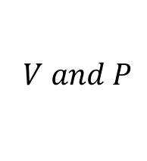
9.2 The Ideal Gas Law
$$V and P$$
Volume and Pressure: Boyle’s Law
An experiment concerning the pressure-volume behavior of a gas sample was conducted at constant temperature.
Study the data/graphs and explain how P and V are related at constant temperature.

Slide 15
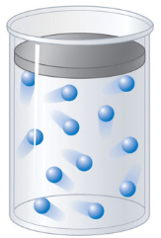
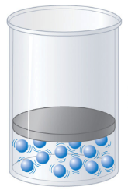









9.2 The Ideal Gas Law
$$V∝1/P$$
$$V=\frac{k}{P}$$
Volume and Temperature: Boyle’s Law
For gases, there is an inverse relationship between pressure and volume (at constant temperature).
$$PV=k$$
Condition 1
Condition 2
$$V_{1}=\frac{k}{P_{1}}$$
$$V_{2}=\frac{k}{P_{2}}$$
$$P_{1}V_{1}=k$$
$$P_{2}V_{2}=k$$
$$P_{1}V_{1}=k=P_{2}V_{2}$$
$$P_{1}V_{1}=P_{2}V_{2}$$

Slide 16
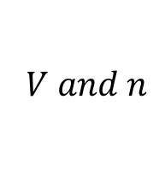
9.2 The Ideal Gas Law
$$V and n$$
Moles and Volume: Avogadro’s Law
Avogadro developed a theory to account for the behavior of gases when they are measured under the same conditions of temperature and pressure.
For a confined gas, the volume (V) and number of moles (n) are directly proportional if P and T remain constant.

Slide 17


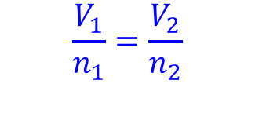

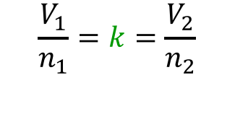





9.2 The Ideal Gas Law
$$V∝n$$
$$V=kn$$
Mass and Volume: Avogadro’s Law
For a sample of gas, the volume is directly proportional to the amount of gas, in moles.
Condition 1
Condition 2
$$V_{1}=kn_{1}$$
$$V_{2}=kn_{2}$$
$$\frac{V_{1}}{n_{1}}=k$$
$$\frac{V_{2}}{n_{2}}=k$$
The balloon contains 4 g of He.
The balloon contains 17 g of NH₃.
$$\frac{V_{1}}{n_{1}}=k=\frac{V_{2}}{n_{2}}$$
$$\frac{V_{1}}{n_{1}}=\frac{V_{2}}{n_{2}}$$

Slide 18
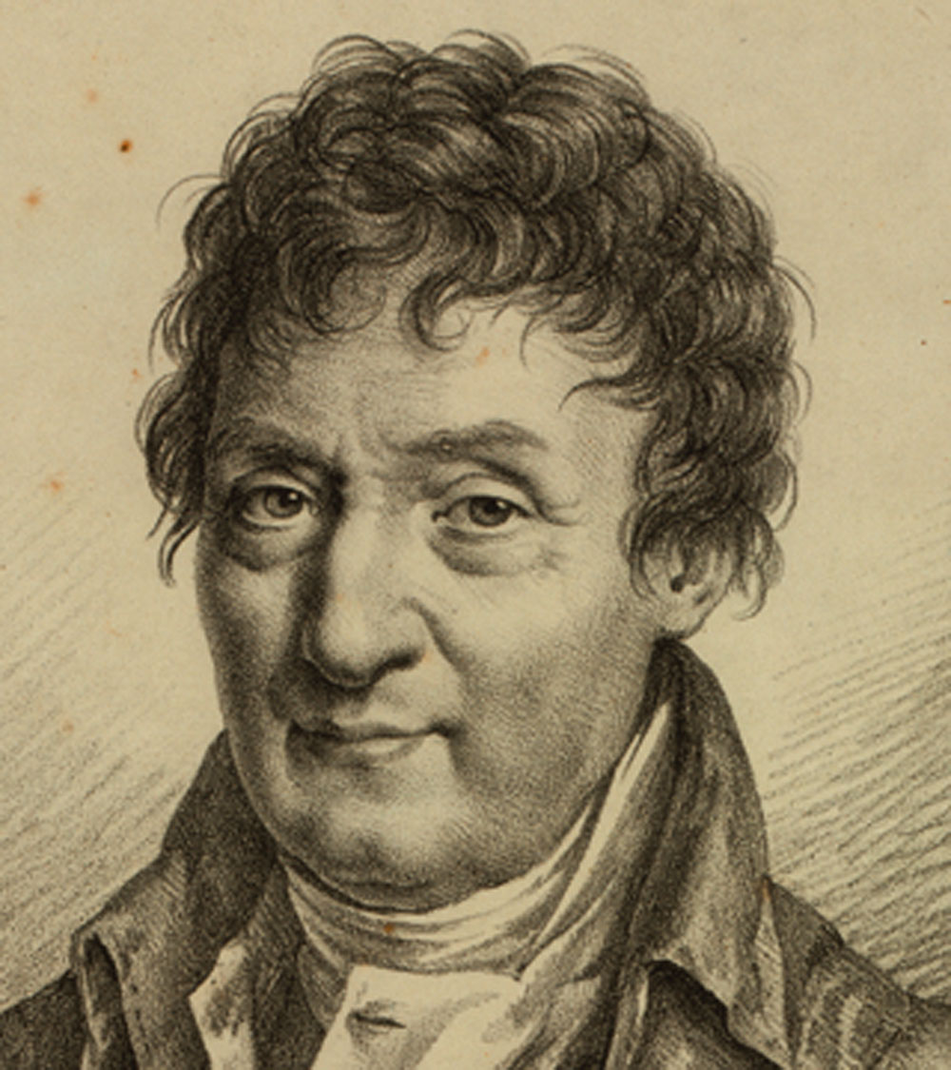
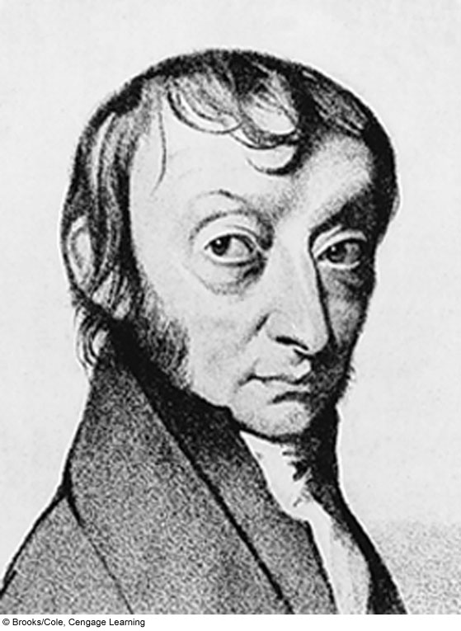





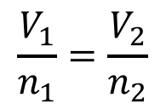


9.2 The Ideal Gas Law
The Ideal Gas Law
Four separate laws concerning gases have been presented.
Amonton’s Law
$$\frac{P_{1}}{T_{1}}=\frac{P_{2}}{T_{2}}$$
$$P=kT$$
n, V constant
Charles’s Law
$$V=kT$$
$$\frac{V_{1}}{T_{1}}=\frac{V_{2}}{T_{2}}$$
n, P constant
$$V=\frac{k}{P}$$
Boyle’s Law
$$P_{1}V_{1}=P_{2}V_{2}$$
n, T constant
$$\frac{V_{1}}{n_{1}}=\frac{V_{2}}{n_{2}}$$
Avogadro’s Law
$$V=kn$$
T, P constant

Slide 19
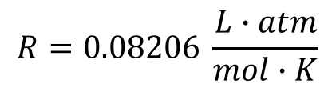
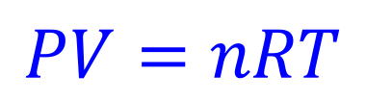
9.2 The Ideal Gas Law
The Ideal Gas Law
Combining the four separate laws yields the ideal gas law.
$$PV=nRT$$
Amonton’s Law
P = pressure (atm)
V = volume (L)
n = moles (mol)
T = temperature (K)
Charles’s Law
$$R=0.08206 \frac{L∙atm}{mol∙K}$$
Boyle’s Law
Standard temperature and pressure (STP) for gas experiments:
T = 273.15 K (0 °C)
P = 1 atm
Avogadro’s Law

Slide 20
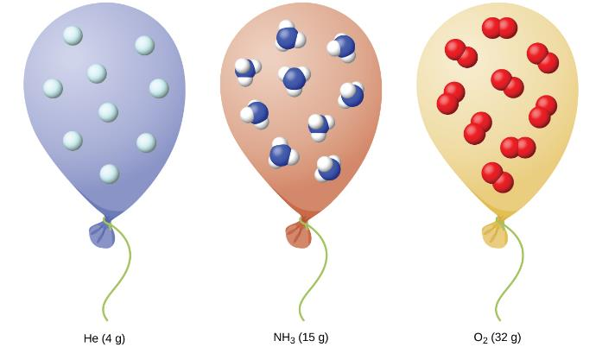
9.2 The Ideal Gas Law
Example – Standard Temperature and Pressure
If the three balloons below are at STP, what is the volume of gas in each balloon?
He: 4 g
NH₃: 17 g
O₂: 32 g

Slide 21
9.2 The Ideal Gas Law
Example 9.9 – Using the Ideal Gas Law
Methane, CH₄, is being considered for use as an alternative automotive fuel to replace gasoline. One gallon of gasoline could be replaced by 655 g of CH₄. What is the volume of this amount of methane at 25 °C and 745 mmHg?

Slide 22


9.2 The Ideal Gas Law
Example 9.10 – The Combined Gas Law
When filled with air, a typical scuba tank with a volume of 13.2 L has a pressure of 153 atm. If the water temperature is 27.0 °C, how many liters of air will such a tank provide to a diver’s lungs (at a body temperature of 37.0 °C at a depth of approximately 70 feet in the ocean where the pressure is 3.13 atm? Hint: Set up two conditions.
Condition 1
Condition 2
$$PV=nRT$$
$$PV=nRT$$
What is the equation for the combined gas law?

Slide 23
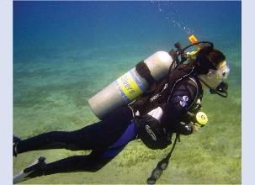
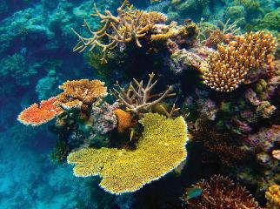
SCUBA Diving and Gas Laws
A nice article and gas laws summary, written by a scientist and former SCUBA instructor is available from from Carolina Biologicals.
https://www.carolina.com/teacher-resources/Interactive/scuba-diving-and-gas-laws/tr29802.tr

Slide 24


9.3 Stoichiometry and Gases
Density and Molar Mass
What is the definition of density? What are the units?
The ideal gas law is:
$$PV=nRT$$
$$\frac{g}{L}$$
To determine the density of a gas, the units needed are:
The number of grams is related to n.
The number of liters is the volume, V.
Use what you know (in the proper units), the ideal gas law, and dimensional analysis to solve the problem.
If you remember PV=nRT and the basic units for density, there is no need to memorize a complicated equation.
An example is given on the next slide.

Slide 25



9.3 Stoichiometry and Gases
Example: Density and Molar Mass
Calculate the density of Freon-12, CF₂Cl₂ at 37.0 °C and 0.954 atm.
$$PV=nRT$$
$$density=\frac{\#g}{\#L}$$
Know:
Want:
$$PV=nRT$$
Know all these,
solve for n.

Slide 26
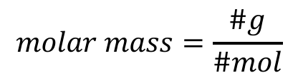

9.3 Stoichiometry and Gases
Example: Molar Mass from Gas Data
A gas has a density of 0.0847 g/L at 17.0 °C and a pressure of 760 torr. What is the molar mass of the gas? Try to identify the gas.
$$molar mass=\frac{\#g}{\#mol}$$
Know:
Want:
$$PV=nRT$$
$$\frac{g}{L}$$
$$PV=nRT$$
Know all these,
solve for n.

Slide 27
9.3 Stoichiometry and Gases
Example: Empirical/Molecular Formula and Gas Data
Cyclopropane, a gas once used with oxygen as a general anesthetic, is composed of 85.7% carbon and 14.3% hydrogen by mass. Find the empirical formula. If 1.56 g of cyclopropane occupies a volume of 1.00 L at 0.984 atm and 50.0 °C, what is the molecular formula for cyclopropane?
Know:
Want:
It’s a gas, so it’s a good bet that PV = nRT will be involved!

Slide 28
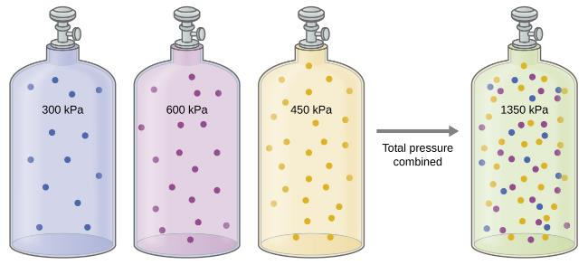
9.3 Stoichiometry and Gases
Dalton’s Law of Partial Pressures
The total pressure for a mixture of gases is equal to sum of the partial pressures of those gases.
If the gases do not interact, each gas in the mixture obeys its own PV=nRT.
P_{b}V_{b}=n_{b}RT_{b}
for blue
P_{p}V_{p}=n_{p}RT_{p}
for purple
P_{y}V_{y}=n_{y}RT_{y}
for yellow
P_{total} = P_{b} + P_{p} + P_{y}

Slide 29
9.3 Stoichiometry and Gases
Dalton’s Law of Partial Pressures
The pressure of each individual gas (P_{b}, P_{p}, P_{y}) is the partial pressure of that gas.
Consider the ideal gas law. What values remain constant?
P_{b}V_{b}=n_{b}RT_{b}
for blue
P_{p}V_{p}=n_{p}RT_{p}
for purple
P_{y}V_{y}=n_{y}RT_{y}
for yellow
P_{total} = P_{b} + P_{p} + P_{y}

Slide 30
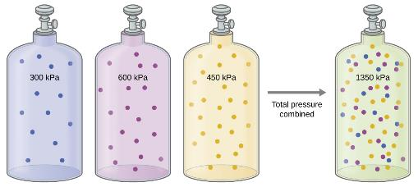

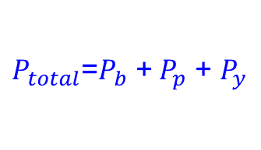



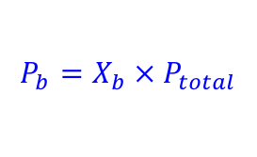
9.3 Stoichiometry and Gases
Dalton’s Law of Partial Pressures
The volume and temperature for the gases are constant because they are mixed together in the same container.
The partial pressure of each gas depends upon the number of moles (n_{b}, n_{p}, n_{y}) of that gas.
The partial pressure of each gas is related to the total pressure by the mole fraction of that gas.
n_{total} = total moles of gas
n_{b} = total moles of blue
X_{b} = mole fraction of blue
$$X_{b}=\frac{n_{b}}{n_{total}}$$
$$P_{b}=X_{b} ×{ P}_{total}$$
$$P_{b}∝n_{b}$$
$$P_{p}∝n_{p}$$
$$P_{y}∝n_{y}$$
$P_{total}$=$P_{b}$ +${ P}_{p}$ + $P_{y}$

Slide 31
9.3 Stoichiometry and Gases
Example 9.14 – The Pressure of a Mixture of Gases
A 10.0-L vessel contains 2.50 × 10⁻³ mol of H₂, 1.00 × 10⁻³ mol of He, and 3.00 × 10⁻⁴ mol of Ne at 35 °C.
What are the partial pressures of each gas?
What is the total pressure (atm) in the container?

Slide 32
9.3 Stoichiometry and Gases
Example 9.15 – The Pressure of a Mixture of Gases
A gas mixture used for anesthesia contains 2.83 mol oxygen, O₂, and 8.41 mol nitrous oxide, N₂O. The total pressure of the mixture is 192 kPa.
What are the mole fractions of O₂ and N₂O?
What are the partial pressures of O₂ and N₂O?

Slide 33
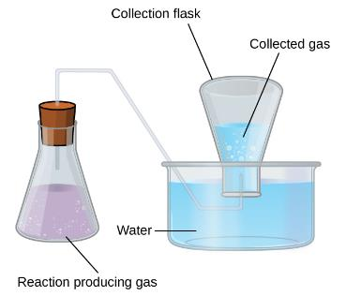
9.3 Stoichiometry and Gases
Collecting Gas Over Water
A simple way to collect a gas is to capture it in a bottle that has been filled with water and then inverted into a large container of water.
The pressure of the gas inside the bottle can be made equal to the air pressure outside by raising or lowering the bottle until the water level is the same both inside and outside the bottle
The pressure of the gas collected is then equal to the atmospheric pressure (measured by using a barometer).
The collection flask has the gas produced by the reaction in it. It also has a small amount of water vapor in it.
P_{total} = P_{sample} + P_{water}
You can look up the vapor pressure of water at various temperatures in the CRC, other reference books, in the textbook.

Slide 34
9.3 Stoichiometry and Gases
Example 9.16 – Pressure of a Gas Collected Over Water
If 0.200 L of argon is collected over water at a temperature of 26 °C and a pressure of 750 torr what is the partial pressure of argon in torr and in atm?

Slide 35
9.3 Stoichiometry and Gases
Example – Decomposition of KClO₃

Slide 36
9.3 Stoichiometry and Gases
Chemical Stoichiometry of Gases
In the introduction to stoichiometry, reactions were balanced, grams were converted to moles and various calculations were done.
Stoichiometry for gases works exactly the same way, except here, the number of moles might be obtained by using calculations related to gases, usually PV=nRT.
Write and balance the reaction.
List what you know and what you want.
Get all units into standard gas units (L, atm, mol, K) and look up constants or molar masses as needed.
Approach the calculation as you would any other stoichiometry problem.

Slide 37
9.3 Stoichiometry and Gases
Example 9.17 – Reaction of Gases
Propane, C₃H₈(g), is used in gas grills to provide the heat for cooking. What volume of O₂(g) measured at 25 °C and 760 torr is required to react with 2.7 L of propane measured under the same conditions of temperature and pressure? Assume that the propane undergoes complete combustion.

Slide 38
9.3 Stoichiometry and Gases
Example 9.18 – Volumes of Reacting Gases
Ammonia is an important fertilizer and industrial chemical. Suppose that a volume of 683 billion cubic feet of gaseous ammonia, measured at 25 °C and 1 atm, was manufactured. What volume of H₂(g), measured under the same conditions, was required to prepare this amount of ammonia by reaction with N₂?
N₂(g) + 3H₂(g) → 2NH₃(g)

Slide 39
9.4 Effusion and Diffusion of gases
Diffusion
The process by which molecules disperse in space in response to difference in concentration is called diffusion.
Diffusion ultimately results in equal concentrations of gas throughout the system.
The rate of diffusion is the amount of gas passing through some area per unit time.

Slide 40
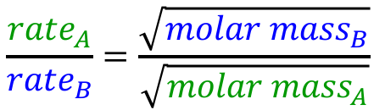
9.4 Effusion and Diffusion of gases
Effusion
By contrast, effusion is the escape of gas molecules through a tiny hole into a vacuum.
Rates of effusion for different gases can be compared by using Graham’s Law: The rate of effusion of a gas is inversely proportional to the square root of the mass of its particles.
$$\frac{{rate}_{A}}{{rate}_{B}}=\frac{\sqrt{{molar mass}_{B}}}{\sqrt{{molar mass}_{A}}}$$

Slide 41
9.4 Effusion and Diffusion of gases
Example: Effusion of an Unknown vs. Helium
An unknown gas effuses through an opening at a rate that is one third that of helium gas. What is the molar mass of the unknown gas?
Example: Ar vs. He Rate of Effusion
Argon gas is ten times denser than helium gas at the same temperature and pressure. Which gas will effuse faster? How much faster?

Slide 42
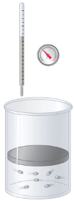


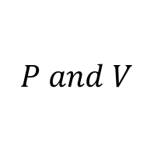
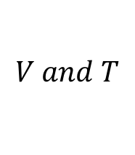
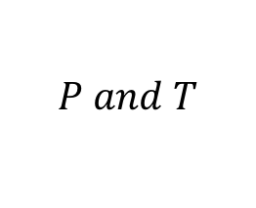
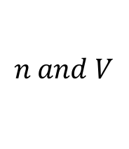
9.5 The Kinetic Molecular Theory
Explaining Gas Laws
The gas laws presented thus far have been derived from experimental observations.
As a mathematical model, PV=nRT generally describes the behavior of most gases at or room temperature and 1-2 atm.
Why do gases behave this way?
  Observations work on a macroscopic level.
  On a microscopic level, kinetic molecular theory is useful.
$$V and T$$
$$n and V$$
$$P and V$$
$$P and T$$

Slide 43
9.5 The Kinetic Molecular Theory
Kinetic Molecular Theory
Particles are in continuous motion.
The volume of each particle is negligible.
Pressure results from collisions between particles and the container walls.
Particles do not exert forces on each other; collision are elastic.
The average kinetic energy is proportional to temperature (K).

Slide 44






9.5 The Kinetic Molecular Theory
Kinetic Molecular Theory Explains the Behavior of Gases
Amonton’s Law
Boyle’s Law
Avogadro’s Law
P and T
V constant
P and V
T constant
n and V
P constant

$$\frac{P_{1}}{T_{1}}=constant$$
$$\frac{V_{1}}{n_{1}}=constant$$
$$P_{1}V_{1}=constant$$
T then P
P then V
n then V
increased frequency and force of collisions
reduced frequency of collisions
constant number of collisions

Slide 45

9.5 The Kinetic Molecular Theory
Molecular Velocities and Kinetic Energy
In a gas sample, particles have various speeds.
Because there are an enormous number of particles in a gas sample, the molecular speed distribution and the average speed remain constant.
The molecular speed distribution is known as a Maxwell-Boltzmann distribution.
Maxwell-Boltzmann Distribution
The relative number of molecules in a gas sample that possess a given speed (the speed distribution) is shown.

Slide 46
9.5 The Kinetic Molecular Theory
Molecular Velocities and Kinetic Energy
If the temperature of a gas sample increases, KE increases.
  more particles at higher speed
  distribution shifts toward higher speeds overall (to the right)
If the temperature decreases, the average KE decreases.
  more particles at lower sped
  distribution shifts to the lower speeds overall (to the left)
The molecular speed distribution for nitrogen gas shifts to the right and flattens at temperature and therefore velocity increases.

Slide 47
9.5 The Kinetic Molecular Theory
Molecular Velocities and Kinetic Energy
At a given temperature, all gases have the same average kinetic energy.
Gases composed of lighter particles have a speed distribution that peaks at higher velocities.
Molecular velocity is directly related to molecular mass. At a given temperature, lighter particles move faster on average than heavier particles.

Slide 48

9.6 Non-Ideal Gas Behavior
Ideal Gases: Assumptions
Gas atoms/molecules have no volume; the particles are point masses.
The atoms/molecules do not experience attractions or repulsions and only undergo elastic collisions.
Real Gases
Deviate from ideal behavior as shown.
Consider the ideal gas law and identify the terms that might be affected for a real gas.
$$PV=nRT$$

Slide 49
9.6 Non-Ideal Gas Behavior
Real Gases
Consider nitrogen gas:
  What happens at extremely high pressure? Low temperature?
Gases deviate most from ideal behavior at high pressure and low temperature.
The behavior of real gases can be approximated by the van der Waals equation. The equation corrects:
  the pressure term to account for attraction between particles.
  the volume term to account for the real volume of gas particles (they are not simply point masses).

Slide 50

extra problems
Gases in Biology
One molecule of the protein hemoglobin will bind four molecules of oxygen gas. If 1.00 g of hemoglobin requires 1.53 mL of oxygen at body temperature (37.0 °C) and 743 mmHg, what is the molar mass of hemoglobin?
O₂
O₂
O₂
O₂
Hemoglobin (PDB: 1A3N)

Slide 51
extra problems
Gases in Biology
A bombardier beetle uses H₂O₂ decomposition as a mechanism to activate enzymes that oxidize organic molecules. The process generates so much heat that the organic chemicals boils. The pressure of the oxygen gas causes the boiling, noxious chemicals to be expelled with explosive force over a large range. This can be fatal to attacking insects.
A simpler reaction can be done in a flask in the laboratory. If 0.25 g of H₂O₂ decomposes in a sealed 1.50 L flask at 19.1 °C. What are the pressures of hydrogen gas and oxygen gas produced?
Video: How Bombardier Beetles Bomb (MIT)
https://www.youtube.com/watch?v=TgqF-ND2XcY

Slide 52


extra problems
Some chemistry students are preparing for a party to celebrate the end of midterms. To create a festive atmosphere, they decide to fill balloons. They only have enough helium gas for ten balloons so they fill the rest of their balloons with hydrogen gas, notwithstanding the obvious explosive danger involved.
The next morning the students notice that the hydrogen balloons are only ¾ of their original size. What will the size of the helium balloons be?
Assume that the temperature of the room remained constant and that all the balloons are made of the same material.

Slide 53
end of chapter problems – chapter 9
Gas Laws: #5, 19, 27, 29, 45
Ideal Gas Law: #31, 33, 35a, 43, 49
Partial Pressure: #57, 59, 61, 63
For detailed solutions to these problems, go to the OpenStax Chemistry website and download the Student Solution Guide.

Slide 54
videos – chapter 9
Boyle’s Law
http://youtu.be/E7jsrdfh82Q
Charles’ Law
http://youtu.be/HCPuOCrj3l0
Ideal Gas Law
http://youtu.be/-wvKbi49y90
Ideal Gas Law w/ Combined Gas Law
http://screencast.com/t/Sgaf4fK0COc
Ideal Gas Law & Density
http://screencast.com/t/ZIytcdPG5l
Gas Stoichiometry
http://screencast.com/t/xOxC2t2jsP
Partial Pressure
http://youtu.be/rc5Cv64nK1I
http://screencast.com/t/338X8zGz4gW
Partial Pressure w/ Mole Fractions
http://screencast.com/t/WBnSDbukGu
http://screencast.com/t/ZDFRyPFei
*All videos were created by MC Chemistry faculty unless otherwise indicated.

Slide 55

simulations – chapter 9
Gas Properties (Simple gas laws, Ideal gas law)
https://phet.colorado.edu/en/simulation/legacy/gas-properties

