Slide 1


CHEMISTRY 2e
Chapter 3 Composition of Substances And Solutions
PowerPoint Image Slideshow

Slide 2
Chapter 3 Outline
3.1 Formula Mass and the Mole Concept
3.2 Determining Empirical and Molecular Formulas
3.3 Molarity
3.4 Other Units for Solution Concentrations

Slide 3
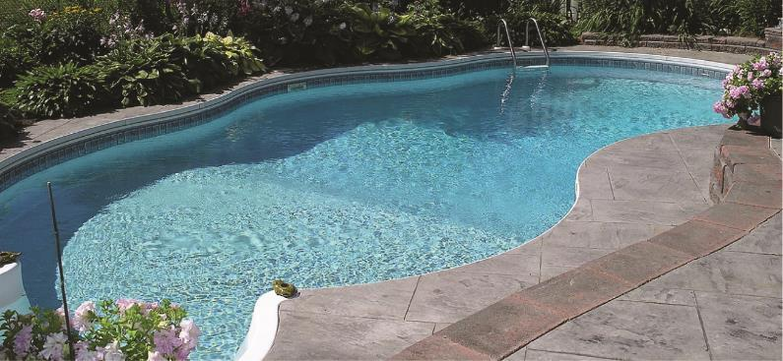
Figure 3.1
The water in a swimming pool is a complex mixture of substances whose relative amounts must be carefully maintained to ensure the health and comfort of people using the pool. (credit: modification of work by Vic Brincat)

Slide 4
Learning Objectives
3.1 Formula Mass and the Mole Concept
  Calculate formula masses for covalent and ionic compounds
  Define the amount unit mole and the related quantity Avogadro’s number Explain the relation between mass, moles, and numbers of atoms or molecules, and perform calculations deriving these quantities from one another

Slide 5
Formula Mass and the Mole Concept
The formulas mass of a substance is the sum of the average atomic masses of all the atoms in the substance’s formula.
Covalent substances exist as discrete molecules.
The formula mass of a covalent substance may be correctly referred to as a molecular mass.

Slide 6
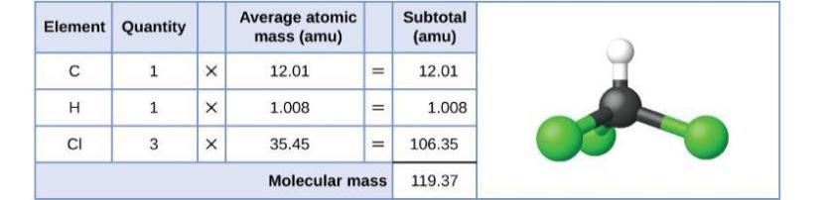
Figure 3.2
The average mass of a chloroform molecule, CHCl₃, is 119.37 amu, which is the sum of the average atomic masses of each of its constituent atoms. The model shows the molecular structure of chloroform.

Slide 7
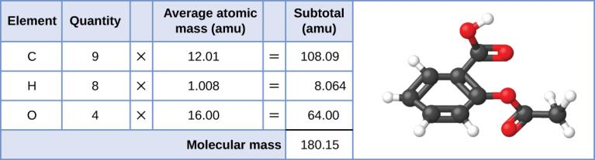
Figure 3.3
The average mass of an aspirin molecule is 180.15 amu. The model shows the molecular structure of aspirin, C₉H₈O₄.

Slide 8
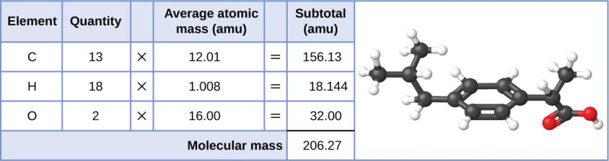
Example 3.1

Slide 9
Formula Mass for Ionic Compounds
Ionic substances are composed of discrete cations and anions combined in ratios to yield electrically neutral bulk matter.
Ionic compounds do not exist as molecules.
The formula mass for an ionic compound may not correctly be referred to as a molecular mass.
The average atomic masses of the ions can be approximated to be the same as the average atomic masses of the neutral atoms.

Slide 10
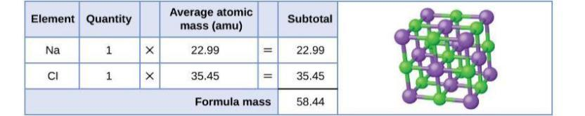
Figure 3.4
Table salt, NaCl, contains an array of sodium and chloride ions combined in a 1:1 ratio. Its formula mass is 58.44 amu.

Slide 11
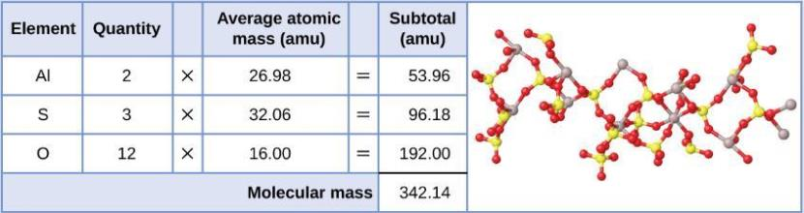
Example 3.2

Slide 12
The Mole
The mole is an amount unit similar to familiar units like pair, dozen, gross, etc.
The mole is defined as the amount of a substance containing the same number of discrete entities (such as atoms, molecules, or ions) as the number of atoms in a sample of pure carbon-12 weighing exactly 12 g.
The mole provides a link between the mass of a sample and the number of atoms, molecules, or ions in that sample.

Slide 13
Avogadro’s Number
The number of entities composing a mole has been determined to be 6.02214179 × 10²³.
This constant is named after Italian scientist Amedeo Avogadro and is known as Avogadro’s Number.
Avogadro’s Number (N_{A}) = 6.022 × 10²³
The masses of 1 mole of different elements, however, are different, since the masses of the individual atoms are drastically different.

Slide 14
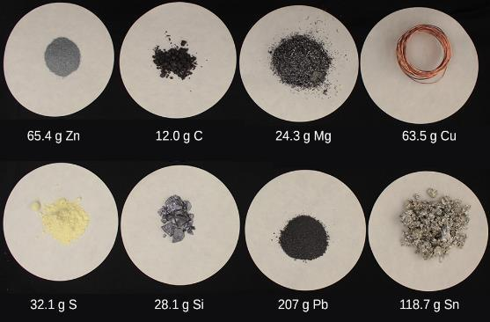
Figure 3.5
Each sample contains 6.022 × 10²³ atoms —1.00 mol of atoms. From left to right (top row): 65.4 g zinc, 12.0 g carbon, 24.3 g magnesium, and 63.5 g copper. From left to right (bottom row): 32.1 g sulfur, 28.1 g silicon, 207 g lead, and 118.7 g tin. (credit: modification of work by Mark Ott)

Slide 15
Molar Mass
The molar mass of an element (or compound) is the mass in grams of 1 mole of that substance, a property expressed in units of grams per mole (g/mol).
The molar mass of any substance is numerically equivalent to its atomic or formula mass in amu.
Example:
  A single 12C atom has a mass of 12 amu.
  A mole of 12C atoms have a mass of 12 g.

Slide 16
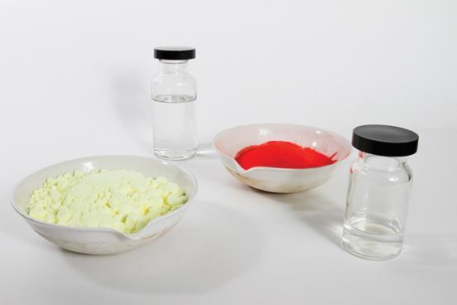
Figure 3.6
Each sample contains 6.02 × 10²³ molecules or formula units—1.00 mol of the compound or element. Clock-wise from the upper left: 130.2 g of C₈H₁₇OH (1-octanol, formula mass 130.2 amu), 454.9 g of HgI₂ (mercury(II) iodide, formula mass 459.9 amu), 32.0 g of CH₃OH (methanol, formula mass 32.0 amu) and 256.5 g of S₈ (sulfur, formula mass 256.6 amu). (credit: Sahar Atwa)

Slide 17
Molar Mass of Elements
Element | Average Atomic Mass (amu) | Molar Mass (g/mol) | Atoms/Mole
C | 12.01 | 12.01 | 6.022 × 10²³
H | 1.008 | 1.008 | 6.022 × 10²³
O | 16.00 | 16.00 | 6.022 × 10²³
Na | 22.99 | 22.99 | 6.022 × 10²³
Cl | 35.45 | 35.45 | 6.022 × 10²³

Slide 18
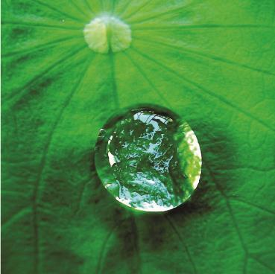
Figure 3.7
The number of molecules in a single droplet of water is roughly 100 billion times greater than the number of people on earth. (credit: “tanakawho”/Wikimedia commons)

Slide 19
Calculations
The relationships between formula mass, the mole, and Avogadro’s number can be applied to compute various quantities that describe the composition of substances and compounds.

Slide 20
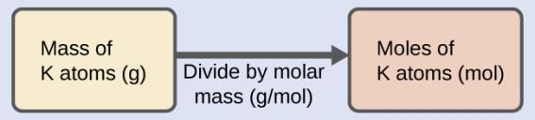
Example 3.3
According to nutritional guidelines from the US Department of Agriculture, the estimated average requirement for dietary potassium is 4.7 g. What is the estimated average requirement of potassium in moles?

Slide 21
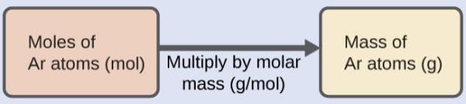
Example 3.4
A liter of air contains 9.2 × 10 ^{–4} mol argon. What is the mass of Ar in a liter of air?

Slide 22
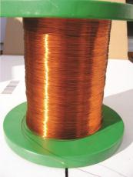
Figure 3.8
Copper wire is composed of many, many atoms of Cu. (credit: Emilian Robert Vicol)

Slide 23
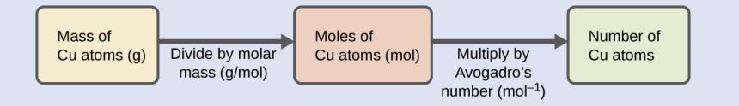
Example 3.5

Slide 24
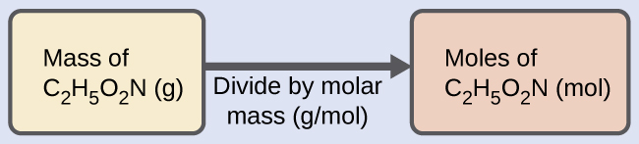
Example 3.6

Slide 25
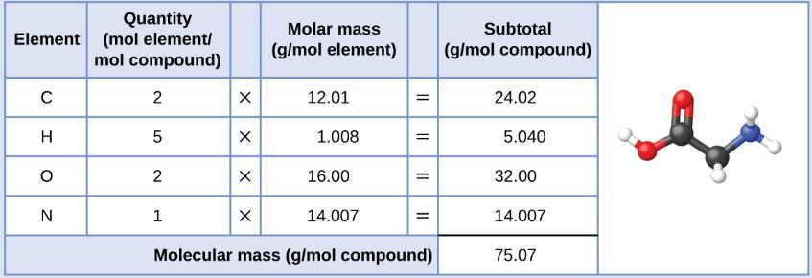
Example 3.6

Slide 26
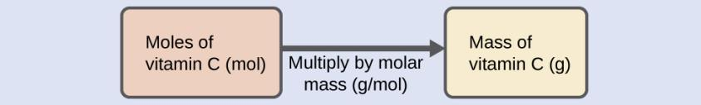
Example 3.7
Vitamin C is a covalent compound with the molecular formula C₆H₈O₆. The recommended daily dietary allowance of vitamin C for children aged 4–8 years is 1.42 × 10 ^{–4} mol. What is the mass of this allowance in grams? The molar mass for this compound is computed to be 176.124 g/mol.

Slide 27
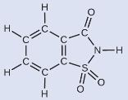
Example 3.8
A packet of an artificial sweetener contains 40.0 mg of saccharin (C₇H₅NO₃S), which has the structural formula:
Given that saccharin has a molar mass of 183.18 g/mol, how many saccharin molecules are in a 40.0-mg (0.0400-g) sample of saccharin? How many carbon atoms are in the same sample?

Slide 28
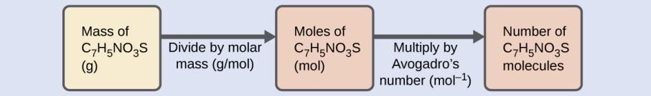
Example 3.8

Slide 29
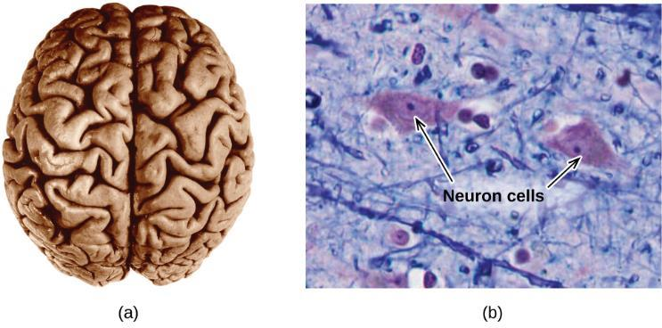
Figure 3.9
(a) A typical human brain weighs about 1.5 kg and occupies a volume of roughly 1.1 L. (b) Information is transmitted in brain tissue and throughout the central nervous system by specialized cells called neurons (micrograph shows cells at 1600× magnification).

Slide 30
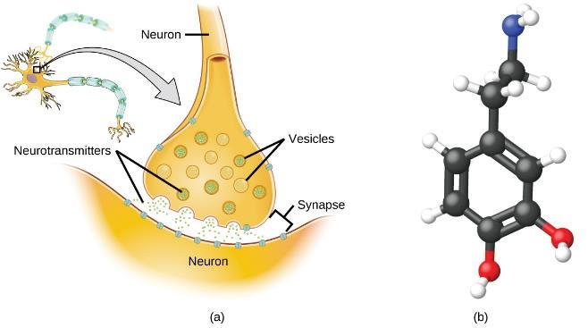
Figure 3.10
(a) Chemical signals are transmitted from neurons to other cells by the release of neurotransmitter molecules into the small gaps (synapses) between the cells. (b) Dopamine, C₈H₁₁NO₂, is a neurotransmitter involved in a number of neurological processes.

Slide 31
Learning Objectives
3.2 Determining Empirical and Molecular Formulas
  Compute the percent composition of a compound
  Determine the empirical formula of a compound
  Determine the molecular formula of a compound

Slide 32
Determining Empirical and Molecular Formulas
Percent composition: The percentage by mass of each element in a compound.
Example: A 10.0 g sample of a compound is determined to contain 2.5 g hydrogen and 7.5 g carbon.

Slide 33
Determining Percent Composition from Molecular or
Empirical Formulas
For compounds of known formula, the percent composition can also be derived from the formula mass and the atomic masses of the constituent elements.
Example: NH₃ (formula mass = 17.03 amu)

Slide 34
Determination of Empirical Formulas
A compound’s empirical formula can be determined from the masses of its constituent elements.
    Convert element masses to moles using molar masses.
    Divide each number of moles by the smallest number of moles.
    If necessary, multiply by an integer, to give the smallest whole-number ratio of subscripts.

Slide 35
Determination of Empirical Formulas
Example: A compound is determined to contain 1.71 g C and 0.287 g H.
1)
2)

Slide 36
Determination of Empirical Formulas
Example: A compound is determined to contain 5.31 g Cl and 8.40 g O.
After steps 1 and 2, the tentative formula is obtained.
3) To convert into whole numbers, multiply each of the subscripts by two, giving the empirical formula.

Slide 37
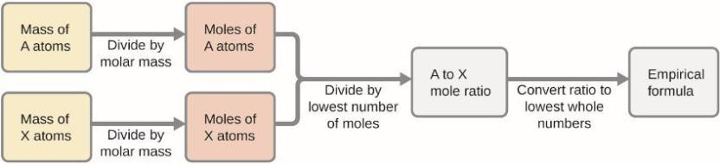
Figure 3.11
The empirical formula of a compound can be derived from the masses of all elements in the sample.

Slide 38
Determination of Empirical Formulas
A compound’s empirical formula can be determined from its percent composition.
    Convert percent composition to masses of elements by assuming a 100 g sample of compound.
    Convert element masses to moles using molar masses.
    Divide each number of moles by the smallest number of moles.
    If necessary, multiply by an integer, to give the smallest whole-number ratio of subscripts.

Slide 39
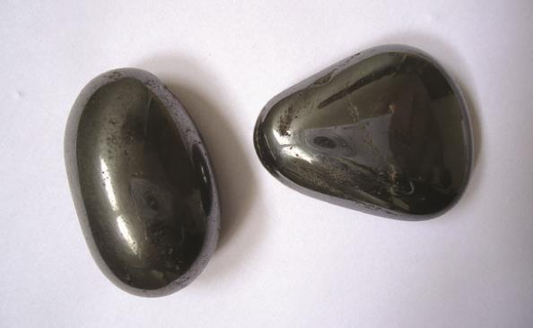
Figure 3.12
Hematite is an iron oxide that is used in jewelry. (credit: Mauro Cateb)

Slide 40
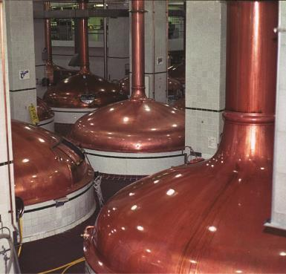
Figure 3.13
An oxide of carbon is removed from these fermentation tanks through the large copper pipes at the top. (credit: “Dual Freq”/Wikimedia Commons)

Slide 41
Example 3.12
The bacterial fermentation of grain to produce ethanol forms a gas with a percent composition of 27.29% C and 72.71% O. What is the empirical formula for this gas?

Slide 42
Derivation of Molecular Formulas
A compound’s molecular formula can be determined from its empirical formula and its molecular or molar mass.
The molecular formula is then obtained by multiplying each subscript in the empirical formula by n.

Slide 43
Derivation of Molecular Formulas
Example: A compound has an empirical formula of CH₂O (empirical formula mass = 30 amu) and a molecular mass of 180 amu.
The molecular formula of this compound is C₆H₁₂O₆ .

Slide 44
Learning Objectives
3.3 Molarity
  Describe the fundamental properties of solutions
  Calculate solution concentrations using molarity
  Perform dilution calculations using the dilution equation

Slide 45
Molarity
In preceding sections, we focused on the composition of pure substances.
However, mixtures—samples of matter containing two or more substances physically combined—are more commonly encountered in nature than are pure substances.
Similar to a pure substance, the relative composition of a mixture plays an important role in determining its properties.

Slide 46
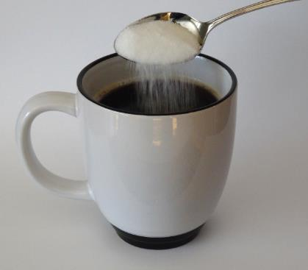
Figure 3.14
Sugar is one of many components in the complex mixture known as coffee. The amount of sugar in a given amount of coffee is an important determinant of the beverage’s sweetness. (credit: Jane Whitney)

Slide 47
Solutions
Solutions occur frequently in nature.
Solutions are another term used for a homogeneous mixture—uniform composition and properties throughout its entire volume.
The relative amount of a given solution component is known as its concentration.

Slide 48
Solutions
A solution consists of two components:
    Solvent: component with a concentration that is significantly greater than that of all other components.
    Solute: component that is typically present at a much lower concentration than the solvent.
    A solution in which water is the solvent is called an aqueous solution.

Slide 49
Molarity
Molarity (M): the number of moles of solute in exactly 1 liter (1 L) of the solution:
Molarity (M) is a useful concentration unit for many applications in chemistry.

Slide 50
Example 3.14
A 355 mL soft drink sample contains 0.133 mol of sucrose (table sugar). What is the molar concentration of sucrose in the beverage?

Slide 51
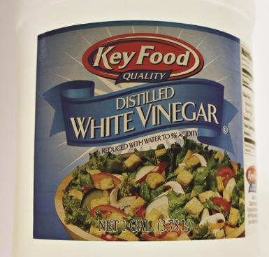
Figure 3.15
Distilled white vinegar is a solution of acetic acid in water.

Slide 52
Dilution of Solutions
Dilution is the process whereby the concentration of a solution is lessened by the addition of solvent.
Dilution is a common means of preparing solutions of a desired concentration.
By adding solvent to a measured portion of a more concentrated stock solution, we can achieve a particular concentration.

Slide 53
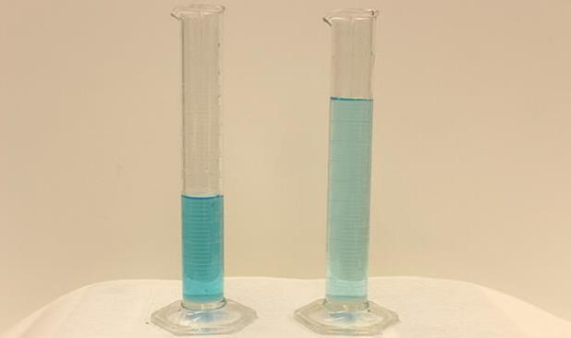
Figure 3.16
Both solutions contain the same mass of copper nitrate. The solution on the right is more dilute because the copper nitrate is dissolved in more solvent. (credit: Mark Ott)

Slide 54
Dilution of Solutions
The molar amount of solute (n) in a solution is equal to the product of the solution’s molarity and its volume in liters:
Expressions like these may be written for a solution before (1) and after (2) it is diluted:

Slide 55
Dilution of Solutions
Since the dilution process does not change the amount of solute in the solution, n₁ = n₂.
Thus, these two equations may be set equal to one another to derive the dilution equation:
Other units of concentration (C) and volume (V) may be used.

Slide 56
Example 3.19
If 0.850 L of a 5.00-M solution of copper nitrate, Cu(NO₃)₂, is diluted to a volume of 1.80 L by the addition of water, what is the molarity of the diluted solution?

Slide 57
Learning Objectives
3.4 Other Units for Solution Concentrations
  Define the concentration units of mass percentage, volume percentage, mass-volume percentage, parts-per million(ppm), and parts-per-billion (ppb)
  Perform computations relating a solution’s concentration and its components’ volumes and/or masses using these units

Slide 58
Other Units for Solution Concentrations
Molarity is a very useful unit for evaluating the concentration of solutions.
In this section, we will introduce some other units of concentration that are commonly used in various applications.

Slide 59
Mass Percentage
The mass percentage of a solution component is defined as the ratio of the component’s mass to the solution’s mass, expressed as a percentage:
We are generally most interested in the mass percentages of solutes, but it is also possible to compute the mass percentage of solvent.

Slide 60
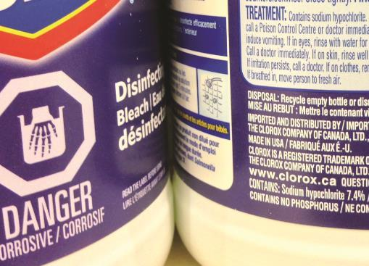
Figure 3.17
Liquid bleach is an aqueous solution of sodium hypochlorite (NaOCl). This brand has a concentration of 7.4% NaOCl by mass.

Slide 61
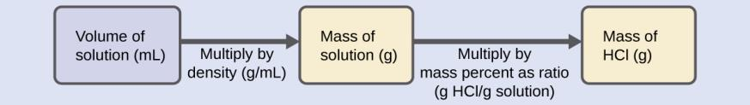
Example 3.23

Slide 62
Volume Percentage
The concentration of a solution formed by dissolving a liquid solute in a liquid solvent is often expressed as a volume percentage.

Slide 63
Mass-Volume Percentage
A mass-volume percent is a ratio of a solute’s mass to the solution’s volume expressed as a percentage.
The specific units used for solute mass and solution volume may vary, depending on the solution.
For example, physiological saline solution, used to prepare intravenous fluids, has a concentration of 0.9% mass/volume (m/v), indicating that the composition is 0.9 g of solute per 100 mL of solution.

Slide 64
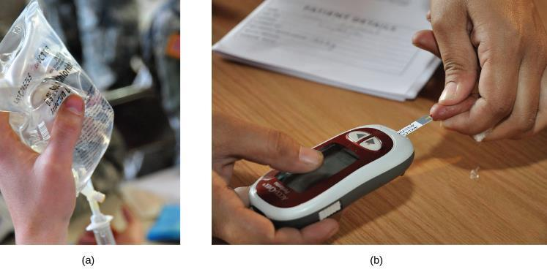
Figure 3.18
“Mixed” mass-volume units are commonly encountered in medical settings. (a) The NaCl concentration of physiological saline is 0.9% (m/v). (b) This device measures glucose levels in a sample of blood. The normal range for glucose concentration in blood (fasting) is around 70–100 mg/dL. (credit a: modification of work by “The National Guard”/Flickr; credit b: modification of work by Biswarup Ganguly)

Slide 65
Parts per Million and Parts per Billion
Very low solute concentrations are often expressed using appropriately small units such as parts per million (ppm) or parts per billion (ppb).
The mass-based definitions of ppm and ppb:

Slide 66
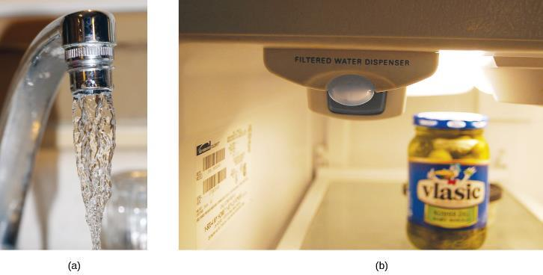
Figure 3.19
(a) In some areas, trace-level concentrations of contaminants can render unfiltered tap water unsafe for drinking and cooking. (b) Inline water filters reduce the concentration of solutes in tap water. (credit a: modification of work by Jenn Durfey; credit b: modification of work by “vastateparkstaff”/Wikimedia commons)

Slide 67

Exercise 4a

Slide 68
Exercise 4b

Slide 69

Exercise 4c

Slide 70

Exercise 4d

Slide 71

Exercise 5a

Slide 72

Exercise 5b

Slide 73

Exercise 5c

Slide 74

Exercise 5d

Slide 75
Exercise 6a

Slide 76

Exercise 6b

Slide 77

Exercise 6c

Slide 78
Blank page
This OpenStax ancillary resource is © Rice University under a CC-BY 4.0 International license; it may be reproduced or modified but must be attributed to OpenStax, Rice University and any changes must be noted.

