Slide 1


CHEMISTRY 2e
Chapter 7 CHEMICAL BONDING AND MOLECULAR GEOMETRY
PowerPoint Image Slideshow

Slide 2
Chapter Outline
7.1 Ionic Bonding
7.2 Covalent Bonding
7.3 Lewis Symbols and Structures
7.4 Formal Charges and Resonance
7.5 Strengths of Ionic and Covalent Bonds
7.6 Molecular Structure and Polarity

Slide 3
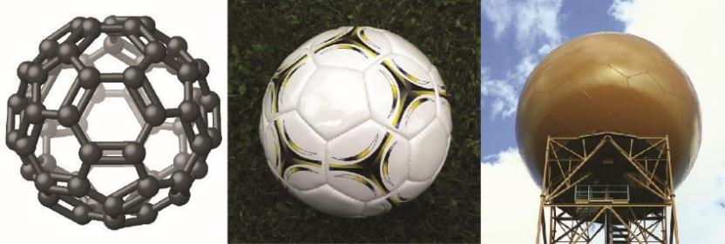
Figure 7.1
Nicknamed “buckyballs,” buckminsterfullerene molecules (C₆₀) contain only carbon atoms. Here they are shown in a ball-and-stick model (left). These molecules have single and double carbon-carbon bonds arranged to form a geometric framework of hexagons and pentagons, similar to the pattern on a soccer ball (center). This unconventional molecular structure is named after architect R. Buckminster Fuller, whose innovative designs combined simple geometric shapes to create large, strong structures such as this weather radar dome near Tucson, Arizona (right). (credit middle: modification of work by “Petey21”/Wikimedia Commons; credit right: modification of work by Bill Morrow)

Slide 4
Learning Objectives
7.1 Ionic Bonding
  Explain the formation of cations, anions, and ionic compounds
  Predict the charge of common metallic and nonmetallic elements, and write their electron configurations

Slide 5
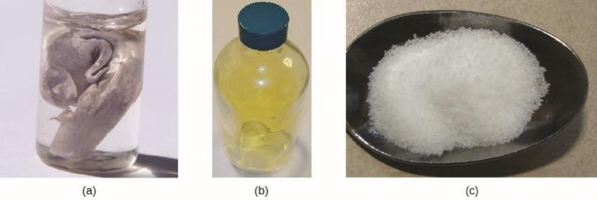
Figure 7.2
(a) Sodium is a soft metal that must be stored in mineral oil to prevent reaction with air or water. (b) Chlorine is a pale yellow-green gas. (c) When combined, they form white crystals of sodium chloride (table salt). (credit a: modification of work by “Jurii”/Wikimedia Commons)

Slide 6
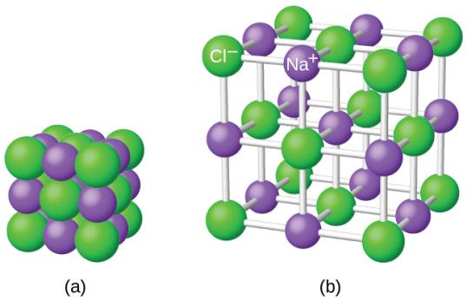
Figure 7.3
The atoms in sodium chloride (common table salt) are arranged to (a) maximize opposite charges interacting. The smaller spheres represent sodium ions, the larger ones represent chloride ions. In the expanded view (b), the geometry can be seen more clearly. Note that each ion is “bonded” to all of the surrounding ions—six in this case.

Slide 7
Learning Objectives
7.2 Covalent Bonding
  Describe the formation of covalent bonds
  Define electronegativity and assess the polarity of covalent bonds

Slide 8
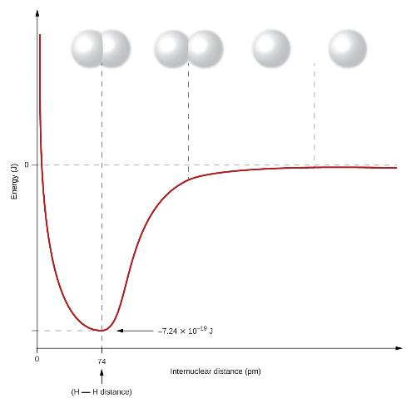
Figure 7.4
The potential energy of two separate hydrogen atoms (right) decreases as they approach each other, and the single electrons on each atom are shared to form a covalent bond. The bond length is the internuclear distance at which the lowest potential energy is achieved.

Slide 9
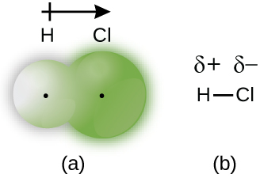
Figure 7.5
(a) The distribution of electron density in the HCl molecule is uneven. The electron density is greater around the chlorine nucleus. The small, black dots indicate the location of the hydrogen and chlorine nuclei in the molecule. (b) Symbols δ+ and δ– indicate the polarity of the H–Cl bond.

Slide 10
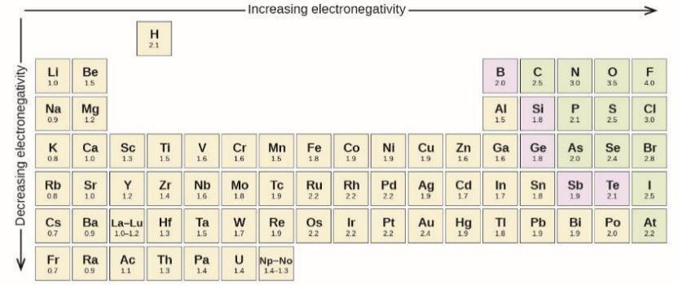
Figure 7.6
The electronegativity values derived by Pauling follow predictable periodic trends with the higher electronegativities toward the upper right of the periodic table.

Slide 11
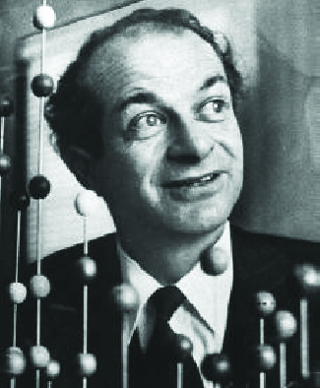
Figure 7.7
Linus Pauling (1901–1994) made many important contributions to the field of chemistry. He was also a prominent activist, publicizing issues related to health and nuclear weapons.

Slide 12
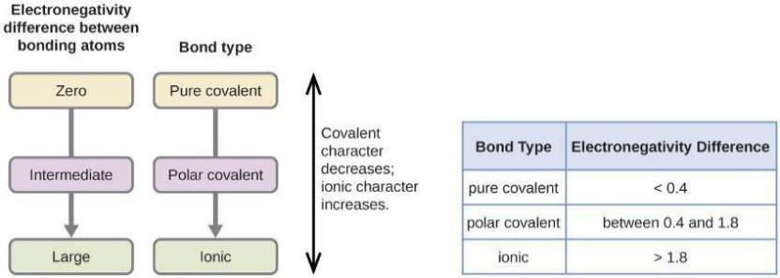
Figure 7.8
As the electronegativity difference increases between two atoms, the bond becomes more ionic.

Slide 13
Learning Objectives
7.3 Lewis Symbols and Structures
  Write Lewis symbols for neutral atoms and ions
  Draw Lewis structures depicting the bonding in simple molecules

Slide 14
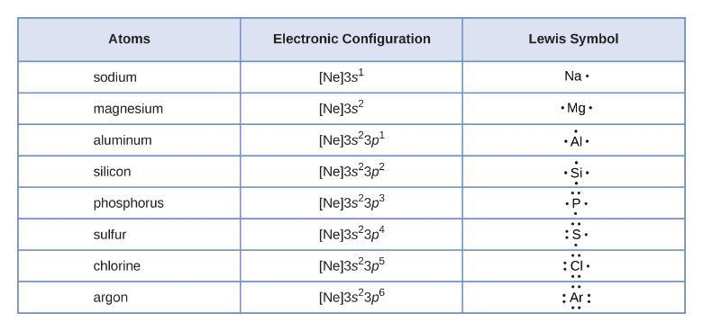
Figure 7.9
Lewis symbols illustrating the number of valence electrons for each element in the third period of the periodic table.

Slide 15
UNFIGURE 7.1

Slide 16
UNFIGURE 7.2

Slide 17
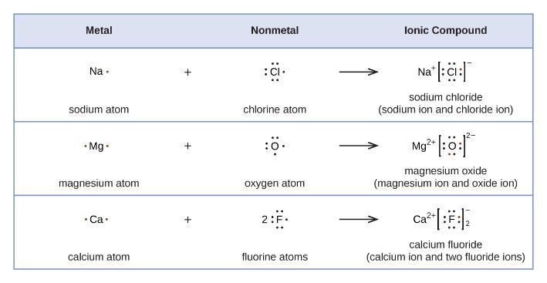
Figure 7.10
Cations are formed when atoms lose electrons, represented by fewer Lewis dots, whereas anions are formed by atoms gaining electrons. The total number of electrons does not change.

Slide 18
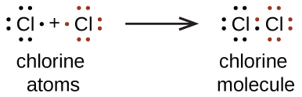
UNFIGURE 7.3

Slide 19

UNFIGURE 7.4

Slide 20
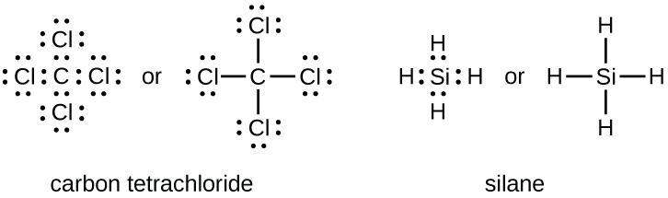
UNFIGURE 7.5

Slide 21
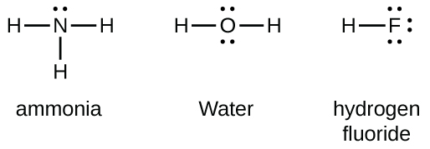
UNFIGURE 7.6

Slide 22
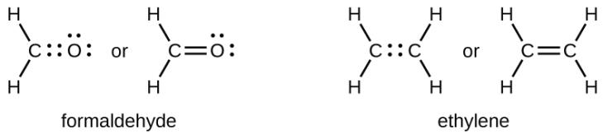
UNFIGURE 7.7

Slide 23

UNFIGURE 7.8

Slide 24
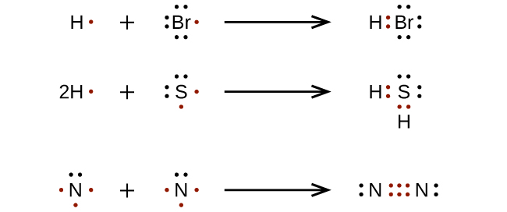
UNFIGURE 7.9

Slide 25
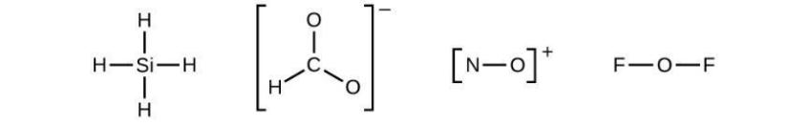
UNFIGURE 7.10

Slide 26
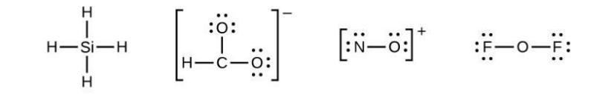
UNFIGURE 7.11

Slide 27

UNFIGURE 7.12

Slide 28
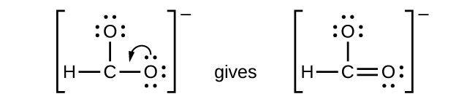
UNFIGURE 7.13

Slide 29

UNFIGURE 7.14

Slide 30

UNFIGURE 7.15

Slide 31
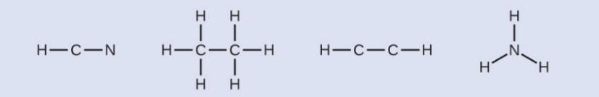
Example 7.4

Slide 32
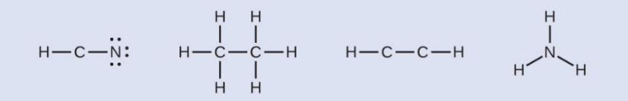
Example 7.4

Slide 33
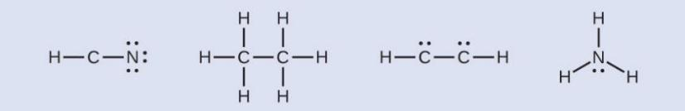
Example 7.4

Slide 34
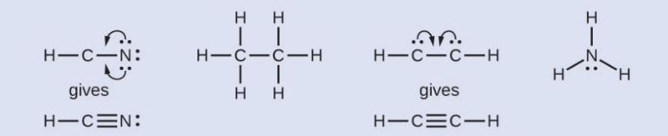
Example 7.4

Slide 35

Example 7.4

Slide 36
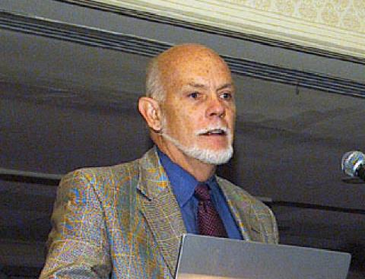
Figure 7.11
Richard Smalley (1943–2005), a professor of physics, chemistry, and astronomy at Rice University, was one of the leading advocates for fullerene chemistry. Upon his death in 2005, the US Senate honored him as the “Father of Nanotechnology.” (credit: United States Department of Energy)

Slide 37

UNFIGURE 7.16

Slide 38

UNFIGURE 7.17

Slide 39
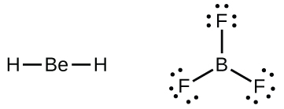
UNFIGURE 7.18

Slide 40
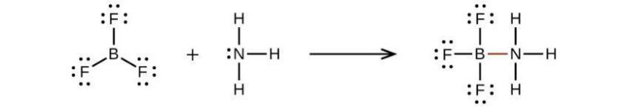
UNFIGURE 7.19

Slide 41
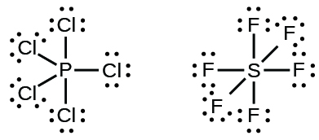
Figure 7.12
In PCl₅, the central atom phosphorus shares five pairs of electrons. In SF₆, sulfur shares six pairs of electrons.

Slide 42
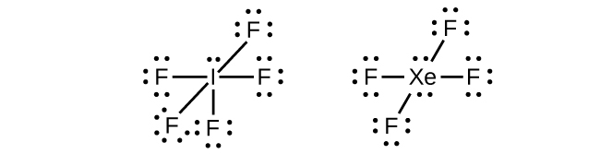
UNFIGURE 7.20

Slide 43
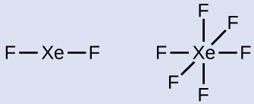
Example 7.5

Slide 44

Example 7.5

Slide 45
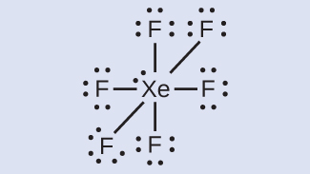
Example 7.5

Slide 46
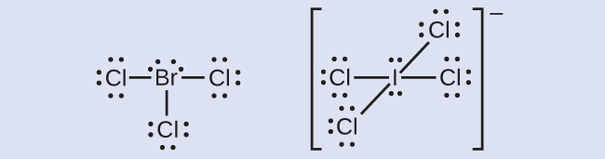
Example 7.5

Slide 47
Learning Objectives
7.4 Formal Charges and Resonance
  Compute formal charges for atoms in any Lewis structure
  Use formal charges to identify the most reasonable Lewis structure for a given molecule
  Explain the concept of resonance and draw Lewis structures representing resonance forms for a given molecule

Slide 48
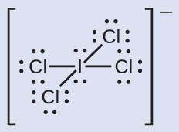
Example 7.6

Slide 49

Example 7.6

Slide 50
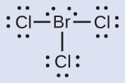
Example 7.7

Slide 51
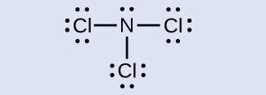
Example 7.7

Slide 52
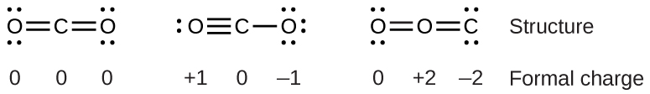
UNFIGURE 7.21

Slide 53

UNFIGURE 7.22

Slide 54

Example 7.8

Slide 55

Example 7.8

Slide 56

Example 7.8

Slide 57

Example 7.8

Slide 58

UNFIGURE 7.23

Slide 59

UNFIGURE 7.24

Slide 60
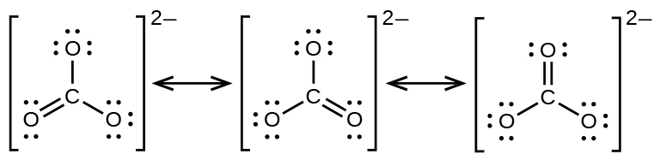
UNFIGURE 7.25

Slide 61
Learning Objectives
7.5 Strengths of Ionic and Covalent Bonds
  Describe the energetics of covalent and ionic bond formation and breakage
  Use the Born-Haber cycle to compute lattice energies for ionic compounds
  Use average covalent bond energies to estimate enthalpies of reaction

Slide 62
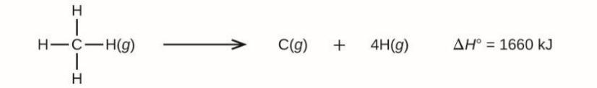
UNFIGURE 7.26

Slide 63
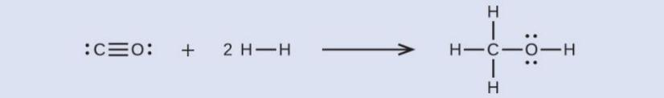
Example 7.9

Slide 64
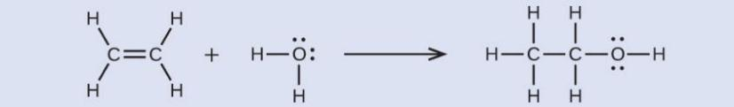
Example 7.9

Slide 65
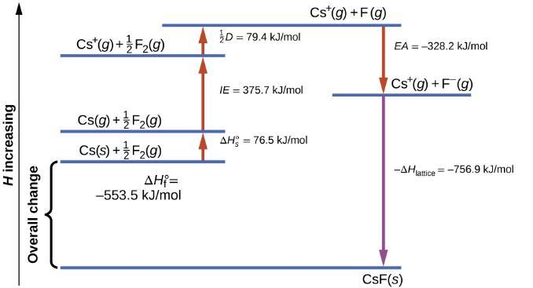
Figure 7.13
The Born-Haber cycle shows the relative energies of each step involved in the formation of an ionic solid from the necessary elements in their reference states.

Slide 66
Learning Objectives
7.6 Molecular Structure and Polarity
  Predict the structures of small molecules using valence shell electron pair repulsion (VSEPR) theory
  Explain the concepts of polar covalent bonds and molecular polarity
  Assess the polarity of a molecule based on its bonding and structure

Slide 67
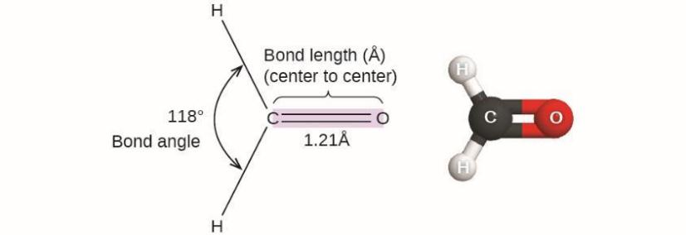
Figure 7.14
Bond distances (lengths) and angles are shown for the formaldehyde molecule, H₂CO.

Slide 68

Figure 7.15
The BeF₂ molecule adopts a linear structure in which the two bonds are as far apart as possible, on opposite sides of the Be atom.

Slide 69
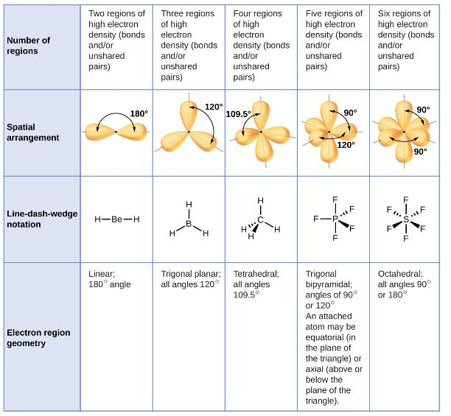
Figure 7.16
The basic electron-pair geometries predicted by VSEPR theory maximize the space around any region of electron density (bonds or lone pairs).

Slide 70
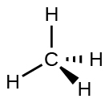
Figure 7.17
The molecular structure of the methane molecule, CH₄, is shown with a tetrahedral arrangement of the hydrogen atoms. VSEPR structures like this one are often drawn using the wedge and dash notation, in which solid lines represent bonds in the plane of the page, solid wedges represent bonds coming up out of the plane, and dashed lines represent bonds going down into the plane.

Slide 71
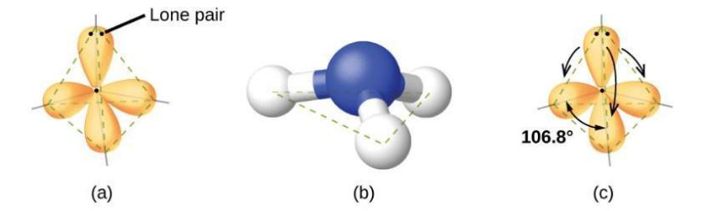
Figure 7.18
(a) The electron-pair geometry for the ammonia molecule is tetrahedral with one lone pair and three single bonds. (b) The trigonal pyramidal molecular structure is determined from the electron-pair geometry. (c) The actual bond angles deviate slightly from the idealized angles because the lone pair takes up a larger region of space than do the single bonds, causing the HNH angle to be slightly smaller than 109.5°.

Slide 72
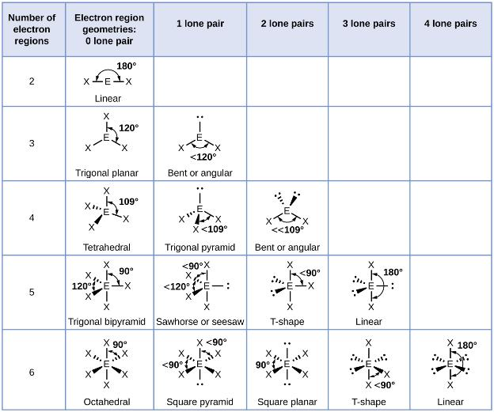
Figure 7.19
The molecular structures are identical to the electron-pair geometries when there are no lone pairs present (first column). For a particular number of electron pairs (row), the molecular structures for one or more lone pairs are determined based on modifications of the corresponding electron-pair geometry.

Slide 73
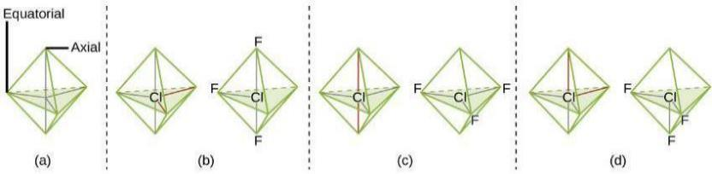
Figure 7.20
(a) In a trigonal bipyramid, the two axial positions are located directly across from one another, whereas the three equatorial positions are located in a triangular arrangement. (b–d) The two lone pairs (red lines) in ClF₃ have several possible arrangements, but the T-shaped molecular structure (b) is the one actually observed, consistent with the larger lone pairs both occupying equatorial positions.

Slide 74

Example 7.11

Slide 75
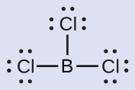
Example 7.11

Slide 76

Figure 7.21

Slide 77
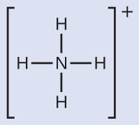
Example 7.12

Slide 78
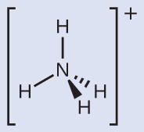
Figure 7.22
The ammonium ion displays a tetrahedral electron-pair geometry as well as a tetrahedral molecular structure.

Slide 79
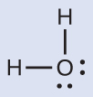
Example 7.13

Slide 80
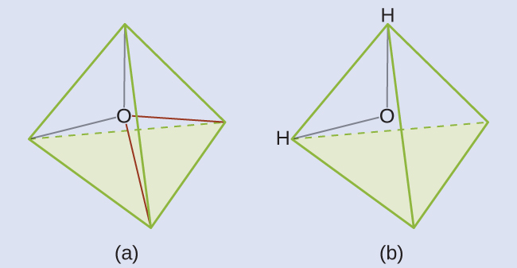
Figure 7.23
(a) H₂O has four regions of electron density around the central atom, so it has a tetrahedral electron-pair geometry. (b) Two of the electron regions are lone pairs, so the molecular structure is bent.

Slide 81

Example 7.14

Slide 82

Figure 7.24
(a) SF4 has a trigonal bipyramidal arrangement of the five regions of electron density. (b) One of the regions is a lone pair, which results in a seesaw-shaped molecular structure.

Slide 83

Example 7.15

Slide 84

Figure 7.25
(a) XeF₄ adopts an octahedral arrangement with two lone pairs (red lines) and four bonds in the electron-pair geometry. (b) The molecular structure is square planar with the lone pairs directly across from one another.

Slide 85

Example 7.16

Slide 86

Example 7.16

Slide 87

Example 7.16

Slide 88

Figure 7.26
(a) There is a small difference in electronegativity between C and H, represented as a short vector. (b) The electronegativity difference between B and F is much larger, so the vector representing the bond moment is much longer.

Slide 89

Figure 7.27
The overall dipole moment of a molecule depends on the individual bond dipole moments and how they are arranged. (a) Each CO bond has a bond dipole moment, but they point in opposite directions so that the net CO₂ molecule is nonpolar. (b) In contrast, water is polar because the OH bond moments do not cancel out.

Slide 90

UNFIGURE 7.27

Slide 91

UNFIGURE 7.28

Slide 92

UNFIGURE 7.29

Slide 93

Figure 7.28
(a) Molecules are always randomly distributed in the liquid state in the absence of an electric field. (b) When an electric field is applied, polar molecules like HF will align to the dipoles with the field direction.

Slide 94

Exercise 26a

Slide 95

Exercise 26b

Slide 96

Exercise 26c

Slide 97

Exercise 26d

Slide 98

Exercise 39a

Slide 99

Exercise 39b

Slide 100

Exercise 39c

Slide 101

Exercise 39d

Slide 102

Exercise 39e

Slide 103

Exercise 44d

Slide 104

Exercise 44e

Slide 105

Exercise 45d

Slide 106

Exercise 45e

Slide 107

Exercise 48

Slide 108

Exercise 62

Slide 109

Exercise 67

Slide 110

Exercise 73

Slide 111

Exercise 74

Slide 112
This OpenStax ancillary resource is © Rice University under a CC-BY 4.0 International license; it may be reproduced or modified but must be attributed to OpenStax, Rice University and any changes must be noted.

