Slide 1
CHEMISTRY 2e
Chapter 8 Advanced Theories of Covalent Bonding
PowerPoint Image Slideshow

Slide 2
Chapter Outline
8.1 Valence Bond Theory
8.2 Hybrid Atomic Orbitals
8.3 Multiple Bonds
8.4 Molecular Orbital Theory

Slide 3
Figure 8.1
Oxygen molecules orient randomly most of the time, as shown in the top magnified view. However, when we pour liquid oxygen through a magnet, the molecules line up with the magnetic field, and the attraction allows them to stay suspended between the poles of the magnet where the magnetic field is strongest. Other diatomic molecules (like N₂) flow past the magnet. The detailed explanation of bonding described in this chapter allows us to understand this phenomenon. (credit: modification of work by Jefferson Lab)

Slide 4
Learning Objectives
8.1 Valance Bond Theory
Describe the formation of covalent bonds in terms of atomic orbital overlap
Define and give examples of σ and π bonds

Slide 5
Orbitals and Covalent Bonding
Linus Pauling and others (1930s) developed the valance bond theory of covalent bonding.
Electrons reside in orbitals.
Covalent bonds form when electrons are shared by the overlapping of singly occupied orbitals.
Electrons in these overlapping orbitals must have opposite spins.

Slide 6
Valance Bond Theory
Consider the formation of the H₂ molecule.

Slide 7
Valance Bond Theory
Consider the formation of the HF molecule.

Slide 8
Valance Bond Theory
To form a covalent bond, an atom must have an unpaired electron.
Number of bonds formed by an atom is determined by the number of unpaired electrons.
This theory works well for explaining the bonding in diatomic molecules with only single bonds.
This theory also works well for explaining the lack of bonding experienced by the noble gases.

Slide 9
Limitations of the Valence Bond Model
Valence bond theory must be modified to explain the covalent bonds formed in other molecules.
Consider BeF₂, BF₃, and CH₄

Slide 10
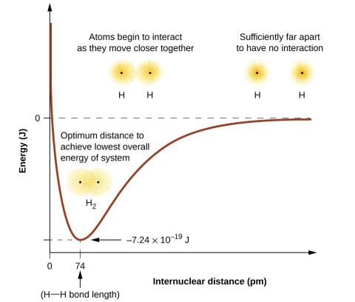
Figure 8.2
(a) The interaction of two hydrogen atoms changes as a function of distance. (b) The energy of the system changes as the atoms interact. The lowest (most stable) energy occurs at a distance of 74 pm, which is the bond length observed for the H₂ molecule.

Slide 11
Figure 8.3
(a) The overlap of two p orbitals is greatest when the orbitals are directed end to end. (b) Any other arrangement results in less overlap. The plus signs indicate the locations of the nuclei.

Slide 12
Figure 8.4
Sigma (σ) bonds form from the overlap of the following: (a) two s orbitals, (b) an s orbital and a p orbital, and (c) two p orbitals. The plus signs indicate the locations of the nuclei.

Slide 13
Figure 8.5
Pi (π) bonds form from the side-by-side overlap of two p orbitals. The plus signs indicate the location of the nuclei.

Slide 15
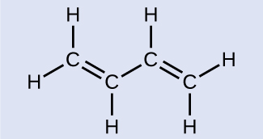
Example 8.1

Slide 16
Example 8.1

Slide 17
Learning Objectives
8.2 Hybrid Atomic Orbitals
Explain the concept of atomic orbital hybridization
Determine the hybrid orbitals associated with various molecular geometries

Slide 18
Hybrid Orbitals
Bonding in other molecules is best explained with hybrid orbitals.
Keep in mind when working with hybrid orbitals.
The number of hybrid orbitals formed always equals the number of atomic orbitals that are combined.

Slide 19
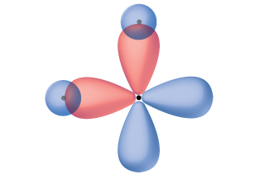
Figure 8.6
The hypothetical overlap of two of the 2p orbitals on an oxygen atom (red) with the 1s orbitals of two hydrogen atoms (blue) would produce a bond angle of 90°. This is not consistent with experimental evidence. (Note that orbitals may sometimes be drawn in an elongated “balloon” shape rather than in a more realistic “plump” shape in order to make the geometry easier to visualize.)

Slide 20
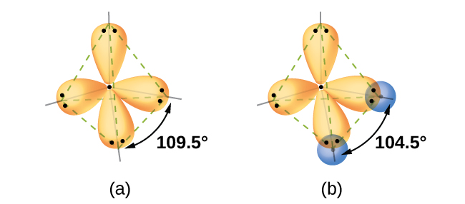
Figure 8.7
(a) A water molecule has four regions of electron density, so VSEPR theory predicts a tetrahedral arrangement of hybrid orbitals. (b) Two of the hybrid orbitals on oxygen contain lone pairs, and the other two overlap with the 1s orbitals of hydrogen atoms to form the O–H bonds in H₂O. This description is more consistent with the experimental structure.

Slide 21
sp Hybrid Orbitals
Two atomic orbitals can hybridize to produce two hybrid orbitals.
one s orbital + one p orbital → two sp hybrid orbitals

Slide 22
Figure 8.8
Hybridization of an s orbital (blue) and a p orbital (red) of the same atom produces two sp hybrid orbitals (purple). Each hybrid orbital is oriented primarily in just one direction. Note that each sp orbital contains one lobe that is significantly larger than the other. The set of two sp orbitals are oriented at 180°, which is consistent with the geometry for two domains.

Slide 23
sp Hybrid Orbitals
Occurs when a central atom is surrounded by two regions of electron density.

Slide 24
Figure 8.9
This orbital energy-level diagram shows the sp hybridized orbitals on Be in the linear BeCl₂ molecule. Each of the two sp hybrid orbitals holds one electron and is thus half filled and available for bonding via overlap with a Cl 3p orbital.

Slide 25
sp² Hybrid Orbitals
Three atomic orbitals can hybridize to produce three hybrid orbitals.
one s orbital + two p orbitals → three sp² hybrid orbitals
Occurs when a central atom is surrounded by three regions of electron density.

Slide 26
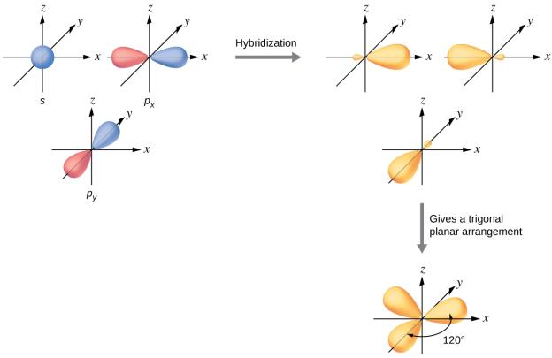
Figure 8.10
The hybridization of an s orbital (blue) and two p orbitals (red) produces three equivalent sp² hybridized orbitals (purple) oriented at 120° with respect to each other. The remaining unhybridized p orbital is not shown here, but is located along the z axis.

Slide 27
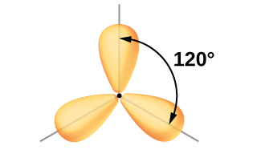
Figure 8.11
This alternate way of drawing the trigonal planar sp² hybrid orbitals is sometimes used in more crowded figures.

Slide 28
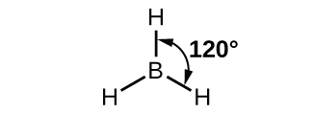
Figure 8.12
BH₃ is an electron-deficient molecule with a trigonal planar structure.

Slide 29
Figure 8.13
In an isolated B atom, there are one 2s and three 2p valence orbitals. When boron is in a molecule with three regions of electron density, three of the orbitals hybridize and create a set of three sp² orbitals and one unhybridized 2p orbital. The three half-filled hybrid orbitals each overlap with an orbital from a hydrogen atom to form three σ bonds in BH₃.

Slide 30
Figure 8.14
The central atom(s) in each of the structures shown contain three regions of electron density and are sp² hybridized. As we know from the discussion of VSEPR theory, a region of electron density contains all of the electrons that point in one direction. A lone pair, an unpaired electron, a single bond, or a multiple bond would each count as one region of electron density.

Slide 31
sp³ Hybrid Orbitals
Four atomic orbitals can hybridize to produce four hybrid orbitals.
one s orbital + three p orbitals → four sp³ hybrid orbitals
Occurs when a central atom is surrounded by four regions of electron density.

Slide 32
Figure 8.15
The hybridization of an s orbital (blue) and three p orbitals (red) produces four equivalent sp³ hybridized orbitals (purple) oriented at 109.5° with respect to each other.

Slide 33
Figure 8.16
The four valence atomic orbitals from an isolated carbon atom all hybridize when the carbon bonds in a molecule like CH₄ with four regions of electron density. This creates four equivalent sp³ hybridized orbitals. Overlap of each of the hybrid orbitals with a hydrogen orbital creates a C–H σ bond.

Slide 34
Figure 8.17
(a) In the ethane molecule, C₂H₆, each carbon has four sp³ orbitals. (b) These four orbitals overlap to form seven σ bonds.

Slide 35
sp³d Hybrid Orbitals
Five atomic orbitals can hybridize to produce five hybrid orbitals.
one s orbital + three p orbitals + one d orbital → five sp³d hybrid orbitals
Occurs when a central atom is surrounded by five regions of electron density.

Slide 36
sp³d² Hybrid Orbitals
Six atomic orbitals can hybridize to produce six hybrid orbitals.
one s orbital + three p orbitals + two d orbitals → six sp³d² hybrid orbitals
Occurs when a central atom is surrounded by six regions of electron density.

Slide 37
Figure 8.18
The three compounds pictured exhibit sp³d hybridization in the central atom and a trigonal bipyramid form. SF₄ and ClF₄⁺ have one lone pair of electrons on the central atom, and ClF₃ has two lone pairs giving it the T-shape shown.

Slide 38
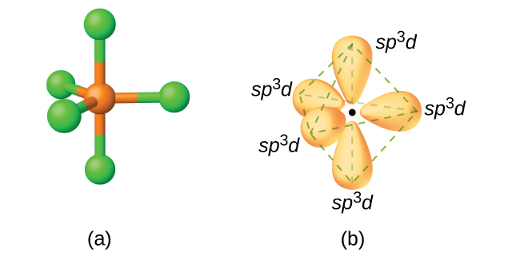
Figure 8.19
(a) The five regions of electron density around phosphorus in PCl₅ require five hybrid sp³d orbitals. (b) These orbitals combine to form a trigonal bipyramidal structure with each large lobe of the hybrid orbital pointing at a vertex. As before, there are also small lobes pointing in the opposite direction for each orbital (not shown for clarity).

Slide 39
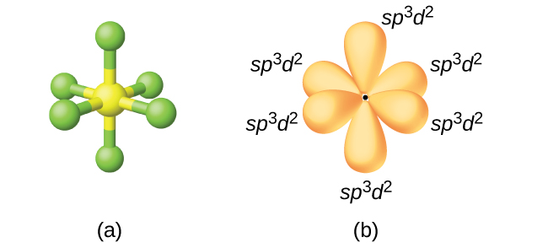
Figure 8.20
(a) Sulfur hexafluoride, SF₆, has an octahedral structure that requires sp³d² hybridization. (b) The six sp³d² orbitals form an octahedral structure around sulfur. Again, the minor lobe of each orbital is not shown for clarity.

Slide 40
Figure 8.21
The shapes of hybridized orbital sets are consistent with the electron-pair geometries. For example, an atom surrounded by three regions of electron density is sp² hybridized, and the three sp² orbitals are arranged in a trigonal planar fashion.

Slide 42
Example 8.2

Slide 43
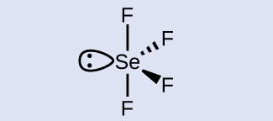
Example 8.2

Slide 44
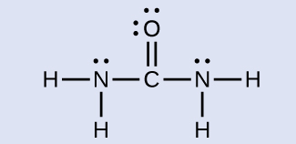
Example 8.3

Slide 45
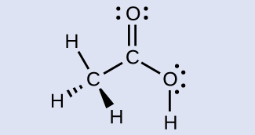
Example 8.3

Slide 46
Learning Objectives
8.3 Multiple Bonds
Describe multiple covalent bonding in terms of atomic orbital overlap
Relate the concept of resonance to π-bonding and electron delocalization

Slide 47
Single, Double, and Triple Bonds
Single bonds are formed by the direct overlap of two hybrid orbitals, p orbitals, or s orbitals.
These are called sigma (σ) bonds.
The additional electrons shared in a multi bond are not a result of directly overlapping hybrid orbitals, but are a result of side-by-side overlap of two regular “p” atomic orbitals.
These are called pi (π) bonds.
Single bond = 1 sigma bond
Double bond = 1 sigma bond, 1 pi bond
Triple bond = 1 sigma bond, 2 pi bonds

Slide 48
Double and Triple Bonds
To determine the hybridization in molecules with multi bonds, recall that a double or triple bond is each one region of electron density.

Slide 49
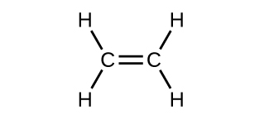

Slide 50
Figure 8.22
In ethene, each carbon atom is sp² hybridized, and the sp² orbitals and the p orbital are singly occupied. The hybrid orbitals overlap to form σ bonds, while the p orbitals on each carbon atom overlap to form a π bond.

Slide 51
Figure 8.23
In the ethene molecule, C₂H₄, there are (a) five σ bonds shown in purple. One C–C σ bond results from overlap of sp² hybrid orbitals on the carbon atom with one sp² hybrid orbital on the other carbon atom. Four C–H bonds result from the overlap between the sp² orbitals with s orbitals on the hydrogen atoms. (b) The π bond is formed by the side-by-side overlap of the two unhybridized p orbitals in the two carbon atoms, which are shown in red. The two lobes of the π bond are above and below the plane of the σ system.

Slide 52
Double Bonds
The π bond is formed by the side-by-side overlap of the two unhybridized p orbitals in the two carbon atoms, which are shown in red in Figure 8.23. The two lobes of the π bond are above and below the plane of the σ system.

Slide 53
Figure 8.24
Diagram of the two linear sp hybrid orbitals of a carbon atom, which lie in a straight line, and the two unhybridized p orbitals at perpendicular angles.

Slide 54
Figure 8.25
(a) In the acetylene molecule, C₂H₂, there are two C–H σ bonds and a C ≡ C triple bond involving one C–C σ bond and two C–C π bonds. The dashed lines, each connecting two lobes, indicate the side-by-side overlap of the four unhybridized p orbitals. (b) This shows the overall outline of the bonds in C₂H₂. The two lobes of each of the π bonds are positioned across from each other around the line of the C–C σ bond.

Slide 55
Triple Bonds
Figure 8.25 shows the overall outline of the bonds in C₂H₂. The two lobes of each of the π bonds are positioned across from each other around the line of the C–C σ bond.

Slide 56
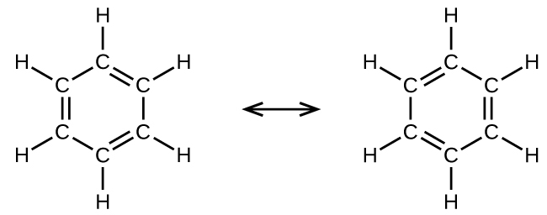
Figure 8.26
Each carbon atom in benzene, C₆H₆, is sp² hybridized, independently of which resonance form is considered. The electrons in the π bonds are not located in one set of p orbitals or the other, but rather delocalized throughout the molecule.

Slide 57
Example 8.4

Slide 58
Learning Objectives
8.4 Molecular Orbital Theory
Outline the basic quantum-mechanical approach to deriving molecular orbitals from atomic orbitals
Describe traits of bonding and antibonding molecular orbitals
Calculate bond orders based on molecular electron configurations
Write molecular electron configurations for first- and second-row diatomic molecules
Relate these electron configurations to the molecules’ stabilities and magnetic properties

Slide 59
Figure 8.27
A Gouy balance compares the mass of a sample in the presence of a magnetic field with the mass with the electromagnet turned off to determine the number of unpaired electrons in a sample.

Slide 60
Figure 8.28
(a) When in-phase waves combine, constructive interference produces a wave with greater amplitude. (b) When out-of-phase waves combine, destructive interference produces a wave with less (or no) amplitude.

Slide 61
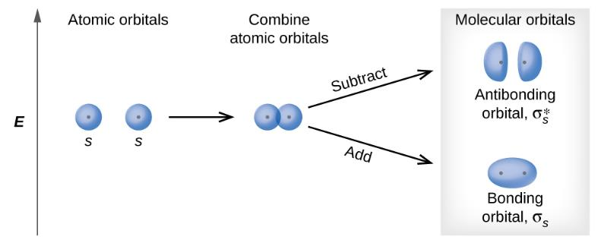
Figure 8.29
Sigma (σ) and sigma-star (σ*) molecular orbitals are formed by the combination of two s atomic orbitals. The dots (•) indicate the locations of nuclei.

Slide 62
Figure 8.30
Combining wave functions of two p atomic orbitals along the internuclear axis creates two molecular orbitals, σ_{p} and σ*_{p} .

Slide 63
Figure 8.31
Side-by-side overlap of each two p orbitals results in the formation of two π molecular orbitals. Combining the out-of-phase orbitals results in an antibonding molecular orbital with two nodes. One contains the axis, and one contains the perpendicular. Combining the in-phase orbitals results in a bonding orbital. There is a node (blue line) directly along the internuclear axis, but the orbital is located between the nuclei (red dots) above and below this node.

Slide 64
Example 8.5

Slide 65
Example 8.5

Slide 66
Example 8.5

Slide 67
Figure 8.32
Walter Kohn developed methods to describe molecular orbitals. (credit: image courtesy of Walter Kohn)

Slide 68
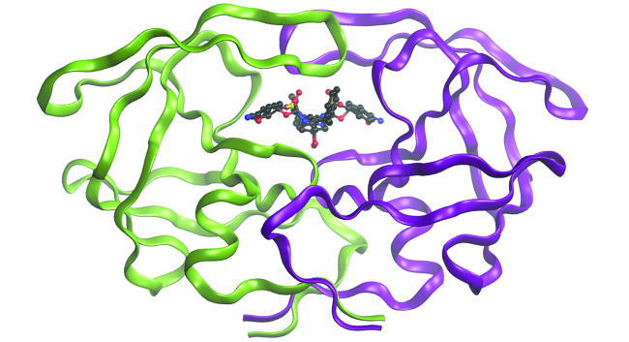
Figure 8.33
The molecule shown, HIV-1 protease, is an important target for pharmaceutical research. By designing molecules that bind to this protein, scientists are able to drastically inhibit the progress of the disease.

Slide 69
Figure 8.34
This is the molecular orbital diagram for the homonuclear diatomic Be₂ ⁺, showing the molecular orbitals of the valence shell only. The molecular orbitals are filled in the same manner as atomic orbitals, using the Aufbau principle and Hund’s rule.

Slide 70
Figure 8.35
The molecular orbital energy diagram predicts that H₂ will be a stable molecule with lower energy than the separated atoms.

Slide 71
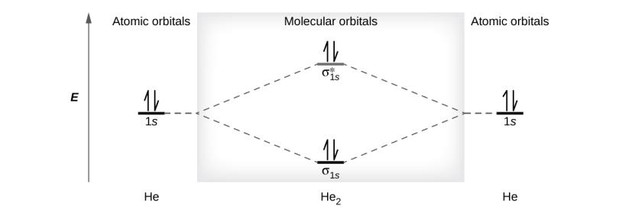
Figure 8.36
The molecular orbital energy diagram predicts that He₂ will not be a stable molecule, since it has equal numbers of bonding and antibonding electrons.

Slide 72
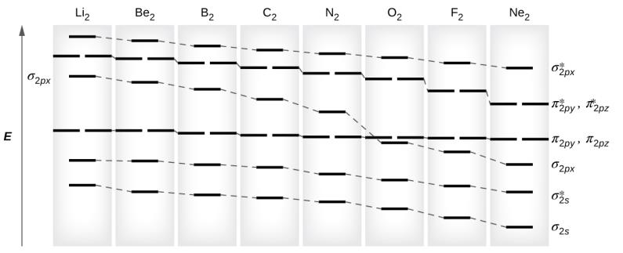
Figure 8.37
This shows the MO diagrams for each homonuclear diatomic molecule in the second period. The orbital energies decrease across the period as the effective nuclear charge increases and atomic radius decreases. Between N₂ and O₂, the order of the orbitals changes.

Slide 73
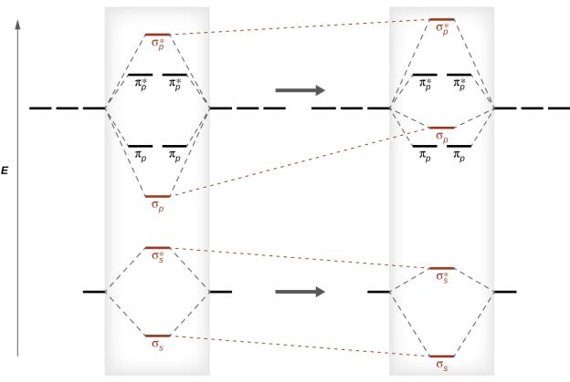
Figure 8.38
Without mixing, the MO pattern occurs as expected, with the σ_{p} orbital lower in energy than the σ_{p} orbitals. When s-p mixing occurs, the orbitals shift as shown, with the σ_{p} orbital higher in energy than the π_{p} orbitals.

Slide 74
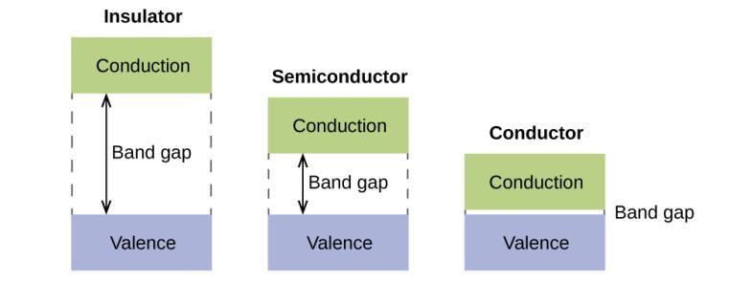
Figure 8.39
Molecular orbitals in solids are so closely spaced that they are described as bands. The valence band is lower in energy and the conduction band is higher in energy. The type of solid is determined by the size of the “band gap” between the valence and conduction bands. Only a very small amount of energy is required to move electrons from the valance band to the conduction band in a conductor, and so they conduct electricity well. In an insulator, the band gap is large, so that very few electrons move, and they are poor conductors of electricity. Semiconductors are in between: they conduct electricity better than insulators, but not as well as conductors.

Slide 75
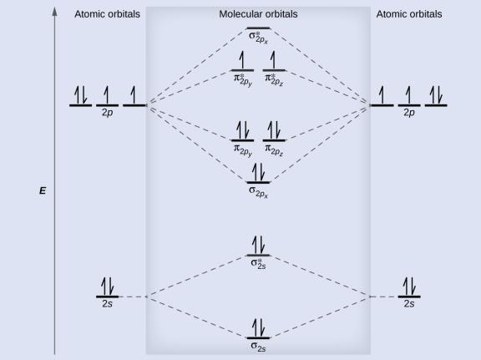
Figure 8.40
The molecular orbital energy diagram for O₂ predicts two unpaired electrons.

Slide 76
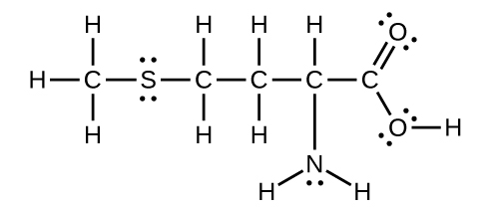
Exercise 14

Slide 77
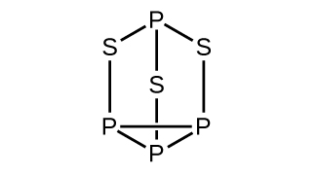
Exercise 19

Slide 78
Exercise 20

Slide 79
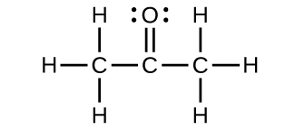
Exercise 30a

Slide 80
Exercise 30b

Slide 81
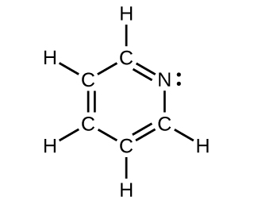
Exercise 30c

Slide 82
This OpenStax ancillary resource is © Rice University under a CC-BY 4.0 International license; it may be reproduced or modified but must be attributed to OpenStax, Rice University and any changes must be noted.

