Slide 1
CHEMISTRY 2e
Chapter 9 GASES
PowerPoint Image Slideshow

Slide 2
Chapter Outline
9.1 Gas Pressure
9.2 Relating Pressure, Volume, Amount, and Temperature: The Ideal Gas Law
9.3 Stoichiometry of Gaseous Substances, Mixtures, and Reactions
9.4 Effusion and Diffusion of Gases
9.5 The Kinetic-Molecular Theory
9.6 Non-Ideal Gas Behavior

Slide 3
Figure 9.1
The hot air inside these balloons is less dense than the surrounding cool air. This results in a buoyant force that causes the balloons to rise when their guy lines are untied. (credit: modification of work by Anthony Quintano)

Slide 4
Learning Objectives
Gas Pressure
Define the property of pressure
Define and convert among the units of pressure measurements
Describe the operation of common tools for measuring gas pressure
Calculate pressure from manometer data

Slide 5
Air—Our Most Familiar Gas
Air has been known to exist since ancient times.
The Greeks considered air one of the four fundamental elements of nature along with earth, water, and fire.
18th century—Lavoisier, Cavendish, and Priestley:
Determined that air is actually a mixture of gases.

Slide 6
Air and Contemporary Issues
Air in the news:
Ozone depletion in the stratosphere.
Carbon dioxide and global warming.

Slide 7
Figure 9.2
The atmosphere above us exerts a large pressure on objects at the surface of the earth, roughly equal to the weight of a bowling ball pressing on an area the size of a human thumbnail.

Slide 8
Gas Pressure
Pressure is defined as the force exerted on a given area.
Gas pressure is a result of the force exerted by gas molecules colliding with the surface of objects.
English system units for pressure: pounds per square inch (psi)
A mercury barometer is a device used to measure the atmospheric pressure.

Slide 9
Figure 9.3
Although (a) an elephant’s weight is large, creating a very large force on the ground, (b) the figure skater exerts a much higher pressure on the ice due to the small surface area of her skates. (credit a: modification of work by Guido da Rozze; credit b: modification of work by Ryosuke Yagi)

Slide 10
Units of Pressure
Due to the way gas pressure is measured, millimeters of mercury (mm Hg) is a commonly used unit of pressure.
Probably the most common unit of gas pressure is the atmosphere (atm).
1 atm is the “normal atmospheric pressure”
1 atm = 760 mm Hg

Slide 11
Units of Pressure
SI unit for pressure is the Pascal (Pa).
1 Pa is defined as the pressure exerted by a 0.1 mm high film of water on the surface beneath it.
Kilopascal (kPa)
A related unit of pressure is the bar.
1 bar = 105 Pa
Pressure conversions:
1.013 bar = 1 atm = 760 mm Hg = 760 torr
= 14.7 psi = 101.3 kPa

Slide 12
Measuring Atmospheric Pressure
The barometer measures pressure in terms of the height of a column of liquid mercury.
The atmosphere exerts a force on the liquid mercury causing it to rise.
Commonly, the pressure of the atmosphere at sea level pushes the column of mercury ~760 mm high.

Slide 13
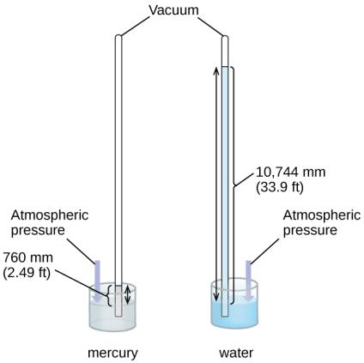
Figure 9.4
In a barometer, the height, h, of the column of liquid is used as a measurement of the air pressure. Using very dense liquid mercury (left) permits the construction of reasonably sized barometers, whereas using water (right) would require a barometer more than 30 feet tall.

Slide 14
Atmospheric Pressure and Altitude
Pressure varies with the height of the column of air above.
We don’t notice atmospheric pressure but do notice changes in atmospheric pressure

Slide 15
Measuring the Pressure of a Confined Gas—The Manometer
The force of the gas in the flask is measured relative to the force of the atmosphere (atmospheric pressure).
The distance and direction that the Hg travels is related to the pressure of the gas.

Slide 16
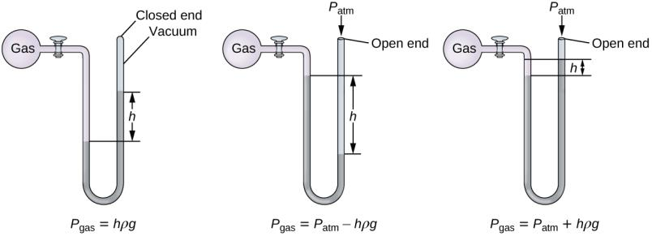
Figure 9.5
A manometer can be used to measure the pressure of a gas. The (difference in) height between the liquid levels (h) is a measure of the pressure. Mercury is usually used because of its large density.

Slide 17
Example 9.3

Slide 18
Example 9.3

Slide 19
Example 9.4

Slide 20
Example 9.4

Slide 21
Figure 9.6
(a) A medical technician prepares to measure a patient’s blood pressure with a sphygmomanometer. (b) A typical sphygmomanometer uses a valved rubber bulb to inflate the cuff and a diaphragm gauge to measure pressure. (credit a: modification of work by Master Sgt. Jeffrey Allen)

Slide 22
Figure 9.7
Meteorologists use weather maps to describe and predict weather. Regions of high (H) and low (L) pressure have large effects on weather conditions. The gray lines represent locations of constant pressure known as isobars. (credit: modification of work by National Oceanic and Atmospheric Administration)

Slide 23
Figure 9.8
Earth’s atmosphere has five layers: the troposphere, the stratosphere, the mesosphere, the thermosphere, and the exosphere.

Slide 24
Learning Objectives
9.2 Relating Pressure, Volume, Amount, Temperature: The Ideal Gas Law
Identify the mathematical relationships between the various properties of gases
Use the ideal gas law, and related gas laws, to compute the values of various gas properties under specified conditions

Slide 25
Volume of a Gas
At constant temperature and pressure, a gas expands uniformly to fill the container in which it is contained.

Slide 26
Relating Pressure, Volume, Amount, Temperature: The Ideal Gas Law
There are many different types of gases.
Elements: Ar, He, H₂, N₂, O₂
Compounds: CO₂, CO, H₂O, NH₃
All gases have the same dependence on those four properties.
Volume
Amount
Temperature
Pressure

Slide 27
Figure 9.9
In 1783, the first (a) hydrogen-filled balloon flight, (b) manned hot air balloon flight, and (c) manned hydrogen-filled balloon flight occurred. When the hydrogen-filled balloon depicted in (a) landed, the frightened villagers of Gonesse reportedly destroyed it with pitchforks and knives. The launch of the latter was reportedly viewed by 400,000 people in Paris.

Slide 28
Figure 9.10
The effect of temperature on gas pressure: When the hot plate is off, the pressure of the gas in the sphere is relatively low. As the gas is heated, the pressure of the gas in the sphere increases.

Slide 29
Pressure and Temperature
The pressure of a gas is directly proportional to its temperature in K.
At constant V and n
This is Amonton’s Law or Gay-Lussac’s Law.

Slide 30
Figure 9.11
For a constant volume and amount of air, the pressure and temperature are directly proportional, provided the temperature is in kelvin. (Measurements cannot be made at lower temperatures because of the condensation of the gas.) When this line is extrapolated to lower pressures, it reaches a pressure of 0 at –273 °C, which is 0 on the kelvin scale and the lowest possible temperature, called absolute zero.

Slide 31
Volume and Temperature
The volume of a gas is directly proportional to its temperature in K.
At constant P and n
This is Charles’s Law.

Slide 32
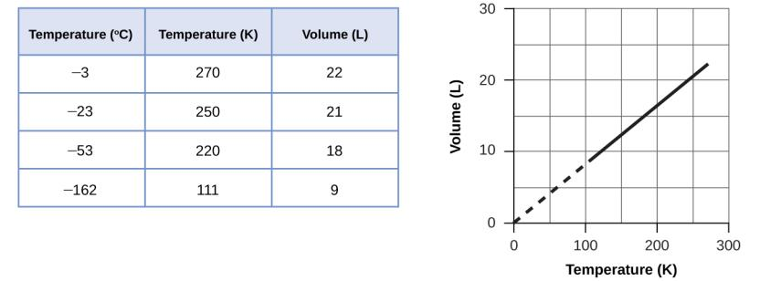
Figure 9.12
The volume and temperature are linearly related for 1 mole of methane gas at a constant pressure of 1 atm. If the temperature is in kelvin, volume and temperature are directly proportional. The line stops at 111 K because methane liquefies at this temperature; when extrapolated, it intersects the graph’s origin, representing a temperature of absolute zero.

Slide 33
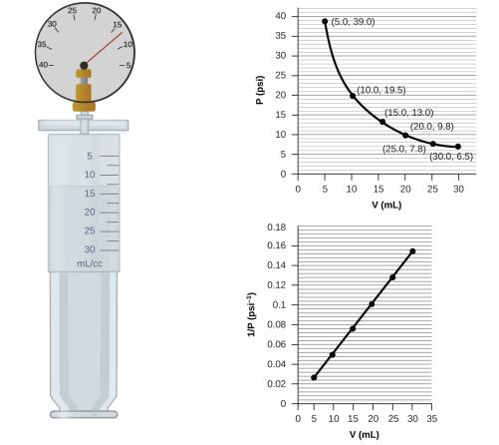
Figure 9.13
When a gas occupies a smaller volume, it exerts a higher pressure; when it occupies a larger volume, it exerts a lower pressure (assuming the amount of gas and the temperature do not change). Since P and V are inversely proportional, a graph of $\frac{1}{P}$ vs. V is linear.

Slide 34
Volume and Pressure
The volume of a gas is inversely proportional to its pressure.
At constant T and n
This is Boyle’s Law.

Slide 35
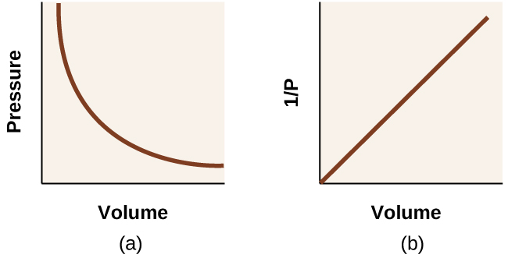
Figure 9.14
The relationship between pressure and volume is inversely proportional. (a) The graph of P vs. V is a parabola, whereas (b) the graph of $\frac{1}{P}$ vs. V is linear.

Slide 36
Figure 9.15
Breathing occurs because expanding and contracting lung volume creates small pressure differences between your lungs and your surroundings, causing air to be drawn into and forced out of your lungs.

Slide 37
Volume and Amount (Moles)
The volume of a gas is directly proportional to its amount (moles of gas).
At constant T and P
This is Avogadro’s Law.

Slide 38
The Ideal Gas Law
These four equations can be combined into a single law consisting of all four properties.
The Ideal Gas Law: PV = nRT
The four constants (k) were combined into a new constant, R, called the ideal gas constant.

Slide 39
The Ideal Gas Law
PV = nRT
P is the pressure in atm.
V is the volume in L.
n is the moles of gas.
T is the temperature in K.
R is the ideal gas constant.

Slide 40
The Ideal Gas Law
PV = nRT
The ideal gas law accurately describes the properties of an ideal gas.
What is an ideal gas? What assumptions are being made?

Slide 41
Figure 9.16
Scuba divers use compressed air to breathe while underwater. (credit: modification of work by Mark Goodchild)

Slide 42
Figure 9.17
Scuba divers, whether at the Great Barrier Reef or in the Caribbean, must be aware of buoyancy, pressure equalization, and the amount of time they spend underwater, to avoid the risks associated with pressurized gases in the body. (credit: Kyle Taylor)

Slide 43
Standard Temperature and Pressure
Sometimes it is important to define standard conditions.
Standard temperature and pressure (STP)
0 ºC = 273 K
1 atm Note: The IUPAC recommended value of standard pressure was changed to 1 bar in 1982, but many texts continue to use the 1 atm value.
At STP, the volume of one mole of any gas can be calculated.

Slide 44
Modified Ideal Gas Law
PV = nRT
Modified version of the ideal gas law:
Moles kept constant
But other properties change

Slide 45
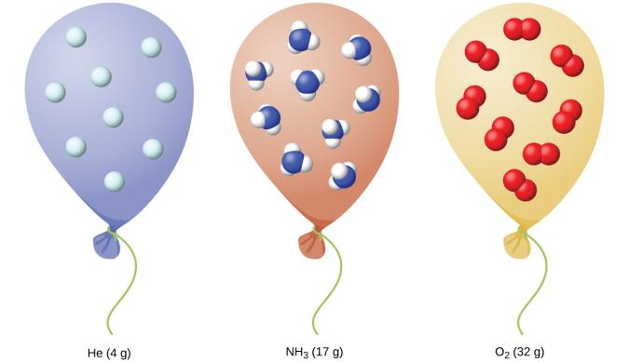
Figure 9.18
Regardless of its chemical identity, one mole of gas behaving ideally occupies a volume of ~22.4 L at STP.

Slide 46
Learning Objectives
9.3 Stoichiometry of Gaseous Substances, Mixtures, and Reactions
Use the ideal gas law to compute gas densities and molar masses
Perform stoichiometric calculations involving gaseous substances
State Dalton’s law of partial pressures and use it in calculations involving gaseous mixtures

Slide 47
Calculating the Density of a Gas
Recall, the density of a substance
We can rearrange the following equation
Substitute into the density equation to obtain

Slide 48
Density of Gases
Recall that density is an intensive property.
Does not depend on the amount of substance
But, the density of a gas does depend on
Pressure
Temperature
Molar mass

Slide 49
Calculating the Molar Mass of a Gas
Recall, the molar mass ( ) of a substance.
This expression can be rearranged.
And then substituted into the Ideal Gas Law.

Slide 50
Figure 9.19
When the volatile liquid in the flask is heated past its boiling point, it becomes gas and drives air out of the flask. At t_{l ⟶ g}, the flask is filled with volatile liquid gas at the same pressure as the atmosphere. If the flask is then cooled to room temperature, the gas condenses and the mass of the gas that filled the flask, and is now liquid, can be measured. (credit: modification of work by Mark Ott)

Slide 51
Dalton’s Law
The ideal gas law also applies to mixtures of gases if the gases don’t react with each other.
Dalton’s law of partial pressure: The total pressure of a mixture of ideal gases is equal to the sum of the partial pressures of the component gases.
P_{T} = P_{A} + P_{B} + P_{C} …

Slide 52
Dalton’s Law of Partial Pressure
P_{T} = P_{A} + P_{B} + P_{C} …
For a mixture of gases A, B, C, …
P_{T} is the total pressure of the gas mixture
P_{A} is the partial pressure of gas A
P_{B} is the partial pressure of gas B
P_{C} is the partial pressure of gas C
The pressure exerted by each individual gas in a mixture is called its partial pressure.
The partial pressure is equal to the pressure that the gas would exert if it were by itself.

Slide 53
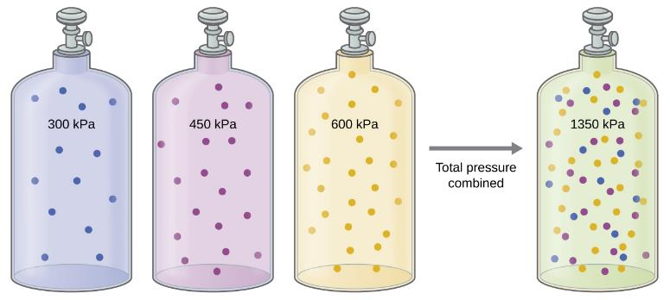
Figure 9.20
If equal-volume cylinders containing gasses at pressures of 300 kPa, 450 kPa, and 600 kPa are all combined in the same-size cylinder, the total pressure of the gas mixture is 1350 kPa.

Slide 54
Partial Pressure and Mole Fraction
We can express the partial pressure of a gas in a mixture in terms of its mole fraction.
Consider a mixture of gases A and B.
The mole fraction of gas A (Χ_{A}) is the number of moles of A divided by the total number of moles of gas in the mixture.

Slide 55
Collecting a Gas Over Water
A common way to collect and quantify a gas produced in a chemical reaction is to capture the gas in an inverted bottle that had been filled with water.
The volume of water displaced can then be related back to the amount of gas produced.
As the gas travels through the water, it picks up water vapor, H₂O (g).
The collected gas mixture has a P_{T} equal to the atmospheric pressure.

Slide 56
Figure 9.21
When a reaction produces a gas that is collected above water, the trapped gas is a mixture of the gas produced by the reaction and water vapor. If the collection flask is appropriately positioned to equalize the water levels both within and outside the flask, the pressure of the trapped gas mixture will equal the atmospheric pressure outside the flask (see the earlier discussion of manometers).

Slide 57
Wet Gases
We refer to the gas collected over water as a wet gas mixture.
Say, for example, that the gas being collected was H₂.
P_{T} is the atmospheric pressure.
P_{H2} is the partial pressure of the H₂ (g) collected.
P_{H2O} is the vapor pressure of water.

Slide 58
Vapor Pressure
Vapor pressure of water: The pressure exerted by water vapor in equilibrium with liquid water in a closed container.
Intensive property—does not depend on the amount of water
Temperature dependent

Slide 59
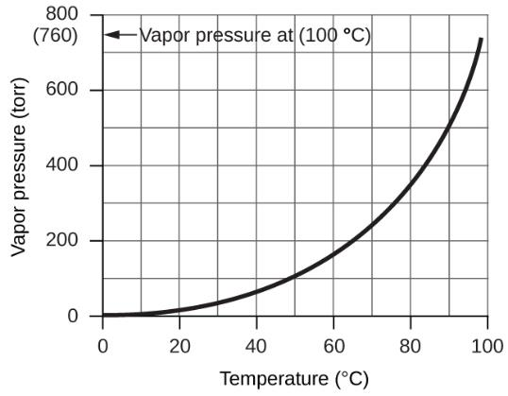
Figure 9.22
This graph shows the vapor pressure of water at sea level as a function of temperature.

Slide 60
Stoichiometry in Gaseous Reactions
Gases may appear as reactants or products in a chemical reaction.
The ideal gas law and a balanced chemical equation can be used to relate the P, V, T, n, and grams of a gas that takes part in a chemical reaction.
Stoichiometric factors can be used to relate the moles of one substance to the moles of any other substance in a balanced chemical equation.

Slide 61
Stoichiometry with Gas Volumes
The volume ratio of any two gases in a reaction at constant temperature and pressure is the same as the stoichiometric ratio (mole ratio) in the balanced chemical equation.
Recall that V = kn (constant T, P). The volume of a gas is directly proportional to the moles of gas.

Slide 62
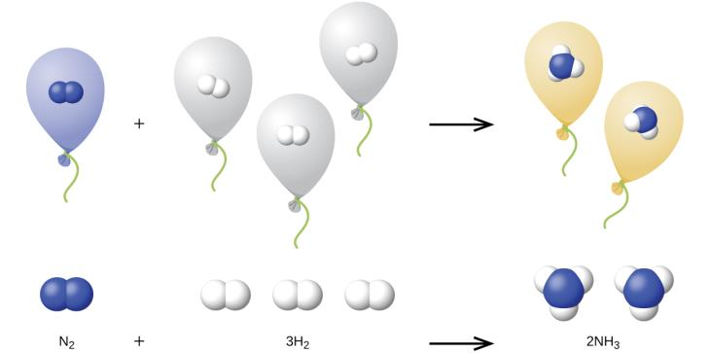
Figure 9.23
One volume of N₂ combines with three volumes of H₂ to form two volumes of NH₃.

Slide 63
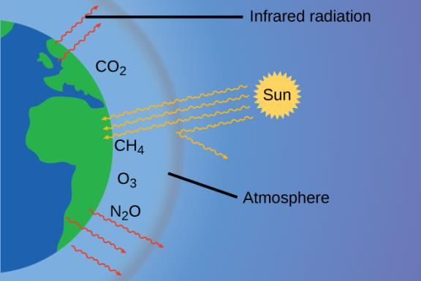
Figure 9.24
Greenhouse gases trap enough of the sun’s energy to make the planet habitable—this is known as the greenhouse effect. Human activities are increasing greenhouse gas levels, warming the planet and causing more extreme weather events.

Slide 64
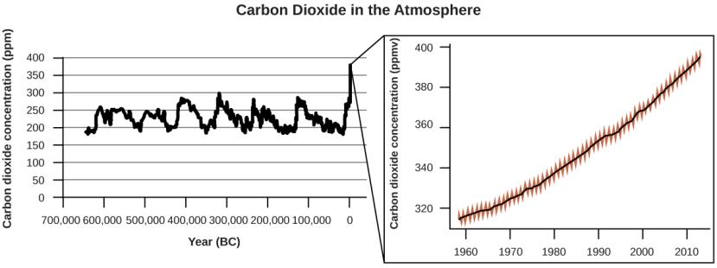
Figure 9.25
CO₂ levels over the past 700,000 years were typically from 200–300 ppm, with a steep, unprecedented increase over the past 50 years.

Slide 65
Figure 9.26
Susan Solomon’s research focuses on climate change and has been instrumental in determining the cause of the ozone hole over Antarctica. (credit: National Oceanic and Atmospheric Administration)

Slide 66
Learning Objectives
9.4 Effusion and Diffusion of Gases
Define and explain effusion and diffusion
State Graham’s law and use it to compute relevant gas properties

Slide 67
Figure 9.27
(a) Two gases, H₂ and O₂, are initially separated. (b) When the stopcock is opened, they mix together. The lighter gas, H₂, passes through the opening faster than O₂, so just after the stopcock is opened, more H₂ molecules move to the O₂ side than O₂ molecules move to the H₂ side. (c) After a short time, both the slower-moving O₂ molecules and the faster-moving H₂ molecules have distributed themselves evenly on both sides of the vessel.

Slide 68
Figure 9.28
Diffusion occurs when gas molecules disperse throughout a container. Effusion occurs when a gas passes through an opening that is smaller than the mean free path of the particles, that is, the average distance traveled between collisions. Effectively, this means that only one particle passes through at a time.

Slide 69
Figure 9.29
The left photograph shows two balloons inflated with different gases, helium (orange) and argon (blue). The right-side photograph shows the balloons approximately 12 hours after being filled, at which time the helium balloon has become noticeably more deflated than the argon balloon, due to the greater effusion rate of the lighter helium gas. (credit: modification of work by Paul Flowers)

Slide 70
Figure 9.30
In a diffuser, gaseous UF₆ is pumped through a porous barrier, which partially separates ²³⁵UF₆ from ²³⁸UF₆. The UF₆ must pass through many large diffuser units to achieve sufficient enrichment in ²³⁵U.

Slide 71
Learning Objectives
9.5 The Kinetic-Molecular Theory
State the postulates of the kinetic-molecular theory
Use this theory’s postulates to explain the gas laws

Slide 72
Figure 9.31
(a) When gas temperature increases, gas pressure increases due to increased force and frequency of molecular collisions. (b) When volume decreases, gas pressure increases due to reduced frequency of molecular collisions. (c) When the amount of gas increases at a constant pressure, volume increases to yield a constant number of collisions per unit wall area.

Slide 73
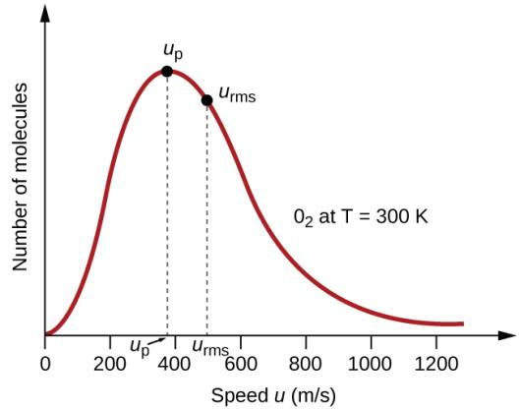
Figure 9.32
The molecular speed distribution for oxygen gas at 300 K is shown here. Very few molecules move at either very low or very high speeds. The number of molecules with intermediate speeds increases rapidly up to a maximum, which is the most probable speed, then drops off rapidly. Note that the most probable speed, ν_{p}, is a little less than 400 m/s, while the root mean square speed, u_{rms}, is closer to 500 m/s.

Slide 74
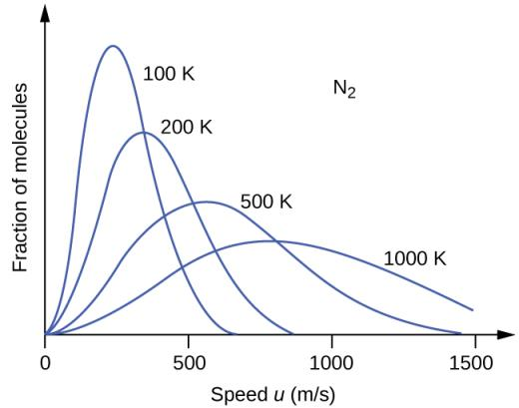
Figure 9.33
The molecular speed distribution for nitrogen gas (N₂) shifts to the right and flattens as the temperature increases; it shifts to the left and heightens as the temperature decreases.

Slide 75
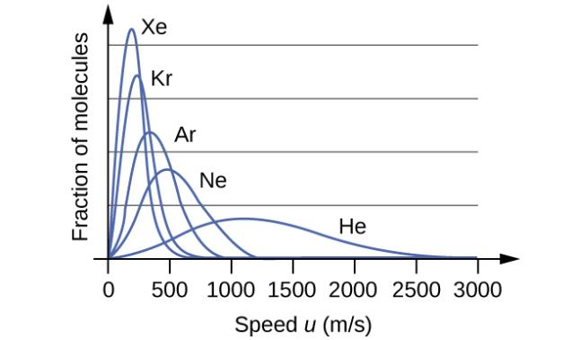
Figure 9.34
Molecular speed is directly related to molecular mass. At a given temperature, lighter molecules move faster on average than heavier molecules.

Slide 76
Learning Objectives
9.6 Non-Ideal Gas Behavior
Describe the physical factors that lead to deviations from ideal gas behavior
Explain how these factors are represented in the van der Waals equation
Define compressibility (Z) and describe how its variation with pressure reflects non-ideal behavior
Quantify non-ideal behavior by comparing computations of gas properties using the ideal gas law and the van der Waals equation

Slide 77
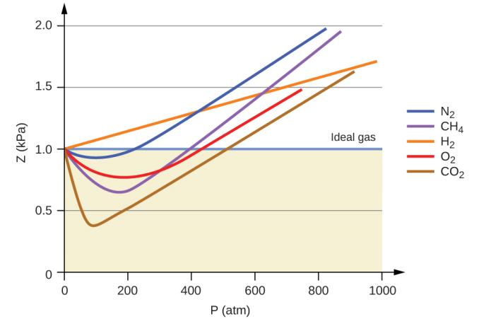
Figure 9.35
A graph of the compressibility factor (Z) vs. pressure shows that gases can exhibit significant deviations from the behavior predicted by the ideal gas law.

Slide 78
Figure 9.36
(a) Attractions between gas molecules serve to decrease the gas volume at constant pressure compared to an ideal gas whose molecules experience no attractive forces. (b) These attractive forces will decrease the force of collisions between the molecules and container walls, therefore reducing the pressure exerted compared to an ideal gas.

Slide 79
UNIFIGURE 9.1

Slide 80
Exercise 13

Slide 81
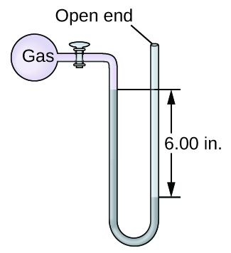
Exercise 14

Slide 82
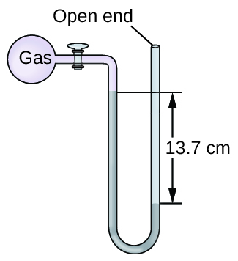
Exercise 15

Slide 83
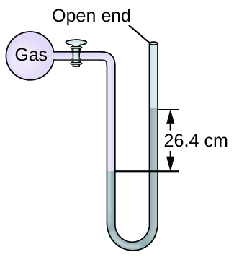
Exercise 16

Slide 84
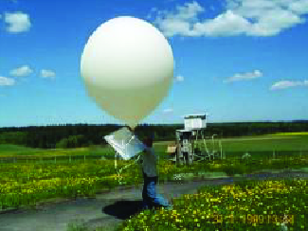
Exercise 31

Slide 85
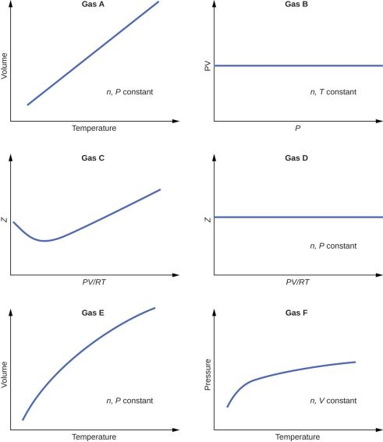
Exercise 99

Slide 86
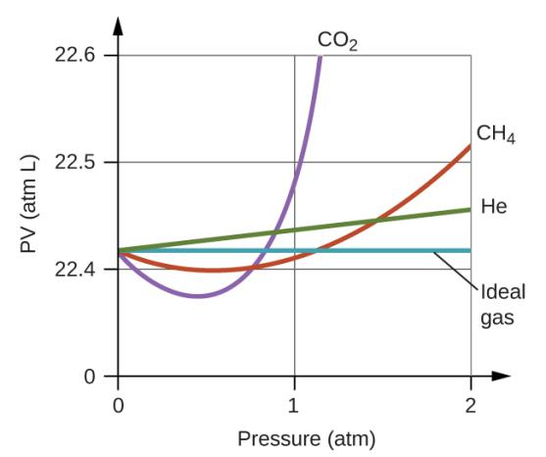
Exercise 100

Slide 87
This OpenStax ancillary resource is © Rice University under a CC-BY 4.0 International license; it may be reproduced or modified but must be attributed to OpenStax, Rice University and any changes must be noted.

