Slide 1
LIQUIDS AND SOLIDS
CHAPTER 10
OpenStax
Joseph DePasquale

Slide 2
Liquids and Solids
In Ch. 9 we saw that the properties of all dilute gases were the same, regardless of the chemical identity of the substance.
The properties of liquid and solids have a dependence on the chemical identity of the substance.

Slide 3
Liquids and Solids Outline
10.1: Intermolecular Forces
10.3: Phase Transitions
Omit sections 10.2 and 10.4 – 10.6

Slide 4
10.1: Intermolecular Forces
Intermolecular Forces (IMFs) – The various forces of attraction that may exist between the atoms and molecules of a substance.
IMFs are a result of electrostatic phenomena.
IMFs are non-covalent forces.
Intramolecular Forces – The forces that hold atoms together in a molecule.
The differences in the properties of a solid, liquid, or gas are a result of differences in strengths of the IMFs that make up each substance.

Slide 5
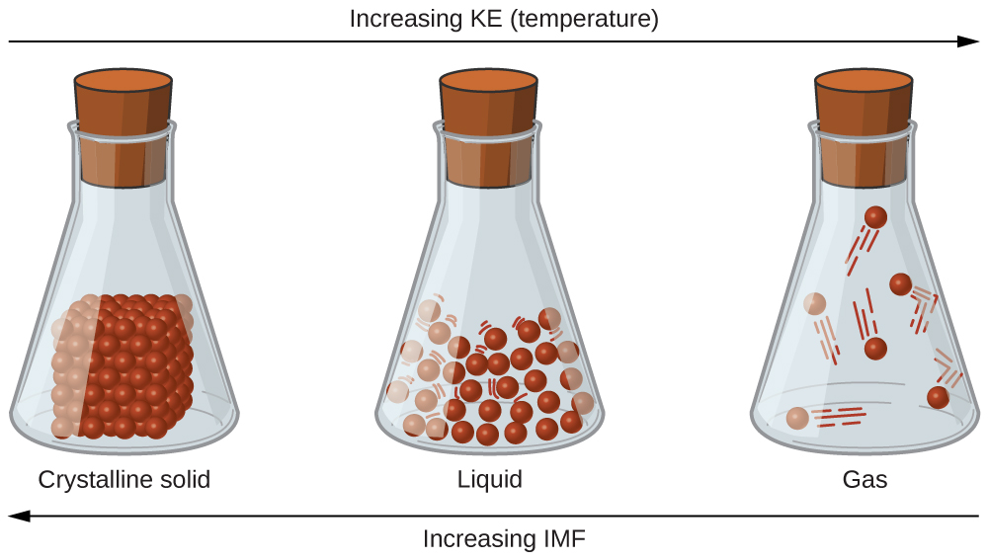
Kinetic Energy (KE) provides the energy required to overcome the IMFs.
Transitions between solid, liquid, and gaseous states of a substance occur when conditions of temperature or pressure favor the associated changes in intermolecular forces. (Note: The space between particles in the gas phase is much greater than shown.)

Slide 6
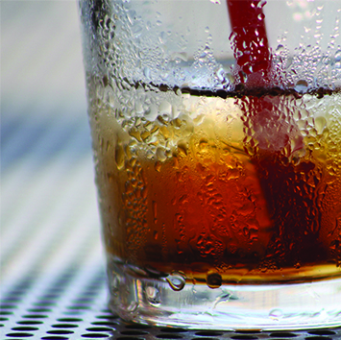
Condensation forms when water vapor in the air is cooled enough to form liquid water, such as on the outside of a cold beverage glass. (credit: modification of work by Jenny Downing)

Slide 7
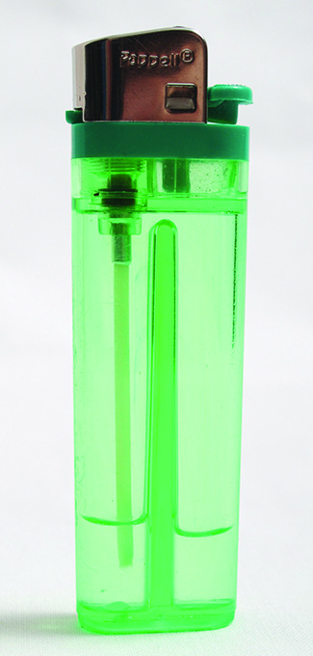
Gaseous butane is compressed within the storage compartment of a disposable lighter, resulting in its condensation to the liquid state. (credit: modification of work by “Sam-Cat”/Flickr)

Slide 8
IMFs – Forces between Molecules
  The strength of IMFs vary for different substances.
  All IMFs are significantly weaker than intramoleculer forces (covalent bonds).
  Three types of IMFs:
  1) Dispersion Forces
  2) Dipole-Dipole Attractions
  3) Hydrogen Bonding
  The Intermolecular Forces above are sometimes collectively referred to as van der Waals forces.

Slide 9
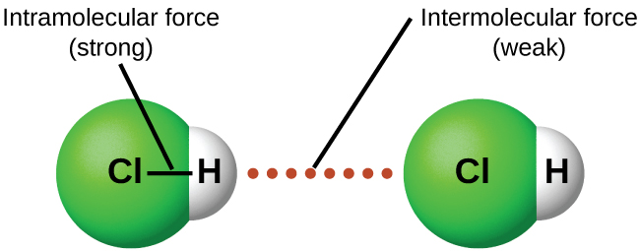
Intramolecular forces keep a molecule intact. Intermolecular forces hold multiple molecules together and determine many of a substance’s properties.

Slide 10
Dispersion Forces
  All substances (polar and non-polar) have Dispersion Forces.
  Also called London Dispersion Forces.
  Constant motion of electrons in molecules and atoms result in instantaneous dipoles.
  An instantaneous dipole in one molecule or atom can then distort the electrons in a neighboring atom or molecules producing an induced dipole.
  Both of these fleeting, temporary dipoles result in weak electrostatic forces known as dispersion forces.

Slide 11
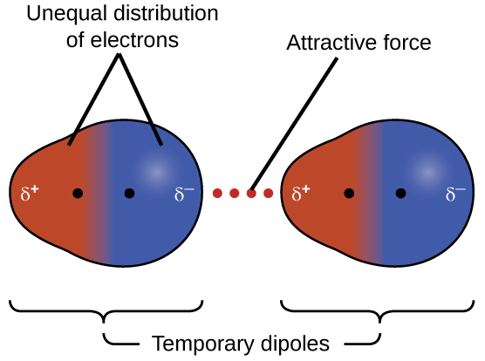
Dispersion Forces
Dispersion forces result from the formation of temporary dipoles, as illustrated here for two nonpolar diatomic molecules.

Slide 13
Dispersion Forces and Molar Mass
  Heavier molecules and atoms exhibit stronger dispersion forces than lighter molecules and atoms.
  This is because larger atoms have greater polarizability due to the valence electrons being farther from the nucleus.
  Polarizability – The measure of how easy or difficult it is for another electrostatic charge to distort a molecule’s charge distribution.

Slide 14
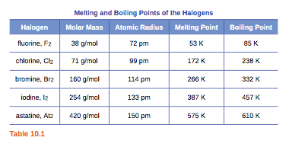
  Stronger dispersion forces lead to higher melting and boiling points.
    Higher temperature and therefore more KE is needed to overcome the IMFs

Slide 15
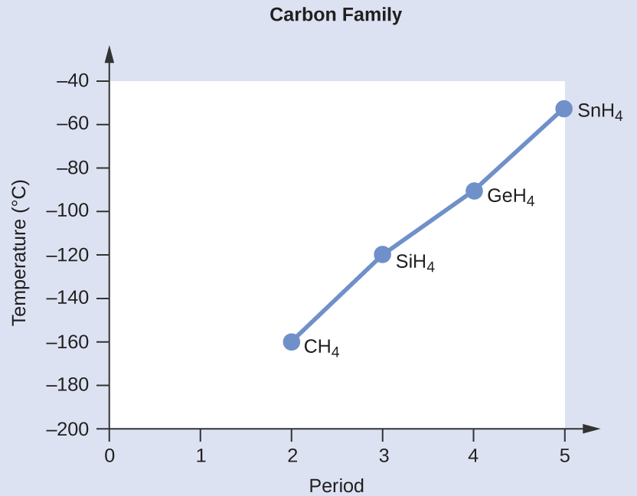

Slide 16
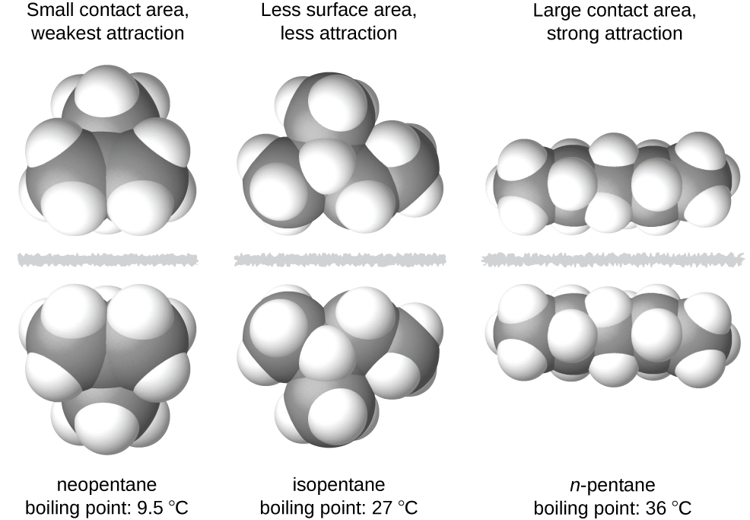
The strength of the dispersion forces also increases with increasing contact area between molecules.
The strength of the dispersion forces increases with the contact area between molecules, as demonstrated by the boiling points of these pentane isomers.

Slide 17
Dipole-Dipole Attractions
Molecules with permanent dipoles display Dipole-Dipole Attractions.
  Present only in polar molecules.
  Dipole-Dipole Attractions are stronger than dispersion forces.
  Polar molecules contain both dipole-dipole attractions and dispersion forces.
  Adjacent molecules line up such that the partial negative pole of one molecule is as close as possible to the partial positive pole of another molecule.

Slide 18
Dipole-Dipole
Attractions

Slide 19
Comparing polar and non-polar molecules of similar MM.
The presence of the stronger dipole forces in polar molecules leads to a small to moderate increase in boiling point.

Slide 20
Hydrogen Bonding
Hydrogen bonding is only present in certain polar molecules.
Unusually strong type of dipole-dipole attraction.
Hydrogen Bonding is the strongest van der Waals force.
  Need a H covalently bonded to one of these highly EN elements: N, O, or F.

Slide 21
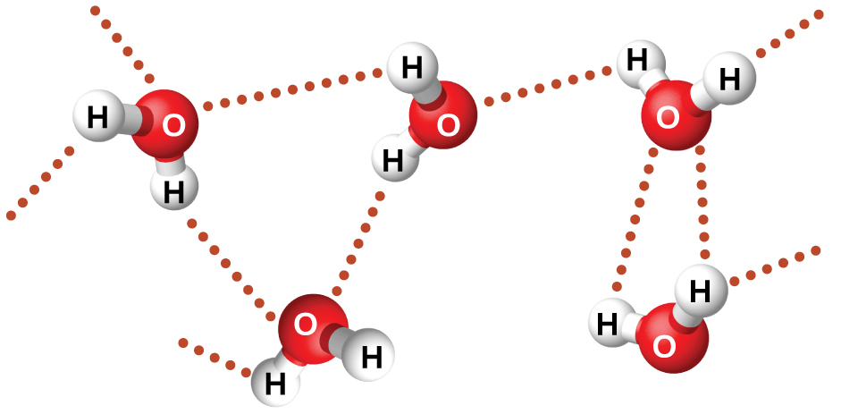
Hydrogen Bonding in Water
Water molecules participate in multiple hydrogen-bonding interactions with nearby water molecules.

Slide 22
Hydrogen Bonding
  Hydrogen bonds are strong IMFs due to highly concentrated partial charges.
  1) Large difference in EN between H and the atom it is bonded to creates a large dipole moment.
  2) Very small size of H and relatively small sizes of F, O, and N

Slide 23
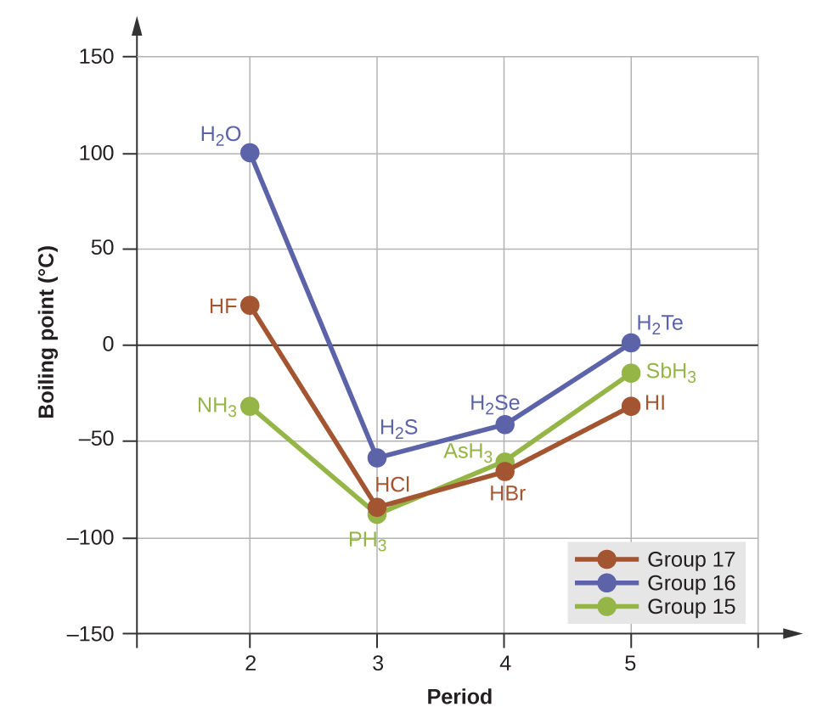
Influence of Hydrogen Bonding on B.P
In comparison to periods 3−5, the binary hydrides of period 2 elements in groups 17, 16 and 15 (F, O and N, respectively) exhibit anomalously high boiling points due to hydrogen bonding.

Slide 24
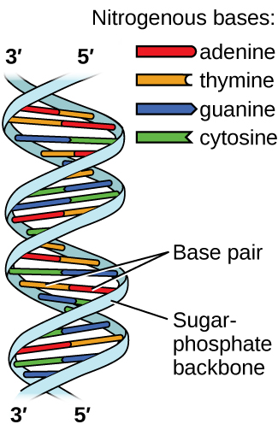
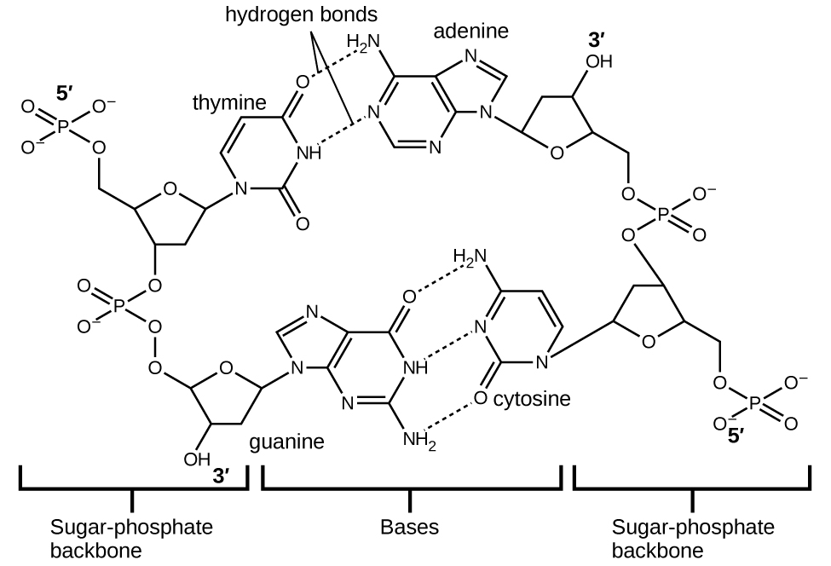
Hydrogen Bonding In DNA
Two separate DNA molecules form a double-stranded helix in which the molecules are held together via hydrogen bonding. (credit: modification of work by Jerome Walker, Dennis Myts)
The geometries of the base molecules result in maximum hydrogen bonding between adenine and thymine (AT) and between guanine and cytosine (GC), so-called “complementary base pairs.”

Slide 25
What about Ionic Bonds?

Slide 26
10.3: Phase Transitions
Vaporization and Condensation:
Melting and Freezing:
Sublimation and Deposition:

Slide 27
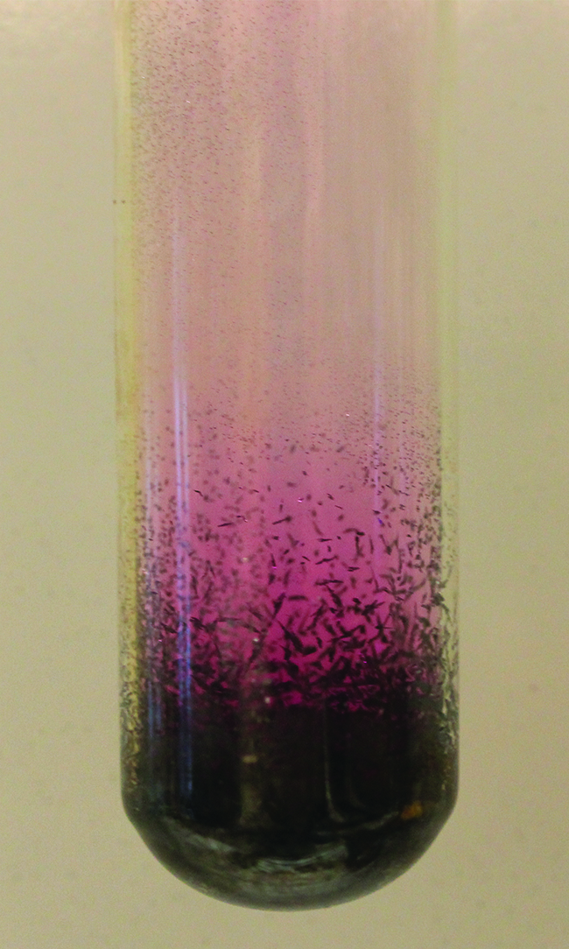
Sublimation and
Deposition of I₂
Sublimation of solid iodine in the bottom of the tube produces a purple gas that subsequently deposits as solid iodine on the colder part of the tube above. (credit: modification of work by Mark Ott)

Slide 28
Liquid-Vapor Equilibrium
Vaporization
  Liquid is converted into a gas (vapor).
  In an open container, vaporization continues until all the liquid is converted into vapor.
  Liquid ➔ Vapor
  In a closed container, the process of vaporization is countered by the process of condensation:
  Liquid ⇌ Vapor
    The double arrow indicates a dynamic equilibrium

Slide 29
Equilibrium
  Liquid ⇌ Vapor
When the rate at which the liquid vaporizes is equal to the rate at which the vapor condenses, a dynamic equilibrium is established.
The liquid level in the container does not change after equilibrium is established.

Slide 30
Bromine liquid and vapor in equilibrium
Br₂ (l) ⇌ Br₂ (g)

Slide 31
Vapor Pressure
After equilibrium has been reached, the number of molecules in the gas phase does not change with time.
Therefore, the pressure exerted by the vapor over the liquid remains constant.
The pressure of a vapor in equilibrium with a liquid is called vapor pressure.

Slide 32
Vapor Pressure
The vapor pressure of a substance is independent of the volume of the container.
Vapor pressure does depend on the IMFs of the substance.

Slide 33
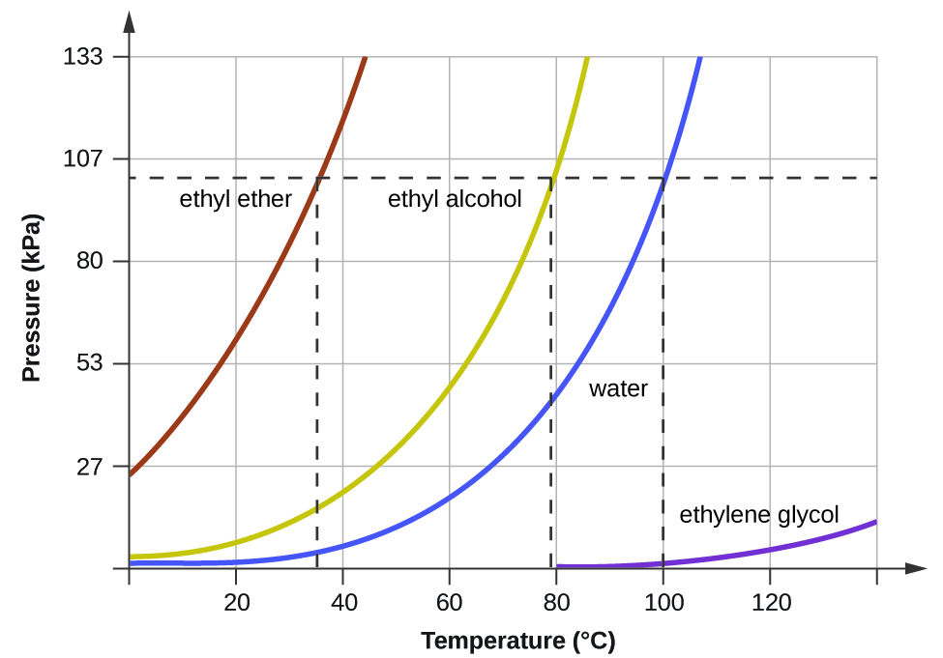
Vapor Pressure and Temperature
The vapor pressure of a liquid always increases with increasing temperature.
  Example: Water
    P is 24 mmHg at 25 °C
    P is 92 mmHg at 50 °C
The boiling points of liquids are the temperatures at which their equilibrium vapor pressures equal the pressure of the surrounding atmosphere. Normal boiling points are those corresponding to a pressure of 1 atm (101.3 kPa.)

Slide 34
Boiling Point
  When the vapor pressure of a liquid increases enough to equal the external atmospheric pressure, the liquid reaches its boiling point.
  The temperature at which a liquid boils depends upon the pressure above it.
    The normal boiling point of a liquid is the temperature at which the liquid boils when the pressure above the liquid is 1 atm.
    During the boiling process, temperature remains constant.

Slide 35
Boiling

Slide 36
Boiling Point and External Pressure
Variations in atmospheric pressure will change the boiling point.
  At high altitude, atmospheric pressure is lower, so the boiling point is lower.

Slide 37
The Clausius-Clapeyron Equation
Relates a substance’s temperature and vapor pressure.
  Two pressures
  Two temperatures
Notes:
  Temperatures must be in Kelvin
  R = 8.31 J/mol·K
  ΔH_{vap} must be in J for use with this value of R

Slide 38
ΔH for Phase Changes

Slide 39
Phase Changes and Temperature
Imagine heating or cooling a substance
During phase changes the temperature remains constant.
If energy is being absorbed in the phase change, then all of this energy is being used to break the intermolecular forces, not increase the temperature of the substance.
If energy is being released during the phase change, then all of this released energy is coming from the formation of intermolecular forces, not from the decrease in temperature of the substance.

