Slide 1
CHAPTER 11: Solutions and Colloids
OpenStax Chemistry
Joseph DePasquale

Slide 2
Ch. 11: Solutions and Colloids
11.1 The Dissolution Process
11.2 Electrolytes
11.3 Solubility
11.4 Colligative Properites
Omit section 11.5 on Colloids.

Slide 3
Review of Solutions
Solutions are homogenous mixtures made up of two or more substances.
  Solute – Substance being dissolved.
  Solvent – Substance that is doing the dissolving.
    Typically, present in largest amount

Slide 4
Review of Solutions
Solutions can exist in all 3 physical states
  Solid Solution – Metal alloys (two or more metals).
  Gas Solution - Ex. Air – Made up of nitrogen, oxygen, and other gases.
  Liquid Solution – This is what we will be primarily discussing in this Chapter. Mostly solutions where water is the solvent (Aqueous solutions).

Slide 5
11.1 The Dissolution Process
Consider the dissolving of different solutes in water.
Sucrose, C₁₂H₂₂O₁₁(s)
Aluminum sulfate, Al₂(SO₄)₃(s)

Slide 6
Traits of Solutions
Homogenous
2) The physical state of the solution is typically the same as the solvent.
  But the properties of the solution and pure solvent can be quite different (11.4).
3) The dissolved solute will not settle out or separate from the solution, even if it is heavier than the solvent.

Slide 7
Traits of Solutions
4) The components of a solution are dispersed and consist of a mixture of separate molecules, atoms, and/or ions.

Slide 8
Review: Intermolecular Forces (IMFs)
Recall intermolecular forces (IMFs).

Slide 9
The Formation of Solutions
Three types of intermolecular attractive forces influence whether substances will form a solution.
1) solute-solute
2) solvent-solvent
3) solute-solvent

Slide 10
The Formation of Solutions
We can think of solution formation as a step-wise process.
Step 1: Solute-Solute IMFs must be overcome. Energy is consumed.
Step 2: Solvent-Solvent IMFs must be overcome. Energy is consumed.
Step 3: Solvation - Solute-Solvent attractive forces are established. Energy is released.

Slide 11
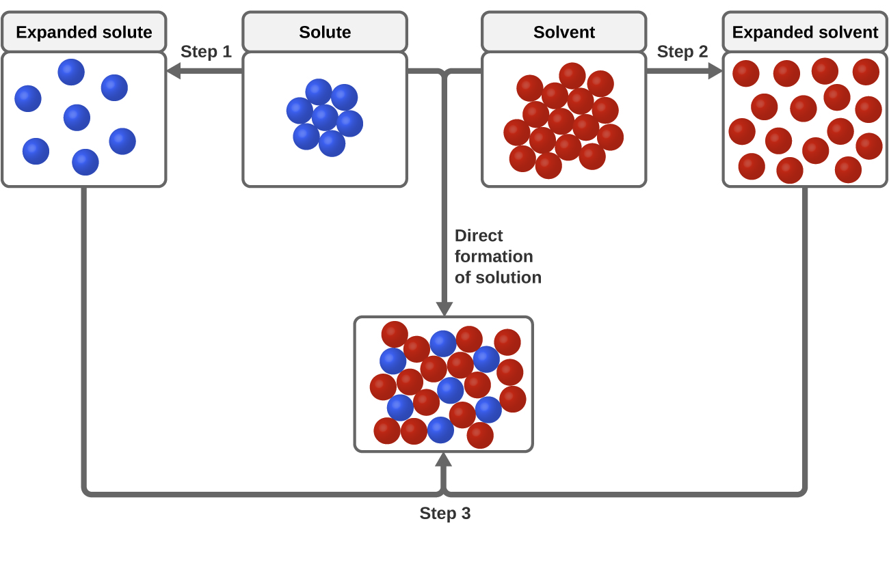

Slide 12
The Formation of Solutions
The relative magnitudes of the energy changes for these three steps determine whether the solution formation process is exothermic, endothermic, or does not occur at all.
  1) If,
  2) If,
  3) If,

Slide 13
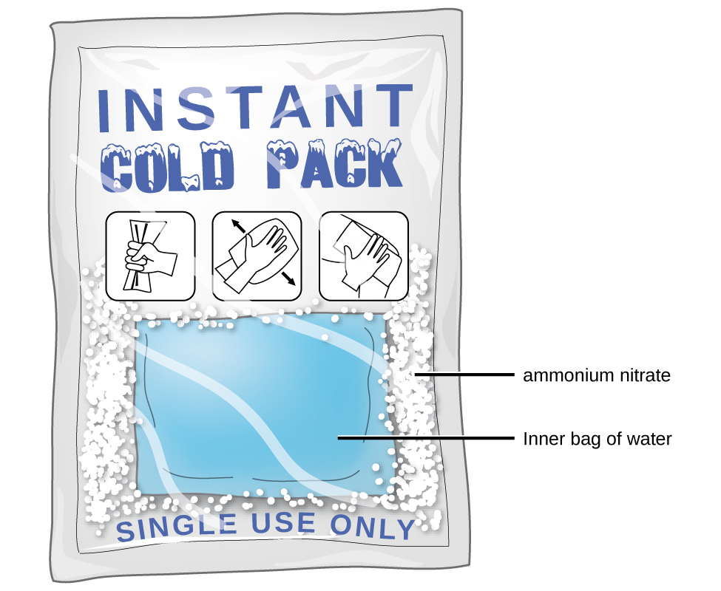

Slide 14
The Golden Rule of Solubility is
“Like Dissolves Like”
Solute-Solvent Interactions
If two substances have very similar IMFs then they are likely to be soluble in one another.
Step 3 will be highly exothermic.
Nonpolar solvents dissolve nonpolar solutes.
Polar solvents dissolve polar solutes and many ionic solutes.

Slide 15
11.2 Electrolytes
Electrolytes – Substances that dissolve in water and undergo a physical or chemical change to produce ions.
Nonelectrolytes – Substances that do not produce ions when dissolved in water.

Slide 16
Strong vs. Weak Electrolytes
Strong Electrolytes – Essentially 100% of the dissolved substance generates ions.

Slide 17
Strong vs. Weak Electrolytes
Weak Electrolytes – Only a relatively small fraction of the dissolved substance generates ions.

Slide 18
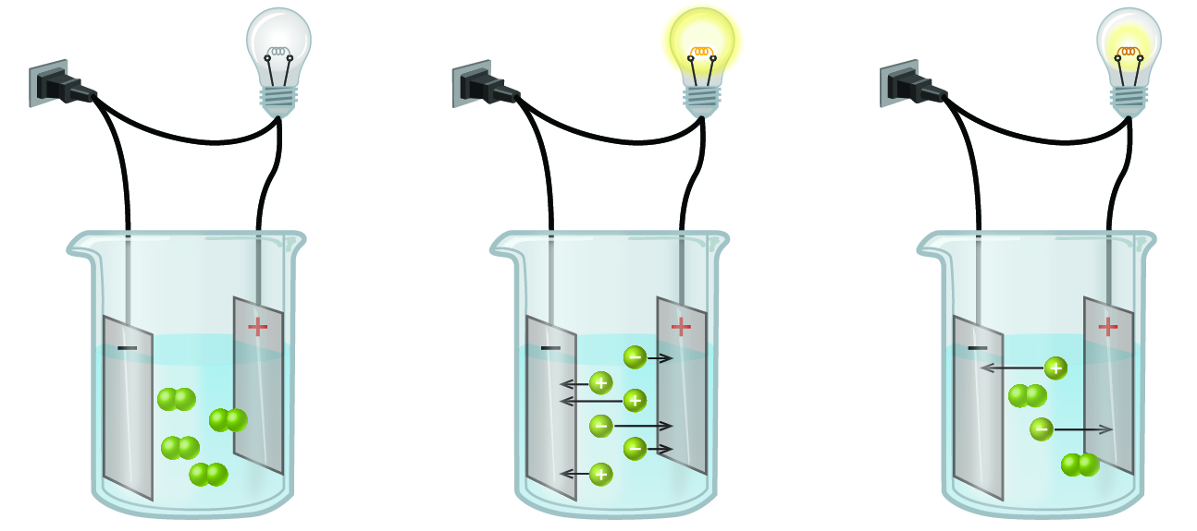
To conduct electricity, a solution must contain ions.
Nonelectrolyte
Strong
Electrolyte
Weak
Electrolyte

Slide 19
Ionic Electrolytes
Water and other polar molecules are attracted to ions.
The electrostatic attraction between an ion and a molecule with a dipole (polar molecule) is called an ion-dipole attraction.
Water molecules surround and solvate the separated ions.
This physical process is known as dissociation.

Slide 20
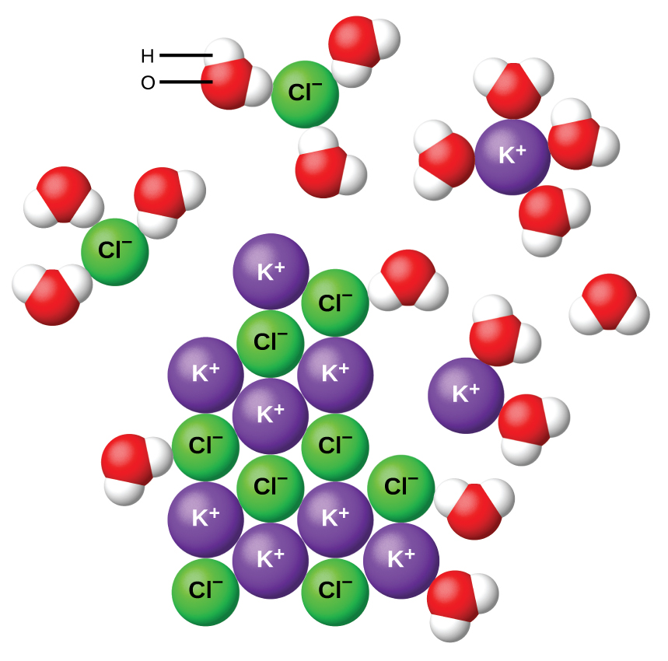

Slide 21
Solubility of Ionic Compounds
Competing forces influence the extent of solubility of an ionic compound.
  1) Ion-dipole attraction: If this is the dominate force then the compound it “pulled” into solution and has very high water solubility.
  2) The force of attraction between oppositely charged ions: If this is the dominate force then the compound tends to remain un-dissolved and in the solid state, and have very low water solubility.

Slide 22
Covalent Electrolytes
Some covalent compounds are electrolytes because they chemically react with water to produce ions.
Example: HCl

Slide 23
11.3 Solubility
Even most highly water soluble compounds have a limit to how much you can dissolve.
Solubility – The maximum concentration of a solute that can be achieved in a particular solvent under given conditions.

Slide 24
Solubility Terms
When a solute’s concentration equals its solubility the solution is called saturated.
When a solute’s concentration is less than its solubility the solution is called unsaturated.
When a solute’s concentration is greater than its solubility the solution is called supersaturated.

Slide 25
Principles of Solubility
The extent to which a solute dissolves in a solvent depends on several factors:
  The nature of the solvent and solute molecules and the interactions between them.
  The temperature at which the solution is formed.
  When dealing with a gaseous solute, the pressure is also important.

Slide 26
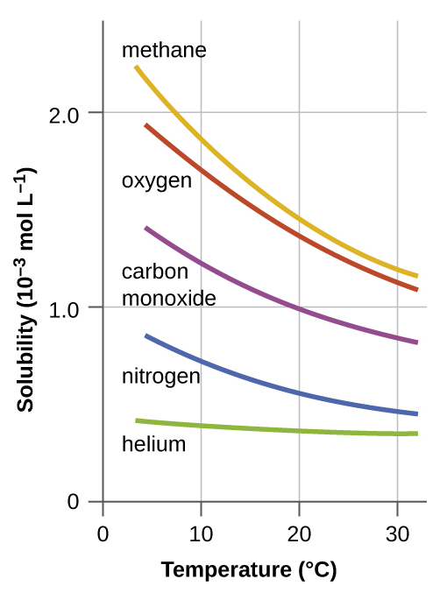
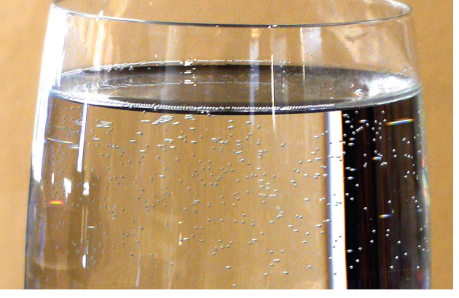

Slide 27
Pressure and Gas Solubility
Pressure has a major effect on the solubility of a gas in a liquid.
Gas solubility (C_{g}) and partial pressure (P_{g}) are directly proportional.
Henry’s Law: Solubility of a Gas
  k = constant of that particular gas-liquid system and temperature.

Slide 28
Pressure and Gas Solubility
An increase in partial pressure leads to an increase in the solubility of a gas.

Slide 29
Henry’s Law and Carbonated Soda

Slide 30
Solutions of Liquids in Liquids
Liquids can be dissolved in other liquids.
Both solute and solvent are liquids.

Slide 31
Miscible Liquids
Two liquids that mix with each other in all proportions are called miscible.
Examples:
  Ethanol and water
  Gasoline and oil

Slide 32
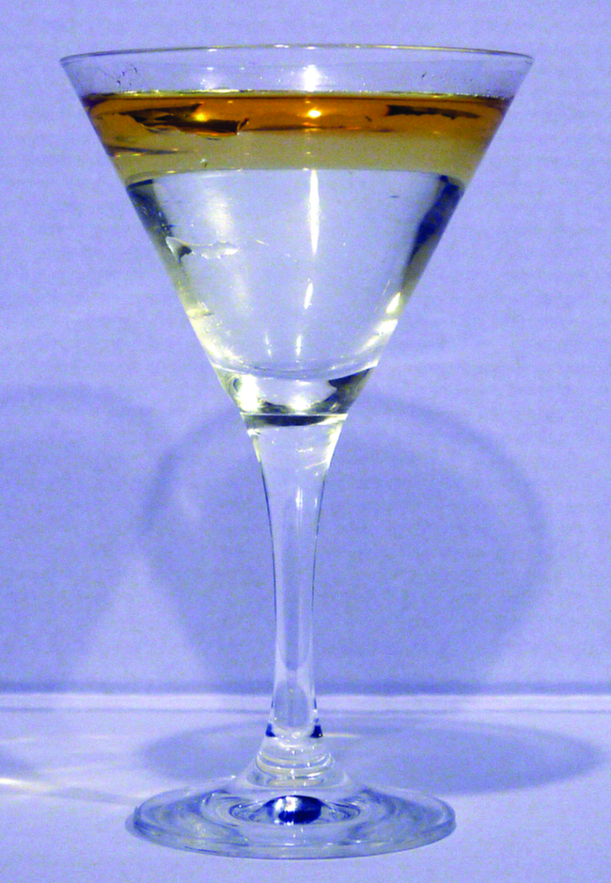
Immiscible Liquids
Two liquids that do not mix to an appreciable extent are called immiscible.
Example:
  Non-polar liquids (gasoline, oil, hydrocarbons) and water.

Slide 33
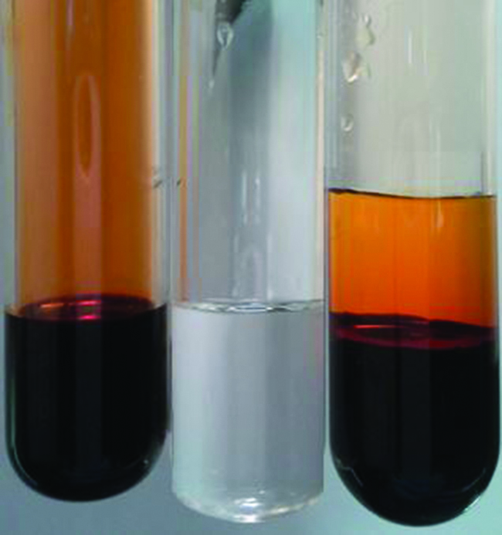
Partially Miscible Liquids
Two liquids that are of moderate mutual solubility are called partially miscible.
Example:
  Bromine and water.

Slide 34
Temperature and Solubility of Solids
Both ionic and covalent solids can dissolve in liquids.
  NaC₂H₃O₂(s) Na⁺ (aq) + C₂H₃O₂⁻ (aq)
Dissolving a solid in a liquid is usually an endothermic process.
  Added heat favors the formation of products (dissolved ions).
Thus, the solubility of most solids tends to increase with temperature.
H₂O

Slide 35
Supersaturated Solutions
To make a supersaturated solution with a solid solute.
  Make a saturated solution of the compound at high temperature.
  Slowly cool to a lower temperature.
  If cooling is slow and careful, the solid won’t precipitate.
  At the lower temperature, you will have a solute concentration that is greater than the compound’s solubility.
Adding a crystal of the solid or agitating the solution results in precipitation of the excess solute. https://www.youtube.com/watch?v=BLq5NibwV5g

Slide 36
11.4 Colligative Properties
The properties of a solution differ considerably from those of the pure solvent and pure solute.
Some solution properties depend on the identity of the solute.
  Examples: Acidity, Basicity, Denisty
Other properties only depend on solute concentration and not its identity.
Colligative properties depend primarily on the concentration of solute particles, and not on the nature or identity of the solute.

Slide 37
Colligative Properties that we will Discuss
1) Vapor Pressure Lowering
2) Boiling Point Elevation
3) Freezing Point Depression
4) Osmotic Pressure

Slide 38
Concentration Units
1) Molarity (M)
2) Mass Percent
3) Mole Fraction (Χ)
4) Molality (m)

Slide 39
Molarity
Molarity is defined as moles of solute per liter of solution. Symbol M (capital letter!)
Limitation: Molarity is temperature dependent. Solution volume changes with temperature.

Slide 40
Concentration by Mass
Mass percent

Slide 41
Mole Fraction (Χ)
Mole fraction is independent of temperature.
  The mole fraction of component A is the moles of A divided by the total number of moles of all solution components.
  The mole fractions of all components must sum to 1

Slide 42
Molality (m)
Molality (m) - Moles of solute per kilogram of solvent.
Lowercase “m” is the symbol for molality.
Molality is also independent of temperature.

Slide 43
Vapor Pressure Lowering
Adding a nonvolatile solute to a pure solvent lowers the solvent’s vapor pressure.
Result: The Solvent in a solution evaporates more slowly than the pure solvent would.
Vapor Pressure Lowering (ΔP) is a Colligative Property

Slide 44
Vapor Pressure Review
Think back to Liquid-Vapor Equilibrium (Ch. 10).
When a liquid is placed in a closed container, vaporization and condensation happen at equal rates.
    Liquid ⇌ Gas
The vapor pressure of the liquid is the pressure exerted by the gas phase molecules.

Slide 45
Why Does Vapor Pressure Lowering (ΔP) Occur?
Liquid ⇌ Gas
To vaporize, solvent molecules must be at the surface of the liquid.
Solute molecules decrease the surface area available for solvent molecules.
The rate of solvent vaporization decreases.
The rate of solvent condensation remains the same.

Slide 46
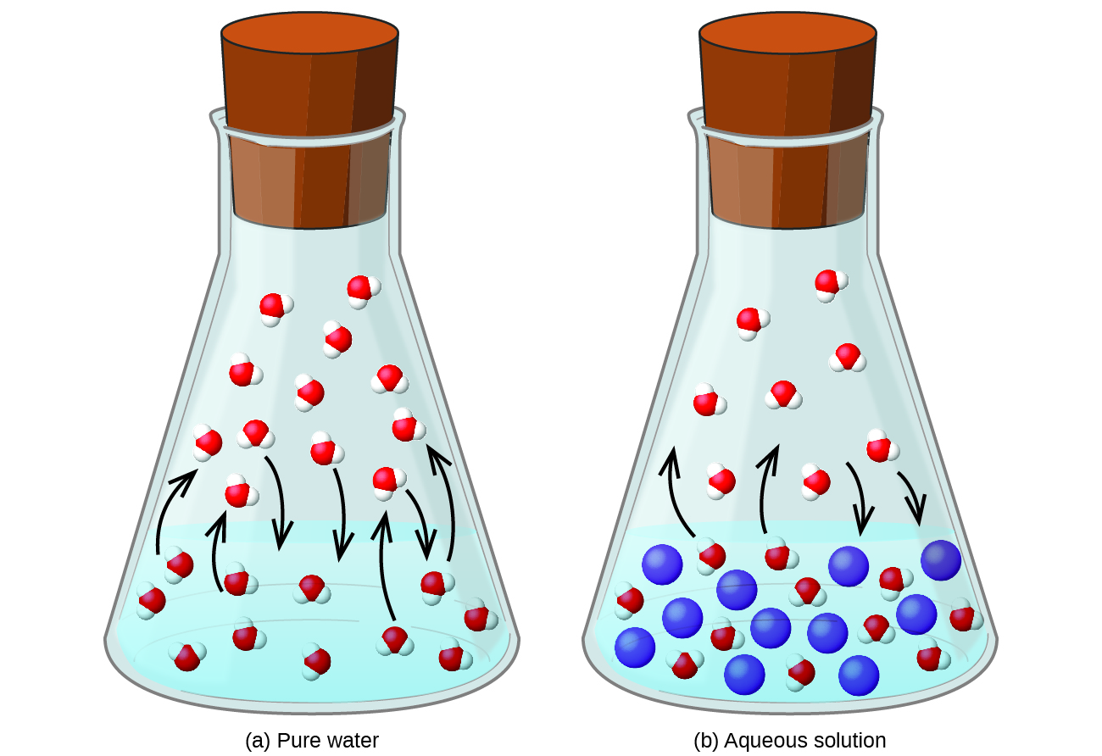
Pure Water Aqueous Solution

Slide 47
Why Does Vapor Pressure Lowering (ΔP) Occur?
Liquid ⇌ Gas
Result: Less solvent molecules in the gas phase.
The decrease in gas phase molecules results in a lowering of the vapor pressure.

Slide 48
Raoult’s Law
Raoult’s Law – The partial pressure exerted by any component of an ideal solution is equal to the vapor pressure of the pure component multiplied by its mole fraction.
P_{solution} = vapor pressure of the solvent in solution.
Χ_{solvent} = mole fraction of the solvent.
P°_{solvent} = vapor pressure of the pure solvent.
Χ₂ = mole fraction of the solute.

Slide 49
Boiling Point Elevation and Freezing Point Depression
A solution boils at a higher temperature than that of the pure solvent.
  The difference in boiling point of the solution and pure solvent is called the boiling point elevation (ΔT_{b}).
A solution freezes at a lower temperature than that of the pure solvent.
  The difference in freezing point of the solution and pure solvent is is called the freezing point depression (ΔT_{f}).
ΔT_{b} and ΔT_{f} are both positive quantities.

Slide 50
Boiling point elevation (ΔT_{b}) and freezing point depression (ΔT_{f}) are both a direct result of vapor pressure lowering.
Boiling occurs when
vapor pressure equals
atmospheric pressure.
Vapor pressure is directly
proportional to temperature.

Slide 51
The presence of a solute lowers the vapor pressure.
A higher temperature is now required for the vapor pressure to equal the atmospheric pressure.
The boiling point has therefore increased.

Slide 52
Vapor Pressure vs. Temperature

Slide 53
Boiling Point Elevation and Freezing Point Lowering
Boiling point elevation (ΔT_{b}) and freezing point lowering (ΔT_{f}) are both colligative properties.
  Depend on the concentration of the solute
  Concentration expressed in molality (m).
  Example: 1 m sucrose and 1 m ethylene glycol solutions boil at the same temp.
k_{b} and k_{f} are called the boiling point elevation constant and freezing point depression constant, respectively.

Slide 54
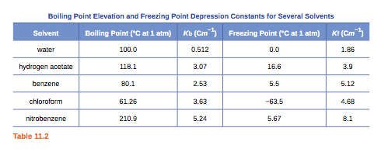
Molal Freezing Point and Boiling Point Constants
k_{b} and k_{f} values depend on the identity of the solvent

Slide 55
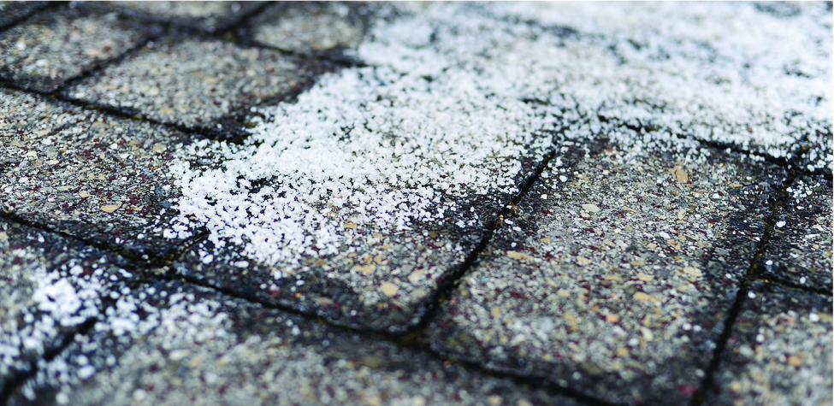

Slide 56
Semi-Permeable Membranes
Semipermeable Membranes – Material that only allows select molecules or ions to pass through of certain size, shape, polarity, charge, or other factor.
Consider a semipermeable membrane that only allows solvent molecules to permeate and not solute.
This semipermeable membrane separates a sample of pure solvent from a solution.

Slide 57
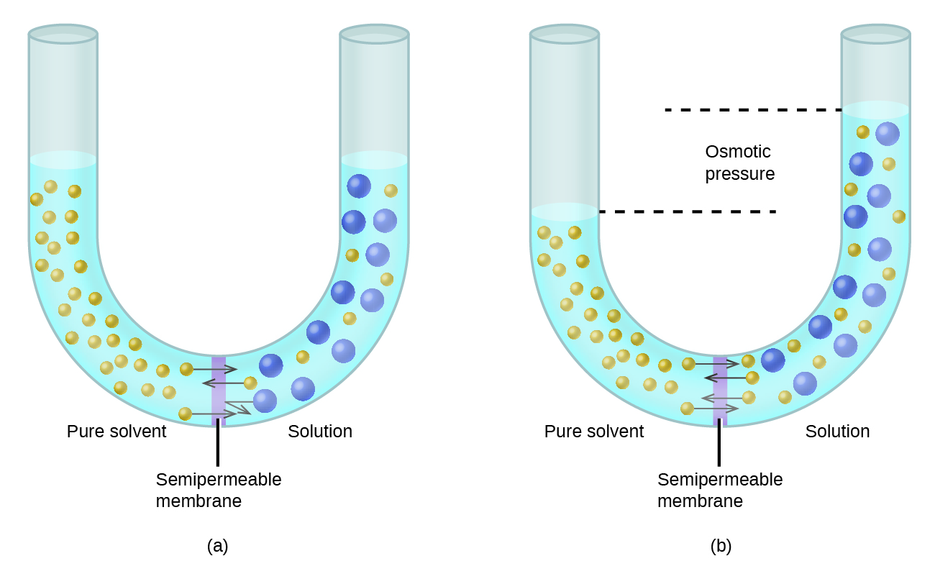
Solvent molecules diffuse across the membrane in both directions.
The concentration of solvent is higher in the pure sample.
This results in solvent molecules diffusing at a faster rate from pure solvent to solution relative to the reverse direction.

Slide 58
Result: A net transfer of solvent molecules from the pure solvent to the solution.
Diffusion-driven transfer of solvent molecules through a semipermeable membrane is a process called osmosis.

Slide 59
Osmotic Pressure is a Colligative Property
The flow of solvent during osmosis creates a force.
The osmotic pressure (symbol π) is the pressure just sufficient to prevent osmosis from occurring.
Conc. is expressed in Molarity (M), not molality (m)!
R = Gas Law Constant = 0.08206 L ∙ atm/mol ∙ K
T = Temperature in K

Slide 60
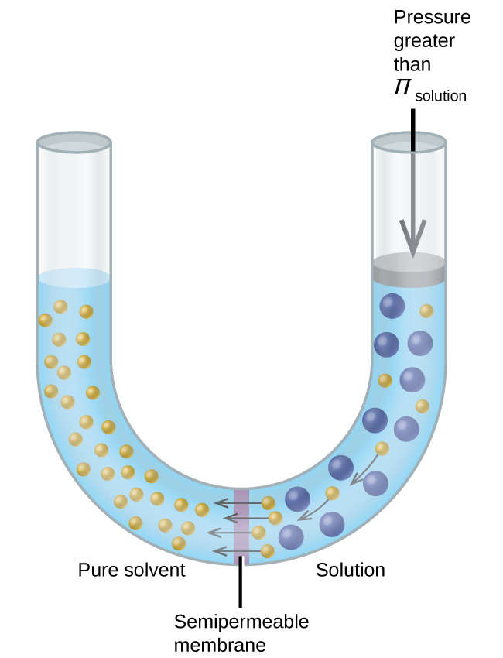
Reverse Osmosis
Applying a pressure to the solution greater than the osmotic pressure results in reverse osmosis.
Solvent molecules are pushed from the solution to the pure solvent.

Slide 61
Determination of Molar Mass from Colligative Properties
Colligative properties can be used to determine the molar mass of an unknown solute.
  Freezing point lowering (ΔT_{f}) and osmotic pressure (Π) are most commonly used.

Slide 62
Determination of Molar Mass from Colligative Properties
  Typical Procedure:
    1) Add a known mass of the solute to either
      A known mass of the solvent
      Or to create a solution of known volume
    2) Measure the colligative property (ΔT_{f} or Π).
    3) Calculate the concentration (m or M) of the solute.
    4) Determine the number of moles of solute present from the concentration.
    5) Calculate the Molar Mass (MM). MM = g/mole

Slide 63
Colligative Properties of Electrolytes
Colligative Properties are directly proportional to the concentration of solute particles. It doesn‘t matter what those particles are.
At a given concentration, electrolytes have a greater effect on colligative properties than non-electrolytes.
Dissolving 1 mole of a glucose, C₆H₁₂O₆ (non-electrolyte), results in 1 mole of solute particles.
Dissolving 1 mole of NaCl (electrolyte) results in 2 moles of solute particles.

Slide 64
The van’t Hoff factor, i
The van’t Hoff factor, (i), is the ratio of solute particles in solution to the number of formula units dissolved.
For NaCl, i (predicted) = 2
For C₆H₁₂O₆, i (predicted) = 1
  What is the predicted i for CaCl₂?
  What is the predicted i for Na₃PO₄?

Slide 65
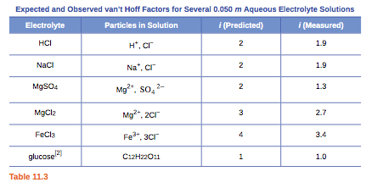
For strong electrolytes, the experimentally measured van’t Hoff factors are lower than that predicted.
This implies incomplete dissociation.

Slide 66
Why incomplete dissociation?
Cation-Anion attraction prevents some of the ions from behaving as completely independent particles.
Some “ion pairs” are formed.
The “effective concentration” known as activity is less than the predicted concentration of ions in solution.
This is less of an issue in dilute solutions.

Slide 67
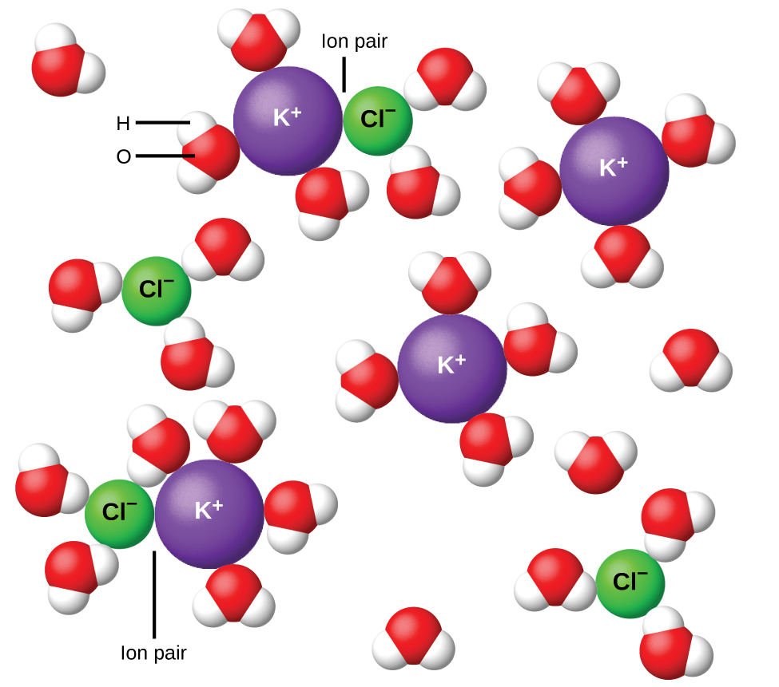

Slide 68
Adjusted Colligative Property Equations for Electrolyte Solutions

