Slide 1
CHAPTER 12
Kinetics
OpenStax Chemistry
Joseph DePasquale

Slide 2
Outline
12.1: Chemical Reaction Rates
12.2: Factors Affecting Reaction Rates
12.3: Rate Laws
12.4: Integrated Rate Laws
12.5: Collision Theory
12.7: Catalysis
Omit section 12.6

Slide 3
12.1: Chemical Reaction Rates
Chemical reactions occur at different rates.
Some reactions are fast, while other reactions are slow.
Chemists study the rates of reactions and also try to control these rates.
The study of reaction rates is known as Kinetics.

Slide 4
12.1 Chemical Reaction Rates
The rate of a reaction is the change in the amount of a reactant or product per unit time.
It is often convenient to express amount in terms of concentration.
Rate Expression: Mathematical Representation of rate of reaction.

Slide 5
Rate Expressions
Reaction rates are always positive quantities.
Concentration is most often expressed in Molarity.
Rate expressions can be written in terms of reactant or product concentration.

Slide 6
Writing Rate Expressions
2N₂O₅(g) → 4NO₂(g) + O₂(g)
Write the rate expression in terms of each species.
Rate of N₂O₅ decomposition =
Rate of NO₂ formation =
Rate of O₂ formation =

Slide 7
Average vs. Instantaneous
Reaction Rates
Average Reaction Rate – The rate at which a reaction proceeds over a time period.
    Calculated using concentrations at the beginning and end of a time period.
Instantaneous Reaction Rate – The rate at which a reaction is proceeding at a specific time and/or conc.
  Calculated using a graph (Conc. vs. time) and a slope of a straight line tangent to the curve at that specific time.
  Or by determining the avg. rate of reaction over a very short time period.
Initial Reaction Rate – The instantaneous reaction rate at “time zero”.

Slide 8
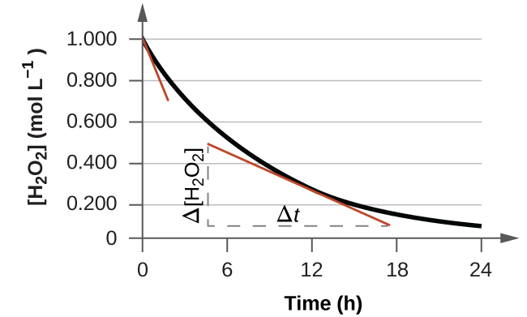
Determining Different Rates of Reaction
2H₂O₂(aq) → 2H₂O(l) + O₂(g)

Slide 9
Relative Rates of Reaction
The rate of a reaction may be expressed in terms of the change in concentration of any reactant or product.
Stoichiometric factors derived from a balanced equation may be used to relate reaction rates.

Slide 10
12.2: Factors Affecting Reaction Rates
  1) Chemical nature of the reactants.
  Example: As you move down a group the alkali metals react at a faster rate with water.
  https://www.youtube.com/watch?v=jI__JY7pqOM

Slide 11
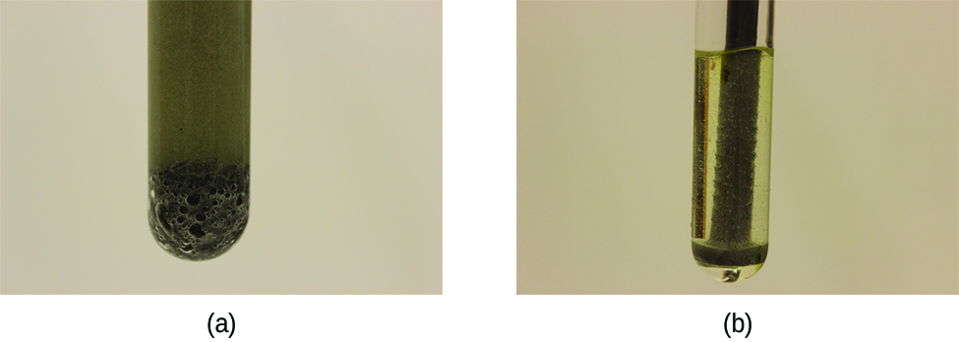
12.2: Factors Affecting Reaction Rates
  2) The state of subdivision of the reactants.
  The rate of most reactions increase with increasing surface area contact between reactants.

Slide 12
12.2: Factors Affecting Reaction Rates
  3) Temperature of the reactants.
Reaction rate ordinarily increases with temperature.
  4) Concentration of the reactants.
Reaction rate ordinarily increases with the concentration of reactants.
  5) The presence of a catalyst

Slide 13
Rate and Collision
Chemical reactions occur as the result of collisions between reactant molecules.
The higher the concentration of reactant molecules, the more likely molecules will collide and react, and therefore the faster the reaction rate.
As reactants get consumed, collisions happen less frequently and the reaction rate decreases.
https://www.youtube.com/watch?v=m4_twEXWjgg

Slide 14
12.3: Rate Laws
Rate is directly related to reactant concentration.

Slide 15
Rate Laws
N₂O₅ (g) → 2NO₂ (g) + ½O₂ (g)
The rate law for this reaction is: Rate = k[N₂O₅]
  Only reactants appear in a rate law.
  k is the rate constant for the reaction.
  The rate law is used to calculate the instantaneous rate or initial rate of reaction with a specific reactant concentration.
  For some reactions the rate law is more complex…

Slide 16
Rate Constant, k
The rate constant, k is specific for a particular reaction at a particular temperature.
k is independent of reactant concentration.
k must be determined experimentally.

Slide 17
Rate Laws
Experiments must be done to determine the rate law for a reaction.
  Can’t just use a balanced chemical equation.
For a reaction with a single reactant
  A → products
  Rate = k[A]^{m}
  m is the order of the reaction
  m must be determined experimentally (not from balanced chemical equations).
  Reaction orders are usually positive integers (0, 1, 2…) but can also be fractions or negative numbers.

Slide 18
Rate Laws
Most reactions involve more than one reactant.
A + B → products
Rate = k[A]^{m}[B]^{n}
There are three orders:
  m is the order with respect to A
  n is the order with respect to B
  The overall order of the reaction = m + n

Slide 19
Order with respect to a reactant
The order with respect to a reactant indicates the dependence of the reaction rate on the concentration of that particular reactant.
The overall order gives an understanding of how all the reactants contribute to the rate of a reaction.
  Also, dictates the units of the rate constant for that reaction.

Slide 20
Determination of a Reaction’s Rate Law
One way to determine the rate law of a reaction is to measure the initial rate.
  The rate at time zero.
If the initial rate is measured with a number of different initial reactant concentrations then the rate law can be determined.

Slide 21
How to Determine a Rate Law
The order with respect to a particular reactant can be determined by varying its initial concentration while holding the initial concentration(s) of the other reactant(s) constant.
  Experimentally measure the initial rate with each of the two different concentrations.
  The change in rate is then a direct result of the reactant which changed in concentration.
  The order with respect to that reactant can then be calculated.
Repeat this process with all reactants.

Slide 22
12.4 Integrated Rate Laws
So far we have only talked about the concentration-rate relationship.
  A → products Rate = k[A]^{m}
The rate law can be integrated with respect to time to produce a concentration-time relationship know as an integrated rate law.
This relationship depends on the order of the reaction: Zero order, 1st order, 2nd order, etc.
A new term, the half-life, will also be introduced.

Slide 23
First-Order Reactions
For 1st order reactions of the type A → products
k is the rate constant
t is time
[A]₀ is the initial reactant conc.
[A]_{t} is the reactant conc. present at time t
Rate = k[A]
Integration with respect
to time gives us:

Slide 24
Linear form of the First-Order Integrated Rate Law
We can put the first-order integrated rate law into the form
y = mx + b
  ln[A]_{t} plotted on the y axis
  time (t) plotted on the x axis
  The slope of the line is –k
  The y-intercept is ln[A]₀

Slide 25
Integrated Rate Laws
Note that when using all of the integrated rate laws
The amount of reactant (A) does not always need to be expressed in Molarity (M) as the equations imply.
The amount can also be expressed in
  Mass (g, mg, etc.)
  Number of molecules or atoms
  Other conc. units such as g/L
  Partial pressure if A is a gas (assuming volume and temperature remain constant).

Slide 26
The Half Life: First Order Reaction
The half life (t_{1/2}) of a reaction is the time it takes for one half of a given amount of reactant to be consumed.
For a first order reaction, at the half life, t_{1/2}
  [A]_{t} = ½[A]₀
  Solving for t in ln[A]_{t} = -kt + ln[A]₀

Slide 27
The Half Life: First Order Reaction
Notice that for a first order reaction, the half life is independent of the initial concentration of reactant.

Slide 28
Second-Order Integrated Rate Law
For A→ products, Rate = k[A]²
Integration with respect to time gives us:
The half-life of a second order reaction does depend on the initial concentration of reactant.

Slide 29
Zero Order Integrated Rate Law
For a zero order reaction: A → Products
Note that the half life of a zero order reaction DOES DEPEND on the initial concentration of reactant.
Integration with respect to time gives us:

Slide 30
12.5 Collision Theory
Collision Theory – Reactants (atoms, molecules, or ions) must collide in order to react with each other.
Postulates of Collision Theory:
1) Rate of Reaction is proportional to the rate of reactant collisions.

Slide 31
Collisions: Effective and Ineffective
Why does every collision not lead to a reaction?
  2) Molecules must be oriented properly when they collide.

Slide 32
Collisions: Effective and Ineffective
Why does every collision not lead to a reaction?
  3) Molecules must have adequate kinetic energy to react.
    The kinetic energy supplied must be high enough to break the chemical bonds.
    Molecules with kinetic energies too small just bounce off each other and don’t react.
    This required energy is called the activation energy
Activation Energy (E_{a}) – minimum energy necessary to form a product during a collision between reactants.

Slide 33
Transition-State Model
Reaction Energy diagram
  Potential energy is plotted on the y-axis
  Reaction path (or extent of reaction) is plotted on the x-axis.
The reactants form an intermediate called an activated complex.
  The state of the system at the activated complex is called a transition state

Slide 34
Reaction Rate and Temperature
Thus far we have discussed
  The concentration-rate relationship
  The concentration-time relationship
Now we will look at the temperature–rate relationship
Reaction rate ordinarily increases with temperature.
  To cook food more quickly, raise the oven temperature.
  To slow the reactions that lead to food spoilage, put food in the refrigerator.
  To really slow the reactions down, put food in the freezer.

Slide 35
Kinetic Theory
Temperature is a measure of the average kinetic energy of molecules.
Higher temperatures mean higher kinetic energies.
The higher the temperature, the larger the fraction of molecules with kinetic energies equal to or greater than the activation energy (E_{a}).
With a larger fraction of molecules possessing E_{a}, a larger fraction of collisions lead to product formation, resulting in a higher rate of reaction.

Slide 36
Consider the following equation:
A is a constant called called the frequency factor and is related to the frequency of collision and orientation.
The rate constant (k) is dependent on the activation energy of the reaction and the temperature.

Slide 37
Consider two different reactions that occur at the same temperature. Each reaction has a different E_{a}.

Slide 38
Consider the same reaction at two different temperatures. E_{a} is independent of temperature.

Slide 39
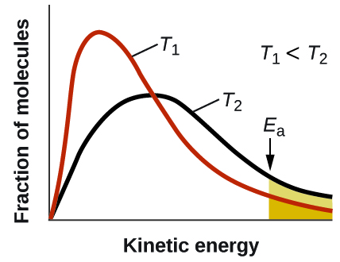
The area under the curve is directly proportional to the number of molecules possessing those energies.

Slide 40
Arrhenius Equation
Taking the natural logarithm of both sides of the equation gives the Arrhenius Equation.

Slide 41
Two-point form of the Arrhenius Equation
This form of the Arrhenius equation can be used with two k values and two corresponding temperatures to calculate E_{a}.
You do not need to know the value of the constant, A, to use this equation.
Make sure that the energy units on E_{a} and R are identical.

Slide 42
12.7 Catalysis
Catalyst – A substance that increases the rate of a chemical reaction by lowering the activation energy without itself being consumed by the reaction.
The catalyst is regenerated in the process.
Catalysts provide an alternate reaction pathway with a lower activation energy.
Sometimes the catalyzed path contains multiple steps, but each individual step has an activation energy that is lower than the activation energy of the uncatalyzed reaction.

Slide 43
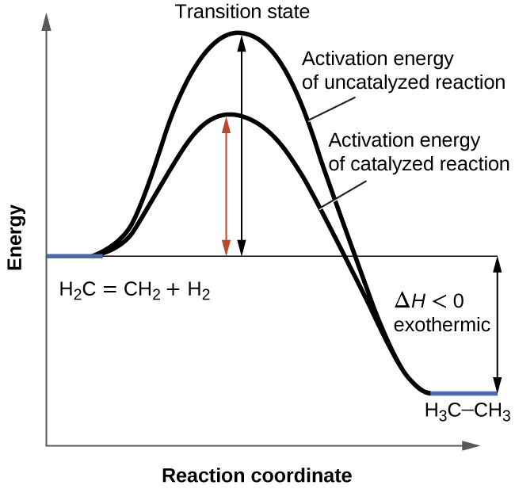
Reaction Diagram: Catalyzed vs. Uncatalyzed

Slide 44
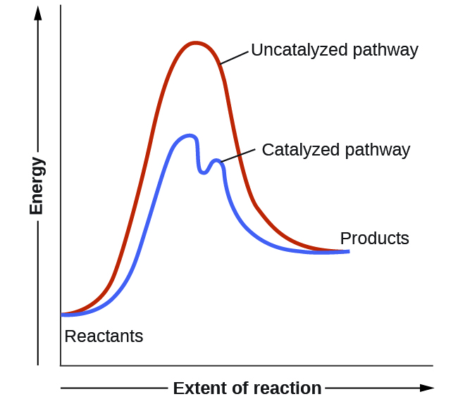
Reaction Diagram: Catalyzed vs. Uncatalyzed

Slide 45
Types of Catalysts
1) A Homogeneous catalyst is in the same phase as the reactants. It speeds up the reaction by forming a reactive intermediate.
The reactive intermediate reacts further to form product and regenerate the catalyst.
The reactive intermediate is formed but immediately consumed.

Slide 46
Homogeneous catalyst
Example: Chlorine radicals (Cl) that catalyze the decomposition of ozone.
Cl(g) + O₃(g) ➔ ClO(g) + O₂(g)
ClO(g) + O(g) ➔ Cl(g) + O₂(g)

Slide 47
Types of Catalysts
2) A Heterogeneous catalyst is in a different phase from that of the reactants.
  Most commonly the catalyst is a solid and the reactants are in the gas or liquid phase.
  Example is the catalytic converter in automobiles which consists of platinum and rhodium metals.
Pt
2CO(g) + O₂(g) → CO₂(g)
NO(g) → N₂(g) + O₂(g)
Rh

Slide 48
Types of Catalysts
3) Enzymes are biocatalysts
  Protein molecules

