Slide 1
CHAPTER 14
Acid-Base Equilibria
OpenStax Chemistry
Joseph DePasquale

Slide 2
Ch. 14 Outline
14.1: Brønsted-Lowry Acids and Bases
14.2: pH and pOH
14.3: Relative Strengths of Acids and Bases
14.5: Polyprotic Acids
14.4: Hydrolysis of Salt Solutions
14.6: Buffers
14.7: Acid-Base Titrations

Slide 3
Acid and Base Definitions
Johannes Brønsted and Thomas Lowry (1923) Definition:
  Focused on the reactions that take place between acids and bases.
  Brønsted-Lowry Acid – A compound that donates a proton to another compound.
  Brønsted-Lowry Base – A compound that accepts a proton from another compound.

Slide 4
What types of compounds are acids and bases?
Acids:
Molecules - Both organic and inorganic
Cations that contain H
Anions that contain H

Slide 5
Bases:
Ionic compounds that contain OH-
Molecules - Primarily amines
Anions – With and without H
Cations – Few examples

Slide 6
Brønsted-Lowry Acid/Base Theory
The species formed when a proton is removed from an acid is the conjugate base of that acid.
The species formed when a proton is added to a base is the conjugate acid of that base.

Slide 7
Amphiprotic Species
A species that can either accept or donate a proton is called amphiprotic.
An amphiprotic species can serve as an acid or a base.
    Example: Water
    In the presence of an acid, water acts as a base.
    In the presence of a base, water acts like an acid.

Slide 8
Water as a Base
The reaction between a Brønsted-Lowry Acid and water is called acid ionization.
  Example:

Slide 9
Water as an Acid
The reaction between a Brønsted-Lowry Base and water is called base ionization.
  Example:

Slide 10
The Autoionization of Water
In pure water, water also acts both as an acid and a base.
Autoionization of Water:
  The equilibrium constant for this reaction is called the ion product constant for water, K_{w}.
    At 25 °C, K_{w} = 1.0 × 10⁻¹⁴

Slide 11
14.2: pH and pOH
K_{w} = [H₃O⁺][OH⁻]
In pure water,
When the concentration of [H₃O⁺] and [OH⁻] are equal, the solution is said to be neutral

Slide 12
H₃O⁺ and OH⁻ Concentration
In pure water [H₃O⁺] and [OH⁻] are equal to each other.
When an acid or base is dissolved in water [H₃O⁺] and [OH⁻] are NOT equal to each other.
    K_{w} = [H₃O⁺] [OH⁻] = 1.0 × 10⁻¹⁴
    [H₃O⁺] and [OH⁻] are inversely related to each other.
  If [H₃O⁺] > 1.0 x 10⁻⁷, then [OH⁻] < 1.0 x 10⁻⁷ and the solution is called acidic
  If [OH⁻] > 1.0 x 10⁻⁷, then [H₃O⁺] < 1.0 x 10⁻⁷ and
  the solution is called basic.

Slide 13
pH
The acidity and basicity of a solution can be expressed in terms of its [H₃O⁺] or [OH⁻].
These concentrations can span many orders of magnitude, therefore logarthmic values are commonly used.
pH

Slide 14
pOH
pOH
  pH + pOH = 14.00

Slide 15
pH and pOH in a Neutral Solution
  If [H₃O⁺] = [OH⁻] = 1.0 x 10⁻⁷ then the solution is considered neutral.

Slide 16
pH and pOH in an Acidic Solution
  If [H₃O⁺] > 1.0 x 10⁻⁷, then [OH⁻] < 1.0 x 10⁻⁷ and the solution is considered acidic

Slide 17
pH and pOH in a Basic Solution
  If [OH⁻] > 1.0 x 10⁻⁷, then [H₃O⁺] < 1.0 x 10⁻⁷ and the solution is considered basic.

Slide 19
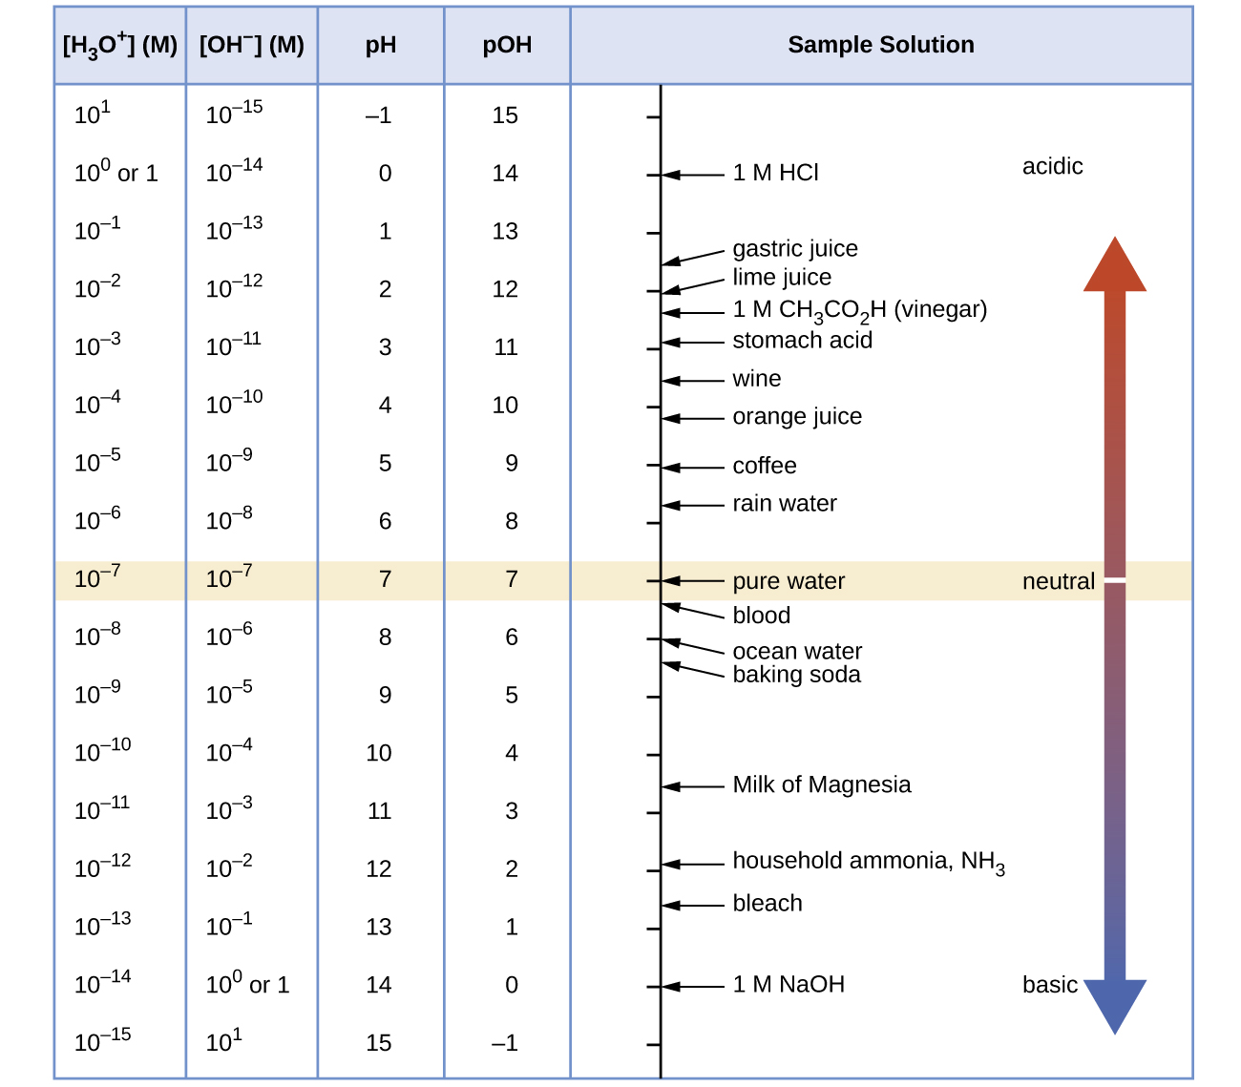

Slide 20
pH of Strong Acid Solutions
Recall from Chapter 4 that some acids are strong.
  HCl, HBr, HI, HClO₄, HNO₃, H₂SO₄
    These acids essentially react completely with water
    Ex: HCl

Slide 21
pH of Strong Bases
Recall as well that some bases are strong:
  LiOH, NaOH, KOH, Ca(OH)₂, Sr(OH)₂, Ba(OH)₂
    These bases dissociate completely into OH⁻

Slide 22
14.3: Relative Strengths of Acids and Bases
  Brønsted-Lowry Acids are H⁺ donors
The strength of an acid is measured by the extent to which it forms H₃O⁺ in water.
HA_{(aq)} + H₂O_{(l)} ⇌ H₃O⁺_{(aq)} + A⁻_{(aq)}
Strong acids yield nearly 100% H₃O⁺
Weak acids yield much less than 100% H₃O⁺

Slide 23
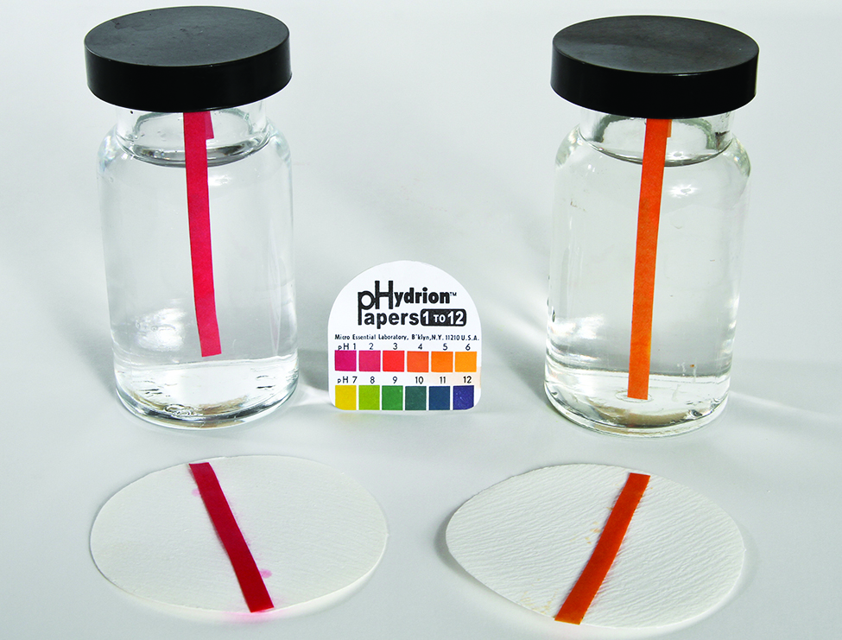
0.1 M HCl 0.1 M CH₃CO₂H

Slide 24
Acid-Ionization Constant, K_{a}
The relative strengths of weak acids can be determined by measuring their equilibrium constants.
The equilibrium constant for an acid is called the acid-ionization constant (K_{a}).
HA_{(aq)} + H₂O_{(l)} ⇌ H₃O⁺_{(aq)} + A⁻_{(aq)}

Slide 25
Acid-Ionization Constant, K_{a}
HA_{(aq)} + H₂O_{(l)} ⇌ H₃O⁺_{(aq)} + A⁻_{(aq)}
K_{a} values are related to the strength of the acid.
  The larger the K_{a} of an acid
  The smaller the K_{a} of an acid

Slide 26
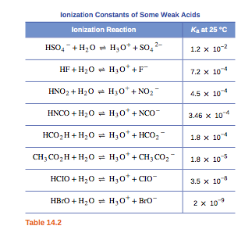
K_{a}
Values

Slide 27
Relative Strength of Bases
  Brønsted-Lowry Bases are H⁺ acceptors
The strength of a base is measured by the extent to which it forms hydroxide ions in water.
B_{(aq)} + H₂O_{(l)} ⇌ HB⁺_{(aq)} + OH⁻_{(aq)}
Strong bases yield nearly 100% OH⁻
Weak bases yield much less than 100% OH⁻

Slide 28
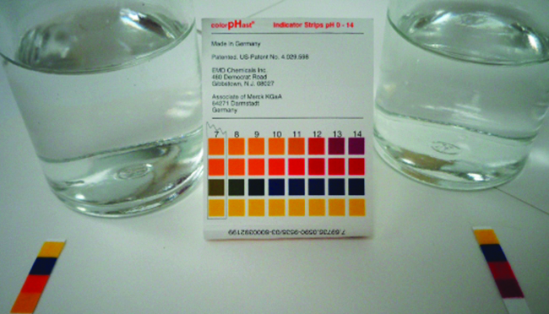
0.1 M NH₃ 0.1 M NaOH

Slide 29
Base-Ionization Constant, K_{b}
The relative strengths of weak bases can be determined by measuring their equilibrium constants.
The equilibrium constant for a base is called the base-ionization constant (K_{b}).
B_{(aq)} + H₂O_{(l)} ⇌ HB⁺_{(aq)} + OH⁻_{(aq)}

Slide 30
Base-Ionization Constant, K_{b}
B_{(aq)} + H₂O_{(l)} ⇌ HB⁺_{(aq)} + OH⁻_{(aq)}
K_{b} values are related to the strength of the base.
  The larger the K_{b} of the base
  The smaller the K_{b} of the base

Slide 31
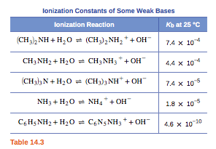
K_{b} Values

Slide 32
Acid/Base Strength Notes
K_{a} and K_{b} are inversely related
  The larger K_{a} is of an acid, the smaller the K_{b} is of its conjugate base.
  The larger K_{b} is of a base, the smaller the K_{a} is of its conjugate acid.

Slide 33
Acid/Base Strength Notes
HA_{(aq)} + H₂O_{(l)} ⇌ H₃O⁺_{(aq)} + A⁻_{(aq)}
The extent to which an acid, HA, donates a proton to a water molecule depends upon the strength of its conjugate base, A⁻.
If A- is a strong base, then any proton donated to a water molecule is recaptured by A⁻.
  Little H₃O⁺ would exist in solution.
  HA is therefore a weak acid.

Slide 34
Acid/Base Strength Notes
HA_{(aq)} + H₂O_{(l)} ⇌ H₃O⁺_{(aq)} + A⁻_{(aq)}
If A⁻ is a weak base, then it is unlikely for A⁻ to recapture a proton donated to a water molecule.
  A large amount of H₃O⁺ would exist in solution.
  HA is therefore a strong acid.

Slide 35
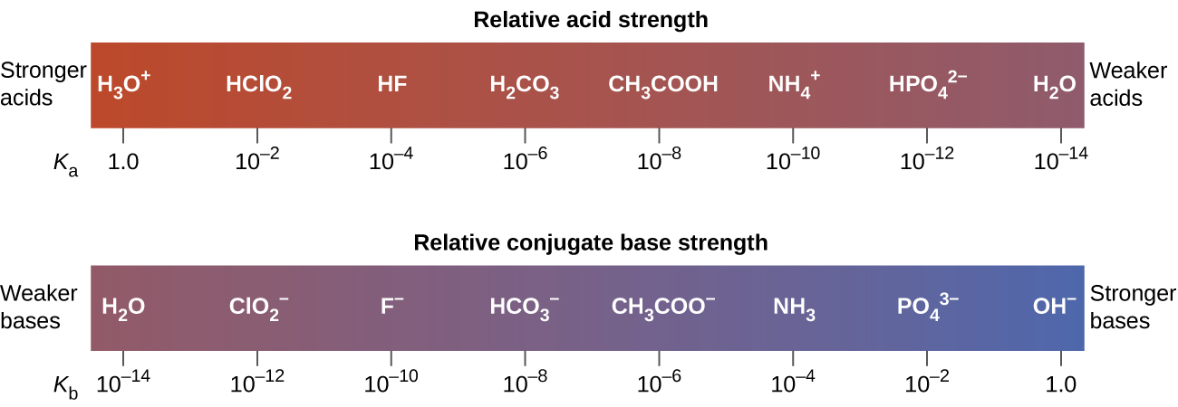

Slide 36
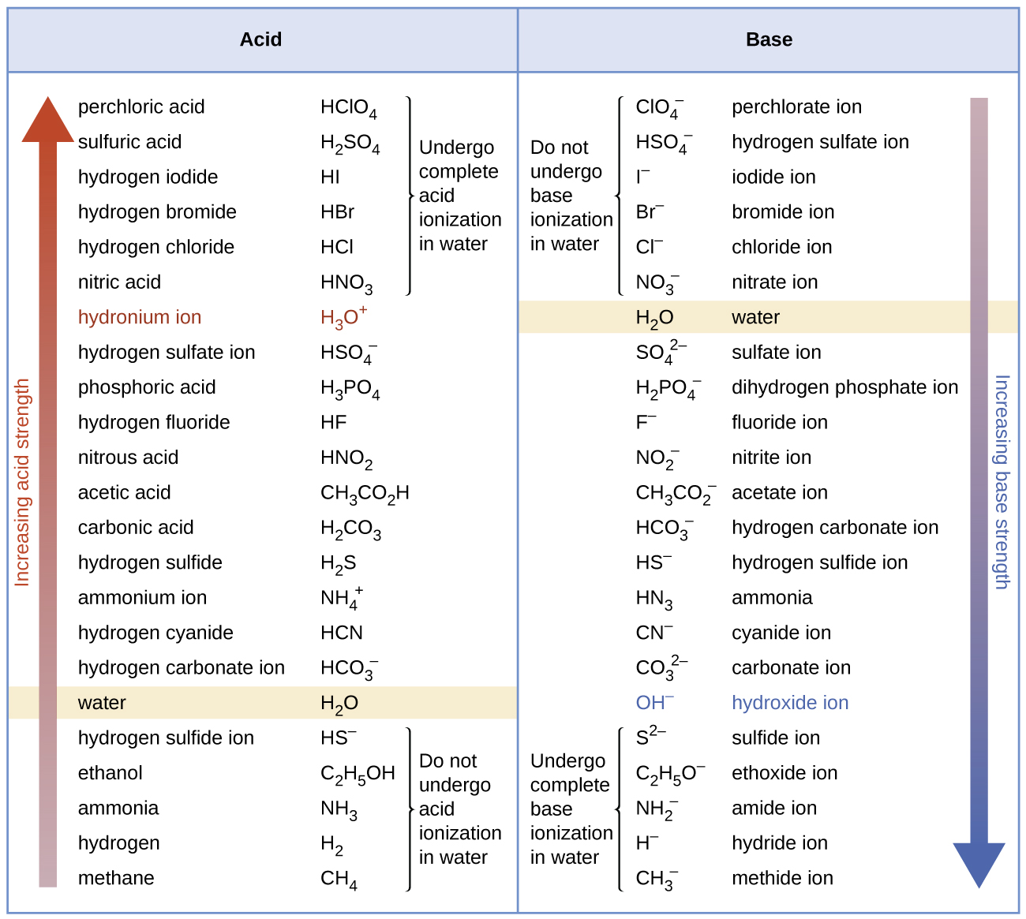

Slide 37
Acid/Base Strength Notes
The conjugates of weak acids and weak bases are weak bases and weak acids, respectively.
These conjugates compete with water.
Solutions of these weak acids and weak bases produce an equilibrium mixture of reactants and products.
Just keep in mind that for conjugate acid/base pairs, the following equation must always be satisfied.

Slide 38
Determining K_{a} or K_{b}
There are several ways to determine the K_{a} or K_{b} value of a weak acid or weak base.
The methods are similar to how K_{c} and K_{p} values were determined in Ch. 13.
One approach is to measure the pH of a solution prepared by dissolving a known amount of the weak acid or base. In these problems…
  Given pH
  Given some information that can be used to find the initial concentration of the acid or base.
  Calculate K_{a} or K_{b}

Slide 39
Percent Ionization
For, HA_{(aq)} + H₂O_{(l)} ⇌ H₃O⁺_{(aq)} + A⁻_{(aq)}
The percent ionization of a weak acid is defined as
Calculate the % ionization from the previous problem:

Slide 40
Percent Ionization of Weak Bases
B_{(aq)} + H₂O_{(l)} ⇌ HB⁺_{(aq)} + OH⁻_{(aq)}

Slide 41
Calculating the pH of a weak acid or weak base solution
The process is similar to that used to calculate equilibrium concentrations or pressures in Ch 13.
In these problems…
  Given K_{a} or K_{b}
  Given some information that can be used to find the initial concentration of the acid or base.
  Calculate [H₃O⁺]_{eq} or [OH⁻]_{eq}
  Calculate pH

Slide 42
Molecular Structure and Acid Strength
As you can start to see, some acids are stronger than other acids.
Bronsted-Lowry Acids are proton donors.
Consider binary compounds of hydrogen (H-A)
    The strength of the acid depends on how easily the bond between the hydrogen and non-metal (A) is broken.
    Acid strength increases as bond strength decreases.

Slide 43
Acid Strength of Binary Hydrogen Compounds
This is a periodic property in terms of non-metal, A.
Down a group (top to bottom), acid strength increases.
  Orbitals of similar size form strong bonds – Good orbital overlap.
  Orbitals of different size form weak bonds – Poor orbital overlap.
  Hydrogen is the smallest element.
  Atoms get larger down a group.
  The H-A bond weakens as A changes down a group.
  Acid strength increases.

Slide 44
Acid Strength of Binary Hydrogen Compounds
This is a periodic property in terms of non-metal, A.
Across a period (left to right), acid strength increases.
  The more polar the bond, the easier an H⁺ ion is produced.
  Electronegativity increases across a period.
  The H-A bond becomes more polar as A changes across a period.
  The H-A bond weakens across a period.
  Acid strength increases.

Slide 45
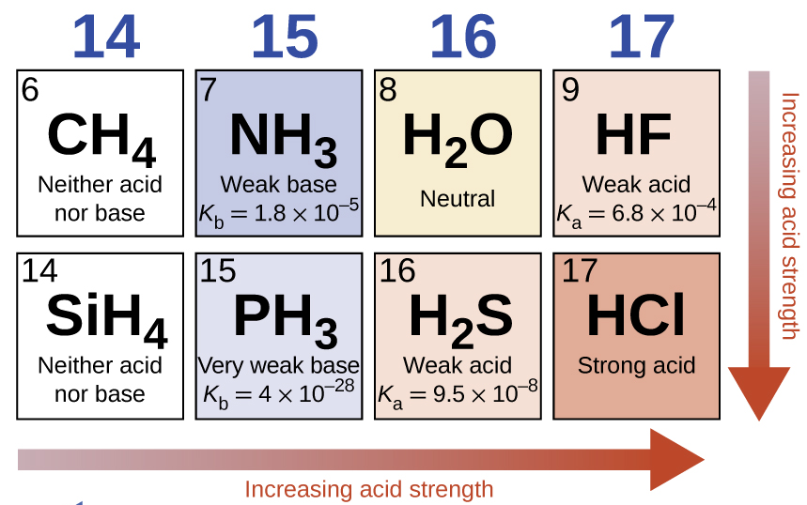

Slide 46
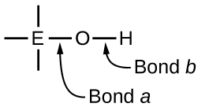
Compounds Containing Oxygen and One or More Hydroxyl Group (OH)
These compounds can be acidic, basic, or amphiprotic depending on the electronegativity of element, E.

Slide 47
If EN of E is low then “Bond a” is polar or ionic.
OH⁻ ions are readily released.
The compound is basic.
Metals have low EN
Metal hydroxides tend to be basic.

Slide 48
If EN of E is high then “Bond a” is covalent.
Electrons in “Bond b” are pulled toward E.
“Bond b” is polar and weak.
H⁺ ions are readily released.
The compound is acidic.
Non-metals have high EN.

Slide 49
If EN of E is intermediate then the molecule is usually amphiprotic.
In the presence of strong acid the compound acts as a base.
In the presence of strong base the compound acts as an acid.

Slide 50
Metalloids and elements near the metalloids have intermediate EN.
Example: Al(H₂O)₃ (OH)₃
In Base:
Al(H₂O)₃ (OH)₃(aq) + OH⁻(aq) ⇌
In Acid:
Al(H₂O)₃ (OH)₃(aq) + H₃O⁺(aq) ⇌

Slide 51
14.5: Polyprotic Acids
Acids that contain one ionizable hydrogen atom are called monoprotic.
Acids that contain more than one ionizable hydrogen atom are called polyprotic.
Polyprotic acids ionize in steps.
The Acid Equilibrium Constant (K_{a}) becomes smaller with each successive step.

Slide 52
Types of Polyprotic Acids
  Diprotic acids
  Triprotic acids

Slide 53
14.4: Hydrolysis of Salt Solutions
A neutral solution contains equal concentrations of hydronium and hydroxide ions.
The reaction between an acid and a base is called an acid-base neutralization reaction.
What are always the products of such a reaction?

Slide 54
14.4: Hydrolysis of Salt Solutions
The resulting solution is not necessarily neutral, even when stoichiometrically equivalent quantities of acid and base are used.
The nature of the salt formed determines whether the solution is acidic, basic or neutral.

Slide 55
Four Types of Acid-Base Neutralizations
Strong Acid-Strong Base
  A neutral solution forms
Strong Acid-Weak Base
  A weakly acidic solution forms
Weak Acid-Strong Base
  A weakly basic solution forms
Weak Acid-Weak Base
  The solution formed may be acidic or basic

Slide 56
Strong Acid – Strong Base Reaction
Example:
Consider the salt formed:
Determine the effect that the cation and anion will have on water.

Slide 57
Strong Acid – Weak Base Reaction
Example:
Consider the salt formed:
Determine the effect that the cation and anion will have on water.

Slide 58
Weak Acid – Strong Base Reaction
Example:
Consider the salt formed:
Determine the effect that the cation and anion will have on water.

Slide 59
Weak Acid – Weak Base Reaction
Examples:
Consider the salts formed:
Determine the effect that the cation and anion will have on water.

Slide 60
14.6: Buffers
Buffer – A solution containing appreciable amounts of both a weak acid and its conjugate base (or a weak base and its conjugate acid).
  Buffer solutions resist changes in pH upon addition of a small amount of strong acid or base.
  Examples:

Slide 61
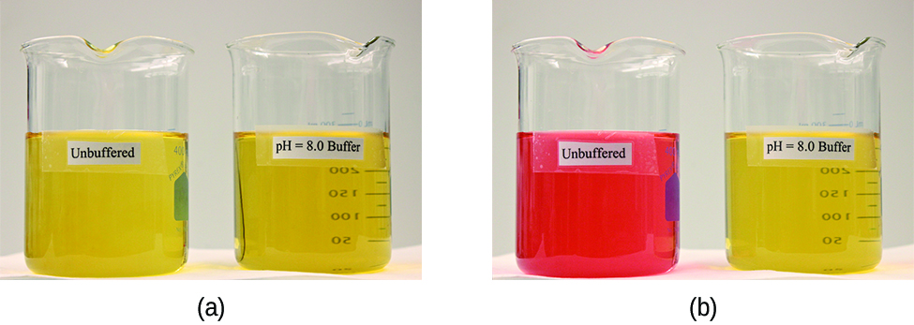
pH 8
No Buffer
pH 8
With Buffer

Slide 62
How Buffers Work
Consider the buffer: HA/A⁻
Buffers are good at getting rid of strong acids and bases.
  Added OH⁻ or H₃O⁺ are consumed and therefore do not directly affect the pH.
  Any added OH⁻, is converted into the weak base, A⁻
  HA (aq) + OH⁻ (aq) → A⁻ (aq) + H₂O
  Any added H₃O⁺ , is converted to the weak acid, HA
  A⁻ (aq) + H₃O⁺ (aq) → HA (aq) + H₂O
Therefore buffers can be used to maintain a nearly constant pH!

Slide 63
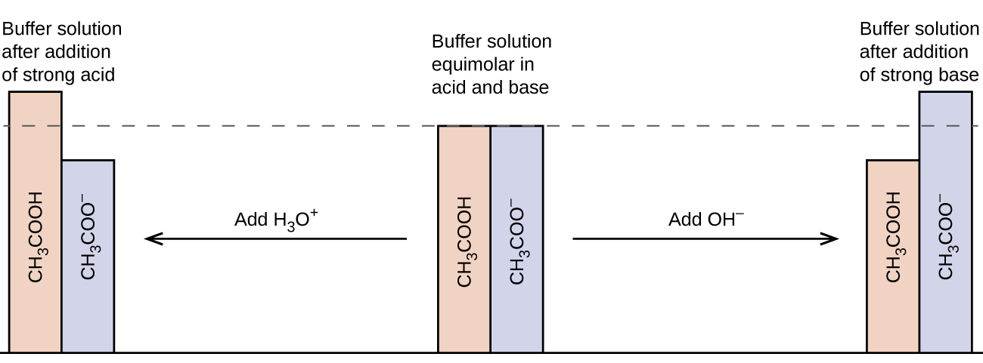
How Buffers Work
CH₃COOH/ NaCH₃CO₂ Buffer
The change in the amounts of CH₃COOH and CH₃CO₂⁻ does result in a small change in pH.

Slide 64
Buffer Capacity
Buffer Capacity – Amount of strong acid or base that can be added to a given volume of a buffer solution before the pH changes significantly.
All buffers have a limited capacity of how much H₃O⁺ or OH⁻ they can “soak up”
  Eventually, all the HA reacts with the added OH⁻
  Eventually, all the A⁻ reacts with the added H₃O⁺

Slide 65
Buffer Capacity
Buffer capacity depends on the number of moles of the weak acid and its conjugate base that are in the mixture.
More moles of buffer components leads to a higher buffer capacity.
Once the buffer components near depletion, large changes in pH result.

Slide 66
Determining the [H₃O⁺] and pH of a Buffer Solution
The pH of a buffer system can be calculated if we know the concentration of the weak acid [HA] and its conjugate base [A⁻]
HA_{(aq)} + H₂O_{(l)} ⇌ H₃O⁺_{(aq)} + A⁻_{(aq)}

Slide 67
Henderson-Hasselbalch Equation
Henderson-Hasselbalch equation can be used to calculate the pH of a buffer.

Slide 68
Compare two buffer solutions
Buffer 1:
  1 L buffer with 1.0 M CH₃CO₂H and 1.0 M NaCH₃CO₂
Buffer 2:
    1 L buffer with 0.1 M CH₃CO₂H and 0.1 M NaCH₃CO₂

Slide 69
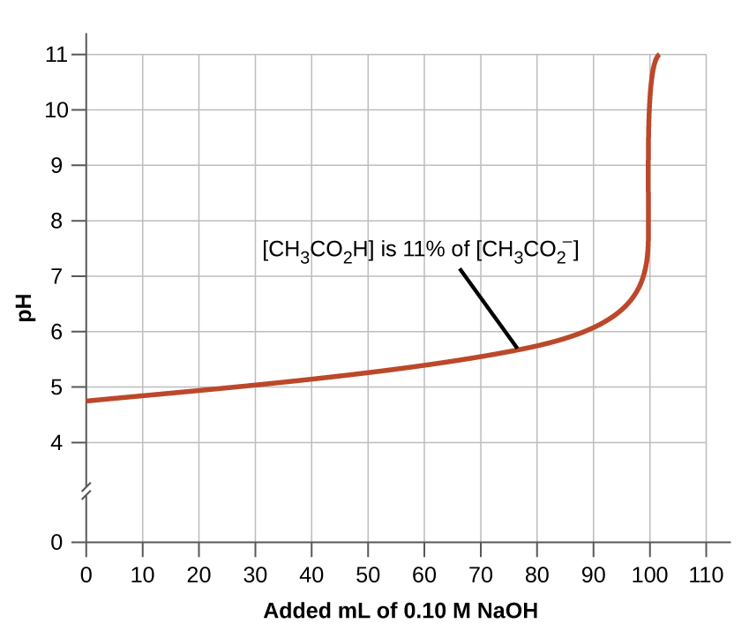
Initially [CH₃CO₂H] = [NaCH₃CO₂]

Slide 70
14.7: Acid-Base Titrations
Recall from Chapter 4 that we can analyze an acid or base by reacting it with a known concentration of the other.
Two types of titrations
  1) Strong acid-strong base
  2) Weak acid-strong base
  Equivalence Point:

Slide 71
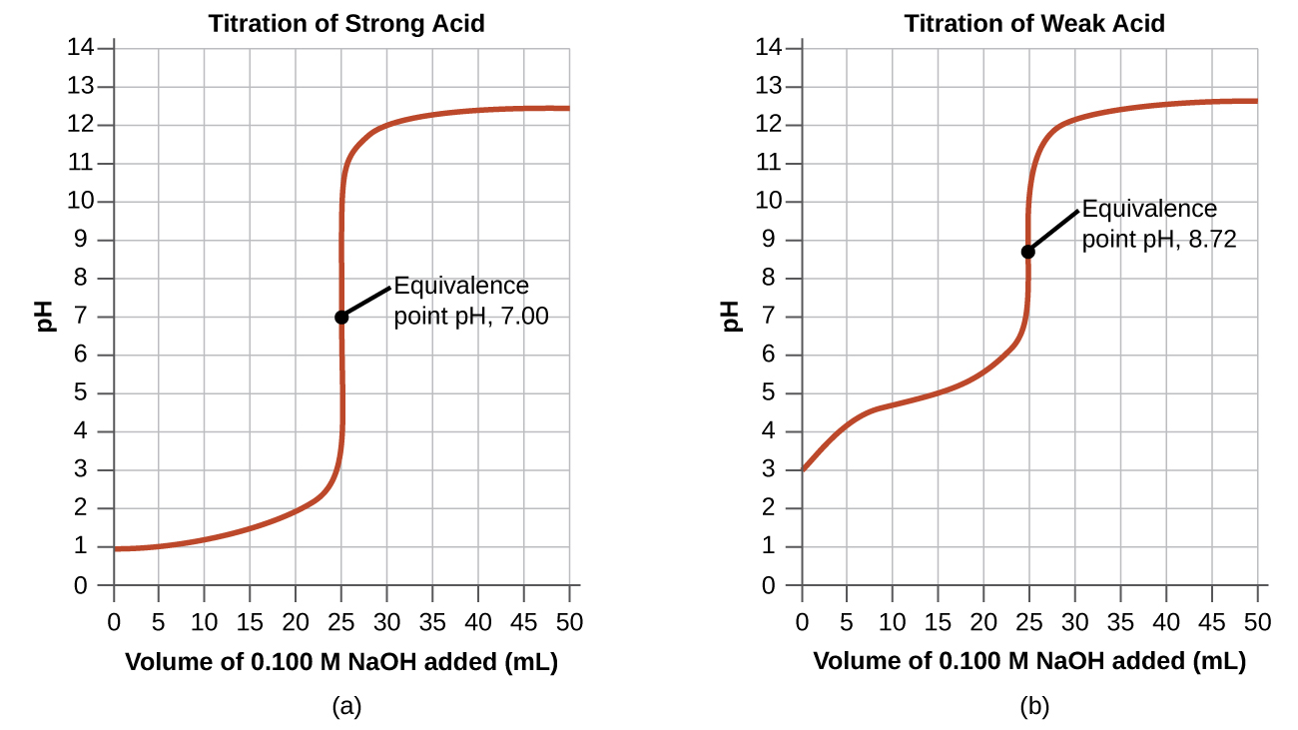
Strong Acid-
Strong Base
Titration
HCl + NaOH ➔ H₂O + NaCl
The pH is initially very low (only strong acid present)
There is a gradual rise in pH as base is added.

Slide 72
HCl + NaOH ➔ H₂O + NaCl
Eventually the pH rises rapidly.
Mid-point of the vertical part of the curve is the equivalence point.
The pH at the equivalence point is 7.
Excess NaOH controls the pH after the equivalence point.

Slide 73
Weak Acid-Strong Base Titration
CH₃CO₂H + NaOH ➔ H₂O + NaCH₃CO₂
Many features of this titration curve are similar to a Strong Acid-Strong Base titration.
But this titration curve is somewhat more complicated.

Slide 74
CH₃CO₂H + NaOH ➔ H₂O + NaCH₃CO₂
The pH starts off low, but not as low as the strong acid titration.
There is a gradual rise in pH as base is added.

Slide 75
CH₃CO₂H + NaOH ➔ H₂O + NaCH₃CO₂
Eventually the pH rises rapidly.
Mid-point of the vertical part of the curve is the equivalence point.
The pH at the equivalence point is 8.72
Excess NaOH controls the pH after the equivalence point.

Slide 76
CH₃CO₂H + NaOH ➔ H₂O + NaCH₃CO₂
Half-Equivalence Point:
Determining pK_{a} from a titration curve.

Slide 77
Acid-Base Indicators
One or two drops of indicator are often added to the sample being titrated.
An acid-base indicator is useful in determining the equivalence point in a titration.
  The pH at which the indicator changes color is called the endpoint.
    You want to choose an indicator that has an endpoint that coincides with the pH at the equivalence point.

Slide 78
Acid-Base Indicators
Indicators are weak acids
  The weak acid is a different color than its conjugate base.

Slide 79
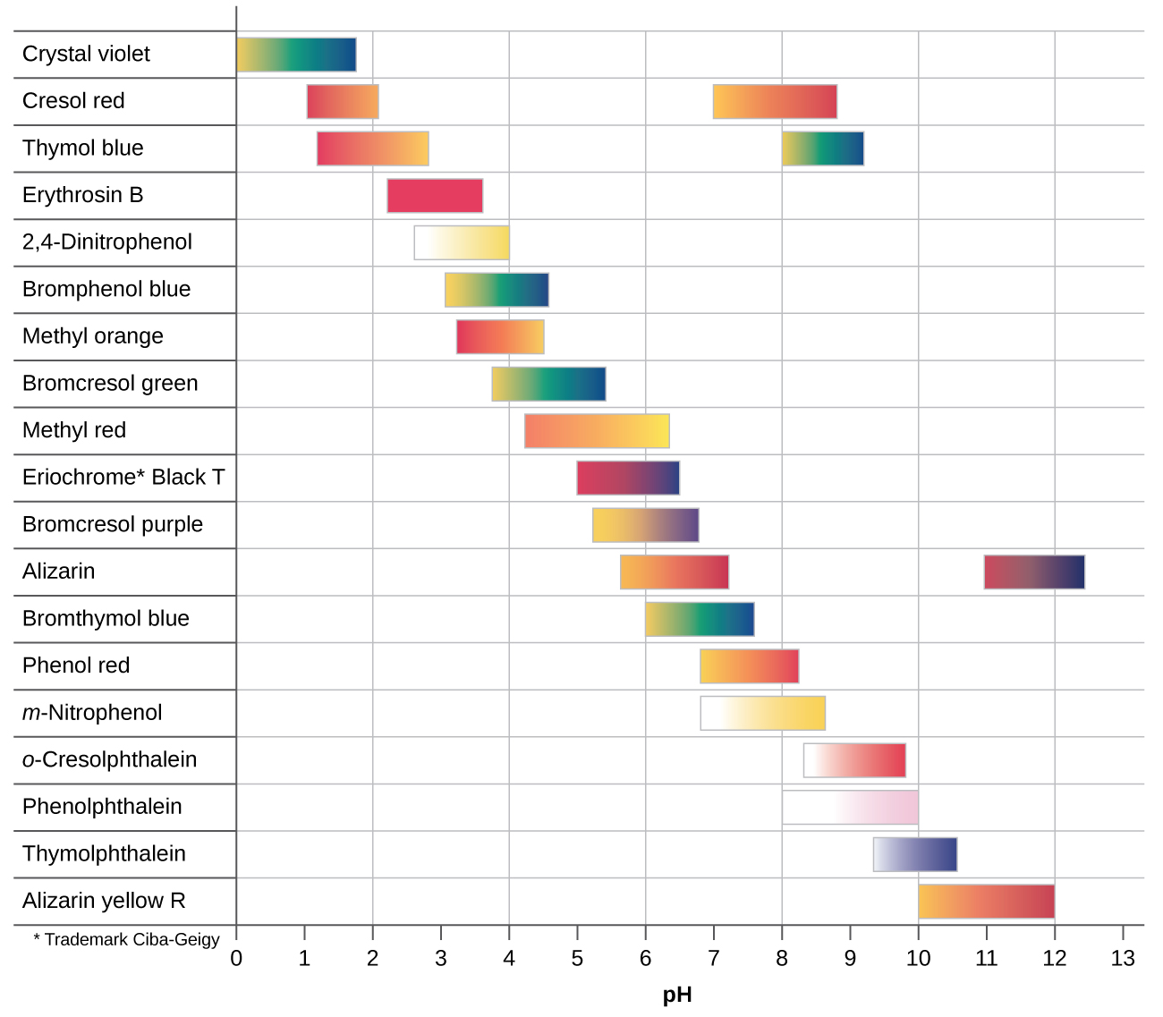

Slide 80
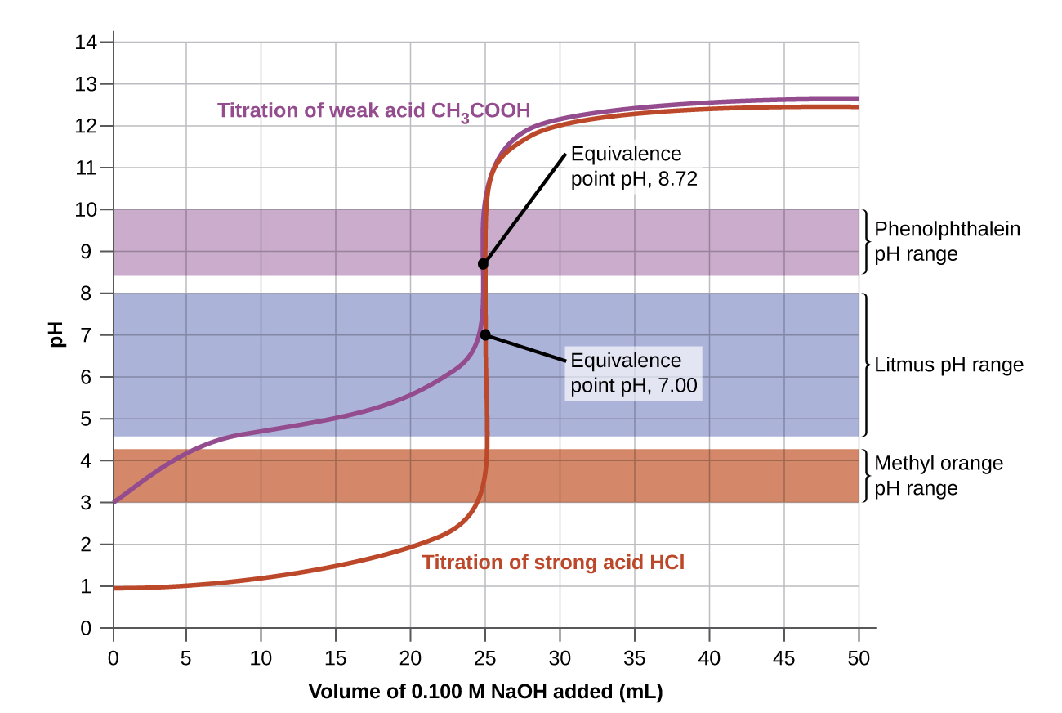
Indicator Selection: Need an indicator that changes color at a pH near the equivalence point.

