Slide 1
Chapter 16:
Thermodynamics
OpenStax Chemistry
Joseph DePasquale

Slide 2
Ch. 16 Outline
16.1: Spontaneity
16.2: Entropy
16.3: The Second and Third Laws of Thermodynamics
16.4: Free Energy

Slide 3
Will a reaction occur “naturally” at a given temperature and pressure, without the exertion of any outside force?
In other words, is a reaction spontaneous?
A process that DOES occur naturally under a specific set of conditions is called a spontaneous process.
A process that DOES NOT occur naturally under a specific set of conditions is called nonspontaneous.

Slide 4
16.1: Spontaneous Processes
A spontaneous process will “just happen”
A spontaneous process occurs naturally at a given set of conditions, without outside forces.
Examples:
  A mixture of hydrogen and oxygen will react in the presence of a spark.
2H₂(g) + O₂(g) + spark → 2H₂O(g)

Slide 5
Spontaneity
It is important to not confuse spontaneous with fast.
The rate of a reaction (Ch. 12) and spontaneity are not necessarily connected.

Slide 6
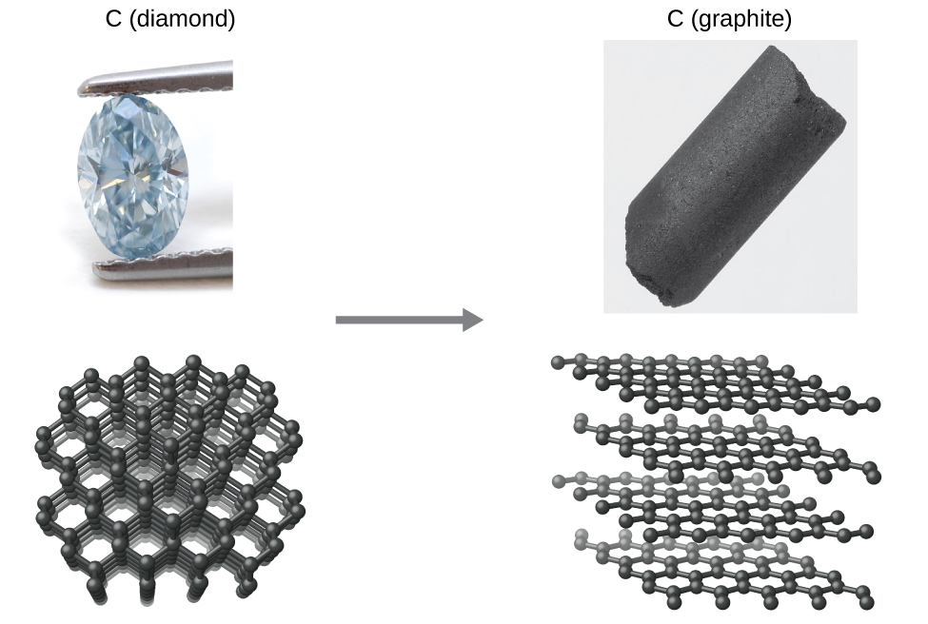
Are Diamonds Really Forever?

Slide 7
Spontaneity
If a reaction is spontaneous in one direction, it will be non-spontaneous in the reverse direction under the same conditions.
A non-spontaneous reaction is still possible with the continual input of energy.
2H₂(g) + O₂(g) → 2H₂O(l) Spontaneous
2H₂O(l) → 2H₂(g) + O₂(g) Non-Spontaneous

Slide 8
Electrolysis of Water

Slide 9
Energy and Spontaneity
Many spontaneous processes proceed with a decrease in energy.
Recall that exothermic reactions also proceed with a decrease in energy.
  Spontaneous reactions are often exothermic, but NOT ALWAYS.
2H₂(g) + O₂(g) + spark → 2H₂O(g)

Slide 10
Exceptions
  Which is spontaneous at room temperature and a pressure of 1 atm?
  H₂O(s) → H₂O(l) ΔH = +6.01 kJ/mol
  H₂O(l) → H₂O(s) ΔH = -6.01 kJ/mol

Slide 11
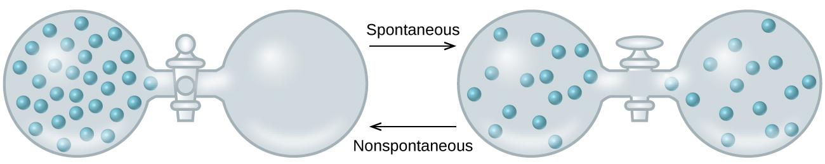
Dispersal of Matter
When the value opens, the gas spontaneously expands to fill both containers.
With an ideal gas, this process results in no change in energy.

Slide 12
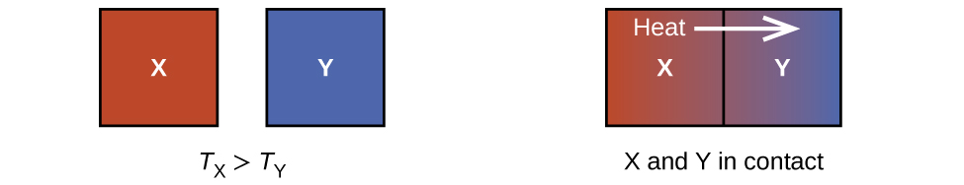
Dispersal of Energy
Two objects at different temperature are placed in contact.
Heat spontaneously flows from the hotter object to the colder object.
But overall there is no change in energy.

Slide 13
Some other Factor
Some factor other than energy, is important to the spontaneity of a process.
It appears that greater, more uniform dispersal of matter and energy can also be the driving force of a spontaneous process.
This other factor is entropy.

Slide 14
Entropy
Spontaneity is favored by an increase in entropy (S).
  k is the Boltzmann constant (1.38 x 10^{–23} J/K)
  W is the number of microstates.
  Microstate (W) – A specific configuration of the locations and energies of the particles in a system.
S = k ln W
The number of microstates possible is given by:
  n is the number of boxes
  N is the number of particles
W = n^{N}

Slide 15
Consider two particles distributed amongst two boxes.

Slide 16
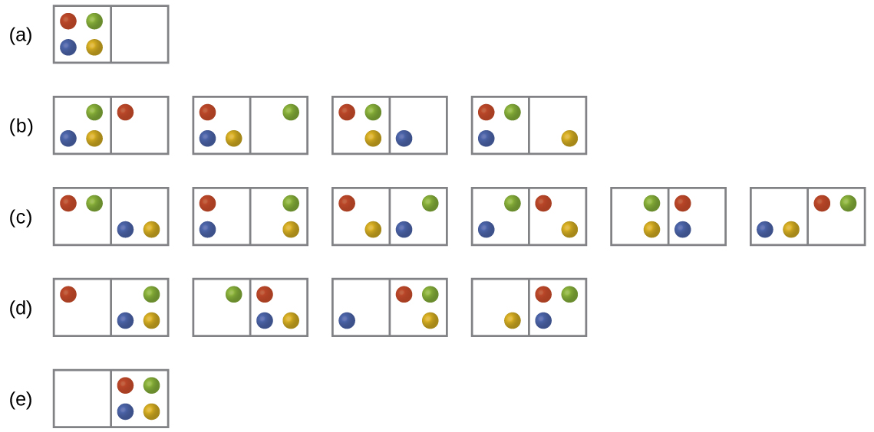
Now consider four particles distributed among two boxes.
Microstates with equivalent particle arrangements are grouped together and called distributions.

Slide 17
There are five possible distributions for this system.
Which distribution is most probable?

Slide 18
The most probable distribution has the largest number of microstates.
The most probable distribution is therefore the one of greatest entropy.
States of high entropy are favored because they are the most probable.
S = k ln W

Slide 19
The most probable distribution has the largest number of microstates.
This same principle applies to all systems including those with larger numbers of particles.
  The most probable state will be the one in which the particles are divided evenly throughout the container.
This same principle can also be applied to spontaneous heat flow.

Slide 20
Entropy Changes
Entropy is another state function.
The change in entropy for a process is the difference in entropy between the final state and the initial state.
Alternatively:
ΔS_{sys} = S_{final} – S_{initial}

Slide 21
Factors that Influence Entropy
1) The phase of the substance.
2) The temperature of the substance.
  Temperature is proportional to the average kinetic energy of the particles.
  With higher temperature, the particles have greater freedom to move around.

Slide 22
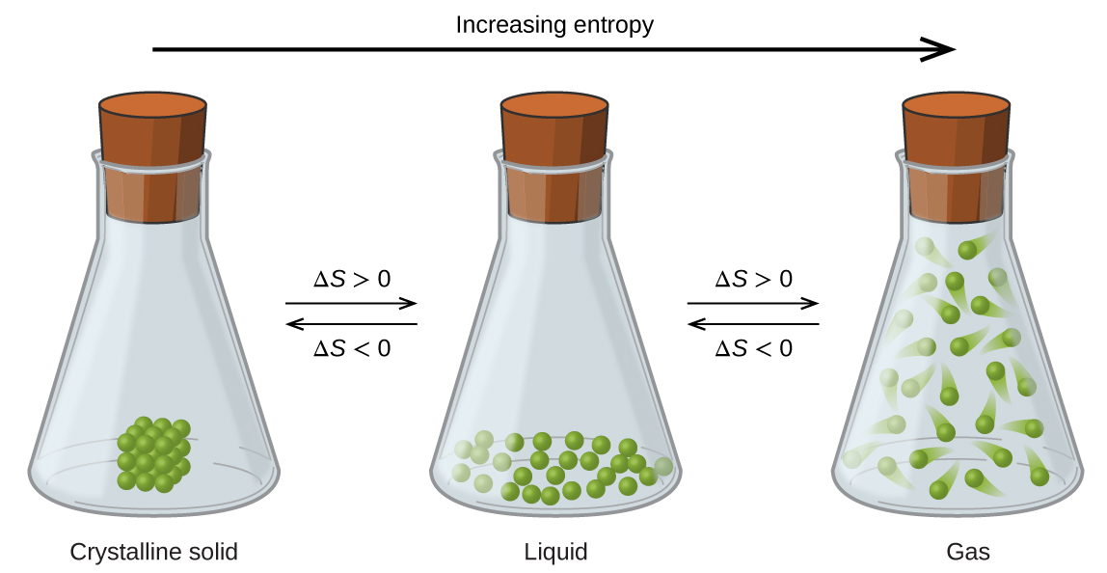

Slide 23
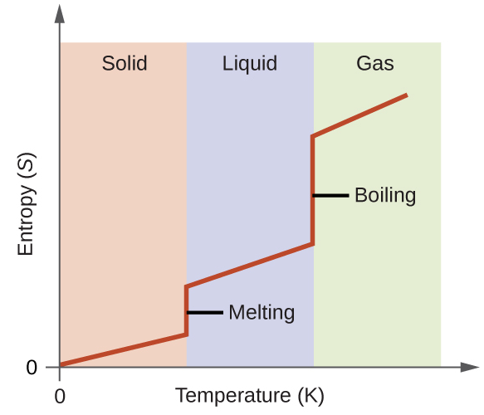
Entropy vs.
Temp.
The effect of temperature on entropy is due mostly to phase changes.

Slide 24
Factors that Influence Entropy
3) The type and number of particles that make up the substance.
  4) Variations in the type of particles.
  Pure substances vs. mixture?

Slide 25
16.3: The Second and Third Laws of Thermodynamics
The system is the part of the universe that is of specific interest.
The surroundings constitute the rest of the universe outside the system. Generally chemists just focus on the immediate surroundings.
Correctly predicting the spontaneity of a process requires us to consider entropy changes in both the system and the surroundings.

Slide 26
Change in Entropy of the Surroundings, ΔS_{surr}
The change in entropy of the surroundings (ΔS_{surr}) is directly proportional to the change in enthalpy of the system.
ΔS_{surr} is also inversely proportional to temperature.

Slide 27
The Second Law of Thermodynamics
The entropy change of the universe is the sum of the entropy changes for the system and surroundings.
The second law of thermodynamics states that all spontaneous changes cause an increase in the entropy of the universe.
  For a spontaneous process ΔS_{universe} must be positive.
A process with –ΔS_{system} can still be spontaneous if

Slide 28
The Second Law of Thermodynamics
  ΔS_{universe} > 0 for a spontaneous process
  ΔS_{universe} < 0 for a nonspontaneous process (spontaneous in the reverse direction).
  ΔS_{universe} = 0 for a process at equilibrium

Slide 29
The Third Law of Thermodynamics
Third Law of Thermodynamics: The entropy of a pure perfect crystalline substance at zero Kelvin is zero.
  Zero Kelvin is called absolute zero.
  There is no lower temperature than zero Kelvin.
  At zero Kelvin all molecular movement completely stops.
  There is only one possible way to arrange the molecules.

Slide 30
Standard Entropies
It is possible to determine the absolute entropy of a substance.
Standard Entropies, S°₂₉₈
  These values are for 1 mole of a substance at a pressure of 1 bar and a temperature of 298 K.
  Aqueous species at 1 M concentration.
Standard entropy values can be used to calculate the Standard Entropy Change (ΔS°) for a process.

Slide 31
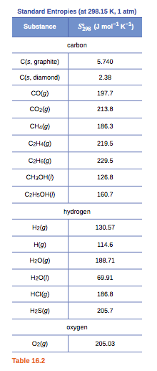
Standard Entropies, S°₂₉₈

Slide 32
ΔS° for Reactions
The equation for calculating ΔS° is similar to that for ΔH°:
When calculating ΔS° and ΔH° remember to multiply the standard entropies and standard enthalpies of formation by the coefficients of the balanced equation.

Slide 33
16.4: Free Energy, G
The second law of thermodynamics can be used to predict spontaneity.
But, measurements on the surroundings are seldom made.
This limits the use of the second law of thermodynamics.
It is convenient to have a thermodynamic function that focuses on just the system and predicts spontaneity.

Slide 34
Gibbs Free-Energy Change, ΔG
Second Law of Thermodynamics:

Slide 35
Gibbs Free Energy Change, ΔG
The changes in Gibbs free energy (ΔG) or simply change in free energy allows us to predict spontaneity by focusing on the system only.
ΔG = ΔH – TΔS

Slide 36
ΔG and Spontaneity
ΔG = ΔH – TΔS
The sign of ΔG indicates if a reaction will be spontaneous or not.
  If ΔG < 0, the reaction is spontaneous in the forward direction.
  If ΔG > 0, the reaction is non-spontaneous in the forward direction
  If ΔG = 0, the system is at equilibrium

Slide 37
Relationship Among ΔG, ΔH, and ΔS
  ΔG = ΔH – TΔS
Spontaneous reactions, those with -ΔG, generally have
  ΔH < 0
    Exothermic reaction.
    A negative ΔH will contribute to a negative ΔG.
  ΔS > 0
    A positive ΔS will contribute to a negative ΔG.
Note that a reaction can still be spontaneous (have a -ΔG) when ΔH is positive or ΔS is negative, but not both.
Also note that there is a temperature dependence.

Slide 38
ΔG = ΔH – TΔS
ΔH | ΔS | ΔG | Spontaneous?
- | +
+ | -
+ | +
- | -

Slide 39
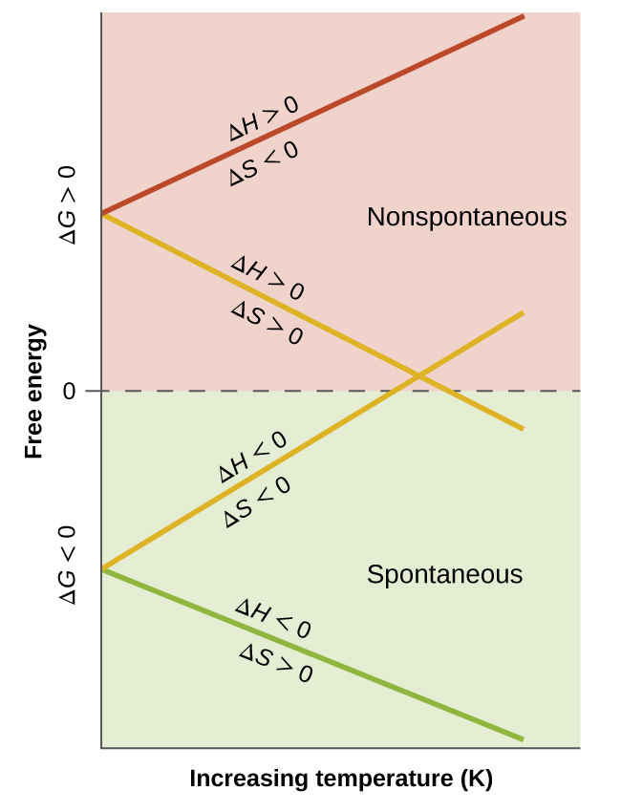

Slide 40
Direction of Spontaneity Change
To calculate the temperature at which the spontaneity of a reaction changes from …
  Spontaneous to non-spontaneous
  Or, non-spontaneous to spontaneous
… find the temperature at which ΔG = 0
ΔG = 0 = ΔH – TΔS
  T = ΔH / ΔS
  This is the temp. at which ΔG = 0 and by definition the system is at equilibrium.

Slide 41
The Standard Free Energy Change, ΔG°
Although the Change in Gibbs Free Energy equation is valid under all conditions we will most often apply it at standard conditions.
Standard conditions:
Under standard conditions, ΔG° = ΔH° – TΔS°
  Pay attention to J vs. kJ in calculations!

Slide 42
Standard Free Energy of Formation, ∆G_{f}°
The Standard Free Energy of Formation (∆G_{f}°) for a compound is defined as the free energy change for the formation of one mole of a substance from its elements in their standard state at 1 bar and 25 °C.
    Analogous to the ∆H_{f}° discussed in Chapter 5
    Example:
    H₂ (g) + ½O₂ (g) → H₂O (l) ∆G_{f}° = -237.2 kJ/mol

Slide 43
∆G_{f}° values can be used to calculate ΔG°
For a chemical reaction:
mA + nB → xC + yD
ΔG° = [xΔG°_{f} (C) + yΔG°_{f} (D)] – [mΔG°_{f} (A) + nΔG°_{f} (B)]
ΔG° = ΣνΔG°_{f} (products) – ΣνΔG°_{f} (reactants)

Slide 44
∆G_{f}° can be used to calculate ΔG°
ΔG° = ΣνΔG°_{f} (products) – ΣνΔG°_{f} (reactants)
This equation only works for calculating ∆G° of a reaction at the temperature for which the values of ∆G_{f}° are tabulated, which is 298 K.
ΔG°_{f} for any element in its most stable form at standard conditions is defined as zero.

Slide 45
Pressure and Concentration Effects
Most of our discussion on free energy to this point has involved the standard free energy change ΔG°.
  All species are at 1 bar of partial pressure or 1 M concentration.
There is a general equation that enables you to calculate ΔG under non-standard conditions.
T is temperature in K
R = 0.008314 kJ/mol . K
Q is the reaction quotient

Slide 46
ΔG and the Equilibrium Constant
Thus far in this chapter we have focused heavily on the relationship between the free energy change and the spontaneity of a reaction.
  For a reaction to be spontaneous ΔG° must be negative.
Another measure of reaction spontaneity is the equilibrium constant, K.
  For a reaction to be spontaneous K must be greater than 1.
  This should make sense because we have discussed that if K is greater than 1 then the reaction is product favored.

Slide 47
ΔG and the Equilibrium Constant
The relationship between ΔG° and K can be found starting with this general equation.
Remember that at equilibrium, ΔG = 0 and Q = K. So,
Therefore,

Slide 48
ΔG and the Equilibrium Constant
This relationship between ΔG° and K holds for all equilibrium constants we have discussed in this course.
  K_{c}, K_{p}, K_{a}, K_{b}, K_{w}, K_{sp}, K_{f}, K_{d}
We can now relate the standard free energy change of a reaction to the extent of a reaction.

Slide 49
Additivity of ΔG; Coupled Reactions
As with enthalpy, free energy changes for reactions are additive, if
Reaction 3 = Reaction 1 + Reaction 2
Then, ΔG₃ = ΔG₁ + ΔG₂
- Also keep in mind that if a reaction is reversed then the sign on ΔG is also reversed.
- If a reaction is multiplied by a factor of “n” then ΔG is also multiplied by a factor of “n”.

