Slide 1
CHAPTER 17 Electrochemistry
OpenStax Chemistry
Joseph DePasquale

Slide 2
Outline
17.1: Balancing Oxidation-Reduction Reactions
17.2 Galvanic Cells (Voltaic Cells)
17.3 Standard Reduction Potentials
17.4 The Nernst Equation

Slide 3
Electrochemistry
Electrochemistry is the study of the interconversion of electrical and chemical energy.
The chemical reactions involve electron transfer.
Electricity – The presence and flow of electrical charge.
Electrons or ions may carry the charge.

Slide 4
Electricity

Slide 5
Electrochemistry Terms
Current – The rate of flow of charge.
SI Unit: Ampere (A)
Electrical current flows in a path, called an electric circuit.
The flow of charge is generated by an electrical potential difference, or potential, between two points in a circuit.
Potential is the ability of the electric field to do work on the charge.
SI Unit: Volt (V)

Slide 6
17.1: Balancing Oxidation-Reduction Reactions
Oxidation
Loss of electrons
Electrons are produced
The species is oxidized
Reduction
Gain of electrons
Electrons are consumed
The species is reduced
Redox Reaction
Oxidation and Reduction occur simultaneously

Slide 7
Oxidizing Agent and Reducing Agent
Something must cause the species to be reduced.
This is the reducing agent (reductant)
Something must cause the species to be oxidized.
This is the oxidizing agent (oxidant)
Note that
The oxidizing agent is reduced
The reducing agent is oxidized
Both of these appear as reactants (not products) in the overall redox reaction.

Slide 8
Oxidation Number (or Oxidation State)
The assignment of oxidation numbers allows one to determine what is being oxidized and what is being reduced.
For elements and monoatomic ions oxidation numbers are just the charge of the species.
In molecules and polyatomic ions, oxidation numbers are not real charges.
Rules exist for assigning oxidation numbers.
Oxidation numbers are generally small whole numbers, but may be fractional.

Slide 9
Redox Reactions and Oxidation Numbers
Oxidation results in an increase in oxidation number.
Cu (s) → Cu²⁺ (aq) + 2 e⁻
Reduction results in a decrease in oxidation number.
2Ag⁺(aq) + 2e⁻ → 2Ag(s)

Slide 10
Steps for Balancing Redox Reactions
1) Assign oxidation numbers.
2) Split the reaction into two half-reactions. An oxidation and a reduction.
3) Balance one half reaction.
4) Balance the other half reaction.
5) Combine the two balanced half reactions in such a way as to eliminate electrons.
6) Check: Atoms and charge must be balanced.

Slide 11
Cu-Ag⁺ Redox Reaction
When a piece of Cu metal is added to Ag⁺(aq) ions:
Cu(s) + 2Ag⁺(aq) → Cu²⁺(aq) + 2Ag(s)
When run directly in a test tube:
Ag metal is deposited on the surface of the Cu strip.
Cu enters the solution as blue Cu²⁺ ions.
What if we forced these electrons to pass through an external wire?

Slide 12
17.2: Galvanic Cells (Voltaic Cells)
In principle, any spontaneous redox reaction can serve as a source of electrical energy in a galvanic cell.
This cell is designed to take advantage of the movement of electrons which occurs during a redox reaction.
The oxidation and reduction half reactions are “compartmentalized” into half cells.
Oxidation at one electrode (anode)
Reduction at the other electrode (cathode)
Electrons move through an external wire from the anode to the cathode.
These “moving” electrons can be used as a source of electrical energy.

Slide 13
Galvanic Cells
The Oxidation and Reduction half-reactions occur at separate electrodes.
The Oxidation Reaction occurs at the Anode
Anions flow to the anode
The Reduction Reaction occurs at the Cathode
Cations flow to the cathode.

Slide 14
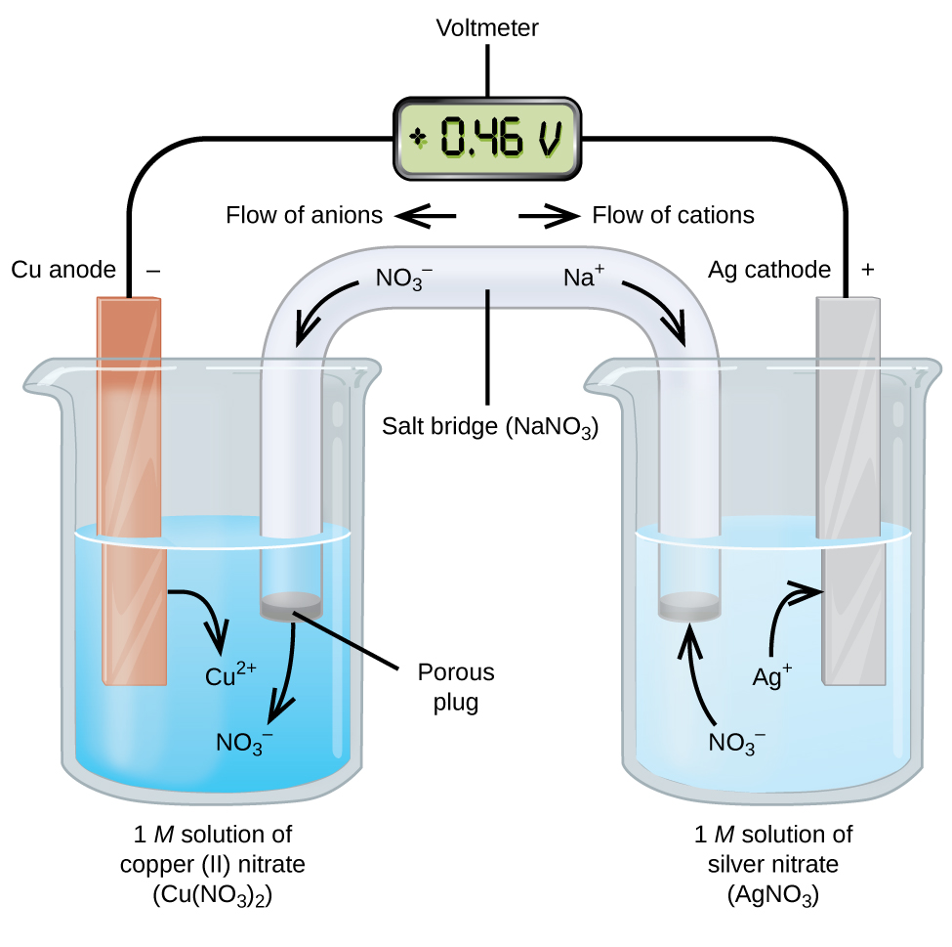
Cu-Ag⁺ Galvanic Cell

Slide 15
Cu(s) + 2Ag⁺(aq) → Cu²⁺(aq) + 2Ag(s)
Cu metal anode dips into a soln. of Cu²⁺ ions.
Ag metal cathode dips into a soln. of Ag⁺ ions.
The external wires are connected to a voltmeter.

Slide 16
Cu(s) + 2Ag⁺(aq) → Cu²⁺(aq) + 2Ag(s)
At the Cu anode, electrons are produced.
Cu (s) → Cu²⁺ (aq) + 2e⁻
Electrons flow from the anode, through the voltmeter, to the Ag cathode; the Voltmeter indicates the cell’s potential.

Slide 17
Cu(s) + 2Ag⁺(aq) → Cu²⁺(aq) + 2Ag(s)
The electrons enter the Ag cathode, at which
2Ag⁺ (aq) + 2e⁻ → Ag(s)

Slide 18
Charge Balance
Cu(s) + 2Ag⁺(aq) → Cu²⁺(aq) + 2Ag(s)
As the oxidation occurs, a surplus of positive ions builds up at the anode.
Cu (s) → Cu²⁺ (aq) + 2e⁻
The area near the cathode becomes deficient in positive ions.
2Ag⁺ (aq) + 2e⁻ → Ag (s)
The Salt Bridge supplies additional cations and anions needed to balance out these charge differences and complete the circuit.

Slide 19
Salt Bridges
The salt bridge is a porous material consisting of a concentrated salt solution.
NaNO₃ or KNO₃ are frequently used.
Anions flow toward the anode to neutralize the build-up of positive charge.
Cations flow toward the cathode to “replace” the cations that are being consumed.
This flow of ions enables electrical neutrality to be achieved, the circuit to be complete, and current to flow!

Slide 20
Salt
Bridge

Slide 21
Cell Notation
Describes what happens in a galvanic cell.
Oxidation on the left (Cu oxidized to Cu²⁺)
Reduction on the right (Ag⁺ reduced to Ag)
Single vertical line represents a phase boundary
Liquid-metal or liquid-gas, etc.
Double line is the salt bridge
Don’t include spectator ions
Sometimes the concentration of the ion(s) is included.
Cu(s) + 2Ag⁺(aq) → Cu²⁺(aq) + 2Ag(s)

Slide 22
Galvanic Cell Summary
“Compartmentalizing” the oxidation and reduction half reactions into half-cells, enables a spontaneous redox reaction to be a source of electrical energy.
In one half-cell, the anode, oxidation occurs.
In the other half-cell, the cathode, reduction occurs.
Each half-cell consists of an electrode dipped into an aqueous solution.
The half-cells are joined by an external wire (electron movement) and salt bridge (ion movement).

Slide 23
17.3: Standard Reduction Potentials (E_{red}°)
In a circuit, the flow of charge is a result of an electrical potential difference between two points in the circuit.
Electrical potential is the ability of the electric field to do work on the charge.
In a galvanic cell, this electrical potential difference is called cell potential.

Slide 24
Cell Potential
The flow of charge in a galvanic cell results from the difference in the electrical potentials at each electrode.

Slide 25
Standard Potentials (E°)
The driving force of an electrochemical reaction is measured by the standard cell potential.
Depends on the nature of the redox reaction and on the concentration of species involved.
Standard potentials (E°) are measured with
All aqueous concentrations at 1M
The pressure of all gases at 1 atm
Temp. held constant (usually at 25 °C)
Units of E° is V or mV

Slide 26
E° Cathode and Anode
Any redox reaction can be split into two half reactions.
Zn (s) + 2H⁺ → Zn²⁺ + H₂
E°_{cell} = +0.762 V

Slide 27
E° Cathode and Anode
Zn (s) + 2H⁺ (aq, 1M) → Zn²⁺ (aq, 1M) + H₂ (g, 1 atm)
E°_{cell} = +0.762 V
The E° for a half reaction cannot be measured only E°_{cell} of the entire redox reaction can be measured.
A standard reduction potential (E°_{red} ) has been set.
The value of E° for the reduction of 2H⁺ ions to H₂(g) has been assigned to be 0.000 V.
This is called the standard hydrogen electrode (SHE).

Slide 28
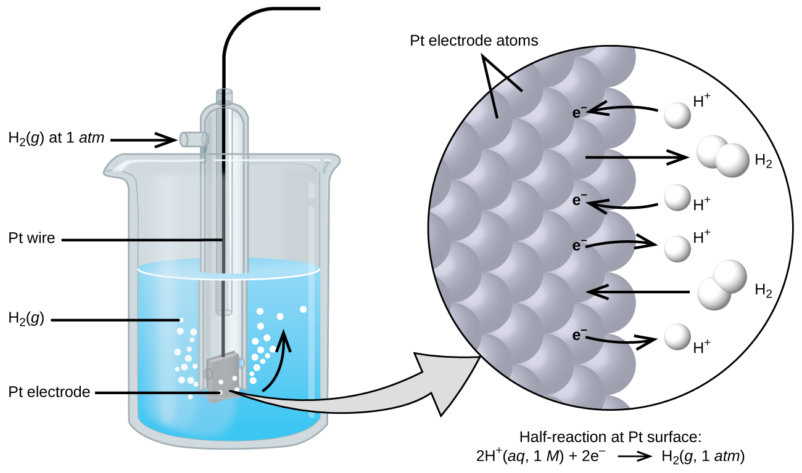
SHE

Slide 29
E° Cathode and Anode
Zn (s) + 2H⁺ → Zn²⁺ + H₂
E_{cell}° = +0.762 V
The E°_{red} value of all other half reactions have been assigned relative to SHE.
Eº_{anode} is subtracted from Eº_{cathode} because oxidation is the reverse of reduction.

Slide 30
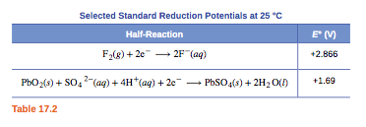
Standard Reduction Potentials (E°_{red})
Tables of standard reduction potentials have been prepared.
Table 17.2 and Appendix L.

Slide 32
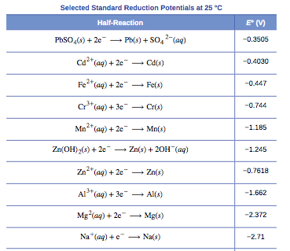

Slide 33
17.4: The Nernst Equation
If the calculated standard potential (E°_{cell}) of a redox reaction is positive, then the reaction is spontaneous at standard conditions.
This is why E°_{cell} for galvanic cells are always positive.
If the standard potential (E°_{cell}) of a redox reaction is negative, then the reaction is non-spontaneous at standard conditions.

Slide 34
Relationship Between E°, ΔG° and K
E°, ΔG°, and K are all measures of reaction spontaneity.
A redox reaction is spontaneous if,
E°_{cell} is positive
ΔG° is negative
K is greater than 1
We will talk about equations that relate these variables.

Slide 35
Relationship Between E° and ΔG°
E° and ΔG°
° indicates standard conditions (gases at 1 atm (or 1 bar); aqueous specices at 1 M)
ΔG° is the standard free energy change
E°_{cell} is the standard cell potential
n is the number of moles of electrons transferred in the balanced redox reaction.
F is called the Faraday constant, this is the charge of a mole of electrons. F = 9.648 x 10⁴ J/mol . V
Notice that ΔG° and E° have opposite signs.

Slide 36
Relationship between E° and K
Redox reactions, like all reactions, eventually reach a state of equilibrium.

Slide 37
Relationship between E° and K (Cont.)
These experiments are usually done at 25 °C (298 K)
This equation applies only at 25 °C
Note that
If E° is positive, K is greater than 1
If E° is negative, K is less than 1

Slide 38
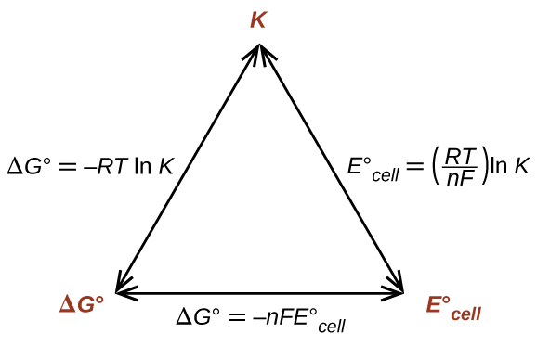
Relationship Between E°, ΔG° and K

Slide 39
Effect of Concentration on Potential
To this point, we have dealt only with “standard” potentials (E°), that is potentials when all gases are at 1 atm (or 1 bar) and aqueous species are at 1M.
Since reaction conditions influence ΔG, Potential (E) must also be influenced by the conditions as well.

Slide 40
Effect of Concentration on Potential
Voltage will increase and the reaction will become more spontaneous if
The concentration of a reactant is increased
The concentration of a product is decreased
Voltage will decrease and the reaction will become less spontaneous if
The concentration of reactant is decreased
The concentration of product is increased

Slide 41
The Nernst Equation
At 25 °C (298 K)

