Slide 1


CHEMISTRY 2e
Chapter 11 Solutions and Colloids
PowerPoint Image Slideshow

Slide 2
Chapter Outline
11.1 The Dissolution Process
11.2 Electrolytes
11.3 Solubility
11.4 Colligative Properties
11.5 Colloids

Slide 3

Figure 11.1
Coral reefs, such as this one at the Palmyra Atoll National Wildlife Refuge, are vital to the ecosystem of earth’s oceans but are threatened by climate change and dissolved pollution. Marine life depends on the specific chemical composition of the complex mixture we know as seawater. (credit: modification of work by “USFWS – Pacific Region”/Wikimedia Commons)

Slide 4
Learning Objectives
11.1 The Dissolution Process
  Describe the basic properties of solutions and how they form
  Predict whether a given mixture will yield a solution based on molecular properties of its components
  Explain why some solutions either produce or absorb heat when they form

Slide 5
Review of Solutions
Solutions are homogenous mixtures made up of two or more substances.
  Solute: substance being dissolved
  Solvent: substance that is doing the dissolving
    Typically, present in largest amount

Slide 6
Review of Solutions
Solutions can exist in all 3 physical states.
  Solid solution: metal alloys (two or more metals)
  Gas solution: Ex: air—made up of nitrogen, oxygen, and other gases
  Liquid solution: This is what we will be primarily discussing in this Chapter. Mostly solutions where water is the solvent (aqueous solutions).

Slide 7
The Dissolution Process
Consider the dissolving of different solutes in water.
Sucrose, C₁₂H₂₂O₁₁(s)
Aluminum sulfate, Al₂(SO₄)₃(s)

Slide 8
Traits of Solutions
Homogenous
The physical state of the solution is typically the same as the solvent.
  But the properties of the solution and pure solvent can be quite different (11.4).
The dissolved solute will not settle out or separate from the solution, even if it is heavier than the solvent.
The components of a solution are dispersed and consist of a mixture of separate molecules, atoms, and/or ions.

Slide 9
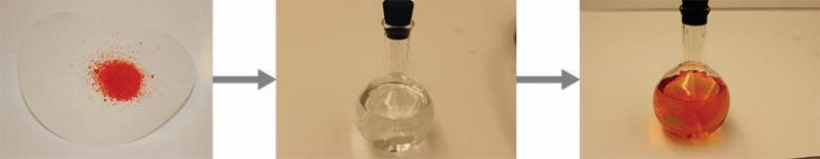
Figure 11.2
When potassium dichromate (K₂Cr₂O₇) is mixed with water, it forms a homogeneous orange solution. (credit: modification of work by Mark Ott)

Slide 10
Review Intermolecular Forces (IMFs)
Recall intermolecular forces (IMFs).

Slide 11
The Formation of Solutions
Three types of intermolecular attractive forces influence whether substances will form a solution.
solute-solute
solvent-solvent
solute-solvent

Slide 12
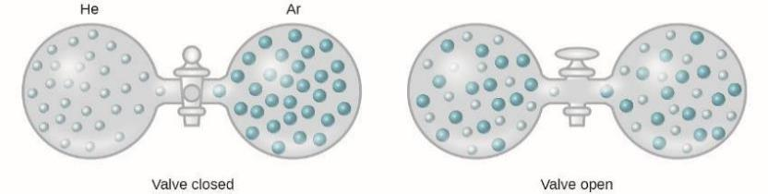
Figure 11.3
Samples of helium and argon spontaneously mix to give a solution.

Slide 13
The Formation of Solutions
We can think of solution formation as a step-wise process.
Step 1: Solute-solute IMFs must be overcome. Energy is consumed.
Step 2: Solvent-solvent IMFs must be overcome. Energy is consumed.
Step 3: Solvation-solute-solvent attractive forces are established. Energy is released.

Slide 14
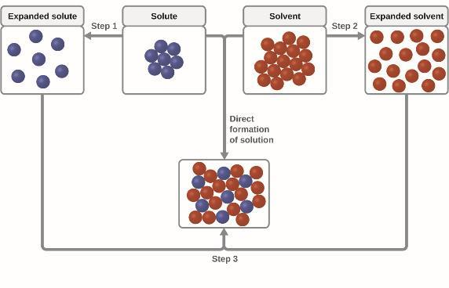
Figure 11.4
This schematic representation of dissolution shows a stepwise process involving the endothermic separation of solute and solvent species (Steps 1 and 2) and exothermic solvation (Step 3).

Slide 15
The Formation of Solutions
The relative magnitudes of the energy changes for these three steps determine whether the solution formation process is exothermic, endothermic, or does not occur at all.
If,
If,
If,

Slide 16
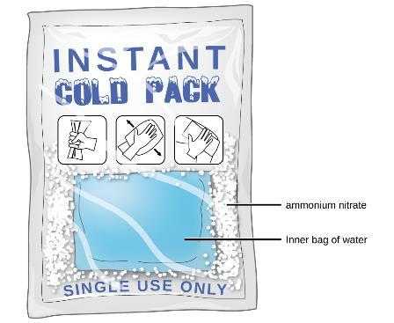
Figure 11.5
An instant cold pack gets cold when certain salts, such as ammonium nitrate, dissolve in water—an endothermic process.

Slide 17
Solvent-Solvent Interactions
The Golden Rule of Solubility is “Like Dissolves Like”
If two substances have very similar IMFs then they are likely to be soluble in one another.
Step 3 will be highly exothermic.
Nonpolar solvents dissolve nonpolar solutes.
Polar solvents dissolve polar solutes and many ionic solutes.

Slide 18
Learning Objectives
11.2 Electrolytes
  Define and give examples of electrolytes
  Distinguish between the physical and chemical changes that accompany dissolution of ionic and covalent electrolytes
  Relate electrolyte strength to solute-solvent attractive forces

Slide 19
Electrolytes
Electrolytes: Substances that dissolve in water and undergo a physical or chemical change to produce ions.
Nonelectrolytes: Substances that do not produce ions when dissolved in water.

Slide 20
Strong vs. Weak Electrolytes
Strong electrolytes: Essentially 100% of the dissolved substance generates ions.
Weak electrolytes: Only a relatively small fraction of the dissolved substance generates ions.

Slide 21
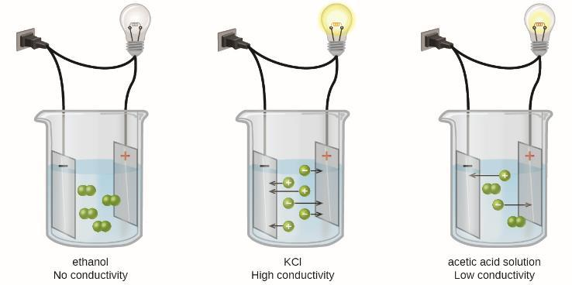
Figure 11.6
Solutions of nonelectrolytes such as ethanol do not contain dissolved ions and cannot conduct electricity. Solutions of electrolytes contain ions that permit the passage of electricity. The conductivity of an electrolyte solution is related to the strength of the electrolyte.

Slide 22
Ionic Electrolytes
Water and other polar molecules are attracted to ions.
The electrostatic attraction between an ion and a molecule with a dipole (polar molecule) is called an ion-dipole attraction.
Water molecules surround and solvate the separated ions.
This physical process is known as dissociation.

Slide 23
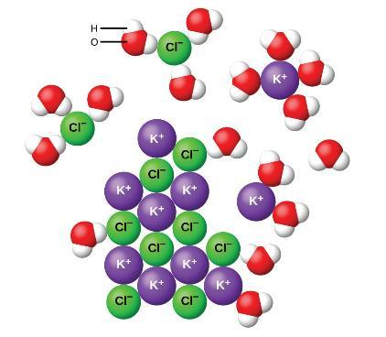
Figure 11.7
As potassium chloride (KCl) dissolves in water, the ions are hydrated. The polar water molecules are attracted by the charges on the K⁺ and Cl⁻ ions. Water molecules in front of and behind the ions are not shown.

Slide 24
Solubility of Ionic Compounds
Competing forces influence the extent of solubility of an ionic compound.
Ion-dipole attraction: If this is the dominate force then the compound it “pulled” into solution and has very high water solubility.
The force of attraction between oppositely charged ions: If this is the dominate force then the compound tends to remain un-dissolved and in the solid state, and have very low water solubility.

Slide 25
Covalent Electrolytes
Some covalent compounds are electrolytes because they chemically react with water to produce ions.
Example: HCl

Slide 26
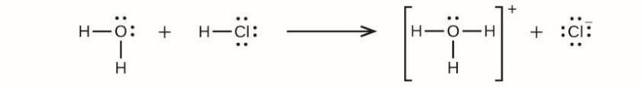
UNFIGURE 11.1

Slide 27
Learning Objectives
11.3 Solubility
  Describe the effects of temperature and pressure on solubility
  State Henry’s law and use it in calculations involving the solubility of a gas in a liquid
  Explain the degrees of solubility possible for liquid-liquid solutions

Slide 28
Solubility
Even most highly water soluble compounds have a limit to how much you can dissolve.
Solubility: The maximum concentration of a solute that can be achieved in a particular solvent under given conditions.

Slide 29
Solubility Terms
When a solute’s concentration equals its solubility the solution is called saturated.
When a solute’s concentration is less than its solubility the solution is called unsaturated.
When a solute’s concentration is greater than its solubility the solution is called supersaturated.

Slide 30
Principles of Solubility
The extent to which a solute dissolves in a solvent depends on several factors:
  The nature of the solvent and solute molecules and the interactions between them.
  The temperature at which the solution is formed.
  When dealing with a gaseous solute, the pressure is also important.

Slide 31
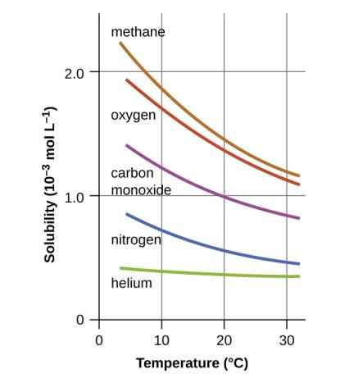
Figure 11.8
The solubilities of these gases in water decrease as the temperature increases. All solubilities were measured with a constant pressure of 101.3 kPa (1 atm) of gas above the solutions.

Slide 32
Pressure and Gas Solubility
Pressure has a major effect on the solubility of a gas in a liquid.
Gas solubility (C_{g}) and partial pressure (P_{g}) are directly proportional.
Henry’s Law: Solubility of a Gas
k = constant of that particular gas-liquid system and temperature.

Slide 33
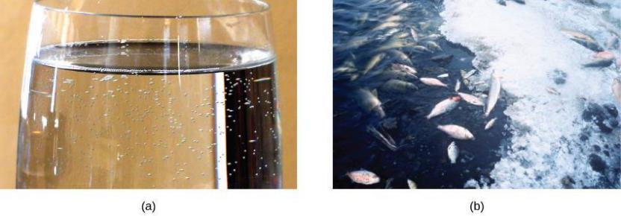
Figure 11.9
(a) The small bubbles of air in this glass of chilled water formed when the water warmed to room temperature and the solubility of its dissolved air decreased. (b) The decreased solubility of oxygen in natural waters subjected to thermal pollution can result in large-scale fish kills. (credit a: modification of work by Liz West; credit b: modification of work by U.S. Fish and Wildlife Service)

Slide 34
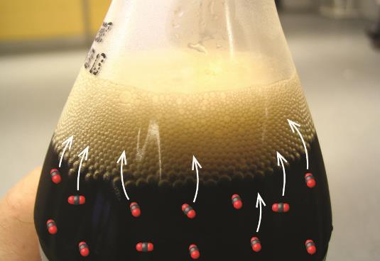
Figure 11.10
Opening the bottle of carbonated beverage reduces the pressure of the gaseous carbon dioxide above the beverage. The solubility of CO₂ is thus lowered, and some dissolved carbon dioxide may be seen leaving the solution as small gas bubbles. (credit: modification of work by Derrick Coetzee)

Slide 35
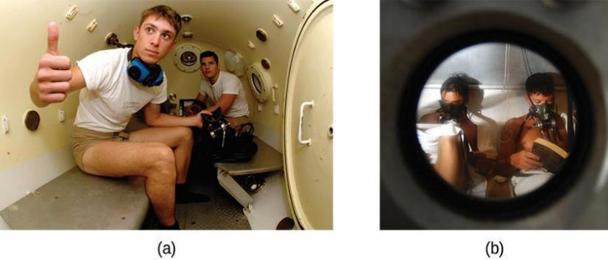
Figure 11.11
US Navy divers undergo training in a recompression chamber.
Divers receive hyperbaric oxygen therapy.

Slide 36
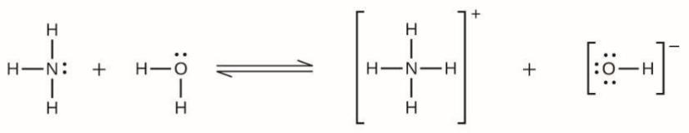
UNFIGURE 11.2

Slide 37
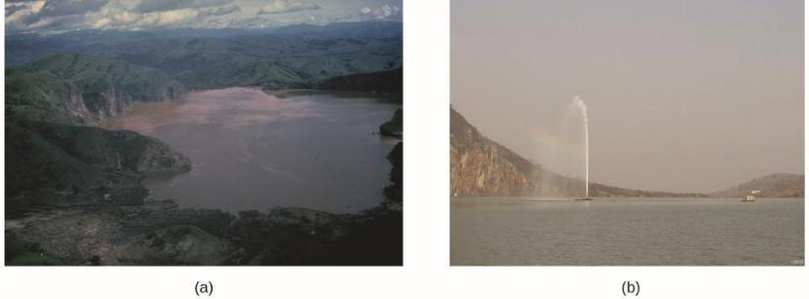
Figure 11.12
(a) It is believed that the 1986 disaster that killed more than 1700 people near Lake Nyos in Cameroon resulted when a large volume of carbon dioxide gas was released from the lake. (b) A CO₂ vent has since been installed to help outgas the lake in a slow, controlled fashion and prevent a similar catastrophe from happening in the future. (credit a: modification of work by Jack Lockwood; credit b: modification of work by Bill Evans)

Slide 38
Solutions of Liquids in Liquids
Liquids can be dissolved in other liquids.
Both solute and solvent are liquids.

Slide 39
Miscible Liquids
Two liquids that mix with each other in all proportions are called miscible.
Examples:
  Ethanol and water
  Gasoline and oil

Slide 40
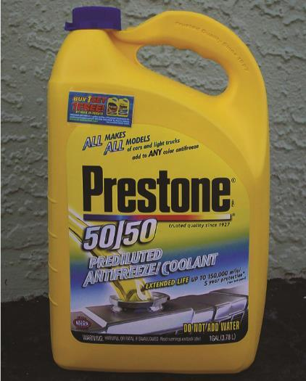
Figure 11.13
Water and antifreeze are miscible; mixtures of the two are homogeneous in all proportions. (credit: “dno1967”/Wikimedia commons)

Slide 41
Immiscible Liquids
Two liquids that do not mix to an appreciable extent are called immiscible.
Example:
  Non-polar liquids (gasoline, oil, hydrocarbons) and water.

Slide 42
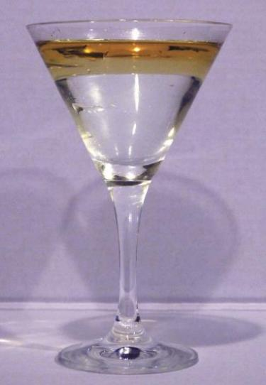
Figure 11.14
Water and oil are immiscible. Mixtures of these two substances will form two separate layers with the less dense oil floating on top of the water. (credit: “Yortw”/Flickr)

Slide 43
Partially Miscible Liquids
Two liquids that are of moderate mutual solubility are called partially miscible.
Example:
  Bromine and water.

Slide 44
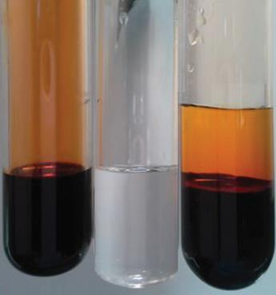
Figure 11.15
Bromine (the deep orange liquid on the left) and water (the clear liquid in the middle) are partially miscible. The top layer in the mixture on the right is a saturated solution of bromine in water; the bottom layer is a saturated solution of water in bromine. (credit: Paul Flowers)

Slide 45
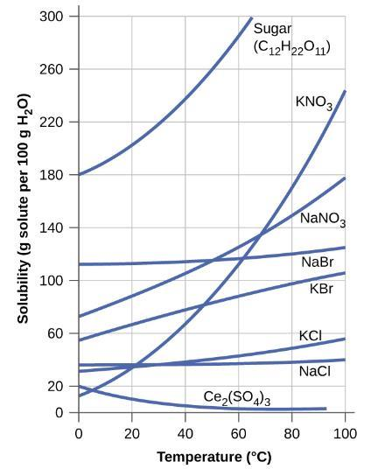
Figure 11.16
This graph shows how the solubility of several solids changes with temperature.

Slide 46
Temperature and Solubility of Solids
Both ionic and covalent solids can dissolve in liquids.
H₂O
  NaC₂H₃O₂(s) Na⁺ (aq) + C₂H₃O₂–(aq)
Dissolving a solid in a liquid is usually an endothermic process.
Added heat favors the formation of products (dissolved ions).
Thus, the solubility of most solids tends to increase with temperature.

Slide 47
Supersaturated Solutions
To make a supersaturated solution with a solid solute.
  Make a saturated solution of the compound at high temperature.
  Slowly cool to a lower temperature.
  If cooling is slow and careful, the solid won’t precipitate.
  At the lower temperature, you will have a solute concentration that is greater than the compound’s solubility.
Adding a crystal of the solid or agitating the solution results in precipitation of the excess solute. https://www.youtube.com/watch?v=BLq5NibwV5g

Slide 48
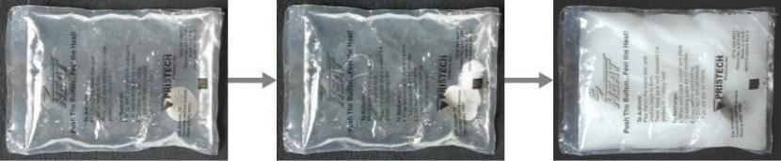
Figure 11.17
This hand warmer produces heat when the sodium acetate in a supersaturated solution precipitates. Precipitation of the solute is initiated by a mechanical shockwave generated when the flexible metal disk within the solution is “clicked.” (credit: modification of work by “Velela”/Wikimedia Commons)

Slide 49
Learning Objectives
11.4 Colligative Properties
  Express concentrations of solution components using mole fraction and molality
  Describe the effect of solute concentration on various solution properties (vapor pressure, boiling point, freezing point, and osmotic pressure)
  Perform calculations using the mathematical equations that describe these various colligative effects
  Describe the process of distillation and its practical applications
  Explain the process of osmosis and describe how it is applied industrially and in nature

Slide 50
Colligative Properties
The properties of a solution differ considerably from those of the pure solvent and pure solute.
Some solution properties depend on the identity of the solute.
  Examples: acidity, basicity, density
Other properties only depend on solute concentration and not its identity.
Colligative properties depend primarily on the concentration of solute particles, and not on the nature or identity of the solute.

Slide 51
Colligative Properties That We Will Discuss
Vapor pressure lowering
Boiling point elevation
Freezing point depression
Osmotic pressure

Slide 52
Concentration Units
Molarity (M)
Mass percent
Mole fraction (X)
Molarity (m)

Slide 53
Molarity
Molarity is defined as moles of solute per liter of solution. Symbol M (capital letter!)
Limitation: Molarity is temperature dependent. Solution volume changes with temperature.

Slide 54
Concentration by Mass
Mass percent

Slide 55
Mole Fraction (X)
Mole fraction is independent of temperature.
  The mole fraction of component A is the moles of A divided by the total number of moles of all solution components.
  The mole fractions of all components must sum to 1.

Slide 56
Molality (m)
Molality (m): Moles of solute per kilogram of solvent.
Lowercase “m” is the symbol for molality.
Molality is also independent of temperature.

Slide 57
Vapor Pressure Lowering
Adding a nonvolatile solute to a pure solvent lowers the solvent’s vapor pressure.
Result: The Solvent in a solution evaporates more slowly than the pure solvent would.
Vapor Pressure Lowering (ΔP) is a colligative property.

Slide 58
Vapor Pressure Review
Think back to Liquid-Vapor Equilibrium (Ch. 10).
When a liquid is placed in a closed container, vaporization and condensation happen at equal rates.
Liquid ⇌ Gas
The vapor pressure of the liquid is the pressure exerted by the gas phase molecules.

Slide 59
Why Does Vapor Pressure Lowering (ΔP) Occur?
Liquid ⇌ Gas
To vaporize, solvent molecules must be at the surface of the liquid.
Solute molecules decrease the surface area available for solvent molecules.
The rate of solvent vaporization decreases.
The rate of solvent condensation remains the same.

Slide 60
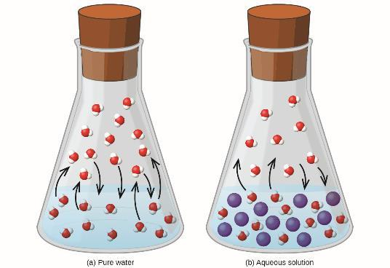
Figure 11.18
The presence of nonvolatile solutes lowers the vapor pressure of a solution by impeding the evaporation of solvent molecules.

Slide 61
Why Does Vapor Pressure Lowering (ΔP) Occur?
Liquid ⇌ Gas
Result: Less solvent molecules in the gas phase.
The decrease in gas phase molecules results in a lowering of the vapor pressure.

Slide 62
Raoult’s Law
Raoult’s law: The partial pressure exerted by any component of an ideal solution is equal to the vapor pressure of the pure component multiplied by its mole fraction.
P_{solution} = vapor pressure of the solvent in solution.
C_{solvent} = mole fraction of the solvent.
P*_{solvent} = vapor pressure of the pure solvent.

Slide 63
Boiling Point Elevation and Freezing Point Depression
A solution boils at a higher temperature than that of the pure solvent.
  The difference in boiling point of the solution and pure solvent is called the boiling point elevation (ΔT_{b}).
A solution freezes at a lower temperature than that of the pure solvent.
  The difference in freezing point of the solution and pure solvent is is called the freezing point depression (ΔT_{f}).
ΔT_{b} and ΔT_{f} are both positive quantities.

Slide 64
Boiling Point Elevation and Freezing Point Depression
Boiling point elevation (ΔT_{b}) and freezing point depression (ΔT_{f}) are both a direct result of vapor pressure lowering.
Boiling occurs when vapor pressure equals atmospheric pressure.
Vapor pressure is directly proportional to temperature.

Slide 65
Boiling Point Elevation and Freezing Point Depression
The presence of a solute lowers the vapor pressure.
A higher temperature is now required for the vapor pressure to equal the atmospheric pressure.
The boiling point has therefore increased.

Slide 66
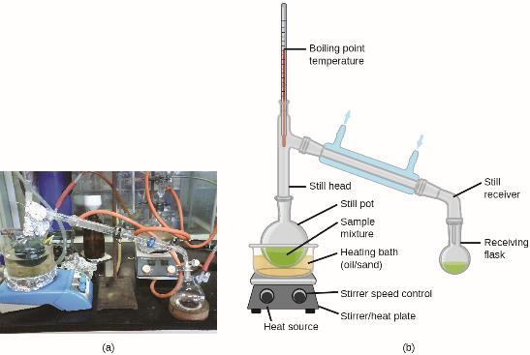
Figure 11.19
A typical laboratory distillation unit is shown in (a) a photograph and (b) a schematic diagram of the components. (credit a: modification of work by “Rifleman82”/Wikimedia commons; credit b: modification of work by “Slashme”/Wikimedia Commons)

Slide 67
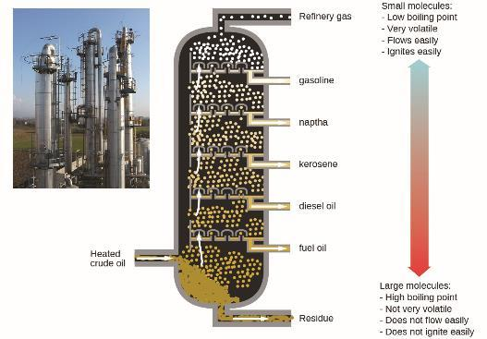
Figure 11.20
Crude oil is a complex mixture that is separated by large-scale fractional distillation to isolate various simpler mixtures.

Slide 68
Boiling Point Elevation and Freezing Point Lowering
Boiling point elevation (ΔT_{b}) and freezing point lowering (ΔT_{f}) are both colligative properties.
  Depend on the concentration of the solute
  Concentration expressed in molality (m).
  Example: 1 m sucrose and 1 m ethylene glycol solutions boil at the same temp.
k_{b} and k_{f} are called the boiling point elevation constant and freezing point depression constant, respectively.

Slide 69
Table 11.2 Boiling Point Elevation and Freezing Point Depression
Constants for Several Solvents
Solvent | Boiling Point (°C at 1 atm) | Kb (Cm^{–1}) | Freezing Point (°C at 1 atm) | Kt (Cm^{–1})
water | 100.0 | 0.512 | 0.0 | 1.86
hydrogen acetate | 118.1 | 3.07 | 16.6 | 3.9
benzene | 80.1 | 2.53 | 5.5 | 5.12
chloroform | 61.26 | 3.63 | –63.5 | 4.68
nitrobenzene | 210.9 | 5.24 | 5.67 | 8.1
k_{b} and k_{f} values depend on the identity of the solvent

Slide 70
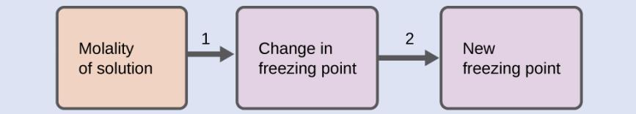
Example 11.7

Slide 71
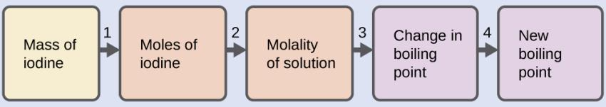
Example 11.8

Slide 72
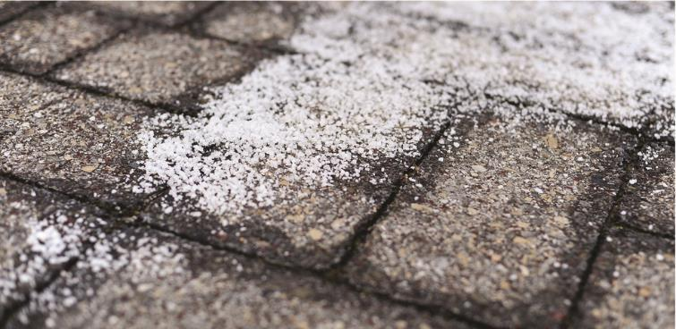
Figure 11.21
Rock salt (NaCl), calcium chloride (CaCl₂), or a mixture of the two are used to melt ice. (credit: modification of work by Eddie Welker)

Slide 73
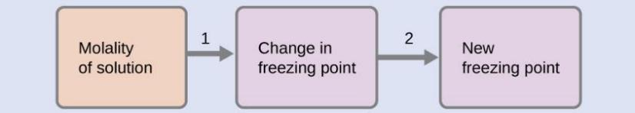
Example 11.9

Slide 74
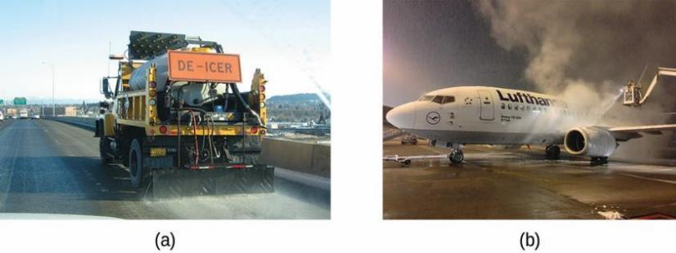
Figure 11.22
Freezing point depression is exploited to remove ice from (a) roadways and (b) the control surfaces of aircraft.

Slide 75
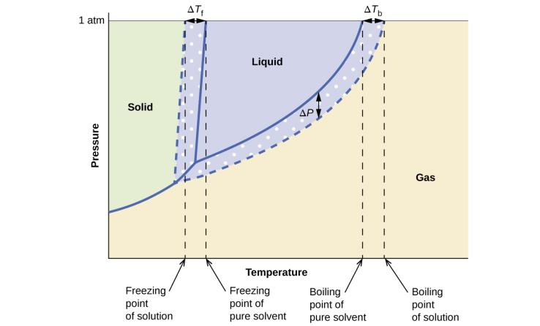
Figure 11.23
These phase diagrams show water (solid curves) and an aqueous solution of nonelectrolyte (dashed curves).

Slide 76
Semipermeable Membranes
Semipermeable membranes: Material that only allows select molecules or ions to pass through of certain size, shape, polarity, charge, or other factor.
Consider a semipermeable membrane that only allows solvent molecules to permeate and not solute.
This semipermeable membrane separates a sample of pure solvent from a solution.

Slide 77
Osmosis and Osmotic Pressure of Solutions
Solvent molecules diffuse across the membrane in both directions.
The concentration of solvent is higher in the pure sample.
This results in solvent molecules diffusing at a faster rate from pure solvent to solution relative to the reverse direction.

Slide 78
Osmosis and Osmotic Pressure of Solutions
Result: A net transfer of solvent molecules from the pure solvent to the solution.
Diffusion-driven transfer of solvent molecules through a semipermeable membrane is a process called osmosis.

Slide 79
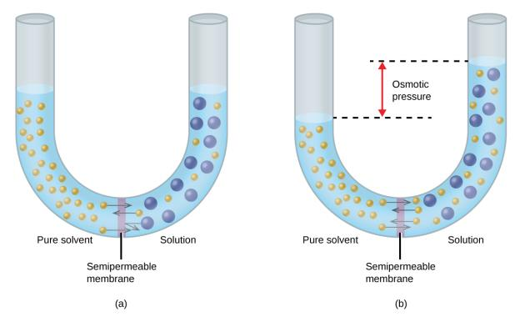
Figure 11.24
(a) A solution and pure solvent are initially separated by an osmotic membrane. (b) Net transfer of solvent molecules to the solution occurs until its osmotic pressure yields equal rates of transfer in both directions.

Slide 80
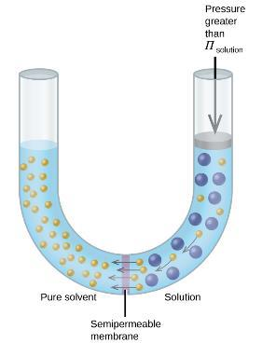
Figure 11.25
Applying a pressure greater than the osmotic pressure of a solution will reverse osmosis. Solvent molecules from the solution are pushed into the pure solvent.

Slide 81
Osmotic Pressure Is a Colligative Property
The flow of solvent during osmosis creates a force.
The osmotic pressure (symbol π) is the pressure just sufficient to prevent osmosis from occurring.
Conc. is expressed in molarity (M), not molality (m)!
R = Gas Law Constant = 0.08206 L ∙ atm/mol ∙ K
T = Temperature in K

Slide 82
Reverse Osmosis
Applying a pressure to the solution greater than the osmotic pressure results in reverse osmosis.
Solvent molecules are pushed from the solution to the pure solvent.

Slide 83
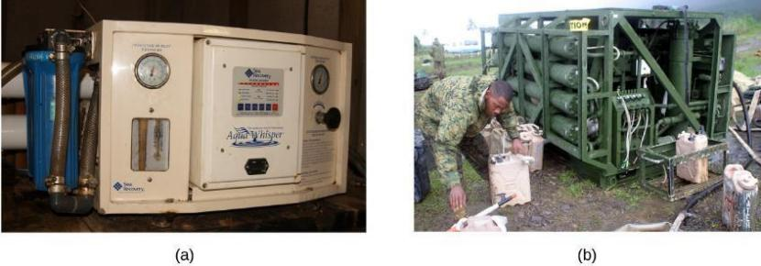
Figure 11.26
Reverse osmosis systems for purifying drinking water are shown here on (a) small and
(b) large scales. (credit a: modification of work by Jerry Kirkhart; credit b: modification of work by Willard J. Lathrop)

Slide 84
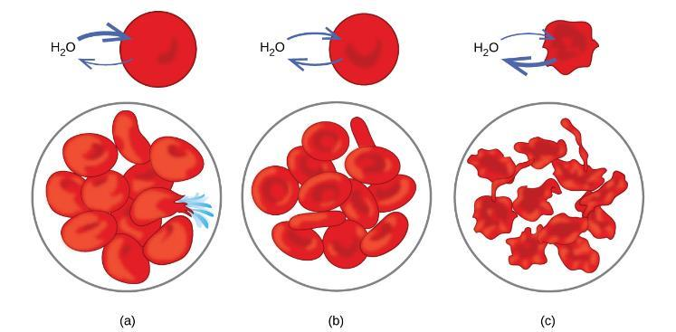
Figure 11.27
Red blood cell membranes are water permeable and will (a) swell and possibly rupture in a hypotonic solution; (b) maintain normal volume and shape in an isotonic solution; and
(c) shrivel and possibly die in a hypertonic solution. (credit a/b/c: modifications of work by “LadyofHats”/Wikimedia commons)

Slide 85
Determination of Molar Mass from Colligative Properties
Colligative properties can be used to determine the molar mass of an unknown solute.
  Freezing point lowering (ΔT_{f}) and osmotic pressure (Π) are most commonly used.

Slide 86
Determination of Molar Mass from Colligative Properties
Typical Procedure:
Add a known mass of the solute to either
  A known mass of the solvent
  Or to create a solution of known volume
Measure the colligative property (ΔT_{f} or Π).
Calculate the concentration (m or M) of the solute.
Determine the number of moles of solute present from the concentration.
Calculate the molar mass (MM).
MM = g/mole

Slide 87
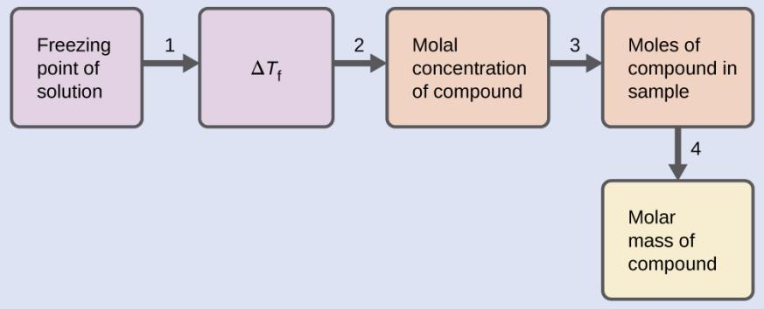
Example 11.11

Slide 88
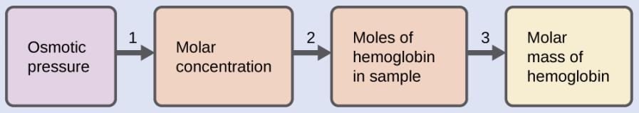
Example 11.12

Slide 89
Colligative Properties of Electrolytes
Colligative properties are directly proportional to the concentration of solute particles. It doesn‘t matter what those particles are.
At a given concentration, electrolytes have a greater effect on colligative properties than non-electrolytes.
Dissolving 1 mole of a glucose, C₆H₁₂O₆ (non-electrolyte), results in 1 mole of solute particles.
Dissolving 1 mole of NaCl (electrolyte) results in 2 moles of solute particles.

Slide 90
The van’t Hoff Factor (i)
The van’t Hoff factor, (i), is the ratio of solute particles in solution to the number of formula units dissolved.
For NaCl, i (predicted) = 2
For C₆H₁₂O₆, i (predicted) = 1
What is the predicted i for CaCl₂?
What is the predicted i for Na₃PO₄?

Slide 91
Table 11.3 Predicated and Measured van’t Hoff Factors for Several
0.050 m Aqueous Solutions
For strong electrolytes, the experimentally measured van’t Hoff factors are lower than that predicted.
This implies incomplete dissociation.
Formula unit | Classification | Dissolution products | i, (predicted) | i, (measured)
C₁₂H₂₂O₁₁ (glucose) | Nonelectrolyte | C₁₂H₂₂O₁₁ | 1 | 1.0
NaCl | Strong electrolyte | Na⁺, Cl– | 2 | 1.9
HCl | Strong electrolyte (acid) | H₃O⁺, Cl– | 2 | 1.9
MgSO₄ | Strong electrolyte | Mg²⁺, SO₄^{2–} | 2 | 1.3
MgCl₂ | Strong electrolyte | Mg²⁺, 2Cl– | 3 | 2.7
FeCl₃ | Strong electrolyte | Fe³⁺, 3Cl– | 4 | 3.4

Slide 92
Why Incomplete Dissociation?
Cation-anion attraction prevents some of the ions from behaving as completely independent particles.
Some “ion pairs” are formed.
The “effective concentration” known as activity is less than the predicted concentration of ions in solution.
This is less of an issue in dilute solutions.

Slide 93
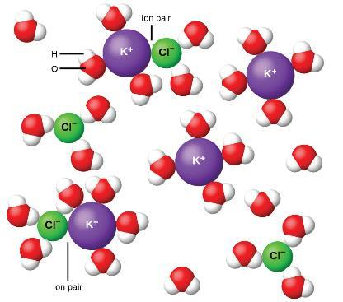
Figure 11.28
Dissociation of ionic compounds in water is not always complete due to the formation of ion pairs.

Slide 94
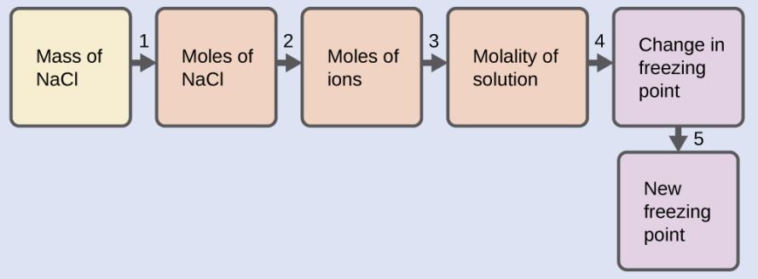
Example 11.13

Slide 95
Learning Objectives
11.5 Colloids
  Describe the composition and properties of colloidal dispersions
  List and explain several technological applications of colloids

Slide 96
Adjusted Colligative Property Equations for Electrolyte
Solutions

Slide 97
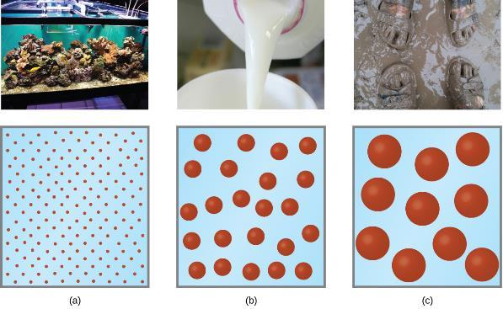
Figure 11.29
(a) A solution is a homogeneous mixture that appears clear, such as the saltwater in this aquarium. (b) In a colloid, such as milk, the particles are much larger but remain dispersed and do not settle. (c) A suspension, such as mud, is a heterogeneous mixture of suspended particles that appears cloudy and in which the particles can settle. (credit a photo: modification of work by Adam Wimsatt; credit b photo: modification of work by Melissa Wiese; credit c photo: modification of work by Peter Burgess)

Slide 98

Figure 11.30
The paths of searchlight beams are made visible when light is scattered by colloidal-size particles in the air (fog, smoke, etc.). (credit: “Bahman”/Wikimedia Commons)

Slide 99

Figure 11.31
Soaps contain a nonpolar hydrocarbon end (blue) and an ionic end (red). The ionic end is a carboxylate group. The length of the hydrocarbon end can vary from soap to soap.

Slide 100
Figure 11.32
Detergents contain a nonpolar hydrocarbon end (blue) and an ionic end (red). The ionic end can be either a sulfate or a sulfonate. The length of the hydrocarbon end can vary from detergent to detergent.

Slide 101
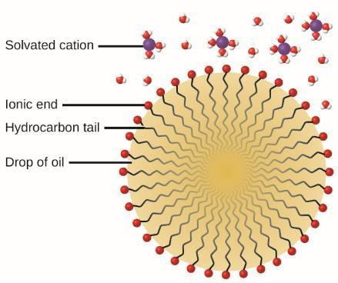
Figure 11.33
This diagrammatic cross section of an emulsified drop of oil in water shows how soap or detergent acts as an emulsifier.

Slide 102
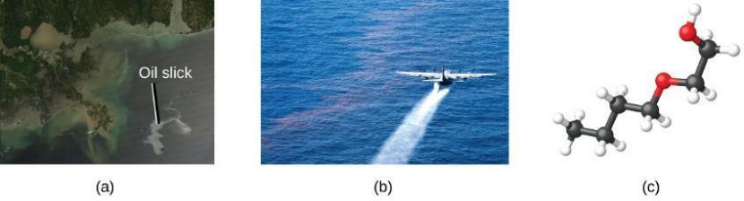
Figure 11.34
(a) This NASA satellite image shows the oil slick from the Deepwater Horizon spill. (b) A US Air Force plane sprays Corexit, a dispersant. (c) The molecular structure of 2-butoxyethanol is shown. (credit a: modification of work by “NASA, FT2, demis.nl”/Wikimedia Commons; credit b: modification of work by “NASA/MODIS Rapid Response Team”/Wikimedia Commons)

Slide 103
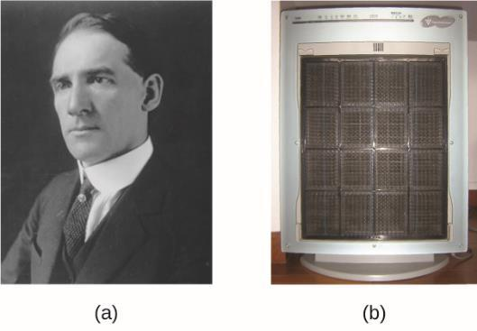
Figure 11.35
(a) Frederick Cottrell developed (b) the electrostatic precipitator, a device designed to curb air pollution by removing colloidal particles from air. (credit b: modification of work by “SpLot”/Wikimedia Commons)

Slide 104
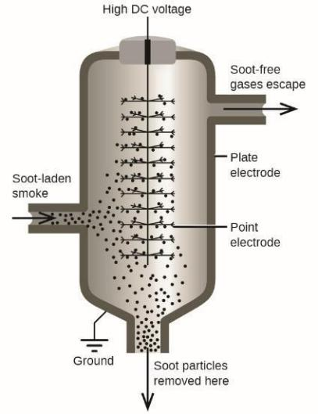
Figure 11.36
In a Cottrell precipitator, positively and negatively charged particles are attracted to highly charged electrodes, where they are neutralized and deposited as dust.

Slide 105
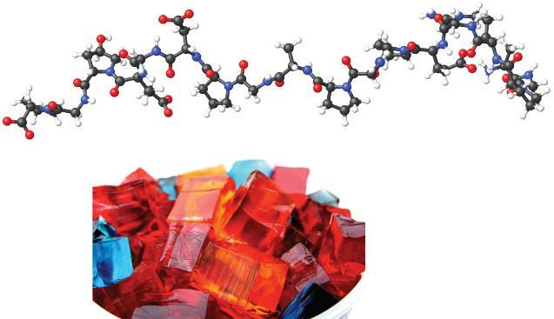
Figure 11.37
Gelatin desserts are colloids in which an aqueous solution of sweeteners and flavors is dispersed throughout a medium of solid proteins. (credit photo: modification of work by Steven Depolo)

Slide 106
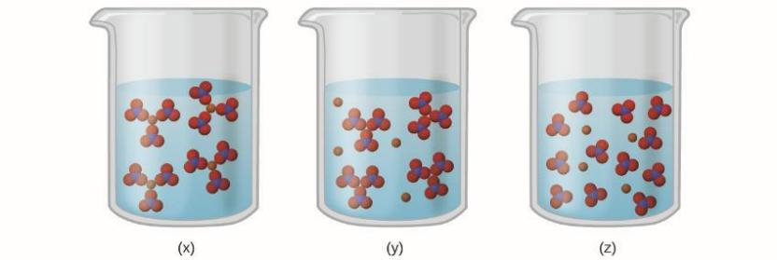
Exercise 11

Slide 107
This OpenStax ancillary resource is © Rice University under a CC-BY 4.0 International license; it may be reproduced or modified but must be attributed to OpenStax, Rice University and any changes must be noted.

