Slide 1


CHEMISTRY 2e
Chapter 12 Kinetics
PowerPoint Image Slideshow

Slide 2
Chapter Outline
12.1 Chemical Reaction Rates
12.2 Factors Affecting Reaction Rates
12.3 Rate Laws
12.4 Integrated Rate Laws
12.5 Collision Theory
12.6 Reaction Mechanisms
12.7 Catalysis

Slide 3
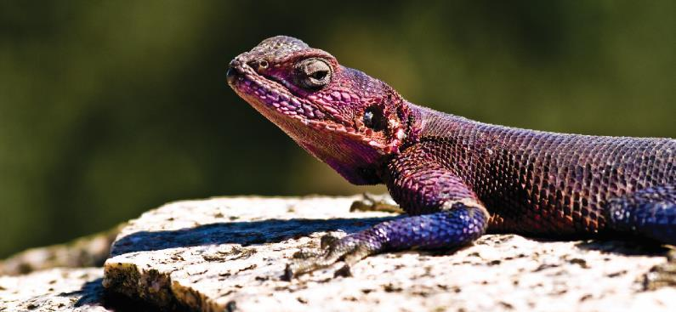
Figure 12.1
An agama lizard basks in the sun. As its body warms, the chemical reactions of its metabolism speed up.

Slide 4
Learning Objectives
12.1 Chemical Reaction Rates
  Define chemical reaction rate
  Derive rate expressions from the balanced equation for a given chemical reaction
  Calculate reaction rates from experimental data

Slide 5
Chemical Reaction Rates
Chemical reactions occur at different rates.
Some reactions are fast, while other reactions are slow.
Chemists study the rates of reactions and also try to control these rates.
The study of reaction rates is known as kinetics.

Slide 6
Chemical Reaction Rates
The rate of a reaction is the change in the amount of a reactant or product per unit time.
It is often convenient to express amount in terms of concentration.
Rate expression: Mathematical representation of rate of reaction.

Slide 7
Rate Expressions
Reaction rates are always positive quantities.
Concentration is most often expressed in Molarity.
Rate expressions can be written in terms of reactant or product concentration.

Slide 8
Writing Rate Expressions
2N₂O₅(g) → 4NO₂(g) + O₂(g)
Write the rate expression in terms of each species.
Rate of N₂O₅ decomposition =
Rate of NO₂ formation =
Rate of O₂ formation =

Slide 9
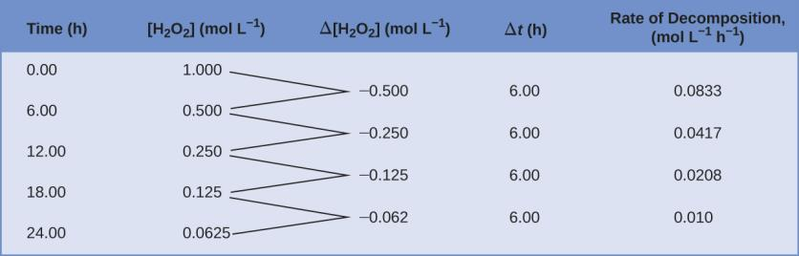
Figure 12.2
The rate of decomposition of H₂O₂ in an aqueous solution decreases as the concentration of H₂O₂ decreases.

Slide 10
Average vs. Instantaneous Reaction Rates
Average reaction rate: The rate at which a reaction proceeds over a time period.
  Calculated using concentrations at the beginning and end of a time period.
Instantaneous reaction rate: The rate at which a reaction is proceeding at a specific time and/or conc.
  Calculated using a graph (Conc. vs. time) and a slope of a straight line tangent to the curve at that specific time.
  Or by determining the avg. rate of reaction over a very short time period.
Initial reaction rate: The instantaneous reaction rate at “time zero”.

Slide 11
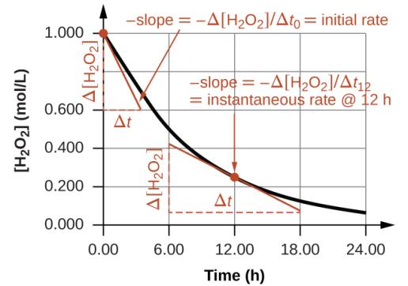
Figure 12.3
Determining Different Rates of Reaction
2H₂O₂(aq) → 2H₂O(l) + O₂(g)
This graph shows a plot of concentration versus time for a 1.000 M solution of H₂O₂. The rate at any instant is equal to the opposite of the slope of a line tangential to this curve at that time. Tangents are shown at t = 0 h (“initial rate”) and at t = 10 h (“instantaneous rate” at that particular time).

Slide 12
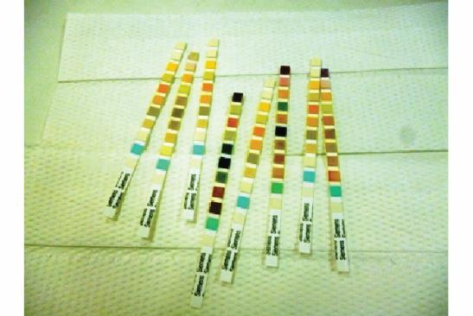
Figure 12.4
Test strips are commonly used to detect the presence of specific substances in a person’s urine. Many test strips have several pads containing various reagents to permit the detection of multiple substances on a single strip. (credit: Iqbal Osman)

Slide 13
Relative Rates of Reaction
The rate of a reaction may be expressed in terms of the change in concentration of any reactant or product.
Stoichiometric factors derived from a balanced equation may be used to relate reaction rates.

Slide 14
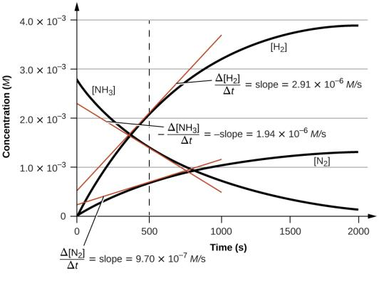
Figure 12.5
This graph shows the changes in concentrations of the reactants and products during the reaction 2NH₃ ⟶ 3N₂ + H₂. The rates of change of the three concentrations are related by their stoichiometric factors, as shown by the different slopes of the tangents at t = 500 s.

Slide 15
Learning Objectives
12.2 Factors Affecting Reaction Rates
  Describe the effects of chemical nature, physical state, temperature, concentration, and catalysis on reaction rates

Slide 16
Factors Affecting Reaction Rates
Chemical nature of the reactants.
  Example: As you move down a group the alkali metals react at a faster rate with water.
https://www.youtube.com/watch?v=jI__JY7pqOM

Slide 17
Factors Affecting Reaction Rates
The state of subdivision of the reactants.
  The rate of most reactions increase with increasing surface area contact between reactants.

Slide 18
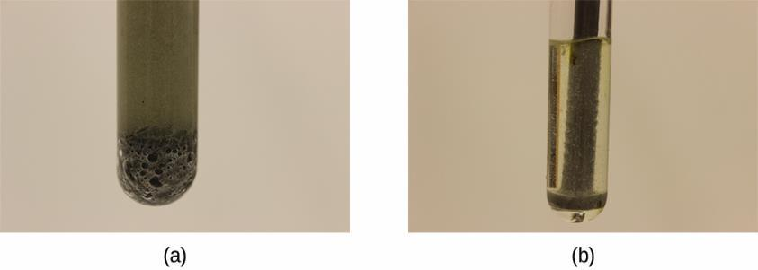
Figure 12.6
(a) Iron powder reacts rapidly with dilute hydrochloric acid and produces bubbles of hydrogen gas: 2Fe(s) + 6HCl(aq) ⟶ 2FeCl3(aq) + 3H₂(g). (b) An iron nail reacts more slowly because the surface area exposed to the acid is much less.

Slide 19
Factors Affecting Reaction Rates
Temperature of the reactants.
  Reaction rate ordinarily increases with temperature.
Concentration of the reactants.
  Reaction rate ordinarily increases with the concentration of reactants.
The presence of a catalyst

Slide 20
Rate and Collision
Chemical reactions occur as the result of collisions between reactant molecules.
The higher the concentration of reactant molecules, the more likely molecules will collide and react, and therefore the faster the reaction rate.
https://www.youtube.com/watch?v=m4_twEXWjgg
As reactants get consumed, collisions happen less frequently and the reaction rate decreases.

Slide 21

Figure 12.7
Statues made from carbonate compounds such as limestone and marble typically weather slowly over time due to the actions of water, and thermal expansion and contraction. However, pollutants like sulfur dioxide can accelerate weathering. As the concentration of air pollutants increases, deterioration of limestone occurs more rapidly. (credit: James P Fisher III)

Slide 22
Learning Objectives
12.3 Rate Laws
  Explain the form and function of a rate law
  Use rate laws to calculate reaction rates
  Use rate and concentration data to identify reaction orders and derive rate laws

Slide 23
Rate Laws
Rate is directly related to reactant concentration.

Slide 24
Rate Laws
N₂O₅ (g) → 2NO₂ (g) + ½O₂ (g)
The rate law for this reaction is: rate = k[N₂O₅]
  Only reactants appear in a rate law.
  k is the rate constant for the reaction.
The rate law is used to calculate the instantaneous rate or initial rate of reaction with a specific reactant concentration.
For some reactions the rate law is more complex…

Slide 25
Rate Constant, k
The rate constant, k is specific for a particular reaction at a particular temperature.
k is independent of reactant concentration.
k must be determined experimentally.

Slide 26
Rate Laws
Experiments must be done to determine the rate law for a reaction.
  Can’t just use a balanced chemical equation.
For a reaction with a single reactant:
  A → products
  rate = k[A]^{m}
  m is the order of the reaction
  m must be determined experimentally (not from balanced chemical equations).
  Reaction orders are usually positive integers (0, 1, 2…) but can also be fractions or negative numbers.

Slide 27
Rate Laws
Most reactions involve more than one reactant.
A + B → products
rate = k[A]^{m}[B]^{n}
There are three orders:
  m is the order with respect to A
  n is the order with respect to B
  The overall order of the reaction = m + n

Slide 28
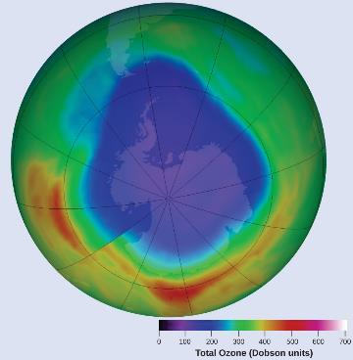
Figure 12.8
A contour map showing stratospheric ozone concentration and the “ozone hole” that occurs over Antarctica during its spring months. (credit: modification of work by NASA)

Slide 29
Order with Respect to a Reactant
The order with respect to a reactant indicates the dependence of the reaction rate on the concentration of that particular reactant.
The overall order gives an understanding of how all the reactants contribute to the rate of a reaction.
  Also, dictates the units of the rate constant for that reaction.

Slide 30
Determination of a Reaction’s Rate Law
One way to determine the rate law of a reaction is to measure the initial rate.
  The rate at time zero.
If the initial rate is measured with a number of different initial reactant concentrations then the rate law can be determined.

Slide 31
How to Determine a Rate Law
The order with respect to a particular reactant can be determined by varying its initial concentration while holding the initial concentration(s) of the other reactant(s) constant.
  Experimentally measure the initial rate with each of the two different concentrations.
  The change in rate is then a direct result of the reactant which changed in concentration.
  The order with respect to that reactant can then be calculated.
Repeat this process with all reactants.

Slide 32
Learning Objectives
12.4 Integrated Rate Laws
  Explain the form and function of an integrated rate law
  Perform integrated rate law calculations for zero-, first-, and second-order reactions
  Define half-life and carry out related calculations
  Identify the order of a reaction from concentration/time data

Slide 33
Integrated Rate Laws
So far we have only talked about the concentration-rate relationship.
A → products Rate = k[A]^{m}
The rate law can be integrated with respect to time to produce a concentration-time relationship known as an integrated rate law.
This relationship depends on the order of the reaction: Zero order, 1st order, 2nd order, etc.
A new term, the half-life, will also be introduced.

Slide 34
First-Order Reactions
For 1st order reactions of the type A → products
rate = k[A]
Integration with respect to time gives us:
k is the rate constant
t is time
[A]₀ is the initial reactant conc.
[A]_{t} is the reactant conc. present at time t

Slide 35
Linear Form of the First-Order Integrated Rate Law
We can put the first-order integrated rate law into the form
y = mx + b
  ln[A]_{t} plotted on the y-axis
  time (t) plotted on the x-axis
  The slope of the line is –k
  The y-intercept is ln[A]₀

Slide 36
Integrated Rate Laws
Note that when using all of the integrated rate laws
The amount of reactant (A) does not always need to be expressed in Molarity (M) as the equations imply.
The amount can also be expressed in
  Mass (g, mg, etc.)
  Number of molecules or atoms
  Other conc. units such as g/L
  Partial pressure if A is a gas (assuming volume and temperature remain constant).

Slide 37
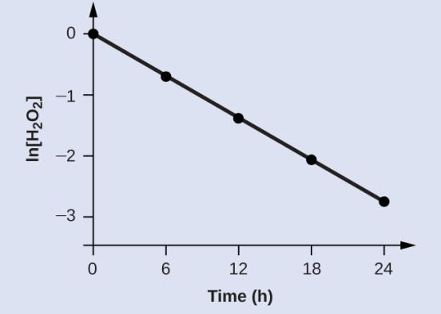
Figure 12.9
The linear relationship between the ln[H₂O₂] and time shows that the decomposition of hydrogen peroxide is a first-order reaction.

Slide 38
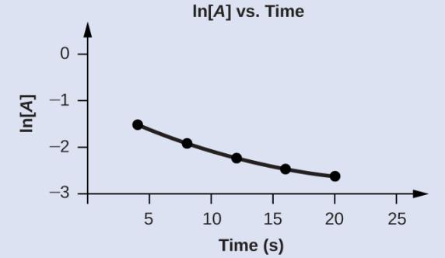
Example 12.7

Slide 39
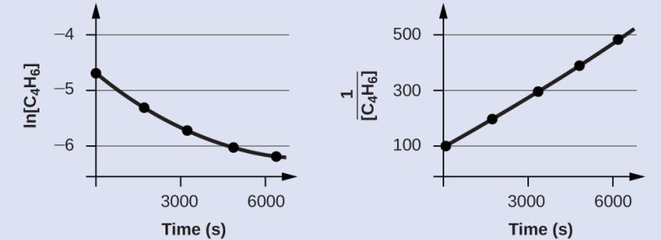
Figure 12.10
These two graphs show first- and second-order plots for the dimerization of C₄H₆. The linear trend in the second-order plot (right) indicates that the reaction follows second-order kinetics.

Slide 40
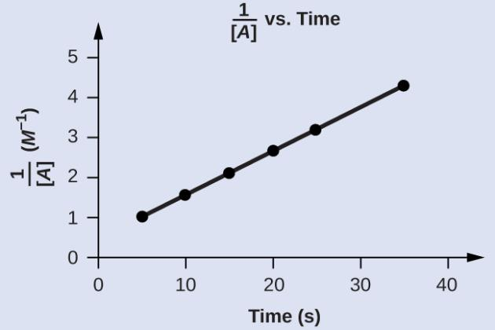
Example 12.9

Slide 41
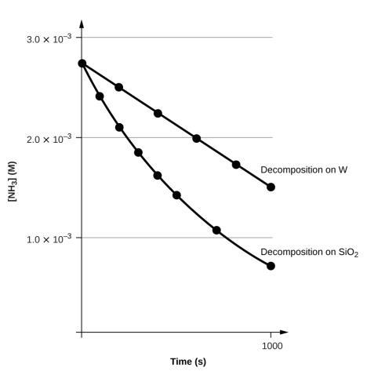
Figure 12.11
The decomposition of NH₃ on a tungsten (W) surface is a zero-order reaction, whereas on a quartz (SiO₂) surface, the reaction is first order.

Slide 42
The Half Life: First-Order Reaction
The half-life (t_{1/2}) of a reaction is the time it takes for one half of a given amount of reactant to be consumed.
For a first-order reaction, at the half-life, t_{1/2}
  [A]_{t} = ½[A]₀
  Solving for t in ln[A]_{t} = –kt + ln[A]₀

Slide 43
The Half Life: First-Order Reaction
Notice that for a first-order reaction, the half-life is independent of the initial concentration of reactant.

Slide 44
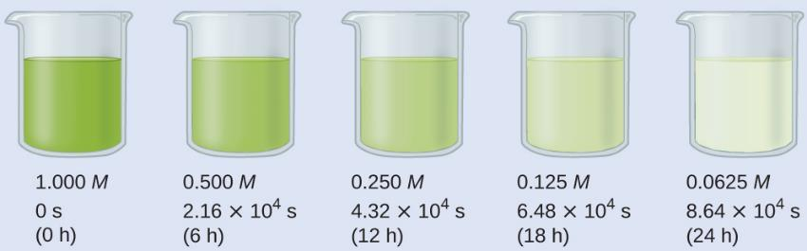
Figure 12.12
The decomposition of H₂O₂ (2H₂O₂ ⟶ 2H₂O + O₂) at 40 °C is illustrated. The intensity of the color symbolizes the concentration of H₂O₂ at the indicated times; H₂O₂ is actually colorless.

Slide 45
Second-Order Integrated Rate Law
For A → products, Rate = k[A]²
Integration with respect to time gives us:
The half-life of a second-order reaction does depend on the initial concentration of reactant.

Slide 46
Zero-Order Integrated Rate Law
For a zero-order reaction: A → products
Integration with respect to time gives us:
Note that the half-life of a zero-order reaction DOES DEPEND on the initial concentration of reactant.

Slide 47
Learning Objectives
12.5 Collision Theory
  Use the postulates of collision theory to explain the effects of physical state, temperature, and concentration on reaction rates
  Define the concepts of activation energy and transition state
  Use the Arrhenius equation in calculations relating rate constants to temperature

Slide 48
Collision Theory
Collision theory: Reactants (atoms, molecules, or ions) must collide in order to react with each other.
Postulates of Collision theory:
Rate of Reaction is proportional to the rate of reactant collisions.

Slide 49
Collisions: Effective and Ineffective
Why does every collision not lead to a reaction?
Molecules must be oriented properly when they collide.

Slide 50
Collisions: Effective and Ineffective
Why does every collision not lead to a reaction?
Molecules must have adequate kinetic energy to react.
  The kinetic energy supplied must be high enough to break the chemical bonds.
  Molecules with kinetic energies too small just bounce off each other and don’t react.
  This required energy is called the activation energy
Activation energy (E_{a}): minimum energy necessary to form a product during a collision between reactants.

Slide 51
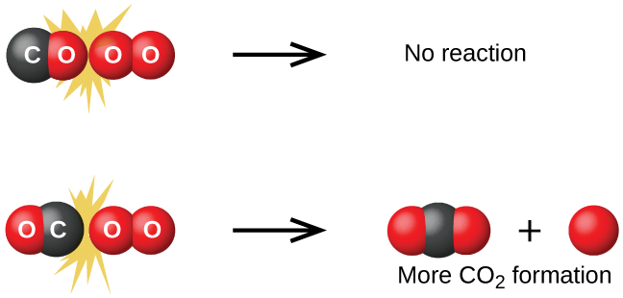
Figure 12.13
Illustrated are two collisions that might take place between carbon monoxide and oxygen molecules. The orientation of the colliding molecules partially determines whether a reaction between the two molecules will occur.

Slide 52
Transition-State Model
Reaction energy diagram
  Potential energy is plotted on the y-axis
  Reaction path (or extent of reaction) is plotted on the x-axis.
The reactants form an intermediate called an activated complex.
  The state of the system at the activated complex is called a transition state.

Slide 53
Reaction Rate and Temperature
Thus far we have discussed:
  The concentration-rate relationship
  The concentration-time relationship
Now we will look at the temperature–rate relationship.
Reaction rate ordinarily increases with temperature.
  To cook food more quickly, raise the oven temperature.
  To slow the reactions that lead to food spoilage, put food in the refrigerator.
  To really slow the reactions down, put food in the freezer.

Slide 54
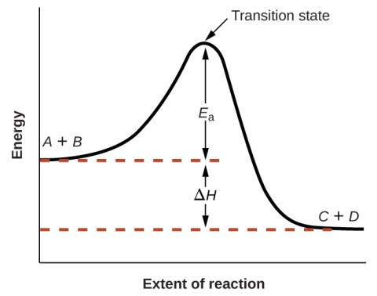
Figure 12.14
This graph shows the potential energy relationships for the reaction A + B ⟶ C + D. The dashed portion of the curve represents the energy of the system with a molecule of A and a molecule of B present, and the solid portion the energy of the system with a molecule of C and a molecule of D present. The activation energy for the forward reaction is represented by E_{a}. The activation energy for the reverse reaction is greater than that for the forward reaction by an amount equal to ΔH. The curve’s peak is represented the transition state.

Slide 55
Kinetic Theory
Temperature is a measure of the average kinetic energy of molecules.
Higher temperatures mean higher kinetic energies.
The higher the temperature, the larger the fraction of molecules with kinetic energies equal to or greater than the activation energy (E_{a}).
With a larger fraction of molecules possessing E_{a}, a larger fraction of collisions lead to product formation, resulting in a higher rate of reaction.

Slide 56
Kinetic Theory
Consider the following equation:
A is a constant called the frequency factor and is related to the frequency of collision and orientation.
The rate constant (k) is dependent on the activation energy of the reaction and the temperature.

Slide 57
Kinetic Theory
Consider two different reactions that occur at the same temperature. Each reaction has a different E_{a}.

Slide 58
Kinetic Theory
Consider the same reaction at two different temperatures. E_{a} is independent of temperature.

Slide 59
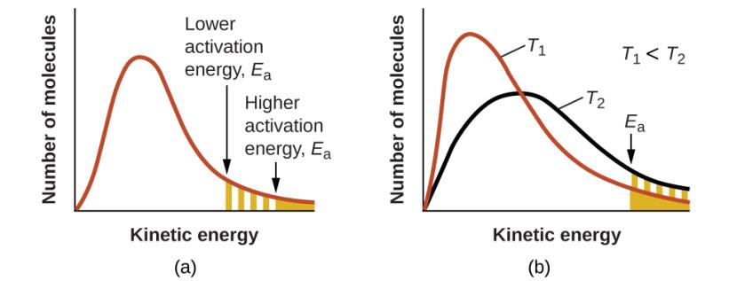
Figure 12.15
The area under the curve (right) is directly proportional to the number of molecules possessing those energies.
Molecular energy distributions showing numbers of molecules with energies exceeding (a) two different activation energies at a given temperature, and (b) a given activation energy at two different temperatures.

Slide 60
Arrhenius Equation
Taking the natural logarithm of both sides of the equation gives the Arrhenius equation.

Slide 61
Two-Point Form of the Arrhenius Equation
This form of the Arrhenius equation can be used with two k values and two corresponding temperatures to calculate E_{a}.
You do not need to know the value of the constant, A, to use this equation.
Make sure that the energy units on E_{a} and R are identical.

Slide 62
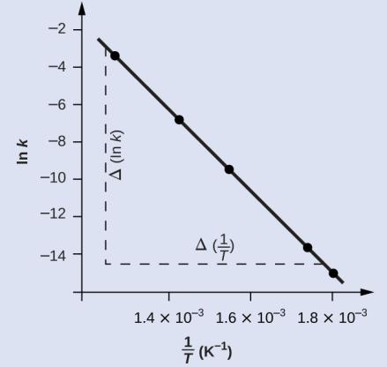
Figure 12.16
This graph shows the linear relationship between ln k and 1/T for the reaction 2HI ⟶ H₂ + I₂ according to the Arrhenius equation.

Slide 63
Learning Objectives
12.6 Reaction Mechanisms
  Distinguish net reactions from elementary reactions (steps)
  Identify the molecularity of elementary reactions
  Write a balanced chemical equation for a process given its reaction mechanism
  Derive the rate law consistent with a given reaction mechanism

Slide 64
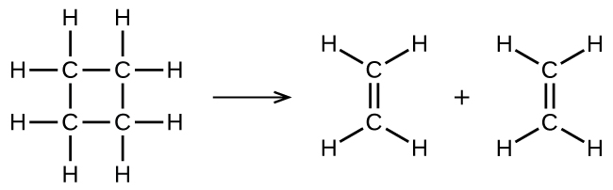
UNFIGURE 12.1

Slide 65
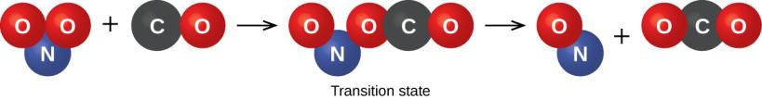
Figure 12.17
The probable mechanism for the reaction between NO₂ and CO to yield NO and CO₂.

Slide 66
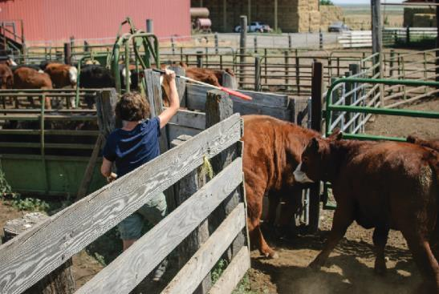
Figure 12.18
A cattle chute is a nonchemical example of a rate-determining step. Cattle can only be moved from one holding pen to another as quickly as one animal can make its way through the chute. (credit: Loren Kerns)

Slide 67
Learning Objectives
12.7 Catalysis
  Explain the function of a catalyst in terms of reaction mechanisms and potential energy diagrams
  List examples of catalysis in natural and industrial processes

Slide 68
Catalysis
Catalyst: A substance that increases the rate of a chemical reaction by lowering the activation energy without itself being consumed by the reaction.
The catalyst is regenerated in the process.
Catalysts provide an alternate reaction pathway with a lower activation energy.
Sometimes the catalyzed path contains multiple steps, but each individual step has an activation energy that is lower than the activation energy of the uncatalyzed reaction.

Slide 69
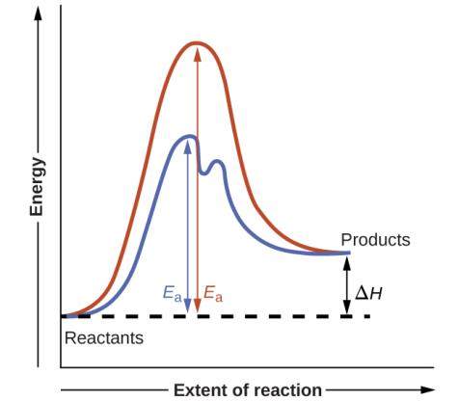
Figure 12.19
Reaction diagrams for an endothermic process in the absence (red curve) and presence (blue curve) of a catalyst. The catalyzed pathway involves a two-step mechanism (note the presence of two transition states) and an intermediate species (represented by the valley between the two transitions states).

Slide 70
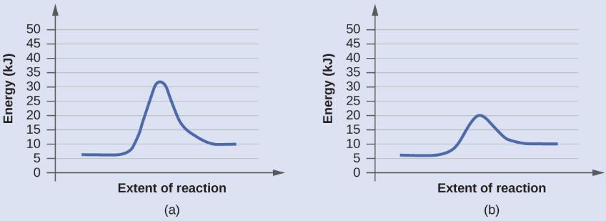
Example 12.15

Slide 71
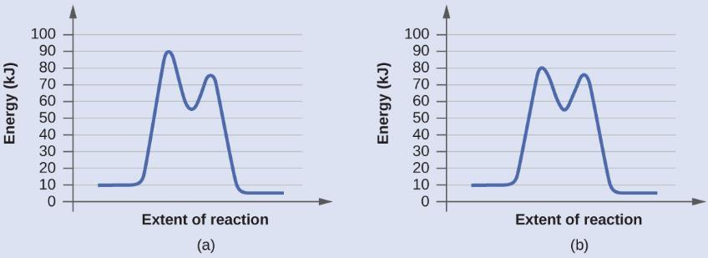
Example 12.15

Slide 72
Types of Catalysis
A homogeneous catalyst is in the same phase as the reactants. It speeds up the reaction by forming a reactive intermediate.
The reactive intermediate reacts further to form product and regenerate the catalyst.
The reactive intermediate is formed but immediately consumed.

Slide 73
Homogeneous Catalyst
Example: Chlorine radicals (Cl) that catalyze the decomposition of ozone.
Cl(g) + O₃(g) → ClO(g) + O₂(g)
ClO(g) + O(g) → Cl(g) + O₂(g)

Slide 74
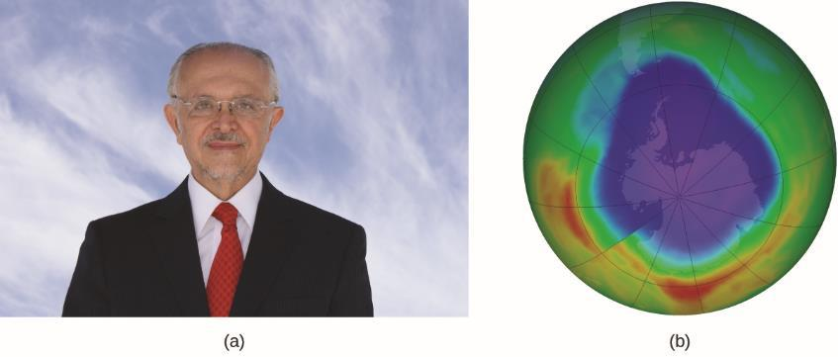
Figure 12.20
(a) Mexican chemist Mario Molina (1943 –) shared the Nobel Prize in Chemistry in 1995 for his research on (b) the Antarctic ozone hole. (credit a: courtesy of Mario Molina; credit b: modification of work by NASA)

Slide 75
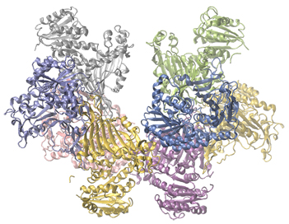
Figure 12.21
Glucose-6-phosphate dehydrogenase is a rate-limiting enzyme for the metabolic pathway that supplies NADPH to cells.

Slide 76
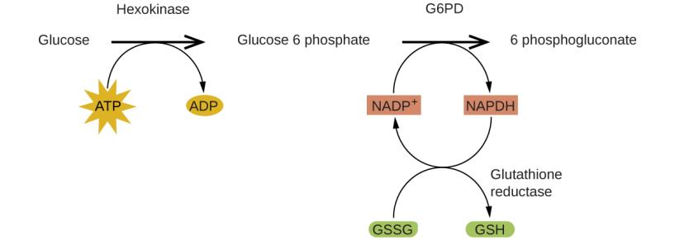
Figure 12.22
In the mechanism for the pentose phosphate pathway, G6PD catalyzes the reaction that regulates NAPDH, a co-enzyme that regulates glutathione, an antioxidant that protects red blood cells and other cells from oxidative damage.

Slide 77
Types of Catalysts
A heterogeneous catalyst is in a different phase from that of the reactants.
  Most commonly the catalyst is a solid and the reactants are in the gas or liquid phase.
  Example is the catalytic converter in automobiles which consists of platinum and rhodium metals.
Pt
2CO(g) + O₂(g) → CO₂(g)
Rh
NO(g) → N₂(g) + O₂(g)

Slide 78
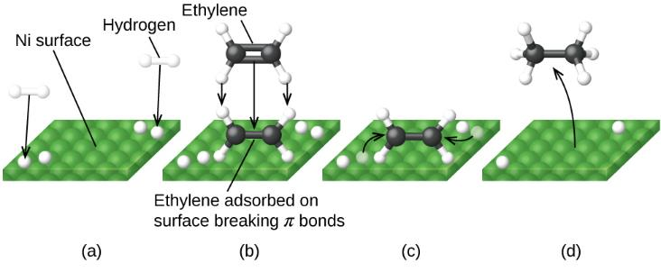
Figure 12.23
Mechanism for the Ni-catalyzed reaction C₂ H₄ + H₂ ⟶ C₂ H₆. (a) Hydrogen is adsorbed on the surface, breaking the H–H bonds and forming Ni–H bonds. (b) Ethylene is adsorbed on the surface, breaking the C–C π-bond and forming Ni–C bonds. (c) Atoms diffuse across the surface and form new C–H bonds when they collide. (d) C₂H₆ molecules desorb from the Ni surface.

Slide 79
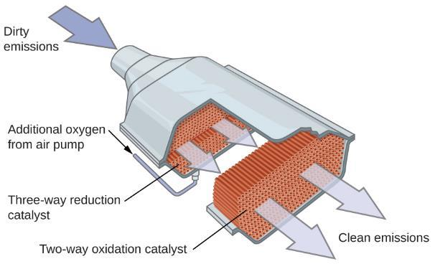
Figure 12.24
A catalytic converter allows for the combustion of all carbon-containing compounds to carbon dioxide, while at the same time reducing the output of nitrogen oxide and other pollutants in emissions from gasoline-burning engines.

Slide 80
Types of Catalysts
Enzymes are biocatalysts
  Protein molecules

Slide 81
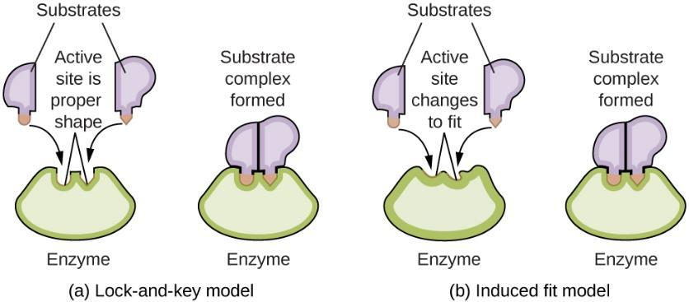
Figure 12.25
(a) According to the lock-and-key model, the shape of an enzyme’s active site is a perfect fit for the substrate. (b) According to the induced fit model, the active site is somewhat flexible, and can change shape in order to bond with the substrate.

Slide 82
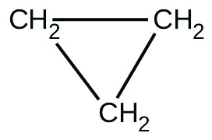
Exercise 44

Slide 83
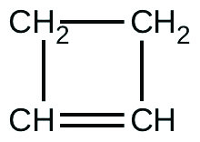
Exercise 49

Slide 84
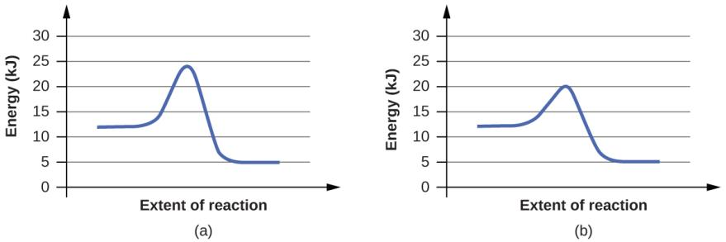
Exercise 79a

Slide 85
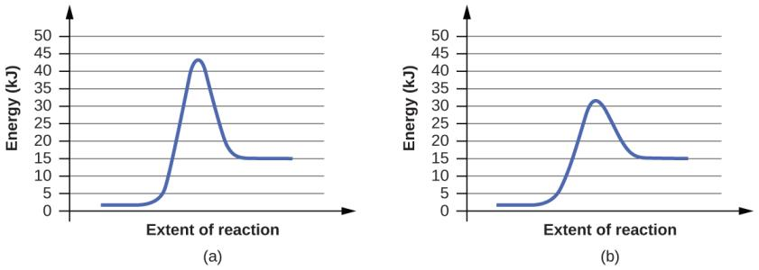
Exercise 79b

Slide 86
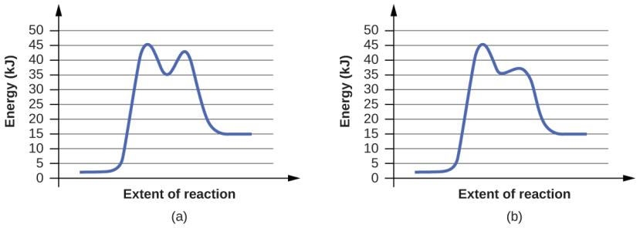
Exercise 80a

Slide 87
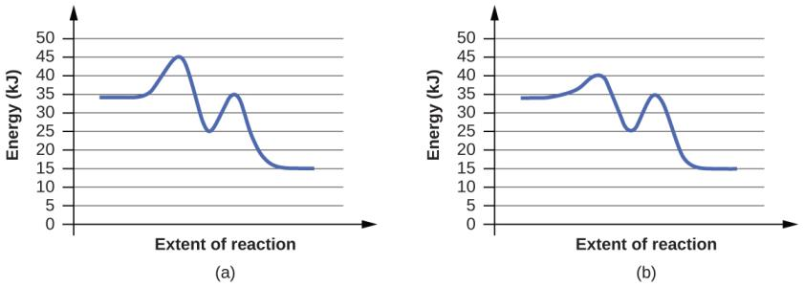
Exercise 80b

Slide 88
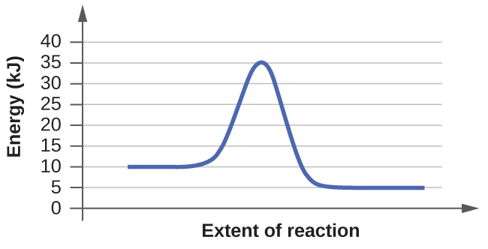
Exercise 81a

Slide 89
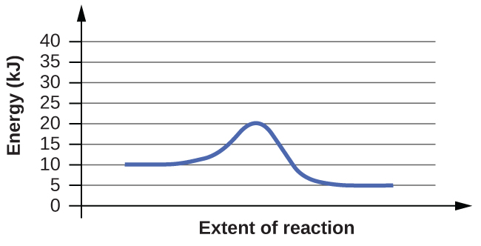
Exercise 81b

Slide 90
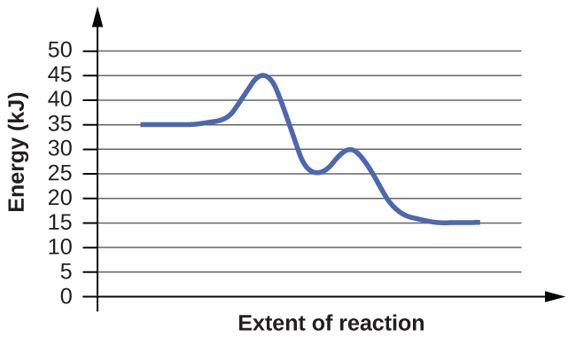
Exercise 82a

Slide 91
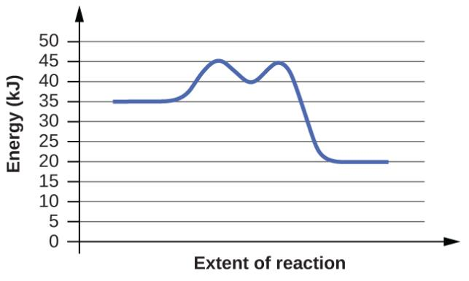
Exercise 82b

Slide 92
This OpenStax ancillary resource is © Rice University under a CC-BY 4.0 International license; it may be reproduced or modified but must be attributed to OpenStax, Rice University and any changes must be noted.

