Slide 1


CHEMISTRY 2e
Chapter 13 Fundamental Equilibrium Concepts
PowerPoint Image Slideshow

Slide 2
Chapter 13 Outline
13.1 Chemical Equilibrium
13.2 Equilibrium Constants
13.3 Shifting Equilibria: Le Châtelier’s Principle
13.4 Equilibrium Calculations

Slide 3
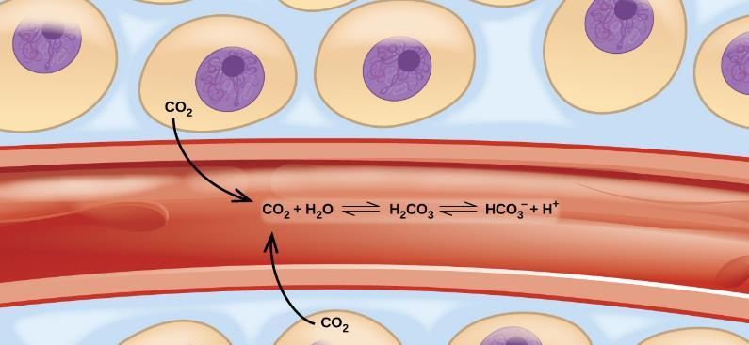
Figure 13.1
Transport of carbon dioxide in the body involves several reversible chemical reactions, including hydrolysis and acid ionization (among others).

Slide 4
Learning Objectives
13.1 Chemical Equilibria
  Describe the nature of equilibrium systems
  Explain the dynamic nature of a chemical equilibrium

Slide 5
Chemical Equilibria
Reactions with an appreciable reverse reaction are often best represented as an equilibrium.

Slide 6
Chemical Equilibria
N₂O₄ is colorless. NO₂ is brown.
When N₂O₄ is placed in a closed container at 100 °C, a reddish-brown color develops due to the formation of NO₂.
  The forward reaction occurs.
As NO₂ builds up, it can react to form N₂O₄
  The reverse reaction occurs.
At equilibrium, the amounts of reactants and products stop changing.

Slide 7
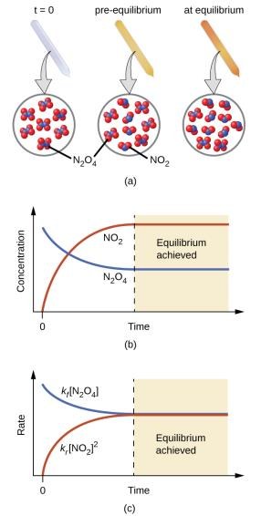
Figure 13.2
(a) A sealed tube containing colorless N2O4 darkens as it decomposes to yield brown NO2. (b) Changes in concentration over time as the decomposition reaction achieves equilibrium. (c) At equilibrium, the forward and reverse reaction rates are equal.

Slide 8
Establishment of Equilibrium
The rate of the forward reaction starts out fast, but slows down as the concentration of N₂O₄ decreases.
The rate of the reverse reaction starts out slow, but speeds up as the concentration of NO₂ increases.
Once the rates of both reactions are equal, equilibrium is established.
  No further changes in concentration of either gas occurs unless the temperature or the volume of the container is changed.

Slide 9
Common Equilibrium Misconceptions
The amount of reactants and products are ordinarily not equal to each other at equilibrium.
Although the amount of reactants and products remains constant at equilibrium, the system is not static at equilibrium.
Chemical equilibrium is a dynamic process.

Slide 10
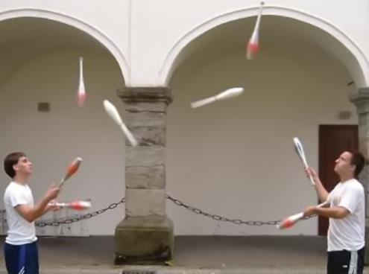
Figure 13.3
A two-person juggling act illustrates the dynamic aspect of chemical equilibria. Each person is throwing and catching clubs at the same rate, and each holds a (approximately) constant number of clubs.

Slide 11
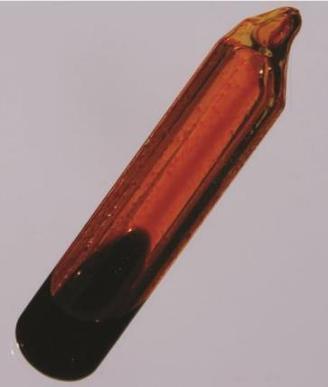
Figure 13.4
A sealed tube containing an equilibrium mixture of liquid and gaseous bromine. (credit: http://images-ofelements.com/bromine.php)

Slide 12
Learning Objectives
13.2 Equilibrium Constants
  Derive reaction quotients from chemical equations representing homogeneous and heterogeneous reactions
  Calculate values of reaction quotients and equilibrium constants, using concentrations and pressures
  Relate the magnitude of an equilibrium constant to properties of the chemical system

Slide 13
Equilibrium Constants
The symbol , placed between reactants and products, is used to designate reversible reactions.
The reaction quotient, Q, allows us to mathematically express the amounts of reactants and products present at any point in a reversible reaction.

Slide 14
The Reaction Quotient, Q
Consider the general reaction:
  A, B, C, D are either gases or aqueous species.
  m, n, x, y are the coefficients in the balanced equation.
When using amounts expressed in concentration, the reaction quotient is called Qc.

Slide 15
The Concentration Reaction Quotient, Q_{c}
All concentrations must be expressed in Molarity.
Product concentrations are in the numerator (multiplied together).
Reactant concentrations are in the denominator (multiplied together).
Each concentration is raised to the power of its coefficient from the balanced equation.

Slide 16
The Value of the Reaction Quotient, Q
The numeric value of Q_{c} for a given reaction can vary prior to equilibrium.
The value of Q_{c} depends on the concentration of products and reactants present at that particular moment.
We can calculate Q_{c} at any point in a reaction.
We will often calculate Q_{c} at the start of the reaction using initial concentrations.

Slide 17
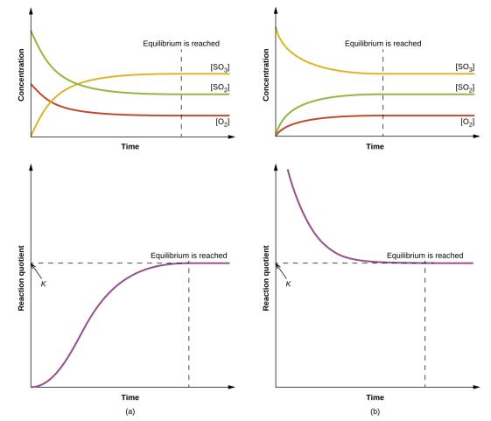
Figure 13.5
Changes in concentrations and Qc for a chemical equilibrium achieved beginning with a (a) mixture of reactants only and (b) products only.

Slide 18
The Equilibrium Constant, K
The value of Q when the reaction is at equilibrium is called the equilibrium constant (K).
Be careful not confuse with the kinetic rate constant (k).

Slide 19
Q and K
The equilibrium constant (K) has the same form as the reaction quotient (Q).
  For K, the concentrations must be those at equilibrium.
  For Q, the concentrations can be those at any point in the reaction, not necessarily when at equilibrium.

Slide 20
The Equilibrium Constant, K
The value of the equilibrium constant is independent of the starting amounts of reactants and products.
The value of the equilibrium constant is dependent on the temperature of the system.
The magnitude of an equilibrium constant indicates the extent of a reaction.
K and Q are unitless values.

Slide 21
The Magnitude of the Equilibrium Constant
If K is very small, the mixture contains mostly reactants at equilibrium.
If K is very large, the mixture contains mostly products at equilibrium.
The value of K gives no indication as to whether the reaction is fast or slow.

Slide 22
Q, K, and the Direction of Reaction
A system that is not at equilibrium will proceed in the direction that establishes equilibrium.
By comparing Q to K, it is possible to determine which direction the system will proceed to achieve equilibrium.

Slide 23
Q, K, and the Direction of Reaction
When Q < K
When Q > K
When Q = K

Slide 24
Changes in Reactant and Product Concentrations
There are many ways to approach the equilibrium state.
Mixture 1: Start with just CO and H₂O.
Mixture 2: Start with just CO₂ and H₂.
Mixture 3: Start with CO, H₂O, CO₂, and H₂.
The value of the equilibrium constant is independent of the starting amounts of the reactants and products.

Slide 25
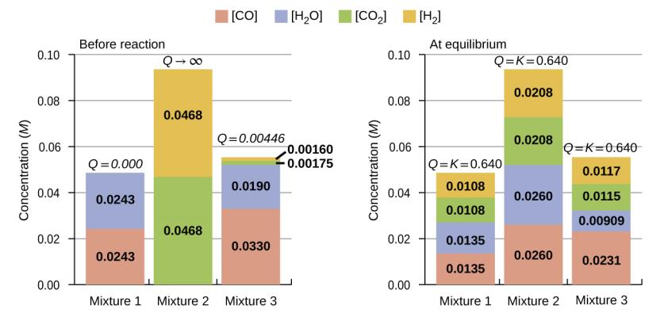
Figure 13.6
Compositions of three mixtures before (Q_{c} ≠ K_{c}) and after (Q_{c} = K_{c}) equilibrium is established for the reaction CO(g) + H₂O(g) ⇌ CO₂ (g) + H₂ (g).

Slide 26
Homogenous Equilibrium
A homogenous equilibrium is one in which all of the reactants and products are present in the same phase.
Most commonly are either liquid or gaseous phases.
Reaction quotients include concentration or pressure terms only for gaseous and solute species.
For gas-phase solutions, the equilibrium constant may be expressed in terms of either the molar concentrations (K_{c}) or partial pressures (K_{p}) of the reactants and products.

Slide 27
Homogenous Equilibria

Slide 28
K_{c} and K_{p}
For gas-phase solutions, the equilibrium constant may be expressed in terms of either the molar concentrations (K_{c}) or partial pressures (K_{p}) of the reactants and products.
A relation between these two K values may be simply derived from the ideal gas equation and the definition of molarity:

Slide 29
K_{c} and K_{p}
The relationship between K_{c} and K_{p}:
Δn is the change in the number of moles of gas.
R = 0.08206 L ∙ atm/mol ∙ K
T is temperature in Kelvin.

Slide 30
Heterogeneous Equilibrium
Some reaction mixtures contain reactants and products that are in two or more different phases. These systems are called heterogeneous equilibria.
Pure solids and pure liquids do not appear in the K expression.
The position of equilibrium is independent of the amount of solid or liquid present, as long as at least some is present in the reaction mixture.

Slide 31
Learning Objectives
13.3 Shifting Equilibria: Le Châtelier’s Principle
  Describe the ways in which an equilibrium system can be stressed
  Predict the response of a stressed equilibrium using Le Chatelier’s principle

Slide 32
Shifting Equilibria: Le Châtelier’s Principle
Le Châtelier’s Principle: When a chemical system at equilibrium is disturbed, it returns to equilibrium by counteracting the disturbance.
At equilibrium Q = K.
The disturbance causes a change in Q.
The reaction will shift to re-establish Q = K.

Slide 33
Adding or Removing a Reactant or Product
If a chemical equilibrium is disturbed by adding a reactant or product, the system will proceed in the direction that consumes part of the added species.
If a chemical equilibrium is disturbed by removing a reactant or product, the system will proceed in the direction that restores part of the removed species.
The system responds in the way that restores equilibrium and therefore allows Q = K again.

Slide 34
Adding or Removing a Pure Liquid or Solid
Adding or removing a pure liquid or solid has no effect on the system unless all of the liquid or solid is removed.
This is because pure liquids and solids do not appear in the equilibrium expression.

Slide 35
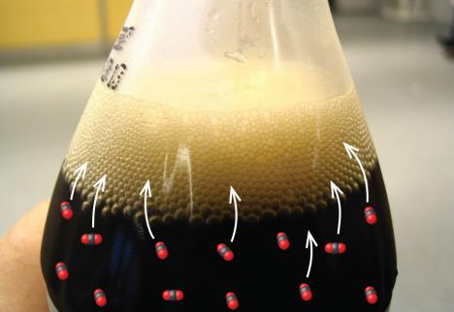
Figure 13.7

Slide 36
Changes in Temperature
If you increase the temperature, you increase the heat. The equilibrium responds in a fashion that consumes the added heat.

Slide 37
Temperature and the Equilibrium Constant
Changing the temperature of a system results in a change in the value of the equilibrium constant.
If the forward reaction is exothermic, then K decreases as T increases.
If the forward reaction is endothermic, then K increases as T increases.

Slide 38
Catalysts do not Affect Equilibrium
A catalyst speeds up the rate of a reaction.
For reversible reactions, catalysts increase the rates of the forward and reverse reactions.
Result: A catalyst causes the system to reach equilibrium more quickly.
But a catalyst does not affect the equilibrium concentrations or value of the equilibrium constant.

Slide 39
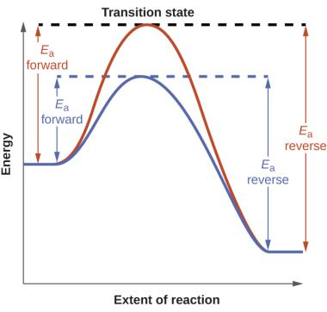
Figure 13.8
Reaction diagrams for an elementary process in the absence (red) and presence (blue) of a catalyst. The presence of catalyst lowers the activation energies of both the forward and reverse reactions but does not affect the value of the equilibrium constant.

Slide 40
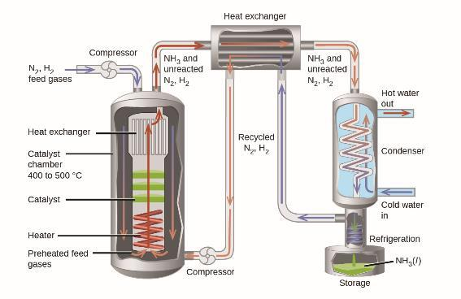
Figure 13.9
The figure shows a typical industrial setup for the commercial production of ammonia by the Haber-Bosch process. The process operates under conditions that stress the chemical equilibrium to favor product formation.

Slide 41
Learning Objectives
13.4 Equilibrium Calculations
  Identify the changes in concentration or pressure that occur for chemical species in equilibrium systems
  Calculate equilibrium concentrations or pressures and equilibrium constants, using various algebraic approaches

Slide 42
Equilibrium Calculations
Types of Equilibrium Calculations:
Calculation of an equilibrium constant
Calculation of missing equilibrium concentration or partial pressure
Calculation of equilibrium concentrations (or partial pressures) from initial concentrations (or partial pressures)

Slide 43
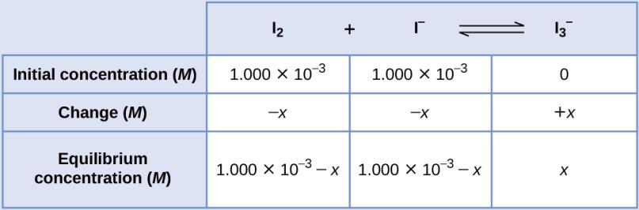
Example 13.6

Slide 44
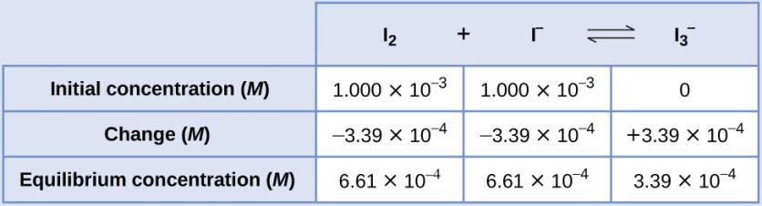
Example 13.6

Slide 45
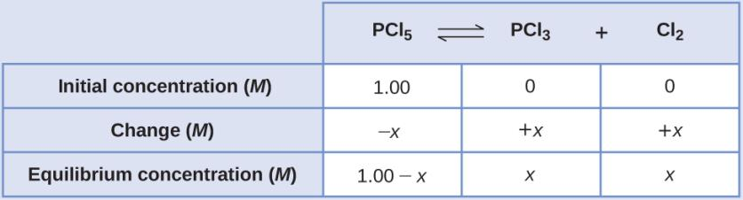
Example 13.8

Slide 46
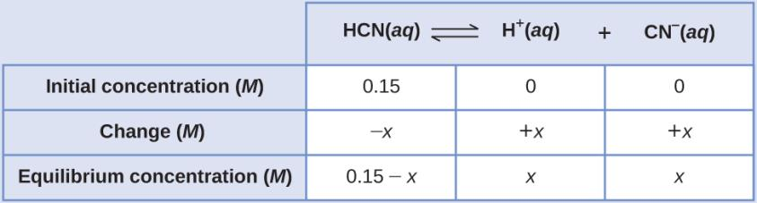
Example 13.9

Slide 47
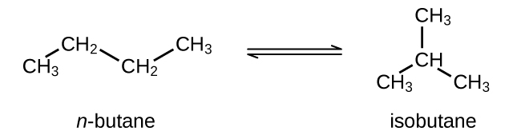
Exercise 80

Slide 48
This OpenStax ancillary resource is © Rice University under a CC-BY 4.0 International license; it may be reproduced or modified but must be attributed to OpenStax, Rice University and any changes must be noted.

