Slide 1


CHEMISTRY 2e
Chapter 16 Thermodynamics
PowerPoint Image Slideshow

Slide 2
Chapter Outline
16.1 Spontaneity
16.2 Entropy
16.3 The Second and Third Laws of Thermodynamics
16.4 Free Energy

Slide 3
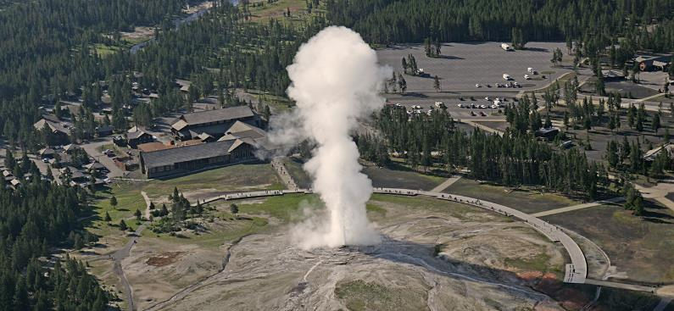
Figure 16.1
Geysers are a dramatic display of thermodynamic principles in nature. As water inside the earth heats up, it rises to the surface through small channels. Pressure builds up until the water turns to steam, and steam is expelled forcefully through a hole at the surface. (credit: modification of work by Yellowstone National Park)

Slide 4
Learning Objectives
16.1 Spontaneity
  Distinguish between spontaneous and nonspontaneous processes
  Describe the dispersal of matter and energy that accompanies certain spontaneous processes

Slide 5
Spontaneous Process
Will a reaction occur “naturally” at a given temperature and pressure, without the exertion of any outside force?
In other words, is a reaction spontaneous?
A process that does occur naturally under a specific set of conditions is called a spontaneous process.
A process that does not occur naturally under a specific set of conditions is called nonspontaneous.

Slide 6
Spontaneous Process
A spontaneous process will “just happen.”
A spontaneous process occurs naturally at a given set of conditions, without outside forces.
Example: A mixture of hydrogen and oxygen will react in the presence of a spark.
2H₂(g) + O₂(g) + spark → 2H₂O(g)

Slide 7
Spontaneity
It is important to not confuse spontaneous with fast.
The rate of a reaction (Chapter 12) and spontaneity are not necessarily connected.

Slide 8
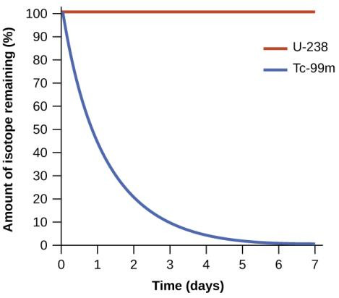
Figure 16.2
Both U-238 and Tc-99m undergo spontaneous radioactive decay, but at drastically different rates. Over the course of one week, essentially all of a Tc-99m sample and none of a U-238 sample will have decayed.

Slide 9
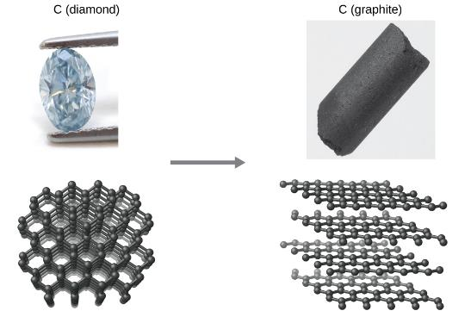
Figure 16.3
The conversion of carbon from the diamond allotrope to the graphite allotrope is spontaneous at ambient pressure, but its rate is immeasurably slow at low to moderate temperatures. This process is known as graphitization, and its rate can be increased to easily measurable values at temperatures in the 1000–2000 K range. (credit “diamond” photo: modification of work by “Fancy Diamonds”/Flickr; credit “graphite” photo: modificaton of work by images-of-elements.com/carbon.php)

Slide 10
Spontaneity
If a reaction is spontaneous in one direction, it will be nonspontaneous in the reverse direction under the same conditions.
2H₂(g) + O₂(g) → 2H₂O(l) Spontaneous
2H₂O(l) → 2H₂(g) + O₂(g) Nonspontaneous
A nonspontaneous reaction is still possible with the continual input of energy.

Slide 11
Energy and Spontaneity
Many spontaneous processes proceed with a decrease in energy.
Recall that exothermic reactions also proceed with a decrease in energy.
  Spontaneous reactions are often exothermic, but not always.
2H₂(g) + O₂(g) + spark → 2H₂O(g)

Slide 12
Exceptions
Which is spontaneous at room temperature and a pressure of 1 atm?
H₂O(s) → H₂O(l) ΔH = +6.01 kJ/mol
H₂O(l) → H₂O(s) ΔH = –6.01 kJ/mol

Slide 13
Dispersal of Matter
When the valve opens, the gas spontaneously expands to fill both containers.
With an ideal gas, this process results in no change in energy.

Slide 14
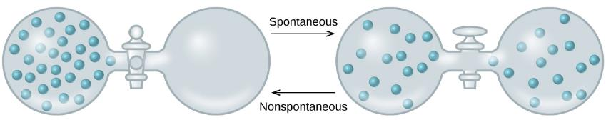
Figure 16.4
An isolated system consists of an ideal gas in one flask that is connected by a closed valve to a second flask containing a vacuum. Once the valve is opened, the gas spontaneously becomes evenly distributed between the flasks.

Slide 15
Dispersal of Energy
Two objects at different temperature are placed in contact.
Heat spontaneously flows from the hotter object to the colder object.
But overall, there is no change in energy.

Slide 16
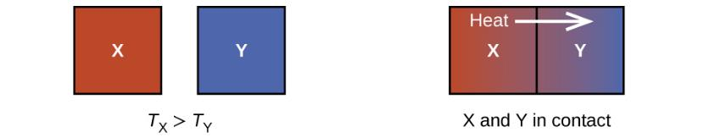
Figure 16.5
When two objects at different temperatures come in contact, heat spontaneously flows from the hotter to the colder object.

Slide 17
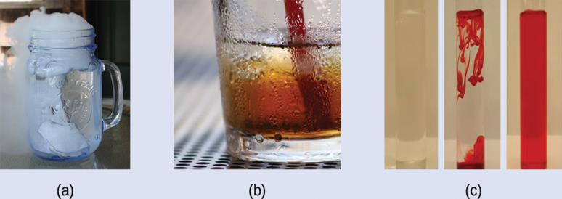
Figure 16.6
(credit a: modification of work by Jenny Downing; credit b: modification of work by
“Fuzzy Gerdes”/Flickr; credit c: modification of work by Sahar Atwa)

Slide 18
Some Other Factor
Some factor other than energy is important to the spontaneity of a process.
It appears that greater, more uniform dispersal of matter and energy can also be the driving force of a spontaneous process.
This other factor is entropy.

Slide 19
Learning Objectives
16.2 Entropy
  Define entropy
  Explain the relationship between entropy and the number of microstates
  Predict the sign of the entropy change for chemical and physical processes

Slide 20
Entropy
Spontaneity is favored by an increase in entropy (S).
S = k ln W
  k is the Boltzmann constant (1.38 × 10^{–23} J/K).
  W is the number of microstates possible
  Microstate: A specific configuration of the locations and energies of the particles in a system.
The number of microstates possible is given by:
W = n^{N}
  n is the number of boxes
  N is the number of particles

Slide 21
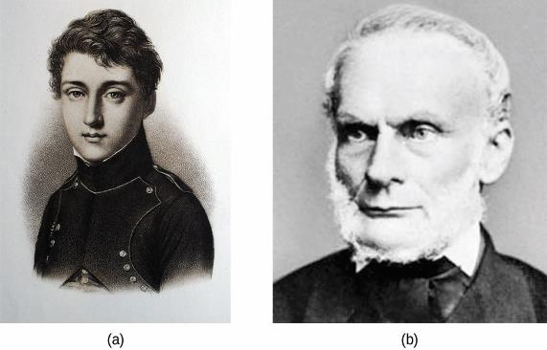
Figure 16.7
(a) Nicholas Léonard Sadi Carnot’s research into steam-powered machinery and (b) Rudolf Clausius’s later study of those findings led to groundbreaking discoveries about spontaneous heat flow processes.

Slide 22
Entropy and Microstates
Consider two particles distributed between two boxes.

Slide 23
Entropy and Microstates
Now consider four particles distributed between two boxes.
Microstates with equivalent particle arrangements are grouped together and called distributions.

Slide 24
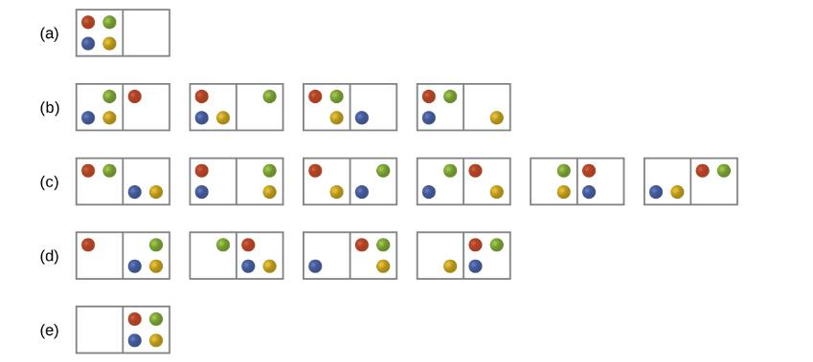
Figure 16.8
The sixteen microstates associated with placing four particles in two boxes are shown. The microstates are collected into five distributions—(a), (b), (c), (d), and (e)—based on the numbers of particles in each box.

Slide 25
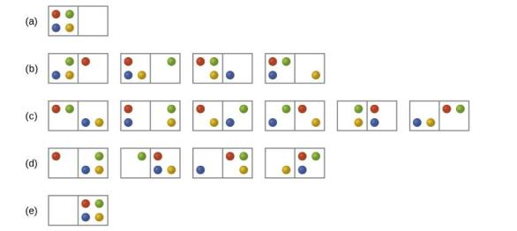
Entropy and Microstates
There are five possible distributions for this system.
Which distribution is most probable?

Slide 26
Entropy and Microstates
The most probable distribution has the largest number of microstates.
The most probable distribution, therefore, is the one of greatest entropy.
S = k ln W
States of high entropy are favored because they are the most probable.

Slide 27
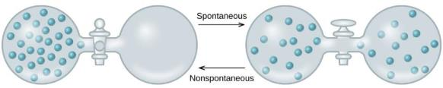
Entropy and Microstates
The most probable distribution has the largest number of microstates.
This same principle applies to all systems, including those with larger numbers of particles.
The most probable state will be the one in which the particles are divided evenly throughout the container.

Slide 28
Entropy Changes
Entropy is another state function.
The change in entropy for a process is the difference in entropy between the final state and the initial state.
ΔS_{sys} = S_{final} – S_{initial}
Alternatively:

Slide 29
Factors That Influence Entropy
The phase of the substance.
The temperature of the substance.
  Temperature is proportional to the average kinetic energy of the particles.
  With higher temperature, the particles have greater freedom to move around.

Slide 30
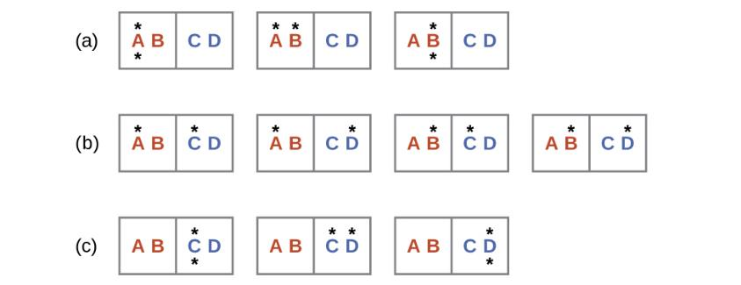
Figure 16.9
This shows a microstate model describing the flow of heat from a hot object to a cold object. (a) Before the heat flow occurs, the object comprised of particles A and B contains both units of energy and as represented by a distribution of three microstates. (b) If the heat flow results in an even dispersal of energy (one energy unit transferred), a distribution of four microstates results. (c) If both energy units are transferred, the resulting distribution has three microstates.

Slide 31
Example 16.2

Slide 32
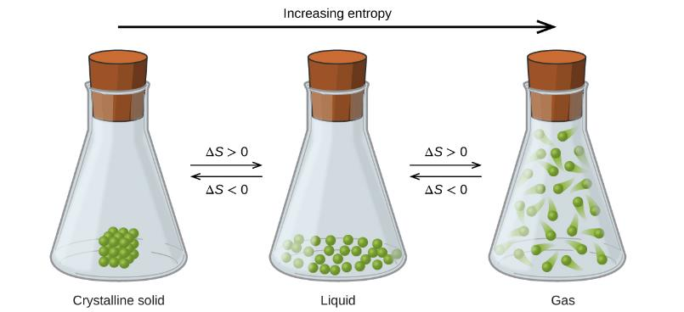
Figure 16.10
The entropy of a substance increases (ΔS > 0) as it transforms from a relatively ordered solid, to a less-ordered liquid, and then to a still less-ordered gas. The entropy decreases (ΔS < 0) as the substance transforms from a gas to a liquid and then to a solid.

Slide 33
Entropy vs. Temperature
The effect of temperature on entropy is due mostly to phase changes.

Slide 34
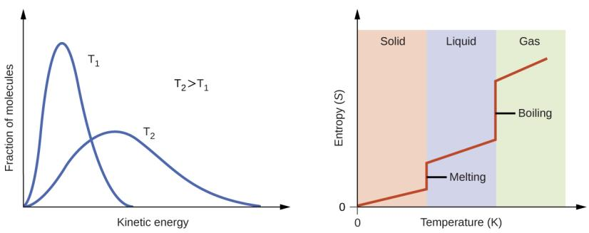
Figure 16.11
Entropy increases as the temperature of a substance is raised, which corresponds to the greater spread of kinetic energies. When a substance melts or vaporizes, it experiences a significant increase in entropy.

Slide 35
Factors that Influence Entropy
The type and number of particles that make up the substance.
Variations in the type of particles.
  Pure substances vs. mixture?

Slide 36
Learning Objectives
16.3 The Second and Third Laws of Thermodynamics
  State and explain the second and third laws of thermodynamics
  Calculate entropy changes for phase transitions and chemical reactions under standard conditions

Slide 37
The Second and Third Laws of Thermodynamics
The system is the part of the universe that is of specific interest.
The surroundings constitute the rest of the universe outside the system. Generally, chemists just focus on the immediate surroundings.
Correctly predicting the spontaneity of a process requires us to consider entropy changes in both the system and the surroundings.

Slide 38
Change in Entropy of the Surroundings, ΔS_{surr}
The change in entropy of the surroundings (ΔS_{surr}) is directly proportional to the change in enthalpy of the system.
ΔS_{surr} is also inversely proportional to temperature.

Slide 39
The Second Law of Thermodynamics
The entropy change of the universe is the sum of the entropy changes for the system and surroundings.
The second law of thermodynamics states that all spontaneous changes cause an increase in the entropy of the universe.
  For a spontaneous process, ΔS_{universe} must be positive.
  A process with –ΔS_{system} can still be spontaneous if …

Slide 40
The Second Law of Thermodynamics
ΔS_{universe} > 0 for a spontaneous process
ΔS_{universe} < 0 for a nonspontaneous process (spontaneous in the reverse direction).
ΔS_{universe} = 0 for a process at equilibrium

Slide 41
The Third Law of Thermodynamics
Third law of thermodynamics: The entropy of a pure perfect crystalline substance at zero Kelvin is zero.
  Zero Kelvin is called absolute zero.
  There is no lower temperature than zero Kelvin.
  At zero Kelvin, all molecular movement completely stops.
  There is only one possible way to arrange the molecules.

Slide 42
Standard Entropies
It is possible to determine the absolute entropy of a substance.
Standard Entropies, S°
  These values are for 1 mole of a substance at a pressure of 1 bar and a temperature of 298 K.
  Aqueous species at 1 M concentration.
Standard entropy values can be used to calculate the standard entropy change (ΔS°) for a process.

Slide 43
Table 16.2
Substance | S°₂₉₈ (J mol^{–1} K^{–1}) | Substance | S°₂₉₈ (J mol^{–1} K^{–1})
carbon |  | hydrogen
C(s, graphite) | 5.740 | H₂(g) | 130.57
C(s, diamond) | 2.38 | H(g) | 114.6
CO(g) | 197.7 | H₂O(g) | 188.71
CO₂(g) | 213.8 | H₂O(l) | 69.91
CH₄(g) | 186.3 | HCl(g) | 186.8
C₂H₄(g) | 219.5 | H₂S(g) | 205.7
C₂H₆(g) | 229.5 | oxygen
CH₃OH(I) | 126.8 | O₂(g) | 205.03
C₂H₅OH(I) | 160.7
Standard entropies for selected substances measured at 1 atm and 298.15 K. (Values are approximately equal to those measured at 1 bar, the currently accepted standard state pressure.)

Slide 44
ΔS° for Reactions
The equation for calculating ΔS° is similar to that for ΔH°:
When calculating ΔS° and ΔH°, remember to multiply the standard entropies and standard enthalpies of formation by the coefficients of the balanced equation.

Slide 45
Learning Objectives
16.4 Free Energy
  Define Gibbs free energy, and describe its relation to spontaneity
  Calculate free energy change for a process using free energies of formation for its reactants and products
  Calculate free energy change for a process using enthalpies of formation and the entropies for its reactants and products
  Explain how temperature affects the spontaneity of some processes
  Relate standard free energy changes to equilibrium constants

Slide 46
Free Energy, G
The second law of thermodynamics can be used to predict spontaneity.
But measurements on the surroundings are seldom made.
This limits the use of the second law of thermodynamics.
It is convenient to have a thermodynamic function that focuses on just the system and predicts spontaneity.

Slide 47
Gibbs Free Energy Change, ΔG
Second Law of Thermodynamics:

Slide 48
Gibbs Free Energy Change, ΔI
The changes in Gibbs free energy (ΔG) or simply change in free energy allow us to predict spontaneity by focusing on the system only.
ΔG = ΔH – TΔS

Slide 49
ΔG and Spontaneity
ΔG = ΔH – TΔS
The sign of ΔG indicates if a reaction will be spontaneous or not.
  If ΔG < 0, the reaction is spontaneous in the forward direction.
  If ΔG > 0, the reaction is nonspontaneous in the forward direction
  If ΔG = 0, the system is at equilibrium

Slide 50
Relationship among ΔG, ΔH, and ΔS
ΔG = ΔH – TΔS
Spontaneous reactions, those with –ΔG, generally have
  ΔH < 0
  Exothermic reaction.
  A negative ΔH will contribute to a negative ΔG.
  ΔS > 0
  A positive ΔS will contribute to a negative ΔG.
Note that a reaction can still be spontaneous (have a –ΔG) when ΔH is positive or ΔS is negative, but not both.
Also note that there is a temperature dependence.

Slide 51
ΔG = ΔH – TΔS
ΔH | ΔS | ΔG | Spontaneous?
– | +
+ | –
– | –

Slide 52
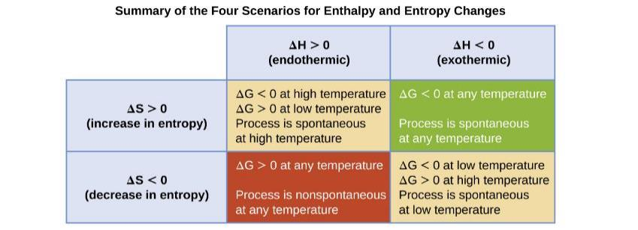
Figure 16.12
There are four possibilities regarding the signs of enthalpy and entropy changes.

Slide 53
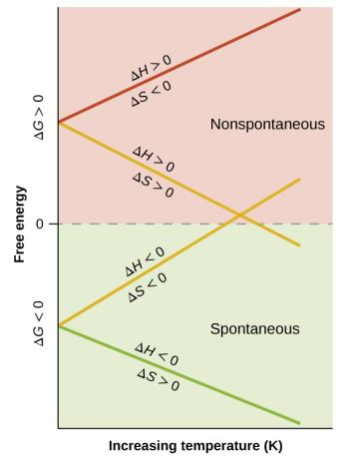
Figure 16.13
These plots show the variation in ΔG with temperature for the four possible combinations of arithmetic sign for ΔH and ΔS.

Slide 54
Direction of Spontaneity Change
To calculate the temperature at which the spontaneity of a reaction changes from …
  Spontaneous to nonspontaneous
  Or nonspontaneous to spontaneous
  … find the temperature at which ΔG = 0
ΔG = 0 = ΔH – TΔS
T = ΔH / ΔS
This is the temperature at which ΔG = 0 and, by definition, the system is at equilibrium.

Slide 55
The Standard Free Energy Change, ΔG°
Although the Change in Gibbs Free Energy equation is valid under all conditions, we will most often apply it at standard conditions.
Standard conditions:
Under standard conditions, ΔG° = ΔH° – TΔS°
Pay attention to J vs. kJ in calculations!

Slide 56
Standard Free Energy of Formation, ∆G°_{f}
The standard free energy of formation (∆G°_{f}) for a compound is defined as the free energy change for the formation of one mole of a substance from its elements in their standard state at 1 bar and 25 °C.
Analogous to the ∆H°_{f} discussed in Chapter 5.
Example:
    H₂(g) + ½O₂(g) → H₂O(l) ∆G°_{f} = –237.2 kJ/mol

Slide 57
∆G°_{f} Values Can Be Used to Calculate ΔG°
For a chemical reaction:
mA + nB → xC + yD
ΔG° = [xΔG° _{f} (C) + yΔG° _{f} (D)] – [mΔG° _{f}(A) + nΔG° _{f} (B)]
ΔG° = ΣnΔG° _{f}(products) – ΣnΔG° _{f}(reactants)

Slide 58
∆G°_{f} Values Can Be Used to Calculate ΔG°
ΔG° = ΣnΔG° _{f} (products) – ΣnΔG° _{f} (reactants)
This equation only works for calculating ∆G° of a reaction at the temperature for which the values of ∆G°_{f} are tabulated, which is 298 K.
ΔG°_{f} for any element in its most stable form at standard conditions is defined as zero.

Slide 59
Pressure and Concentration Effects
Most of our discussion on free energy to this point has involved the standard free energy change ΔG°.
All species are at 1 bar of partial pressure or 1 M concentration.
There is a general equation that enables you to calculate ΔG under non-standard conditions.
T is temperature in K
R = 0.008314 kJ/mol . K
Q is the reaction quotient

Slide 60
ΔG and the Equilibrium Constant
Thus far in this chapter, we have focused heavily on the relationship between the free energy change and the spontaneity of a reaction.
  For a reaction to be spontaneous, ΔG° must be negative.
Another measure of reaction spontaneity is the equilibrium constant, K.
  For a reaction to be spontaneous, K must be greater than 1.
  This should make sense because we have discussed that if K is greater than 1, then the reaction is product favored.

Slide 61
ΔG and the Equilibrium Constant
The relationship between ΔG° and K can be found starting with this general equation.
Remember that at equilibrium, ΔG = 0 and Q = K. So,
Therefore,

Slide 62
ΔG and the Equilibrium Constant
This relationship between ΔG° and K holds for all equilibrium constants we have discussed in this course.
K_{c}, K_{p}, K_{a}, K_{b}, K_{w}, K_{sp}, K_{f}, K_{d}
We can now relate the standard free energy change of a reaction to the extent of a reaction.

Slide 63
Additivity of ΔG; Coupled Reactions
As with enthalpy, free energy changes for reactions are additive if
Reaction 3 = Reaction 1 + Reaction 2
Then, ΔG₃ = ΔG₁ + ΔG₂
  Also keep in mind that if a reaction is reversed, then the sign on ΔG is also reversed.
  If a reaction is multiplied by a factor of “n,” then ΔG is also multiplied by a factor of “n.”

Slide 64
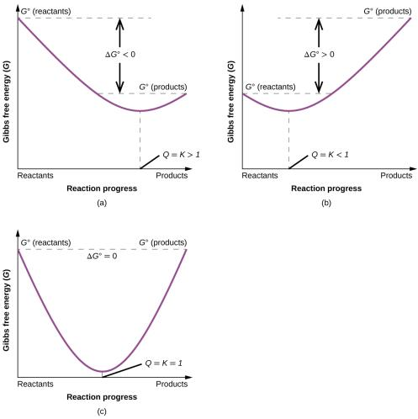
Figure 16.14
These plots show the free energy versus reaction progress for systems whose standard free changes are (a) negative, (b) positive, and (c) zero. Nonequilibrium systems will proceed spontaneously in whatever direction is necessary to minimize free energy and establish equilibrium.

Slide 65

Exercise 55

Slide 66
This OpenStax ancillary resource is © Rice University under a CC-BY 4.0 International license; it may be reproduced or modified but must be attributed to OpenStax, Rice University and any changes must be noted.

