Slide 1


CHEMISTRY 2e
Chapter 17 electrochemistry
PowerPoint Image Slideshow

Slide 2
Chapter Outline
17.1 Review of Redox Chemistry
17.2 Galvanic Cells
17.3 Electrode and Cell Potentials
17.4 Potential, Free Energy, and Equilibrium
17.5 Batteries and Fuel Cells
17.6 Corrosion
17.7 Electrolysis

Slide 3
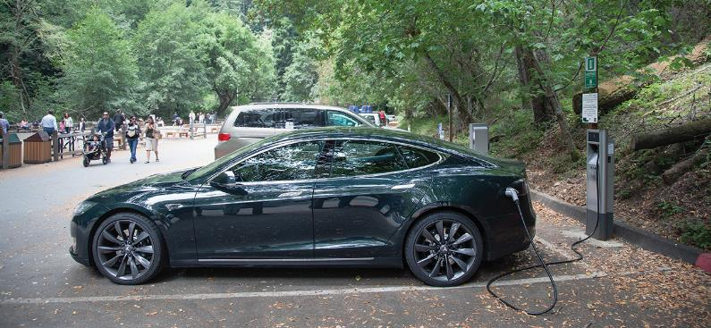
Figure 17.1
Electric vehicles contain batteries that can be recharged, thereby using electric energy to bring about a chemical change and vice versa. (credit: modification of work by Robert Couse-Baker)

Slide 4
Learning Objectives
17.1 Review of Redox Chemistry
  Describe defining traits of redox chemistry
  Identify the oxidant and reductant of a redox reaction
  Balance chemical equations for redox reactions using the half-reaction method

Slide 5
Electrochemistry
Electrochemistry is the study of the interconversion of electrical and chemical energy.
  The chemical reactions involve electron transfer.
Electricity: The presence and flow of electrical charge.
Electrons or ions may carry the charge.

Slide 6
Review of Redox Chemistry
Oxidation
  Loss of electrons
  Electrons are produced
  The species is oxidized
Reduction
  Gain of electrons
  Electrons are consumed
  The species is reduced
Redox Reaction
  Oxidation and reduction occur simultaneously

Slide 7
Oxidizing Agent and Reducing Agent
Something must cause the species to be reduced.
  This is the reducing agent (reductant).
Something must cause the species to be oxidized.
  This is the oxidizing agent (oxidant).
Note that
  The oxidizing agent is reduced.
  The reducing agent is oxidized.
  Both of these appear as reactants (not products) in the overall redox reaction.

Slide 8
Oxidation Number (or Oxidation State)
The assignment of oxidation numbers allows one to determine what is being oxidized and what is being reduced.
For elements and monoatomic ions oxidation numbers are just the charge of the species.
In molecules and polyatomic ions, oxidation numbers are not real charges.
  Rules exist for assigning oxidation numbers.
Oxidation numbers are generally small whole numbers, but may be fractional.

Slide 9
Redox Reactions and Oxidation Numbers
Oxidation results in an increase in oxidation number.
Cu (s) → Cu²⁺ (aq) + 2e–
Reduction results in a decrease in oxidation number.
2Ag⁺(aq) + 2e– → 2Ag(s)

Slide 10
Steps for Balancing Redox Reactions
Assign oxidation numbers.
Split the reaction into two half-reactions. An oxidation and a reduction.
Balance one half-reaction.
Balance the other half-reaction.
Combine the two balanced half-reactions in such a way as to eliminate electrons.
Check: Atoms and charge must be balanced.

Slide 11
Learning Objectives
17.2 Galvanic Cells
  Describe the function of a galvanic cell and its components
  Use cell notation to symbolize the composition and construction of galvanic cells

Slide 12
Cu-Ag⁺ Redox Reaction
When a piece of Cu metal is added to Ag+(aq) ions:
Cu(s) + 2Ag ⁺(aq) → Cu²⁺(aq) + 2Ag(s)
When run directly in a test tube:
  Ag metal is deposited on the surface of the Cu strip.
  Cu enters the solution as blue Cu²⁺ ions.
What if we forced these electrons to pass through an external wire?

Slide 13
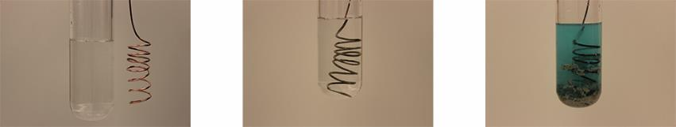
Figure 17.2
A copper wire and an aqueous solution of silver nitrate (left) are brought into contact (center) and a spontaneous transfer of electrons occurs, creating blue Cu²⁺(aq) and gray Ag(s) (right).

Slide 14
Galvanic Cells (Voltaic Cells)
In principle, any spontaneous redox reaction can serve as a source of electrical energy in a galvanic cell.
This cell is designed to take advantage of the movement of electrons, which occurs during a redox reaction.
The oxidation and reduction half reactions are “compartmentalized” into half-cells.
  Oxidation at one electrode (anode)
  Reduction at the other electrode (cathode)
  Electrons move through an external wire from the anode to the cathode.
  These “moving” electrons can be used as a source of electrical energy.

Slide 15
Galvanic Cells
The oxidation and reduction half-reactions occur at separate electrodes.
The oxidation reaction occurs at the Anode
  Anions flow to the anode
The reduction reaction occurs at the cathode
  Cations flow to the cathode.

Slide 16
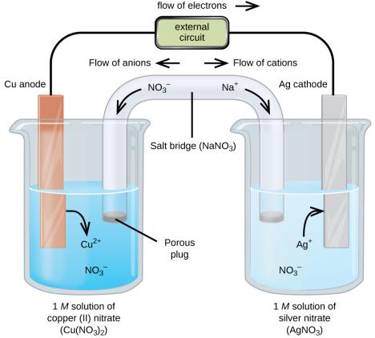
Figure 17.3
A galvanic cell based on the spontaneous reaction between copper and silver(I) ions.

Slide 17
Cu-Ag⁺ Galvanic Cell
Cu(s) + 2Ag⁺(aq) → Cu²⁺(aq) + 2Ag(s)
Cu metal anode dips into a solution of Cu²⁺ ions.
Ag metal cathode dips into a solution of Ag⁺ ions.
The external wires are connected to a voltmeter.

Slide 18
Cu-Ag⁺ Galvanic Cell
Cu(s) + 2Ag⁺(aq) → Cu²⁺(aq) + 2Ag(s)
At the Cu anode, electrons are produced.
Cu(s) → Cu²⁺ (aq) + 2e–
Electrons flow from the anode, through the voltmeter, to the Ag cathode; the voltmeter indicates the cell’s potential.

Slide 19
Cu-Ag⁺ Galvanic Cell
The electrons enter the Ag cathode, at which
2Ag⁺ (aq) + 2e– → Ag(s)

Slide 20
Charge Balance
Cu(s) + 2Ag⁺(aq) → Cu²⁺(aq) + 2Ag(s)
As the oxidation occurs, a surplus of positive ions builds up at the anode.
Cu (s) → Cu²⁺ (aq) + 2e–
The area near the cathode becomes deficient in positive ions.
2Ag⁺ (aq) + 2e– → Ag (s)
The salt bridge supplies additional cations and anions needed to balance out these charge differences and complete the circuit.

Slide 21
Salt Bridges
The salt bridge is a porous material consisting of a concentrated salt solution.
  NaNO₃ or KNO₃ are frequently used.
  Anions flow toward the anode to neutralize the build-up of positive charge.
  Cations flow toward the cathode to “replace” the cations that are being consumed.
This flow of ions enables electrical neutrality to be achieved, the circuit to be complete, and current to flow!

Slide 22
Cell Notation
Describes what happens in a galvanic cell.
Oxidation on the left (Cu oxidized to Cu²⁺)
Reduction on the right (Ag⁺ reduced to Ag)
Single vertical line represents a phase boundary
  Liquid-metal or liquid-gas, etc.
Double line is the salt bridge
Don’t include spectator ions
Sometimes the concentration of the ion(s) is included.
Cu(s) + 2Ag⁺(aq) → Cu²⁺(aq) + 2Ag(s)

Slide 23
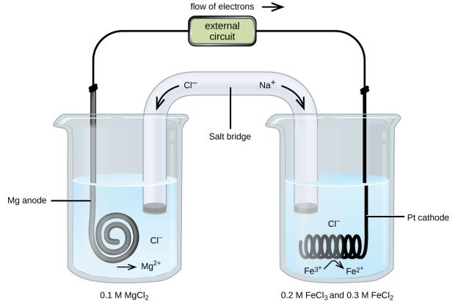
Figure 17.4
A galvanic cell based on the spontaneous reaction between magnesium and iron(III) ions.

Slide 24
Galvanic Cell Summary
“Compartmentalizing” the oxidation and reduction half-reactions into half-cells enables a spontaneous redox reaction to be a source of electrical energy.
In one half-cell, the anode, oxidation occurs.
In the other half-cell, the cathode, reduction occurs.
Each half-cell consists of an electrode dipped into an aqueous solution.
The half-cells are joined by an external wire (electron movement) and salt bridge (ion movement).

Slide 25
Learning Objectives
17.3 Electrode and Cell Potentials
  Describe and relate the definitions of electrode and cell potentials
  Interpret electrode potentials in terms of relative oxidant and reductant strengths
  Calculate cell potentials and predict redox spontaneity using standard electrode potentials

Slide 26
Electrode and Cell Potentials
In a circuit, the flow of charge is a result of an electrical potential difference between two points in the circuit.
Electrical potential is the ability of the electric field to do work on the charge.
In a galvanic cell, this electrical potential difference is called cell potential.

Slide 27
Cell Potential
The flow of charge in a galvanic cell results from the difference in the electrical potentials at each electrode.

Slide 28
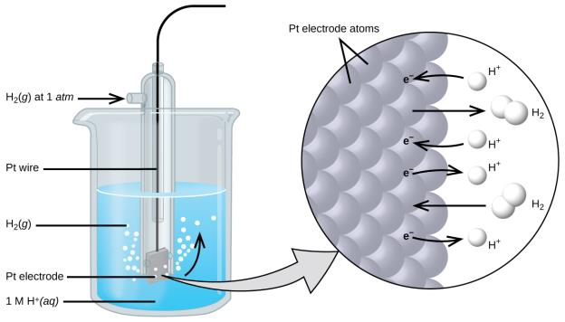
Figure 17.5
A standard hydrogen electrode (SHE).

Slide 29
Standard Potentials (E°)
The driving force of an electrochemical reaction is measured by the standard cell potential.
Depends on the nature of the redox reaction and on the concentration of species involved.
Standard potentials (E°) are measured with
  All aqueous concentrations at 1M
  The pressure of all gases at 1 atm
  Temperature held constant (usually at 25 °C)
  Units of E° is V or mV

Slide 30
E° Cathode and Anode
Any redox reaction can be split into two half-reactions.
Zn (s) + 2H⁺ → Zn²⁺ + H₂
E°_{cell} = +0.762 V

Slide 31
E° Cathode and Anode
Zn (s) + 2H⁺ (aq, 1M) → Zn²⁺ (aq, 1M) + H₂ (g, 1 atm)
E°_{cell} = +0.762 V
The E° for a half-reaction cannot be measured; only E°_{cell} of the entire redox reaction can be measured.
A standard reduction potential (E°_{red} ) has been set.
The value of E° for the reduction of 2H⁺ ions to H₂(g) has been assigned as 0.000 V.
  This is called the standard hydrogen electrode (SHE).

Slide 32
E° Cathode and Anode
Zn (s) + 2H⁺ → Zn²⁺ + H₂
E_{cell}° = +0.762 V
The E°_{red} value of all other half-reactions have been assigned relative to SHE.
Eº_{anode} is subtracted from Eº_{cathode} because oxidation is the reverse of reduction.

Slide 33
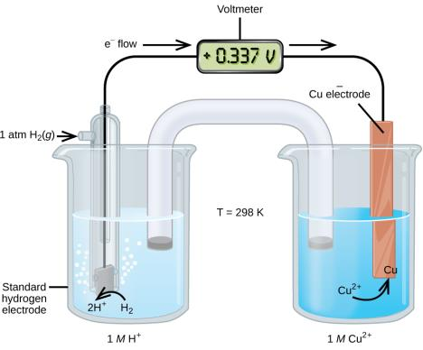
Figure 17.6
A cell permitting experimental measurement of the standard electrode potential for the half-reaction Cu²⁺(aq) + 2e⁻ → Cu(s)

Slide 34
Table 17.1 Selected Standard Reduction Potentials at 25 °C
Half-Reaction | E° (V)
Hg₂²⁺(aq) + 2e⁻ ⟶ 2Hg(l) | +0.7973
Fe³⁺(aq) + e− ⟶ Fe³⁺(aq) | +0.771
MnO₄⁻(aq) + 2H₂O(l) + 3e⁻ ⟶ MnO₂(s) + 4OH⁻ (aq) | +0.558
I₂(s) + 2e⁻ ⟶ 2I⁻ (aq) | +0.5355
NiO₂ (s) + 2H₂O(l) + 2e⁻ ⟶ Ni(OH) ₂(s) + 2OH⁻ (aq) | +0.49
Cu²⁺(aq) + 2e⁻ ⟶ Cu(s) | +0.34
Hg₂Cl₂ (s) + 2e⁻ ⟶ 2Hg(l) + 2Cl⁻ (aq) | +0.26808
AgCl(s) + e⁻ ⟶ Ag(s) + Cl⁻ (aq) | +0.22233
Sn⁴⁺(aq) + 2e⁻ ⟶ Sn²⁺(aq) | +0.151
2H⁺ (aq) + 2e⁻ ⟶ H₂ (g) | 0.00
Pb²⁺ (aq) + 2e⁻ ⟶ Pb(s) | −0.1262
Sn²⁺ (aq) + 2e⁻ ⟶ Sn(s) | −0.1375
Ni²⁺ (aq) + 2e⁻ ⟶ Ni(s) | −0.257
Co²⁺ (aq) + 2e⁻ ⟶ Co(s) | −0.28

Slide 35
Table 17.1 Selected Standard Reduction Potentials at 25 °C
(continued)
Half-Reaction | E° (V)
PbSO₄ (s) + 2e⁻ ⟶ Pb(s) + SO₄²⁻ (aq) | −0.3505
Cd²⁺(aq) + 2e⁻ ⟶ Cd(s) | −0.4030
Fe²⁺(aq) + 2e⁻ ⟶ Fe(s) | −0.447
Cr³⁺(aq) + 3e⁻ ⟶ Cr(s) | −0.744
Mn²⁺(aq) + 2e⁻ ⟶ Mn(s) | −1.185
Zn(OH)₂(s) + 2e⁻ ⟶ Zn(s) + 2OH⁻ (aq) | −1.245
Zn²⁺(aq) + 2e⁻ ⟶ Zn(s) | −0.7618
Al³⁺(aq) + 3e⁻ ⟶ Al(s) | −1.662
Mg2(aq) + 2e⁻ ⟶ Mg(s) | −2.372
Na⁺ (aq) + e⁻ ⟶ Na(s) | −2.71
Ca²⁺(aq) + 2e⁻ ⟶ Ca(s) | −2.868
Ba²⁺(aq) + 2e⁻ ⟶ Ba(s) | −2.912
K⁺ (aq) + e⁻ ⟶ K(s) | −2.931
Li⁺ (aq) + e⁻ ⟶ Li(s) | −3.04

Slide 36
Learning Objectives
17.4 Potential, Free Energy, and Equilibrium
  Explain the relations between potential, free energy change, and equilibrium constants
  Perform calculations involving the relations between cell potentials, free energy changes, and equilibrium
  Use the Nernst equation to determine cell potentials under nonstandard conditions

Slide 37
Potential, Free Energy, and Equilibrium
If the calculated standard cell potential (E°_{cell}) of a redox reaction is positive, then the reaction is spontaneous at standard conditions.
  This is why E°_{cell} for galvanic cells is always positive.
If the standard potential (E°_{cell}) of a redox reaction is negative, then the reaction is nonspontaneous at standard conditions.

Slide 38
Relationship Between E°, ΔG° and K
E°, ΔG°, and K are all measures of reaction spontaneity.
A redox reaction is spontaneous if,
  E°cell is positive
  ΔG° is negative
  K is greater than 1
We will talk about equations that relate these variables.

Slide 39
Relationship Between E°, ΔG° and K
E° and ΔG°
  ° indicates standard conditions (gases at 1 atm (or 1 bar); aqueous species at 1 M)
  ΔG° is the standard free energy change
  E°_{cell} is the standard cell potential
  n is the number of moles of electrons transferred in the balanced redox reaction.
  F is called the Faraday constant; this is the charge of a mole of electrons. F = 9.648 × 10⁴ J/mol . V
  Notice that ΔG° and E° have opposite signs.

Slide 40
Relationship Between E°, ΔG° and K
Redox reactions, like all reactions, eventually reach a state of equilibrium.

Slide 41
Relationship Between E°, ΔG° and K
These experiments are usually done at 25 °C (298 K).
This equation applies only at 25 °C.
Note that
  If E° is positive, K is greater than 1.
  If E° is negative, K is less than 1.

Slide 42
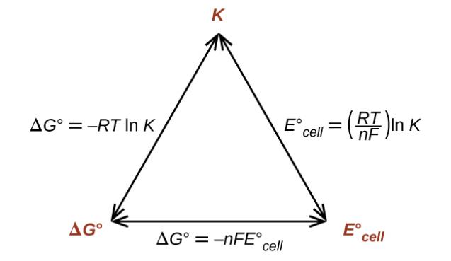
Figure 17.7
Graphic depicting the relation between three important thermodynamic properties.

Slide 43
Effect of Concentration on Potential
To this point, we have dealt only with “standard” potentials (E°), that is, potentials when all gases are at 1 atm (or 1 bar) and aqueous species are at 1M.
Since reaction conditions influence ΔG, potential (E) must also be influenced by the conditions.

Slide 44
Effect of Concentration on Potential
Voltage will increase and the reaction will become more spontaneous if
  The concentration of a reactant is increased
  The concentration of a product is decreased
Voltage will decrease and the reaction will become less spontaneous if
  The concentration of reactant is decreased
  The concentration of product is increased

Slide 45
The Nernst Equation
At 25 °C (298 K)

Slide 46
Learning Objectives
17.5 Batteries and Fuel Cells
  Describe the electrochemistry associated with several common batteries
  Distinguish the operation of a fuel cell from that of a battery

Slide 47
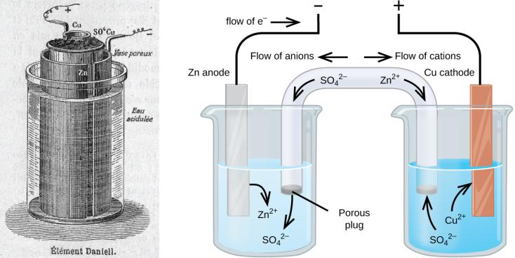
Figure 17.8
Illustration of a Daniell cell taken from a 1904 journal publication (left) along with a simplified illustration depicting the electrochemistry of the cell (right). The 1904 design used a porous clay pot to both contain one of the half-cell’s content and to serve as a salt bridge to the other half-cell.

Slide 48
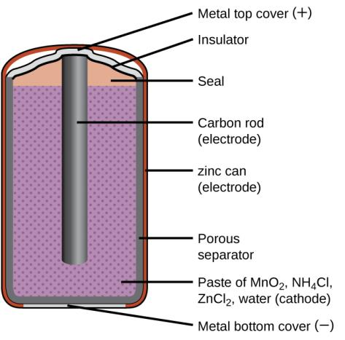
Figure 17.9
A schematic diagram shows a typical dry cell.

Slide 49
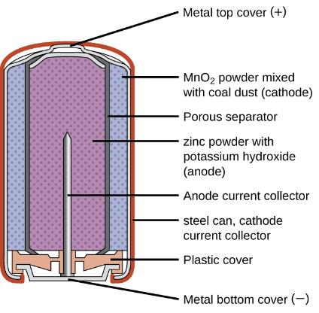
Figure 17.10
Alkaline batteries were designed as direct replacements for zinc-carbon (dry cell) batteries.

Slide 50
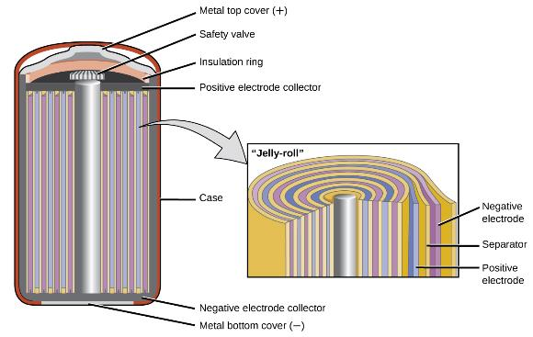
Figure 17.11
NiCd batteries use a “jelly-roll” design that significantly increases the amount of current the battery can deliver as compared to a similar-sized alkaline battery.

Slide 51
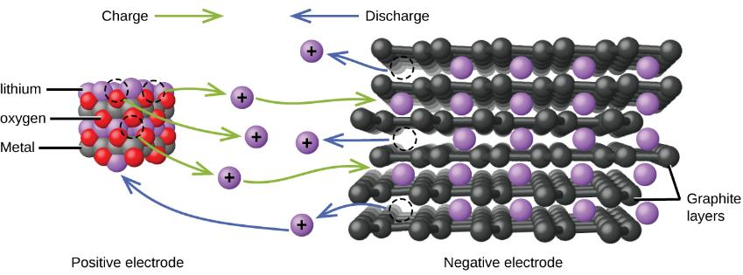
Figure 17.12
In a lithium ion battery, charge flows between the electrodes as the lithium ions move between the anode and cathode.

Slide 52
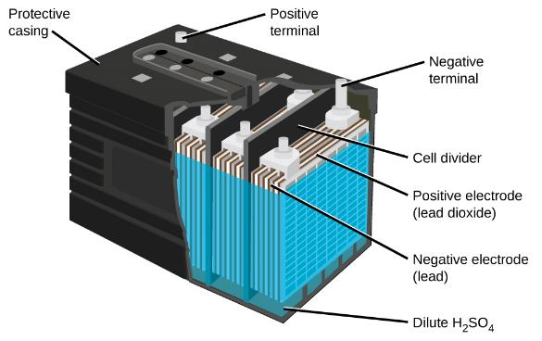
Figure 17.13
The lead acid battery in your automobile consists of six cells connected in series to give 12 V.

Slide 53
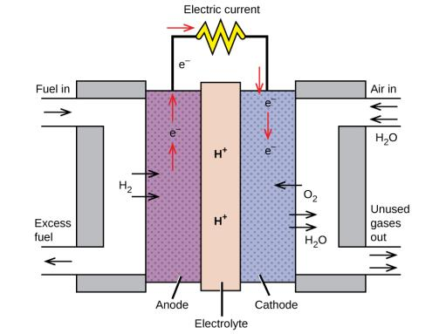
Figure 17.14
In this hydrogen fuel-cell schematic, oxygen from the air reacts with hydrogen, producing water and electricity.

Slide 54
Learning Objectives
17.6 Corrosion
  Define corrosion
  List some of the methods used to prevent or slow corrosion

Slide 55
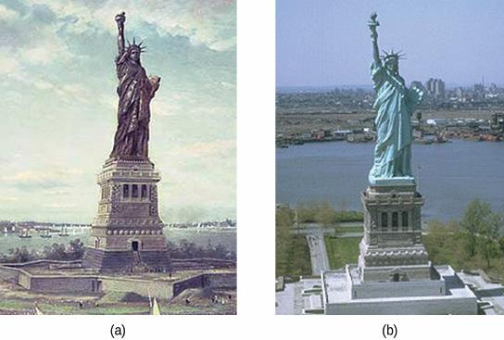
Figure 17.15
(a) The Statue of Liberty is covered with a copper skin, and was originally brown, as shown in this painting. (b) Exposure to the elements has resulted in the formation of the blue-green patina seen today.

Slide 56
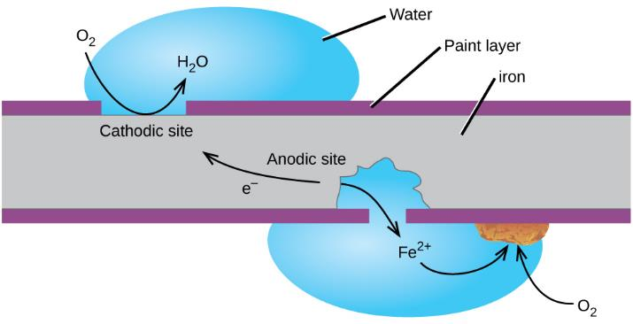
Figure 17.16
Corrosion can occur when a painted iron or steel surface is exposed to the environment by a scratch through the paint. A galvanic cell results that may be approximated by the simplified cell schematic Fe(s) | Fe²⁺(aq) ||O₂(aq), H₂O(l) | Fe(s).

Slide 57
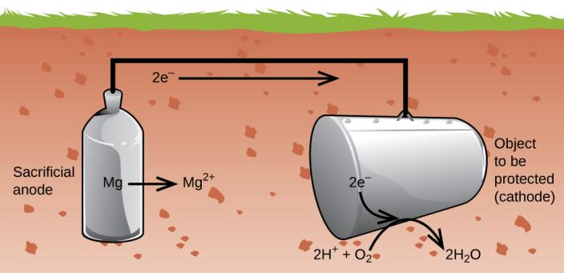
Figure 17.17
Cathodic protection is a useful approach to electrochemically preventing corrosion of underground storage tanks.

Slide 58
Learning Objectives
17.7 Electrolysis
  Describe the process of electrolysis
  Compare the operation of electrolytic cells with that of galvanic cells
  Perform stoichiometric calculations for electrolytic processes

Slide 59
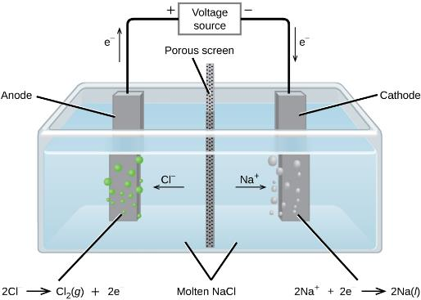
Figure 17.18
Cells of this sort (a cell for the electrolysis of molten sodium chloride) are used in the Downs process for production of sodium and chlorine, and they typically use iron cathodes and carbon anodes.

Slide 60
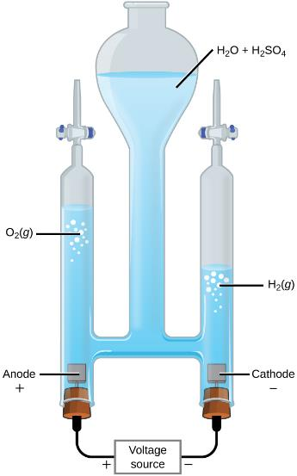
Figure 17.19
The electrolysis of water produces stoichiometric amounts of oxygen gas at the anode and hydrogen at the anode.

Slide 61
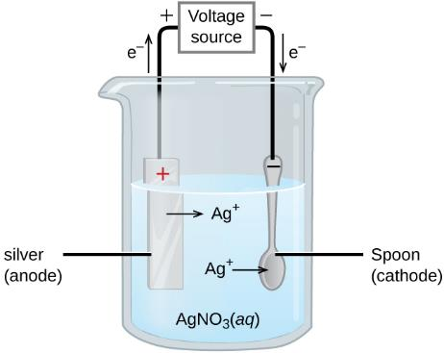
Figure 17.20
This schematic shows an electrolytic cell for silver plating eating utensils.

Slide 62
This OpenStax ancillary resource is © Rice University under a CC-BY 4.0 International license; it may be reproduced or modified but must be attributed to OpenStax, Rice University and any changes must be noted.

