Slide 1
CHEMISTRY 2e
Chapter 20 Organic Chemistry
PowerPoint Image Slideshow

Slide 2
Chapter Outline
20.1 Hydrocarbons
20.2 Alcohols and Ethers
20.3 Aldehydes, Ketones, Carboxylic Acids, and Esters
20.4 Amines and Amides

Slide 3
Figure 20.1
All organic compounds contain carbon and most are formed by living things, although they are also formed by geological and artificial processes. (credit left: modification of work by Jon Sullivan; credit left middle: modification of work by Deb Tremper; credit right middle: modification of work by “annszyp”/Wikimedia Commons; credit right: modification of work by George Shuklin)

Slide 4
Learning Objectives
20.1 Hydrocarbons
Explain the importance of hydrocarbons and the reason for their diversity
Name saturated and unsaturated hydrocarbons, and molecules derived from them
Describe the reactions characteristic of saturated and unsaturated hydrocarbons
Identify structural and geometric isomers of hydrocarbons

Slide 5
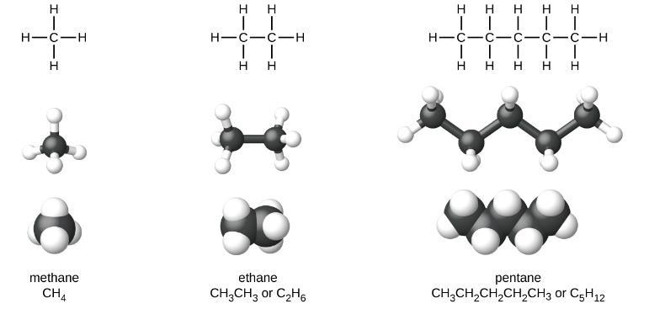
Figure 20.2
Pictured are the Lewis structures, ball-and-stick models, and space-filling models for molecules of methane, ethane, and pentane.

Slide 6
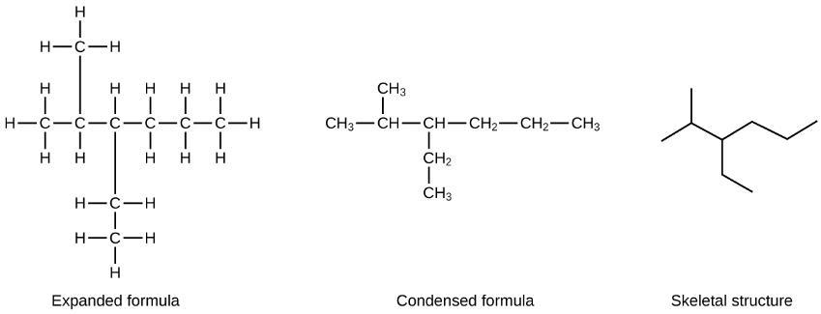
Figure 20.3
The same structure can be represented three different ways: an expanded formula, a condensed formula, and a skeletal structure.

Slide 7
Example 20.1

Slide 8
Example 20.1

Slide 9
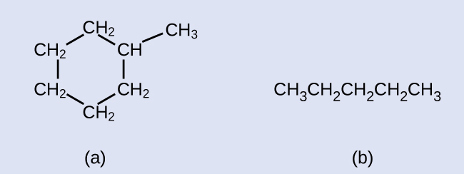
Example 20.1

Slide 10
Example 20.1

Slide 11
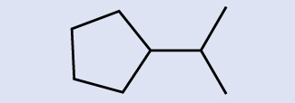
Example 20.2

Slide 12
Example 20.2

Slide 13
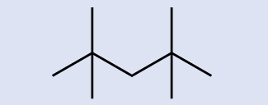
Example 20.2

Slide 14
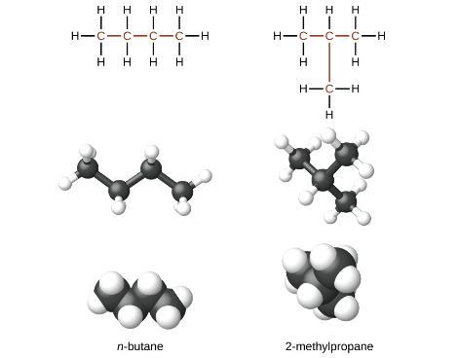
UNFIGURE 20.1

Slide 15
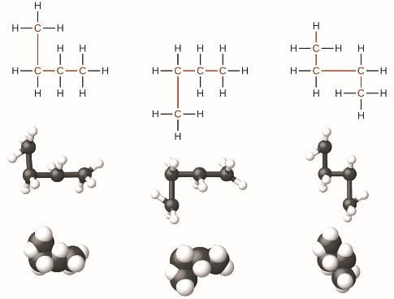
Figure 20.4
These three representations of the structure of n-butane are not isomers because they all contain the same arrangement of atoms and bonds.

Slide 16
UNFIGURE 20.2

Slide 17
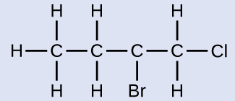
Example 20.3

Slide 18
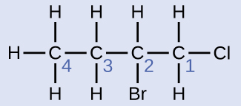
Example 20.3

Slide 19
Example 20.3

Slide 20
UNFIGURE 20.3

Slide 21
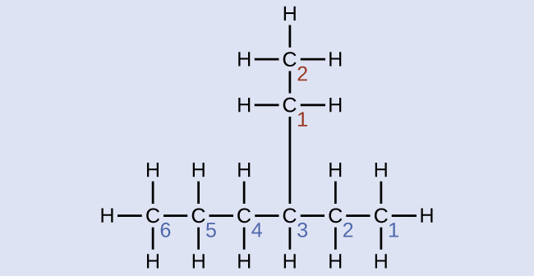
Example 20.4

Slide 22
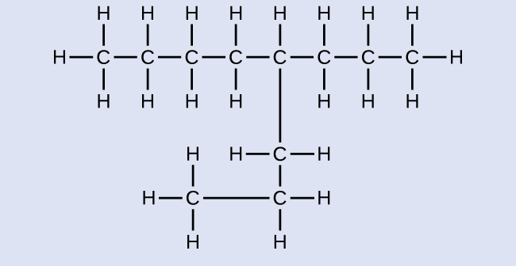
Example 20.4

Slide 23
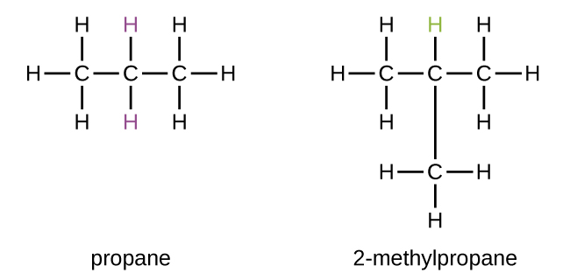
UNFIGURE 20.4

Slide 24
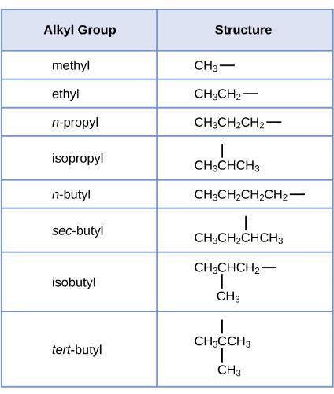
Figure 20.5
This listing gives the names and formulas for various alkyl groups formed by the removal of hydrogen atoms from different locations.

Slide 25
UNFIGURE 20.5

Slide 26
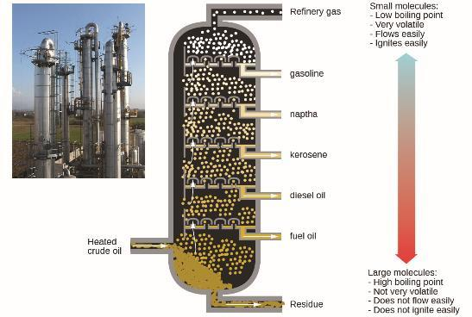
Figure 20.6
In a column for the fractional distillation of crude oil, oil heated to about 425 °C in the furnace vaporizes when it enters the base of the tower. The vapors rise through bubble caps in a series of trays in the tower. As the vapors gradually cool, fractions of higher, then of lower, boiling points condense to liquids and are drawn off. (credit left: modification of work by Luigi Chiesa)

Slide 27
UNFIGURE 20.6

Slide 28
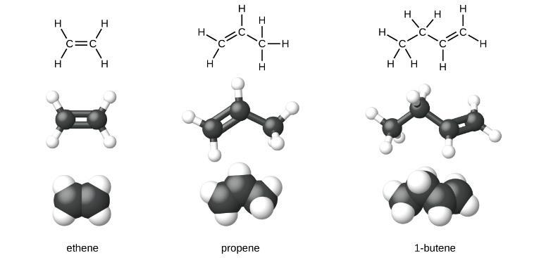
Figure 20.7
Expanded structures, ball-and-stick structures, and space-filling models for the alkenes ethene, propene, and 1-butene are shown.

Slide 29
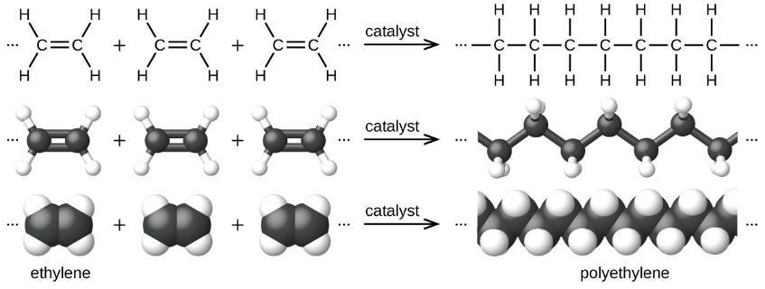
Figure 20.8
The reaction for the polymerization of ethylene to polyethylene is shown.

Slide 30
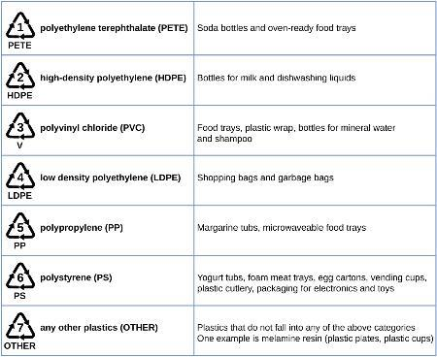
Figure 20.9
Each type of recyclable plastic is imprinted with a code for easy identification.

Slide 31
UNFIGURE 20.7

Slide 32
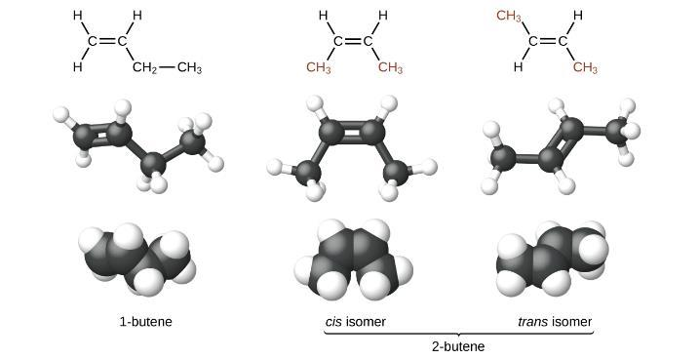
Figure 20.10
These molecular models show the structural and geometric isomers of butene.

Slide 33
UNFIGURE 20.8

Slide 34
Example 20.5

Slide 35
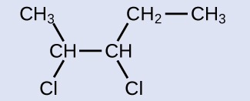
Example 20.5

Slide 36
Example 20.5

Slide 37
UNFIGURE 20.9

Slide 38
Example 20.6

Slide 39
Example 20.6

Slide 40
UNFIGURE 20.10

Slide 41
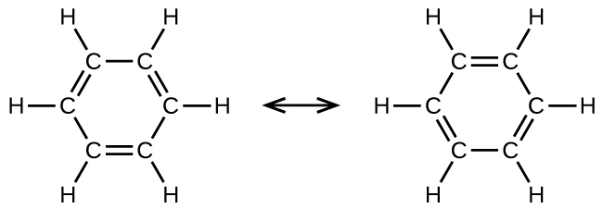
UNFIGURE 20.11

Slide 42
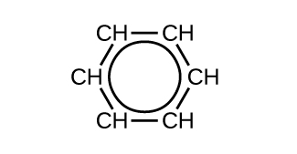
Figure 20.11
This condensed formula shows the unique bonding structure of benzene.

Slide 43
UNFIGURE 20.12

Slide 44
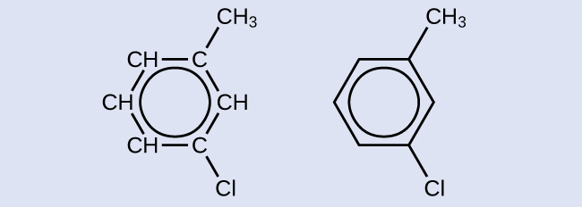
Example 20.7

Slide 45
Example 20.7

Slide 46
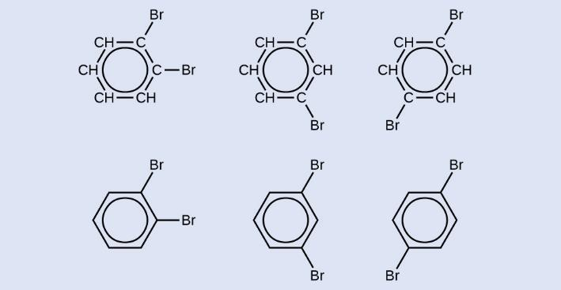
Example 20.7

Slide 47
Learning Objectives
20.2 Alcohols and Ethers
Describe the structure and properties of alcohols
Describe the structure and properties of ethers
Name and draw structures for alcohols and ethers

Slide 48
UNFIGURE 20.13

Slide 49
UNFIGURE 20.14

Slide 50
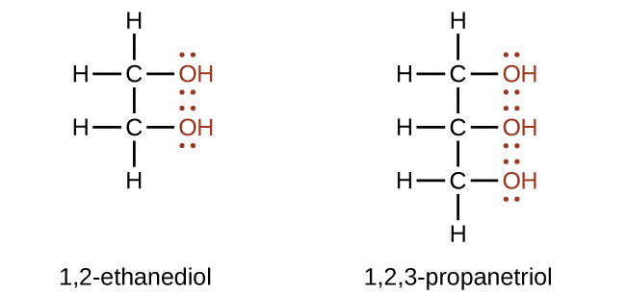
UNFIGURE 20.15

Slide 51
Example 20.8

Slide 52
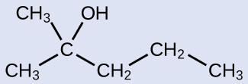
Example 20.8

Slide 53
UNFIGURE 20.16

Slide 54
Example 20.9

Slide 55
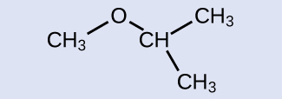
Example 20.9

Slide 56
UNFIGURE 20.17

Slide 57
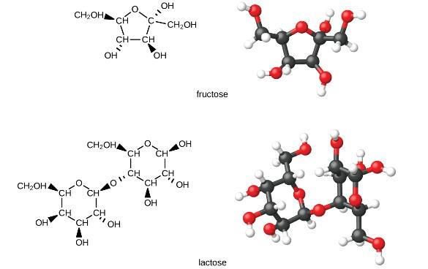
Figure 20.12
The illustrations show the molecular structures of fructose, a five-carbon monosaccharide, and of lactose, a disaccharide composed of two isomeric, six-carbon sugars.

Slide 58
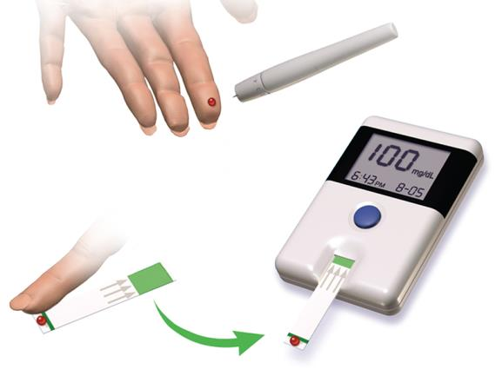
Figure 20.13
Diabetes is a disease characterized by high concentrations of glucose in the blood. Treating diabetes involves making lifestyle changes, monitoring blood-sugar levels, and sometimes insulin injections. (credit: “Blausen Medical Communications”/Wikimedia Commons)

Slide 59
Learning Objectives
20.3 Aldehydes, Ketones, Carboxylic Acids, and Esters
Describe the structure and properties of aldehydes, ketones, carboxylic acids and esters

Slide 60
UNFIGURE 20.18

Slide 61
UNFIGURE 20.19

Slide 62
UNFIGURE 20.20

Slide 63
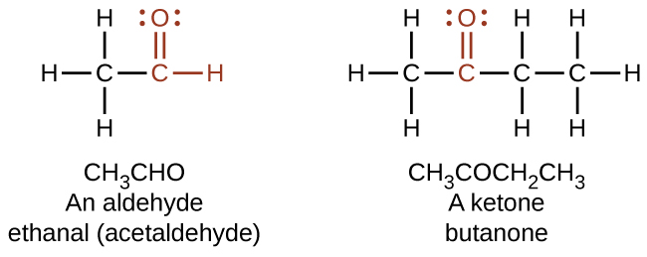
UNFIGURE 20.21

Slide 64
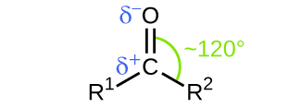
Figure 20.14
The carbonyl group is polar, and the geometry of the bonds around the central carbon is trigonal planar.

Slide 65
UNFIGURE 20.22

Slide 66
Example 20.10

Slide 67
Example 20.10

Slide 68
UNFIGURE 20.23

Slide 69
UNFIGURE 20.24

Slide 70
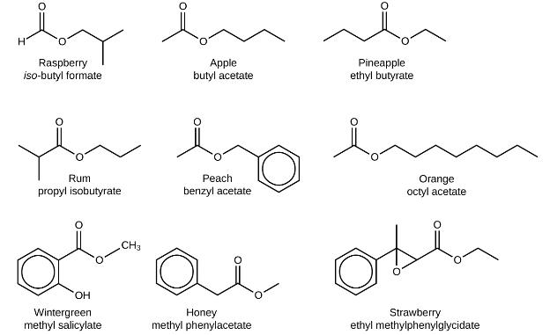
Figure 20.15
Esters are responsible for the odors associated with various plants and their fruits.

Slide 71
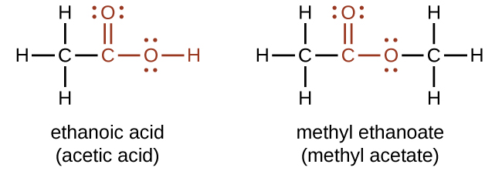
UNFIGURE 20.25

Slide 72
UNFIGURE 20.26

Slide 73
UNFIGURE 20.27

Slide 74
UNFIGURE 20.28

Slide 75
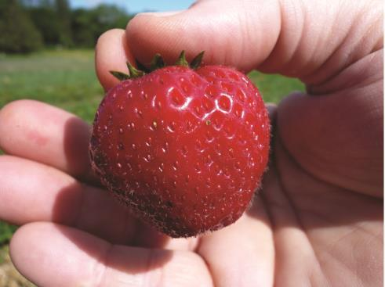
Figure 20.16
Over 350 different volatile molecules (many members of the ester family) have been identified in strawberries. (credit: Rebecca Siegel)

Slide 76
Learning Objectives
20.4 Amines and Amides
Describe the structure and properties of an amine
Describe the structure and properties of an amide

Slide 77
UNFIGURE 20.29

Slide 78
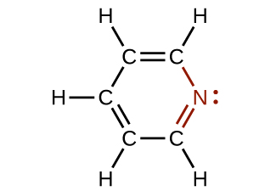
Figure 20.17
The illustration shows one of the resonance structures of pyridine.

Slide 79
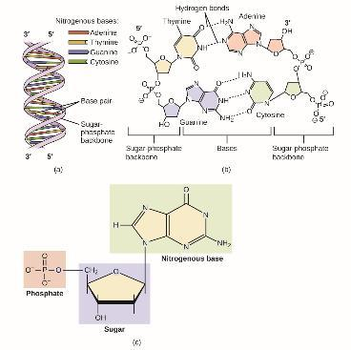
Figure 20.18
DNA is an organic molecule and the genetic material for all living organisms. (a) DNA is a double helix consisting of two single DNA strands hydrogen bonded together at each nitrogenous base. (b) This detail shows the hydrogen bonding (dotted lines) between nitrogenous bases on each DNA strand and the way in which each nucleotide is joined to the next, forming a backbone of sugars and phosphate groups along each strand. (c) This detail shows the structure of one of the four nucleotides that makes up the DNA polymer. Each nucleotide consists of a nitrogenous base (a double-ring molecule, in this case), a five-carbon sugar (deoxyribose), and a phosphate group.

Slide 80
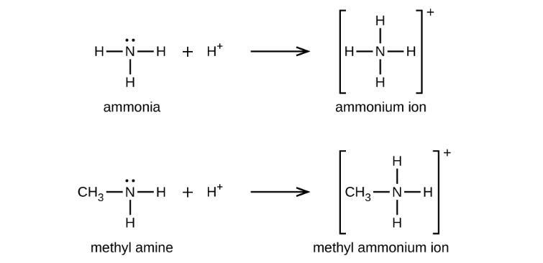
UNFIGURE 20.30

Slide 81
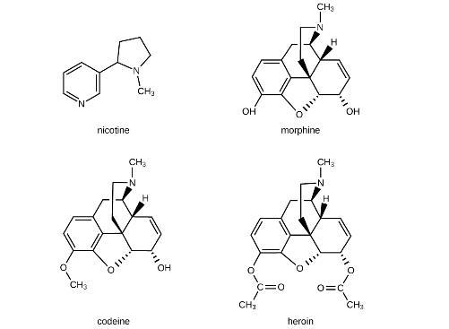
UNFIGURE 20.31

Slide 82
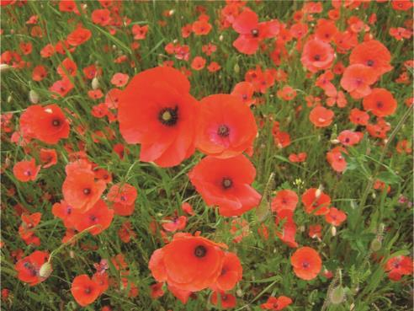
Figure 20.19
Poppies can be used in the production of opium, a plant latex that contains morphine from which other opiates, such as heroin, can be synthesized. (credit: Karen Roe)

Slide 83
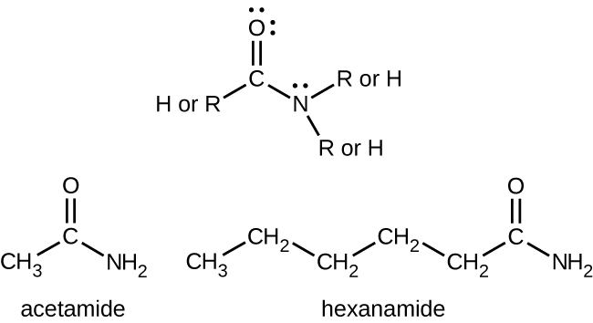
UNFIGURE 20.32

Slide 84
UNFIGURE 20.33

Slide 85
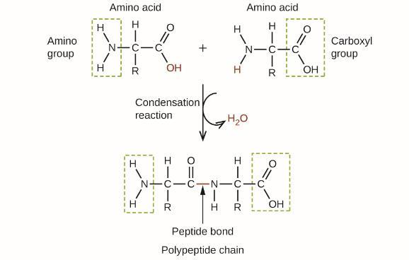
Figure 20.20
This condensation reaction forms a dipeptide from two amino acids and leads to the formation of water.

Slide 86
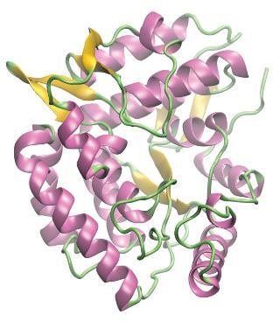
Figure 20.21
A computer rendering shows the three-dimensional structure of the enzyme phenylalanine hydroxylase. In the disease phenylketonuria, a defect in the shape of phenylalanine hydroxylase causes it to lose its function in breaking down phenylalanine.

Slide 87
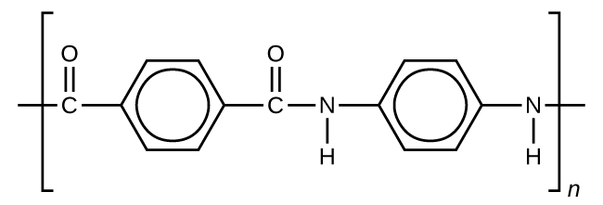
Figure 20.22
This illustration shows the formula for polymeric Kevlar.

Slide 88
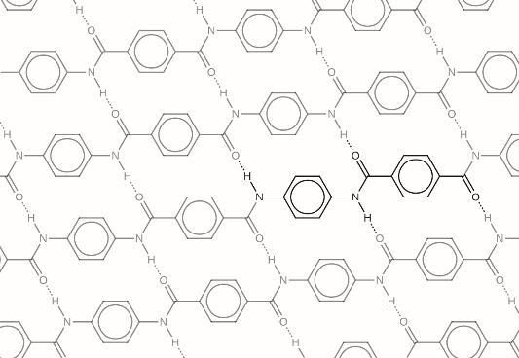
Figure 20.23
The diagram shows the polymer structure of Kevlar, with hydrogen bonds between polymer chains represented by dotted lines.

Slide 89
Figure 20.24
(a) These soldiers are sorting through pieces of a Kevlar helmet that helped absorb a grenade blast. Kevlar is also used to make (b) canoes and (c) marine mooring lines. (credit a: modification of work by “Cla68”/Wikimedia Commons; credit b: modification of work by “OakleyOriginals”/Flickr; credit c: modification of work by Casey H. Kyhl)

Slide 90
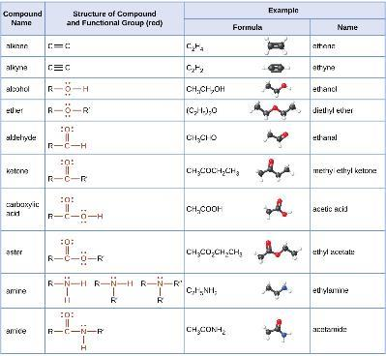
UNFIGURE 20.34

Slide 91
Exercise 6

Slide 92
Exercise 7

Slide 93
Exercise 11c

Slide 94
Exercise 11e

Slide 95
Exercise 11f

Slide 96
Exercise 12c

Slide 97
Exercise 12e

Slide 98
Exercise 17

Slide 99
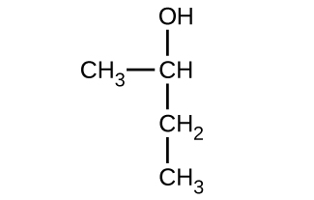
Exercise 32a

Slide 100
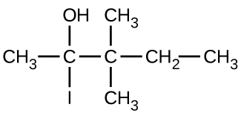
Exercise 32b

Slide 101
Exercise 32c

Slide 102
Exercise 33a

Slide 103
Exercise 33b

Slide 104
Exercise 33c

Slide 105
Exercise 40

Slide 106
Exercise 41a

Slide 107
Exercise 41b

Slide 108
Exercise 41c

Slide 109
Exercise 42a

Slide 110
Exercise 42b

Slide 111
Exercise 42c

Slide 112
This OpenStax ancillary resource is © Rice University under a CC-BY 4.0 International license; it may be reproduced or modified but must be attributed to OpenStax, Rice University and any changes must be noted.

