Slide 1

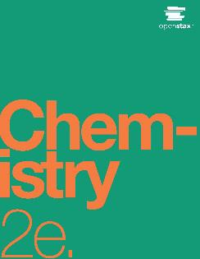
CHEMISTRY 2e
Chapter 21 Nuclear Chemistry
PowerPoint Image Slideshow

Slide 2
Chapter Outline
21.1 Nuclear Structure and Stability
21.2 Nuclear Equations
21.3 Radioactive Decay
21.4 Transmutation and Nuclear Energy
21.5 Uses of Radioisotopes
21.6 Biological Effects of Radiation

Slide 3
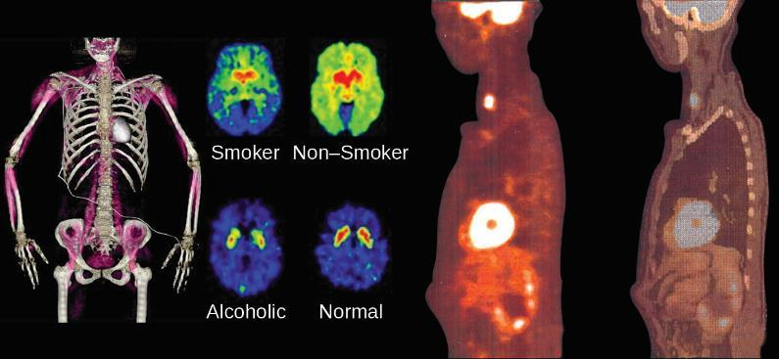
Figure 21.1
Nuclear chemistry provides the basis for many useful diagnostic and therapeutic methods in medicine, such as these positron emission tomography (PET) scans. The PET/computed tomography scan on the left shows muscle activity. The brain scans in the center show chemical differences in dopamine signaling in the brains of addicts and nonaddicts. The images on the right show an oncological application of PET scans to identify lymph node metastasis.

Slide 4
Learning Objectives
21.1 Nuclear Structure and Stability
  Describe nuclear structure in terms of protons, neutrons, and electrons
  Calculate mass defect and binding energy for nuclei
  Explain trends in the relative stability of nuclei

Slide 5
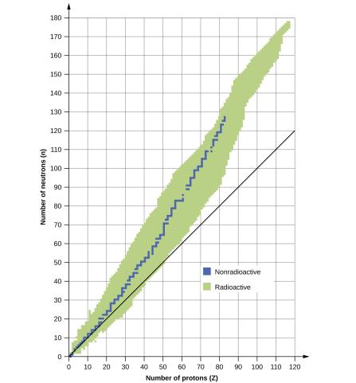
Figure 21.2
This plot shows the nuclides that are known to exist and those that are stable. The stable nuclides are indicated in blue, and the unstable nuclides are indicated in green. Note that all isotopes of elements with atomic numbers greater than 83 are unstable. The solid line is the line where
n = Z.

Slide 6
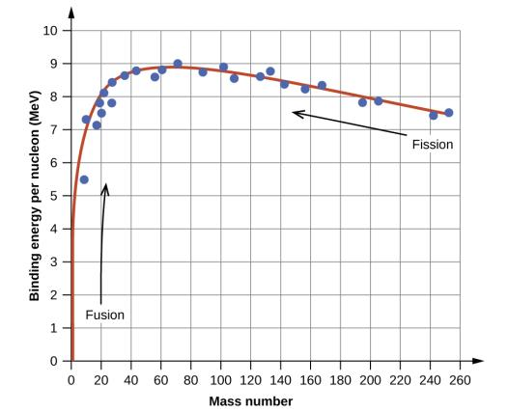
Figure 21.3
The binding energy per nucleon is largest for nuclides with mass number of approximately 56.

Slide 7
Learning Objectives
21.2 Nuclear Equations
  Identify common particles and energies involved in nuclear reactions
  Write and balance nuclear equations

Slide 8
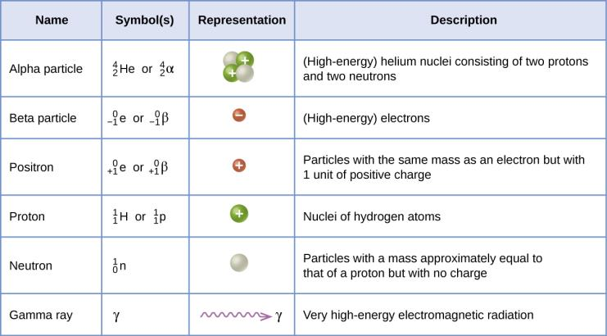
Figure 21.4
Although many species are encountered in nuclear reactions, this table summarizes the names, symbols, representations, and descriptions of the most common of these.

Slide 9
Learning Objectives
21.3 Radioactive Decay
  Recognize common modes of radioactive decay
  Identify common particles and energies involved in nuclear decay reactions
  Write and balance nuclear decay equations
  Calculate kinetic parameters for decay processes, including half-life
  Describe common radiometric dating techniques

Slide 10
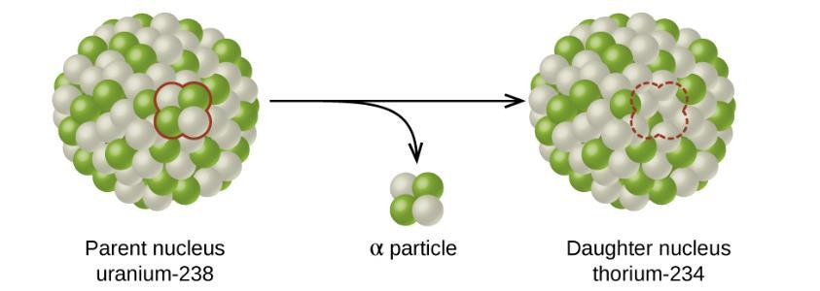
Figure 21.5
A nucleus of uranium-238 (the parent nuclide) undergoes α decay to form thorium-234 (the daughter nuclide). The alpha particle removes two protons (green) and two neutrons (gray) from the uranium-238 nucleus.

Slide 11
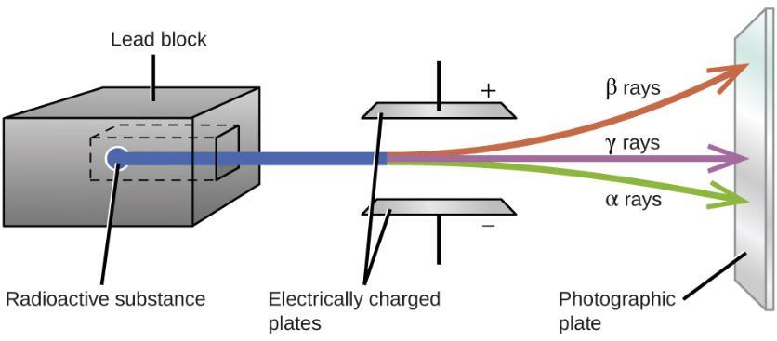
Figure 21.6
Alpha particles, which are attracted to the negative plate and deflected by a relatively small amount, must be positively charged and relatively massive. Beta particles, which are attracted to the positive plate and deflected a relatively large amount, must be negatively charged and relatively light. Gamma rays, which are unaffected by the electric field, must be uncharged.

Slide 12
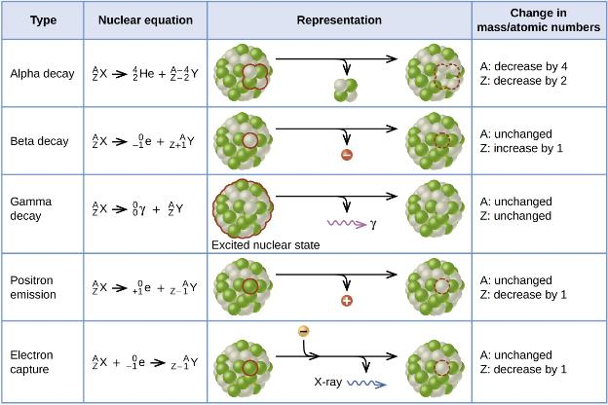
Figure 21.7
This table summarizes the type, nuclear equation, representation, and any changes in the mass or atomic numbers for various types of decay.

Slide 13
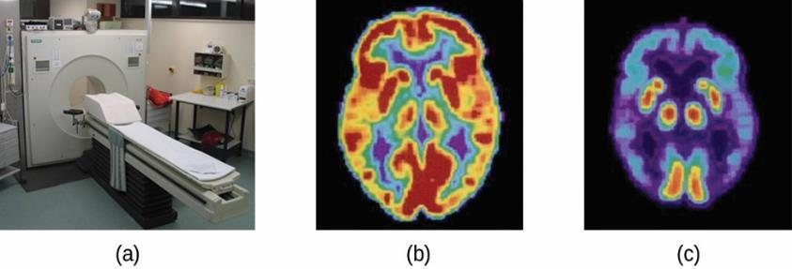
Figure 21.8
A PET scanner (a) uses radiation to provide an image of how part of a patient’s body functions. The scans it produces can be used to image a healthy brain (b) or can be used for diagnosing medical conditions such as Alzheimer’s disease (c). (credit a: modification of work by Jens Maus)

Slide 14
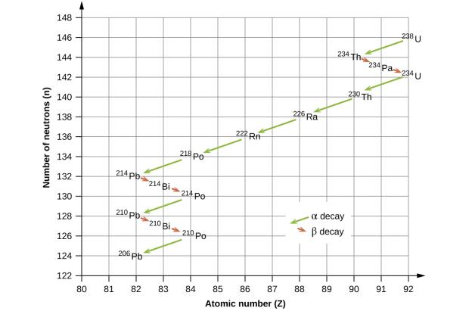
Figure 21.9
Uranium-238 undergoes a radioactive decay series consisting of 14 separate steps before producing stable lead-206. This series consists of eight α decays and six β decays.

Slide 15
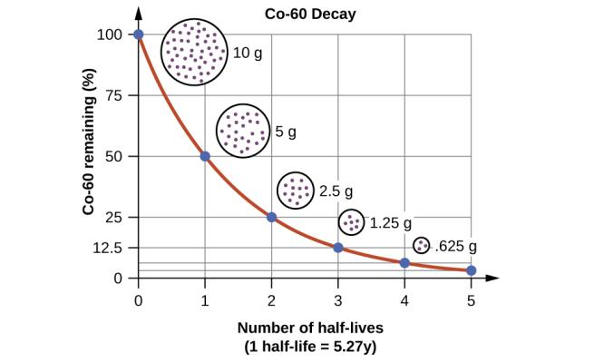
Figure 21.10
For cobalt-60, which has a half-life of 5.27 years, 50% remains after 5.27 years (one half-life), 25% remains after 10.54 years (two half-lives), 12.5% remains after 15.81 years (three half-lives), and so on.

Slide 16
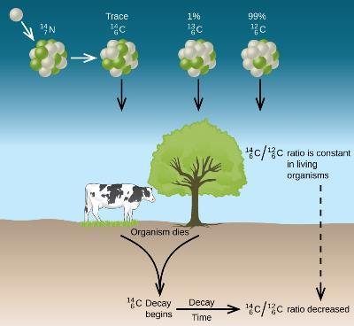
Figure 21.11
Along with stable carbon-12, radioactive carbon-14 is taken in by plants and animals, and remains at a constant level within them while they are alive. After death, the C-14 decays and the C-14:C-12 ratio in the remains decreases. Comparing this ratio to the C-14:C-12 ratio in living organisms allows us to determine how long ago the organism lived (and died).

Slide 17
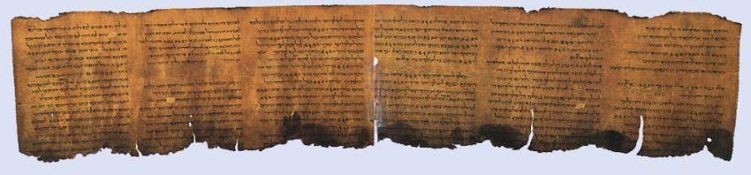
Figure 21.12
Carbon-14 dating has shown that these pages from the Dead Sea Scrolls were written or copied on paper made from plants that died between 100 BC and AD 50.

Slide 18
Learning Objectives
21.4 Transmutation and Nuclear Energy
  Describe the synthesis of transuranium nuclides
  Explain nuclear fission and fusion processes
  Relate the concepts of critical mass and nuclear chain reactions
  Summarize basic requirements for nuclear fission and fusion reactors

Slide 19
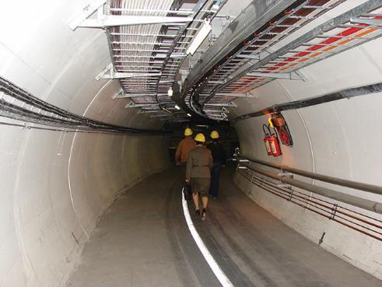
Figure 21.13
A small section of the LHC is shown with workers traveling along it. (credit: Christophe Delaere)

Slide 20
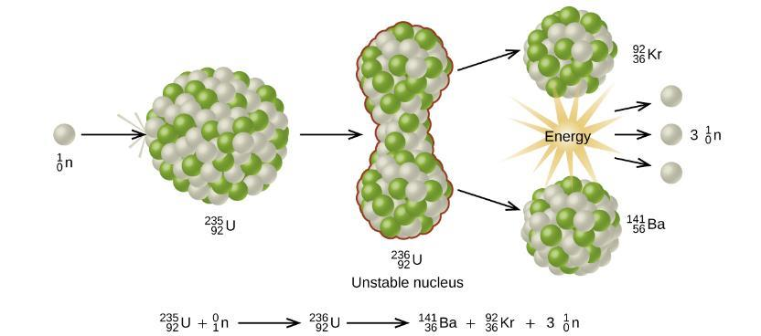
Figure 21.14
When a slow neutron hits a fissionable U-235 nucleus, it is absorbed and forms an unstable U-236 nucleus. The U-236 nucleus then rapidly breaks apart into two smaller nuclei (in this case, Ba-141 and Kr-92) along with several neutrons (usually two or three), and releases a very large amount of energy.

Slide 21
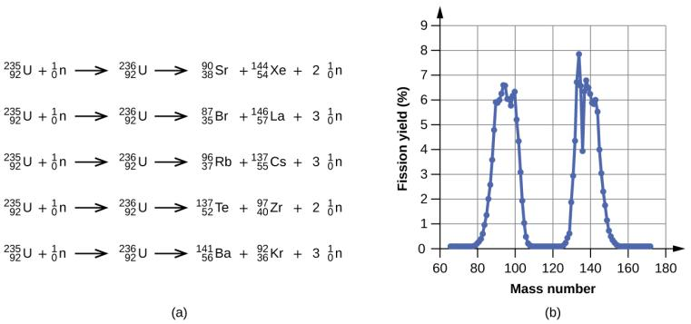
Figure 21.15
Nuclear fission of U-235 produces a range of fission products.
The larger fission products of U-235 are typically one isotope with a mass number around 85–105, and another isotope with a mass number that is about 50% larger, that is, about 130–150.

Slide 22
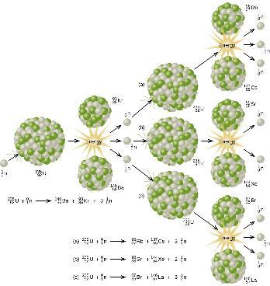
Figure 21.16
The fission of a large nucleus, such as U-235, produces two or three neutrons, each of which is capable of causing fission of another nucleus by the reactions shown. If this process continues, a nuclear chain reaction occurs.

Slide 23
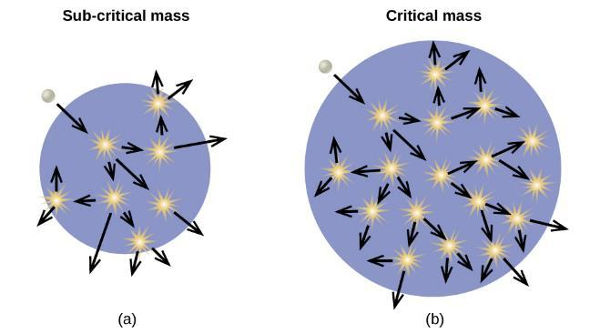
Figure 21.17
(a) In a subcritical mass, the fissile material is too small and allows too many neutrons to escape the material, so a chain reaction does not occur. (b) In a critical mass, a large enough number of neutrons in the fissile material induce fission to create a chain reaction.

Slide 24
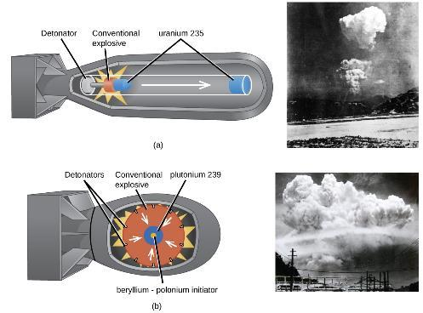
Figure 21.18
(a) The nuclear fission bomb that destroyed Hiroshima on August 6, 1945, consisted of two subcritical masses of U-235, where conventional explosives were used to fire one of the subcritical masses into the other, creating the critical mass for the nuclear explosion. (b) The plutonium bomb that destroyed Nagasaki on August 12, 1945, consisted of a hollow sphere of plutonium that was rapidly compressed by conventional explosives. This led to a concentration of plutonium in the center that was greater than the critical mass necessary for the nuclear explosion.

Slide 25
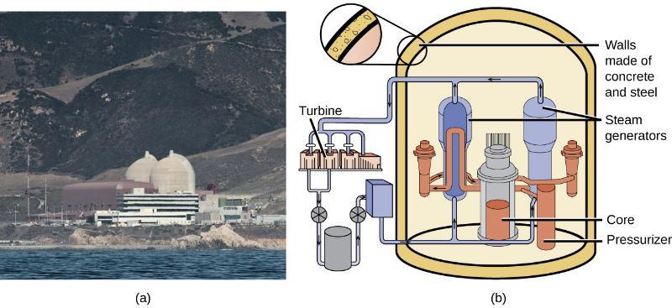
Figure 21.19
(a) The Diablo Canyon Nuclear Power Plant near San Luis Obispo is the only nuclear power plant currently in operation in California. The domes are the containment structures for the nuclear reactors, and the brown building houses the turbine where electricity is generated. Ocean water is used for cooling. (b) The Diablo Canyon uses a pressurized water reactor, one of a few different fission reactor designs in use around the world, to produce electricity. Energy from the nuclear fission reactions in the core heats water in a closed, pressurized system. Heat from this system produces steam that drives a turbine, which in turn produces electricity. (credit a: modification of work by “Mike” Michael L. Baird; credit b: modification of work by the Nuclear Regulatory Commission)

Slide 26
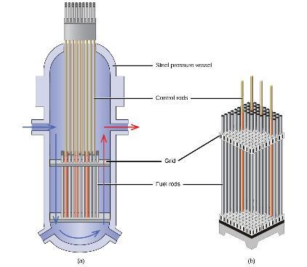
Figure 21.20
The nuclear reactor core shown in (a) contains the fuel and control rod assembly shown in (b). (credit: modification of work by E. Generalic, http://glossary.periodni.com/glossary.php?en=control+rod)

Slide 27
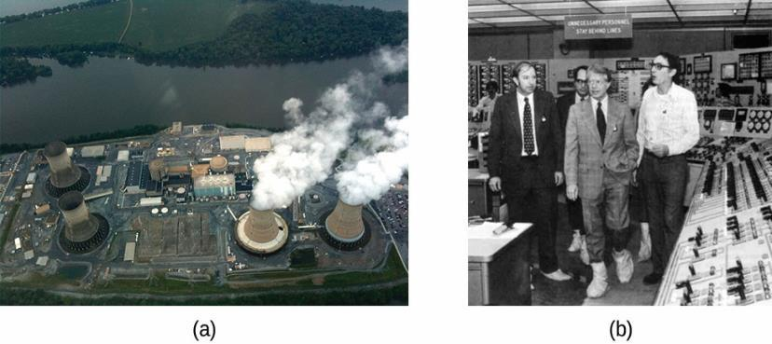
Figure 21.21
(a) In this 2010 photo of Three Mile Island, the remaining structures from the damaged Unit 2 reactor are seen on the left, whereas the separate Unit 1 reactor, unaffected by the accident, continues generating power to this day (right). (b) President Jimmy Carter visited the Unit 2 control room a few days after the accident in 1979.

Slide 28
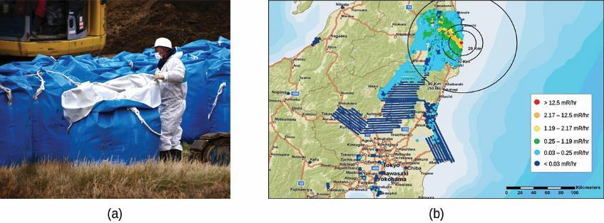
Figure 21.22
(a) After the accident, contaminated waste had to be removed, and (b) an evacuation zone was set up around the plant in areas that received heavy doses of radioactive fallout. (credit a: modification of work by “Live Action Hero”/Flickr)

Slide 29
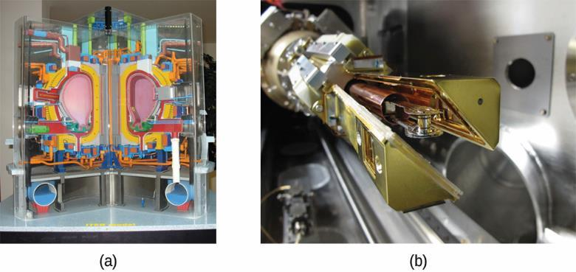
Figure 21.23
(a) This model is of the International Thermonuclear Experimental Reactor (ITER) reactor. Currently under construction in the south of France with an expected completion date of 2027, the ITER will be the world’s Largest experimental Tokamak nuclear fusion reactor with a goal of achieving large-scale sustained energy production. (b) In 2012, the National Ignition Facility at Lawrence Livermore National Laboratory briefly produced over 500,000,000,000 watts (500 terawatts, or 500 TW) of peak power and delivered 1,850,000 joules (1.85 MJ) of energy, the largest laser energy ever produced and 1000 times the power usage of the entire United States in any given moment. Although lasting only a few billionths of a second, the 192 lasers attained the conditions needed for nuclear fusion ignition. This image shows the target prior to the laser shot. (credit a: modification of work by Stephan Mosel)

Slide 30
Learning Objectives
21.5 Uses of Radioisotopes
  List common applications of radioactive isotopes

Slide 31
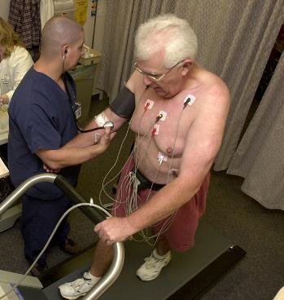
Figure 21.24
Administering thallium-201 to a patient and subsequently performing a stress test offer medical professionals an opportunity to visually analyze heart function and blood flow. (credit: modification of work by “Blue0ctane”/Wikimedia Commons)

Slide 32
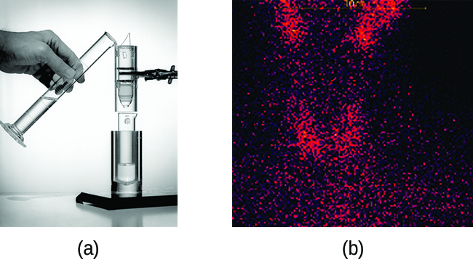
Figure 21.25
(a) The first Tc-99m generator (circa 1958) is used to separate Tc-99 from Mo-99. The MoO₄ ²⁻ is retained by the matrix in the column, whereas the TcO₄− passes through and is collected. (b) Tc-99 was used in this scan of the neck of a patient with Grave’s disease. The scan shows the location of high concentrations of Tc-99. (credit a: modification of work by the Department of Energy; credit b: modification of work by “MBq”/Wikimedia Commons)

Slide 33
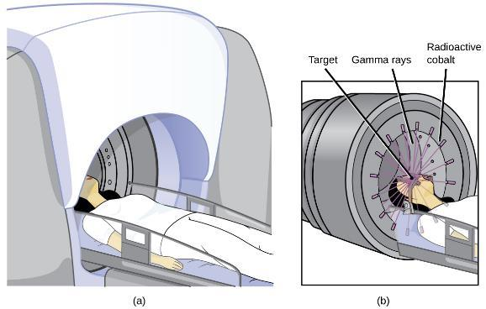
Figure 21.26
The cartoon in (a) shows a cobalt-60 machine used in the treatment of cancer. The diagram in (b) shows how the gantry of the Co-60 machine swings through an arc, focusing radiation on the targeted region (tumor) and minimizing the amount of radiation that passes through nearby regions.

Slide 34
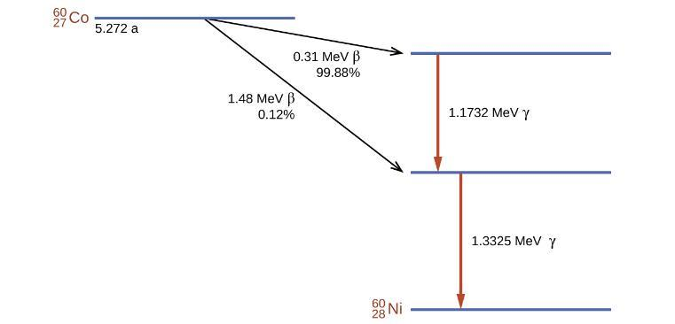
Figure 21.27
Co-60 undergoes a series of radioactive decays. The γ emissions are used for radiation therapy.

Slide 35
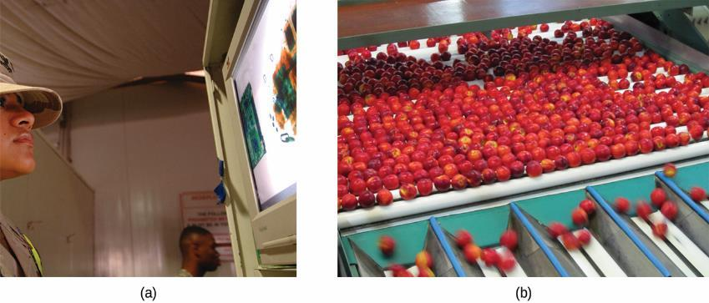
Figure 21.28
Common commercial uses of radiation include (a) X-ray examination of luggage at an airport and (b) preservation of food. (credit a: modification of work by the Department of the Navy; credit b: modification of work by the US Department of Agriculture)

Slide 36
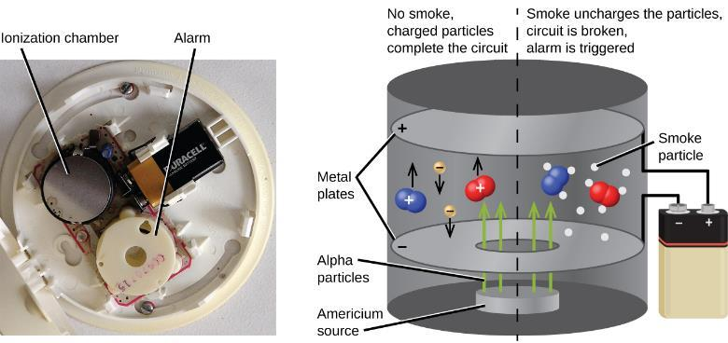
Figure 21.29
Inside a smoke detector, Am-241 emits α particles that ionize the air, creating a small electric current. During a fire, smoke particles impede the flow of ions, reducing the current and triggering an alarm. (credit a: modification of work by “Muffet”/Wikimedia Commons)

Slide 37
Learning Objectives
21.6 Biological Effects of Radiation
  Describe the biological impact of ionizing radiation
  Define units for measuring radiation exposure
  Explain the operation of common tools for detecting radioactivity
  List common sources of radiation exposure in the US

Slide 38
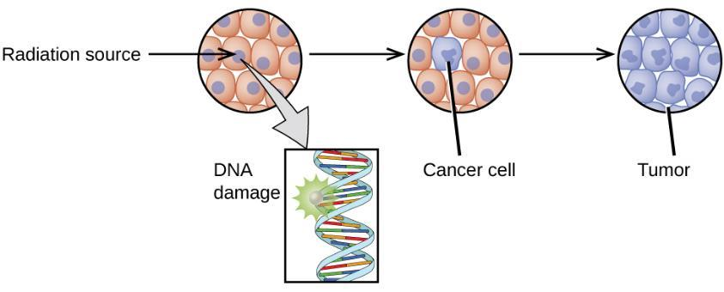
Figure 21.30
Radiation can harm biological systems by damaging the DNA of cells. If this damage is not properly repaired, the cells may divide in an uncontrolled manner and cause cancer.

Slide 39
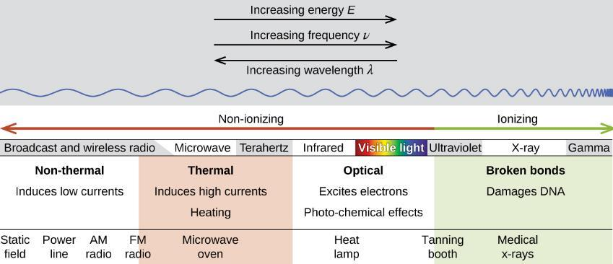
Figure 21.31
Lower frequency, lower-energy electromagnetic radiation is nonionizing, and higher frequency, higher-energy electromagnetic radiation is ionizing.

Slide 40

Figure 21.32
Ionizing radiation can (a) directly damage a biomolecule by ionizing it or breaking its bonds, or (b) create an H₂O⁺ ion, which reacts with H₂O to form a hydroxyl radical, which in turn reacts with the biomolecule, causing damage indirectly.

Slide 41
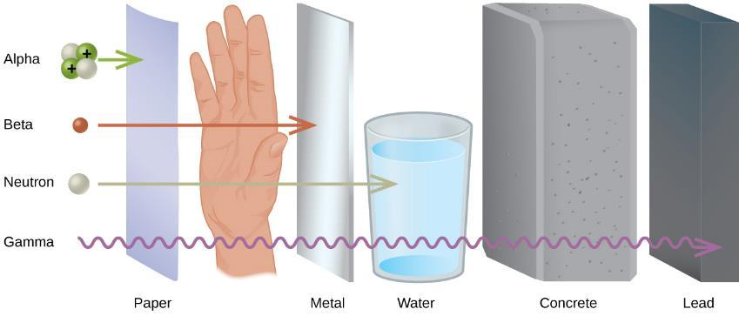
Figure 21.33
The ability of different types of radiation to pass through material is shown. From least to most penetrating, they are alpha < beta < neutron < gamma.

Slide 42
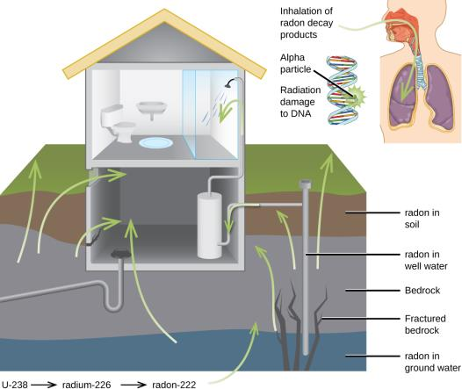
Figure 21.34
Radon-222 seeps into houses and other buildings from rocks that contain uranium-238, a radon emitter. The radon enters through cracks in concrete foundations and basement floors, stone or porous cinderblock foundations, and openings for water and gas pipes.

Slide 43
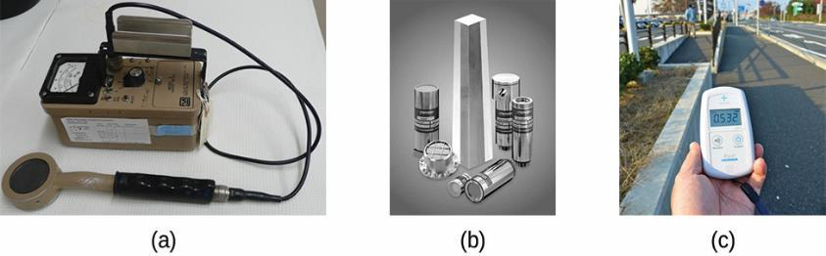
Figure 21.35
Devices such as (a) Geiger counters, (b) scintillators, and (c) dosimeters can be used to measure radiation. (credit c: modification of work by “osaMu”/Wikimedia commons)

Slide 44
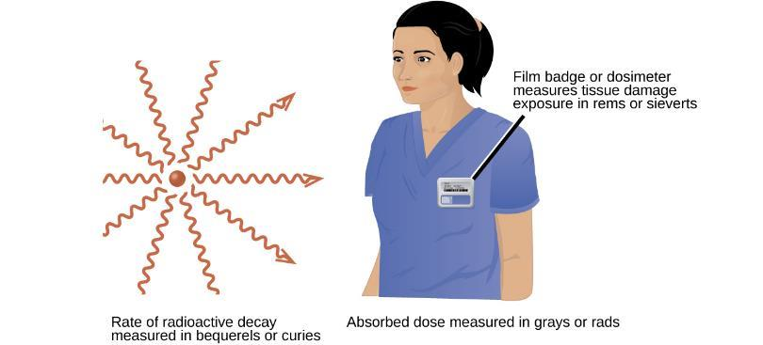
Figure 21.36
Different units are used to measure the rate of emission from a radioactive source, the energy that is absorbed from the source, and the amount of damage the absorbed radiation does.

Slide 45
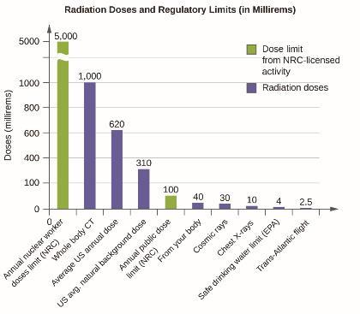
Figure 21.37
The total annual radiation exposure for a person in the US is about 620 mrem. The various sources and their relative amounts are shown in this bar graph. (source: U.S. Nuclear Regulatory Commission)

Slide 46
This OpenStax ancillary resource is © Rice University under a CC-BY 4.0 International license; it may be reproduced or modified but must be attributed to OpenStax, Rice University and any changes must be noted.

